Slide 1
Tobacco Settlement Agreement Fund Oversight Committee
October 2, 2019
Jason Chesney, MD, PhD
Director, J. Graham Brown Cancer Center
Associate VP of Health Affairs, University of Louisville

Slide 2
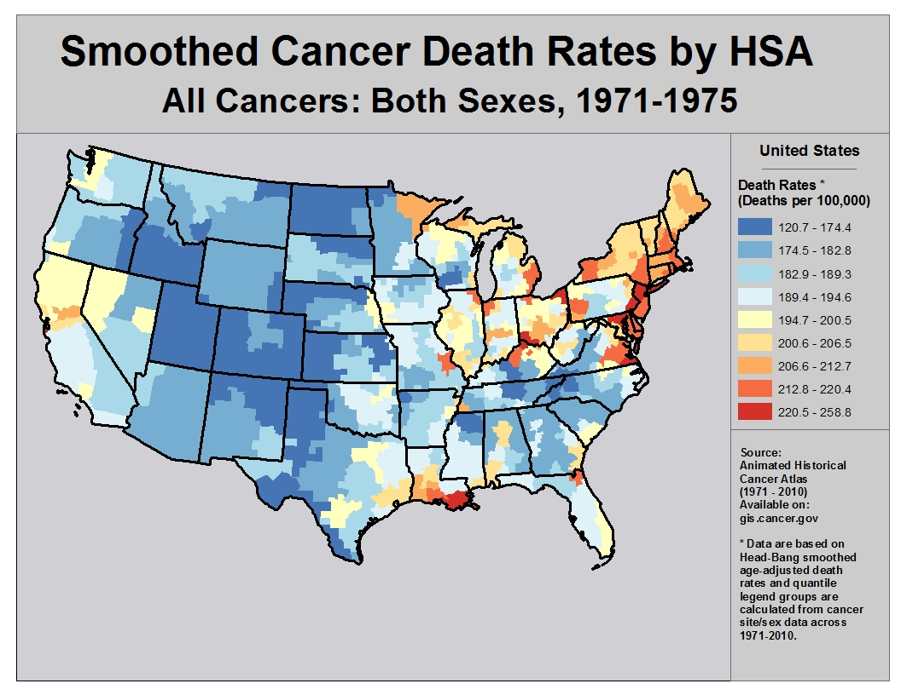
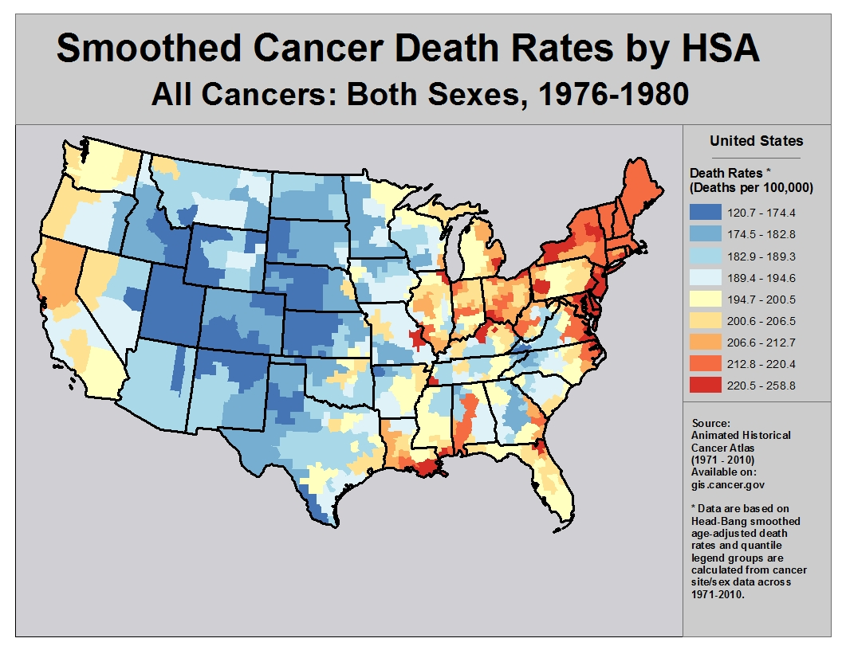
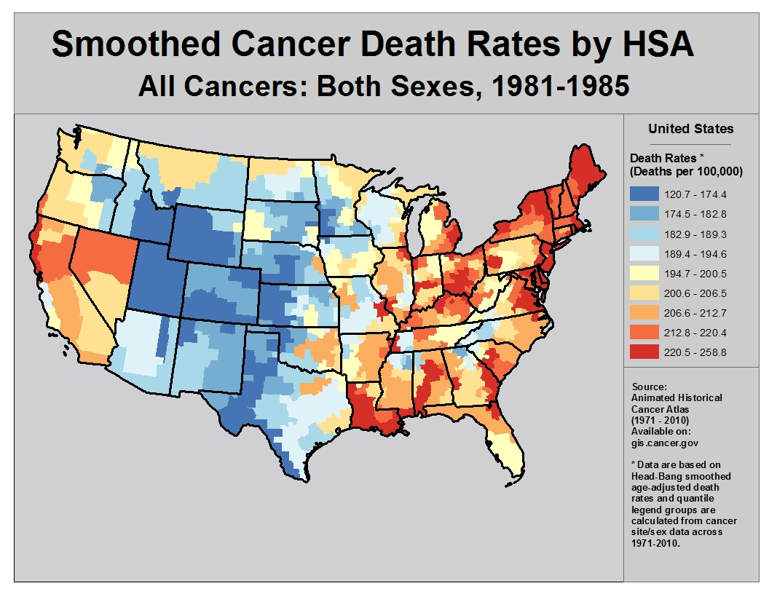
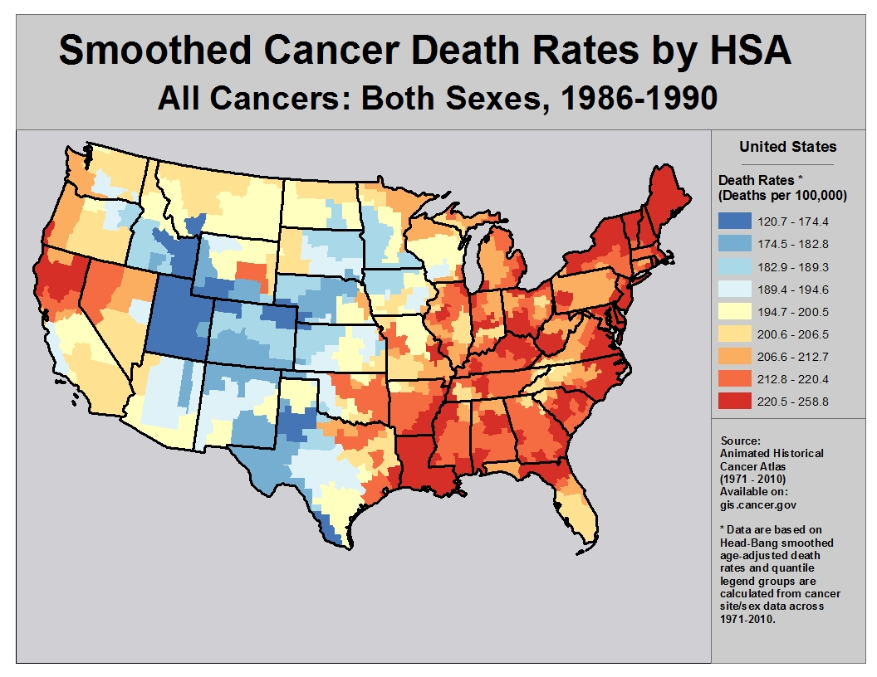
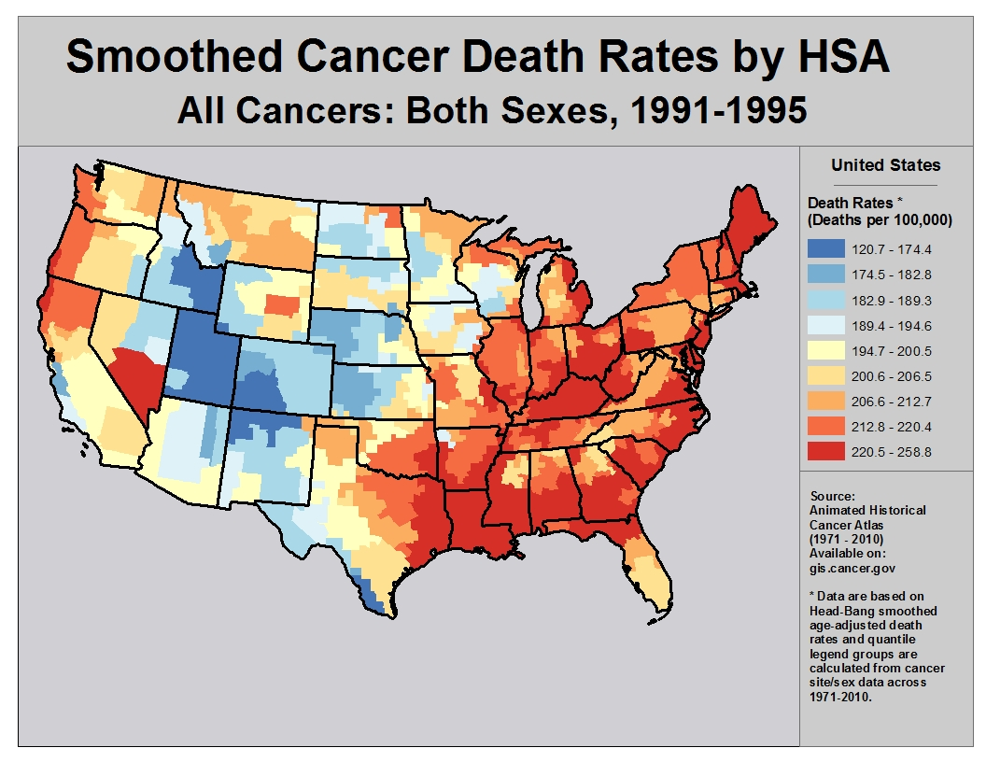
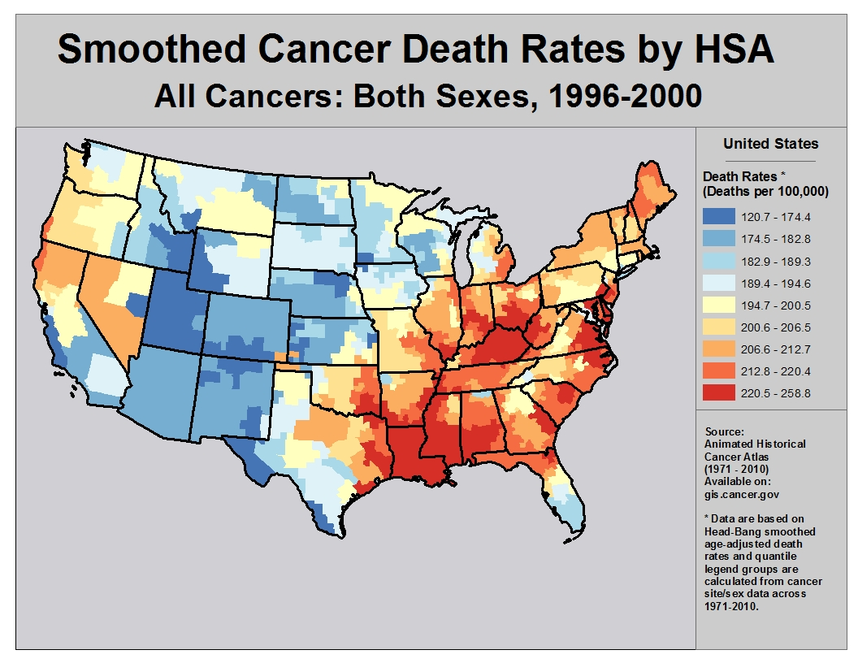
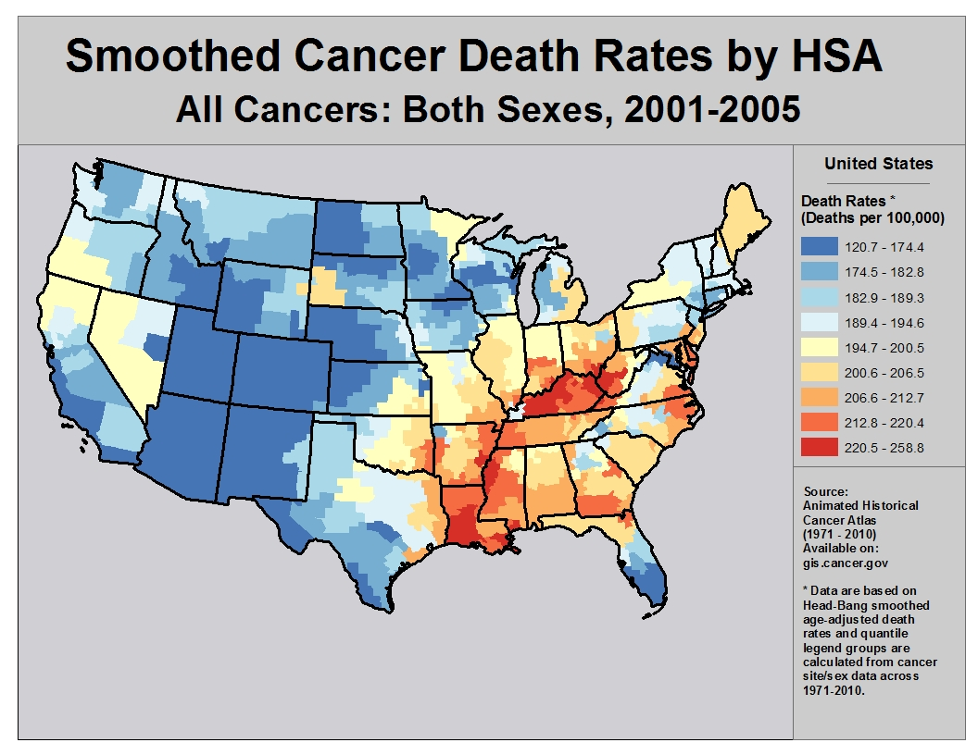
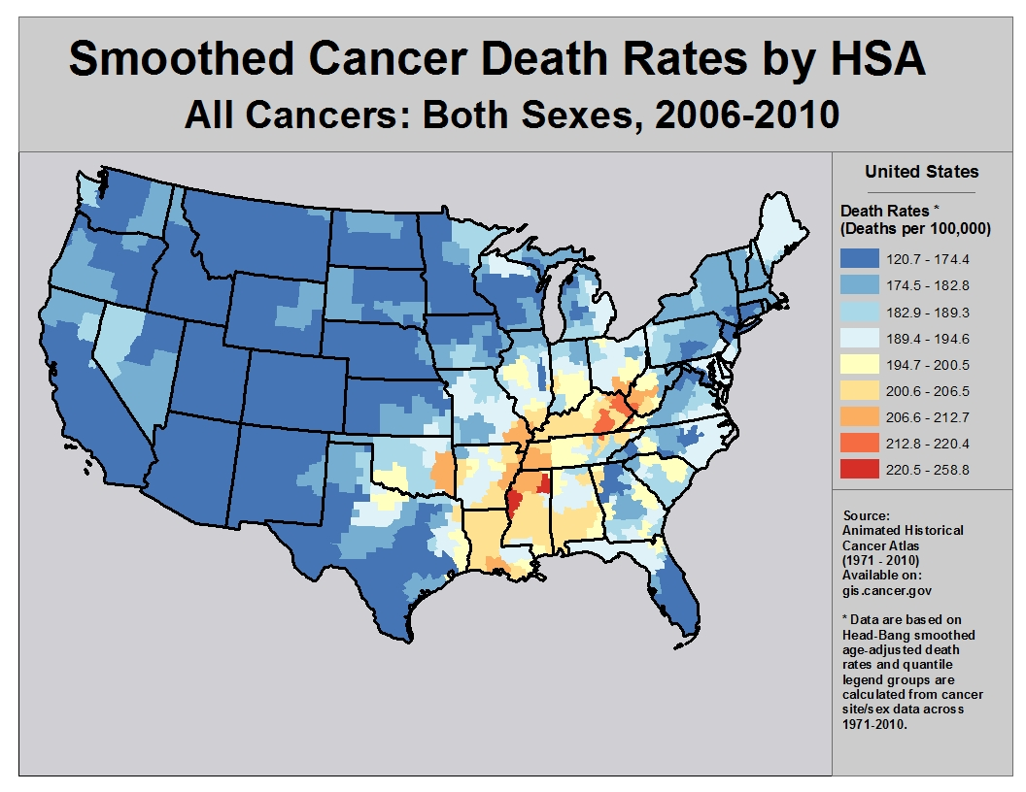

Slide 3
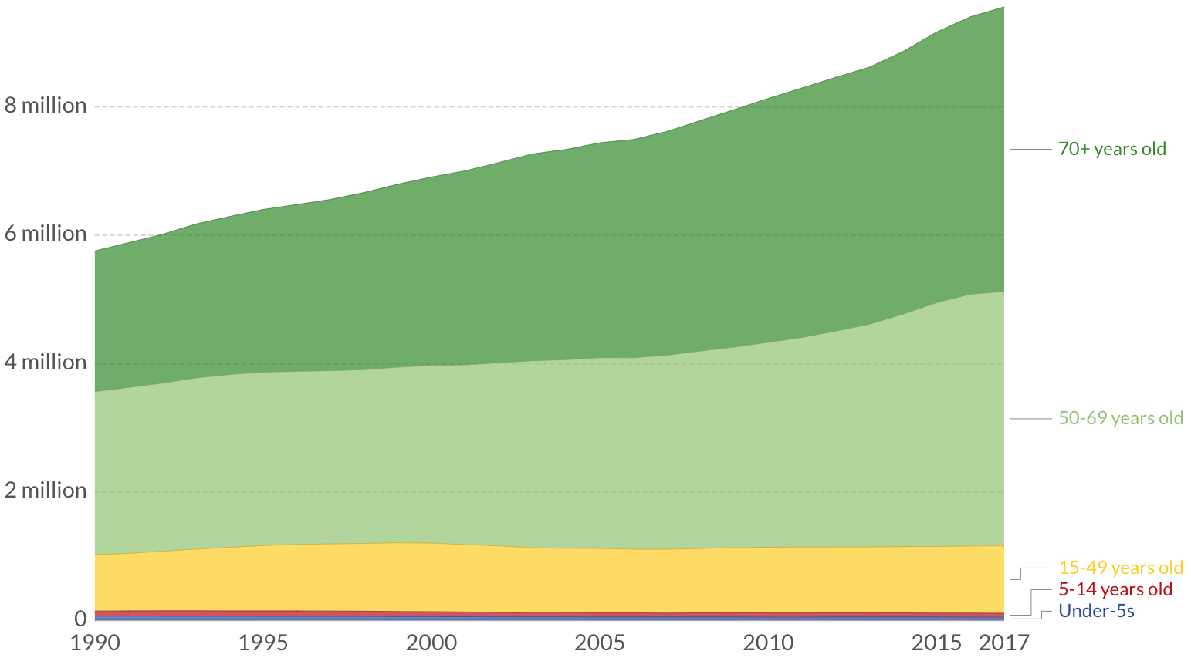
Someone Dies of Cancer In Kentucky Every Hour (9000 Each Year)
Cancer strikes many Kentuckians just as they are entering the most productive period of their lives
Cancer Deaths by Age (Global)
3

Slide 4
Someone Dies of Cancer In Kentucky Every Hour (9000 Each Year)
The financial, psychological and social impact of a cancer diagnosis or worse a cancer death on a family is enormous
The majority of cancer is caused by bad luck (not bad behaviors)
DNA-copying mistakes are responsible for 66 percent of the mutations, while 29 percent are due to environmental factors (such as smoking) and 5 percent to heredity
While reducing smoking through taxes, education and cessation programs are helping to reduce the cancer death rate, supporting innovative cancer screening and research programs helps the 66% of cancer patients who simply were dealt a bad hand
4

Slide 5
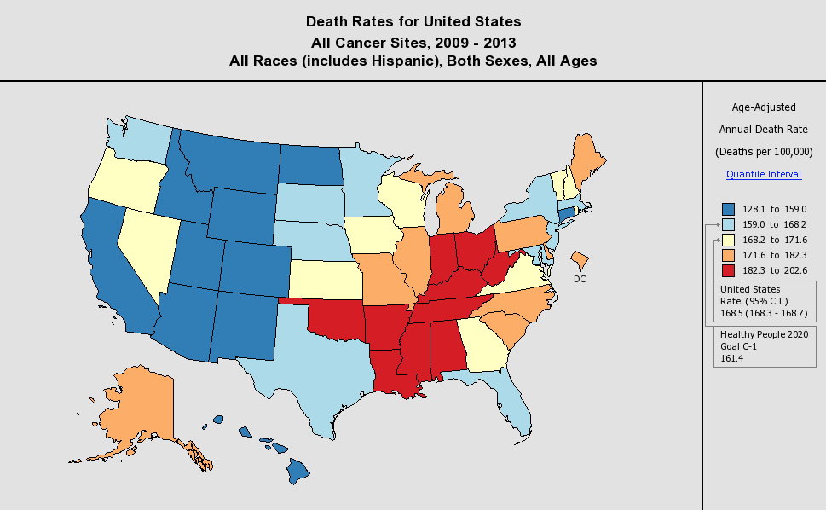
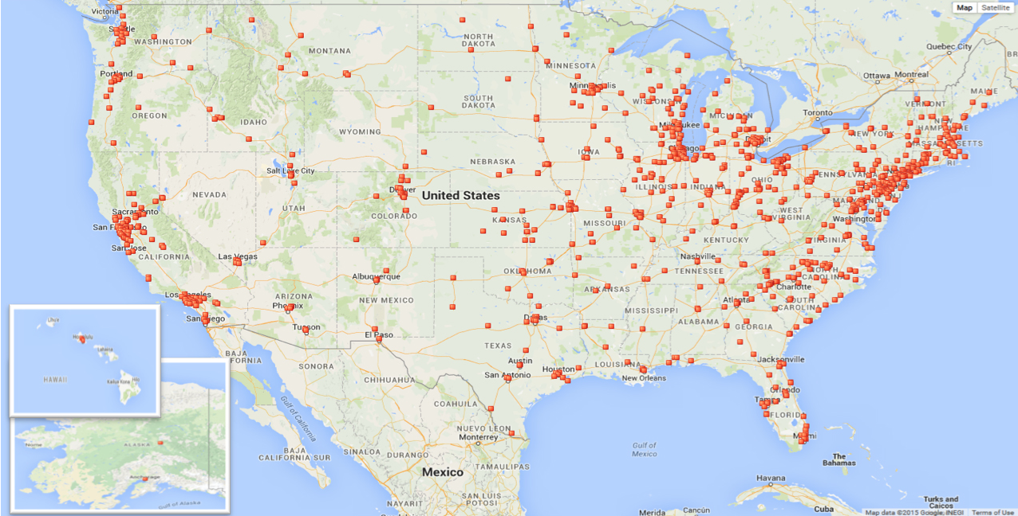
Distribution of Cancer Deaths vs Cancer Centers
U.S. CANCER DEATH RATES
X
U.S. CANCER CENTERS
KY
X

Slide 6
Cancer Incidence Is Rising in the U.S.
Despite a 27% reduction in the cancer death rate due to improved screening and research (1991-2016), US cancer diagnoses are expected to rise from 1.7M to 2.1M per year in the next decade
These 400,000 additional cancer patients in the U.S. are in part due to the aging population (i.e. the baby boomers) but also increased rates of thyroid cancer, melanoma and uterine cancer
To meet this demand, Kentucky’s two academic cancer centers will need to expand their clinical operations both at the existing facilities and throughout the region
The Brown Cancer Center was built with 8 infusion chairs/beds in 1981 and currently has 42 – we are currently renovating to double our pharmacy and increase the number of infusion chairs by 12
6

Slide 7
Cancer Incidence Is Rising in the U.S.
The incorporation of existing KentuckyOne Health facilities, staff and physicians creates an opportunity to make quality cancer care more accessible to patients from adjacent and faraway counties
Strategic plans are being proposed to establish outpatient infusion and radiotherapy capacity in facilities along the I64 and I65 corridors so that patients can receive high quality cancer care closer to home
To meet the demand of the increased cancer population, the life-saving cancer screening and research programs at Kentucky’s two academic cancer centers need to grow as their cancer care programs grow
7

Slide 8
The Brown Cancer Center Provides Cancer Care to Patients From All Over Kentucky
(In 2018, 39% came from outside of Jefferson County)
Our nationally-recognized academic cancer subspecialists use innovative technologies and therapeutics to ensure that our patients receive the highest level of cancer care offered anywhere in the United States
We are integrated with the UofL Hospital which is where our oncologists conduct inpatient trials, bone marrow transplants, cancer surgeries, image-guided tumor biopsies and injections, and cellular immunotherapies
Our oncologists provide care to >5000 Kentuckians with cancer annually – 1700 of these patients were first diagnosed in the outpatient facility at the Brown Cancer Center
8

Slide 9
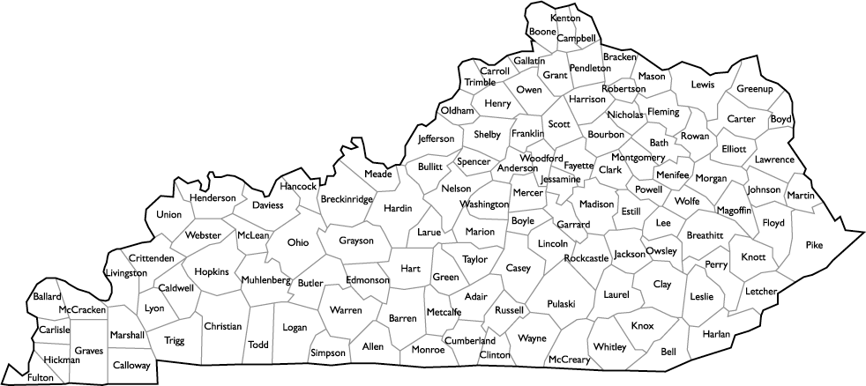
The Brown Cancer Center Provides Cancer Care to Patients From All Over Kentucky
(In 2018, 39% came from outside of Jefferson County)
1
4
8
2
49
11
2
9
1
3
1004
32
8
1
1
15
.
6
2
3
15
52
1
1
1
1
3
39
8
3
3
30
83
12
16
1
1
2
3
4
6
9
24
3
6
4
13
11
22
1
1
1
13
4
2
1
10
1
6
16
3
1
4
1
4
1
8
2
16
6
1
1
1
5
5
1
3
4
5
9

Slide 10
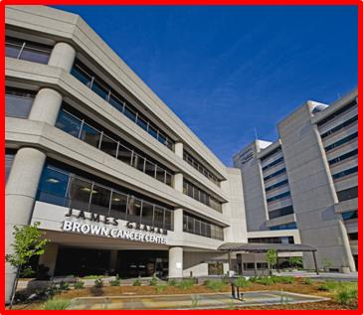
Update: Cancer Screening

Slide 11
Update: Cancer Screening
Effective cancer screening programs must be efficient, organized and include technology to ensure patient education and compliance
The vast majority of healthy individuals and high-risk individuals have poor access to effective cancer screening programs (e.g. 7% of heavy smokers undergo screening)
With support from Tobacco Settlement funds, we have created a new position, Cancer Screening Navigator, to work with providers from across Kentucky (and KCP) to facilitate cancer screening at our facilities
Providing better access to mammography, low dose CT screening and colonoscopies are our top priorities since each of these procedures have been proven to save lives

Slide 12
Update: Cancer Screening
Tobacco Settlement funds also are being used to support the development of the new Kentucky Innovative Cancer Screening (KICS) Program at the Brown Cancer Center
The objective of this program is to coordinate our cancer screening programs with our translational research programs that are focused on developing new methods for early cancer detection
The earlier cancer is detected, the greater the likelihood that the patient can be cured with surgery or immunotherapy
Our researchers are focused on developing new technologies to detect cancer in blood, urine and breath

Slide 13
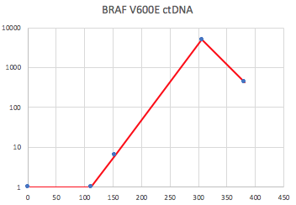
Update: Cancer Screening
One example:
Multiplex PCR (mPCR) can be applied to all types of cancer since each cancer type has several DNA mutations that can be distinguished from normal DNA
Brown Cancer Center researchers are testing mPCR in high risk cancer patients in order to develop the technology to as a screening blood test to detect the most common types of cancer
Baseline
Follow-up
Baseline
Follow-up

Slide 14
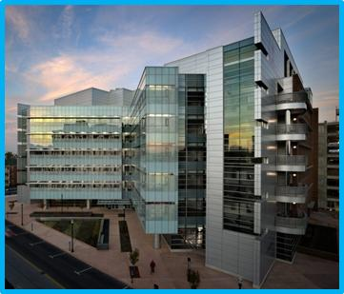
Update: Cancer Research

Slide 15
Update: Cancer Research
During the current funding period, we have focused our cancer research programs on the development of novel approaches to stimulate immunity against cancer (Immuno-Oncology)
Notable accomplishments include:
The development of a new Division of Immunotherapy in the Department of Surgery (now with 7 faculty)
The creation of a dedicated CAR T Cell GMP Facility to create novel genetically-altered cellular immunotherapies
The expansion of the Tumor Infiltrating Lymphocyte clinical trial program to include melanoma, lung cancer, head & neck cancer and cervical cancer patients
The creation of the 1st NIH Center for Biomedical Research Excellence (CoBRE) on Cancer Immunology & Immunotherapy

Slide 16
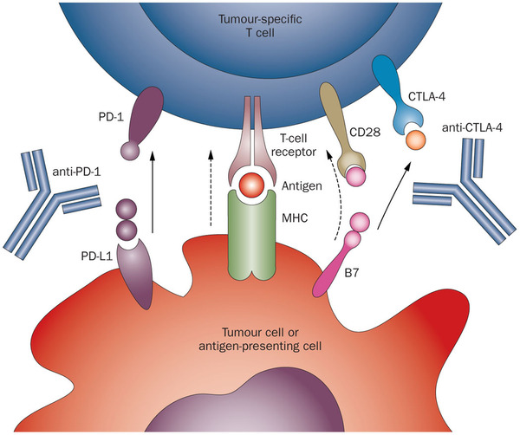
Why Focus Our Basic and Clinical Research Efforts on Stimulating Immunity Against Cancer?
From 2007 to 2012, we tested antibodies against two immune cell brakes called CTLA4 and PD1 in melanoma patients who had a 5% chance at long-term survival
This approach was proven to be not just successful for melanoma patients but also for patients suffering from multiple other types of cancer

Slide 17
372(21): 2006-2017, 2015 PMID:25891304
αCTLA4 + αPD1
Golladay Swartz Baum

Slide 18
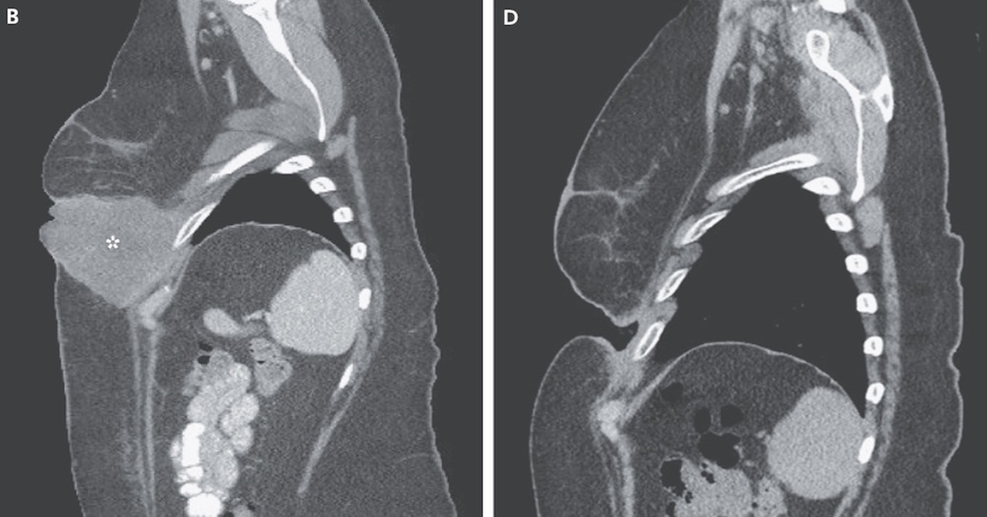
372(21): 2006-2017, 2015 PMID:25891304
αCTLA4 + αPD1

Slide 19
The Brown Cancer Center Is A Leader In Testing “Immune Checkpoint Inhibitors” And Several Are Now FDA-Approved for Multiple Cancers

Slide 20
Despite the impact of these innovative immunotherapies, >600,000 US adults and children will die of cancer in 2019 (8M globally)
Cell-based immunotherapeutic approaches that use the patient’s own immune cells hold great promise
These immune cells (called lymphocytes or T cells) can be isolated from patients’ tumors or from their blood
The Brown Cancer Center is becoming a national leader in the testing of “Tumor Infiltrating Lymphocytes” and “Chimeric Antigen Receptor T Cells”

Slide 21
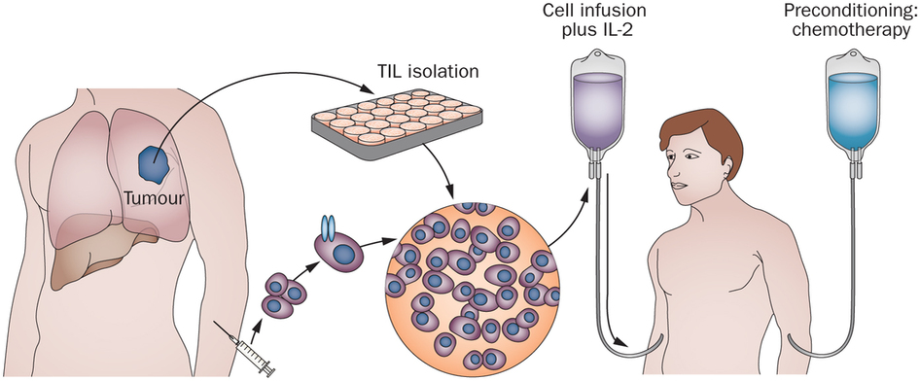
Tumor Infiltrating Lymphocytes (TILs)
Melanoma, NSCLC, Cervical Cancer, Head & Neck Cancer
April 2017
July 2017
Sept 2017
Oct 2017
TILS

Slide 22
TIL Therapy Helps Patients Who Have Progressed on Standard Therapies and Is Saving the Lives of Kentuckians
Reported at the American Society of Clinical Oncology, June 2019
Melanoma response rate 38% (2 CR, 18 PR, 1 uPR) and disease control rate 76% (in patients with no hope)
Cervical carcinoma response rate 44% (1 CR, 9 PR, 2 uPR) and disease control rate 89% (in patients with no hope)
The Brown Cancer Center is one of only 3 sites worldwide to have TILs available to melanoma, lung, cervical and head/neck patients
48 patients enrolled at the Brown Cancer Center from across multiple counties in Kentucky as well from Tennessee, Ohio, Illinois, Colorado and Minnesota

Slide 23
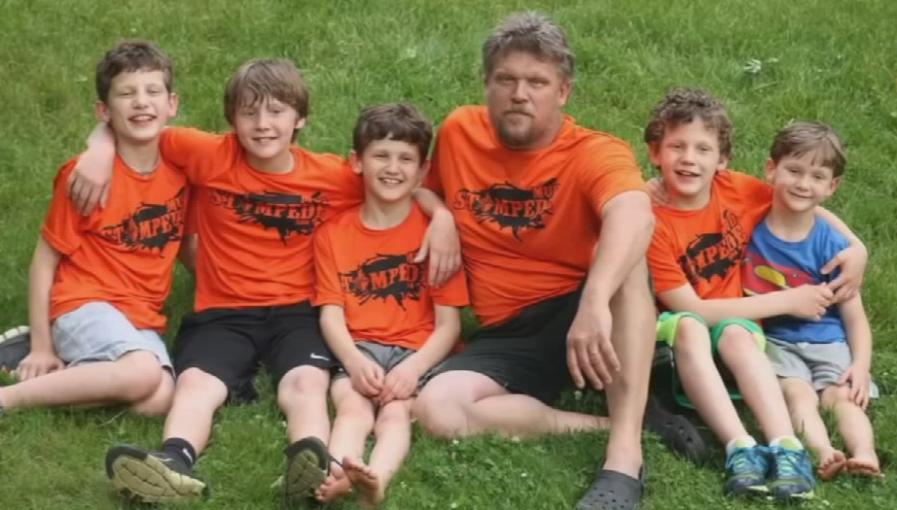
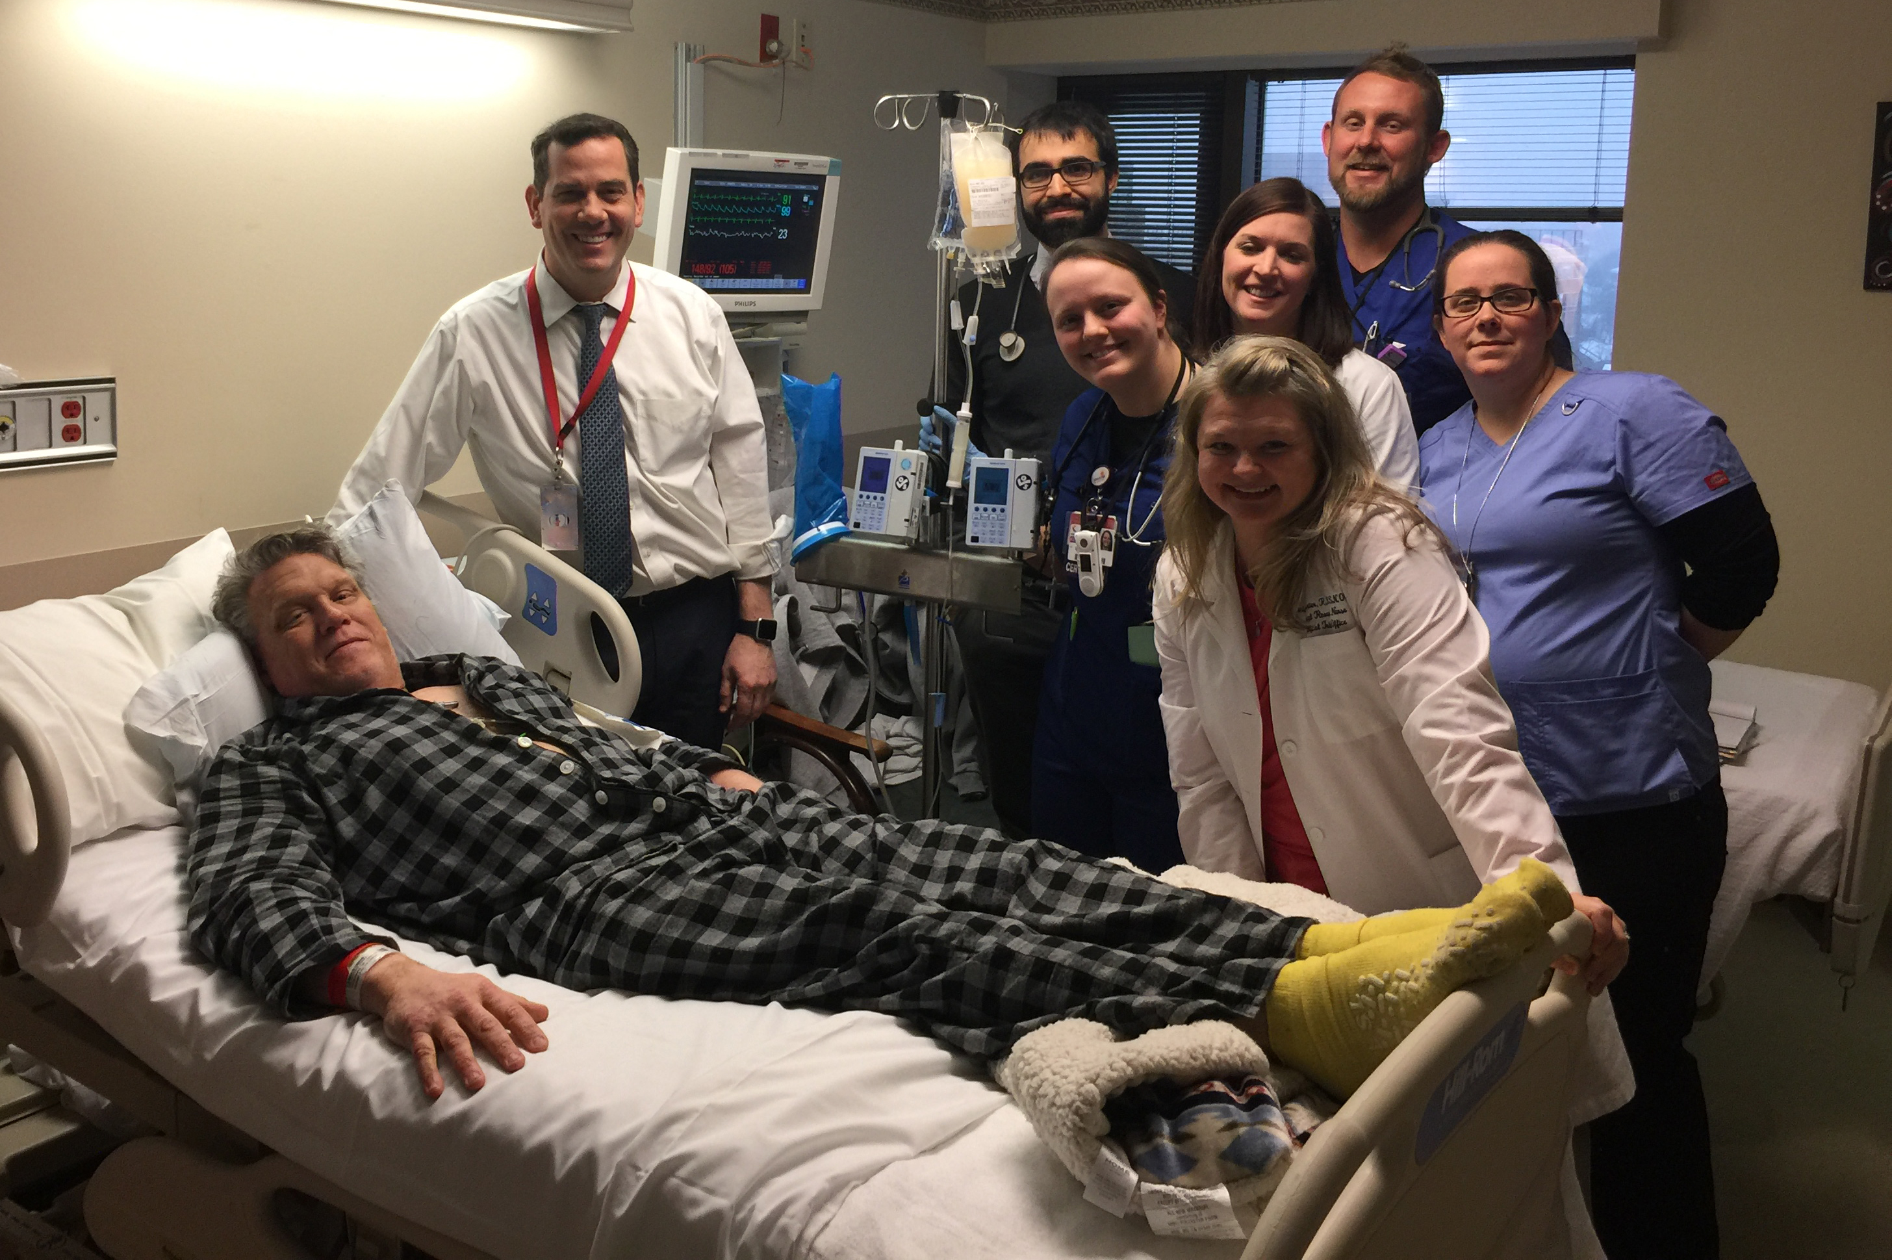
TIL Therapy Helps Patients Who Have Progressed on Standard Therapies and Is Saving the Lives of Kentuckians

Slide 24
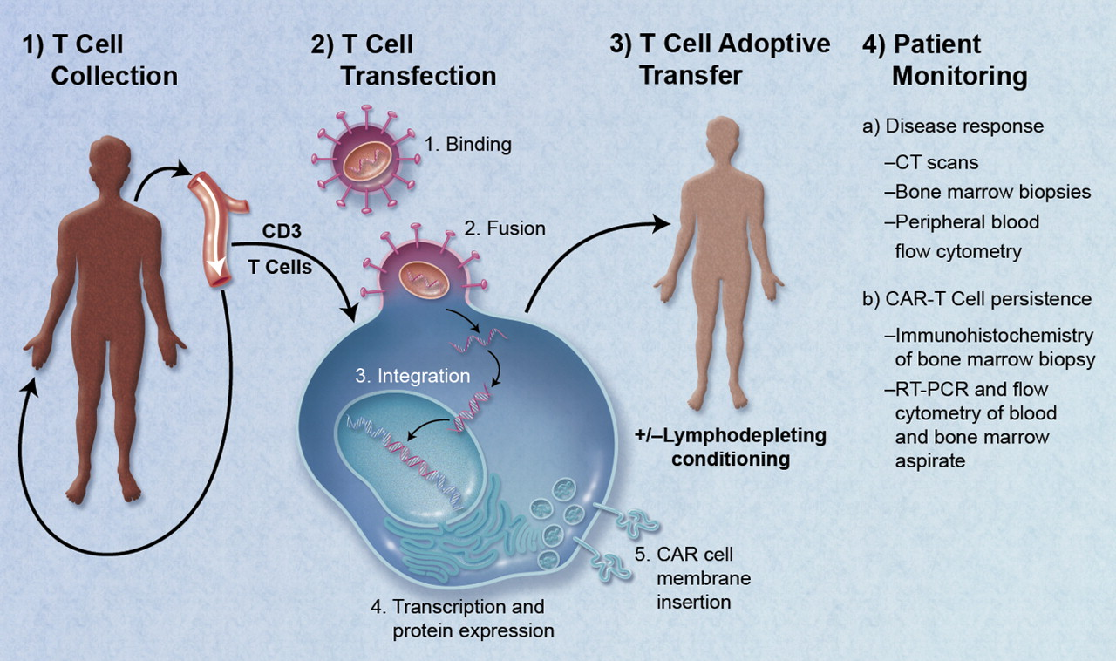
Chimeric Antigen Receptor (CAR) T Cells
CAR T cells are immune cells from cancer patients’ own blood genetically engineered to stick to and kill cancer cells
Has been proven to cure children with B cell leukemias and lymphomas– in theory should work against all types of cancer

Slide 25
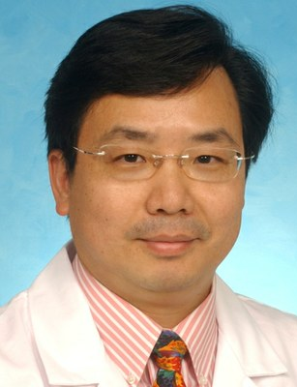
Chimeric Antigen Receptor (CAR) T Cells: AML
Ma
Tse

Slide 26
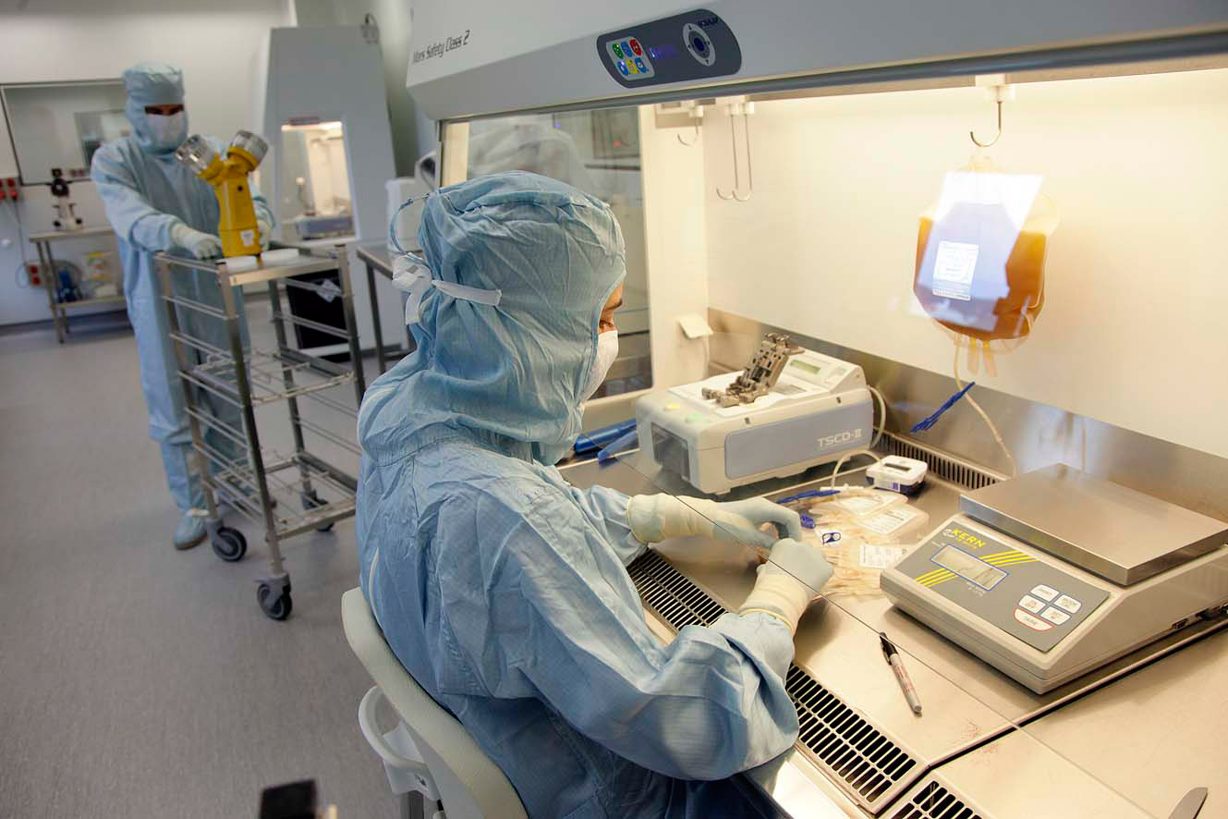
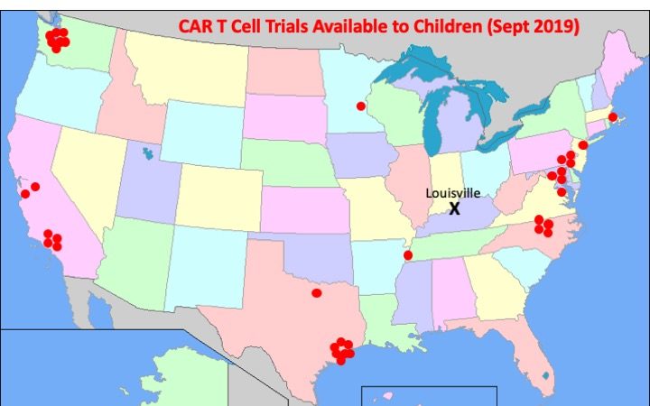
Dunbar CAR T Cell GMP Facility
Despite the promise of CAR T cells for cancer patients, there are no CAR T cell GMP manufacturing labs in KY, few in the Central US, and only 3 CAR T cell trials for kids not on the coasts
With support from the Tobacco Settlement funds and grateful patients, in particular Tom Dunbar, we are developing the first CAR T Cell GMP lab in KY for trial testing in children and adults suffering from cancer throughout the state (and the central US)

Slide 27
New Center for Cancer Immunology & Immunotherapy
Mission is to conduct biomedical research that works towards harnessing the power of the immune system to eradicate cancer
$12M 5 year CoBRE grant application to the NIH received a top score of 25 with funding anticipated to start in 2020
CoBRE is renewable for up to 15 years with total funding of ~$30M – institutional support provided through the Tobacco Settlement funds was cited as a key strength by the NIH scientific reviewers
This $12M grant will support the new center with an emphasis on the training of junior investigators and the creation of essential scientific core facilities

Slide 28
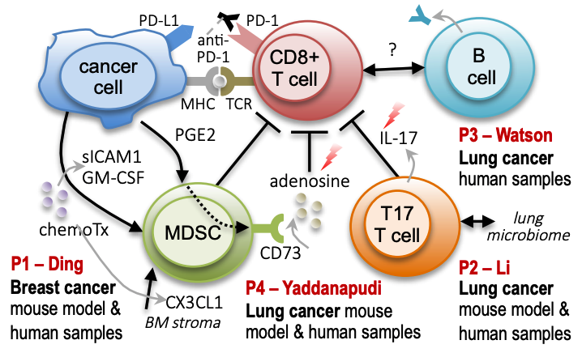
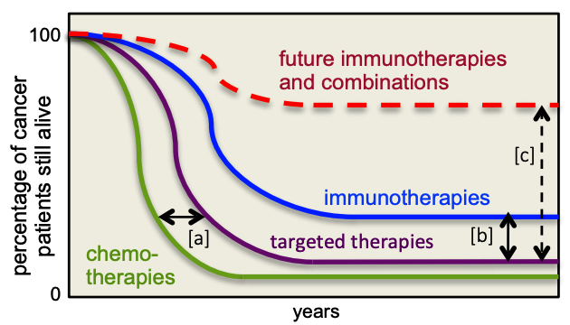
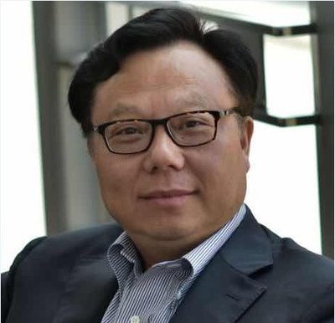
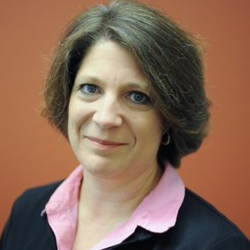
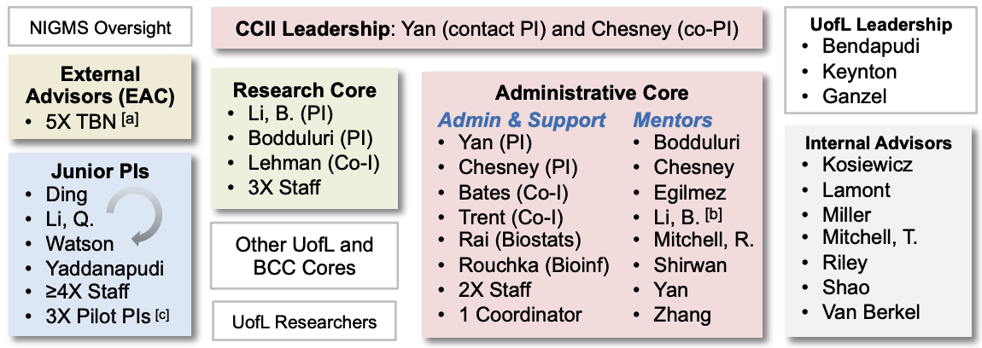
New Center for Cancer Immunology & Immunotherapy
Mission is to conduct biomedical research that works towards harnessing the power of the immune system to eradicate cancer
Yan Bates

Slide 29
Conclusions
Our goal is to make cancer a disease of the past, a disease only discussed in history books, and a disease that doesn’t cause our friends and family, young and old, to die before their time
To reach this goal, we need continued support for our innovative cancer screening and research programs so that we can continue to reduce the cancer death rate in Kentucky, the US and the world

