Slide 1
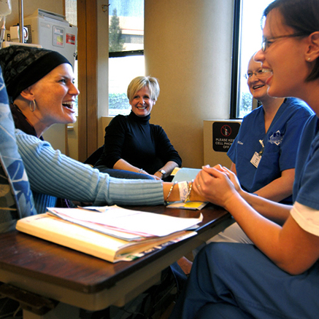
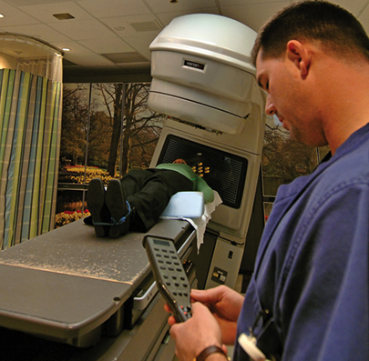
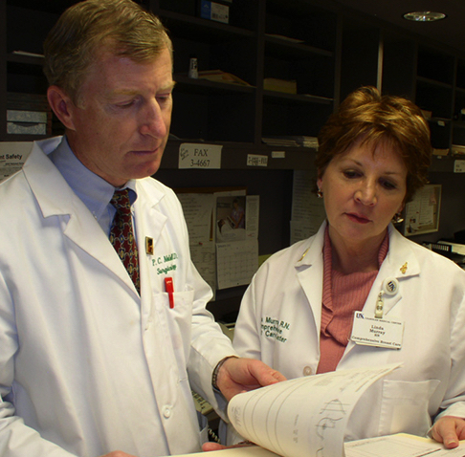
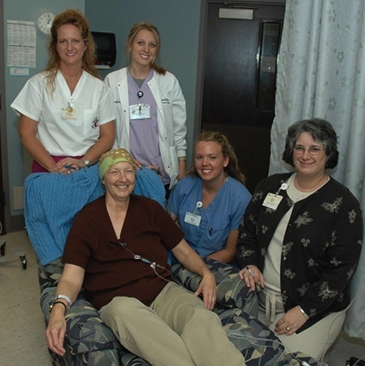

Tobacco Settlement
Fund Update
B. Mark Evers, MD
October 2, 2019

Slide 2
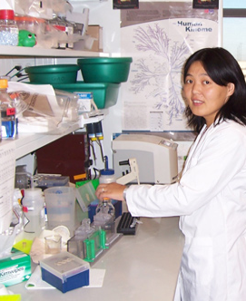
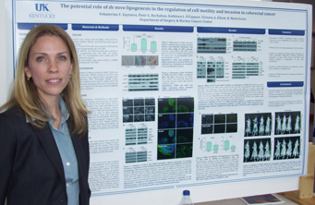
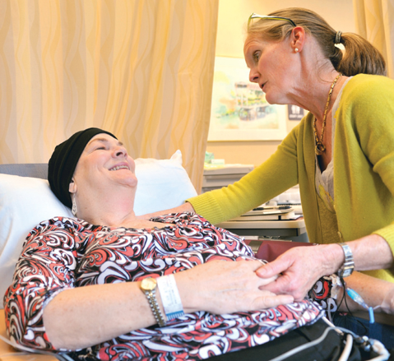
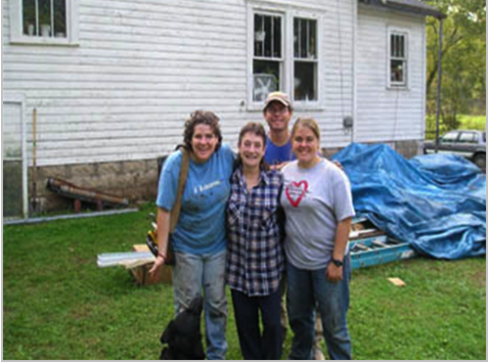

Markey Cancer Center (MCC): Our Mission
To reduce cancer mortality in our state through a comprehensive program of cancer research, treatment, education, and community engagement with a particular focus on the underserved population of Appalachian Kentucky.

Slide 3
Bold Goal:
“Conquering Cancer in the
Commonwealth”
DROP FROM
STATE
IN CANCER MORTALITY
50% REDUCTION
#1
In cancer mortality in the Commonwealth
(Nearly 11,000 cancer deaths every year)

Slide 4
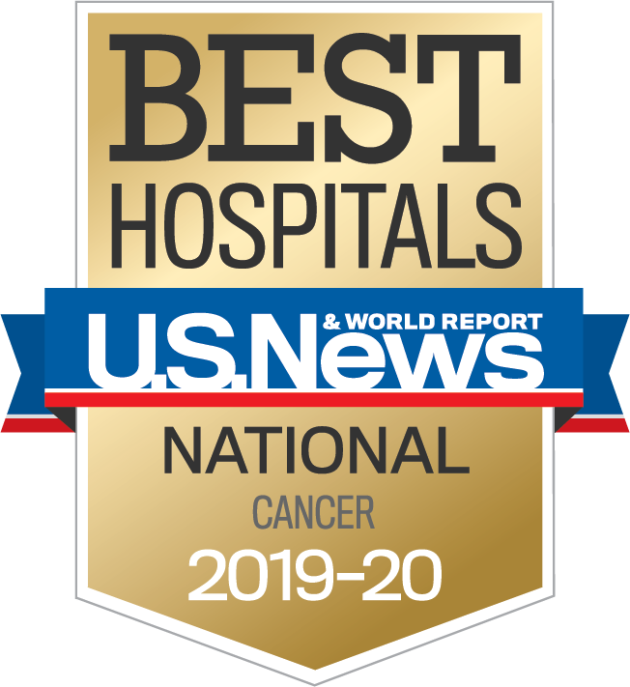

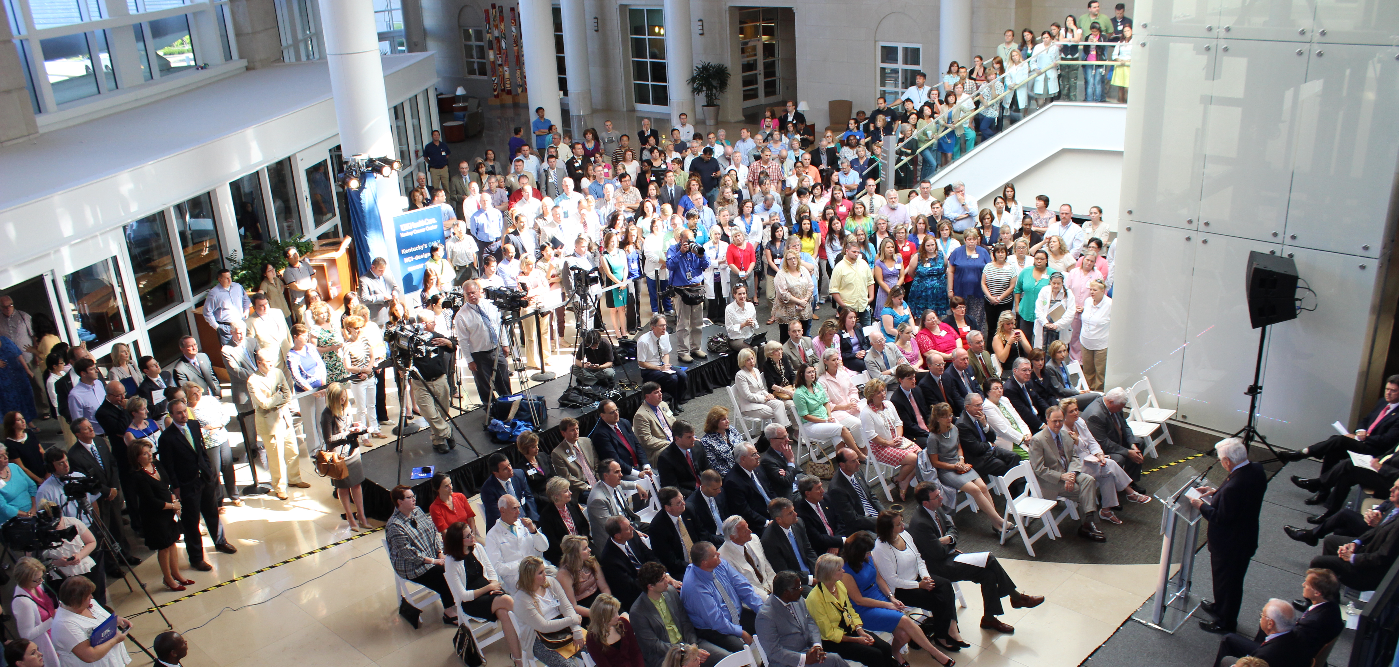
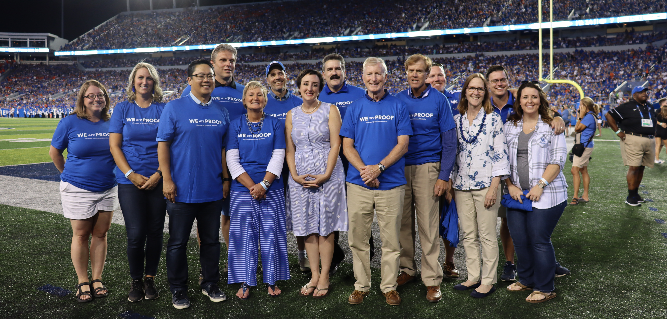
IMPACT OF STATE FUNDING:
Achieving NCI Designation and National Recognition

Slide 5
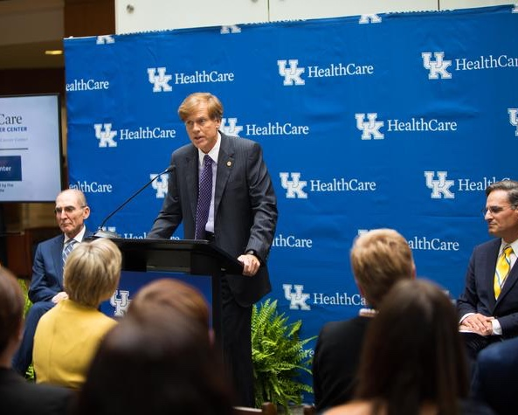
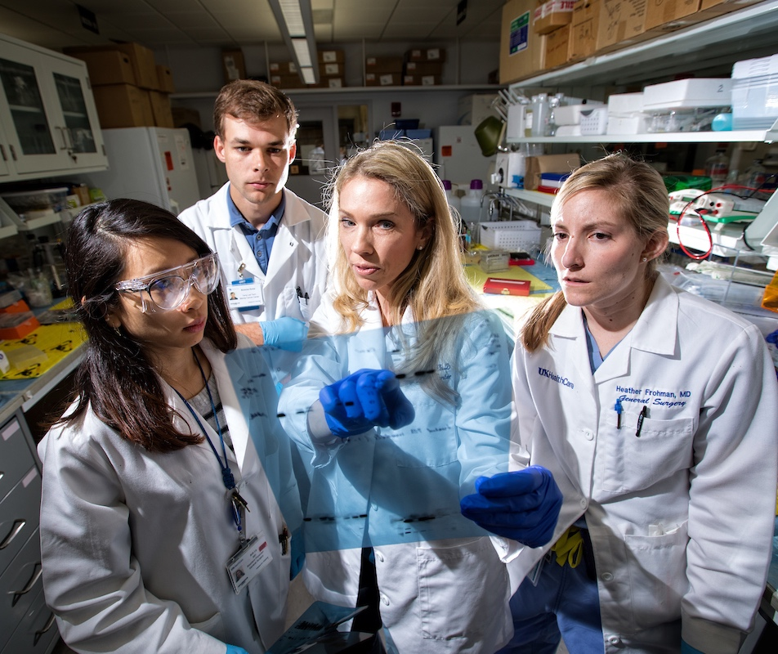
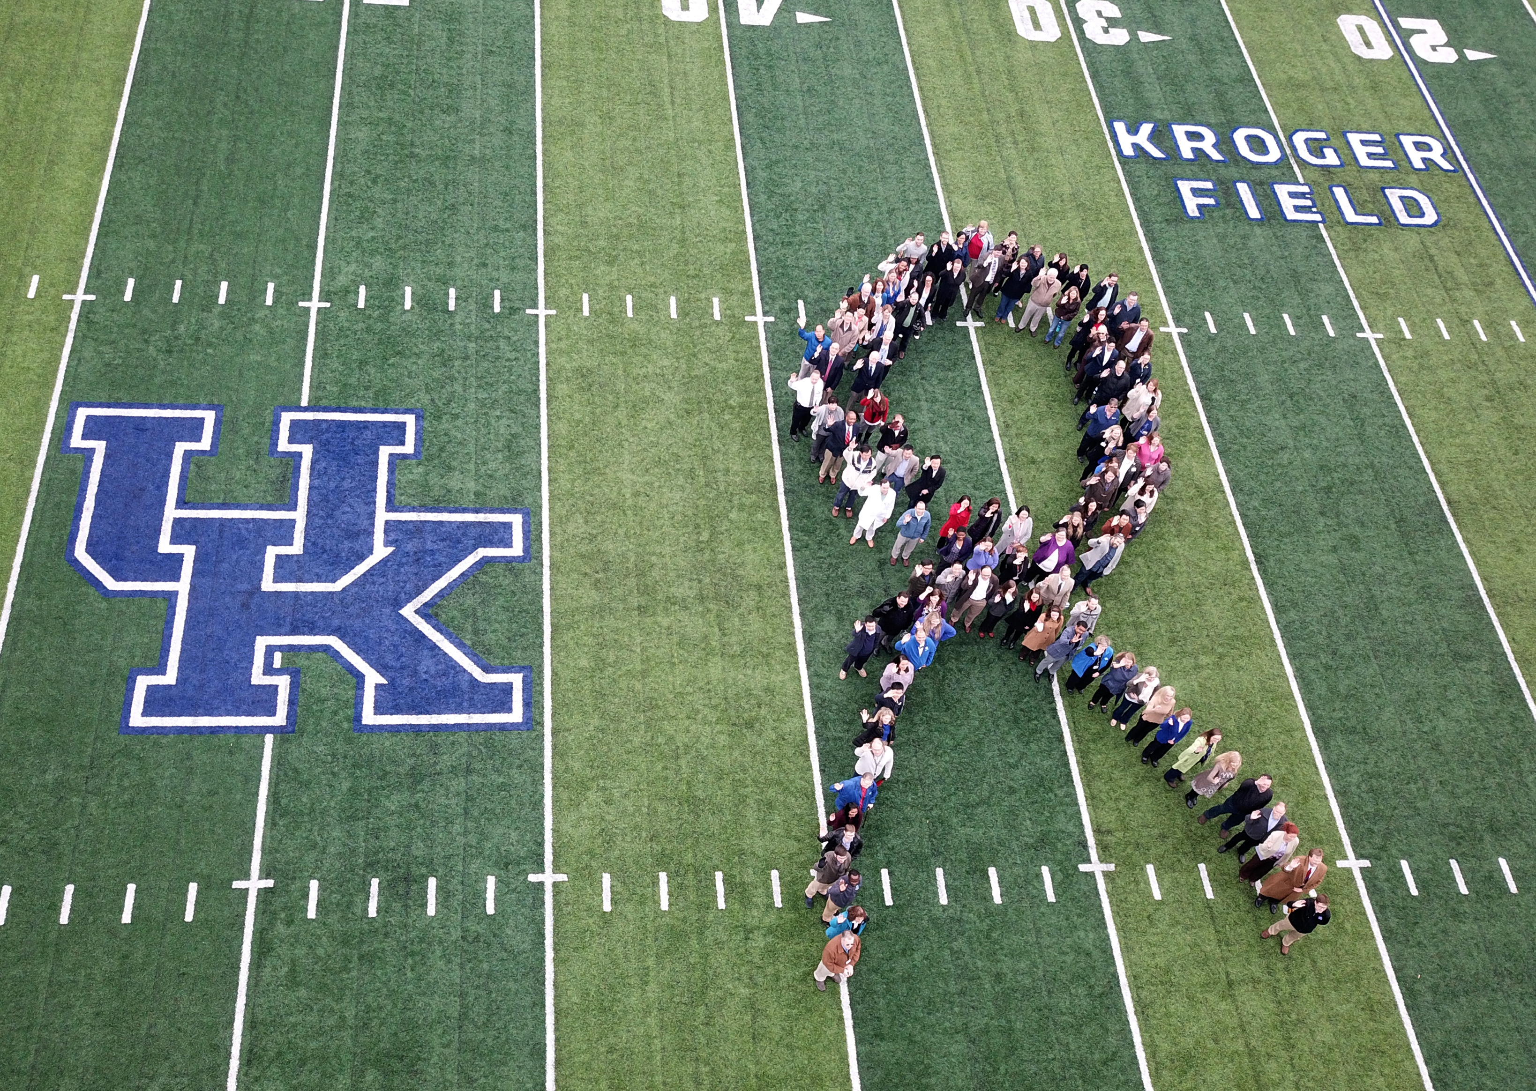
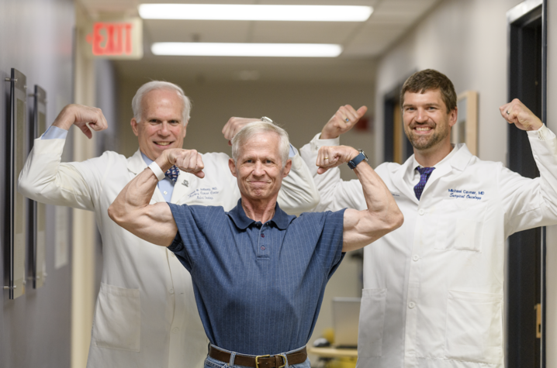
MCC’s NCI Designation Path
Awarded initial designation (5 years) – July 2013
Successful renewal for another 5 years – July 2018
Application for Comprehensive Status – September 2022
*

Slide 6
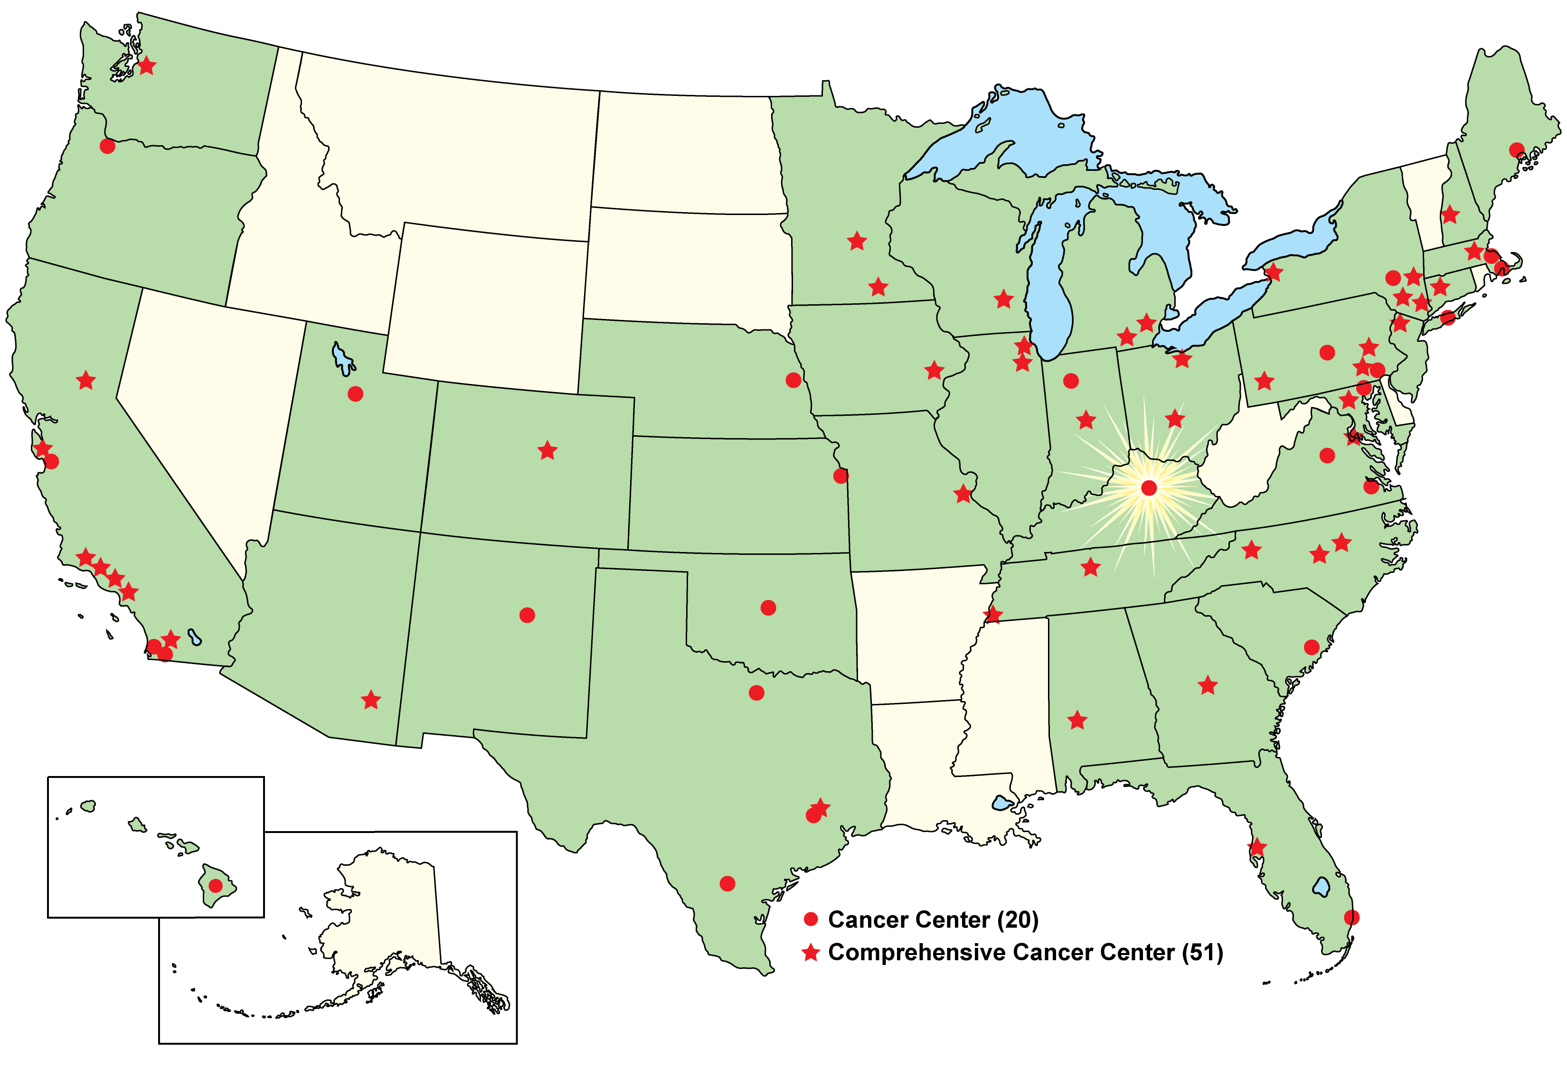
NCI-Designated Cancer Centers
July 12, 2013
Markey Cancer Center became the 68th
NCI-designated cancer center in the U.S.

Slide 7
U.S. News and World Reports
Top 50 Cancer Centers in the U.S.
2019
2018
2017
#33
#38
#50

Slide 8
Increasing Cancer Patient Volume
5000
110,000
4500
4000
105,000
3500
100,000
3000
Inpatient
2500
95,000
Outpatient
2000
1500
90,000
1000
85,000
500
0
80,000
2015
2016
2017
2018
2019*
Inpatient
Outpatient
Since FY15…
  Inpatient cases have grown 12.4%
  Outpatient cases have grown 19.5%

Slide 9

Cancer Research Funding (Total)
$46.2M
63%
$16.7M
NCI
INCREASE
SINCE 2012
$28.4M
Funding (in Millions)
$10.6M
NCI
$29.5M
other
sources
$17.8M
other
sources
131
Projects
199
Projects

Slide 10
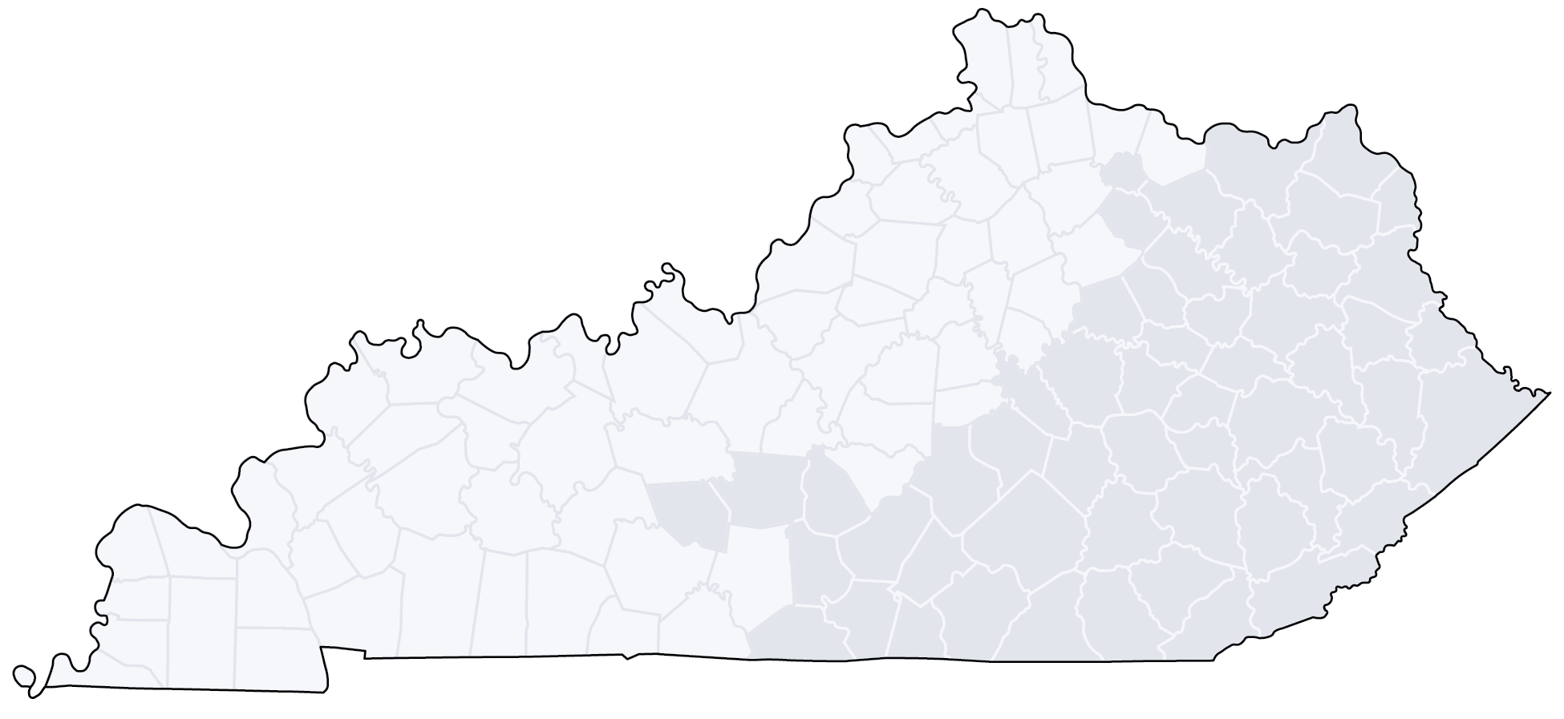
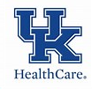
MCC Affiliate and Research Networks
41.5% of all new cancer cases in Kentucky are directly or indirectly cared for by MCC
MCC Affiliate Network (19 sites)
Prospective Affiliate Network (7 sites)
Edgewood
Portsmouth, OH
MCC Research Network (7 sites)
Prospective Research Network (4 sites)
Ashland
Huntington, WV
Georgetown
Cynthiana
Morehead
Charleston, WV
Indiana
Winchester
South
Williamson
Beckley, WV
Owensboro
Elizabethtown
Prestonsburg
Danville
Pikeville
Campbellsville
Mt. Vernon
Hazard
Bowling
Green
Paducah
Glasgow
Somerset
Manchester
Harlan
Middlesboro
Tennessee
Bristol, TN

Slide 11

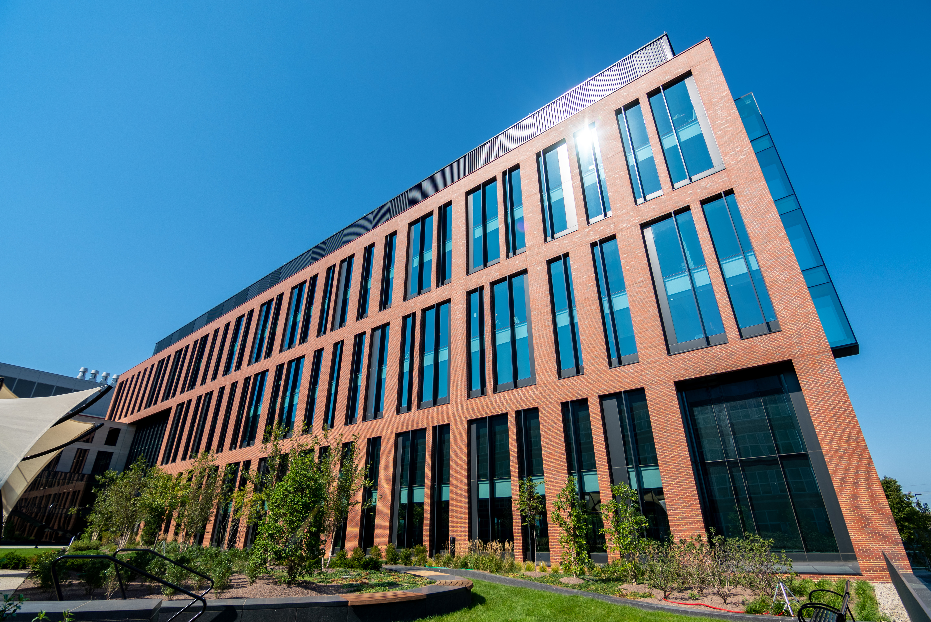
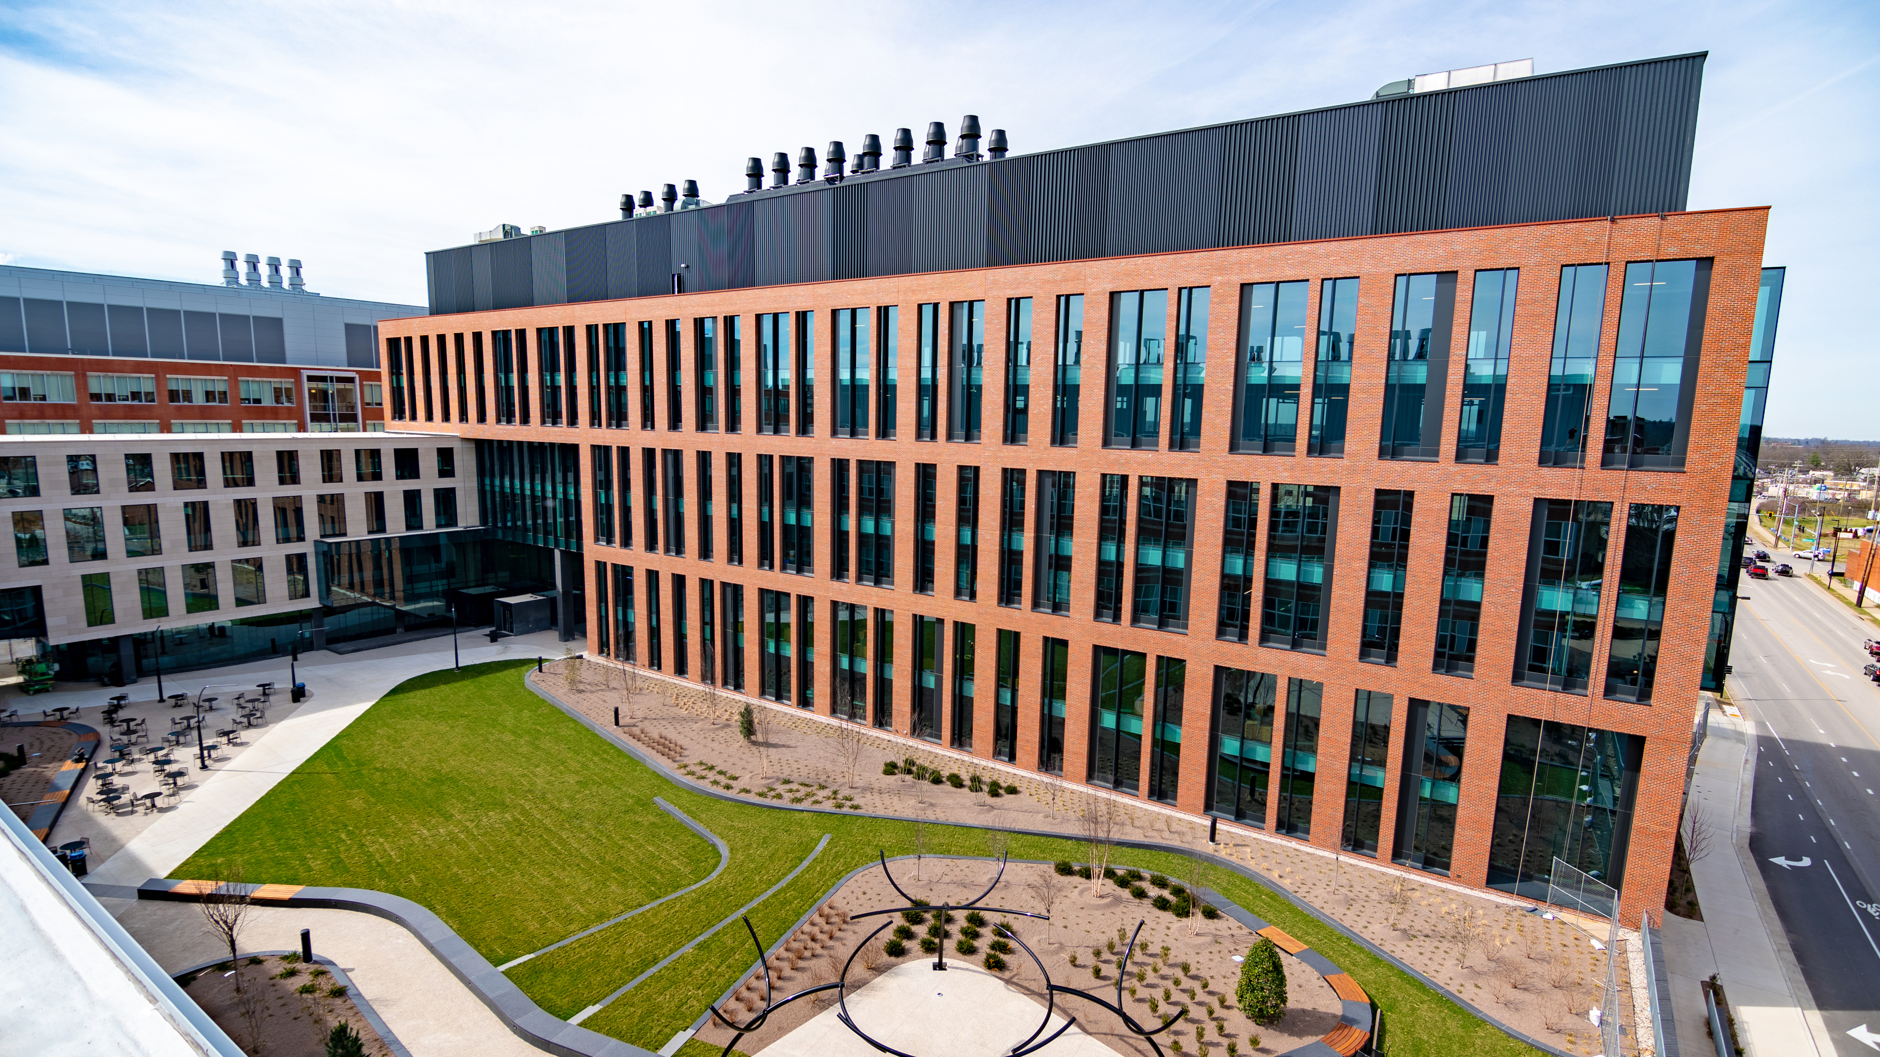
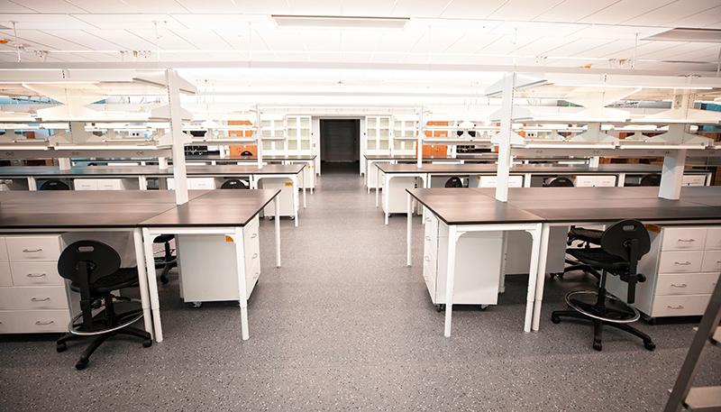
MCC Space Expansion
Healthy Kentucky Research Building (HKRB) made possible because of state support to tackle Kentucky’s most serious health problems
MCC has entire 3rd floor of lab space
  Collaborative space on floor to be named in memory of Lynda Morris Thomas, KY Sen. Reggie Thomas’ wife
MCC will be allocated 4th and 5th floors
  Coming on board summer 2020

Slide 12

Other Impacts of NCI Designation
76 new faculty recruits since NCI Designation
Accrual of nearly 12,000 subjects to interventional trials; 44% from Appalachia
Training more than 5,700 health care professionals across the state
Nearly $18 million in new funding since NCI Designation

Slide 13
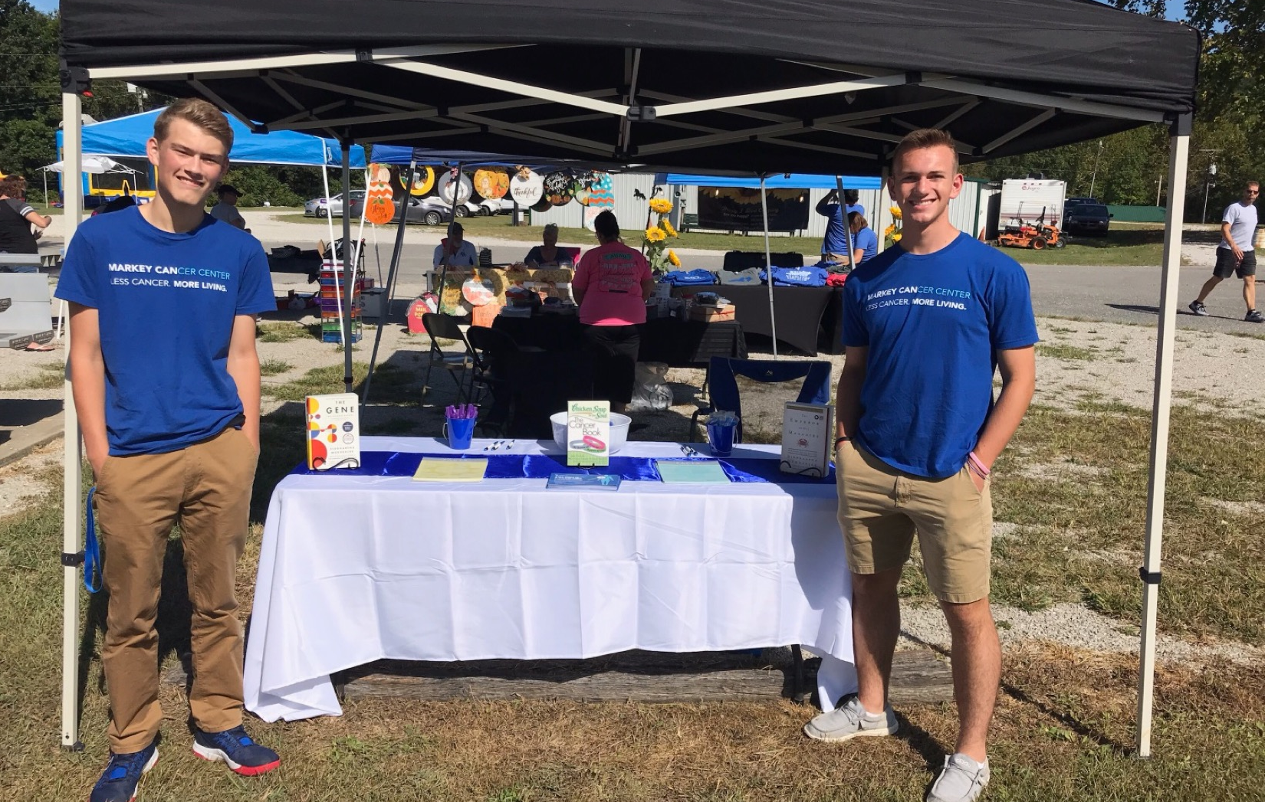
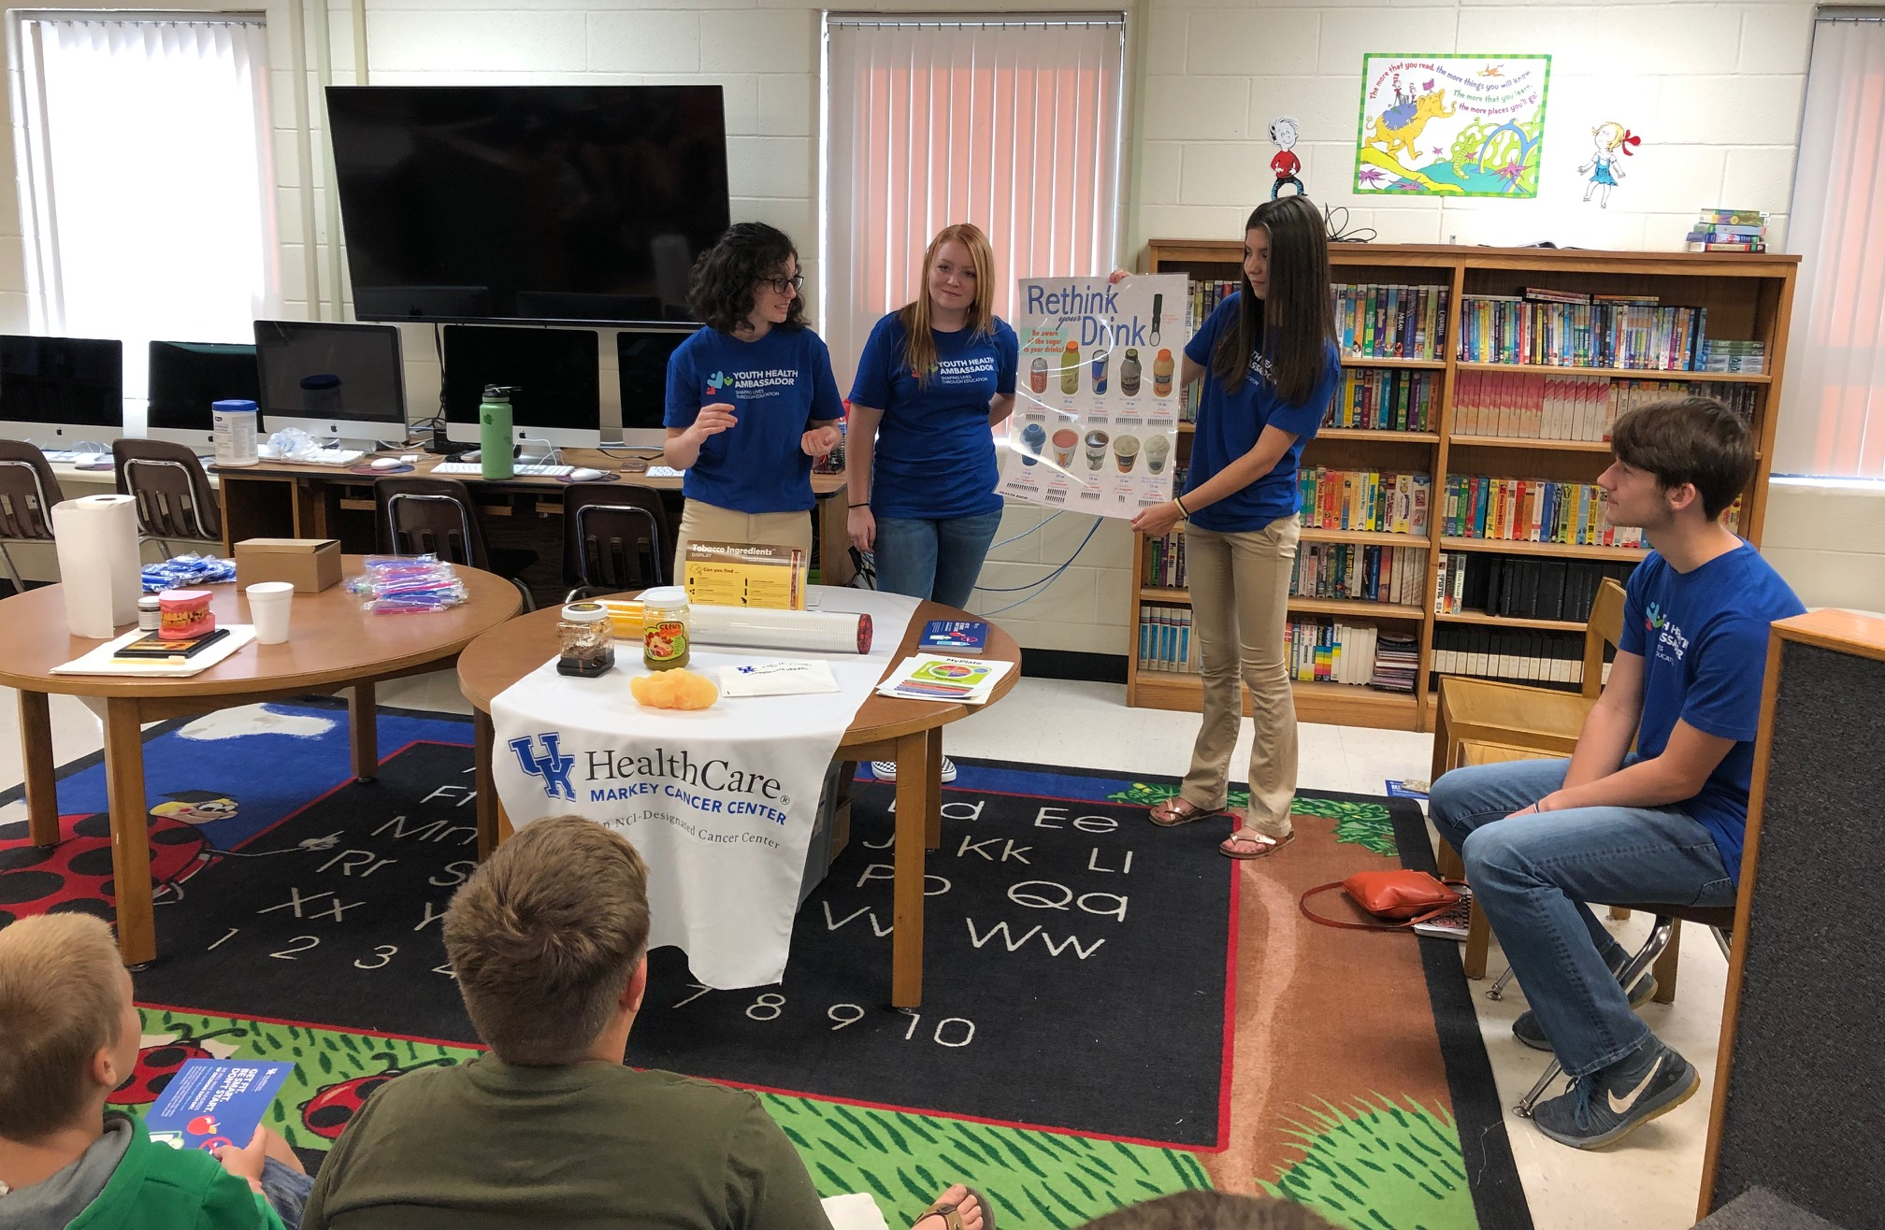
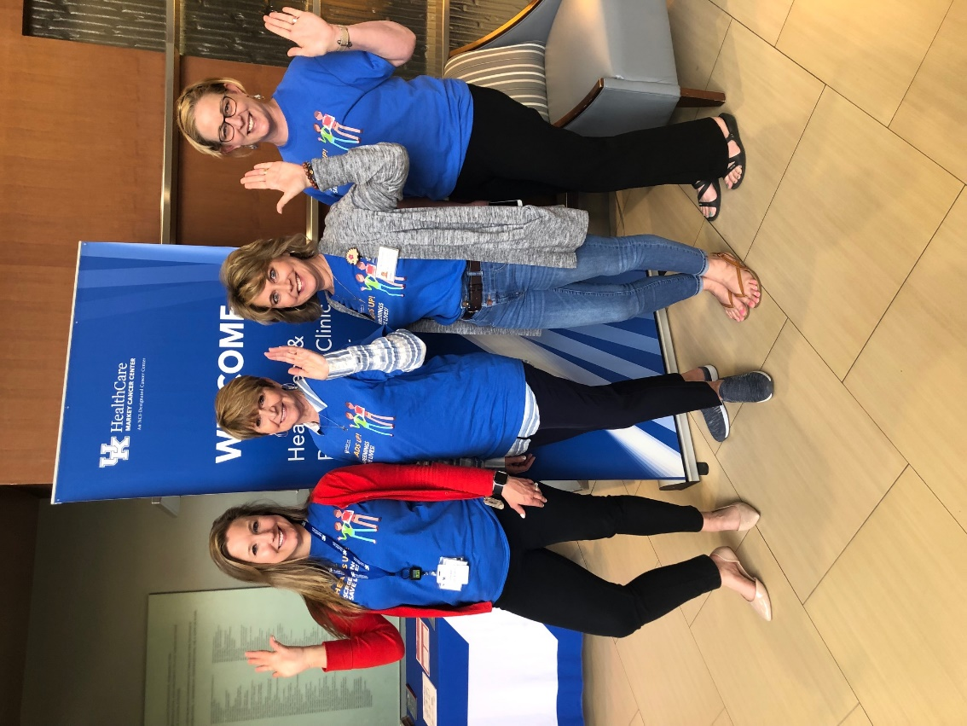
Impact of 2019-2020
state cancer prevention and research funding
to MCC

Slide 14
Tobacco Settlement Appropriations
FY19 | FY20
Research and Screening Funds
FY19
FY20
$3.5M
$3.34M
( ~$160,000)

Slide 15



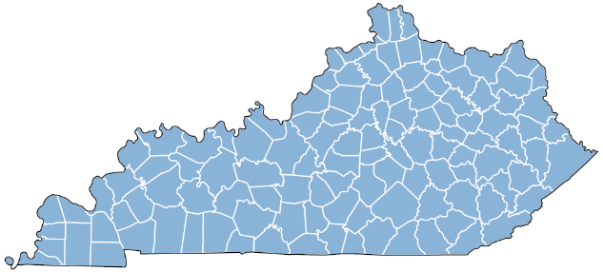


Lung Cancer Prevention and Control
Plan To Be Tobacco Free
Smoking Cessation Classes
Quit Now Kentucky
% population covered by 100% smoke-free laws (Oct 2017)
Survivorship
Prevention & Early Detection
0%
32.5%
0
0%
0.5
0.5%
0.5%
0
32.1%
0.5
32.1
0.
28.5%
28.5
13.1
2.7
2.7%
13.1%
18.4%
0
0%
Educated 2,670 providers
and support staff
Lung Cancer Network
KY has the 6th highest lung cancer screening volume
Senate Bill 89:
Mandates insurance and MCD coverage for tobacco cessation programs
Notes:
Related to lung cancer, our research and outreach programs are active in promoting tobacco prevention and cessation and quality lung cancer screening among community members and providers. [ANIMATION] They are also leading implementation of policies that support smoke-free communities and evidence-based tobacco treatment.
[ANIMATION] An example of this multifaceted work is the KY LEADS Collaborative, a $7 million award from the Bristol Meyers Squibb Foundation to Dr. Studts in CP. The LEADS team, including DT investigators, have collaborated with all 15 district cancer councils, the Kentucky Cancer Program, the Kentucky Cancer Consortium, and community hospitals statewide to educate and train on innovations in lung cancer across the care continuum. To date, over 2,600 providers and their support staff have received LEADS educational services. One outcome to note, Kentucky now has the 6th highest lung cancer screening volume in the U.S.

Slide 16






HPV-Related Cancer Prevention and Control
NCI recognized: National dissemination
HPV vaccination in schools,
88% completed full series
Senate Bill 101:
Allows pharmacists to vaccinate down to age 9 without a physician’s prescription
Pap testing (n=317) and HPV self-testing (n=400) among under-screened women
Notes:
Regarding prevention and control of HPV-related cancers, we have two highly productive partnerships with district health departments: one focused on HPV vaccination in the schools, and the other delivering traditional Pap testing and HPV self-testing to under-screened women in eastern KY.
[ANIMATION] A recent collaboration with the UK College of Pharmacy – focused on HPV vaccination in pharmacy settings – contributed to Senate Bill 101, which allows pharmacists to vaccinate down to age 9 without a physician’s order.
[ANIMATION] We are honored to have two NCI recognized research-tested interventions at Markey: (1) 1-2-3 Pap, an HPV vaccination intervention, which has been replicated across Kentucky, West Virginia, and North Carolina, and (2) Faith Moves Mountains, Dr. Schoenberg’s faith-based lay health advisor program, which has been expanded from cervical cancer to address breast and colon cancer, tobacco cessation, healthy living, and diabetes.

Slide 17
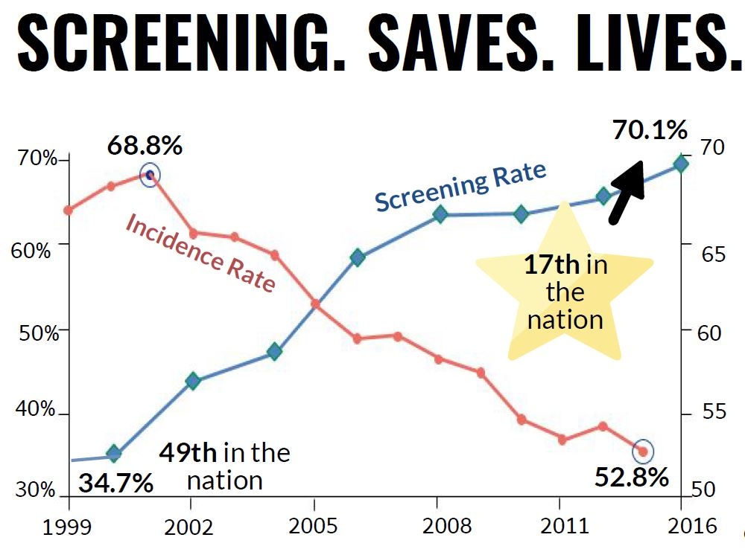
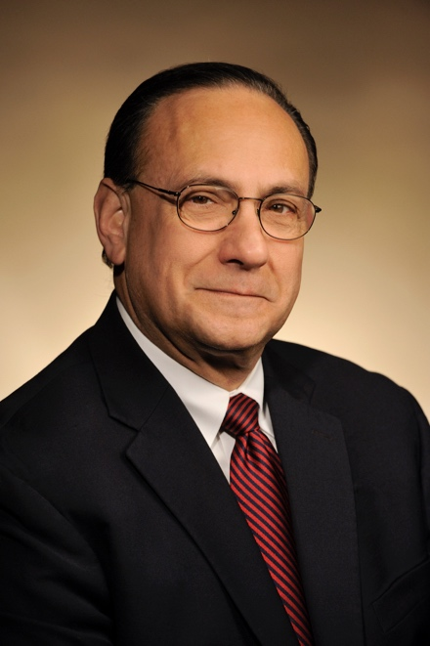
Decreasing Colorectal Cancer (CRC) Mortality in the Commonwealth
Thomas Tucker PhD
After implementation, mortality rate decreased 30% (Kentucky dropped to #6 in the U.S.)
Notes:
A 25% decrease in the CRC incidence rate and a 30% decrease in the mortality rate represents a significant public health accomplishment. We clearly are not done. However, to put this in perspective, a 25% decrease in the incidence of CRC means that every year 230 Kentuckians who developed CRC in the past no longer get the disease.

Slide 18
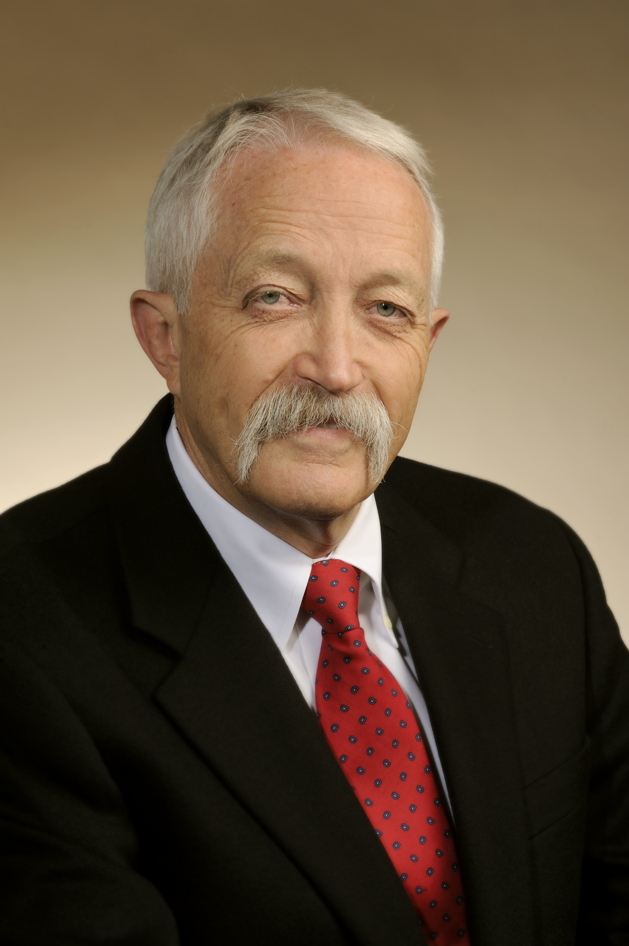
Colorectal Cancer Screening in Appalachia
(new programs)
Accelerating CRC Screening (ACCSIS)
  $5.4 Million in funding over 5 years
Effectiveness and Implementation of
mPATH-CRC:
a Mobile Health System for CRC Screening
Both projects:
  Increase CRC screening and outcomes in rural Appalachia
  Interventions at multiple levels including patients, providers, health systems and community partners (patient activation, distribution of FIT kits, and increasing access to screening through patient navigation)
Mark Dignan, PhD

Slide 19
Recruiting for Kentucky’s Population
State-funded Recruitments
Jerod Stapleton, PhD
  Recruited from Rutgers Cancer Institute of New Jersey
  Research focus: Indoor tanning in young adults, policy, social media, health disparities
  Brings grants totaling >$616,000 per year
Laurie McLouth, PhD
  Recruited from Wake Forest Comprehensive Cancer Center
  Research focus: Improving the lives of cancer survivors and their family members, particularly lung cancer survivors
  Brings grants totaling >$76,500 per year
Shyanika Rose, PhD
  Recruited from the Truth Initiative Schroeder Institute (Washington, DC)
  Research focus: Policy initiatives for marketing tobacco products to young adult populations (specifically flavored tobacco)
  Brings grants totaling >$76,500 per year

Slide 20
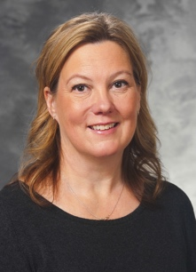
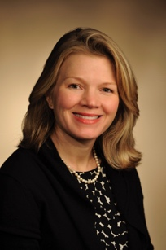
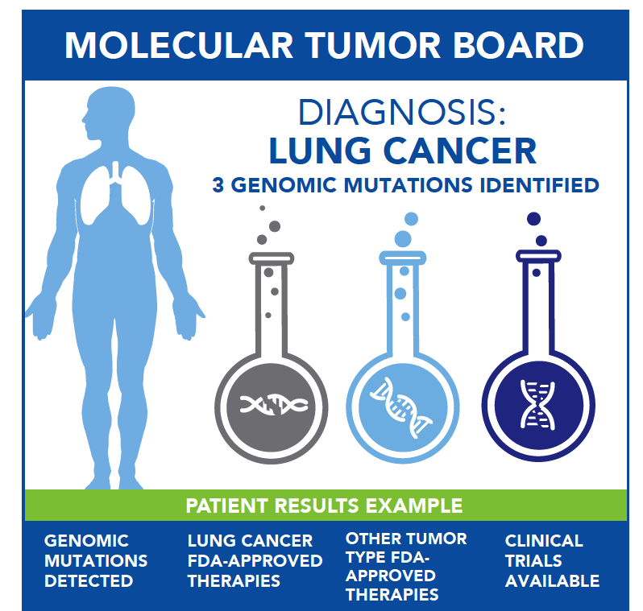
Molecular Tumor Board (MTB)
Launched October 2016 and now statewide through teleconferencing options
The MTB analyzes the molecular characteristics of cancers on a case-by-case basis and provides individualized recommendations for treatment
Jill Kolesar, PharmD
Professor
College of Pharmacy
Rachel Miller, MD
Associate Professor,
College of Medicine

Slide 21
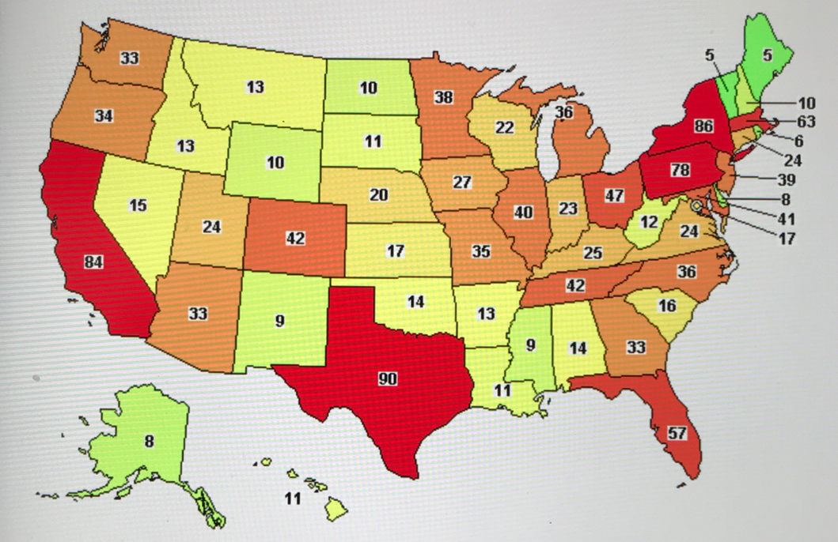
Neuroendocrine Tumor Program /
Lutathera
A new peptide receptor radionuclide therapy (PRRT) specifically for neuroendocrine tumors occurring in the pancreas or gastrointestinal tract
Patients who receive this therapy have failed standard of care and/or have cancer that continues to progress.
MCC is the first cancer center in Kentucky to
offer newly FDA-approved Lutathera for certain neuroendocrine tumors
Expect to see roughly 30 to 40 patients a year who may be eligible for the therapy
36 patients treated to date
Lowell Anthony, MD
NET Clinical Trials in U.S.
Source: ClinicalTrials.gov

Slide 22
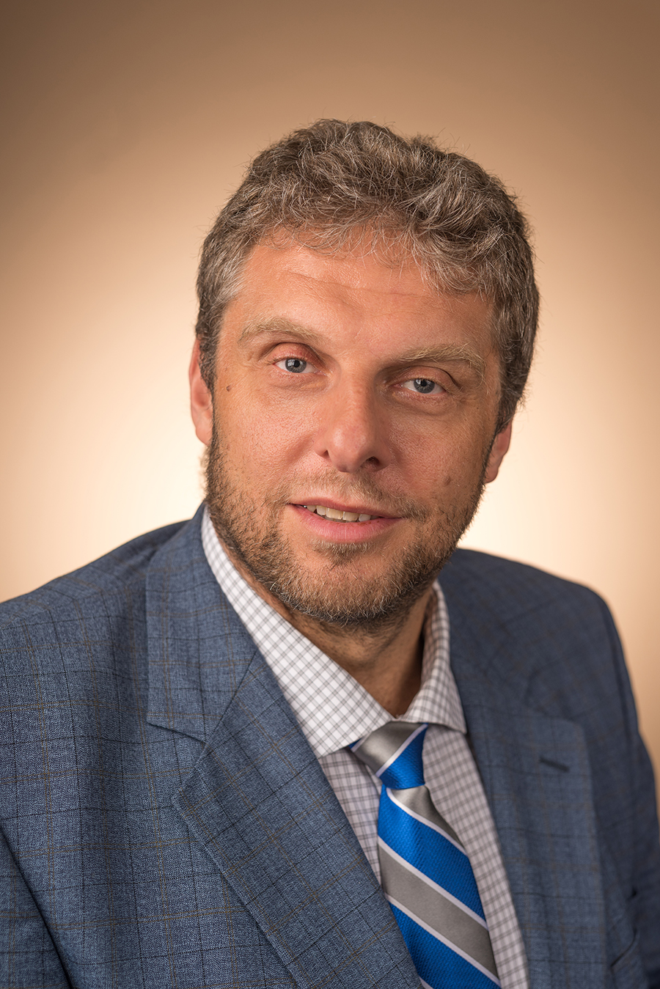
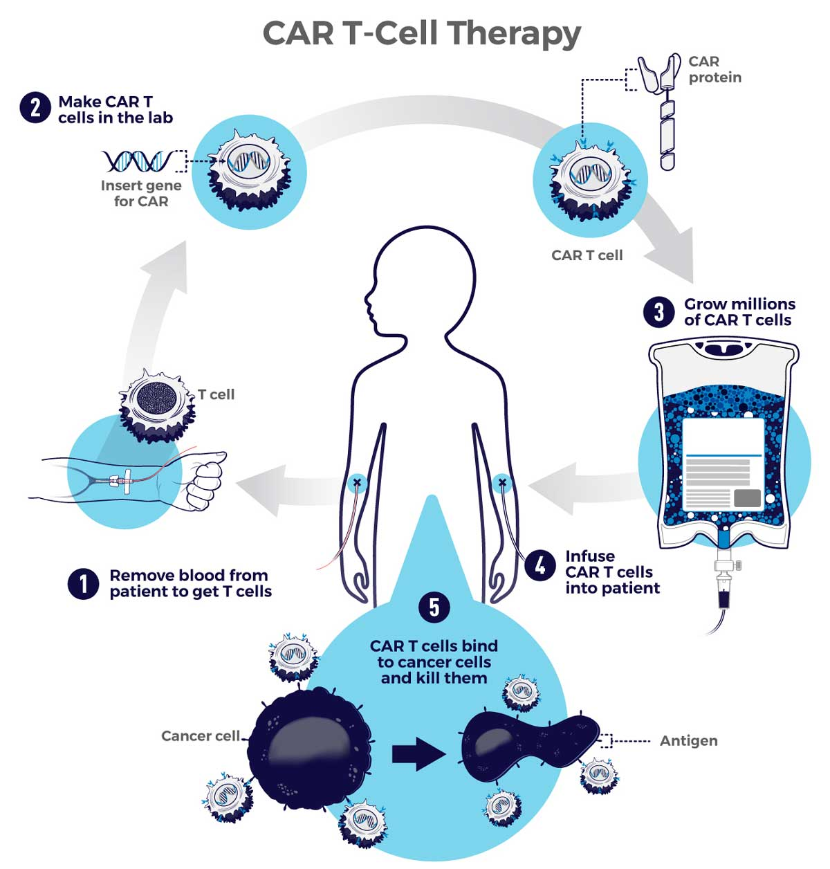
CAR-T Cell Program
A groundbreaking form of immunotherapy in which T cells from the patient are modified to specifically
attack cancer
Currently approved for patients who have failed
standard of care therapy for diffuse large B-cell lymphoma (DLCBL) and acute lymphocytic leukemia (ALL) that would otherwise face limited treatment options and poor outcomes
Further indications are on the forefront, such as multiple myeloma
10 patients treated at MCC
2 patients on clinical trial (18-NHL-22-JT-PMC (017006): A Phase 2 study of JCAR017 as Second-Line Therapy in Adult Patients with Aggressive B-cell NHL
Gerhard
Hildebrandt, MD

Slide 23
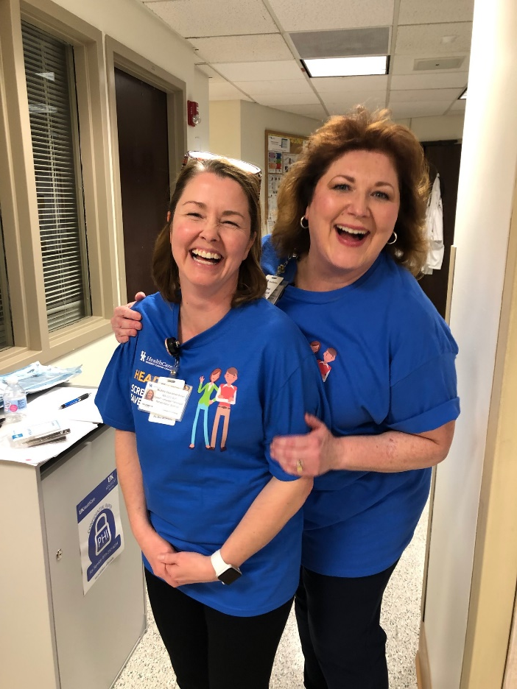
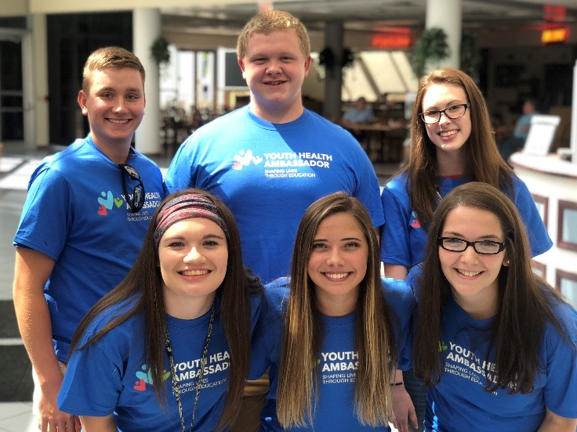
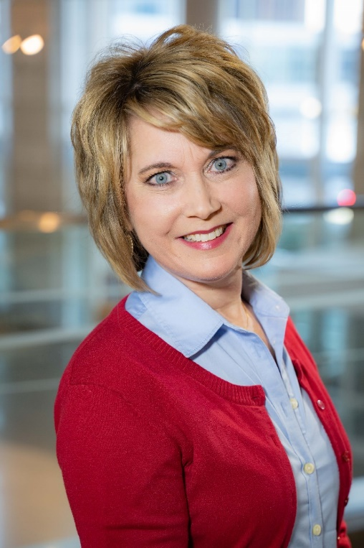
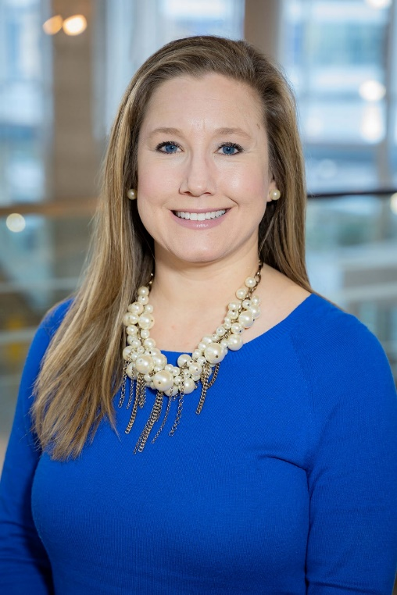
Markey Outreach
Mamms Day Out Saturday Screening Event
Colon Cancer Screening Program
Body and Soul Wellness Program
Youth Health Ambassadors
Head and Neck Cancer Screening Event
Health and Wellness Presentations
Counties covered
by Markey Outreach

Slide 24
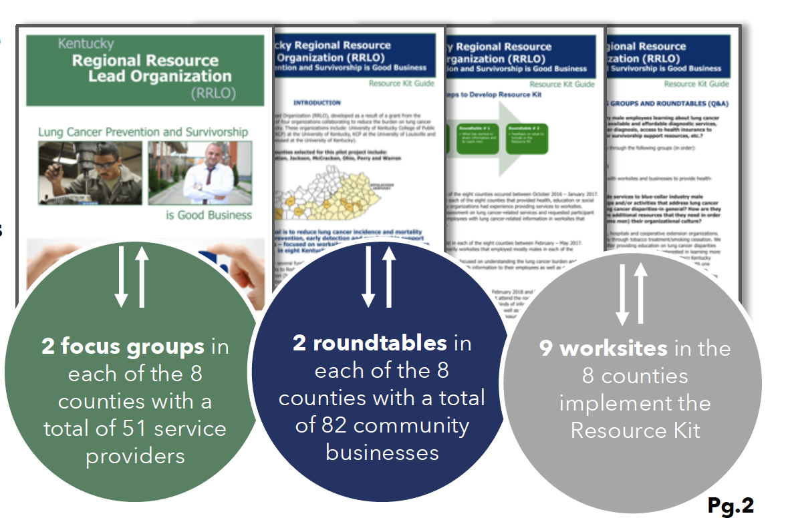
2018-2019 Kentucky Cancer Program
By The Numbers
461 Partnerships formed with community organizations /coalitions
901 Partnership meetings held
1,917 Instances of assisting with planning, implementing and evaluating activities, providing resources, and facilitating collaboration
28,799 Materials and resources distributed to partnership organizations for use in offices, clinics and other outreach
279 Activities / events held in collaboration with community organizations and groups
11,631 People reached through group education programs and one-on-one interventions
21 Community mass media outlets utilized for prevention and screening messaging
1,850 People received prevention and related screening
services
915 people participated in research activities (surveys, key
informant interviews, focus groups)

Slide 25
Future Directions for MCC
(2020-2022)
Strategic recruitments
  Clinician scientists (GI, Breast) / Clinical Leaders
  Cancer prevention and control researchers (dissemination and implementation, epidemiology – specifically lung cancer); community outreach
  Basic scientists (epigenetics, cancer metabolism, tumor immunology)
  Goal to increase membership by an additional 15 members by 2022
Space
  Fully move in to Healthy Kentucky Research Building (HKRB) floors 3–5
  Begin plans for a Cancer Multispecialty Building
Submit application for Comprehensive Status in 2022

Slide 26
Benefits of
NCI Comprehensive Status
Additional federal funding for research, cancer prevention and clinical trials
Ability to recruit more faculty and staff
Treatment options and clinical trials not available to other centers
Bigger draw for patients in and outside of the state

Slide 27
WE NEED YOUR
CONTINUED SUPPORT!

Slide 28
Decreased State Funding Hurts MCC’s
Growth Potential
With the additional $160,000, we could have…
Provided more colon cancer testing and statewide screening events
Hired an outreach coordinator for western Kentucky
Provided additional support for our MCC affiliate sites
Provide more HPV vaccinations

Slide 29
Thank you!

