Slide 1
Tobacco Settlement Oversight
Paulette Akers, Director
Kentucky Division of Conservation
November 2019

Slide 2
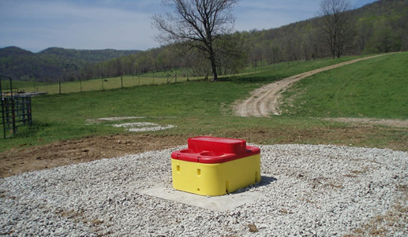
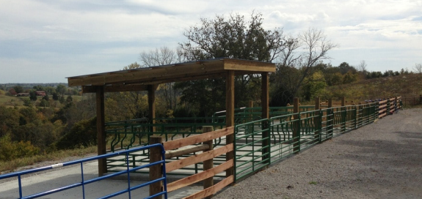
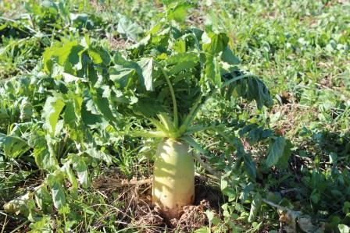
State Cost Share Summary
Originally established in 1994 and funded from General Funds and pesticide Product Registration Fees
Starting in 2000, the program was funded through Tobacco Master Settlement Agreement Funds
Provides financial assistance to farmers at a 75% reimbursement rate for those implementing best management practices on their farms with the assistance of local conservation districts
Notes:
First few slides are going to be based on a summary of all the years and then we will get into this year specifically

Slide 4
Notes:
More than $161 million dollars have been approved for use by Kentucky farmers in the past 25 years. It is larger than the total appropriations over that time because it is hard to give out money.

Slide 5
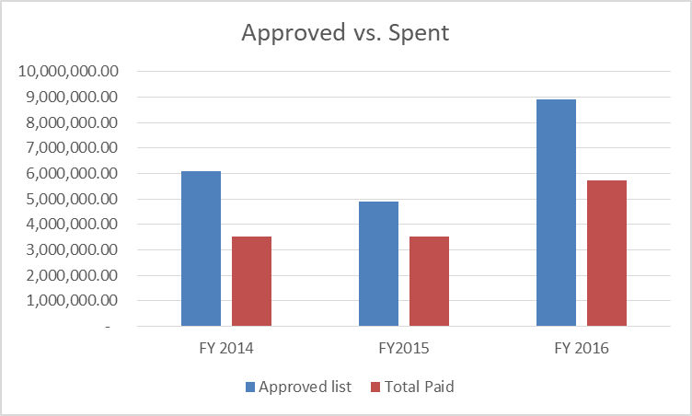
Why is it hard to give out money?
FY15 cost share data
16% canceled
11% overestimated
$4,885,627 approved and only $3,526,410 paid out
FY16 cost share data
13% canceled
23% overestimated
$8,904,428.13 approved and $5,733,397.55 paid out

Slide 6
FY 17 Approved in September 2018
Requests 1242 individuals and $8,961,250.78
Approved 942 individuals and $6,011,372.44
Delay in award because of web tool
At one year
10% canceled
39% paid
$3,124,135.25 still to be paid
Notes:
Web tool provides greater transparency and less clerical error

Slide 7
State Cost Share Projects Money FY 17 Funds

Slide 8
FY18 Approved in February 2019
Requests 541 individuals and $4,051,130
Approved 403 individuals and $2,469,726.78
At 8 months
3% canceled
21% paid
$1,879,736.26 still to be paid

Slide 9
State Cost Share Projects Money FY 18 Funds

Slide 10
FY19 Approved in July 2019
Requests 784 individuals and $5,967,738.50
Approved 722 individuals and $4,523,347.81
At 3 months
2% canceled
5% paid
$4,221,575.02 still to be paid
Notes:
Many waiting for design plans from technical staff, also paid for more pasture renovation due to the wet winters.

Slide 11
State Cost Share Projects Money FY 19 Funds

Slide 12
25-year Total Applications Approved

Slide 13
25-year Total Dollars Approved
Notes:
Slightly different since animal waste structures are funded at a higher rate than other practices, so areas of animal ag may receive more money with an equal number of projects.

Slide 14
Account balance
$12,504,033.40 currently in the cost-share portion of the account
$3,124,135.26 obligated from FY17
$1,879,736.26 obligated from FY18
$4,221,575.02 obligated from FY19
$250,000 required contingency fund set aside
$3,028,586.81 available funds for January 2020 funding cycle

Slide 15
Demonstration of Need
Calendar year 2018
Requests 1242 individuals and $8,961,250.78
Approved 942 individuals and $6,011,372.44
Calendar year 2019
Requests 1325 individuals and $10,018,868.50
Approved 1125 individuals and $6,993,074.59
Additional projects funded to help repair pastures damaged by wet weather
Calendar year 2020
Only $3,028,586.81 available. At least $4,000,000 needed to meet current demand.
Calendar year 2021
Assuming carryforward from canceled projects, will need at least $5,000,000 to meet current demand.

Slide 16
Future
Regulation revision changing the funding cap of $7,500 ($20,000 for animal waste storage) to across the board $20,000
Partnerships
Conservation District staff
Division of Water to determine priority areas
Regional Conservation Planning Project Managing Poo – Kentucky Beef Network and Kentucky Dairy Development Council
Natural Resources Conservation Service – technical assistance
Notes:
In the last three funding cycles, 49-53% of the awarded applicants were restricted by the practice cap.

Slide 17
Contact Information
Paulette.Akers@ky.gov
502-782-6300
Kentucky Division of Conservation
300 Sower Blvd, 2nd floor

Slide 18
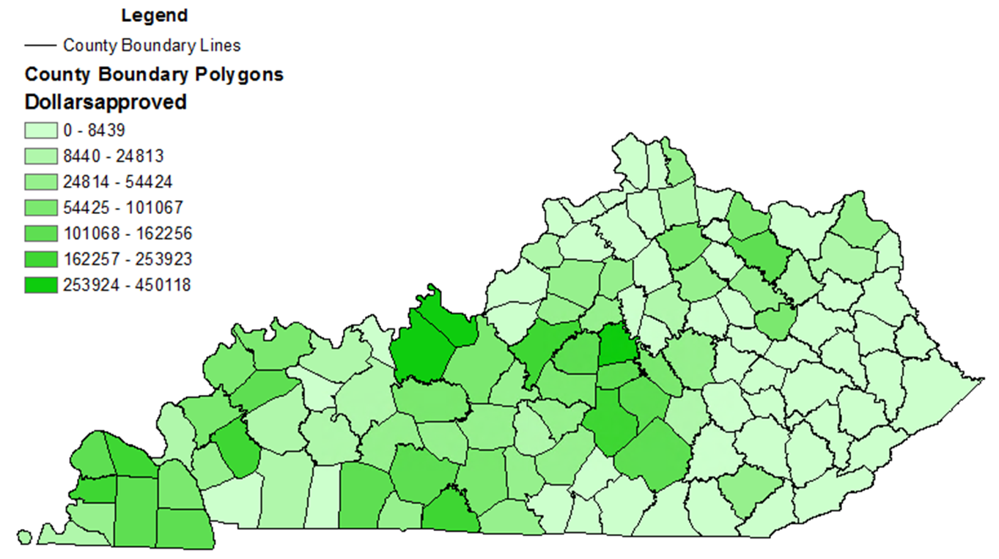
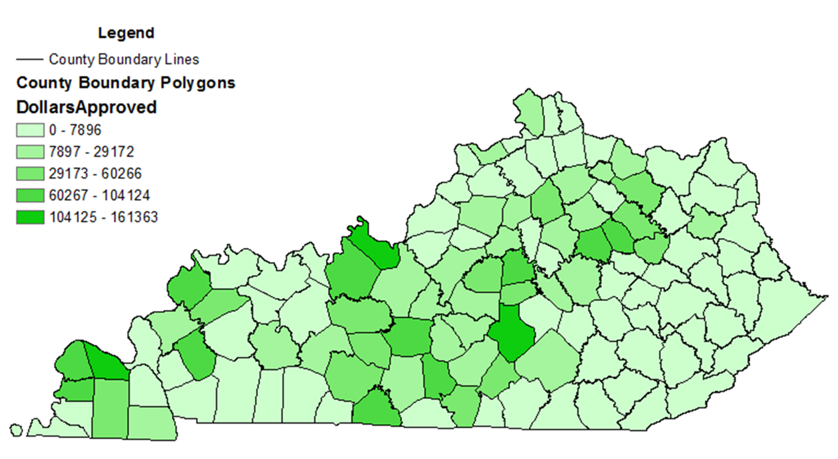
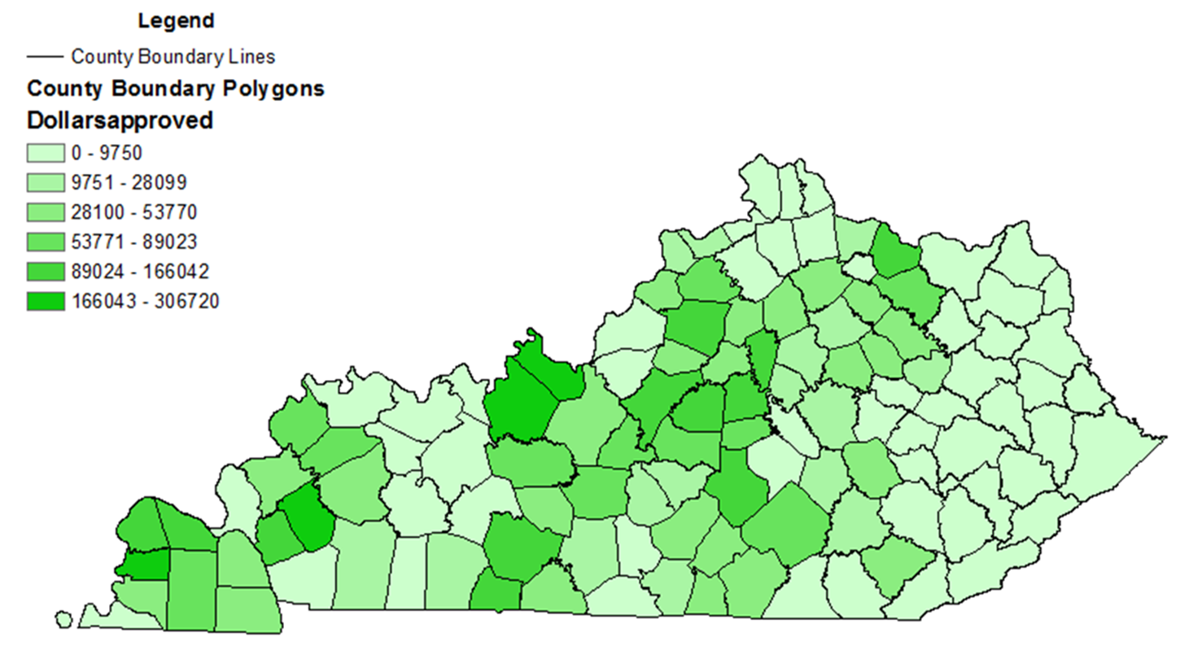
FY17
FY18
FY19

Slide 19
Does Cost Share Improve Water Quality?
Implemented practices make a difference on the scale of that farm
Only 1-2% of farmers receive state cost share in a year
Legacy sediments in the stream channel
Notes:
Small amount of money over a large area where there have been decades of land use.

Slide 20
Success Story
Fleming Creek
$1,408,288 in state cost share funds between 1991 and 2007

Slide 21
Notes:
Townsend Creek had conservation district staff providing assistance

