Slide 1
Kentucky Agricultural Finance Corporation
625 Participating Loans - $88,000,000

Slide 2
KAFC Loan Programs
Agricultural Infrastructure (AILP)
Agricultural Processing (APLP)
Beginning Farmer (BFLP)
Diversification through Entrepreneurship in Agribusiness (DEAL)
Large/Food Animal Veterinary (VET)

Slide 3
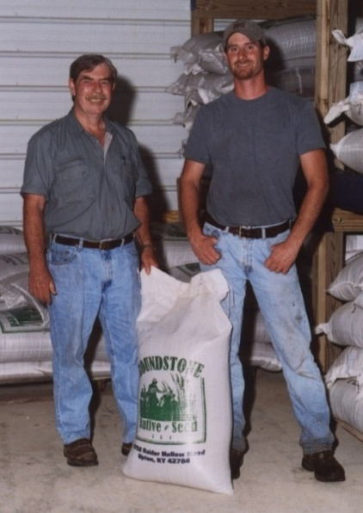
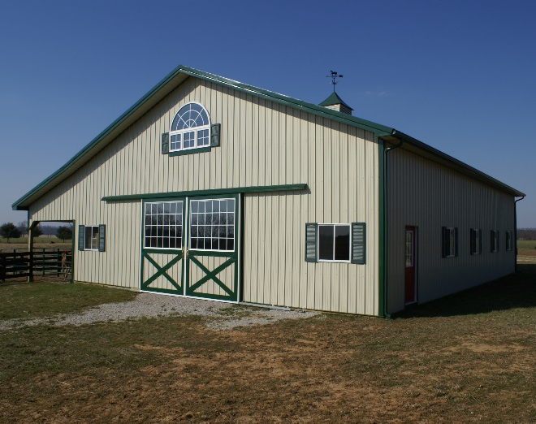
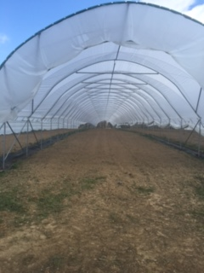
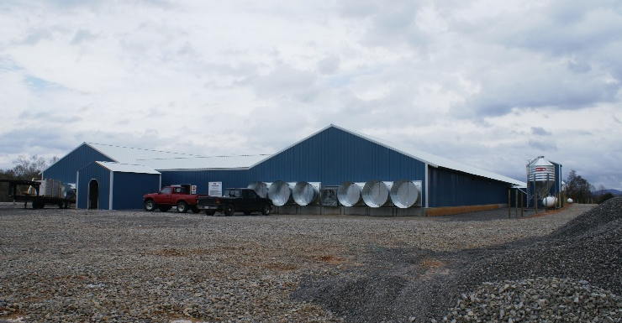
Ag Infrastructure Loan Program (AILP)
Maximum participation of 50% of project cost,
Up to $150,000 with tobacco involvement*
Up to $100,000 with no tobacco involvement
20% of gross income must come from farming
Net worth less than $3.5 million
*within previous five years (evidenced by tax returns)
Seed operation expansion
Hart Co.
Construction of equine facilities
Warren Co.
Construction of high tunnels
Daviess Co.
Construction of pullet houses
Wayne Co.

Slide 4
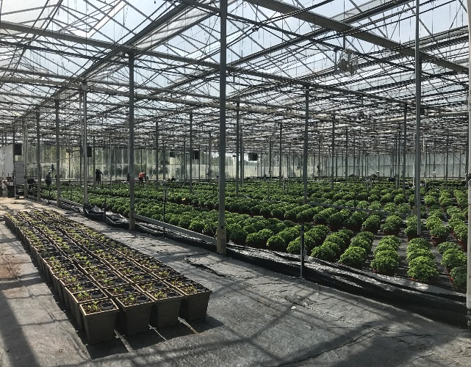
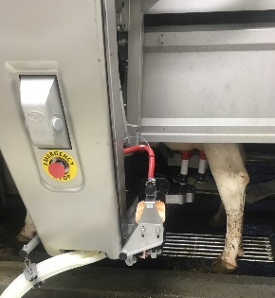
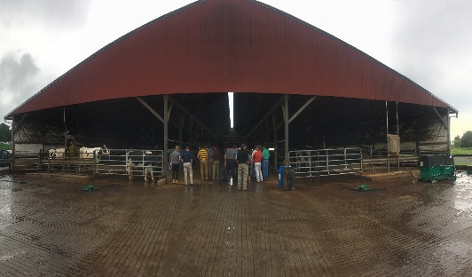
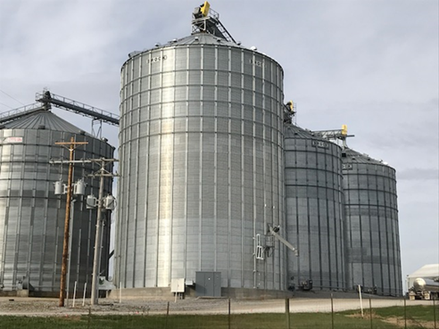
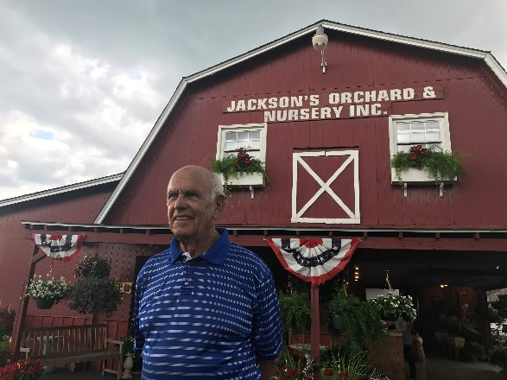
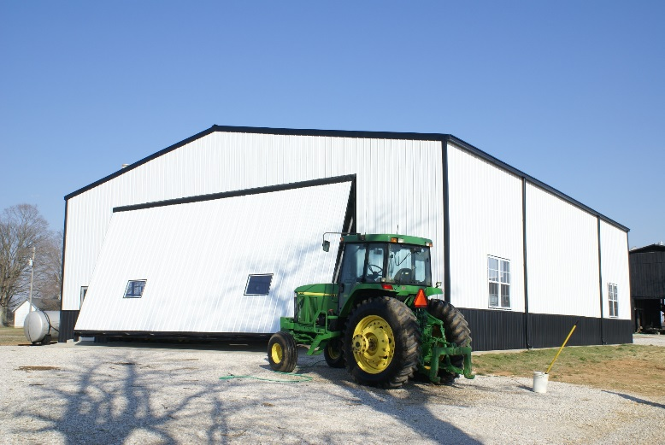
Ag Infrastructure Loan Program (AILP)
Purchase & install greenhouse boiler system
Bourbon Co.
Renovate dairy barn & purchase robotic milkers
Adair Co.
Construct grain bin system
Christian Co.
Purchase & install solar panels
Warren Co.
Construct farm shop
Edmonson Co.

Slide 5
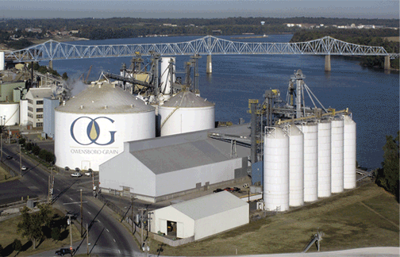
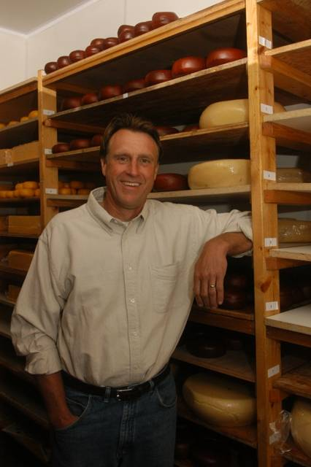
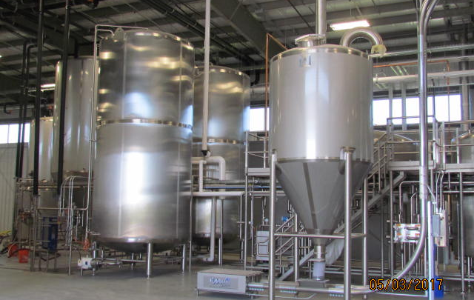
Ag Processing Loan Program (APLP)
Maximum participation of 50% of project cost,
Up to $150,000 for projects under $1 million
Amount may vary on projects over $1 million
Eligible expenses: purchase of equipment; acquisition, construction or renovation of operating facilities; permanent working capital
Construct glycerin refinery
Daviess Co.
Construct storage & aging facilities
Barren Co.
Construct brewing facility & purchase equipment
Scott Co.

Slide 6
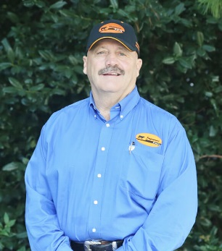
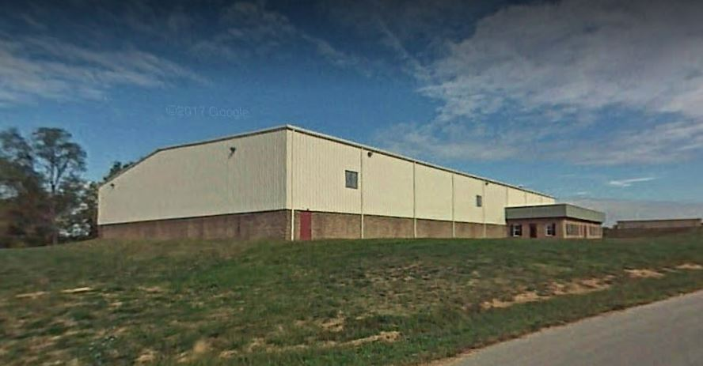
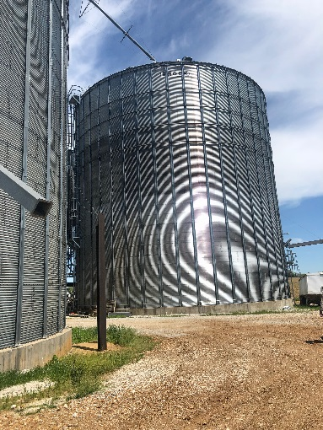
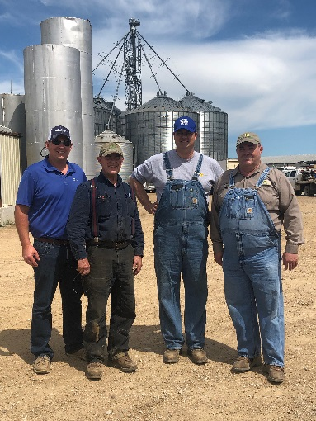
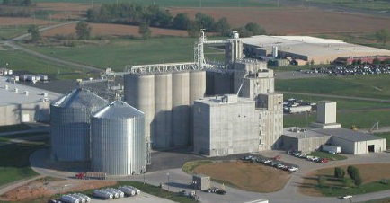
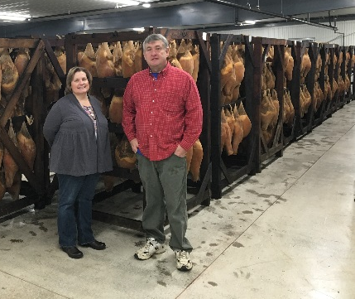
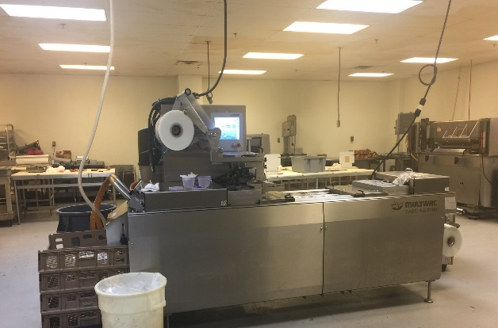
Ag Processing Loan Program (APLP)
Renovate building & purchase equipment for feed operation
Garrard Co.
Construct grain bins
Marion Co.
Expand curing & storage facilities and purchase equipment
Lyon Co.
Expand wheat milling operation
Christian Co.

Slide 7
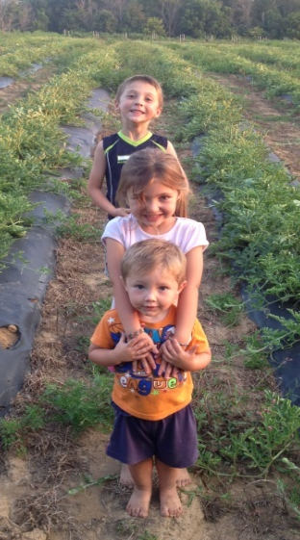
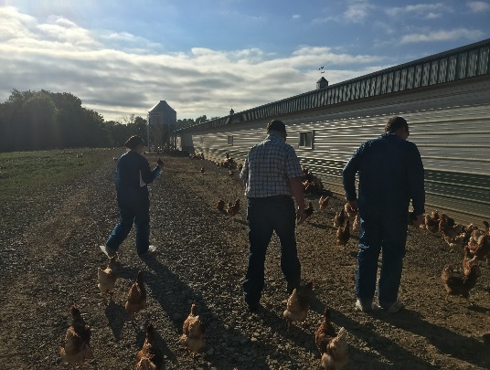
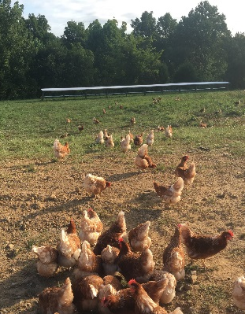
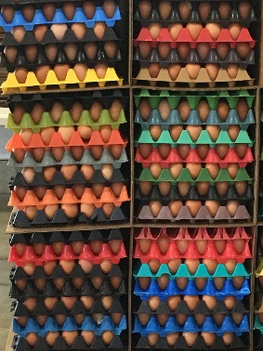
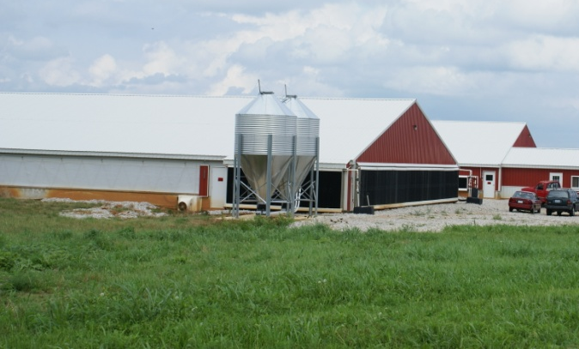
Beginning Farmer Loan Program (BFLP)
Maximum participation of 50% of project cost,
Up to $250,000
Net worth less than $500,000
Annual off-farm income less than $125,000
Cannot have owned farm longer than 10 years
Must identify a mentor
Must develop business plan
Purchase real estate
Shelby Co.(Lender/KAFC/FSA)
Construct farrow-to-wean facilities
LaRue Co.
Purchase real estate & construct pasture poultry barns
Washington Co.(FSA Guarantee)

Slide 8
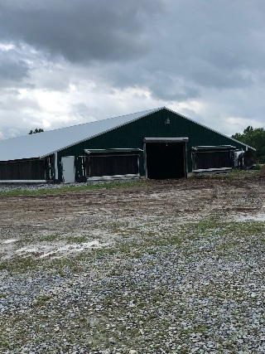
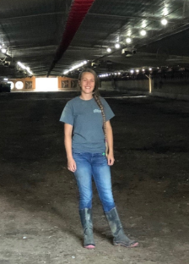
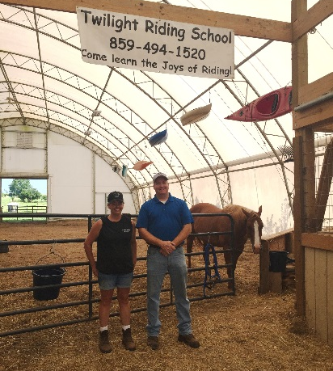
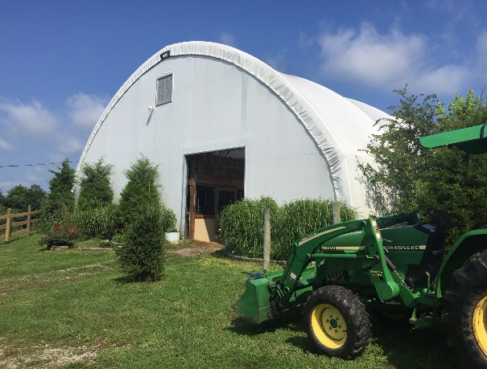
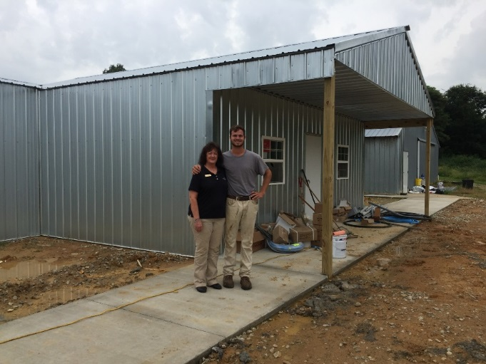
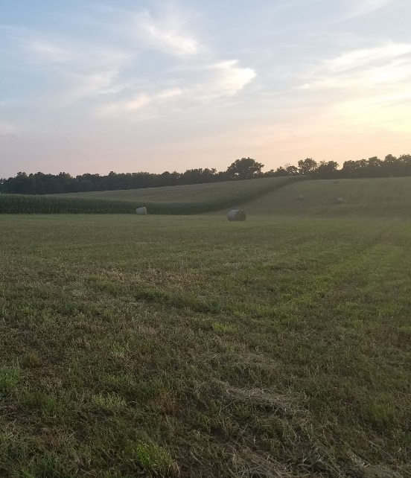
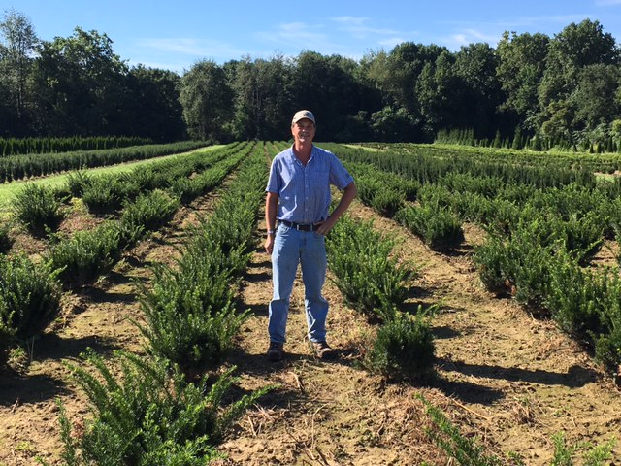
Beginning Farmer Loan Program (BFLP)
Purchase farmland and two mega broiler houses
Adair Co.
Construct livestock arena
Clark Co.
Purchase & upgrade existing breeder barns
McLean Co. (Lender, KAFC, FSA)
Purchase land for beef operation Anderson Co. (FSA Guarantee)
Purchase real estate for nursery expansion
Trimble Co.

Slide 9
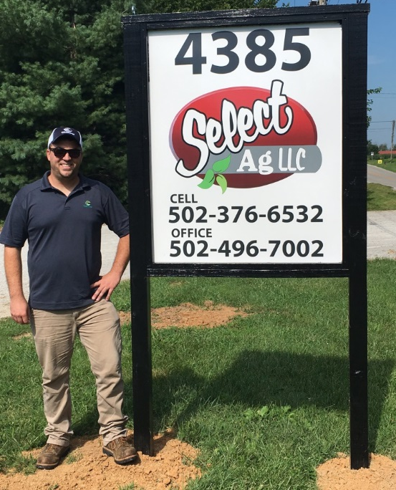
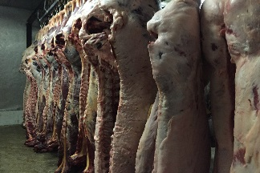
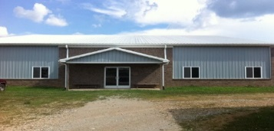
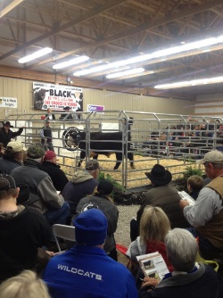
Diversification Through Entrepreneurship (DEAL)
Maximum participation of 50% of project cost,
Up to $100,000
Net worth less than $750,000
Annual off-farm income less than $125,000
Must identify a mentor
Must develop business plan
Purchase seed dealership & treatment facility
Shelby Co.
Purchase real estate and renovate & equip meat processing facility
Lewis Co.
Construct meeting hall, sales arena & holding barns
Hart Co.
Renovate building for welding school
Fleming Co.

Slide 10
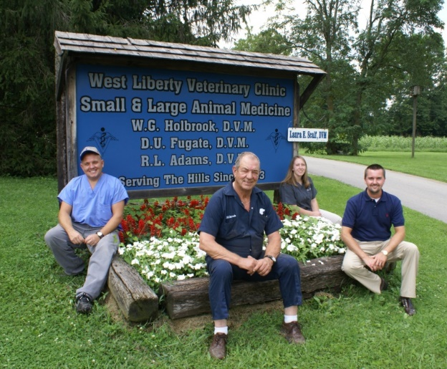
Large/Food Animal Vet Loan Program (VET)
Maximum participation of 50% of project cost,
Up to $100,000
Net worth less than $500,000
Annual off-farm income less than $125,000
License to practice veterinary medicine in KY
Must develop business plan
Buy into existing veterinary practice
Morgan Co.
Establish equine clinic
Metcalfe Co.
Buy into existing veterinary practice
Shelby Co.

Slide 11
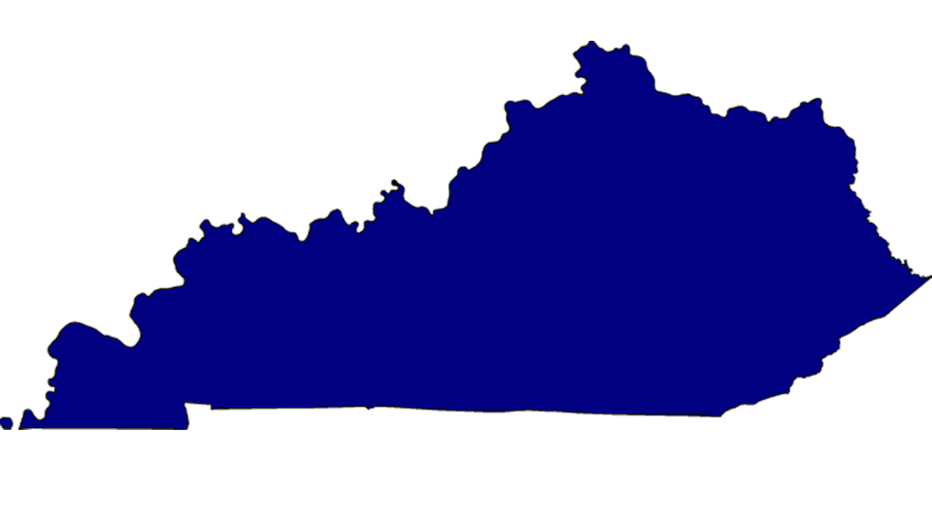
More than
900
LOANS APPROVED
FUNDS APPROVED
$133,000,000

Slide 12
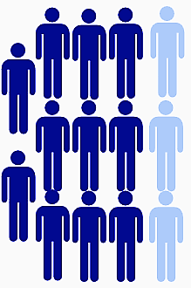
Evaluation of Investments
Based on an evaluation by the University of Kentucky,
79%
of lenders would not have funded a project without the participation
of the KAFC.
KAFC is critical component
Strengthens cash flow,
FSA Guarantee fee is waived,
Mitigates risk,
Ability to finance up to 100%,
Flexible repayment terms,

Slide 13
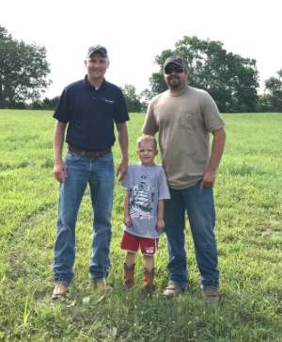
KAFC Loan Programs
Benefits to the Lender
Strengthen customer relationships
Remain the face to the customer
Improve overall cash flow position
When used in conjunction with an eligible FSA program, 1.5% FSA origination fee is waived
Streamline application and disbursement process
KAFC utilizes Lender documents
KAFC will take a subordinate collateral position
Helps to mitigate risk
Retain 0.75% servicing fee

Slide 14
Impact of Investments
70
participating institutions
300
Originating loan officers
69%
82
Counties with KAFC participated projects

Slide 15
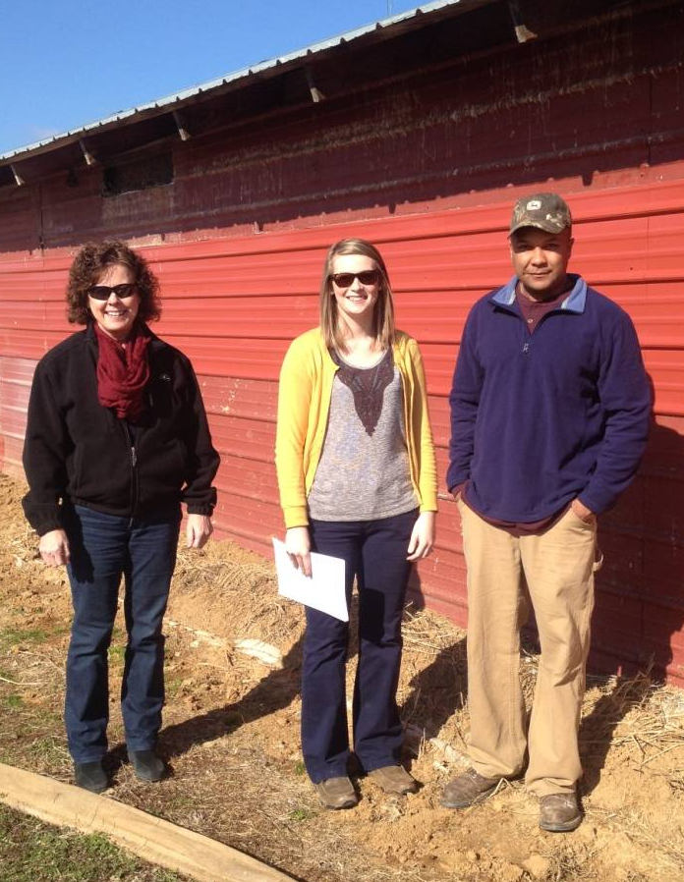
KAFC Loan Programs
Benefits to the Borrower
Low, fixed rate of 2.75%
No prepayment penalties
Utilize existing Lender relationship
May begin project after application is received
Simple application process
Flexible repayment terms
Increased profitability potential
Multiple loan programs to access
Payments are made to Lender
Lender forwards KAFC their portion

Slide 16
KAFC Loan Portfolio, by Program
KAFC Investment, by Program ($)
Ag Infrastructure | $ 13,340,684.66
Ag Processing | $ 5,916,012.55
Beginning Farmer | $ 57,445,189.43
Diversification | $ 593,595.70
VET | $ 372,031.91
KADB | $ 3,896,800.55
New Ag Enterprise | $ 1,066,726.25
Total | $ 82,631,041.05

Slide 17
KAFC Loan Portfolio, by Enterprise
Beef | $ 13,882,019.09
Dairy | $ 2,057,777.64
Equine | $ 1,622,421.88
Forage | $ 860,429.03
Grain | $ 17,292,298.63
Horticulture | $ 550,643.16
Lamb/Goat | $ 891,572.06
Microprocessor | $ 3,667,648.79
Other | $ 2,052,854.53
Poultry | $ 30,682,016.86
Swine | $ 3,116,220.92
Timber | $ 320,048.69
Tobacco | $ 3,231,902.54
Turkey | $ 1,116,147.40
Vegetable | $ 915,007.92
Veterinary | $ 372,031.91

