Slide 1
Tobacco settlement Agreement fund Oversight Committee
October 15, 2020
Amy Neal
Executive director, Kentucky governor’s office of early childhood

Slide 2
Kentucky Governor’s Office of Early Childhood
Mission Statement: Provide leadership and direction for the Commonwealth by providing a comprehensive and sustainable prenatal to age five early childhood system that will ensure a strong foundation for all children.

Slide 3
Early Childhood Distribution of Master Tobacco Settlement Funds for FY21
Division of Early Childhood Development (GOEC) $1,400,000
Early Child Care Development Program $9,750,000
Early Childhood Adoption & Foster Care Supports $2,500,000
Healthy Start Program
$942,000
HANDS
Program
$7,000,000
Total FY21 Tobacco Funds $25,439,100
Early Childhood Mental Health $942,000
Early Childhood Oral Health $989,100
Substance Abuse Treatment Program $1,416,000
KY Rural Mental Health & Suicide Prevention Pilot
$500,000

Slide 4
Kentucky Early Childhood System Timeline

Slide 5
The Role of the Governor’s Office of Early Childhood
Uniting Partnerships To Positively Impact Policy & Practice
High-quality early learning experiences are critical components of K-12 success to ensure children reach their full potential.
A fundamental challenge is the lack of a coordinated, comprehensive prenatal to age 5 system; an incredible obstacle to advancing large-scale social change.

Slide 6
Accelerating Change
In 2018, a 5-year statewide strategic plan was developed guided by a comprehensive needs assessment and analysis gleaned from the Preschool Development Grant.
Facilitating collective commitment across the state to tackle some of the most difficult problems to improve educational outcomes.
Uniting the most effective organizations and influencers around the first critical years of a child’s life.
Unification and accountability of the early childhood system and strengthening and cultivating strategic partnerships will ensure more children have a strong start in Kentucky.

Slide 7
Regional Collaboratives Promoting School Readiness

Slide 8
Supporting Kentucky’s Early Childhood Workforce Early Childhood Institute 2017-2020
4,000 participants
Child Care
Public Pre-K
Head Start
400 areas of study
Language development
Family Engagement
Trauma Informed Practice
30,000 credits
Up to 30 hours of training per educator

Slide 9
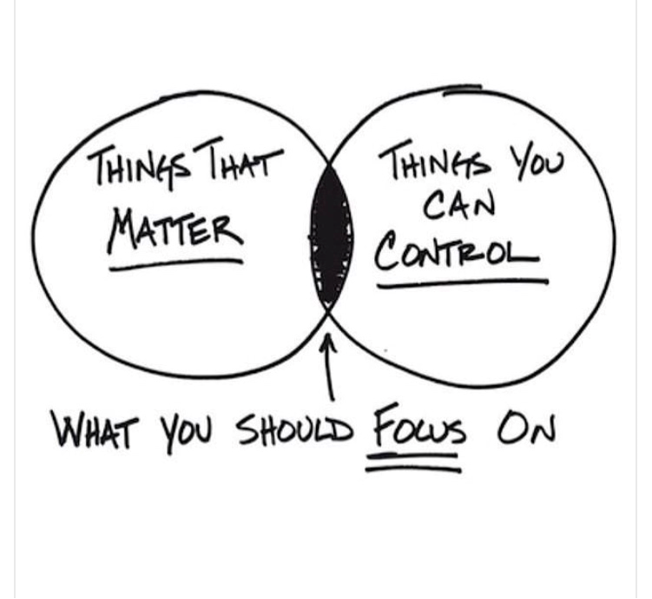
Unifying the System to Create a Larger and Sustainable Impact
Public pre-school
Head Start
Department for Public Health
Division of Child Care

Slide 10
Department for Community Based Services
FY20 Child Care Allotment: $9,750,000
Dr. Sarah Vanover
Director, DCBS Division of Child Care

Slide 11
Tobacco Settlement Funds in Community Based Services
Child Care - $9,750,000
Family & Community Based
Services - $175,000
Early Childhood Adoption & Foster Care Supports - $2.5M
FY20 Child Care Expenditures
$9,750,000
Percentage of expenditures atypical due to COVID-19
FY20 Tobacco Settlement Funds Child Care Expenditures

Slide 12
The Child Care and Development Fund (CCDF) SFY20 allocation (mandatory & discretionary funds): $125,093,817
This federal grant is designed to promote success for children, employment for parents, and economic security for parents by ensuring stable, high quality child care.
CCDF funds support the following initiatives in Kentucky:
Child care subsidies for 23,101 families and 41,600 children in SFY20
Monitoring and supports for approximately 2,200 child care centers and family child care homes at any given time
Professional development supports and background checks for 58,102 child care workers since February 2018
Special initiatives for infant and toddler care, disaster preparedness training and response, and consumer education
Tobacco dollars serve as the entirety of the required matching funds for CCDF

Slide 13
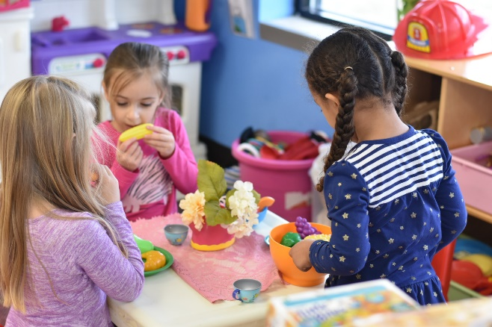
What is Kentucky All STARS?
Kentucky All STARS is Kentucky's five-star quality rating and improvement system for early childhood education programs.
Child care programs participating in Kentucky All STARS demonstrate a commitment to quality by focusing on the following indicators:
Family and community engagement
Classroom and instructional quality
Staff qualifications and professional development
Administrative and leadership practices

Slide 14
Kentucky All STARS Levels by Provider Type
 | Level 1 | Level 2 | Level 3 | Level 4 | Level 5 | Total
CERTIFIED | 147 | 34 | 24 | 22 | 7 | 234
LICENSED TYPE I | 796 | 147 | 351 | 304 | 198 | 1,796
LICENSED TYPE II | 25 | 6 | 5 | 5 | 5 | 46
Total | 968 | 187 | 380 | 331 | 210 | 2,076
Child Care Assistance Program (CCAP) children currently enrolled in high quality (levels 3-5) centers: 10,247

Slide 15
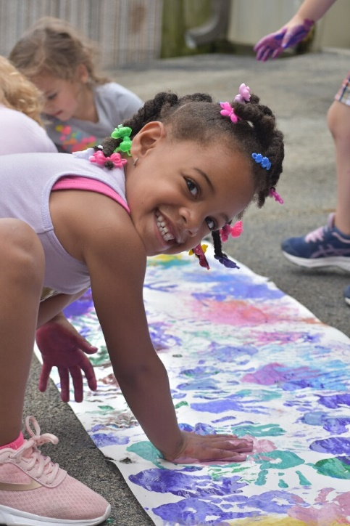
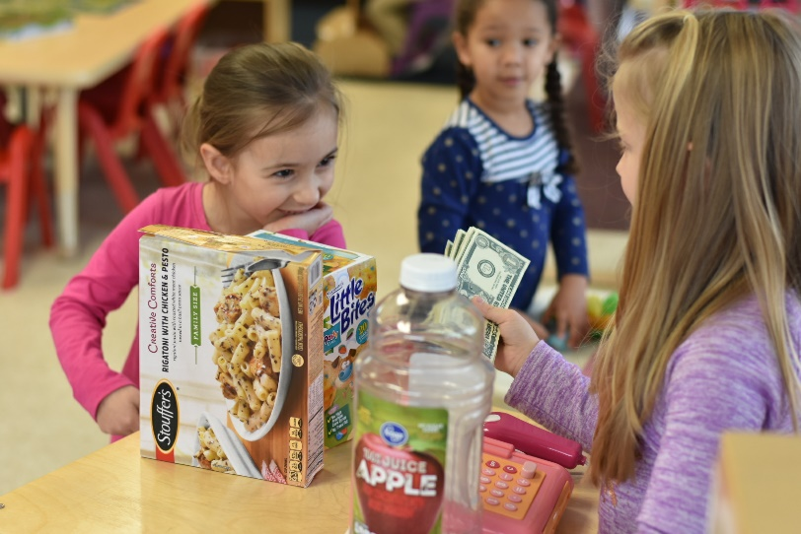
What Does High Quality Look Like?

Slide 16
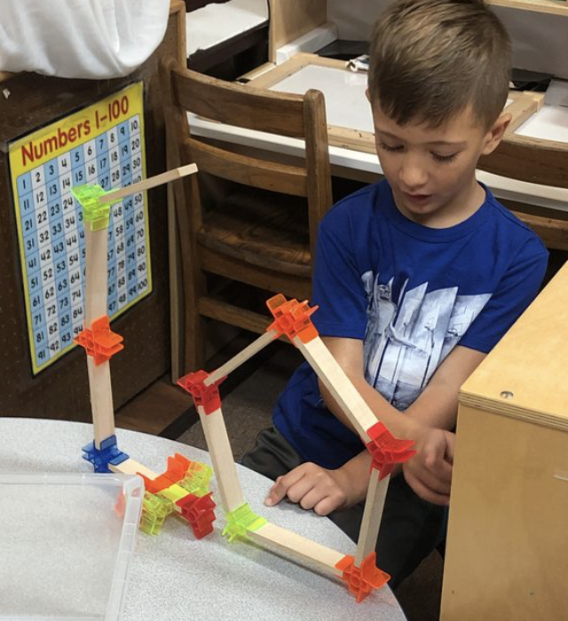
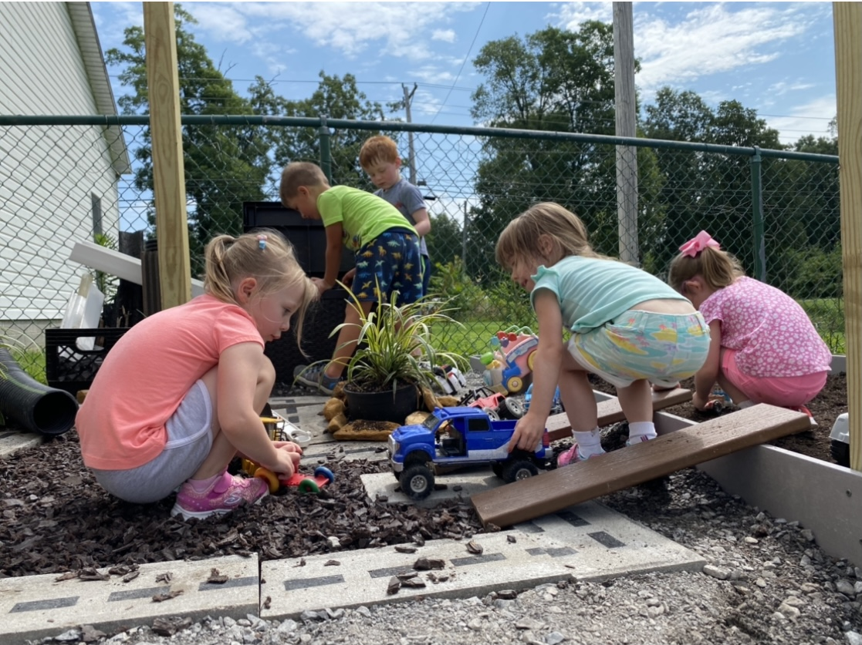
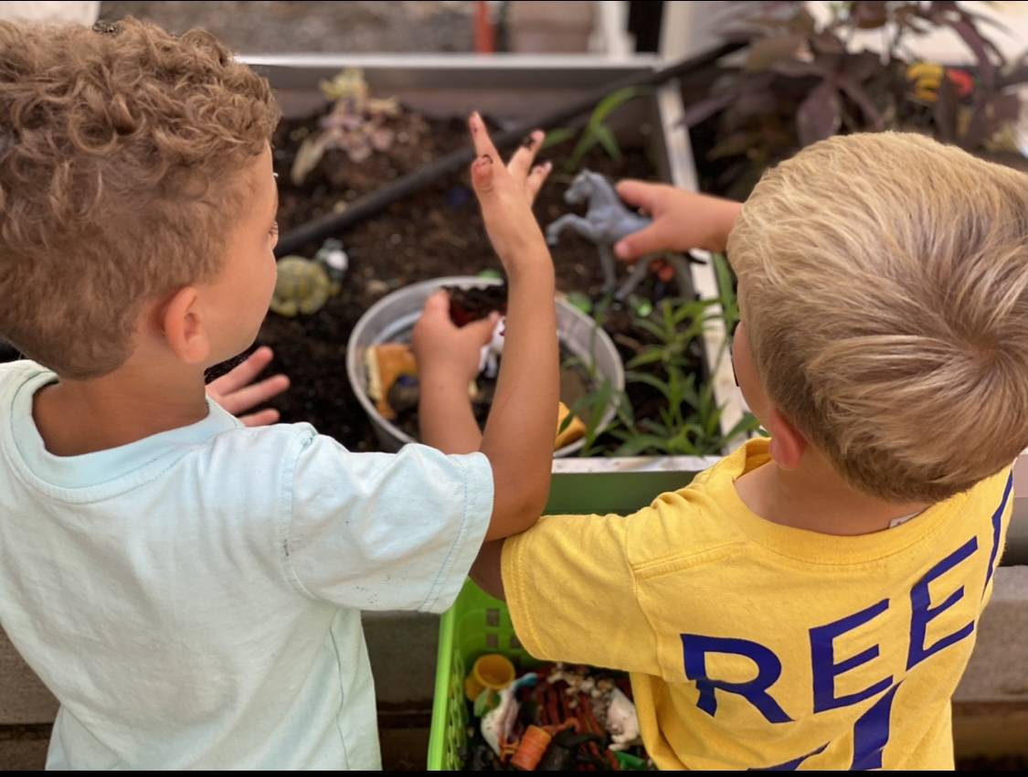
Who Am I?
Who Are We?
Jennifer Washburn
iKids Childhood Enrichment Center
iKids is an early childhood center located in Benton, KY
We are accredited by the National Association for the Education of Young Children (NAEYC)
We are rated 5 STARS by the Governor’s Office of Early Childhood Education
We are licensed for 97 children, however, because we choose to have lower teacher-to-child ratios, our enrollment is 89 daily
We have been in operation for 21 years
I am the owner of a small business in Benton, KY, that serves the early care and preschool needs of our community. I have a bachelor's degree from Murray State University, master's degree in counseling from the University of Louisville, completing a PhD in Developmental Psychology from Capella University and a Certificate in Early Education Leadership from Harvard. I have owned and operated my small business for 21 years.
Jennifer Washburn - iKids Inc. - jennifer@ikids-care.com - 270.556.0912

Slide 17
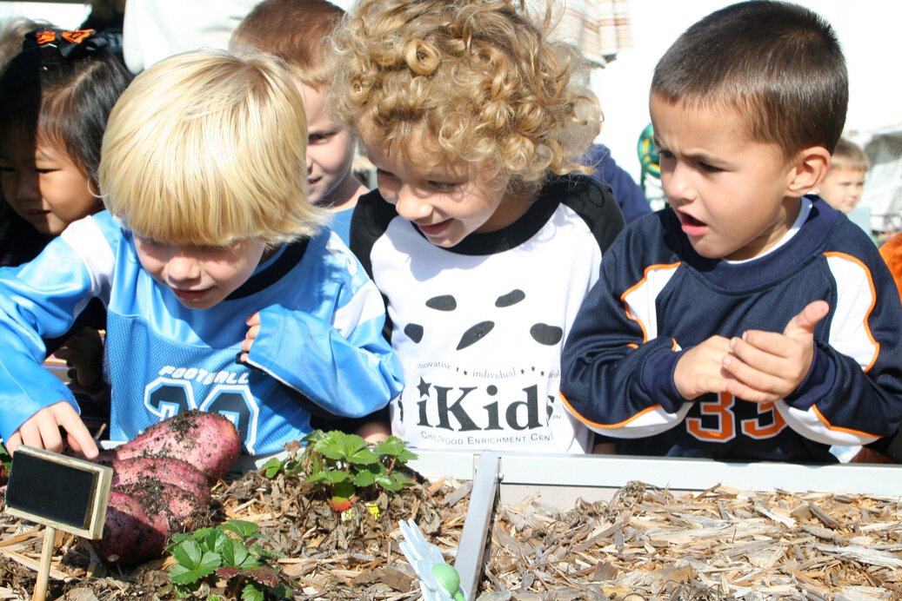
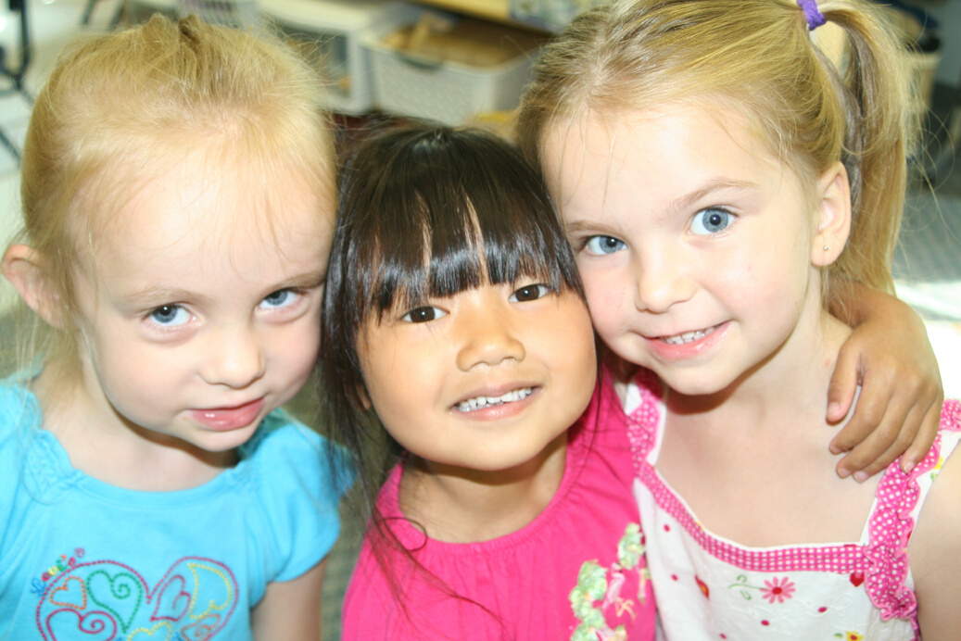
How We Contribute to the Field
Marshall County High School: 4 co-op placements annually for seniors to earn their Child Development Associate Credential and 5 placements annually for juniors in the Child Development Program to earn the Commonwealth Child Care Credential
Murray State University: 6 practicum placements annually for Interdisciplinary Early Childhood Education bachelor’s and master’s degree students
Western Kentucky Community and Technical College System: 7 practicum placements annually for Interdisciplinary Early Childhood Education associate's degree students
NAEYC
ACCREDITED

Slide 18
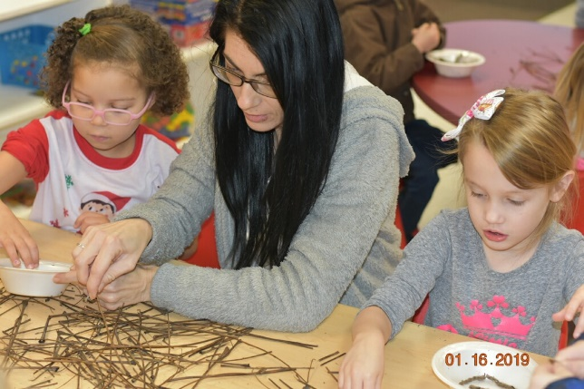
Professional Development Initiatives
In SFY20 tobacco settlement funds helped to support the following:
270 scholarships for Child Development Associates (CDA)
471 scholarships for Commonwealth Child Care Credential
122 mini grants for Child Development Associates
295 Milestone Achievement Awards
162 education reimbursement grants

Slide 19
How Does Kentucky Stand Out?
Comprehensive professional registry
Integrated systems to support quality (specifically public health support during COVID-19)
Family child care pilot program for networking & education
Monetary incentives for high quality
Balanced approach to Child Care and Development Fund (CCDF) mandated activities

Slide 20
Department for Public Health
Early Childhood Programs Supported with MSA Funds
FY20
Paula Goff
Division of Maternal and Child Health

Slide 21
Early Childhood Mental Health (ECMH)
(Amount of Tobacco Funding: FY21 $942,000)
Purpose: To build capacity to meet the mental health needs of young children and their families by partnering with the Departments for Public Health and Behavioral Health, Developmental and Intellectual Disabilities.
Structure: Funds support Early Childhood Mental Health specialists in fourteen comprehensive community mental health centers (CMHC) and one administrator. Funds distributed to the CMHC were unchanged from FY20.
Served 1,264 children and families in FY20
Provided 3,273 consultations to child-serving agencies
Provided training to over 1,000 early care and education staff in Head Start, childcare, and state-funded preschool

Slide 22
Healthy Start (Child Care Health Consultation) (Amount of Tobacco Funding: FY21 $942,000)
Purpose: To provide technical assistance and training on health, safety, and social-emotional development to licensed and certified child care providers statewide.
Structure: Funds support ten regional health consultants and two consultant trainers. Regional staff are housed through local health departments with the consultant trainers located at the Technical Assistance Center at the Fayette County Health Department. Funds to the health departments were unchanged from FY20.
CCHC consultants provided training to 1,354 child care providers, impacting over 8,000 children in care
CCHC consultants field numerous calls from child care providers regarding COVID-19 pandemic

Slide 23
Health Access Nurturing Development Services (HANDS) (Amount of Tobacco Funding: FY21 $7,000,000)
Voluntary weekly home visiting program administered by local health departments designed to:
Assist overburdened parents/caregivers during the prenatal period until the child’s third birthday
Improve health outcomes for both mother and child
Improve social outcomes for child and family
In FY20, 4,106 families served through support of tobacco settlement funds with 101,913 home visits provided to first-time parents
FY20 indicates a decrease from FY19 primarily due to state of emergency status late March to end of June

Slide 24
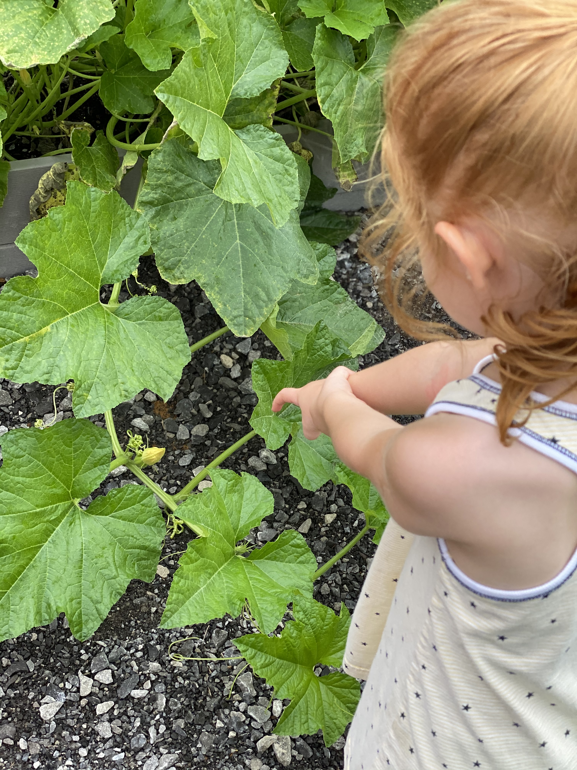
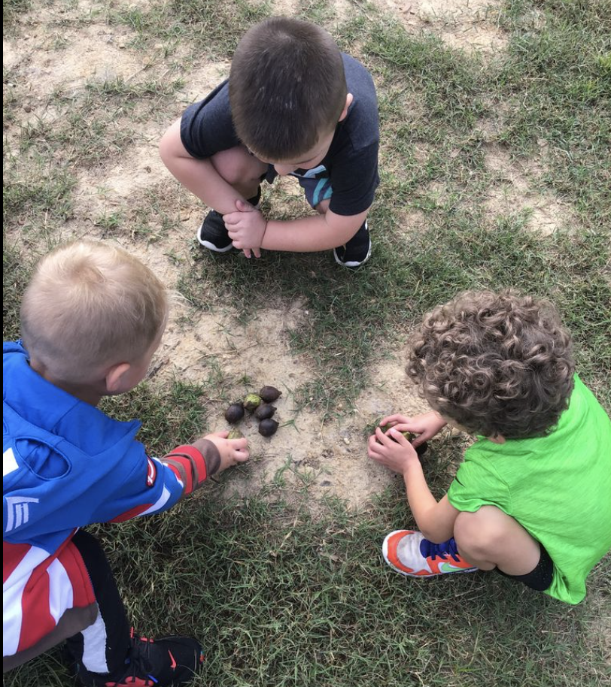
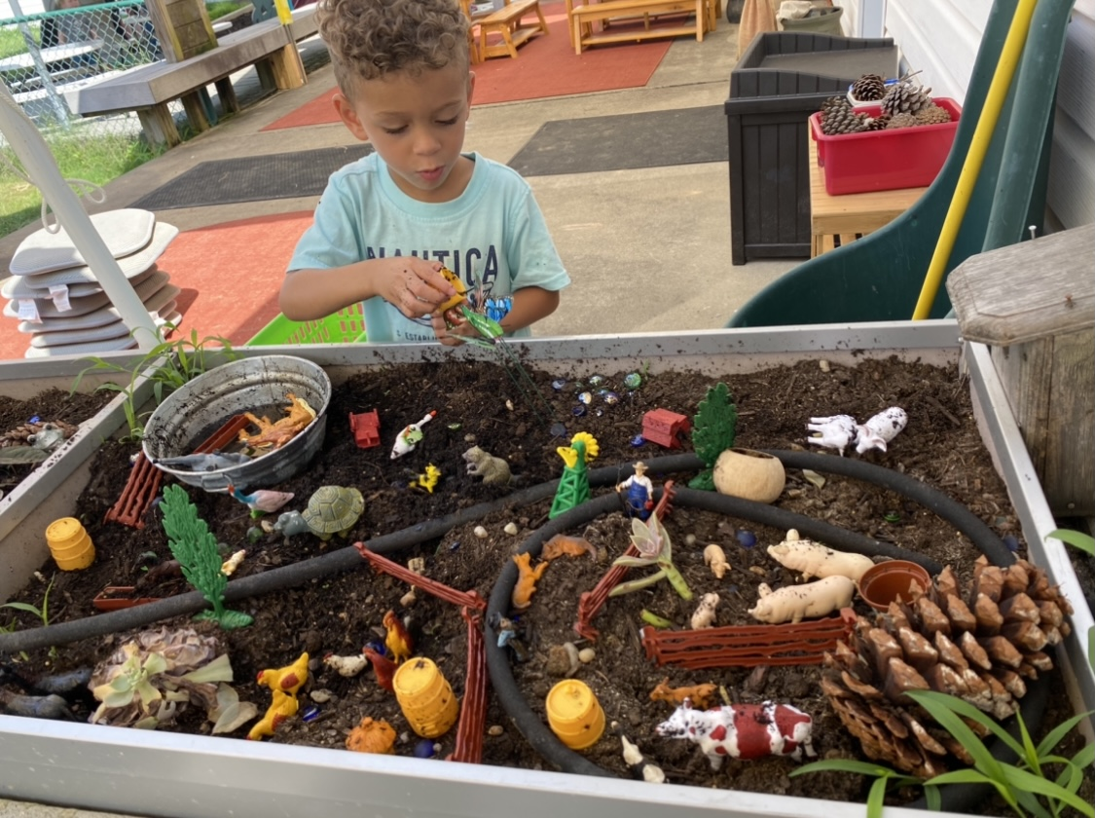
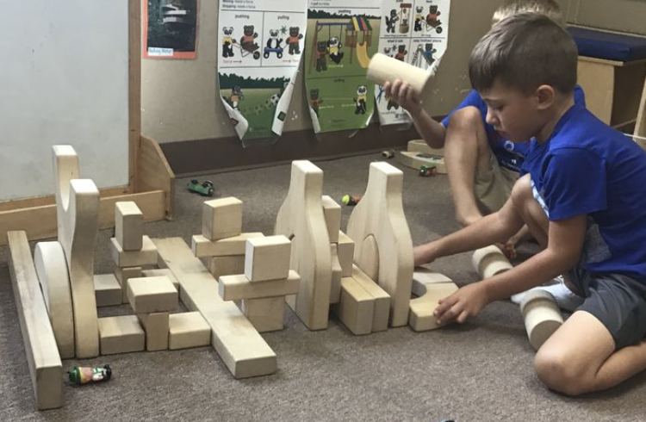
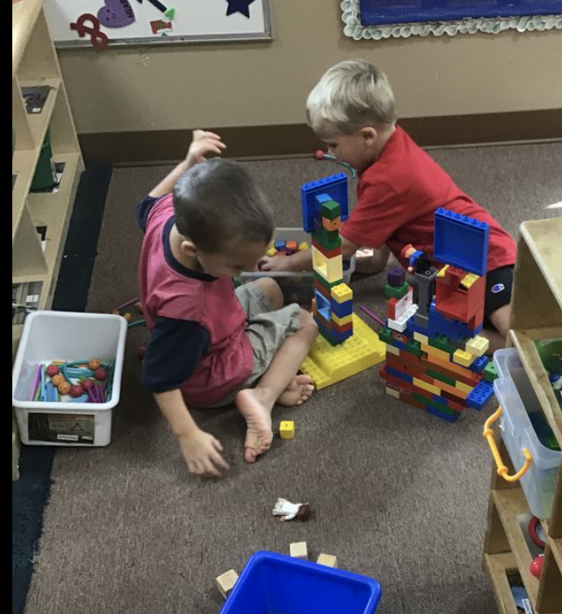
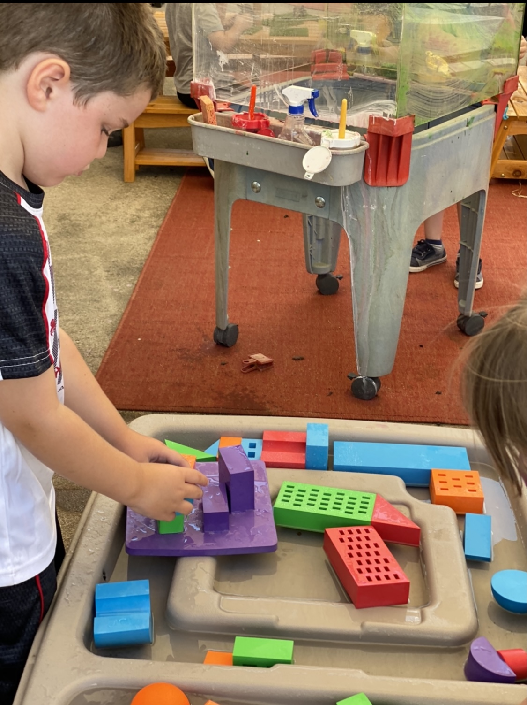
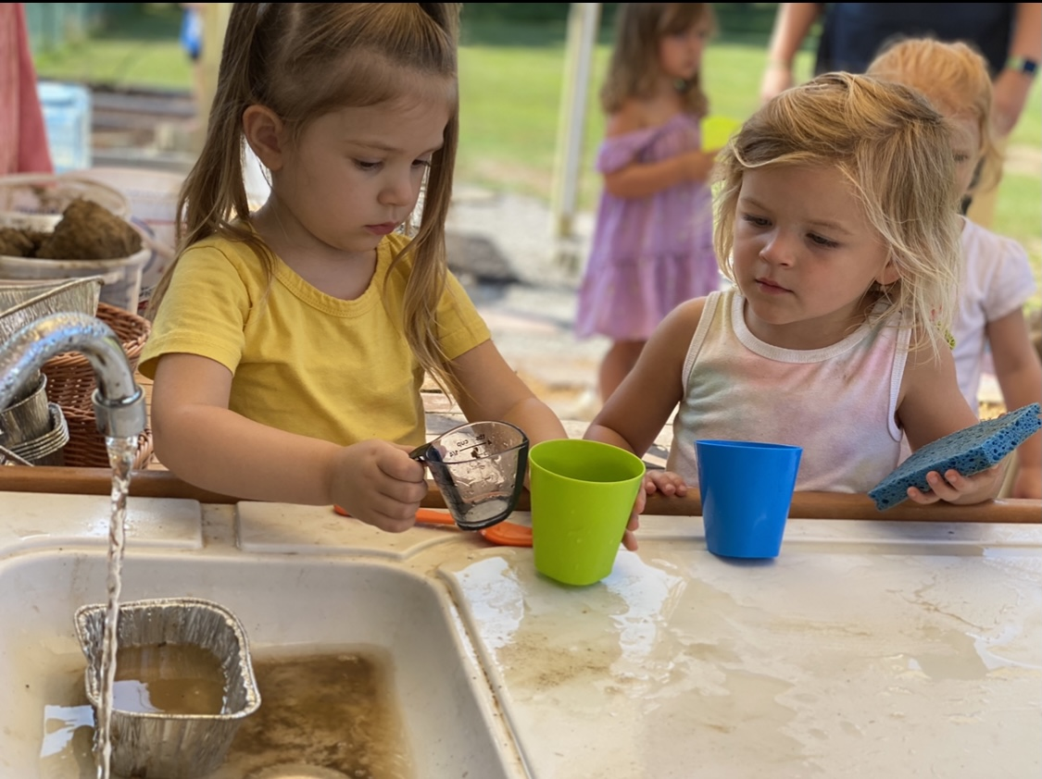
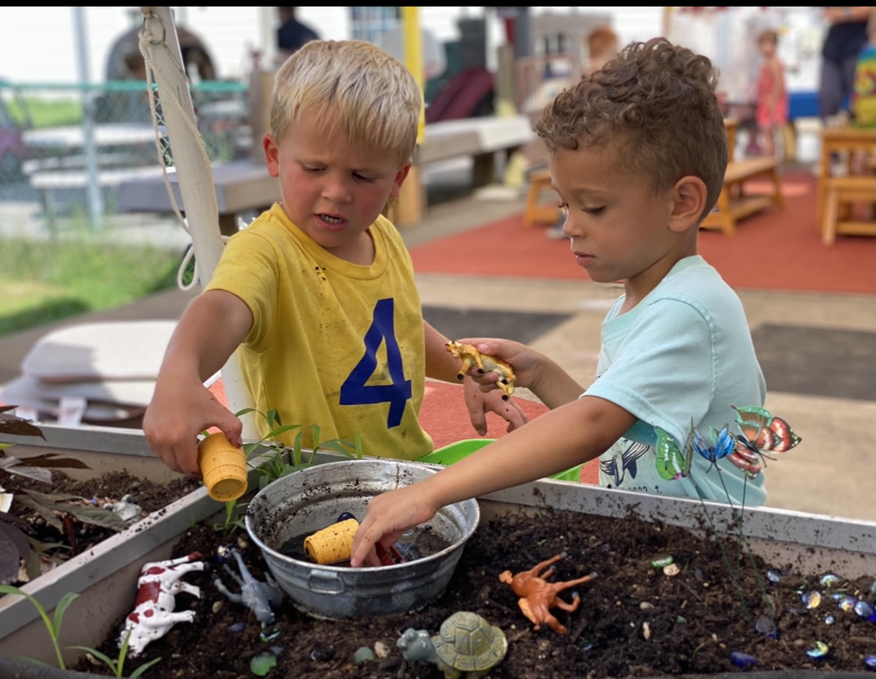
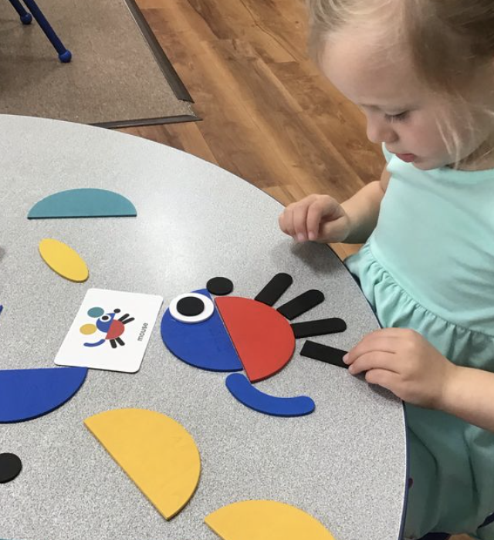
Division of Early Childhood
Early Child Care Development Program
Early Childhood Adoption & Foster Care Supports
HANDS
Program
Healthy Start Program
Early Childhood Mental Health
Early Childhood Oral Health
Substance Abuse Treatment Program
Because of PARTNERSHIPS between these programs, iKids has been able to maintain
national accreditation standards for over eleven years.
High-quality early care and education for the children and families in our community has been made possible by your investment in these programs.

Slide 25
Contact Information
Amy Neal
Executive Director, Kentucky Governor’s Office of Early Childhood
Amy.Neal@ky.gov, https://kyecac.ky.gov/Pages/index.aspx
Dr. Sarah Vanover
Director, Department for Community Based Services Division of Child Care
Sarah.Vanover@ky.gov, https://chfs.ky.gov/agencies/dcbs/dcc
Paula Goff
Kentucky Department for Public Health, Division of Maternal and Child Health
Paula.Goff@ky.gov, https://chfs.ky.gov/agencies/dph/dmch/Pages/default.aspx
Jennifer Washburn
Executive Director, iKids Inc., Benton, KY
Jennifer@ikids-care.com, https://www.facebook.com/iKidsChildhoodEnrichment/

