Slide 1
Tobacco Settlement Oversight
Paulette Akers, Director
Kentucky Division of Conservation
November 2020

Slide 2
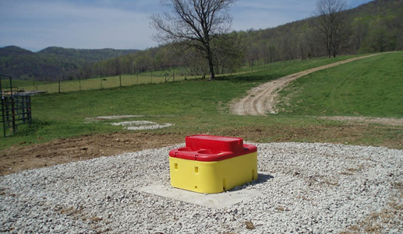
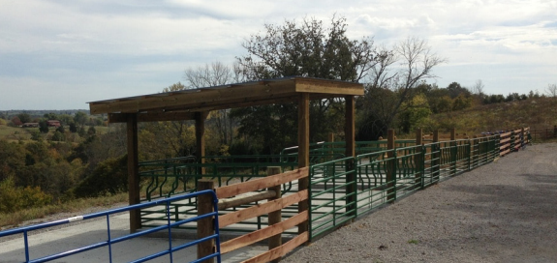
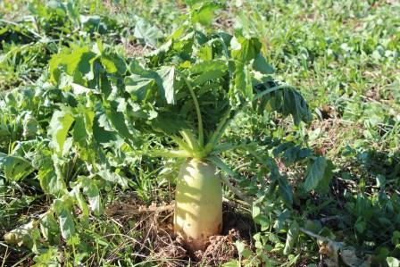
State Cost Share Summary
Originally established in 1994 and funded from General Funds and pesticide Product Registration Fees
Starting in 2000, the program was funded through Tobacco Master Settlement Agreement Funds
Provides financial assistance to farmers at a 75% reimbursement rate for those implementing best management practices on their farms with the assistance of local conservation districts
Notes:
First few slides are going to be based on a summary of all the years and then we will get into this year specifically

Slide 3
Notes:
Updated 10/13/20

Slide 4
Notes:
More than $165 million dollars have been approved for use by Kentucky farmers in the past 26 years. It is larger than the total appropriations over that time because it is hard to give out money.
The appropriations from the Tobacco Settlement were larger in FY20 and FY21, but included funds for Direct Aid to Conservation Districts and the amount going to Cost share was about $2.5 each of those years.
Updated 10/13/20

Slide 5
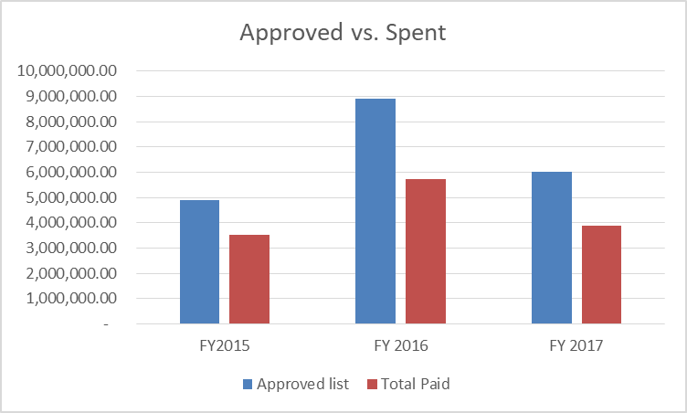
Why is it hard to give out money?
FY15 cost share
16% canceled
11% overestimated
$4,885,627 approved and $3,526,410 paid out
FY16 cost share
13% canceled
23% overestimated
$8,904,428 approved and $5,733,397 paid out
FY17 cost share
23% canceled
25% overestimated
$6,006,932 approved and $3,870,289 paid out
Notes:
Updated through 10/31/20

Slide 6
FY 17 Approved in September 2018
Requests 1242 individuals and $8,961,250.78
Approved 942 individuals and $6,011,372.44
Completion Date 10/1/20
At 24 months
23% canceled
70% paid
$479,877 still to be paid
Notes:
Web tool provides greater transparency and less clerical error
216 canceled, 656 paid by 10/31/20
70 people outstanding

Slide 7
State Cost Share Projects Money FY 17 Funds

Slide 8
FY18 Approved in February 2019
Requests 541 individuals and $4,051,130
Approved 403 individuals and $2,469,726.78
At 20 months
15% canceled
52% paid
$861,334 still to be paid
Notes:
At 10/31/20 – 60 canceled, 211 paid

Slide 9
State Cost Share Projects Money FY 18 Funds

Slide 10
FY19 Approved in July 2019
Requests 784 individuals and $5,967,738.50
Approved 722 individuals and $4,523,347.81
At 15 months
11% canceled
47% paid
$1,044,743 still to be paid
Notes:
Many waiting for design plans from technical staff, also paid for more pasture renovation due to the wet winters.
10/31/20- 82 canceled, 341 paid

Slide 11
State Cost Share Projects Money FY 19 Funds

Slide 12
FY20 Approved in January 2020
Requests 864 individuals and $6,741,757.64
Approved 705 individuals and $4,554,818.46
At 10 months
3% canceled
20% paid
$3,583,857 still to be paid
Notes:
10/31/20 – 19 canceled, 142 paid

Slide 13
State Cost Share Projects Money FY 20 Funds

Slide 14
26-year Total Applications Approved

Slide 15
26-year Total Dollars Approved
Notes:
Slightly different since animal waste structures are funded at a higher rate than other practices, so areas of animal ag may receive more money with an equal number of projects.

Slide 16
Account balance
$12,288,678 currently in the account
$132,248 obligated Direct Aid to Conservation Districts
$479,877 obligated from FY17
$861,334 obligated from FY18
$1,044,743 obligated from FY19
$3,583,857 obligated from FY20
$52,500 obligated RCPP Mud and Manure project
$250,000 required contingency fund set aside
$5,884,119 available funds for February 2021 funding cycle
Notes:
Direct Aid to Conservation Districts - $907,300 obligated goes to districts and pay for audits. $775,052 has been spent
12,288,677.61
Updated 11/2/20

Slide 17
Demonstration of Need
Calendar year 2018
Requests 1242 individuals and $8,961,250.78
Approved 942 individuals and $6,011,372.44
Calendar year 2019
Requests 1325 individuals and $10,018,868.50
Approved 1125 individuals and $6,993,074.59
Additional projects funded to help repair pastures damaged by wet weather
Calendar year 2020
Requests 864 individuals and $6,741,757.64
Approved 705 individuals and $4,554,818.46
Calendar year 2021
Currently unobligated $5,884,119
Cap increase from $7,500 to $20,000
Notes:
Check unobligated number with cancelations
Updated 11/2/20

Slide 18
Regulation Revision
416 KAR 1:010 revised July 9, 2020
Practice cap increased from $7,500 to $20,000
2 year completion requirement included in regulation instead of manual incorporated by reference

Slide 19
Contact Information
Paulette.Akers@ky.gov
502-782-6300
Kentucky Division of Conservation
300 Sower Blvd, 2nd floor

Slide 20
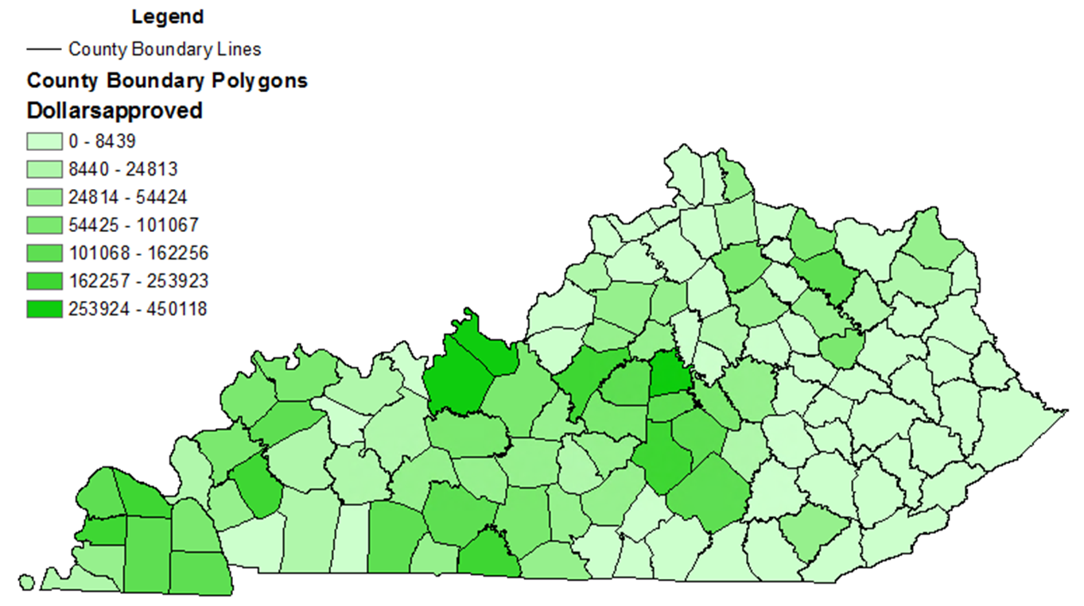
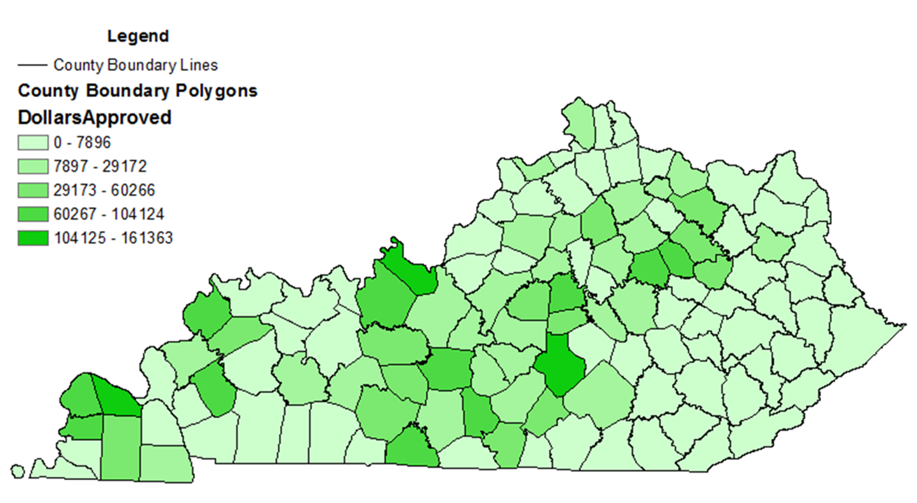
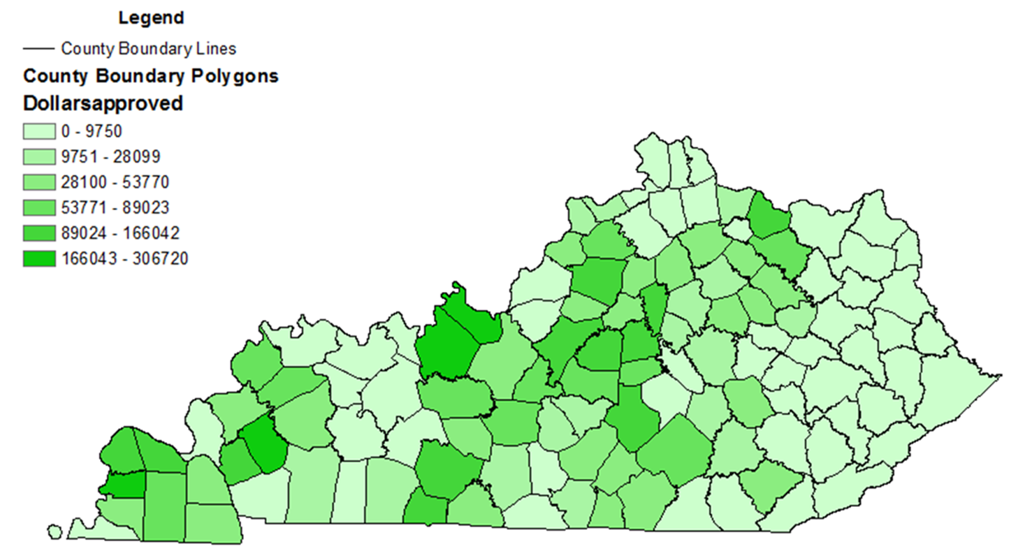
FY17
FY18
FY19
FY20

