Slide 1
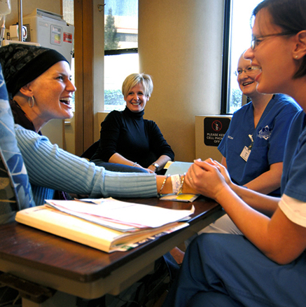
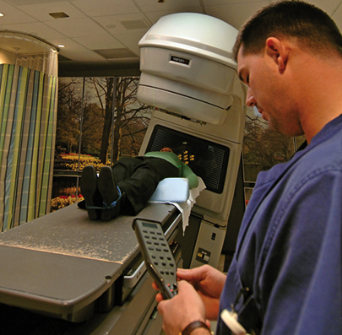
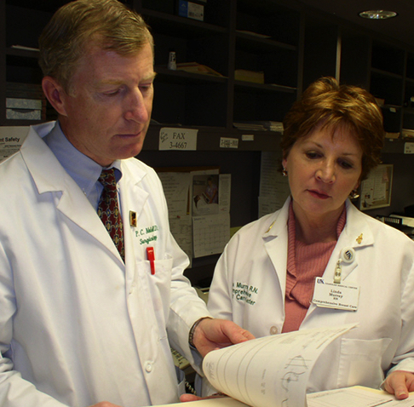
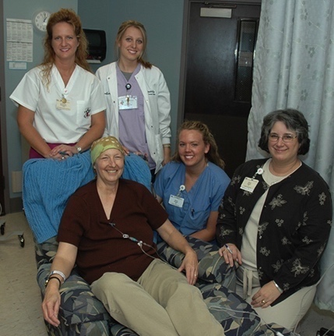

Tobacco Settlement
Fund Update
B. Mark Evers, MD
December 15, 2020

Slide 2
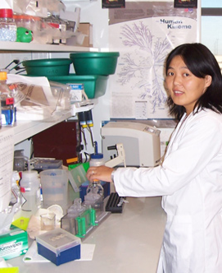
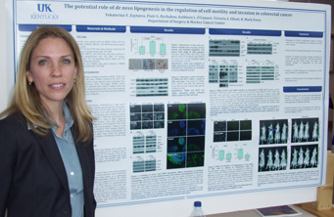
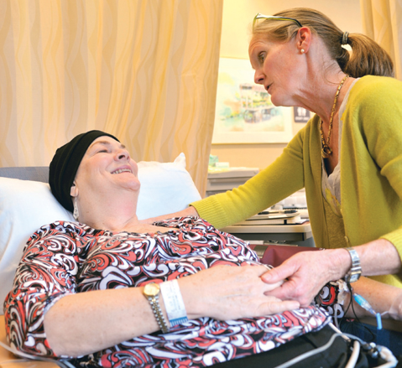
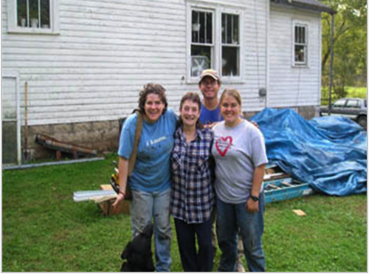

Markey Cancer Center (MCC): Our Mission
To reduce cancer mortality in our state through a comprehensive program of cancer research, treatment, education, and community engagement with a particular focus on the underserved population of Appalachian Kentucky.

Slide 3
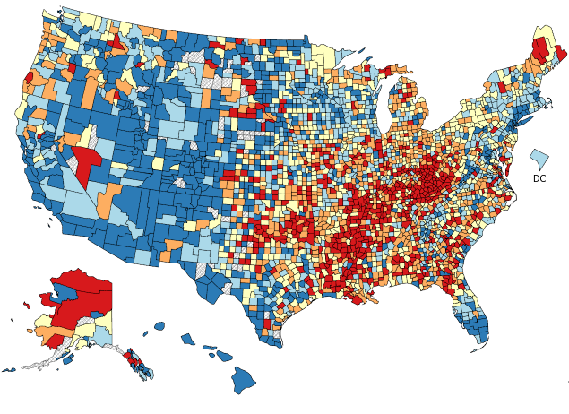
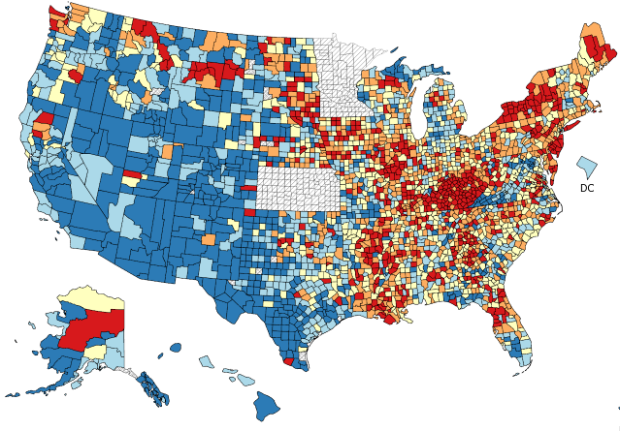


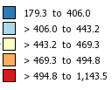

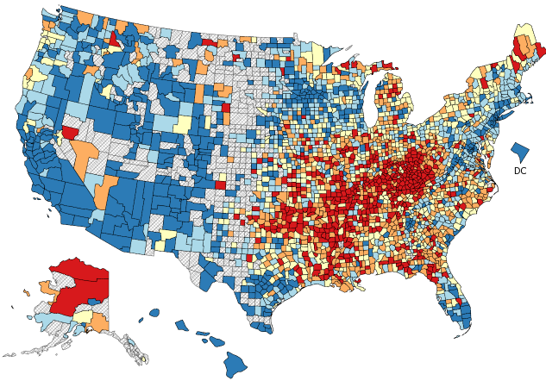
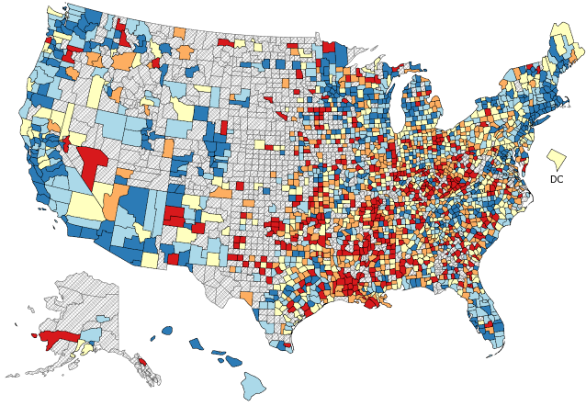




Kentucky’s Cancer Burden
All Cancer Mortality
All Cancer Incidence
#1
#1
Mortality rate, 2014 -2018
Incidence rate, 2013 -2017
Lung Cancer Mortality
Colorectal Cancer Mortality
#1
#5
Mortality rate,
2014-2018
Mortality rate, 2014 -2018
Source: Healthy People, CDC 2020
Notes:
Kentucky’s cancer burden has recently been highlighted in several national reports:
[ANIMATE] 6 of the 10 U.S. counties with the highest cancer death rates are in Kentucky
[ANIMATE] We have very high colorectal and lung cancer mortality rates
[ANIMATE] And we have the highest incidence of HPV-related cancers among men and women in the U.S.

Slide 4
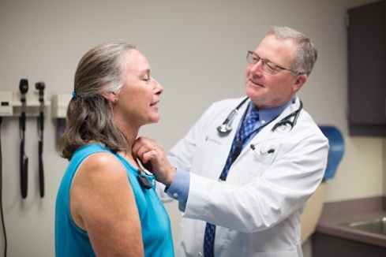
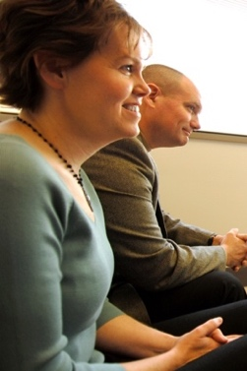
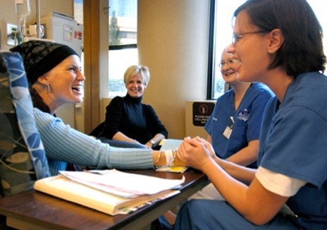
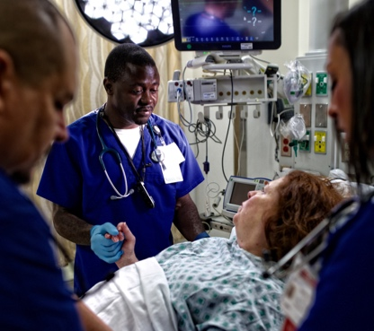
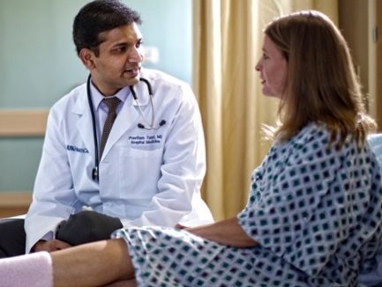
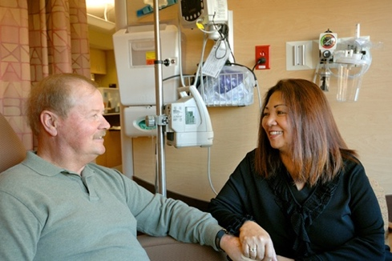
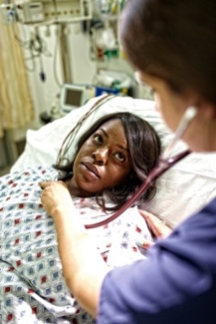
Markey Serving Communities Across the State
MCC
Lexington
93%
5%
98% of MCC patients are from Kentucky
Notes:
AS THE ONLY NCI-DESIGNATED CANCER CENTER IN THE STATE, THE MARKEY EMBRACES THE ENTIRE COMMONWEALTH OF KENTUCKY WITH A POPULATION OF OVER 4.4 MILLION AS ITS CATCHMENT AREA. 98% OF OUR PATIENTS ARE KENTUCKY RESIDENTS—91% ARE FROM CENTRAL AND EASTERN KENTUCKY, AND 7% FROM THE REMAINDER OF THE STATE, A FIGURE THAT IS GROWING WITH THE AGGRESSIVE EXPANSION OF OUR MARKEY NETWORK THROUGHOUT THE STATE AND REGION. (CLICK)

Slide 5
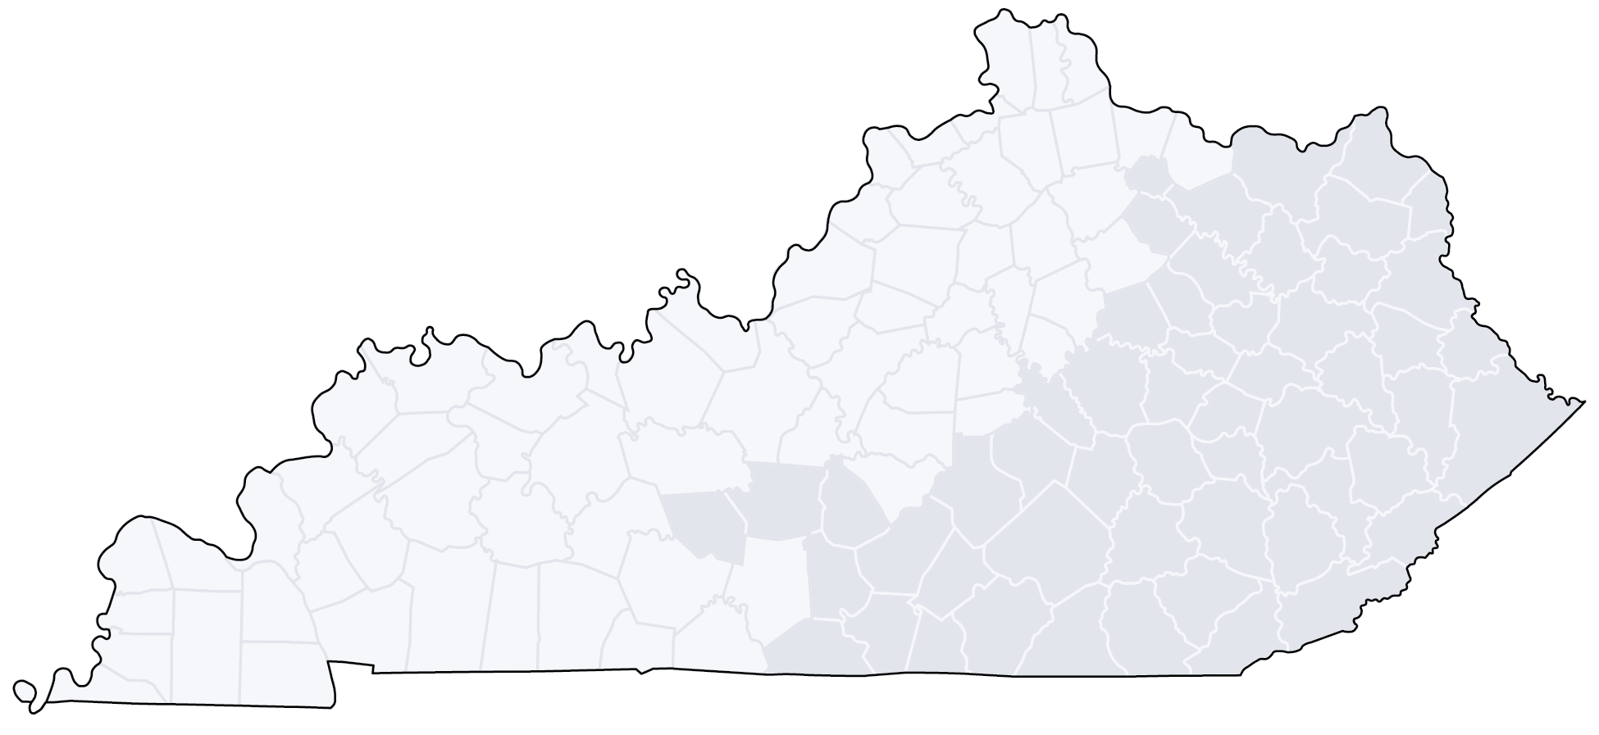
MCC Affiliate and Research Networks
MCC Affiliate Network (20 sites)
Prospective Affiliate Network (5 sites)
MCC Research Network (7 sites)
Prospective Research Network (8 sites)
Edgewood
Portsmouth, OH
Ashland
Cynthiana
Huntington, WV
Georgetown
Morehead
Charleston, WV
Indiana
MCC
Winchester
South
Williamson
Beckley, WV
Owensboro
Elizabethtown
Danville
Prestonsburg
Pikeville
Campbellsville
Mt. Vernon
Hazard
Bowling
Green
Paducah
Glasgow
Somerset
Manchester
Harlan
Middlesboro
Bristol, TN
Notes:
LED BY DR. TIM MULLETT, A THORACIC SURGEON AND NEWLY-ELECTED CHAIR OF THE AMERICAN COLLEGE OF SURGEONS COMMISSION ON CANCER, THE MARKEY NETWORK, COMPRISED OF AFFILIATE AND RESEARCH SITES, COLLABORATES WITH HEALTHCARE FACILITES ACROSS KENTUCKY AND WESTERN WEST VIRGINIA TO EFFECTIVELY EXTEND THE MARKEY’S REACH INTO RURAL COMMUNITIES ACROSS KENTUCKY AND BEYOND. (CLICK) THE AFFILIATE NETWORK HAS ALMOST TRIPLED IN SIZE SINCE 2013, EXPANDING FROM 8 TO CURRENTLY 21 SITES WITH TWO NEW SITES ESTABLISHED SINCE LAST YEAR. FIVE ADDITIONAL SITES ARE CURRENTLY BEING VETTED FOR INCLUSION. THIS NETWORK INFRASTRUCTURE SUPPORTS THE EFFORTS OF COMMUNITY HOSPITALS IN PROVIDING HIGH-QUALITY CANCER CARE INCLUDING MEETING CRITERIA FOR COMMISSION ON CANCER ACCREDITATION, FACILITATION OF CANCER SCREENING AND PREVENTION, AND PROFESSIONAL EDUCATION AND TRAINING PROGRAMS. (CLICK) IT IS IMPORTANT TO NOTE THAT THERE WILL BE 26,000 NEW CANCER DIAGNOSES IN KENTUCKY THIS YEAR. THE MARKEY CANCER CARES FOR ALMOST 42% OF THOSE PATIENTS EITHER DIRECTLY IN LEXINGTON OR INDIRECTLY THROUGH OUR AFFILIATE HOSPITALS.
(CLICK) IN 2015, THE MARKEY RESEARCH NETWORK WAS ESTABLISHED TO IMPLEMENT ONCOLOGY CLINICAL TRIALS THROUGHOUT KENTUCKY AND BEYOND WITH A FOCUS ON THE MOST PREVALENT CANCERS IN OUR CATCHMENT AREA. THERE ARE CURRENTLY 7 RESEARCH NETWORK SITES AND 8 SITES THAT ARE BEING VETTED AS POTENTIAL NEW SITES. (CLICK) SINCE 2015, 395 PATIENTS HAVE BEEN ACCRUED TO CLINICAL TRIALS AT MARKEY RESEARCH NETWORK SITES WITH 75% OF THESE PATIENTS ACCRUED TO INTERVENTIONAL TRIALS. IMPORTANTLY, 86% OF OUR RESEARCH NETWORK TRIALS ARE MARKEY IITs.
THE EXPANSION OF OUR NETWORK SITES, WHICH ARE STRATEGIC IN LOCATION, INCLUDE HOPITALS IN WESTERN KENTUCKY, THAT PROVIDE ACCESS TO CRITICAL MINORITY POPULATIONS, AND HOSPITALS IN WESTERN WEST VIRGINIA, SOUTHERN OHIO AND NORTHEASTERN TENNESSEE, REFLECTING OUR MISSION TO PROVIDE ACCESS TO OTHER AREAS OF CENTRAL APPALACHIA WITH A SIMILAR CANCER BURDEN AS KENTUCKY. IN ADDITION, OUR GROWING PRESENCE AND EXPANSION INTO WESTERN KENTUCKY IS FURTHER DEMONSTRATED BY AFFILIATE SITES IN PADUCAH, ILOCATED N THE SOUTHWESTERN CORNER OF KENTUCKY, AND BOWLING GREEN WHERE, THROUGH THE LEADERSHIP OF DR. DIPAOLA, THE UK COLLEGE OF MEDICINE HAS ESTABLISHED A FOUR-YEAR REGIONAL CAMPUS IN PARTNERSHIP WITH WESTERN KENTUCKY AND THE MEDICAL CENTER AT BOWLING GREEN.

Slide 6
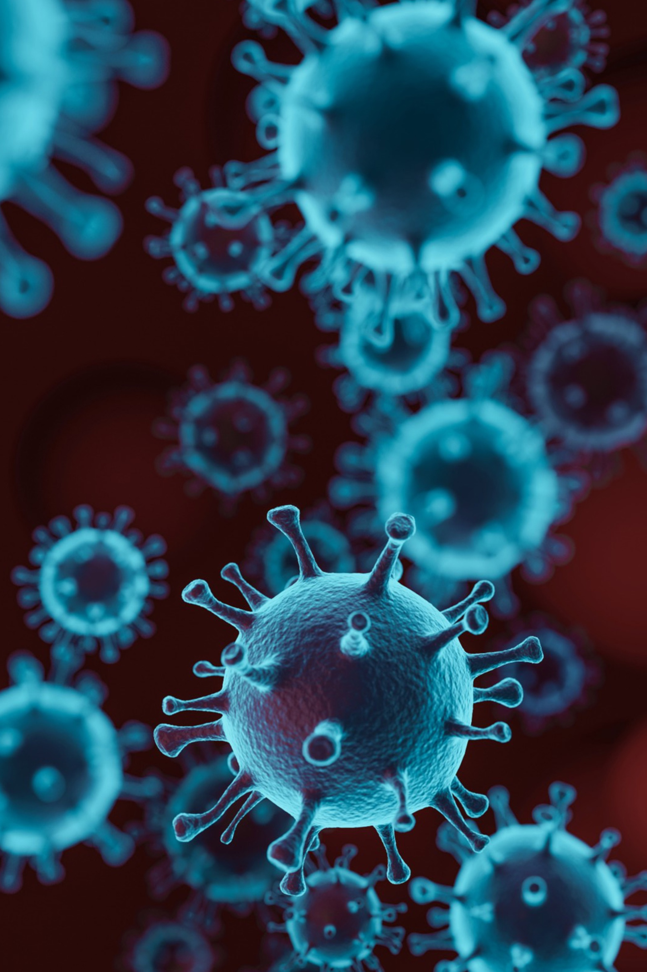
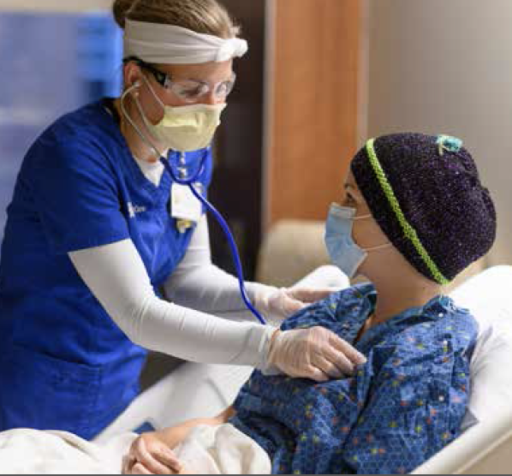
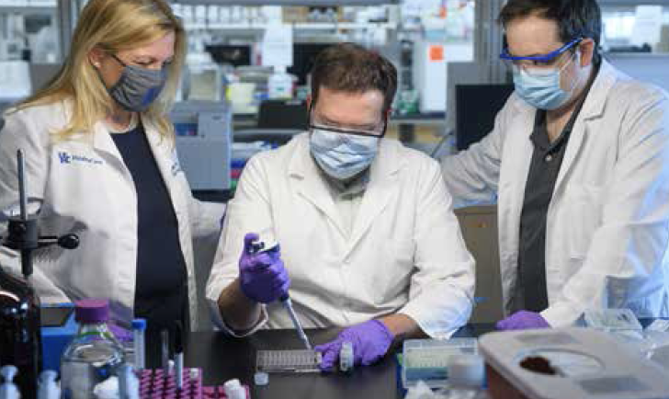
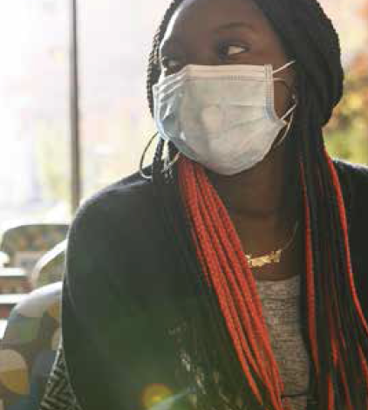
CANCER CARE DURING A PANDEMIC:
“Cancer doesn’t shelter in place”

Slide 7
Patient Care Still Sees Growth in Many
Areas Amid Pandemic
Outpatients
Inpatients
114,473
3,771
Visits
Fiscal Year
Fiscal Year
Notes:
Middle column on left. Can we make it a bar graph normal- type in patient and outpatient volumes side by side.

Slide 8
Perseverance During a Pandemic
Surgery volume
  Markey typically accounts for about 15 percent of all surgeries at UK HealthCare.
  In April 2020, Markey was responsible for 25 percent of surgical procedures.
Infusions and telehealth
  July – Nov 2020 saw a 2% growth in number of infusion visits since the same period in 2019
  From July 2019 – February 2020, Markey saw 112 patients via telehealth.
  From March – November 2020, Markey jumped to 2,360 total telehealth patients
pre-COVID 19
during COVID-19
MCC
Surgical
Procedures
MCC
Telehealth
Visits
MCC
Infusion
Visits
% of all ukhc telehealth pre covid- 3.9%
% of all ukhc telehealth during covid- 1.7%

Slide 9
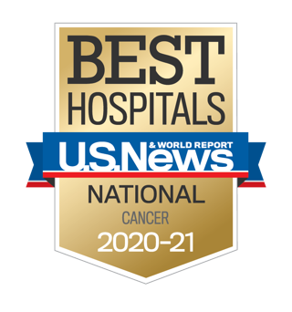

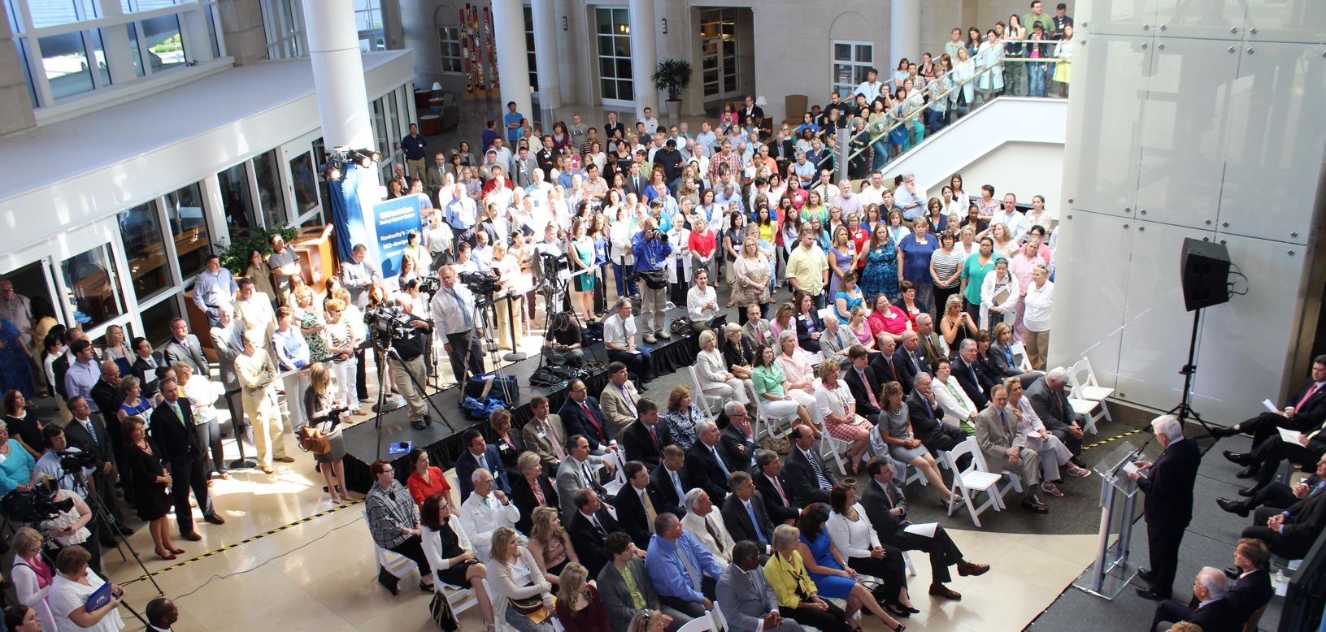
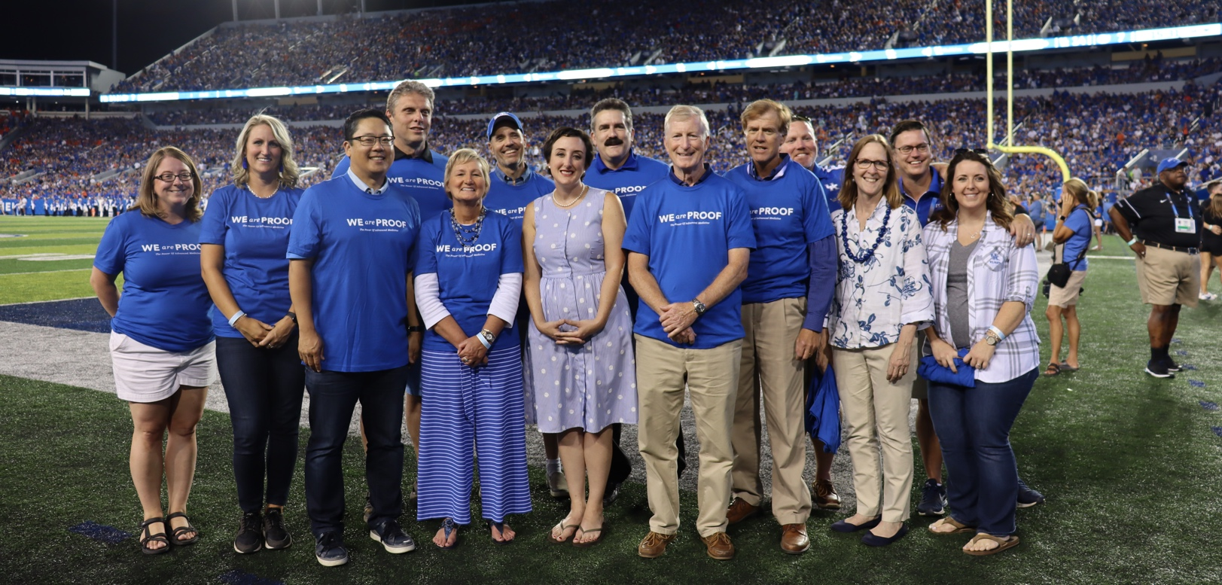
IMPACT OF STATE FUNDING:
Achieving NCI Designation and National Recognition

Slide 10
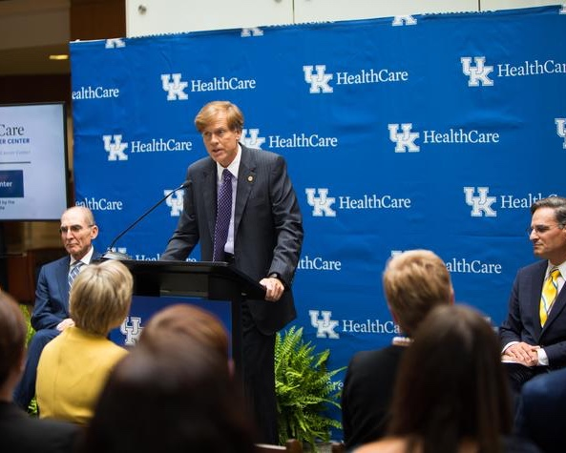
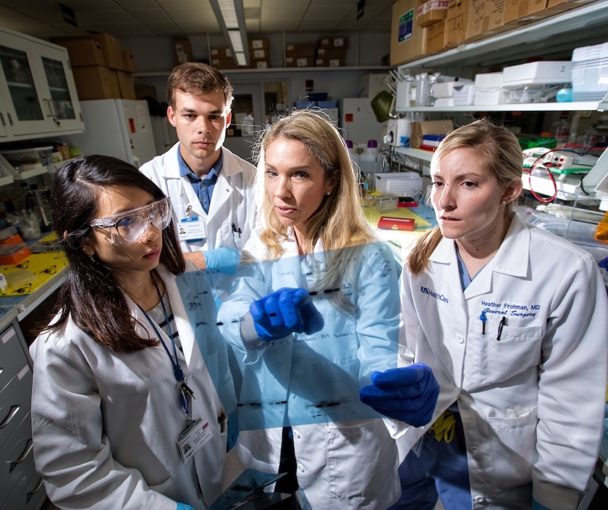
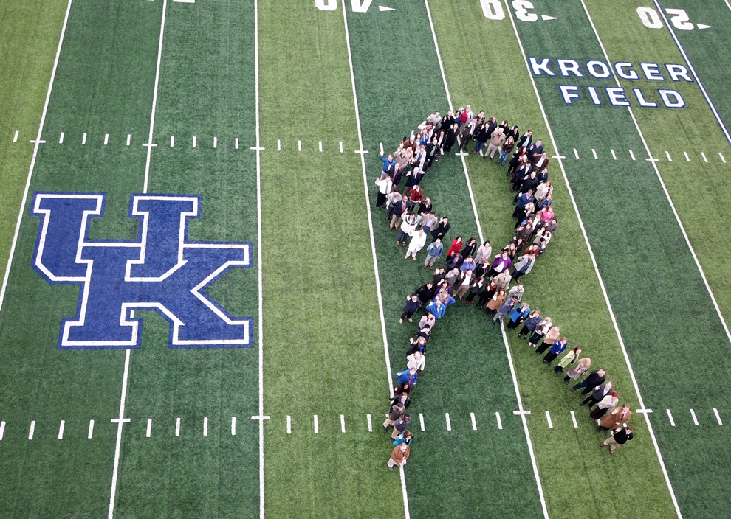
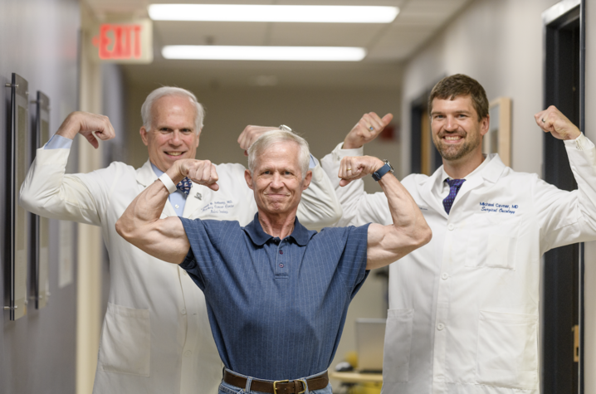
MCC’s NCI Designation Path
Awarded initial designation (5 years) – July 2013
Successful renewal for another 5 years – July 2018
Application for Comprehensive Status – September 2022
*

Slide 11
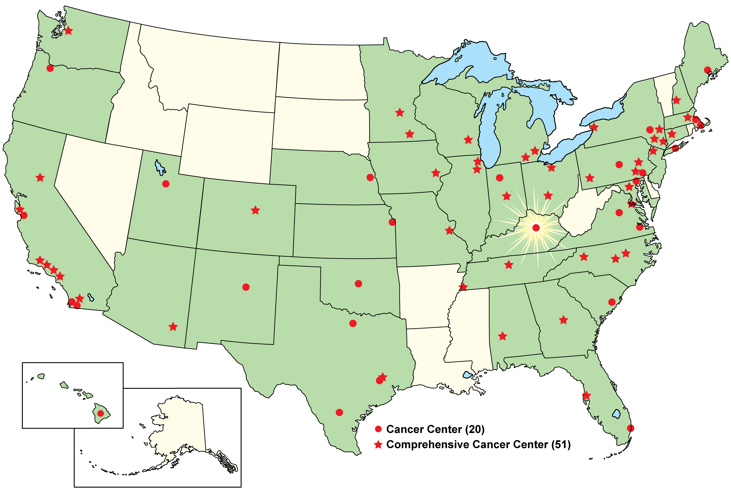
NCI-Designated Cancer Centers
July 12, 2013
Markey Cancer Center became the 68th
NCI-designated cancer center in the U.S.

Slide 12
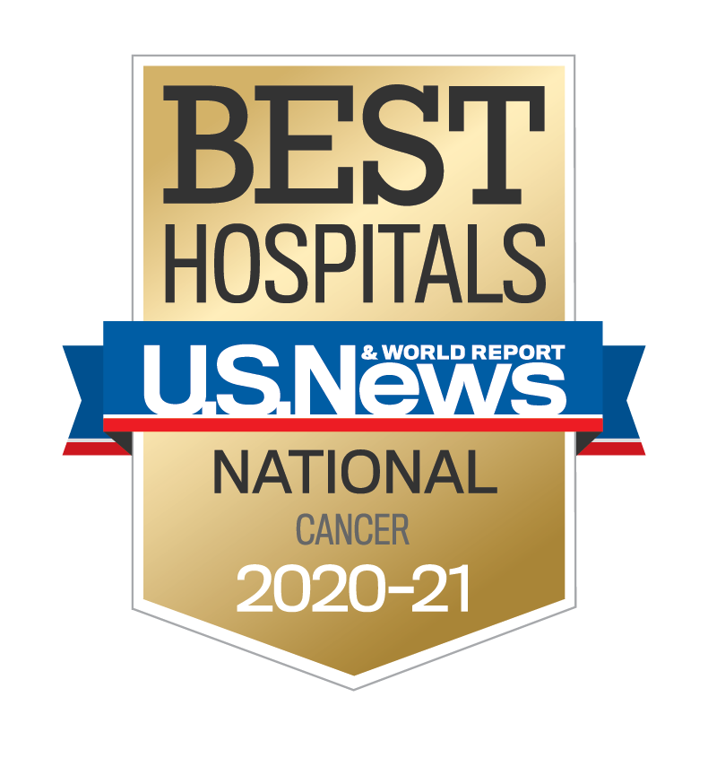
U.S. News and World Reports
Top 50 Cancer Centers in the U.S.
2019
2018
2017
2020
#29
#33
#38
#50
Notes:
Red circle after arrow auto

Slide 13

Cancer Research Funding (Total)
$52.2M
84%
INCREASE
SINCE 2012
Funding (in Millions)
$28.4M
131
Projects
259
Projects
Notes:
Switch 2019 to 2020

Slide 14

Other Impacts of NCI Designation
63 new faculty recruits since 2018 NCI re-designation
Accrual of 6,628 subjects to interventional trials since 2016; 39% from Appalachia
Over 14,000 people reached through outreach events or education in 2020
Over $10M in new funding since 2018 NCI re-designation

Slide 15
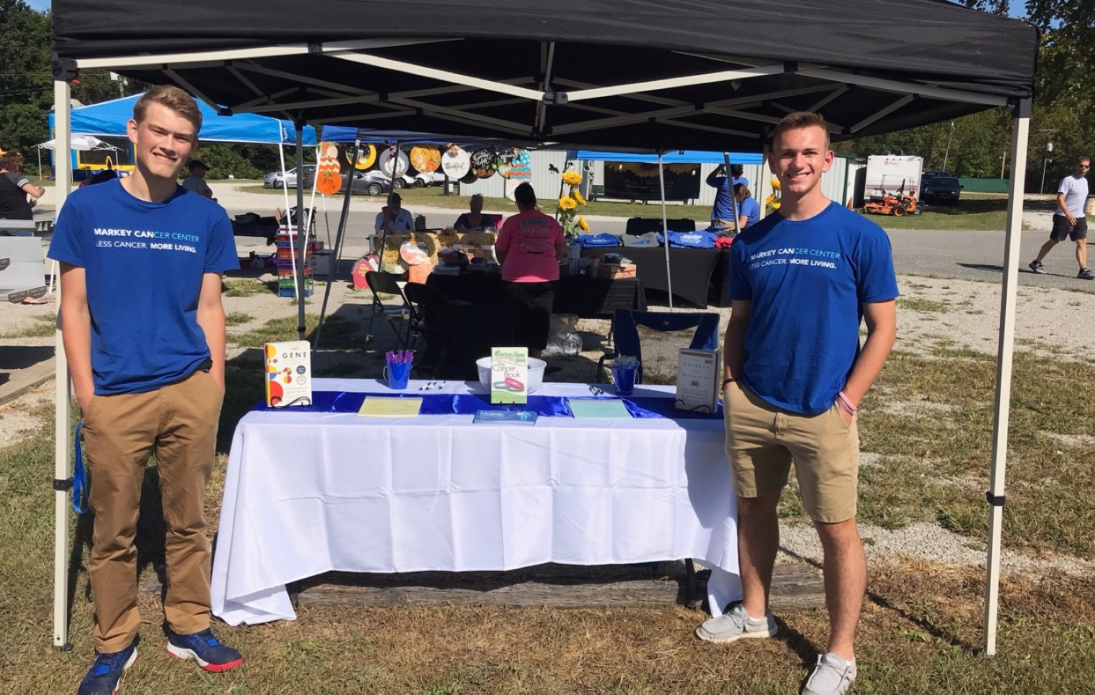
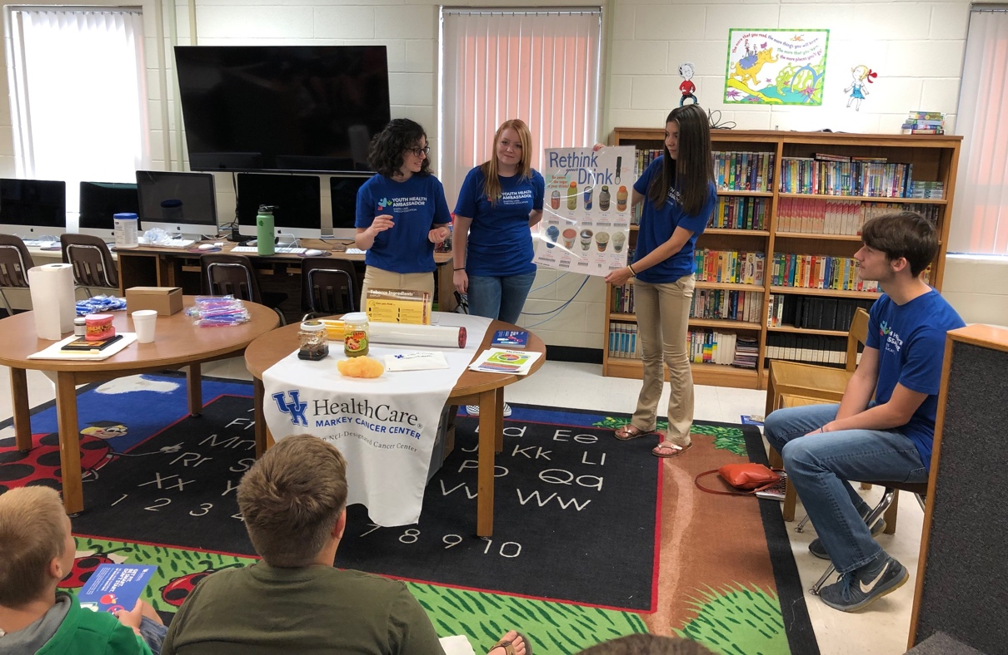
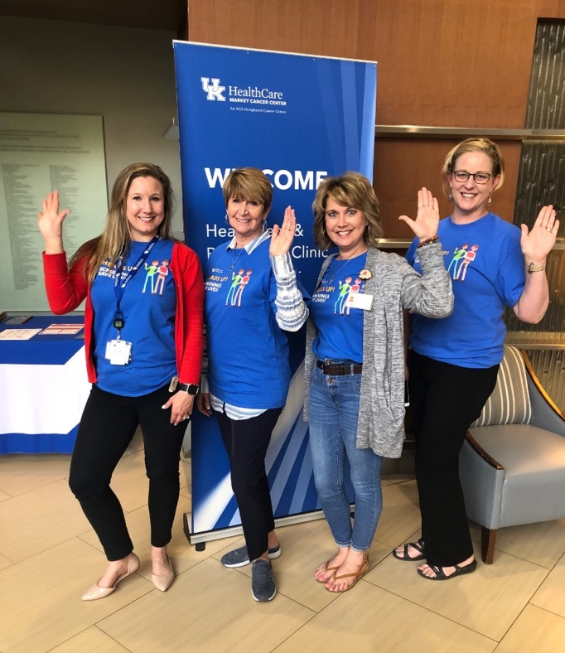
Impact of 2020-2021
state cancer prevention and research funding
to MCC

Slide 16
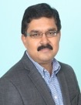
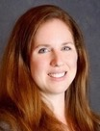
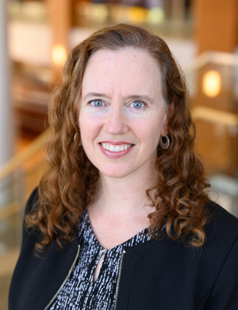
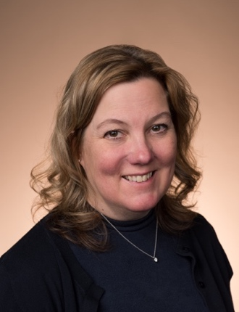

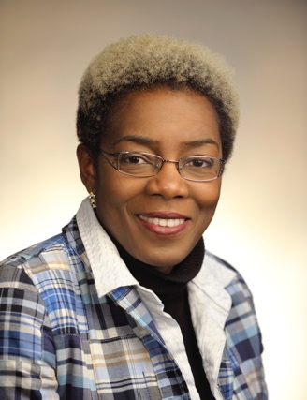
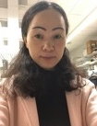
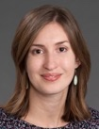
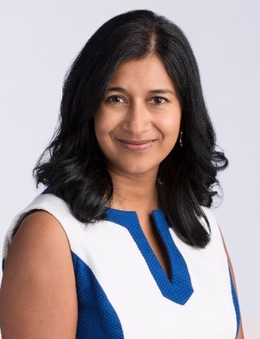
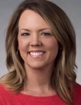
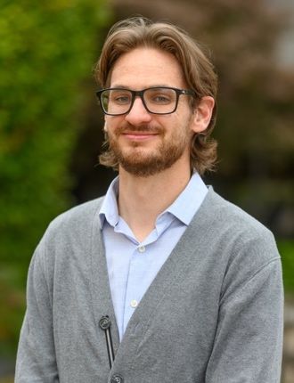

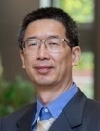
State Funding Contributed to the Recruitment or Retention of 13 Cancer Investigators
Ashfaqul Alam, PhD
Eva Goellner, PhD
Pamela Hull, PhD
Jill Kolesar, PharmD
Krystal Kuhs, PhD, MPH
Xia Liu,
PhD
Yvonne Fondufe-Mittendorf, PhD
Laurie Mclouth, PhD
Shyanika Rose, PhD
Stacy Stanifer, PhD
Jerod Stapleton, PhD
Ramon Sun, PhD
Shen Tong, PhD
Notes:
TAKE OUT RECRUIT AND RETAIN, MAKE YF-N PART OF THE GROUP AS A WHOLE.

Slide 17








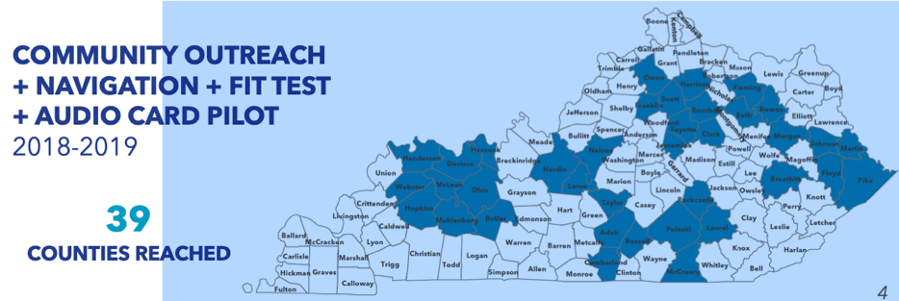

Increasing Colorectal Cancer Screening
Kentucky Needs
Community-Identified Priorities
Outcomes
Kentucky
Screening Rates
Colorectal Cancer
Healthcare Access
Community Education
Provider Education
Mailed
FIT Kits
35%
2001
70%
2018
Mortality Rates
US
13%
Decline
KY
30%
Decline
Notes:
Combine 15 and 16 (definitely keep rates). Don’t animate.
Use everything else from 16.

Slide 18

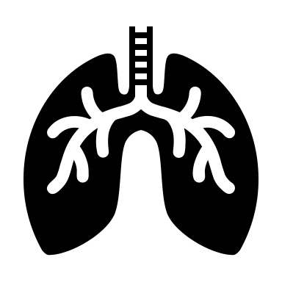









Improving Lung Cancer Screening and
Survivorship Care
Kentucky Needs
Community-Identified Priorities
Outcomes
Multilevel Intervention with Statewide and National Reach
Tobacco Use
Lung Cancer
Provider Education
Survivorship
Care
Lung
Screening
10%
4th highest
Lung Cancer Network
Educated
900+ providers 800+ staff across KY
10 hospitals
coached
7500+ lung screenings
100+
Health Systems and Partner Organizations
Notes:
Remove animation

Slide 19










Culturally-Targeted Cancer Prevention Interventions in Rural Appalachia
Kentucky Needs
Community-Identified Priorities
Outcomes
Faith-Based and Food Environment Interventions for Energy Balance
Cervical Cancer
Obesity
Early Detection
Cessation
Support
Energy
Balance
Notes:
Remove animation

Slide 20



Outreach Highlights
(September 2019 - August 2020)
16,800+
People reached through media dissemination
14,400+
People reached through events or education
300+
Outreach events with partners
900+
People given prevention & screening services
600
People in evaluation data collection
Notes:
TIME PERIOD – SEPT 2019 – Aug 2020
Check with Caree if there are any more updates to make on the numbers

Slide 21


Kentucky Community Cancer Awareness Research and Education (K-CARE) Project
Kentucky’s Problem
Lung cancer disparities among racial/ethnic minorities and the medically underserved
  How We Are Implementing Change
Studies show potential for success, improvements in knowledge and attitudes, reduced lung cancer stigma, and evidence of efficacy
>50 Community-health workers promote screening in community settings (including churches and health clinics)
Expand MCC’s reach in western Kentucky, focus on enrolling Black participants
  Enrolling ~500 minority and/or medically underserved participants
Notes:
https://www.3blmedia.com/News/Using-Trusted-Members-Community-Reduce-Fear-Lung-Cancer-Screening
https://www.uky.edu/nursing/about-us/news/dr-lovoria-williams-named-nurse-researcher-year-national-black-nurses-association
Dr. Lovoria Williams’ work addresses the extremely low uptake of lung cancer screening, particularly among smokers in underserved populations. Dr. Williams has developed a much-needed lung cancer screening education intervention that is designed to be delivered by trained community-based health workers. The intervention targets racial/ethnic minority or lower SES individuals with the goal of educating them on lung cancer screening guidelines, changing knowledge, attitudes, and beliefs about cancer risk factors and lung cancer, and to connecting participants to no-cost LDCT screening facilities.
Dr. Williams’ initial pilot intervention trial demonstrated that intervention participants had significantly higher knowledge about lung screening and lung cancer, decreases in barriers of screening, and increases in perceive screening benefits and self-efficacy. Most promising, nearly 40% of those meeting screening eligibility criteria had undergone LDCT screening. In a subsequent 2020 study, Dr. Williams further refined the intervention to reduce the total time and found similar benefits. This study also added to their work by demonstrating feasibility in the CHW training approach as they were able to demonstrate that nearly 80% of CHW who signed up for intervention training received it and implemented the program in their community.
Dr Williams and colleagues are applying for funding to test the implementation of this program across clinics in the MCCAN.

Slide 22


Enhancing the Diabetes Prevention Program to Promote Weight Loss Among Nonresponders in a Community Based Lifestyle Intervention
Kentucky’s Problem
Obesity is the leading cause of Type 2 diabetes and is closely linked with multiple cancers
Adult Blacks carry a disproportionate burden of obesity 47.8% compared to 33.4% Whites
Blacks are underrepresented in lifestyle change interventions and when enrolled lose less weight
How We Are Implementing Change
Identifying weight loss nonresponders early and offering individual level attention may affect greater weight loss
500 Black community-based participants will be recruited from 20 sites, primarily churches
Advance the science regarding weight loss nonresponders

Slide 23












Mining For A Cure
Going into mines, getting samples and making new drugs
Using Kentucky’s natural resources to develop novel anti-cancer drugs
Unique Natural Product Repository
Novel Appalachian collection sites
OH
O
9
1
O
A
B
C
extreme
6
4
D
O
O
O
Frenolicin B (FB)
KY MINES
underground
>900 distinct microbial strains
>450 pure products
6 new structural classes
MCV Small T
antigen
MCV Large T
antigen
P
P
P
P
4E-BP1
SAMPLES
CANCER
TREATMENT
Oncogene translation
Thorson
Merkel Cell
Carcinoma
Over 900 bacteria strains
Over 450 pure products
Colorectal
Prostate
Skin
Notes:
The Merkel cell carcinoma (MCC) is a rare and aggressive neuroendocrine skin cancer that frequently carries an integrated copy of Merkel cell polyomavirus (MCPyV) and expresses viral transforming antigens (TAgs) that play a key role in tumorigenesis. Approximately 80% of MCC carries MCPyV (also simplified and named as MCV). MCC is one of the most aggressive skin cancers with a disease-associated mortality rate between 33-46% that exceeds the rate of melanoma and less than 45% five-year survival rate. The MCV small T antigen has been shown to result in increased hyperphosphorylation of 4E-BP1 that independent of mTORC1 signaling, which has been linked to MCV transformation.

Slide 24



Cultivating the Future of Cancer Care
Collaboration with UK College of Agriculture to grow sweet wormwood (Artemisia Annua)
Kentucky is the only state growing the plant in large quantities
Similar plant production process to tobacco
  Seedlings are transplanted in the fields using the same machine used to farm tobacco
  The drug artesunate, created from dried sweet wormwood leaves, is studied at MCC to treat various cancers
  Clinical trials currently test artesunate as treatment for ovarian and pediatric cancers
“Can you imagine if we could get rid of something that
causes cancer and replace it with something
that treats cancer?”
- Dr. Jill Kolesar

Slide 25
Support From the State has Provided:
Critical funding for cancer screenings throughout the state
Funding for new recruitment and retention of cancer investigators
Pilot funding for new cancer research projects
Funding for new clinical trials

Slide 26
WE NEED YOUR
CONTINUED SUPPORT!

Slide 27

Thank you!

