Slide 1
KENTUCKY OFFICE OF
DRUG CONTROL POLICY
Tobacco Settlement Agreement Fund Oversight Committee
Thursday, January 21, 2021
Van Ingram, Executive Director
Justice & Public Safety Cabinet

Slide 2
STAFF
Van Ingram, Executive Director – van.ingram@ky.gov
Heather Wainscott, Branch Manager – heather.wainscott@ky.gov
Amy Andrews, KY-ASAP Program Manager – amy.andrews@ky.gov
Office of Drug Control Policy
Justice & Public Safety Cabinet
125 Holmes Street
Frankfort, Kentucky 40601
502-564-9564
502-564-6104 (fax)
1-888-414-ODCP
www.odcp.ky.gov

Slide 3
Executive Summary
KY-ASAP has continued to evolve since its placement into the Office of Drug Control Policy in 2004
KY-ASAP continues to embrace and incorporate the philosophy of ODCP to involve the three-pronged approach of prevention, treatment and law enforcement
The Kentucky Agency for Substance Abuse Policy is unique in that local boards determine their own needs for their service area. Through a strategic plan and needs assessment, the local boards identify the issues they need to direct their dollars toward concerning tobacco, alcohol, and other drugs as related to abuse.
KY-ASAP Local Boards now exist in 119 of Kentucky’s 120 counties and is currently being used in many of these communities as the primary component of a comprehensive drug education/prevention, treatment, and law enforcement programs
Local KY-ASAP boards are effective in their individual communities because these boards are comprised of the key stakeholders in the communities.

Slide 4
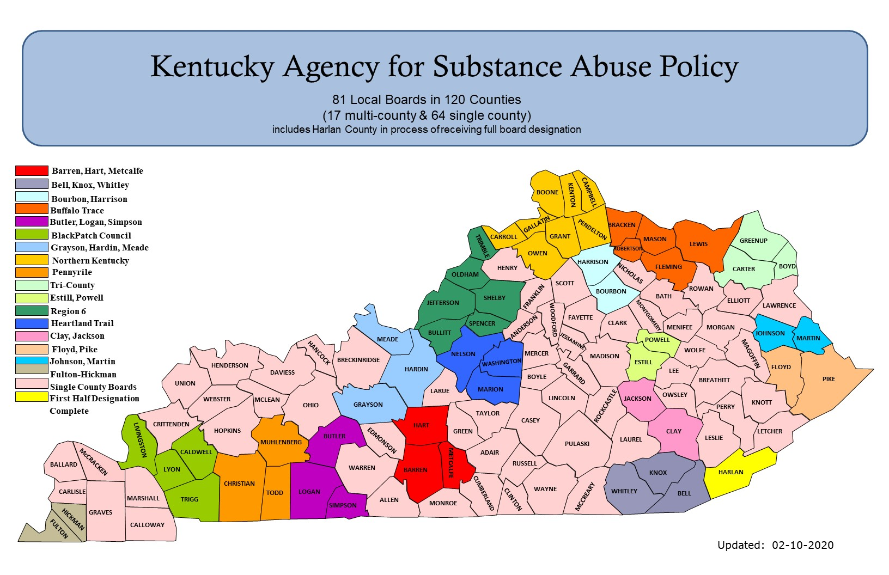

Slide 5
KY-ASAP State Board
Laurie Dudgeon, Director – Administrative Office of the Courts (Designee – Elizabeth Nichols)
Shannon Smith – American Heart Association (Designee - David Sloane)
Shannon Black Baker – American Lung Association
Eric Friedlander, Secretary – Cabinet for Health & Family Services (Designee – Maggie Schroeder)
Jason Glass, Commissioner – Department of Education (Designee – Doug Roberts)
Dr. Steven Stack – Department for Public Health (Designee – James House)
Patti Clark – Division for Behavioral Health, Dept. of Behavioral Health, Developmental & Intellectual Disabilities
Justice Mary C. Noble, RET. Secretary – Justice & Public Safety Cabinet (Designee – Van Ingram)
Charles Kendell – Local Tobacco Addiction, Substance Abuse Board
Shane Britt – Local Tobacco Addiction, Substance Abuse Board
Steve Shannon – KY Association of Regional Programs
VACANT – KY Cancer Society
Megan Nicodemus – KY Family Resource Youth Services Coalition (Designee – T.C. Johnson)
Dana Nickles, KY Public Health Association
Shelley Elswick, Private Community Based Organization
Chair Tim Cesario, Private Community Based Organization (Designee – Tony Landrum)

Slide 6
KY-ASAP SFY2020 Program Expenditures
KENTUCKY AGENCY FOR SUBSTANCE ABUSE POLICY SFY2020 Budget
Description | Amount
2020 Allocation | $7,362,799.97
2019 Carryover | $4,616,890.63
2020 Reduction (tobacco receipt shortfall) | $460,638.04
SFY2020 BUDGET | $11,519,052.56
Salary & Fringe | $242,989.75
Local Boards (Regular Awards - $25,000 per county) | $2,937,500.00
Local Boards (Harm Reduction) | $23,779.55
New Boards (Elliott County) | $20,000
State Board Meetings | $202.80
Travel | $14,163.34
Auditor/COT/EMARS/AGATE/Copier | $22,561.56
Supplies | $1,039.31
Trainings | $5,032.38
Media | $24,228.70
UNITE – Call Center | $1,000,000
Eastern KY Concentrated Employment Program - Recovery & Support Specialists | $650,000.00
Kentucky Chamber of Commerce - Recovery Friendly Workplaces | $175,000.00
Naloxone for Law Enforcement – Kentucky Pharmacy Education & Research Foundation (KPERF) | $100,000.00
Community Foundations - Reducing Barriers to Re-Entry | $75,000.00
KSP – Harm Reduction Program | $500,000.00
TOTAL EXPENDITURES | $5,791,497.39
BALANCE | $5,727.555.17

Slide 7
KY-ASAP SFY2020 Funded Programs
KY-ASAP Local Boards – Traditional & Harm Reduction Awards - to operate ATOD prevention, enforcement projects & programs
UNITE Call Center – to operate a screening & statewide referral service
Kentucky Pharmacy Education & Research Foundation - Naloxone for Law Enforcement - to purchase, provide & train law enforcement agencies for Naloxone
Eastern Kentucky Concentrated Employment Program – Recovery & Support Specialists - to increase access to and retention of employment for persons in recovery from substance use disorders as well as those with associated mental health issues seeking (re)employment and job training
Kentucky Chamber of Commerce – Recovery Friendly Workforce – to address the destigmatizing the addiction epidemic & support employers’ role in Opioid prevention, treatment & recovery in the workplace, business engagement & opioid use, prevention & response
Community Foundations – Reducing Barriers to ReEntry – to connect justice involved individuals to supports and opportunities that will re-direct them into productive lives by identifying services & supports to improve outcomes & remove barriers to successful re-entry.
Kentucky State Police – Harm Reduction Projects – to enhance interdiction & prevention efforts

Slide 8
KY-ASAP SFY2020 Program Expenditures

Slide 9
KY-ASAP Local Boards Projects & Programs
RX DRUG DISPOSAL: units, disposal costs, marketing & awareness
NALOXONE: Naloxone kits & training for Community Members, Schools, 1st Responders, Health Departments
SYRINGE EXCHANGE PROGRAMS: Program supplies & supports, marketing, peer training
PREVENTION/EDUCATION: School & Community Assemblies and Meetings, awareness campaigns, SRO, prevention curriculum & materials, teen conferences, e-cigarette campaign, smoke-free campaign, Lifeskills, Sources of Strength, Social Host campaign, lunch & learn, capacity building, Girls Empowerment, Early Intervention Program, Too Good for Drugs, surveys/needs assessments, scholarships, PSAs, community resource fair
TREATMENT: Celebrate Recovery, AA/NA, recovery residence, tobacco cessation, drug testing, drug recovery program for inmates, MAT, treatment vouchers, drug court support, quit line promotion, Casey’s Law support, transportation vouchers, 7 Challenges, Celebrating Families, GED support
ENFORCEMENT: Portable Breathalyzers, training, evidence collection & interdiction resources, RX Drug Summit, crisis intervention, K-9 Support, minor alcohol sales checks

Slide 10
KY-ASAP Local Boards Spending Plans
*spending plans include 2019 carryover
Administration includes: clerical, supplies, dues, fees, meeting expenses, travel/training, equipment, fiscal agent fees & rent

Slide 11
KY-ASAP Local Boards Harm Reduction Spending Plans

Slide 12
Kentucky RX Disposal Locations
193 Locations in 116 Counties
116
Counties with Operational Prescription Disposal Locations
4
Counties without Permanent Prescription Disposal Locations
6
BOONE
CAMPBELL
2
KENTON
7
1
GALLATIN
PENDLETON
BRACKEN
1
1
GRANT
1
2
TRIMBLE
CARROLL
MASON
LEWIS
GREENUP
1
OWEN
1
ROBERTSON
1
1
HENRY
HARRISON
1
FLEMING
BOYD
OLDHAM
1
2
NICHOLAS
1
CARTER
1
2
SCOTT
1
ROWAN
1
FRANKLIN
3
BOURBON
1
JEFFERSON
SHELBY
1
1
BATH
2
ELLIOTT
LAWRENCE
2
3
1
2
MONTGOMERY
1
2
SPENCER
WOODFORD
FAYETTE
CLARK
2
1
MORGAN
ANDERSON
MEADE
BULLITT
1
1
JESSAMINE
2
MENIFEE
1
JOHNSON
1
2
2
3
POWELL
2
MARTIN
2
NELSON
MERCER
2
WOLFE
1
HENDERSON
HANCOCK
BRECKINRIDGE
1
WASHINGTON
MADISON
ESTILL
1
MAGOFFIN
DAVIESS
3
HARDIN
1
GARRARD
2
2
1
FLOYD
UNION
2
6
1
BOYLE
2
LEE
BREATHITT
1
PIKE
2
LARUE
MARION
2
OWSLEY
1
1
1
WEBSTER
MCLEAN
OHIO
GRAYSON
1
LINCOLN
JACKSON
1
PERRY
KNOTT
1
1
1
1
2
3
TAYLOR
CASEY
ROCKCASTLE
1
CRITTENDEN
HOPKINS
2
HART
GREEN
2
CLAY
2
1
2
MUHLENBERG
BUTLER
EDMONSON
2
1
1
PULASKI
LAUREL
LESLIE
LETCHER
LIVINGSTON
CALDWELL
2
2
1
ADAIR
4
2
1
1
1
McCRACKEN
1
2
1
METCALFE
1
RUSSELL
2
BALLARD
1
LYON
2
WARREN
BARREN
1
1
KNOX
HARLAN
1
1
CHRISTIAN
3
3
WAYNE
1
TODD
LOGAN
1
WHITLEY
BELL
CARLISLE
MARSHALL
TRIGG
2
ALLEN
MONROE
CUMBERLAND
CLINTON
2
1
2
3
1
GRAVES
2
3
SIMPSON
1
2
1
MCCREARY
HICKMAN
2
1
CALLOWAY
FULTON
2
updated: August 27, 2020

Slide 13
National Drug Take Back Day

Slide 14
Questions
Van Ingram, Executive Director – van.ingram@ky.gov
Heather Wainscott, Branch Manager – heather.wainscott@ky.gov
Amy Andrews, KY-ASAP Program Manager – amy.andrews@ky.gov
Office of Drug Control Policy
Justice & Public Safety Cabinet
125 Holmes Street
Frankfort, Kentucky 40601
502-564-9564
502-564-6104 (fax)
1-888-414-ODCP
www.odcp.ky.gov

