Slide 1
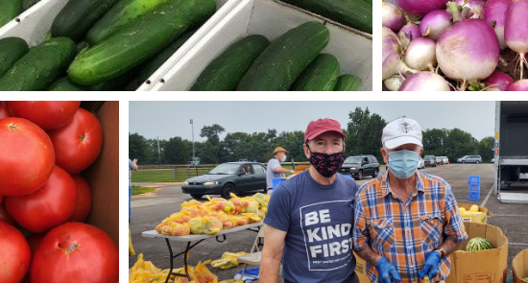
Partnering in the Fight Against Hunger Report to the Tobacco Settlement Oversight Committee
July 2021

Slide 2
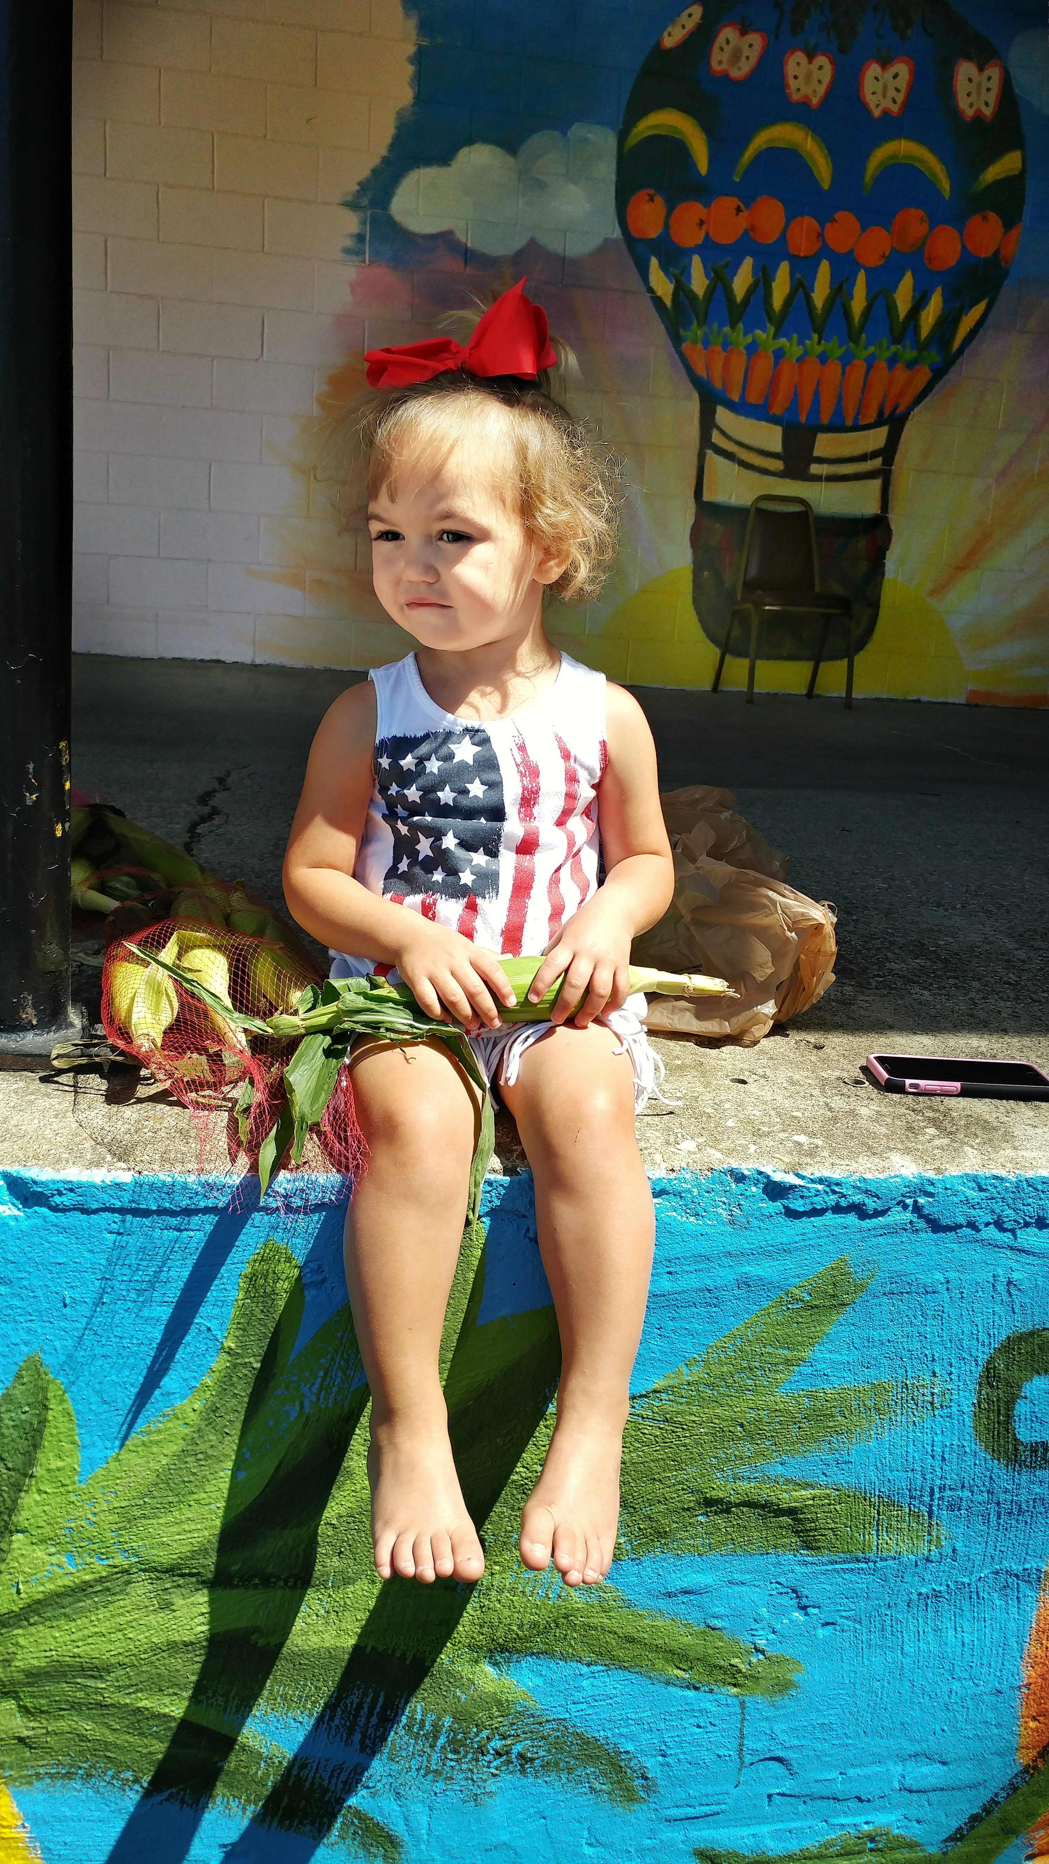
Contents
Hunger in Kentucky
Our response
Farms to Food Banks
Kentucky Kids Eat
Notes:
Agenda Overview-Katrina

Slide 3
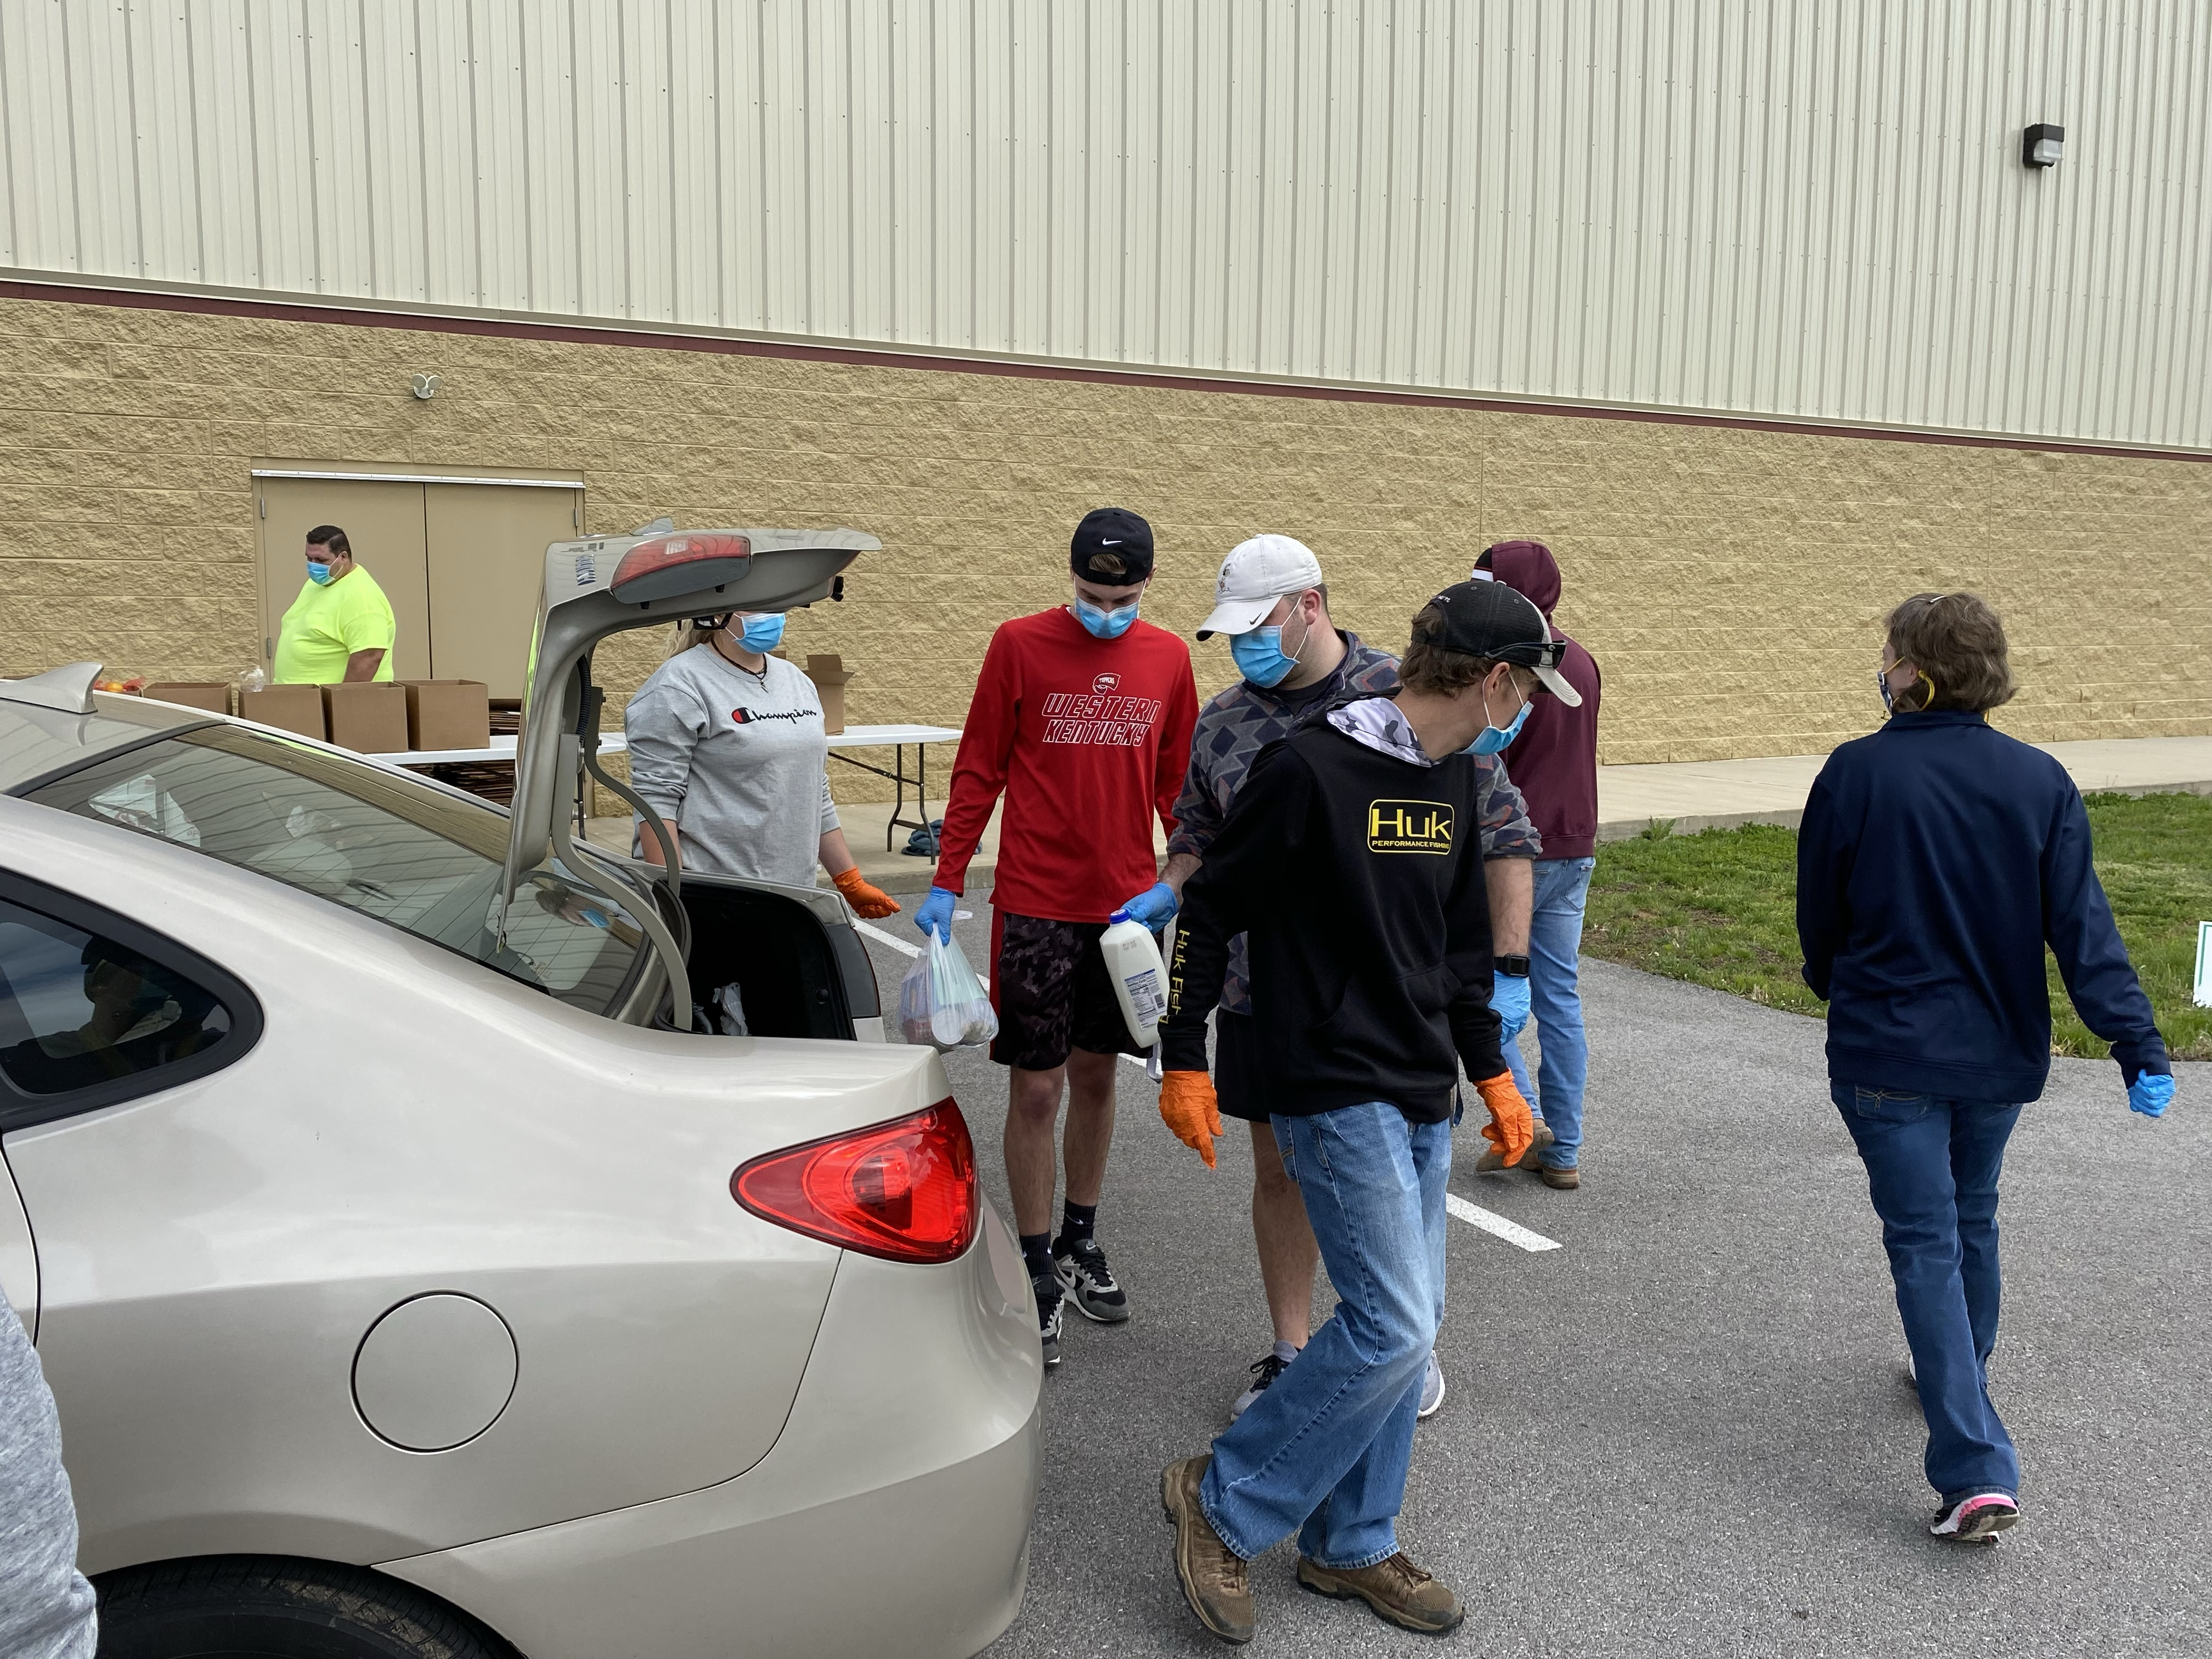
1
Hunger in Kentucky

Slide 4
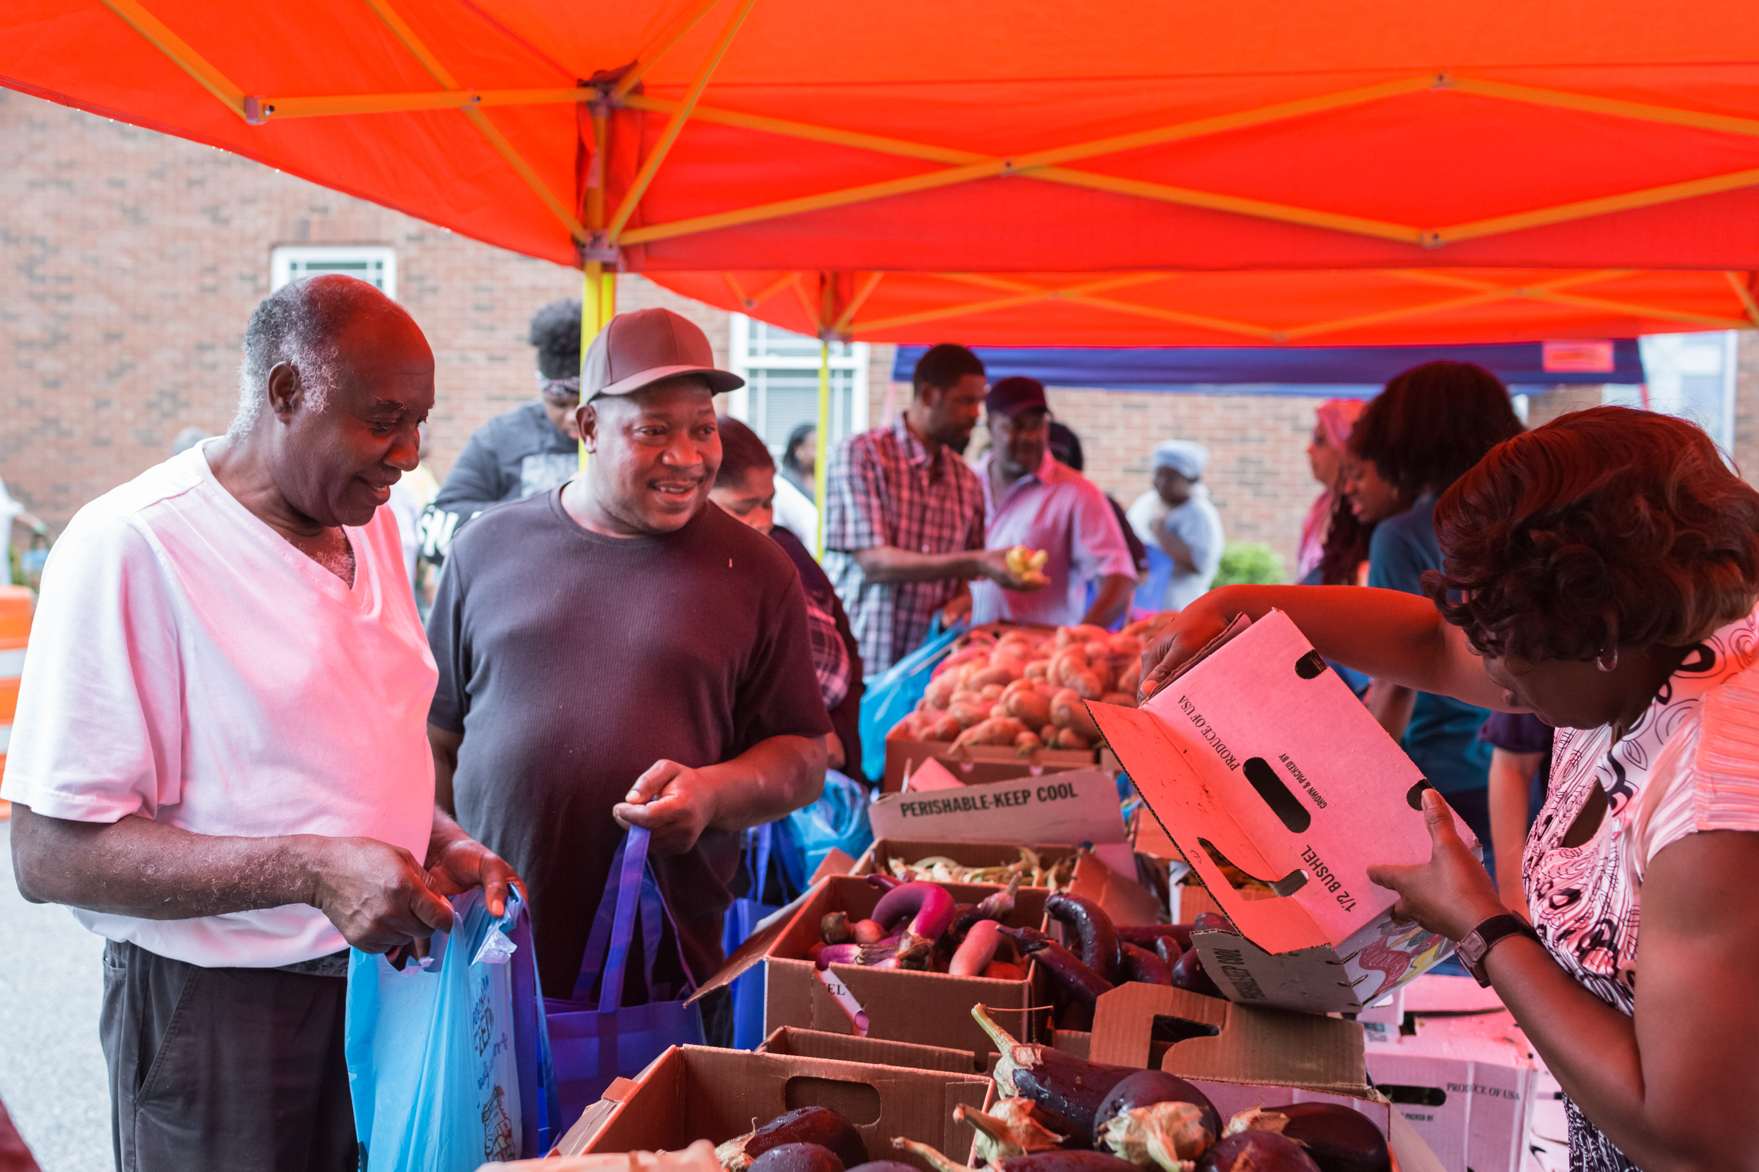
1 in 6
KENTUCKIANS ARE FOOD INSECURE
Notes:
From FA map called Coronavirus impact on Food Insecurity ---- https://feedingamericaaction.org/resources/state-by-state-resource-the-impact-of-coronavirus-on-food-insecurity/

Slide 5
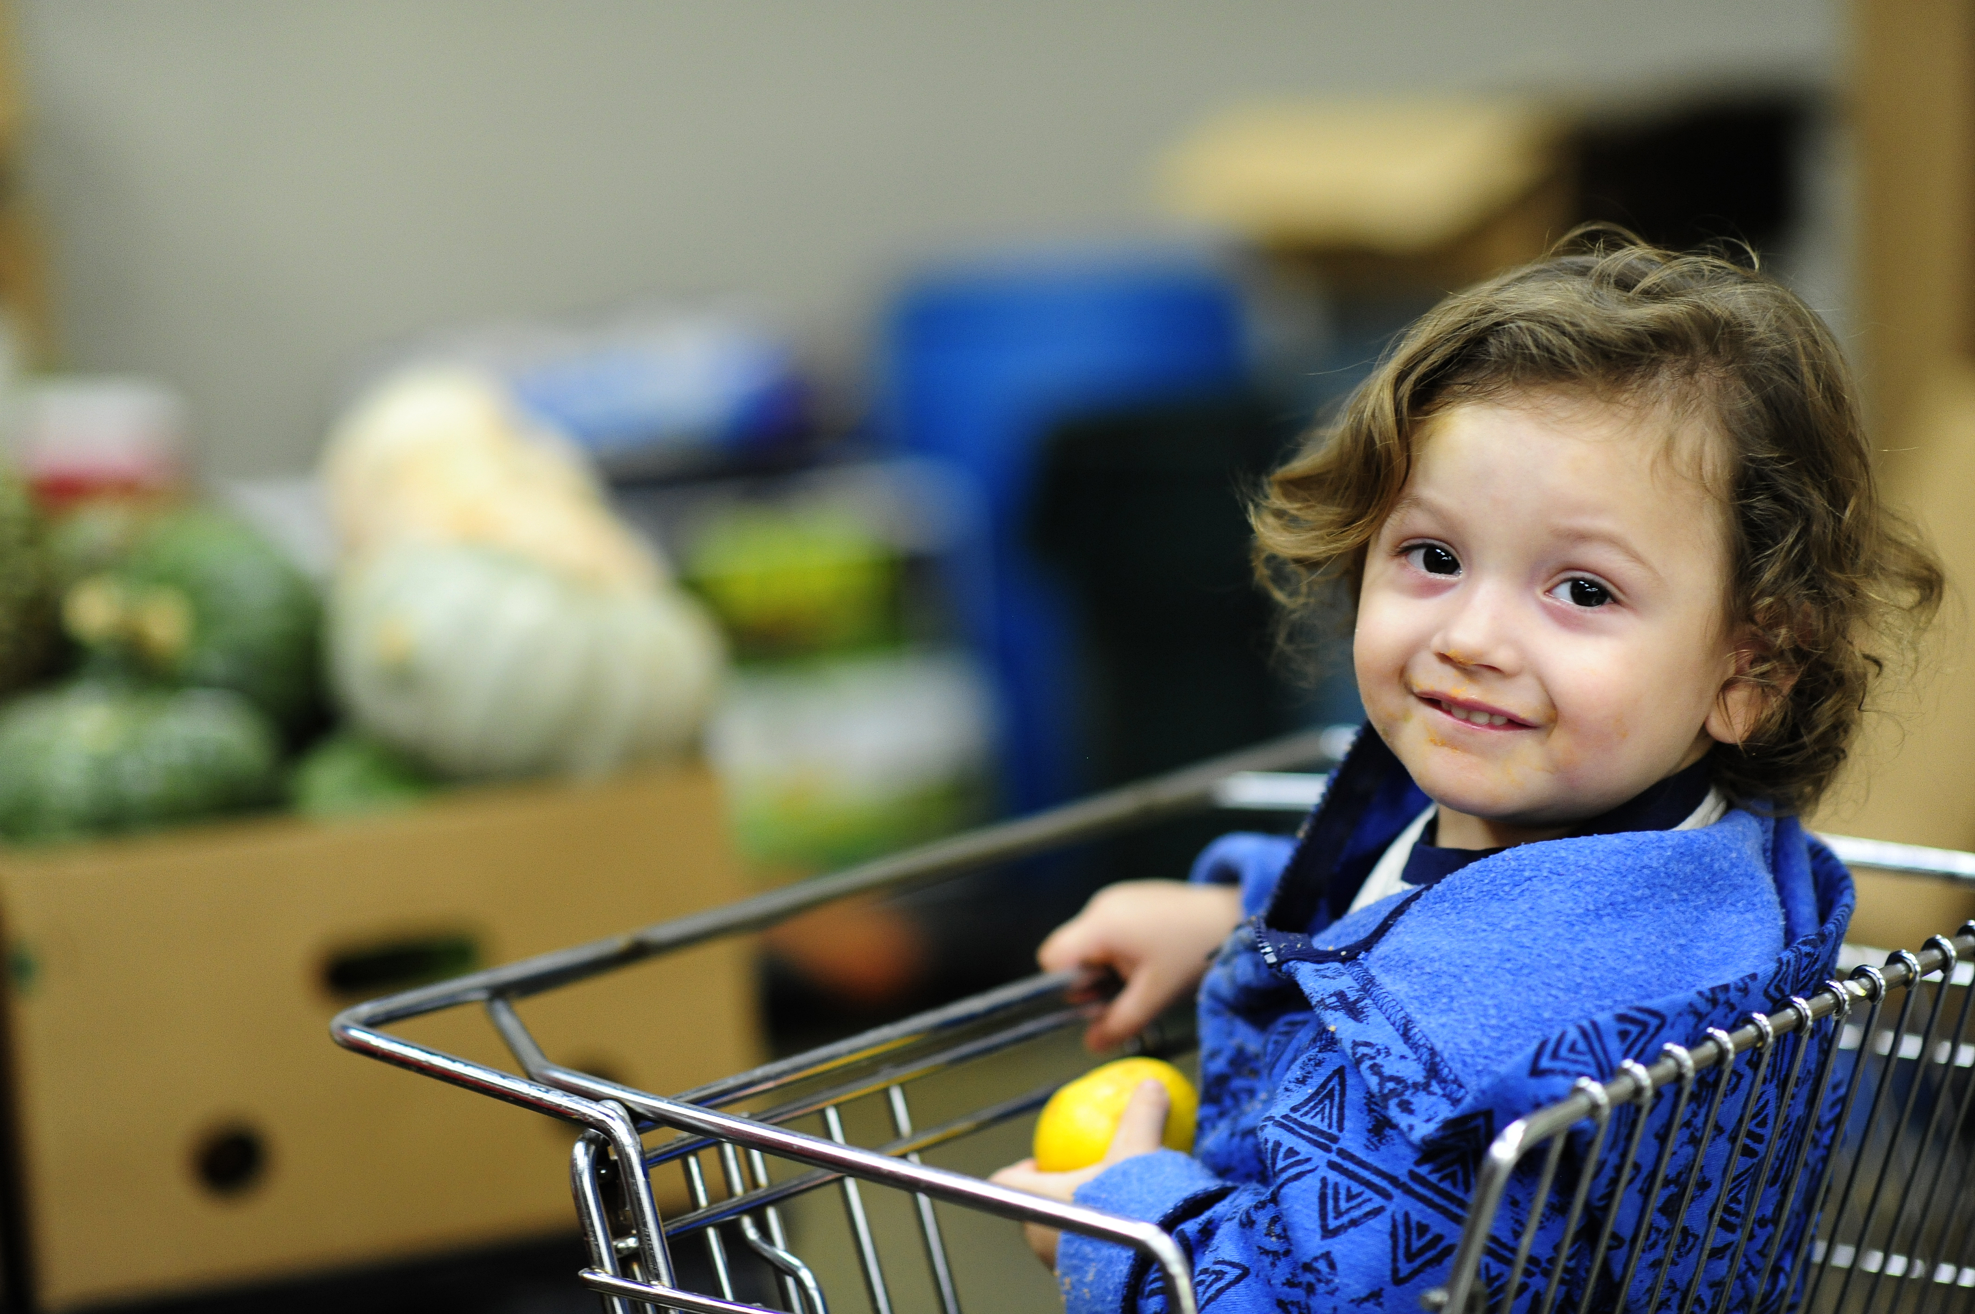
1 in 5
KY CHILDREN ARE FOOD INSECURE
Notes:
Deficits in cognitive, social, and emotional development.
Special education services, grade repeat.
Chronic health conditions, behavioral problems, psychiatric distress.

Slide 6
Counties with the highest estimated food insecurity rates:
Harlan
Leslie
Magoffin
Breathitt
Clay
Bell
Letcher
Notes:
All counties have more than 1 in 4 food insecuirty rate .

Slide 7
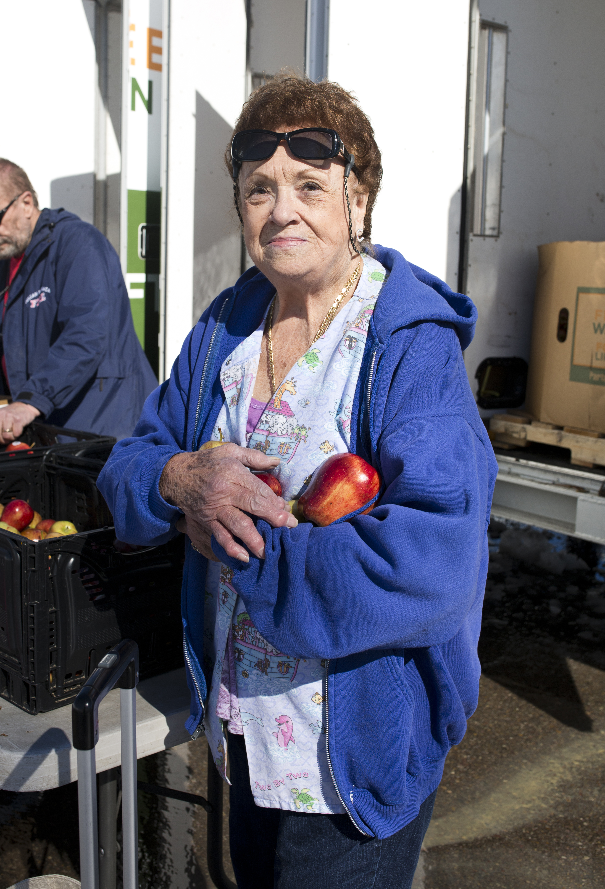
KENTUCKY
IS #1
IN FOOD INSECURITY AMONG OLDER ADULTS
Notes:
Kentucky has the nation’s highest rate of food insecurity among residents 50 to 59 years old, according to Feeding America’s first-time effort to document hunger in older adults.

Slide 8
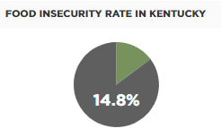
Meal Gap
Source: Map the Meal Gap 2020
Notes:
(adults 33% of food insecure Kentuckian do not qualify for federal nutrition programs)
Must rely on charitable food assistance

Slide 9
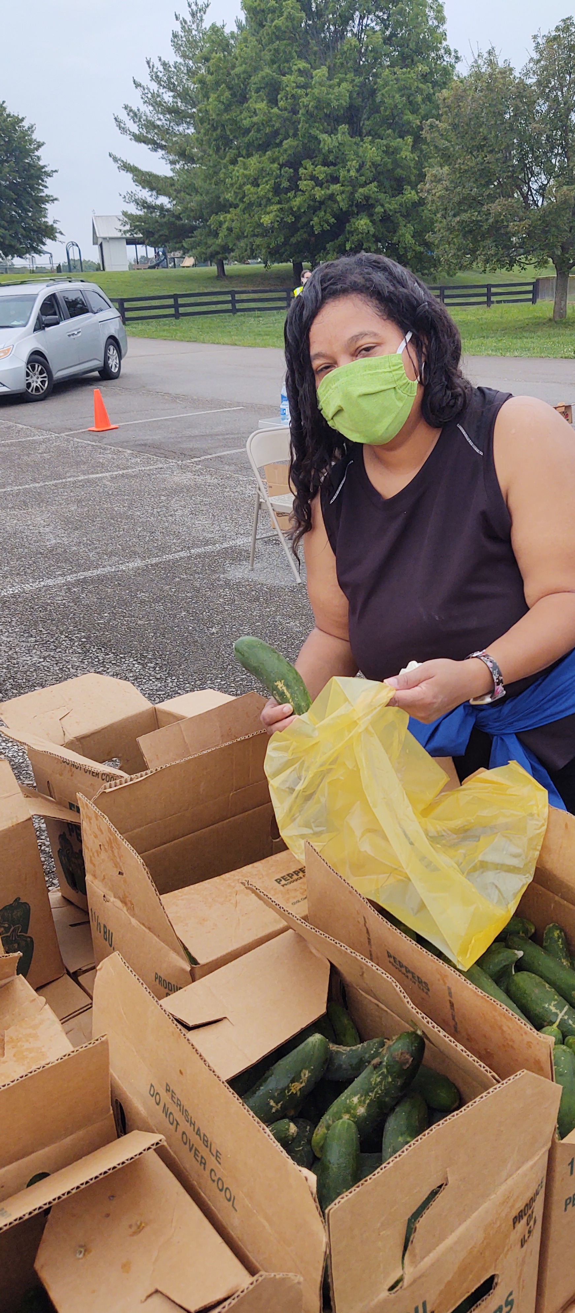
Pandemic
Feeding America estimates that food insecurity increased by 18% during the pandemic
Kentucky food banks experienced a 30% average increase in demand
Notes:
From FA Tool Measuring the impact of Coronavirus on Food Insecurity -- https://feedingamericaaction.org/resources/state-by-state-resource-the-impact-of-coronavirus-on-food-insecurity/
30% increase in demand is from December; self reported by food banks
USDA Pulse Survey (Just the people who completed the survey);
Food sufficiency in last 7 days: Over 270,000 Kyians (July 16, 2020 to July 21, 2020)
Sometimes not enough to eat Often not enough to eat
227,093 46,580
It was the highest number of people reporting insufficient food since the Census started tracking that information in early May.
"We believe that over the next 12 months we are looking at 54.3 million Americans who will be estimated to be food insecure," Fitzgerald told CNN. "That's 17 million more Americans, about a 46% increase."
Similar to unemployment and poverty -- and the virus itself -- food insecurity disproportionately affects communities of color, women, children, senior citizens and people with disabilities.
"Those disparities have only been exacerbated by this crisis…Just like Covid-19 has disproportionately impacted people of color, so too have the elevated levels of food insecurity."

Slide 10
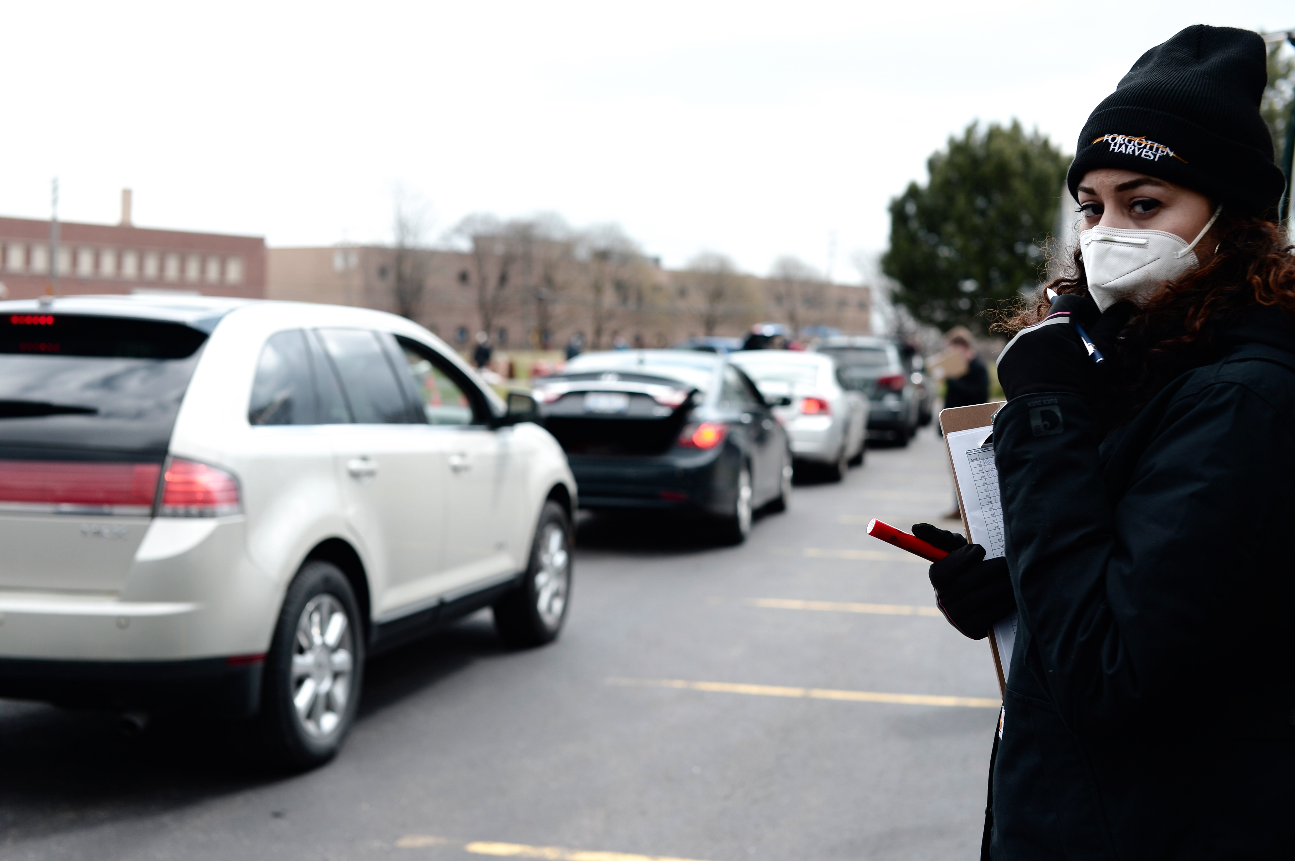
2
Our Response

Slide 11
Notes:
We are a statewide network of 7 member food banks and 800 partner agencies such as food pantries, soup kitchens, and shelters.

Slide 12
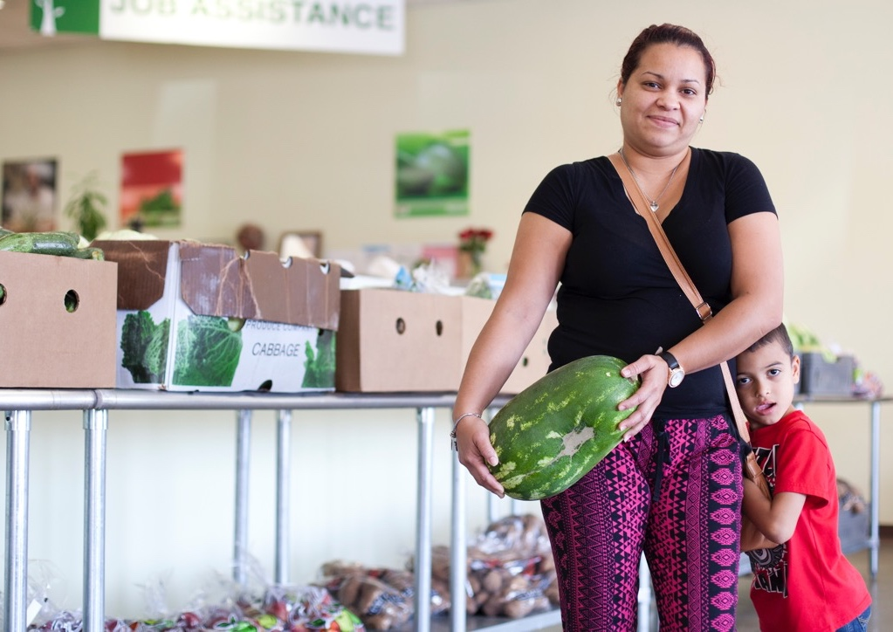
50,000
KENTUCKIANS
SERVED EACH WEEK

Slide 13
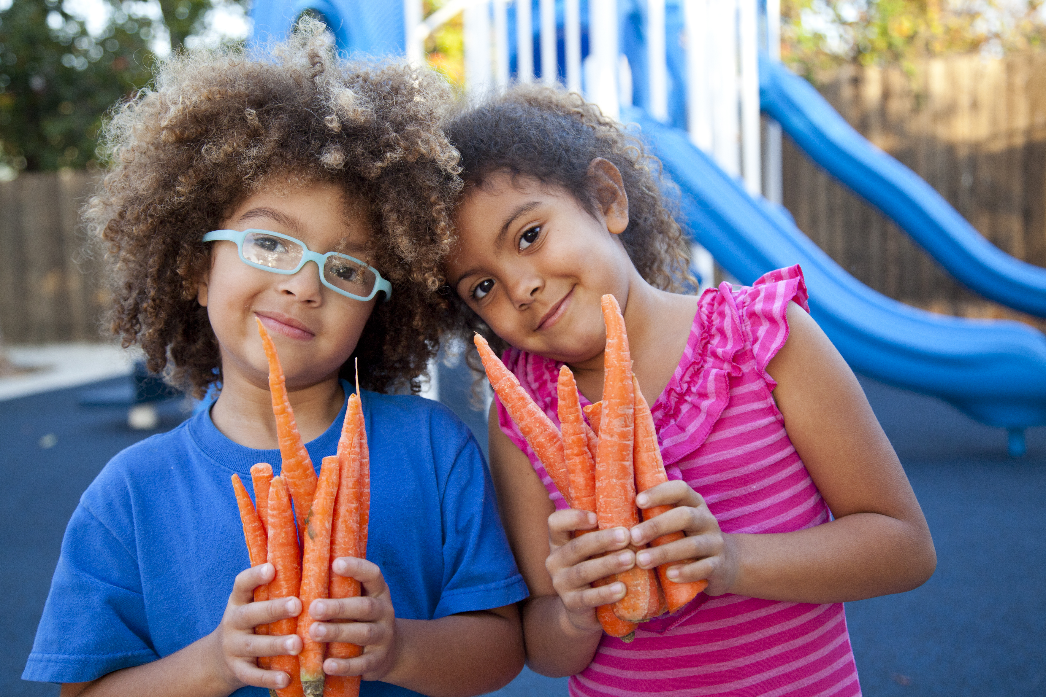
79 million
meals served to Kentuckians in need
Notes:
In Fiscal Year 2020

Slide 14
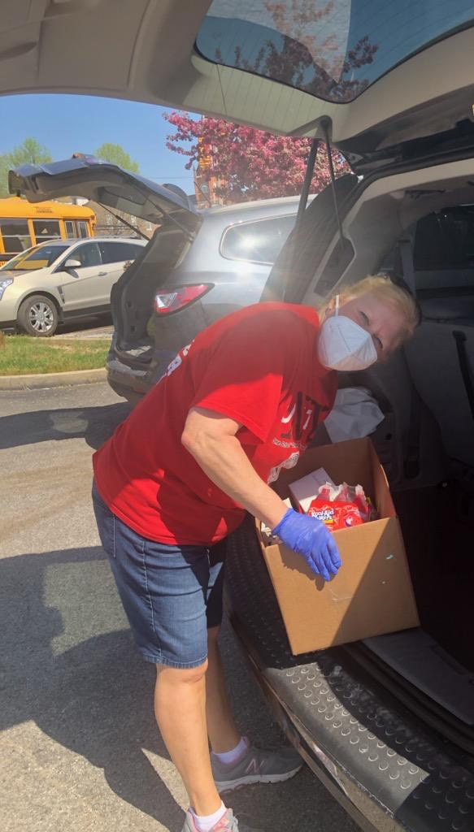
Our Needs
Brick and mortar infrastructure
Cold storage
Continued flexibility in school and federal nutrition programs
Notes:
Regional distribution hubs, increased cold storage, grants for pantries
Maintain COVID-19 flexibilities; more children and adults have been served by federal nutrition programs through COVID-19
For every 1 meal we serve, SNAP serves 9!!!!! SNAP is the backbone of the emergency food network

Slide 15
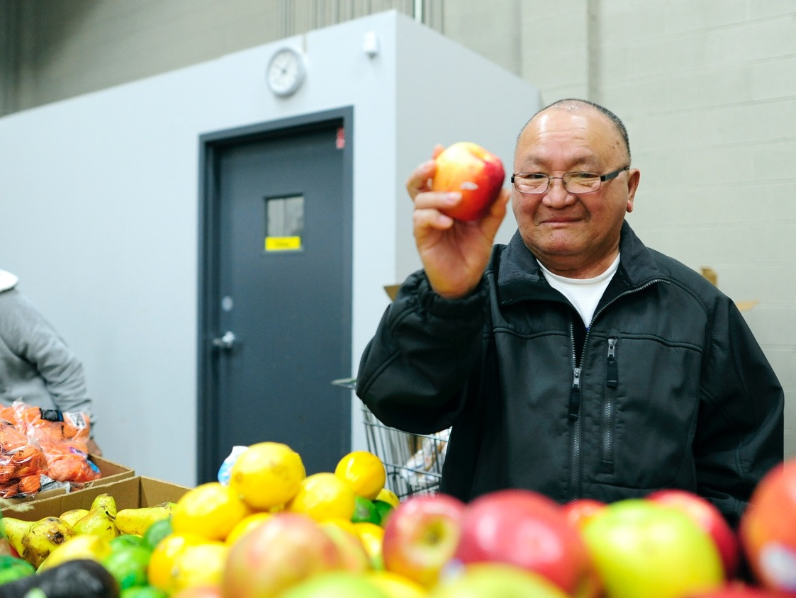
3
Farms to Food Banks

Slide 16
Farms to Food Banks
Agricultural products from farmers needing a market

Slide 17
Farms to Food Banks
…to Kentuckians in need.

Slide 18
Goals
Increase Access
Support Farmers
Reduce Waste
Notes:
The three main goals of the Farms to Food Banks program are to:
1) Increase access to healthy food among our struggling neighbors.
2) Pay fair prices that help farmers recoup losses.
3) Reduce the amount of wasted food.

Slide 19
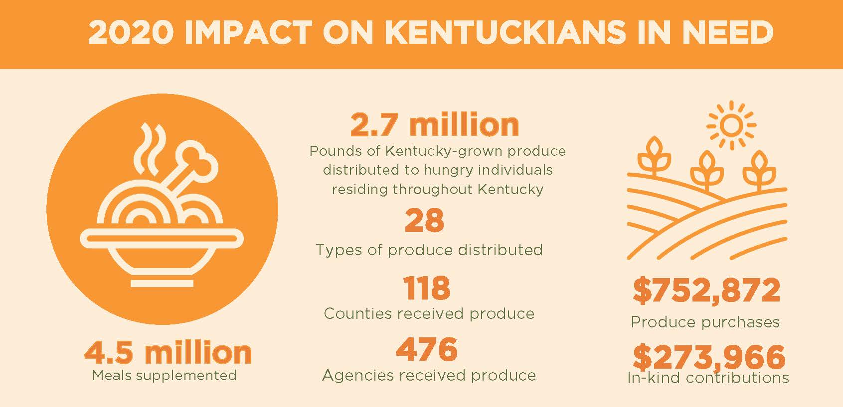

Slide 21
Impact since 2011
21M pounds rescued
35 million meals
1,000 KY farmers
$4.2M paid to farmers

Slide 22
Good for the Economy
$4,700,000 total additional annual economic benefit for the Commonwealth.
$8,900,000 return on investment.
Notes:
From $4.2M investment in Farmers
$2,625,268 in additional dollars generated as a result of interactions between fruit producers, suppliers and household spending.
$2,032,465 in additional income generated within the local economy as a result of new income generated for vegetable producers.
Assuming half the funding is spent on fruit and the other half on vegetables.
Output multiplier: additional dollars generated as result of interactions between fruit producers, suppliers and household spending.
Income multiplier: additional income generated within local economy as a result of new income generated for vegetable producers.
Source: Alison Davis, UK. The Importance of Agriculture for Kentucky 2007.

Slide 23
Supporters
Notes:
Taxpayers
Individual donors

Slide 24
4
Kentucky Kids Eat

Slide 25
Kentucky Kids Eat
End childhood hunger in Kentucky by connecting kids to healthy food 365 days a year.
The No Kid Hungry Kentucky campaign, a partnership between Share Our Strength and Feeding Kentucky, is the key strategy to ensuring kids get the food they need by increasing access to school breakfast and lunch, summer meals, and afterschool meals.
Training
Resources
Advocacy
Notes:
A statewide network of nonprofits, school systems, policy makers, business leaders, and community members creating innovative hunger solutions.
Kentucky had the 3rd largest increase in children served summer meals and moved in the national rankings on the indicator from 49th lowest to 47th.
Only 1 in 11 KY kids who need summer meals access them.
When school lets out, millions of low-income children lose access to the school meals and healthy afterschool snacks they receive during the regular school year. The Summer Nutrition Programs help fill this gap by providing free meals and snacks that meet federal nutrition standards to children who might otherwise go hungry.

Slide 26
COVID-19 Response
68 No Kid Hungry grants to schools and community organizations to support meal programs.
$1.1 million in grant funds distributed since March 2020.
Alternative meal model training, toolkits, technical assistance for schools.

Slide 27
Katrina Thompson
Executive Director
katrina@feedingky.org
Sarah Vaughn
Programs Director
sarah@feedingky.org

