Slide 1
Tobacco Settlement Oversight
Paulette Akers, Director
Kentucky Division of Conservation
August 2021

Slide 2
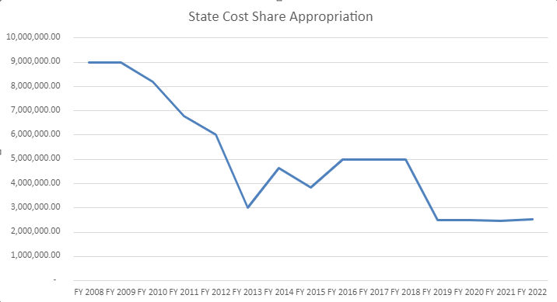
FY21 Tobacco Settlement Allocation
State Cost Share $2,479,500
Direct Aid $907,300

Slide 3
Direct Aid to Conservation Districts
Notes:
Pays for audits required by 65A and then distributed on a sliding scale based on balance on hand, if they are on millage tax, number of employees and completion of regulatory requirements.

Slide 4
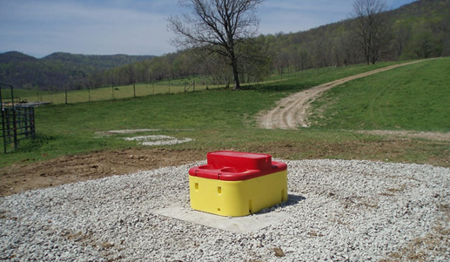
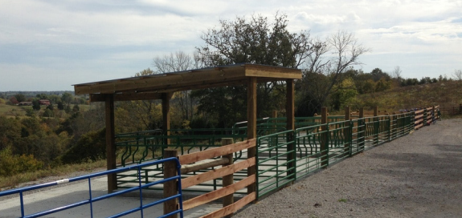
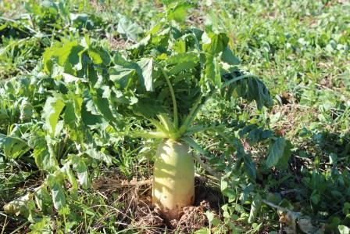
State Cost Share Summary
Originally established in 1994 and funded from General Funds and pesticide Product Registration Fees
Starting in 2000, the program was funded through Tobacco Master Settlement Agreement Funds
Provides financial assistance to farmers at a 75% reimbursement rate for those implementing best management practices on their farms with the assistance of local conservation districts
Notes:
First few slides are going to be based on a summary of all the years and then we will get into this year specifically

Slide 5
FY19 Approved in July 2019
Requests 784 individuals and $5,967,738.50
Approved 722 individuals and $4,523,347.81
At 24 months
18% canceled
67% paid
$220,212.35 still to be paid
Notes:
Many waiting for design plans from technical staff, also paid for more pasture renovation due to the wet winters.
8/4/21- 173 canceled, 482 paid

Slide 6
State Cost Share Projects Money FY 19 Funds

Slide 7
FY20 Approved in January 2020
Requests 864 individuals and $6,741,757.64
Approved 705 individuals and $4,554,818.46
At 17 months
15% canceled
47% paid
$1,783,843.58 still to be paid
Notes:
8/4/21 – 106 canceled, 334 paid

Slide 8
State Cost Share Projects Money FY 20 Funds

Slide 9
FY21 Approved in February 2021
Requests from 1179 individuals and $12,455,872.40
Approved 592 individuals and $5,920,643.90
At 5 months
2% canceled
4% paid
$5,609,772.10 still to be paid
Notes:
8/4/21 – 12 canceled, 23 paid

Slide 10
State Cost Share Projects Money FY 21 Funds

Slide 11
Total Applications Approved

Slide 12
Total Dollars Approved
Notes:
Slightly different since animal waste structures are funded at a higher rate than other practices, so areas of animal ag may receive more money with an equal number of projects.

Slide 13
Account balance
$12,967,056.51 currently in the account
$907,300 obligated Direct Aid to Conservation Districts
$220,212.35 obligated from FY19
$1,783,843.58 obligated from FY20
$5,609,772.10 obligated from FY21
$7,500 obligated RCPP Mud and Manure project
$342,340 required contingency fund set aside
$4,096,088.48 available for award January 2022
Notes:
Direct Aid to Conservation Districts - $907,300 obligated goes to districts and pay for audits. $2,516,100 in cost share this year

Slide 14
Demonstration of Need
Calendar year 2020
Requests from 864 individuals and $6,741,757.64
Approved 705 individuals and $4,554,818.46
Calendar year 2021
Requests from 1179 individuals and $12,455,872.40
Approved 592 individuals and $5,920,643.90
Currently unobligated $4,096,088.48
Cut off for FY22 funding is November 15, 2021
Notes:
Check unobligated number with cancelations
Updated 11/2/20

Slide 15
Contact Information
Paulette.Akers@ky.gov
502-782-6300
Kentucky Division of Conservation
300 Sower Blvd, 2nd floor

Slide 16
Notes:
More than $165 million dollars have been approved for use by Kentucky farmers in the past 26 years. It is larger than the total appropriations over that time because it is hard to give out money.
The appropriations from the Tobacco Settlement were larger in FY20 and FY21, but included funds for Direct Aid to Conservation Districts and the amount going to Cost share was about $2.5 each of those years.
Updated 10/13/20

Slide 17
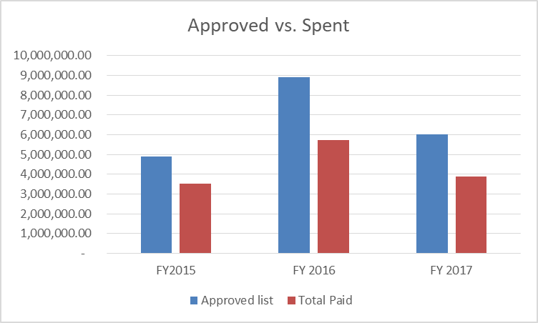
Why is it hard to give out money?
FY15 cost share
16% canceled
11% overestimated
$4,885,627 approved and $3,526,410 paid out
FY16 cost share
13% canceled
23% overestimated
$8,904,428 approved and $5,733,397 paid out
FY17 cost share
23% canceled
25% overestimated
$6,006,932 approved and $3,870,289 paid out
Notes:
Updated through 10/31/20

Slide 18
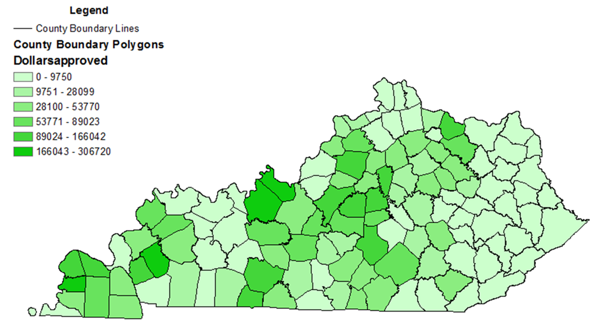
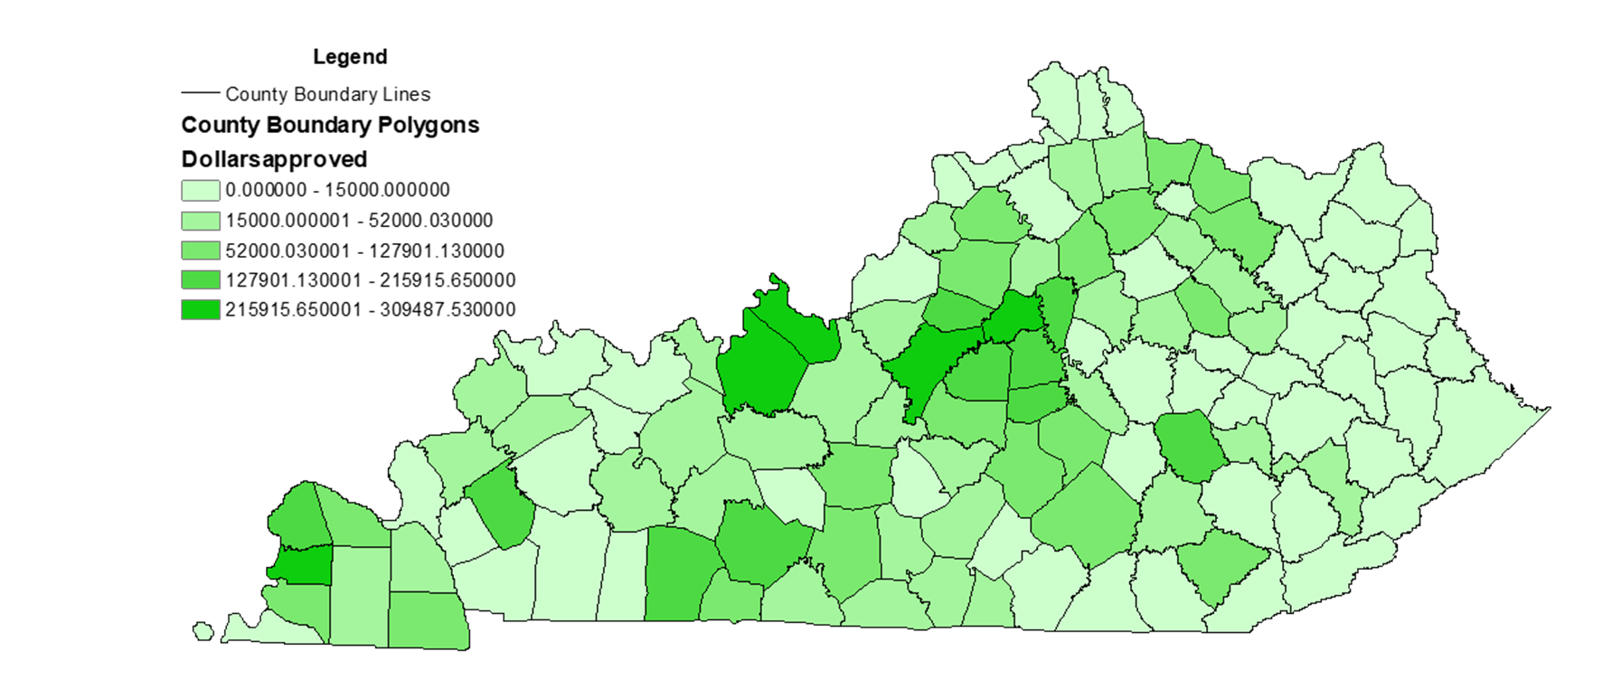
FY19
FY20
FY21

