Slide 1

Suicide Prevention Project
Where we were, where we are, and where we are going

Slide 2



Slide 3


Campaign Name: Raising Hope – Supporting Healthy Lives on Kentucky Farms
Mission statement: Promote the physical/mental health and safety of Kentucky's (KY’s) farmers and farm families through translational research, prevention/intervention, and community education/outreach informed by key stakeholders with the common goal to enhance quality of life for our farmers and farm families.
Goal for current project: Develop community-based programming, education, communication and support systems informed by local voices to support the mental health of our farmers and farm families by focusing on the reduction of stress, depression, and suicide rates among farmers and farm families.

Slide 4






Partnership is Key

Slide 5
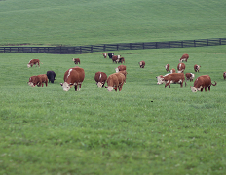
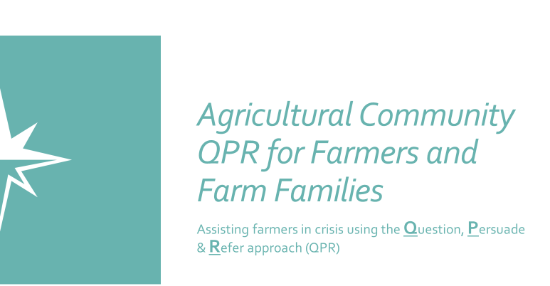
Where it all started… Oct. 14, 2019
Appropriation #1 notification: July 2020
Southeast Ag Center S-FRSAN & Continuing Education Funding provided May 2020 – March 2021:
  17 QPR Trainers Recruited from high farmer contact groups (ministerium, equipment dealers, safety professionals, commodity groups etc).
  27 Training Sessions conducted
  415 QPR Trained Participants
    278 (KY)/137 (Out-of-State)
  Created specialized agricultural training materials for community based QPR.

Slide 6
Kentucky Rural Mental Health and Suicide Prevention Pilot Program
General Fund (Tobacco) appropriation of $500,000 for FY 2020-2021.
Department for Behavioral Health, Developmental and Intellectual Disabilities, Kentucky Department of Agriculture, University of Kentucky Southeast Center for Agricultural Health and Injury Prevention, and others raise awareness of National Suicide Prevention Lifeline (988) in rural communities.
Cultural competency training for staff.
Outreach, treatment, and other necessary services for rural communities.
Partners to apply for federal funds through the Agriculture Improvement Act of 2018, 7 U.S.C. sec. 5936, to supplement the General Fund (Tobacco) appropriation.
CHFS to submit annual report on the pilot on the results of the pilot program.

Slide 7
Develop community-based support systems informed by local voices to address mental illness and suicide among farmers and farm families.
Increase Awareness
Reduce Stigma
Show Farmers Appreciation
Prevention
Intervention
Postvention
Data/Surveillance

Slide 8
County | Farm Rate | Mortality Count | Mortality Rate | Morbidity Count | Morbidity Rate | Number of Indicators
Adair | Cumberland | Hopkins | Morgan
Allen | Edmonson | Jackson | Nelson
Barren | Elliott | Larue | Nicholas
Bath | Fleming | Lewis | Owen
Bourbon | Garrard | Lincoln | Pendleton
Bracken | Graves | Livingston | Robertson
Breckinridge | Grayson | Logan | Rockcastle
Butler | Green | Marion | Russell
Caldwell | Hardin | Mason | Todd
Carlisle | Harrison | McLean | Trimble
Casey | Hart | Menifee | Union
Christian | Henderson | Mercer | Washington
Clinton | Henry | Metcalf | Webster
Crittenden | Hickman | Monroe | Wolfe
3 indicators | 2 indicators

Slide 9
Develop community-based support systems informed by local voices to address
mental illness and suicide among farmers and farm families.
Prevention
Intervention
Postvention
Data/Surveillance
QPR
CRUSH Training
Crisis Call Center
Assessing and Managing Suicide Risk (AMSR) Training
ESSENCE
Mortality and Morbidity
Rural Suicide Prevention Project Visual Identity
Challenge Coins

Slide 10
Center Capacity for Increased Lifeline / 988 Volume
Projected Call Volume Increase - KY
Between July 2022-June 2023 (Year 1), it is projected that KY will receive:
42,600 inbound calls + place 2,100 outbound calls
28,700 chats
1,700 texts

Slide 11

Rural Suicide Prevention Project
Year 2

Slide 12


Develop community-based support systems informed by local voices to address mental illness and suicide among farmers and farm families.
Prevention
Intervention
Postvention
Data/Surveillance
Farmers’ Stories
Web page
Challenge Coins to include youth participation
988 Crisis Call Center
AMSR Training
ESSENCE
Mortality and Morbidity
Progressive Web App
CRUSH Training
QPR
Follow-up with Coin Recipients

Slide 13
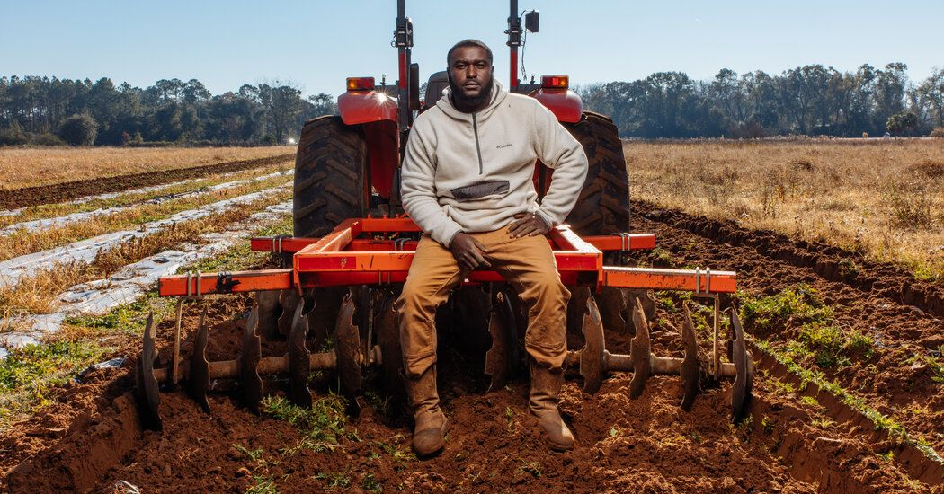
USDA Omnibus grant funding for State Depts. Of Agriculture & Potential Future Funding Opportunities

Slide 14
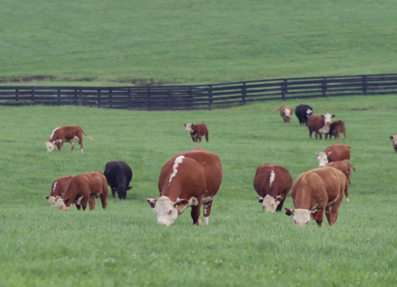
USDA Omnibus grant funding for
State Depts of Agriculture
Public Marketing Campaign
Small Grants for Farmer Appreciation
Peer-to-Peer Mobile Support
External Program Evaluation
Farm Youth/FFA/4H/Young Farmers

Slide 15


Develop community-based support systems informed by local voices to address mental illness and suicide among farmers and farm families.
Prevention
Intervention
Postvention
Data/Surveillance
Visual Marketing Campaign
Web page
Challenge Coins to include youth participation
988 Crisis Call Center
AMSR Training
ESSENCE
Mortality and Morbidity
Progressive Web App
CRUSH Training
QPR
Follow-up with Coin Recipeints
Youth Curriculum
Farmers’
Stories
Continued support and maintenance
External Evaluator
Small Grants for Farmer Appreciation
Mobile App

Slide 16




Partnership is Key

Slide 17


