Slide 1
Department for Community Based Services
FY21 Child Care Allotment: $9,750,000
Dr. Sarah Vanover
Director, DCBS Division of Child Care

Slide 2
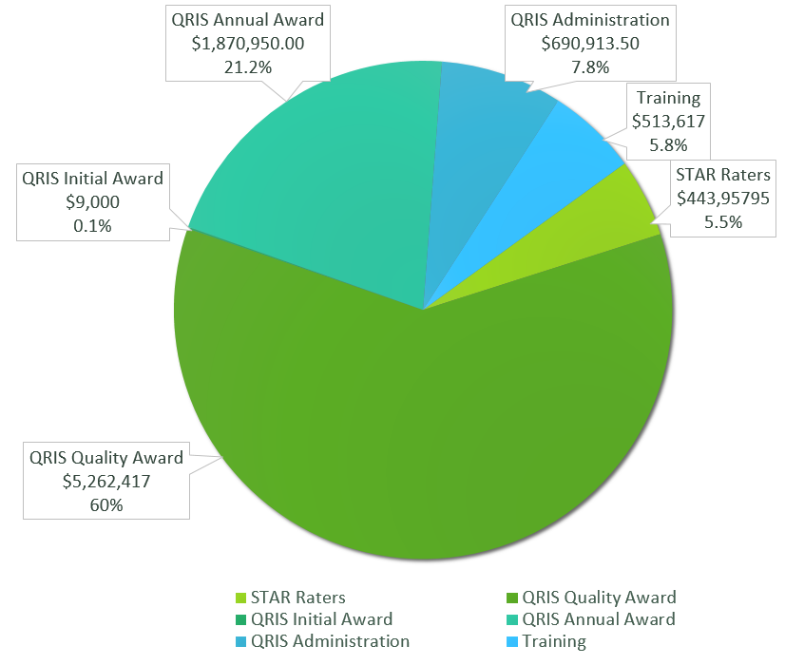
Tobacco Settlement Funds in Community Based Services
Child Care - $9,750,000
Early Childhood Adoption & Foster Care Supports - $2.5M
FY21 Child Care Expenditures
$8,790,855
Atypical expenditures due to COVID-19

Slide 3
The Child Care and Development Fund (CCDF) SFY21 allocation (mandatory & discretionary funds): $149,606,783
This federal grant is designed to promote success for children, employment for parents, and economic security for parents by ensuring stable, high quality child care.
CCDF funds support the following initiatives in Kentucky:
Child care subsidies for 16,359 families and 29,752 children
Monitoring and supports for approximately 2,025 child care centers and family child care homes at any given time
Professional development supports and background checks for 70,367 child care workers since February 2018
Special initiatives for infant and toddler care, disaster preparedness training and response, and consumer education
Tobacco dollars serve as the entirety of the required matching funds for CCDF

Slide 4
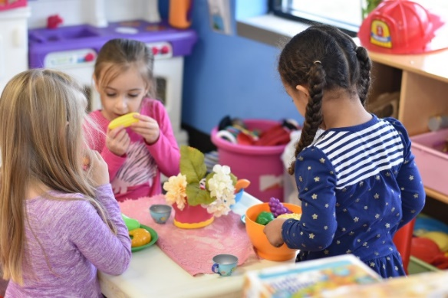
What is Kentucky All STARS?
Kentucky All STARS is Kentucky's five-star quality rating and improvement system for early childhood education programs.
Child care programs participating in Kentucky All STARS demonstrate a commitment to quality by focusing on the following indicators:
Family and community engagement
Classroom and instructional quality
Staff qualifications and professional development
Administrative and leadership practices

Slide 5
Kentucky All STARS Levels by Provider Type
 | Level 1 | Level 2 | Level 3 | Level 4 | Level 5 | Total
CERTIFIED | 144 | 28 | 23 | 21 | 6 | 222
LICENSED TYPE I | 832 | 120 | 321 | 278 | 184 | 1,735
LICENSED TYPE II | 22 | 5 | 4 | 2 | 4 | 37
Total | 998 | 153 | 348 | 301 | 194 | 1,994
Child Care Assistance Program (CCAP) children currently enrolled in high quality (levels 3-5) centers: 9,173

Slide 6
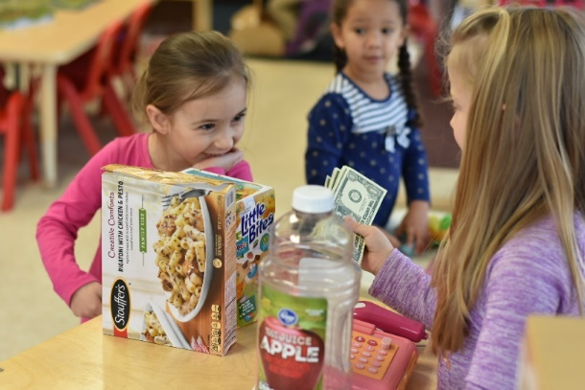
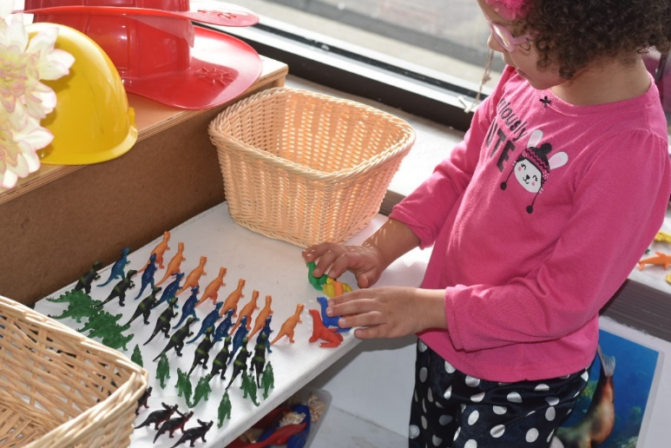
What Does High Quality Look Like?

Slide 7
High Quality Classrooms
Healthy and safe facilities
Low adult to child ratios
Trained and experienced teachers
Parent and family involvement
Planned curriculum and developmental assessments
Language-rich classrooms

Slide 8
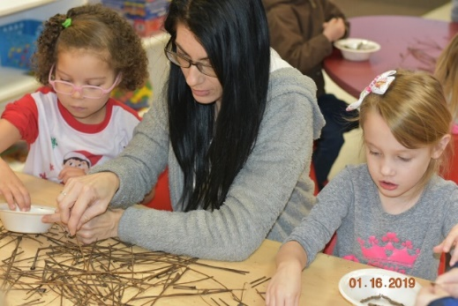
Professional Development Initiatives
In SFY21 tobacco settlement funds helped to support the following:
137 scholarships for Child Development Associates (CDA)
177 scholarships for Commonwealth Child Care Credential
64 mini grants for Child Development Associates
163 Milestone Achievement Awards
121 education reimbursement grants

Slide 9
How Does Kentucky Stand Out?
Comprehensive professional registry
Integrated systems to support quality (specifically public health support during COVID-19)
Family child care network to support home-based child care
Monetary incentives for high quality
Balanced approach to Child Care and Development Fund (CCDF) mandated activities

Slide 10
Department for Public Health
Early Childhood Programs Supported with MSA Funds
FY22
Elizabeth Goode
Division of Prevention and Quality Improvement
Paula Goff
Division of Maternal and Child Health

Slide 11
Dental Fluoride Varnish Provision (Amount of Tobacco Funding: FY22 $1,013,200)
Purpose:
Provides funding for non-Medicaid children health department patients for fluoride varnish.
Provides the kits to health departments for all varnish services.
Supports training by providing teaching materials, technical manuals, and demonstration varnish kits.
Structure:
34 health departments are supported with this funding for unpaid services and kits for all.
The program holds day-long required training for public health nurses.
Funds to the health departments have remained stagnant over the years, but were increased by 50% for FY22 because of evidence of early balance use in recent years.
Experience
In FY 21 (unusual year with LHD COVID response), approximately 8,000 services were provided through this funding.
In FY 21 (unusual year due to meeting limitations), four sessions of training were provided via a $147,000 contract with the University of Kentucky College of Dentistry.
The remainder of this amount was carried over for a future project.

Slide 12
Early Childhood Mental Health (ECMH) (Amount of Tobacco Funding: FY22 $965,000)
Purpose:
To build capacity to meet the mental health needs of young children and their families by partnering with the Departments for Public Health and Behavioral Health, Developmental and Intellectual Disabilities.
Structure:
Funds support Early Childhood Mental Health specialists in fourteen comprehensive community mental health centers (CMHC) and one administrator.
Served 942 children and families in FY21, a decrease of 26% from FY20. Services were provided through telehealth, which is difficult to use with children under the age of five.
Provided 2,982 consultations to child-serving agencies.
Provided training to over 1,600 early care and education staff in Head Start, childcare, and state-funded preschool.

Slide 13
Healthy Start (Child Care Health Consultation) (Amount of Tobacco Funding: FY22 $965,000)
Purpose:
To provide technical assistance and training on health, safety, and social-emotional development to licensed and certified child care providers statewide.
Structure:
Funds support ten regional health consultants and two consultant trainers. Regional staff are housed through local health departments with the consultant trainers located at the Technical Assistance Center at the Fayette County Health Department.
CCHC consultants provided training to 1,694 child care providers, an increase of 21% from FY20, impacting over 10,000 children in care.
CCHC consultants fielded numerous calls from child care providers regarding the COVID-19 pandemic and assisted child care providers in remaining an open, safe environment for staff and children.
CCHC consultants also provided 156 trainings to child care providers.

Slide 14
Health Access Nurturing Development Services (HANDS) (Amount of Tobacco Funding: FY22 $7,000,000)
Purpose:
Voluntary weekly home visiting program designed to assist overburdened parents/caregivers during the prenatal period until the child’s third birthday. Goals include improving health and social outcomes for both mother and child.
Structure:
HANDS is administered through local health departments and one contract (Jefferson County).
In FY21, 3,221 families were served through support of tobacco settlement funds primarily through telehealth. This is a decrease of 22% from FY20.
FY21 indicates a decrease in services from FY20 due to impact of pandemic. Referrals to HANDS were low most likely due to parents not frequenting primary referral sources such as physicians, health departments, and other community services. Telehealth was beneficial, but had limitations in certain populations.
All Tobacco MSA-funded program services are increasing as we move out of the pandemic. Due to the pandemic, there is a bigger need for mental health supports.

Slide 15
Questions?
For questions or information related to this presentation, please contact: Kelli Rodman (kelli.rodman@ky.gov) Office of Legislative and Regulatory Affairs Executive Director (502) 564-7042

