Slide 1
Tobacco MSA Oversight Committee
November 10, 2021
Amy Neal
Executive Director, Kentucky Governor’s Office of Early Childhood
amy.neal@ky.gov

Slide 3
Early Childhood Distribution of Master Tobacco Settlement Funds for FY22
Division of Early Childhood Development (GOEC) $1,400,000
Early Child Care Development Program $9,750,000
Early Childhood Adoption & Foster Care Supports $2,561,000
Healthy Start Program
$965,000
HANDS
Program
$7,000,000
Total FY22 Tobacco Funds $25,604,700
Early Childhood Mental Health $965,000
Early Childhood Oral Health $1,013,200
Substance Abuse Treatment Program $1,450,500
KY Rural Mental Health & Suicide Prevention Pilot
$500,000

Slide 4
Kentucky’s Long History of Leading the Way

Slide 5
Original Goals of the Kentucky Governor’s Office of Early Childhood
Promote Greater Collaboration
Emphasize Quality and Continuous Improvement
Ensure More Children Enter Kindergarten Prepared

Slide 6
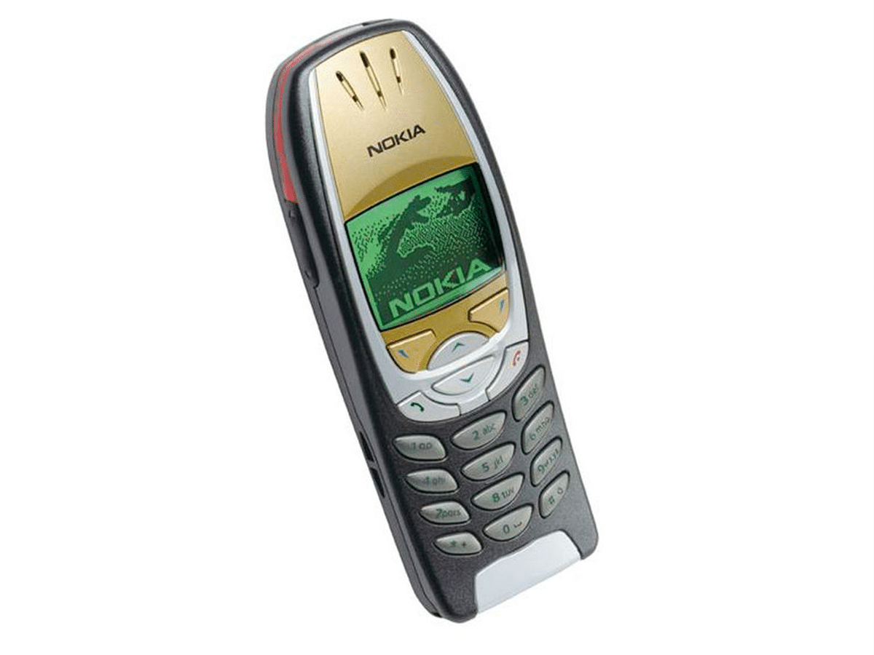
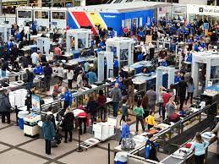
Innovation to Stay Competitive

Slide 7
The Best Place to Start and Raise a Family

Slide 8
Kentucky’s Outcomes for Young Children
We have significant improvements and opportunities to make in ensuring equitable access and opportunities for our children in the first 5 years of their lives.
Infant Mortality
According to Zero to Three’s State of Babies 2020 report, Kentucky’s infant mortality rate was 6.5 . While this represents a decline from the 2019 rate of 6.7, it still is higher than the national rate of 5.8. There are disparities in infant mortality when examined by demographic group: mortality among White babies was 6.4, while mortality in African American babies was 10.4 . According to United Health Foundation’s 2020 America’s Health Rankings (AHR) Health of Women and Children (HWC) report, Kentucky ranked 37th in the nation on infant mortality.
Late or No Pre-Natal Care
State of Babies 2020 report indicated that 5.7% of pregnant women received late or no prenatal care, which was below the national average of 6.2%. However, these overall findings again hide racial disparities in access to and use of care: 5% of White women received late or no care, compared to 8.3 African American women and 11% of Hispanic women.
Overall Health of Women and Children
The report ranked Kentucky 46th for overall health of women and 41st for overall health of children.

Slide 9
Kentucky’s Outcomes for Young Children
Pre-Term Births State of Babies 2020 indicated that 11.3% of births in Kentucky were pre-term (compared to 10% nationally) and there was a higher incidence in African American women (14.2%) compared to Whites (11.2%) and Hispanics (9.4%). (These and other factors may contribute to the incidence of low birthweight in Kentucky.)
Low-Birth Weight
State of Babies 2020 reported that 8.9% of babies were born with low birth weight, compared to 8.3% nationally—but again, this overall percentage masks racial and ethnic disparities. Among Whites, 8.3% of babies were low birthweight, compared to 14.5% African American and 7.2% Hispanic.
Maltreatment Rate
The stresses of poverty and lack of understanding of developmental milestones may affect family patterns of care . Kentucky’s infant and toddler maltreatment rate was 38.2, more than twice the national average of 15.9 (State of Babies, 2020).
Adverse Childhood Experiences
14.6% of children had two or more adverse childhood experiences (ACES), compared to 8.6% nationally (and children who are low-income have a higher likelihood of ACES; State of Babies, 2020).

Slide 10
Kentucky Continues to Lead the Way!
Nearly $6 million in additional funds from the annual Tobacco Master Settlement Agreement
Invest in “best practices” solutions through local innovation and decision-making
Address the most underserved communities
Plan for sustainability and matching dollars from key stakeholders
Work collectively to organize and focus community assets on critical outcomes and longer-term Regional Collaborative plans
Pivot investments from one-day activities to those that support long-term behavior change

Slide 11
Unifying the System to Create a Larger and Sustainable Impact
Public Pre-School
Head Start
Department for Public Health
Division of Child Care

