Slide 1



Tobacco Settlement
Fund Update
B. Mark Evers, MD
December 9, 2021

Slide 2

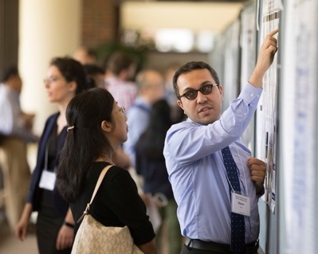
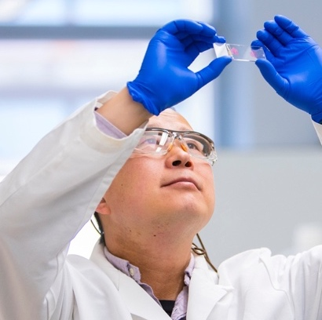

Our Mission
To reduce the cancer burden
with a focus on Kentucky
and its most vulnerable
populations through research,
prevention, treatment,
education and community
engagement.

Slide 3
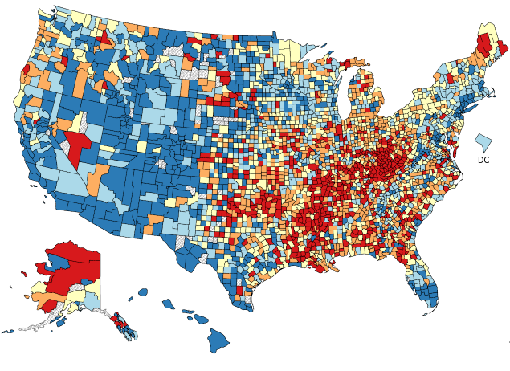
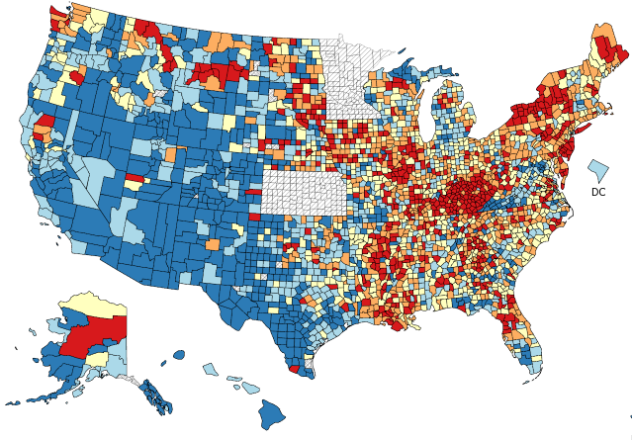


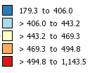

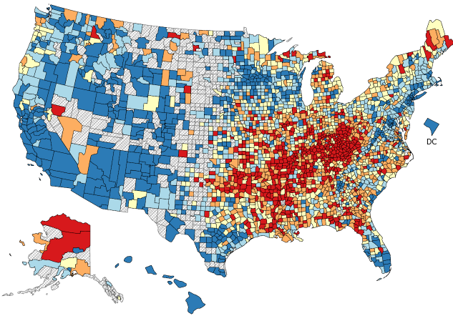
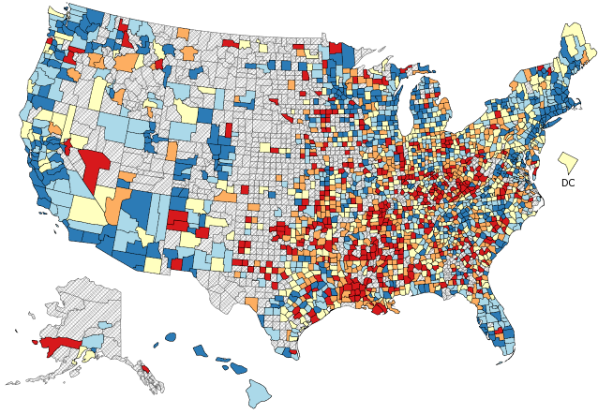




Kentucky’s Cancer Burden
All Cancer Mortality
All Cancer Incidence
#1
#1
Mortality rate, 2014 -2018
Incidence rate, 2013 -2017
Lung Cancer Mortality
Colorectal Cancer Mortality
#1
#5
Mortality rate,
2014-2018
Mortality rate, 2014 -2018
Source: Healthy People, CDC 2020
Notes:
Kentucky’s cancer burden has recently been highlighted in several national reports:
[ANIMATE] 6 of the 10 U.S. counties with the highest cancer death rates are in Kentucky
[ANIMATE] We have very high colorectal and lung cancer mortality rates
[ANIMATE] And we have the highest incidence of HPV-related cancers among men and women in the U.S.

Slide 4

Burden of Cancer in Kentucky
CANCER TYPES
Kentucky is a top 5 state in incidence or mortality
Lung
Colorectal
Head & Neck
Cervical
Melanoma
RISK FACTORS
Kentucky-focused exposures and other risk factors
Tobacco
Obesity
Environmental exposures
Viral infections (HPV, HCV)
HEALTH EQUITY
Disparities in cancer burden
Geographic disparities
Racial / ethnic disparities
Access to screening
Poverty

Slide 5
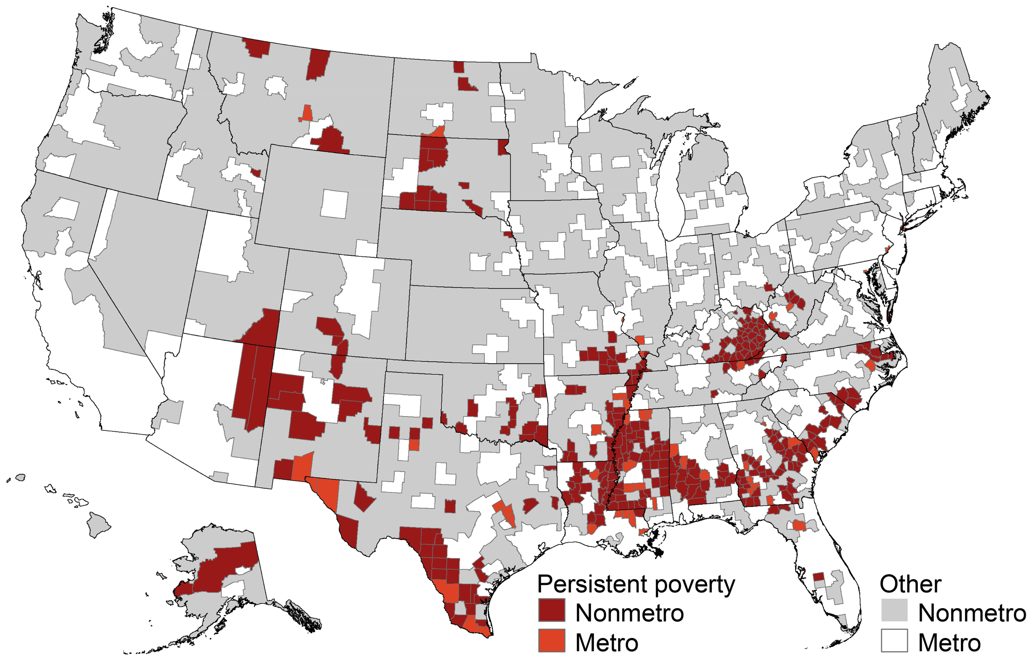
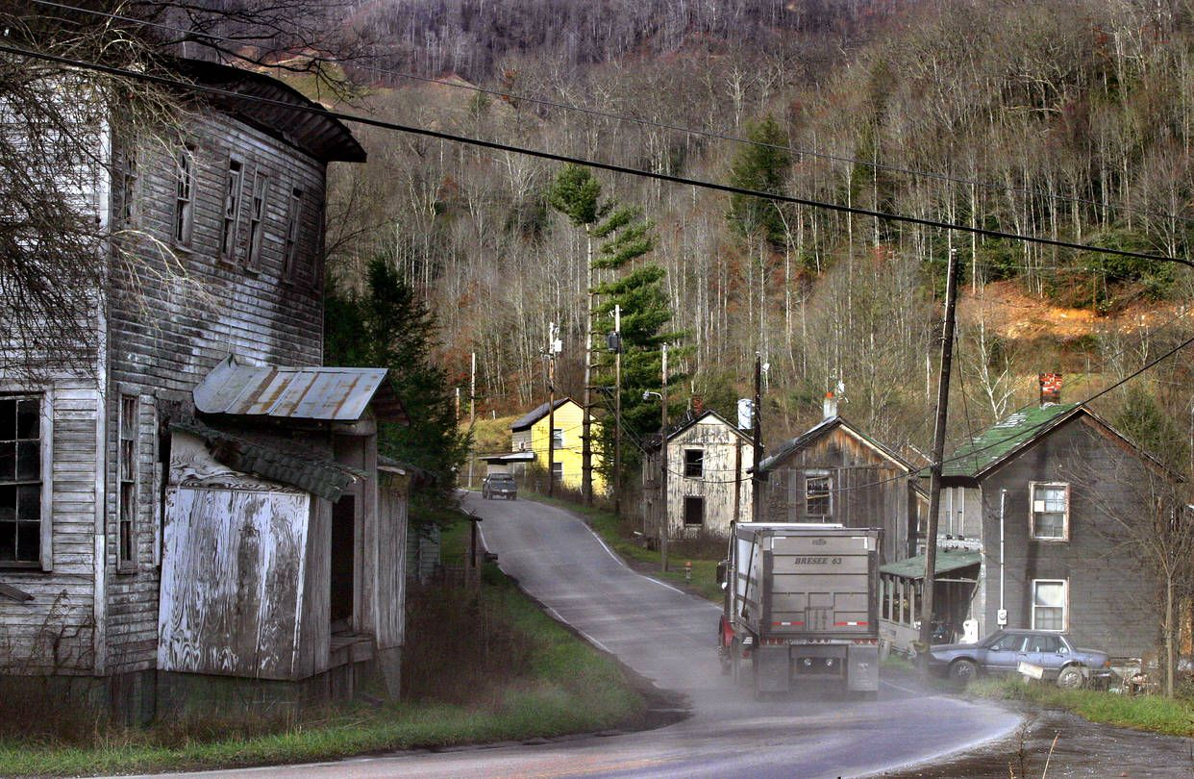
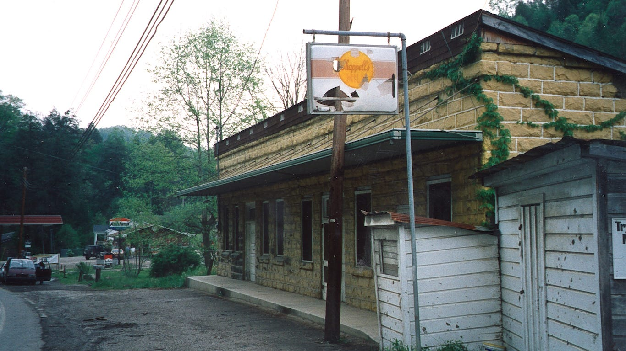
U.S. Counties with Persistent Poverty
40 Kentucky counties have persistent poverty
Source: USDA, Economic Research Service using data from U.S. Census Bureau

Slide 6
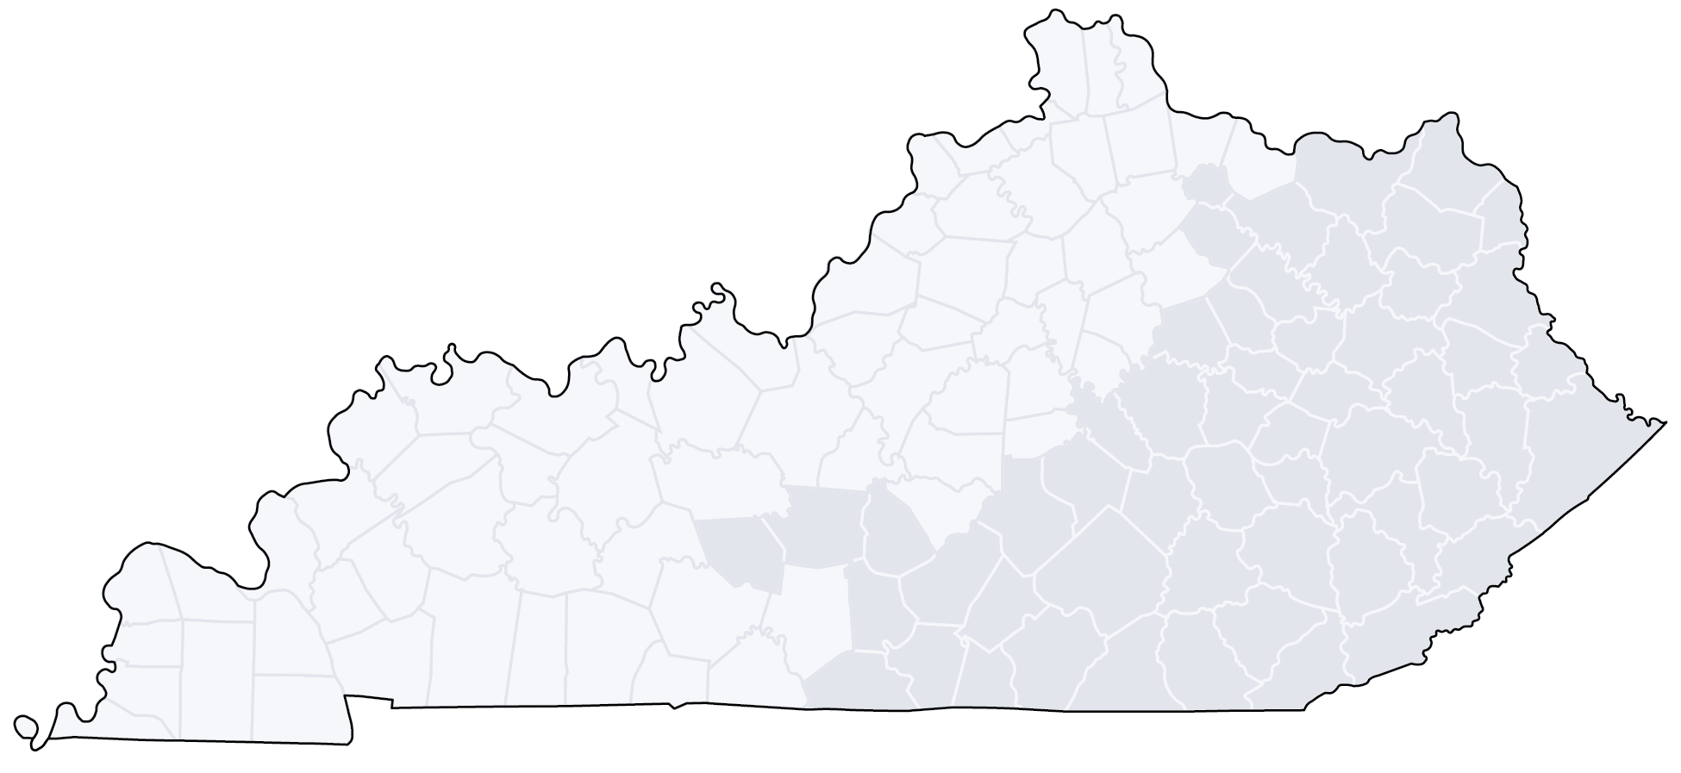
Markey Cancer Center’s Reach
MCC NETWORK SITES
~47% of all new cancer cases in KY (2019) were directly or indirectly cared for by MCC
CANCER CARE
CLINICAL TRIAL ACCRUALS
Patients from 120/120
Kentucky counties
in 2020
Individuals enrolled from 105/120
Kentucky counties
in 2020
Notes:
AS THE ONLY NCI-DESIGNATED CANCER CENTER IN THE STATE, THE MARKEY EMBRACES THE ENTIRE COMMONWEALTH OF KENTUCKY WITH A POPULATION OF OVER 4.4 MILLION AS ITS CATCHMENT AREA. 98% OF OUR PATIENTS ARE KENTUCKY RESIDENTS—91% ARE FROM CENTRAL AND EASTERN KENTUCKY, AND 7% FROM THE REMAINDER OF THE STATE, A FIGURE THAT IS GROWING WITH THE AGGRESSIVE EXPANSION OF OUR MARKEY NETWORK THROUGHOUT THE STATE AND REGION. (CLICK)

Slide 7

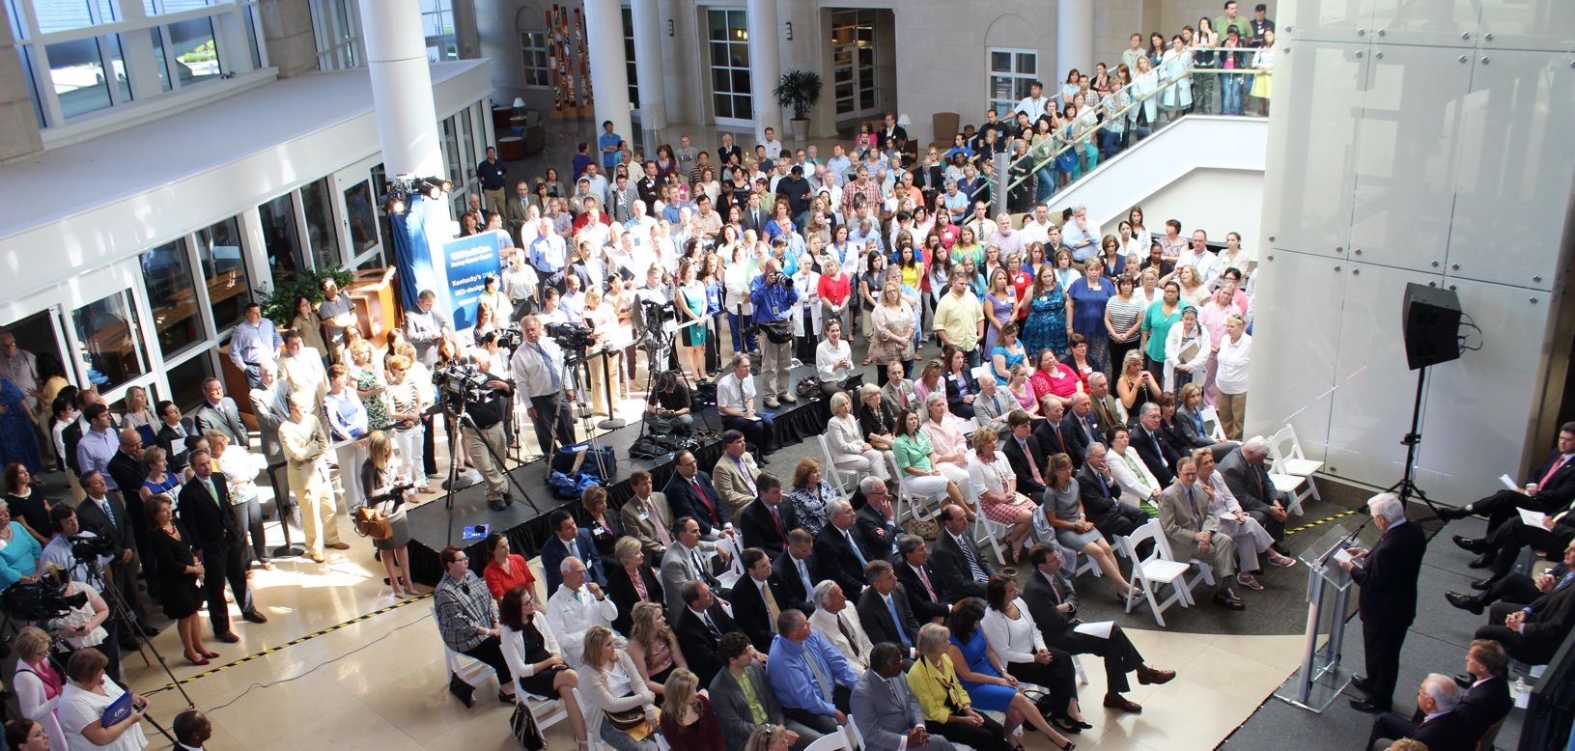
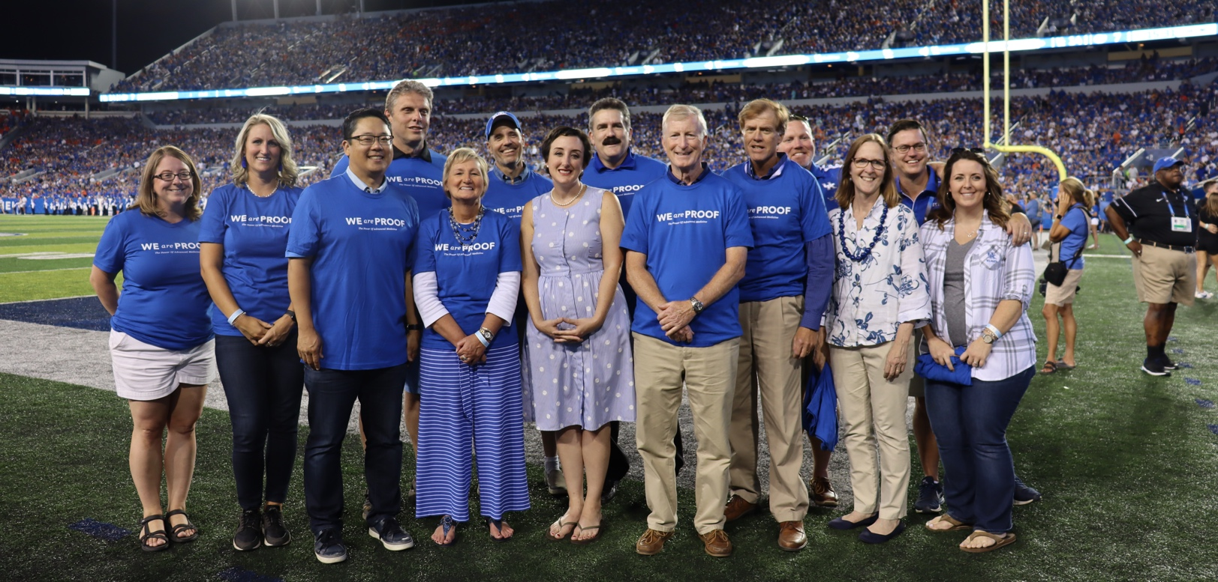
IMPACT OF STATE FUNDING:
Achieving NCI Designation and National Recognition

Slide 8
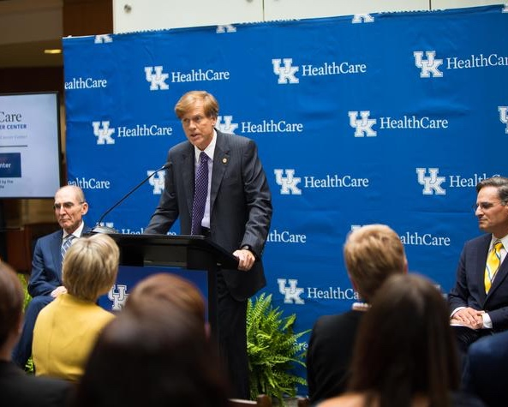
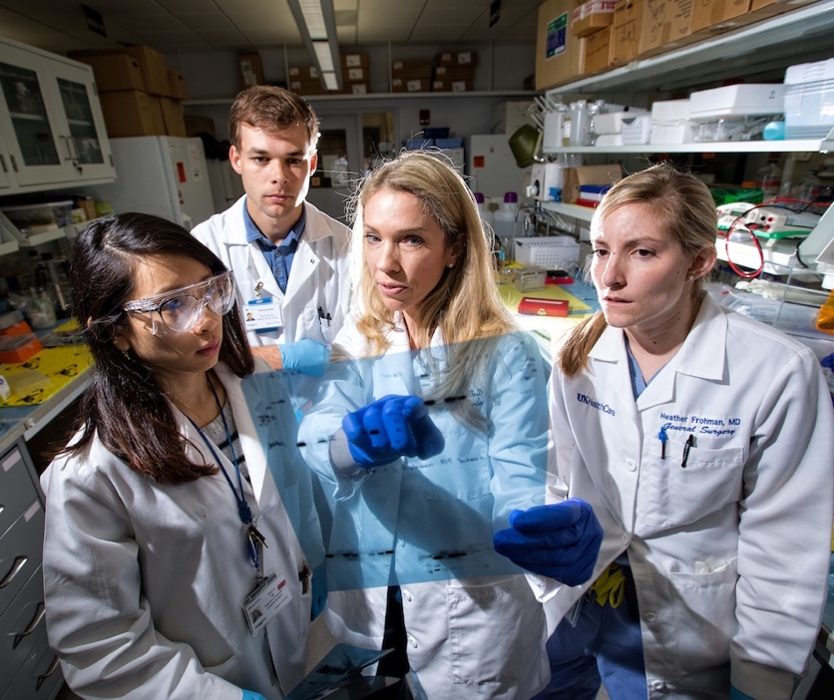
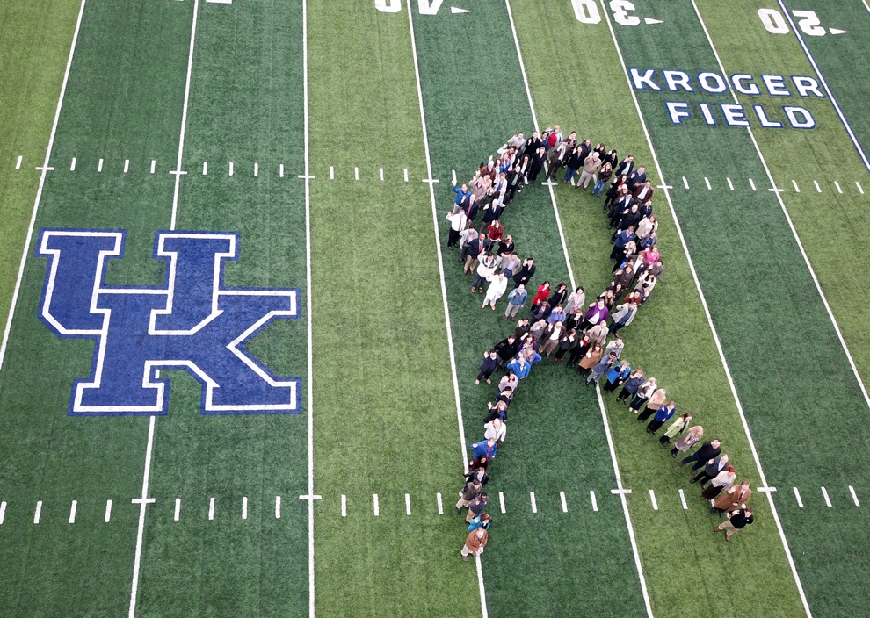
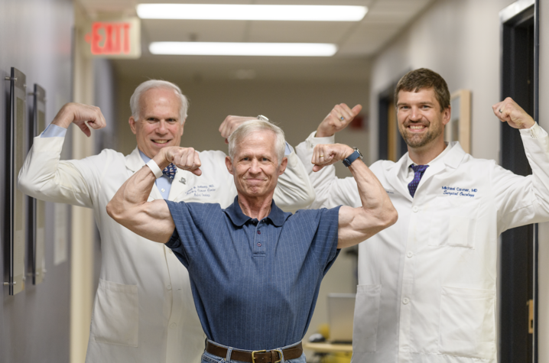
MCC’s NCI Designation Path
Awarded initial designation (5 years) – July 2013
Successful renewal for another 5 years – July 2018
Application for Comprehensive Status – September 2022
*

Slide 9
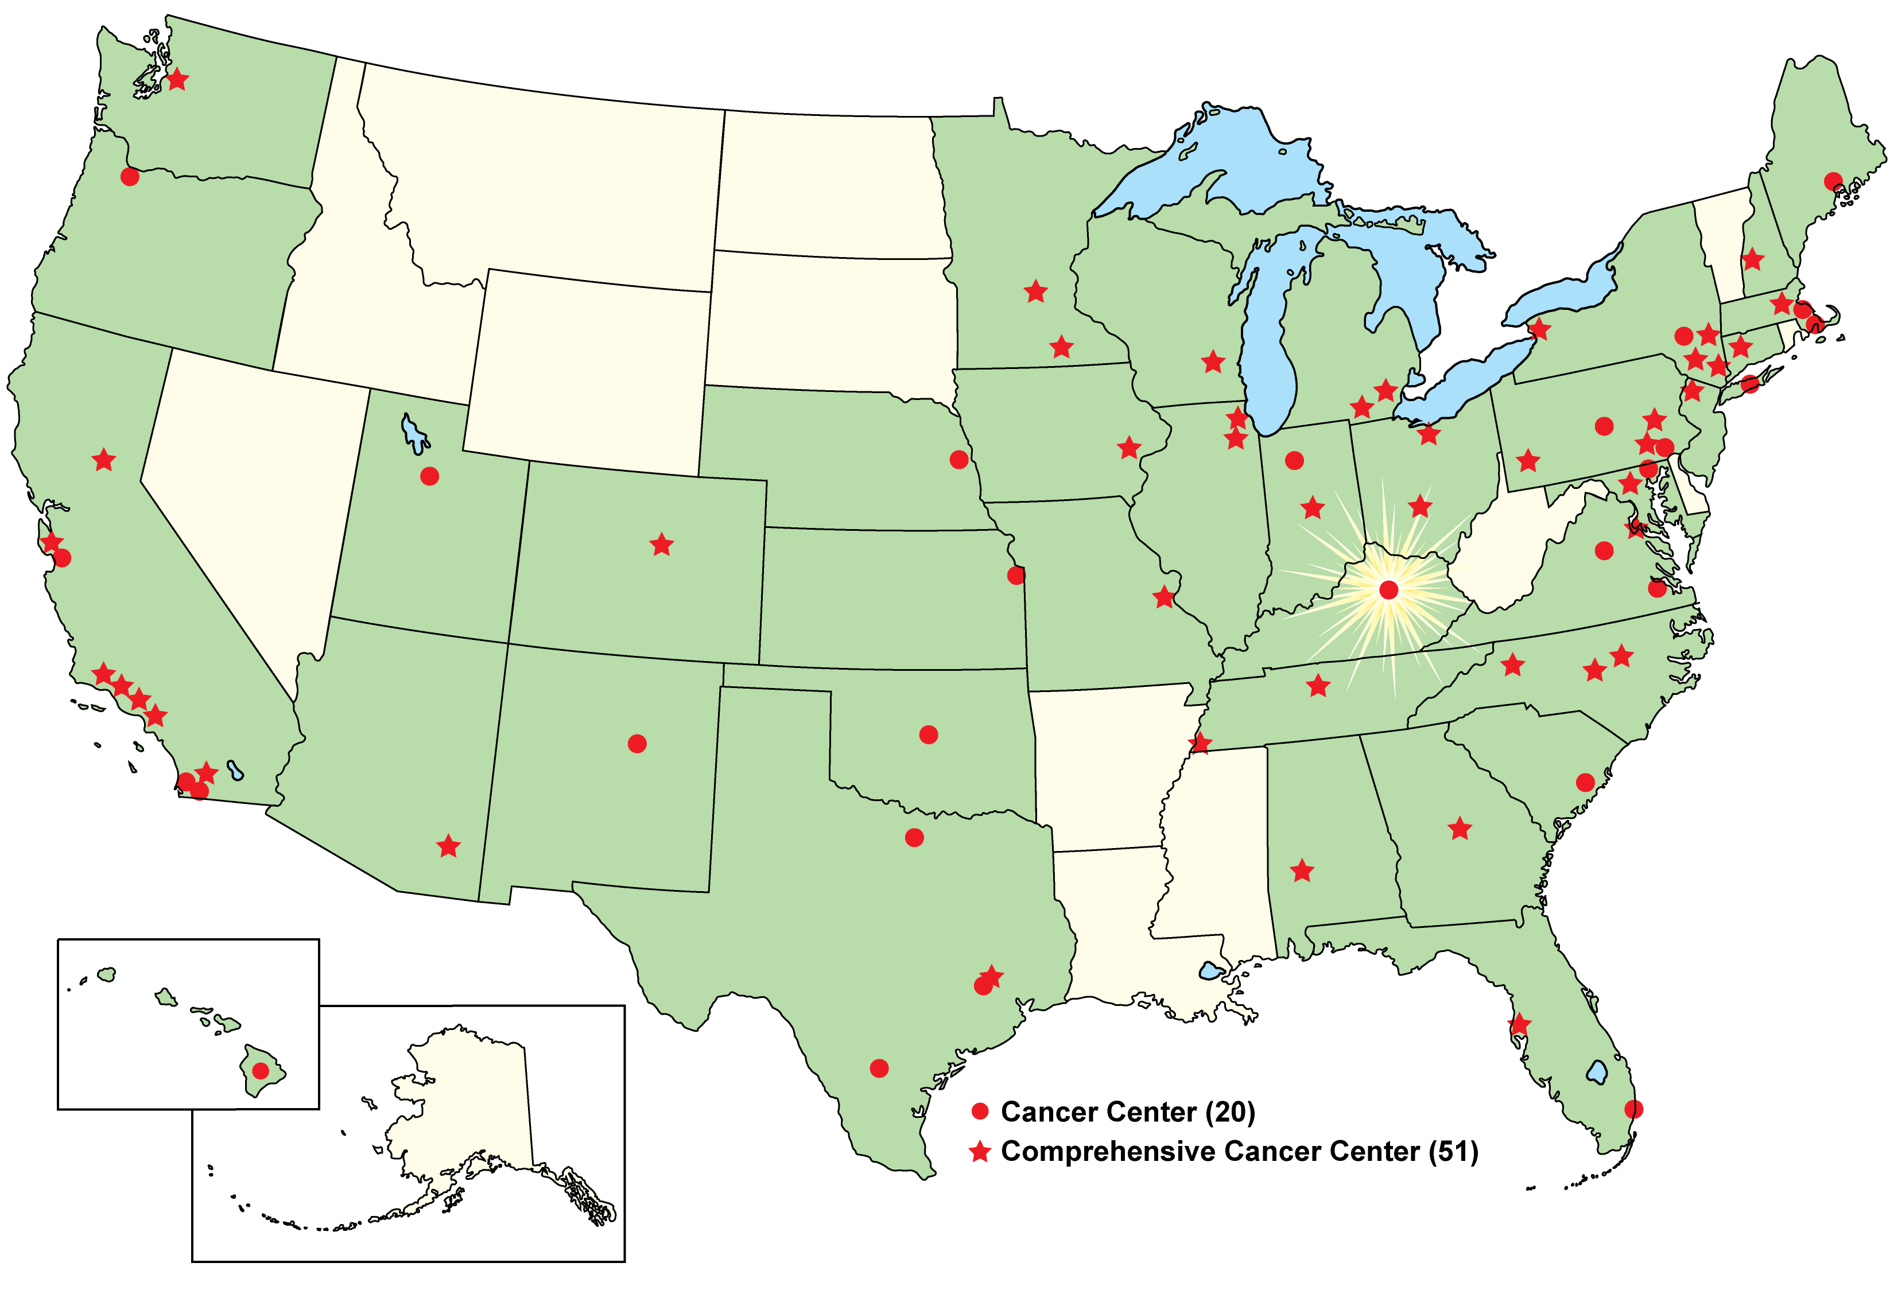
NCI-Designated Cancer Centers
July 12, 2013
Markey Cancer Center became the 68th
NCI-designated cancer center in the U.S.

Slide 10

Other Impacts of NCI Designation
67 new faculty recruits since 2018 NCI re-designation
Accrual of 6,714 subjects to interventional trials since 2018; 57% from Appalachia
Over 14,400 people reached through outreach events or education
42% increase in cancer related funding since 2018

Slide 11
Increased Research Funding
(Compared with 2018)
Total Direct Costs
42%
27%
Dollars (in Millions)
37%
51%
NCI
Other
NIH
Total
Peer-Reviewed
Total
Cancer-Related
*End of June 2021

Slide 12
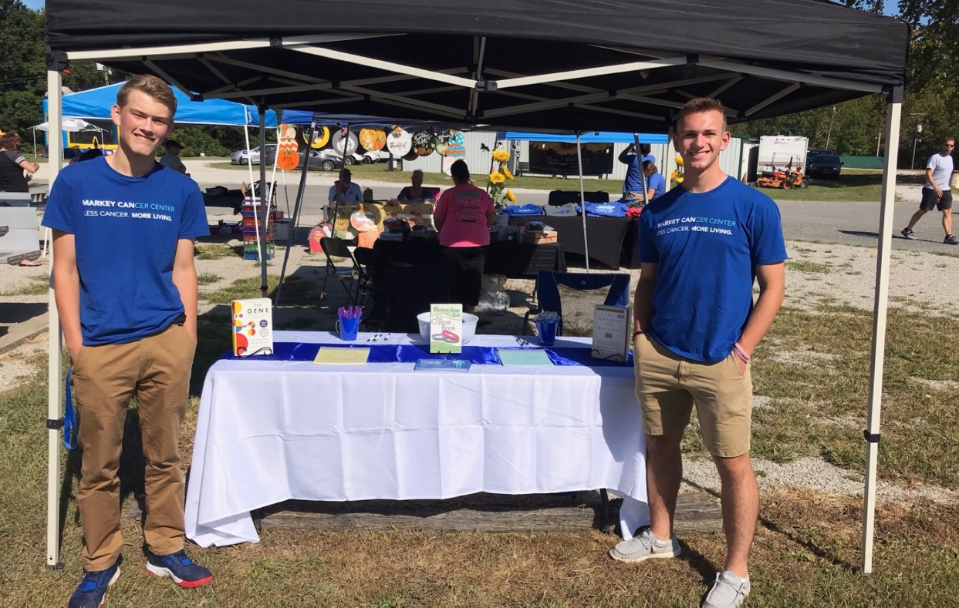
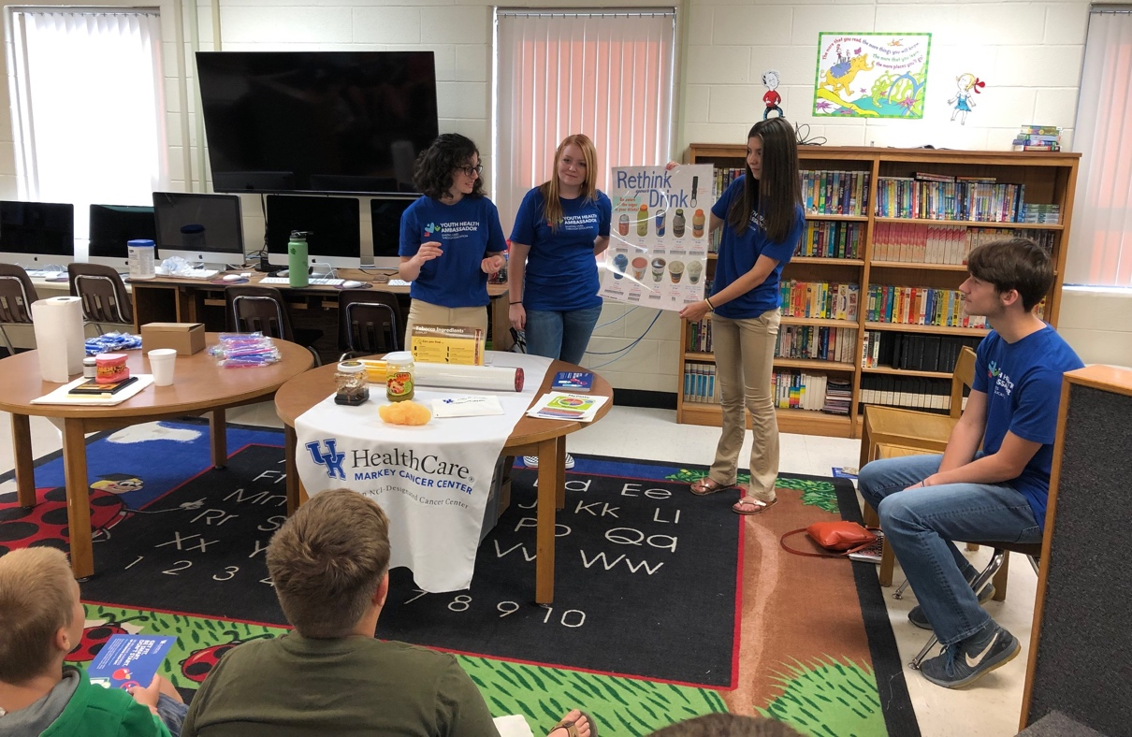
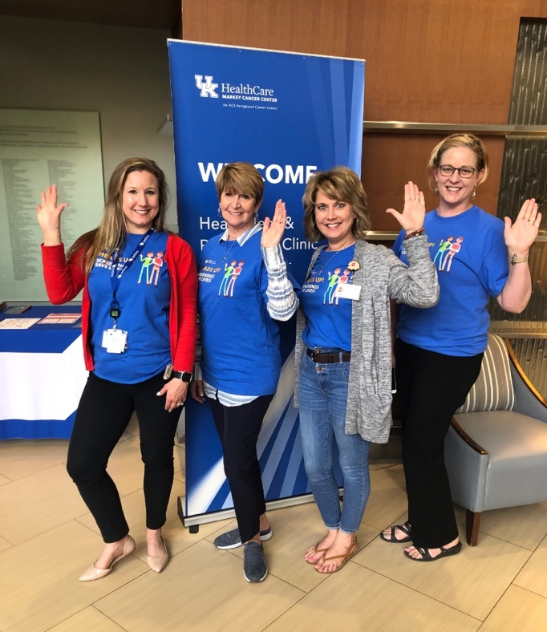
Impact of 2021-2022
state cancer prevention and research funding to MCC

Slide 13
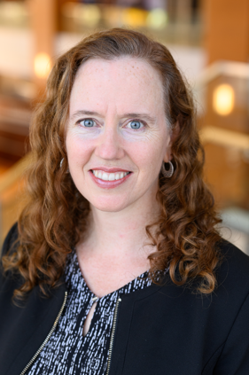
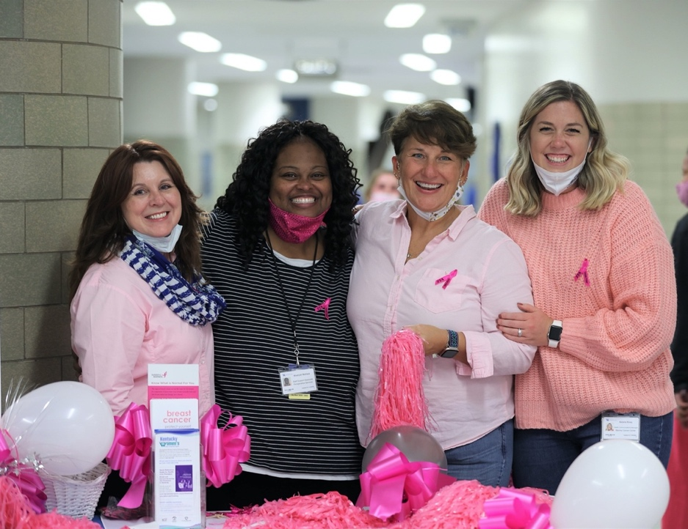
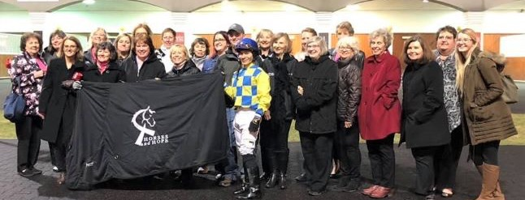
Commitment to Our Community Outreach and Engagement (COE) Efforts
Total investment in COE since 2018 is ~$15.9M
41 total FTEs support COE (18 new since 2018)
New positions in Community Impact Office (CIO) since 2020
  Community Health Worker
  Director of Operations and Evaluation
  Quality Improvement Research Director
  Health Communication Manager
  Data Visualization Manager
  Administrative Assistant
Completely reorganized our Community Advisory Board (CAB)
HULL
TOTAL FTES from org chart in COE slide deck:
KCP East=Currently 12 (1 is new)
KCC = Currently 3 (0 new)
Data = Currently 5 (5 new)
MCCAN = Currently 12 (7 previously per Jen, so 5 are new)
MCCRN = Currently 10 (3 previously per Jen, so 7 are new)
Total is 42 (but two are half time per Danielle, so 41) with 18 new since 2018

Slide 14
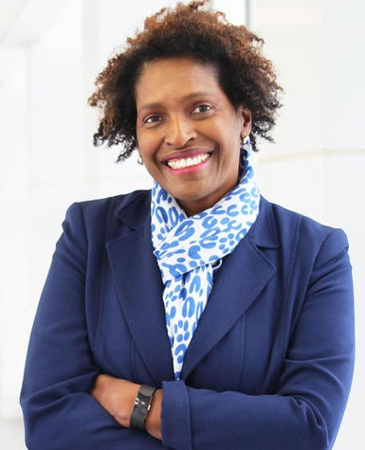
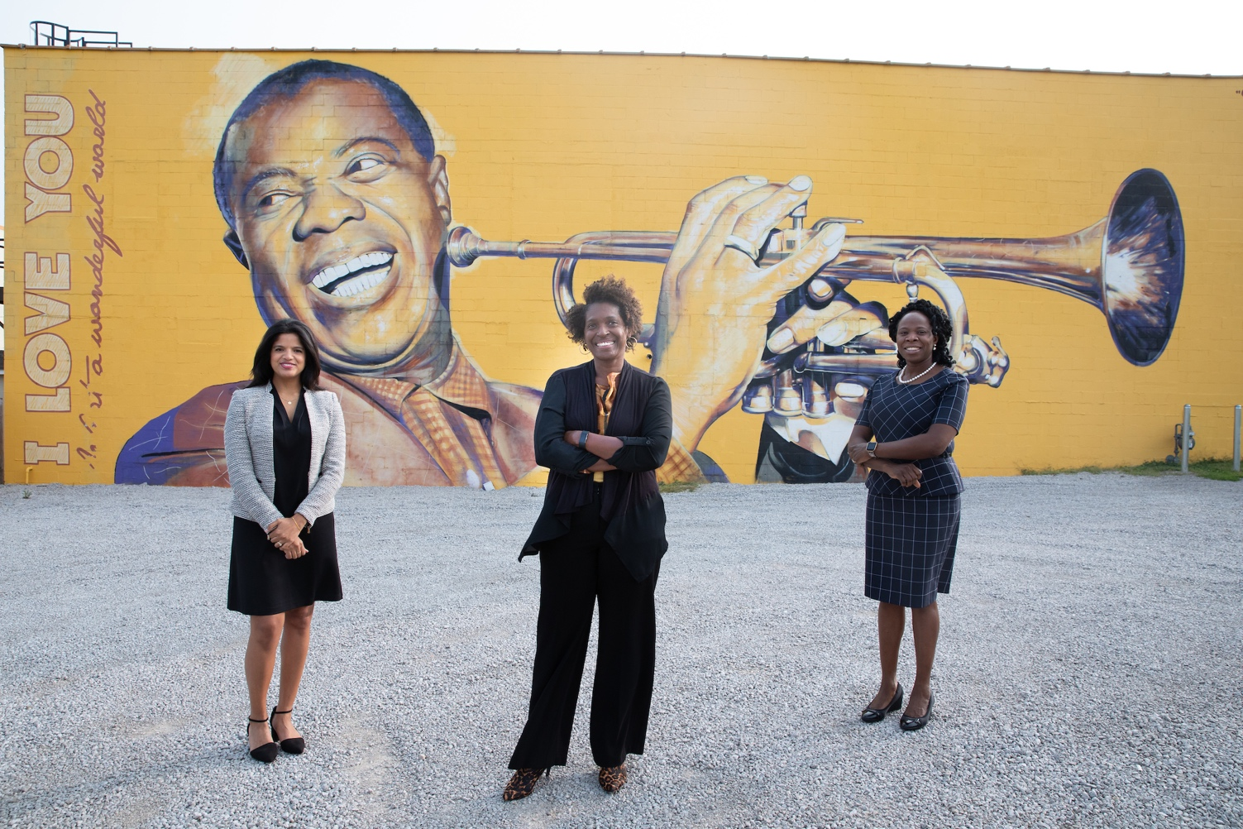

MCC’s Ongoing Efforts for
Diversity, Equity and Inclusion (DEI)
Appointed Dr. Lovoria Williams as Associate Director of Cancer Health Equity
Strong participation by MCC members and staff on UK and College of Medicine DEI work groups
Dedicated listening sessions with MCC trainees
Inclusion of more diverse speakers and topics
for MCC seminar series
More detailed demographic collection
MCC DEI committee started in January 2021
New pipeline programs for minority high school
students, graduate students, and faculty
WILLIAMS

Slide 15
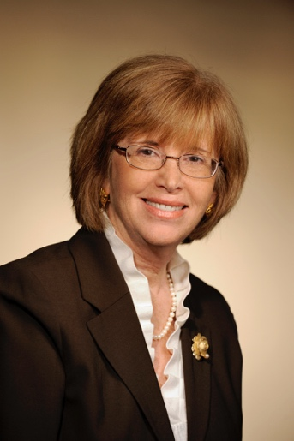
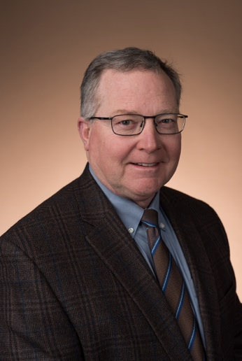


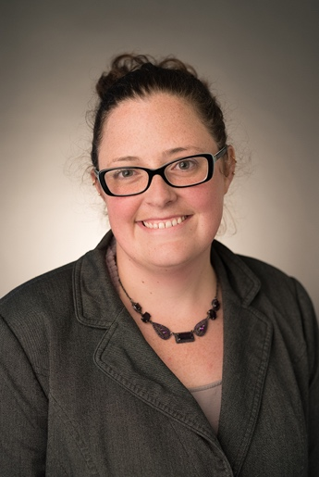
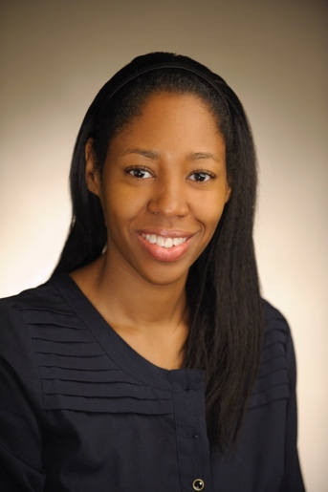
Focus on Lung Cancer Prevention / Screening
Lung Cancer Screening Rate (2020)
20
KY is #2 in the US!
MA
KY
15
HAHN
MULLETT
ND
NH
ME
Proportion eligible adults (aged 55-80) screened for lung cancer
WI
IA
10
VT
SD
US Average
ID
VA
MO
PA
KS
OR
MI
NC
DE
IL
MT
TN
WA
MN
IN
CT
OH
5
GA
AL
NY
MS
AK
MD
RI
CA
WV
ME
HI
NJ
FL
CO
LA
AR
NM
UT
TX
OK
AZ
0
CA
FALLIN-BENNETT
BURRIS
Data from Chest, 2021
“Kentucky, which has supported screening implementation efforts, is unique as its screening rates are over twice the national average and four times that of other high lung cancer burden states, like West Virginia and Arkansas.”
—ASCO post, 2021
FUNDING
R01 ES030380
R37 CA229337
R01 CA254734
Bristol Myers Squibb

Slide 16

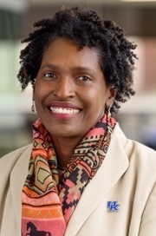

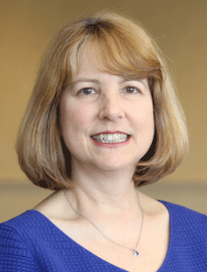

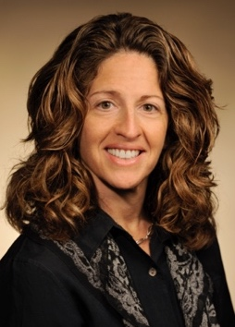
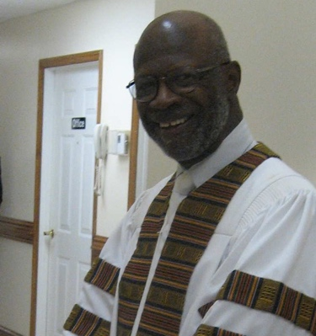

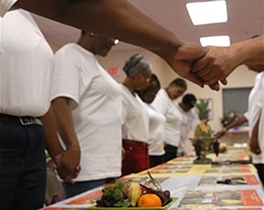

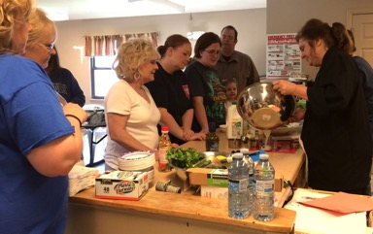
Focus on Obesity / Healthy Eating in Kentucky’s Vulnerable Populations
Appalachian
African-American
Hispanic
WILLIAMS
MUDD-MARTIN
SCHOENBERG
FUNDING
R01 NR016262; R01 NR019456
FUNDING
U01 MD010556; R01 HL152714
FUNDING
R01 DK125801

Slide 17
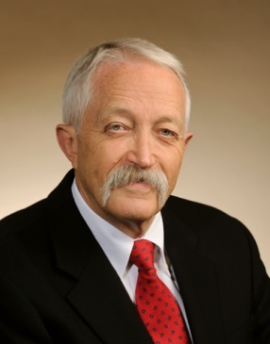
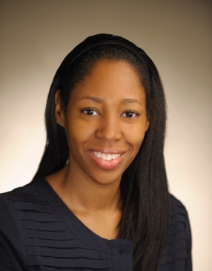

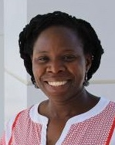
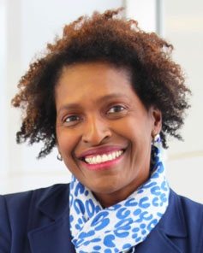

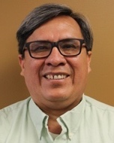
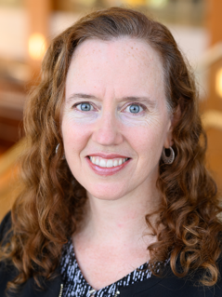
Cervical Cancer Prevention in Appalachia
OSU
WVU
DIGNAN
MULTI-PI
BURRIS
MCC
APPALACHIA
UVA
ADEGBOYEGA
WILLIAMS
CANEDO
HULL
FUNDING
P01 CA229143; R01 CA207401

Slide 18
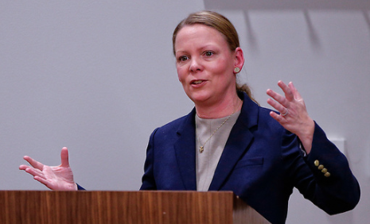
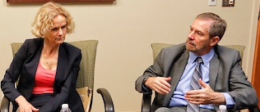
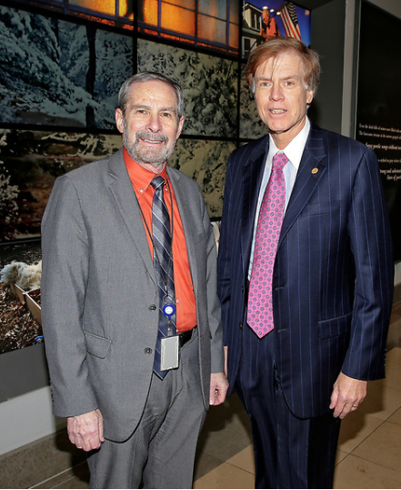
Markey-Led Viral Hepatitis Treatment Project
Impact
Elimination of hepatitis C virus (HCV) from Perry Co.
Prevention of liver-related morbidity and mortality, including hepatocellular carcinoma
Model of HCV treatment for rural areas impacted by the opioid epidemic
HAVENS
VOLKOW
(NIDA)
LOWY
(NCI)
NIDA
Gilead
CDC
MCC
Kentucky has the 5th highest rate of new HCV infections in the U.S.
CDAR
NCI
Positive Confirmatory HCV Results
(January 2017 – June 2019)
CCTS
HCV Treatment
HCV-positive county residents
Syringe
Services
Program
Medication
Assisted
Treatment
FUNDING
R01 DA047952 (2/3 from NCI); Gilead Sciences
Rate per 100,000
62.3–353.3
353.4–703.9
704.0–1142.1
1142.2–2609.9
Case Management
Source: Via labs electronically reported to Kentucky Department of Public Health

Slide 19
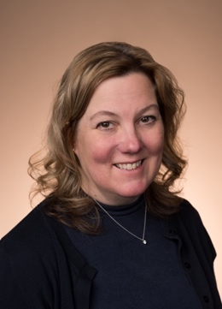
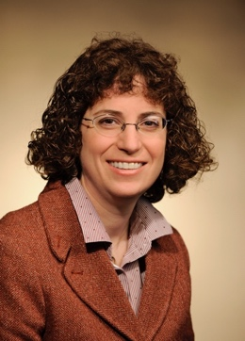
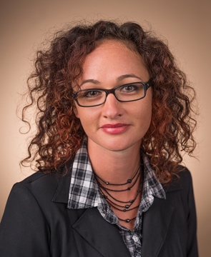
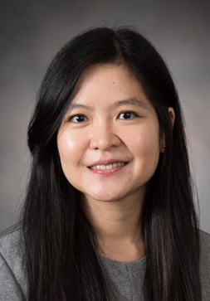
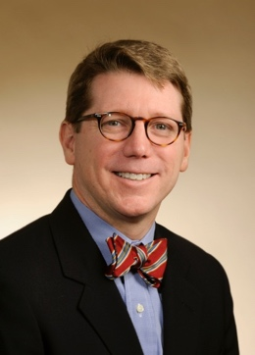






From Kentucky Fields to the Clinic
MCC
COM
Ag
A&S
Transdisciplinary Collaboration
  Grow Artemisia Annua (Aa) as a tobacco replacement crop
  New compounds by directed evolution of Aa
Demonstration of in vitro anticancer activity
  Identification of novel resistance mechanisms and targets
  NSCLC, AML, Prostate, Ovarian
New clinical trials
  Phase I study in MCC patients with advanced ovarian cancer
  Pilot study in pediatric AML to determine feasibility
  Phase II in prostate cancer and lung cancer in development
Pharm
KOLESAR
PLATTNER
ELLINGSON
MYINT
BADGETT
LIU
UELAND
GUY
PUBLICATIONS
Cancers (2021); Diagnostics (2021); Patent filing ART-02-WO
FUNDING
Pediatric Cancer Research Trust Fund; ArtemiLife
CLINICAL TRIAL
NCT04805333

Slide 20



Taking ACTION to Train Appalachian Students
(Appalachian Career Training In Oncology)
Highlights
Undergraduates and high school students from Appalachian Kentucky
Students engage in research, education, clinical shadowing and outreach activities
Impact
88 Appalachian students trained (40 high schoolers; 48 undergraduates)
  17 attending medical schools
  2 in pharmacy school
  1 in graduate school (PhD)
  2 in physician assistant Master’s program
  13/14 of eligible 1st high school cohort matriculated to college
VANDERFORD
Students from
29 of 54
Kentucky Appalachian counties
Making an Impact in Kentucky
FUNDING
R25 CA221765
Notes:
Bocklage is also a collaborator.

Slide 21
Support From the State has Provided:
Critical funding for cancer screenings throughout the state
Funding for new recruitment and retention of cancer investigators
Pilot funding for new cancer research projects
Funding for new clinical trials

Slide 22
WE NEED YOUR
CONTINUED SUPPORT!

Slide 23

Thank you!

