Slide 1
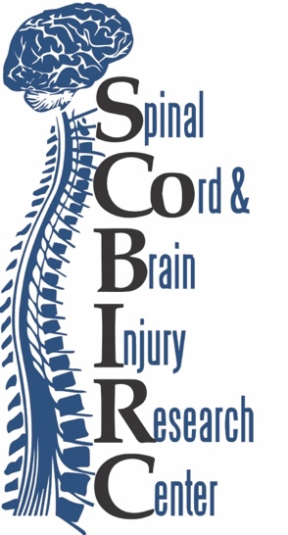


Joint Report to “Tobacco Settlement Agreement Fund Oversight Committee”
December 9, 2021
Scott R. Whittemore, PhD
Henry D and Marianna Garretson Endowed Chair
Professor and Vice Chair for Research
Department of Neurological Surgery
Distinguished University Scholar
Director, KSCIRC
University of Louisville School of Medicine
Joe E. Springer, PhD
SCoBIRC Endowed Chair
Professor of Neuroscience
Interim Director, SCoBIRC
University of Kentucky College of Medicine

Slide 2
Mission Statement: To develop successful spinal cord repair strategies in the laboratory that can be taken to the clinic in a timely and responsible fashion.
Mission Statement: To promote functional repair of the injured spinal cord and brain through advances in basic and clinical research, support collaborative efforts across health-related disciplines, endorse and support patient advocacy, and develop programs of excellence in education and training.

Slide 3
Kentucky Spinal Cord and Head Injury Research Trust Funding
(yearly, at both UofL and UK)
$150,000 to support trainees – postdoctoral fellows and graduate, medical and undergraduate students
$10,000 to support visiting lecture series speakers
$30,000 to support the international KSCHIRT Symposium (alternate years at UofL/UK)
Faculty development - $500,000 for matching funds for endowed chairs (1998 – 2009)
Remainder of funds support 3 year grant proposals*
*The KSCHIRT Study Section, which evaluates all grants, is an independent group of outstanding, senior scientists (not from KY) with expertise in SCI, TBI. Grants are funded solely on scientific merit, regardless of institution. Administrative costs are minimal.

Slide 4
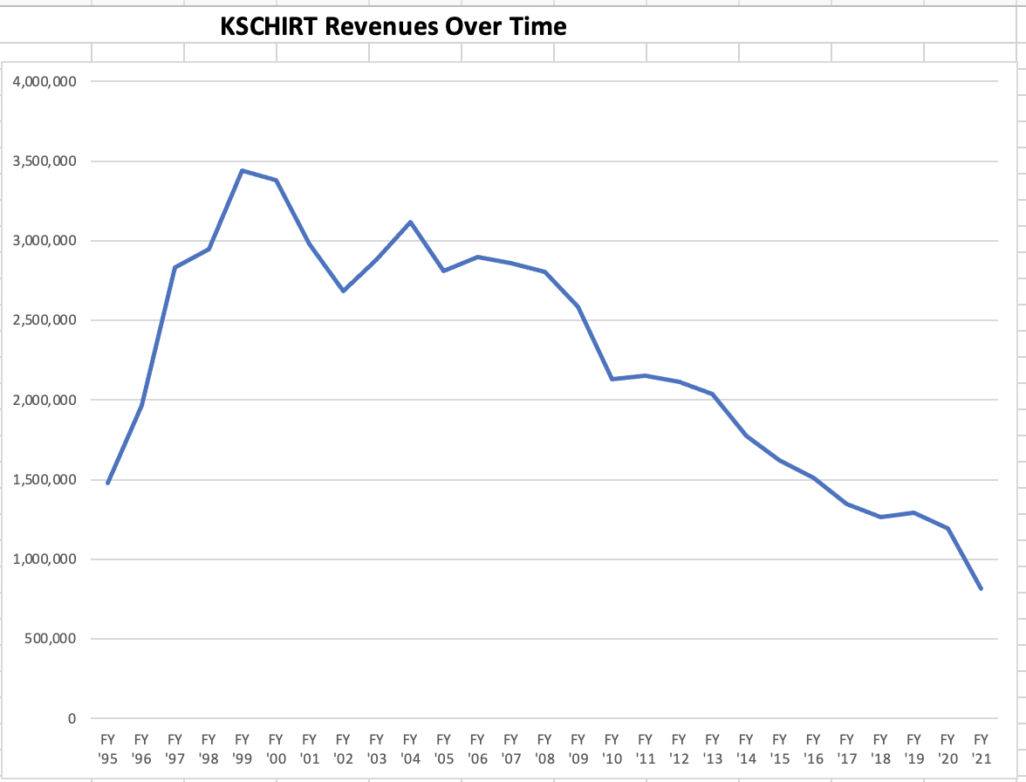
Minimal yearly support needed for continued growth
Change in distribution formula
Many outstanding grants went unfunded
# Grants Funded 5 7 7 8 11 9 4 4 6 8 4 4 6 5 5 5 5 4 4 3 3 3 2 2 1 2

Slide 5

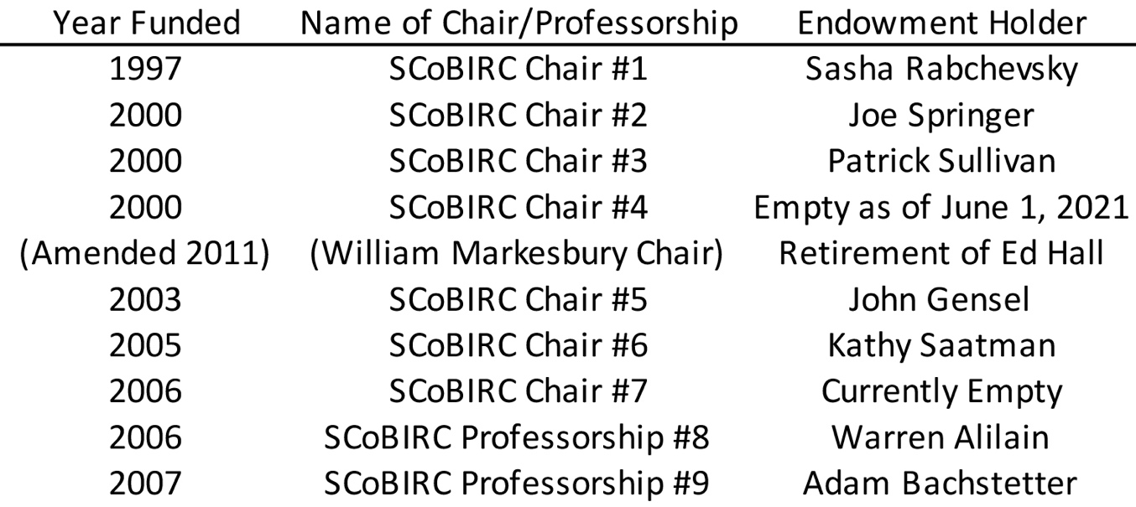
KSCHIRT Supported Endowed Chairs
All KSCHIRT funds for Endowed Chairs were matched by $500,000 donations

Slide 6
1999 – 2021
84 KSCHIRT Grants¹ Resulted in 52 Subsequent Federal² Grants
¹3 year grants; yearly total costs: $100,000
²National Institutes of Health (NIH), Department of Defense (DoD)
2-5 year grants; yearly total costs of $300,000 - $750,000

Slide 7
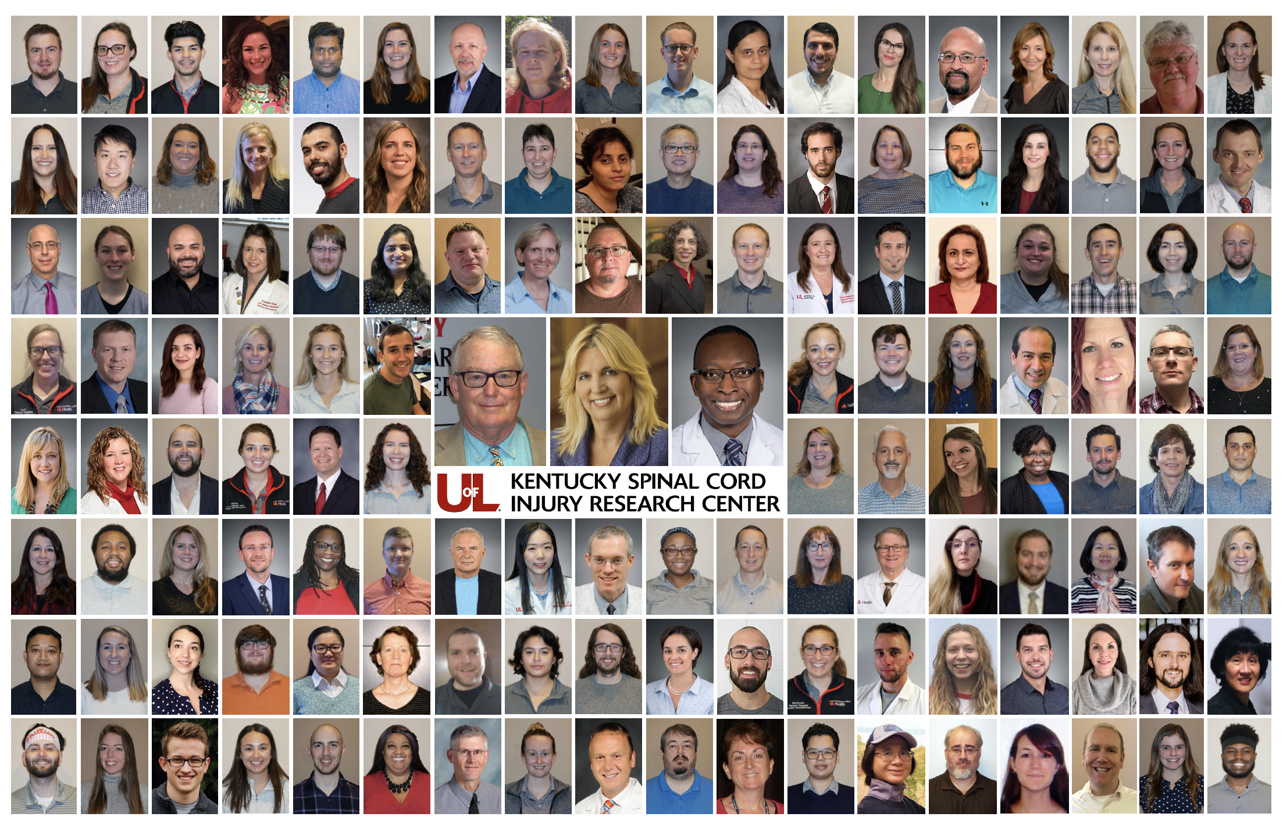
When KSCIRC started in 1995, there were 2 investigators; no NIH $

Slide 8
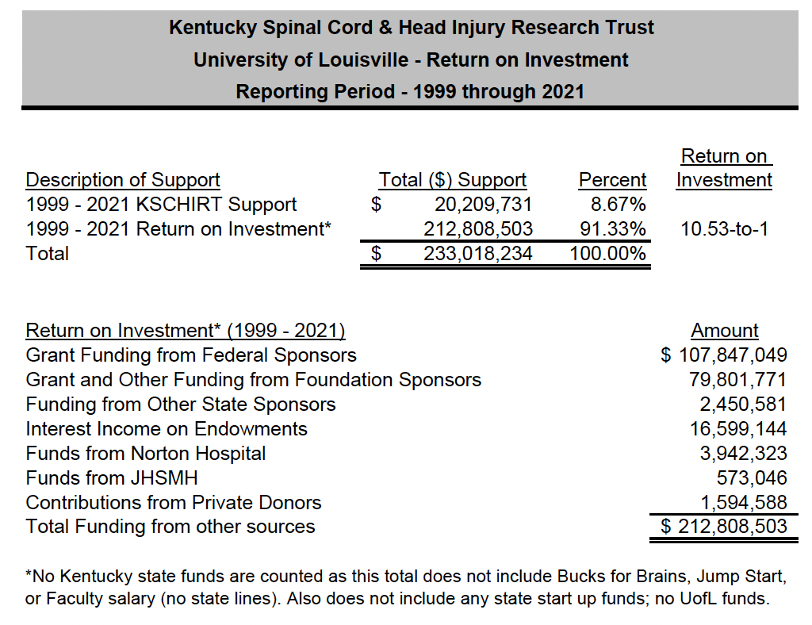
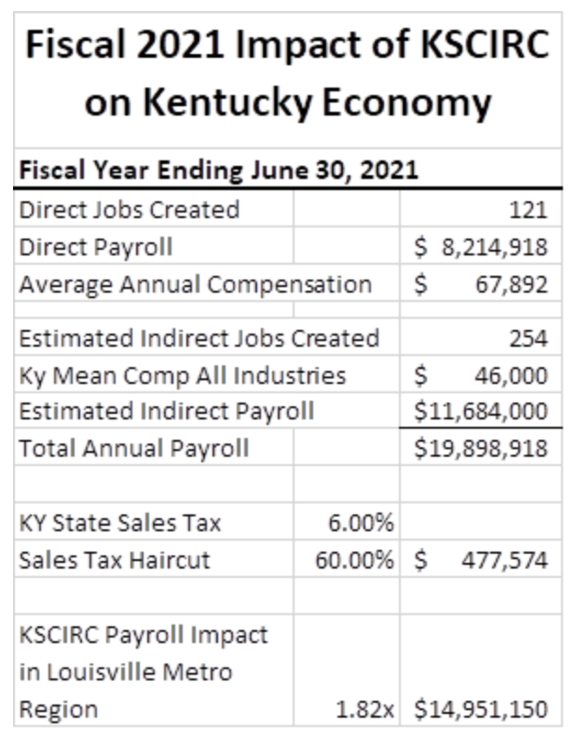

Slide 9
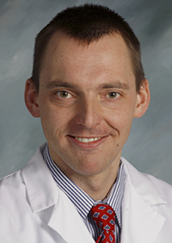
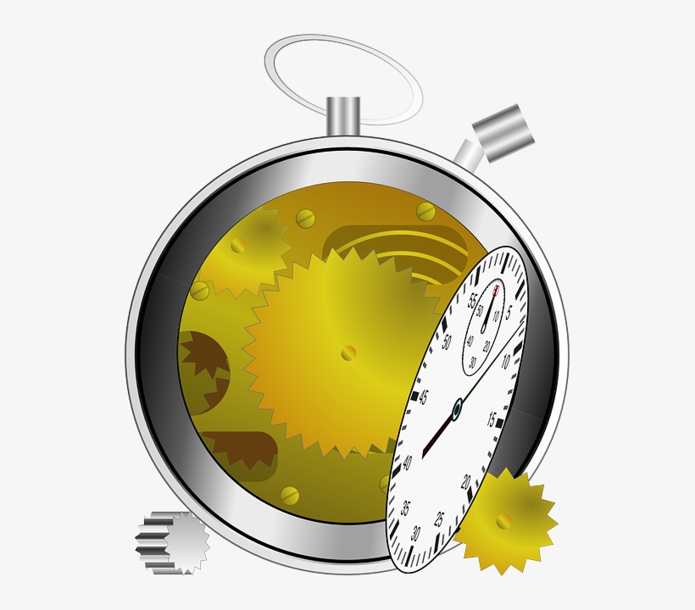
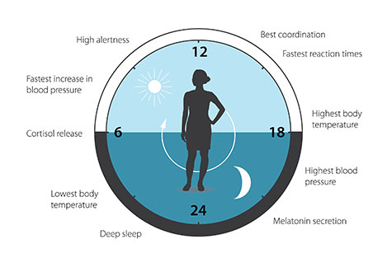
Michal Hetman, MD, PhD
Experimental SCI in mice with
defective diurnal rhythmicity
results in less tissue damage and improved recovery
Presenting severity of human SCI
is affected by time of injury (n=727)
12
Physiological rhythms around the clock
24
6
18
Less
severe
Ugiliweneza et al., in preparation
Slomnicki et al, Scientific Reports, 2020
Kentucky Spinal Cord Head Injury Research Trust Contract 18-2 (co-PIs: Hetman, Saraswat Ohri, 10/01/19-09/30/22), total costs: $300,000
NINDS 1R01 NS114404 (co-PIs: Hetman, Saraswat Ohri, Whittemore, 08/15/20-05/30/25), total costs: $2,700,000

Slide 10
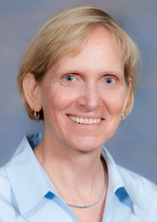
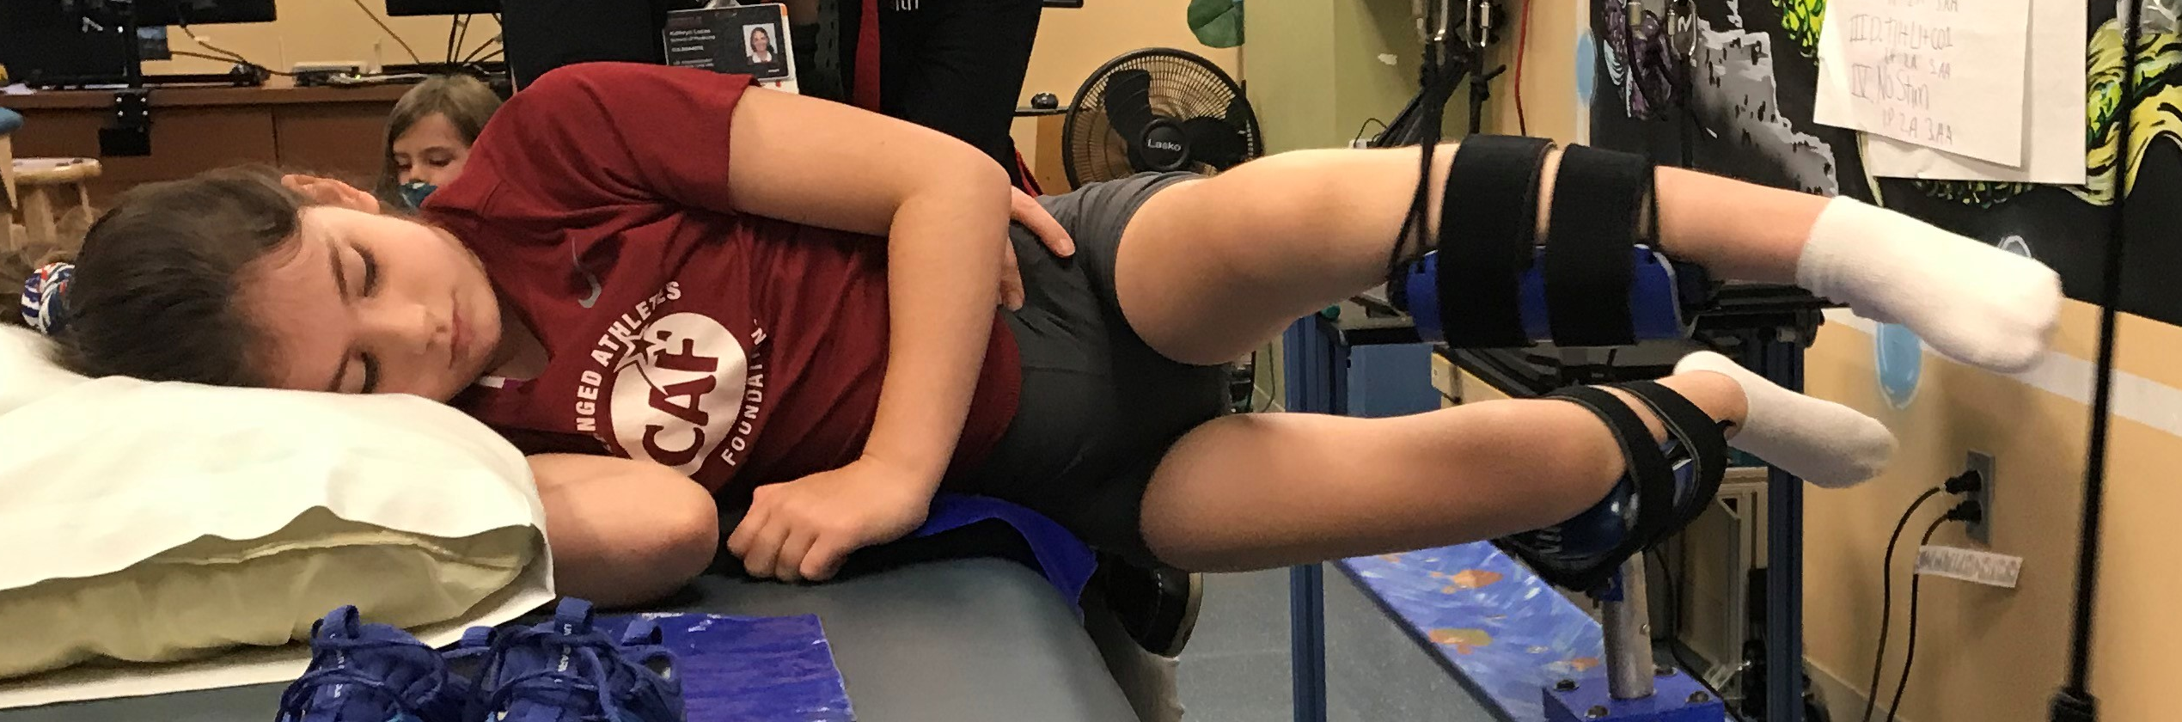
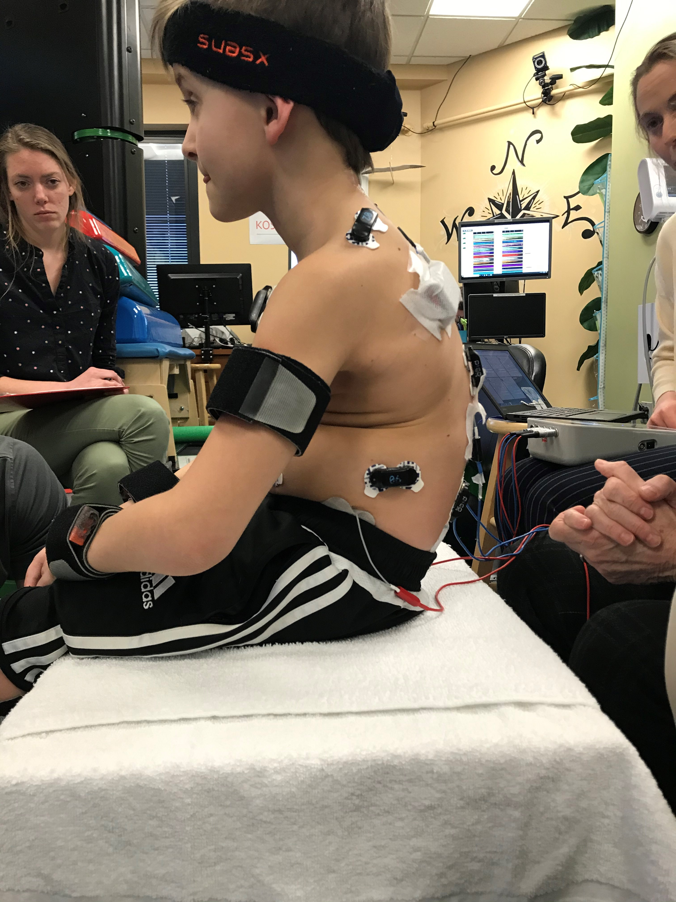
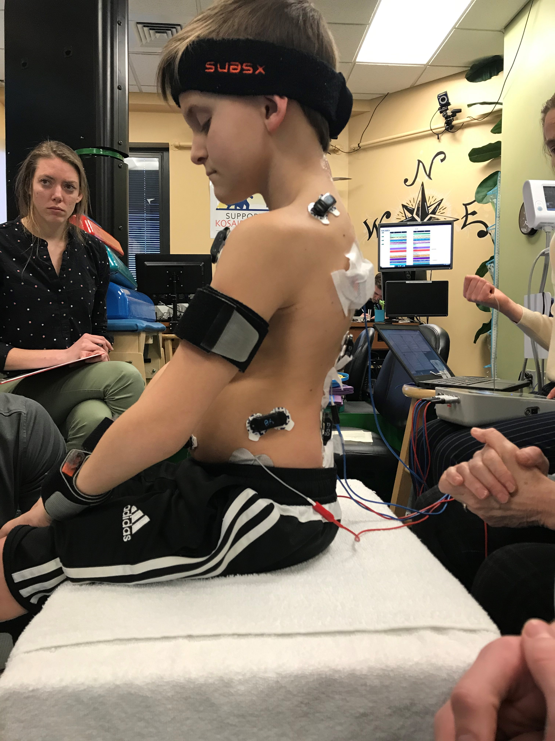
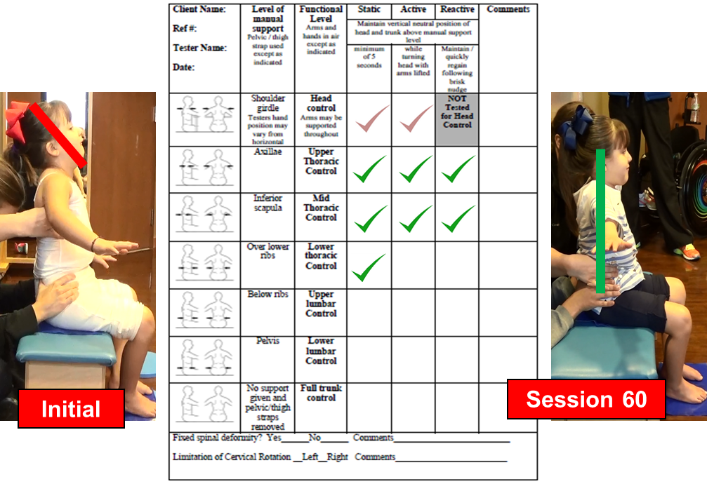
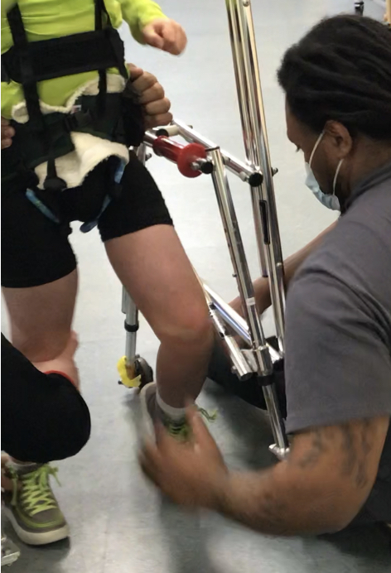
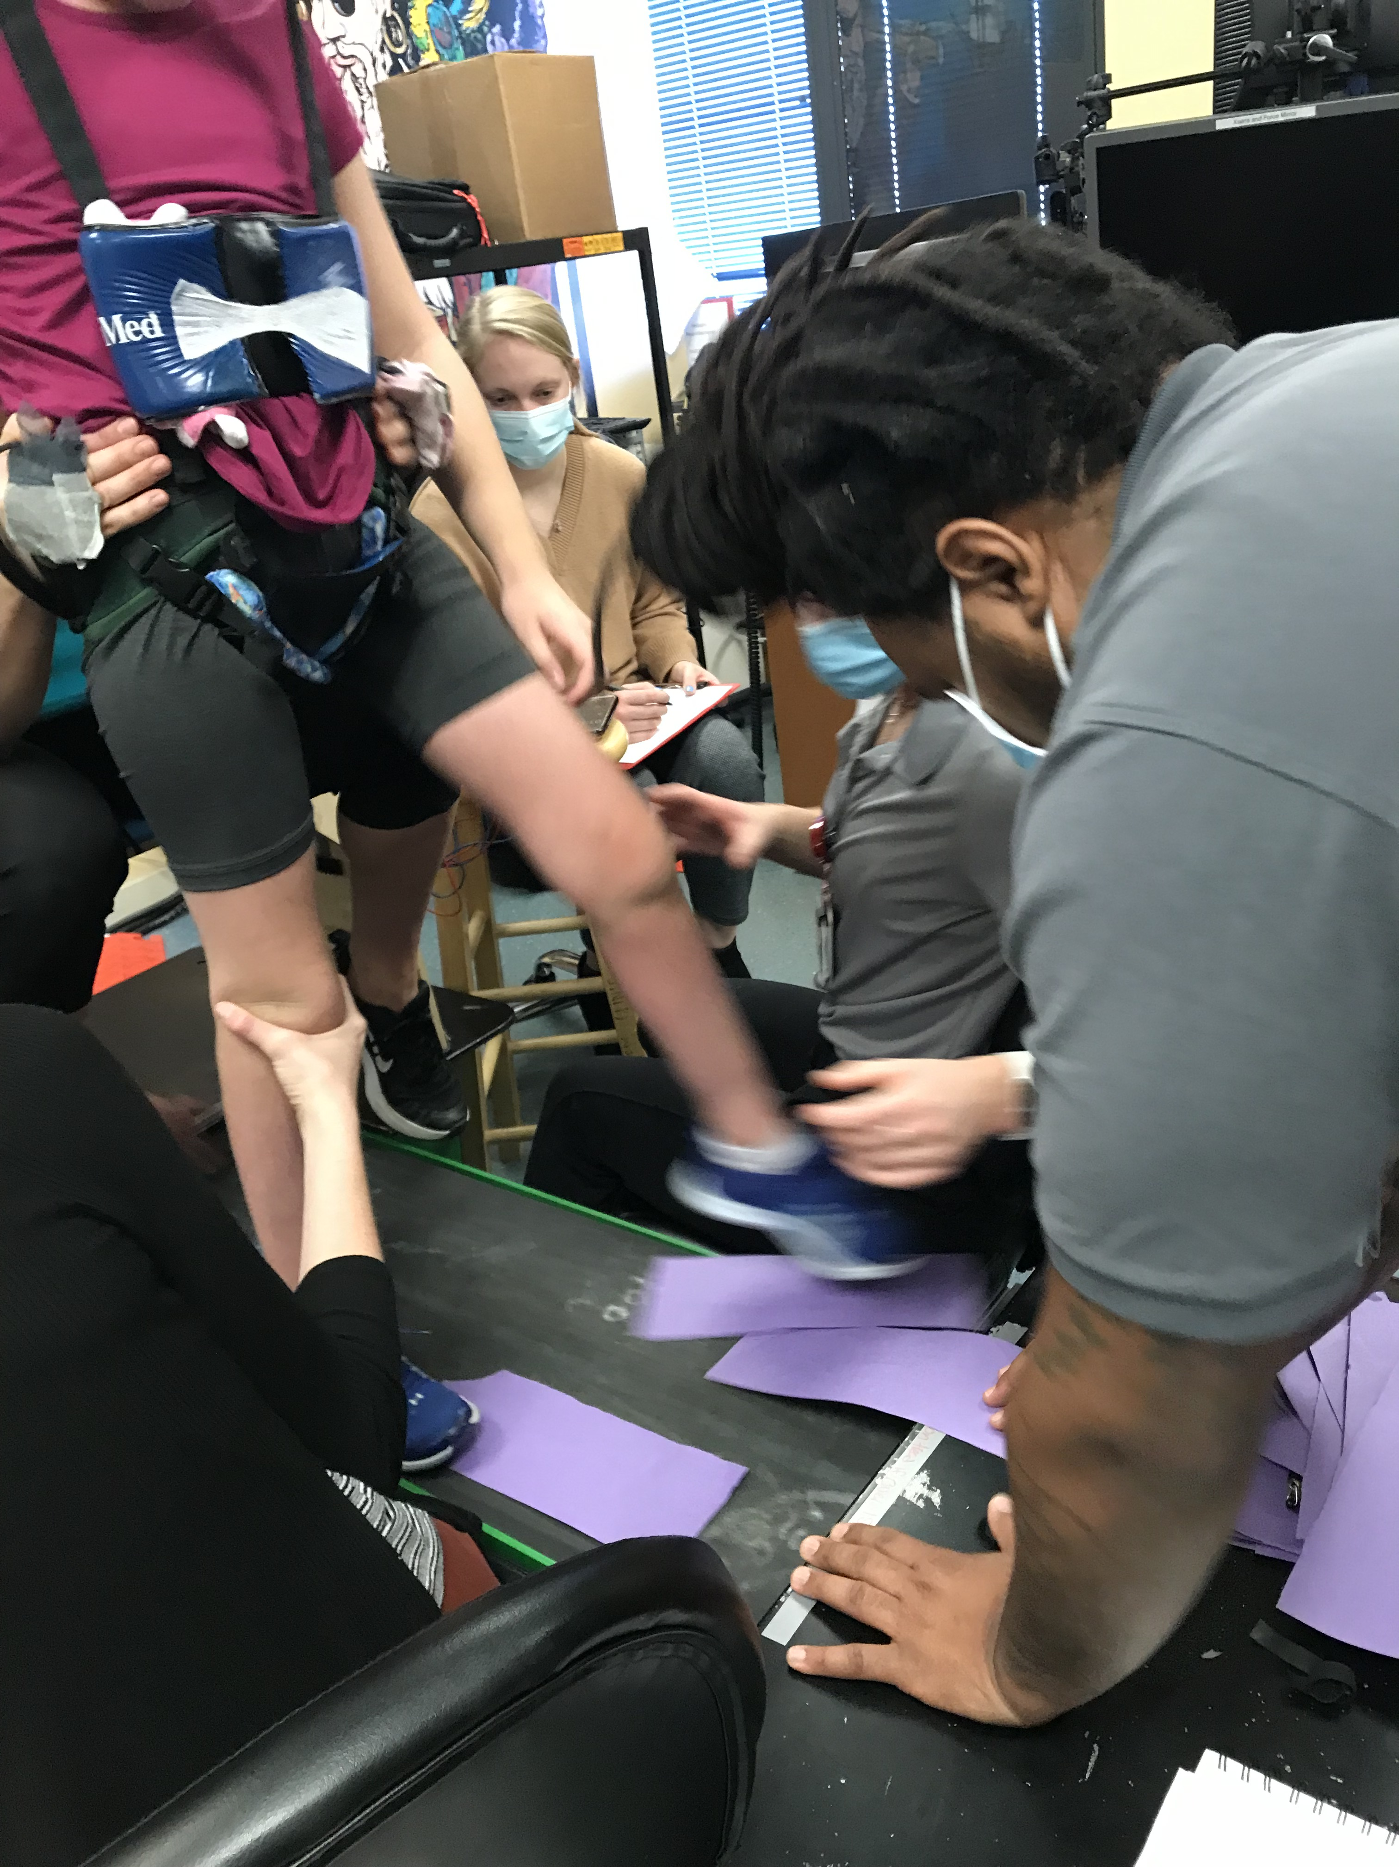
Andrea Behrman, PT, PhD, FAPTA
Professor, Neurological Surgery
Director, Pediatric Recovery Network
Gravity-neutral device
No stimulation -
Sitting
Posture
Spinal Stimulation -
Sitting
Posture
Treadmill,
Treadmill
Walker
Argetsinger et al.,
Dev NeuroRehab, 2019
Keller et al.,
Nature Communications, 2021
Training for stepping with stimulation
To assess the effect of locomotor training, transcutaneous spinal stimulation on trunk control in children with SCI and other pediatric disorders that result in impaired ability to sit upright or walk.
Behrman A (PI), Kentucky Spinal Cord and Head Injury Research Board, 2020-2023, total costs, $300,000

Slide 11
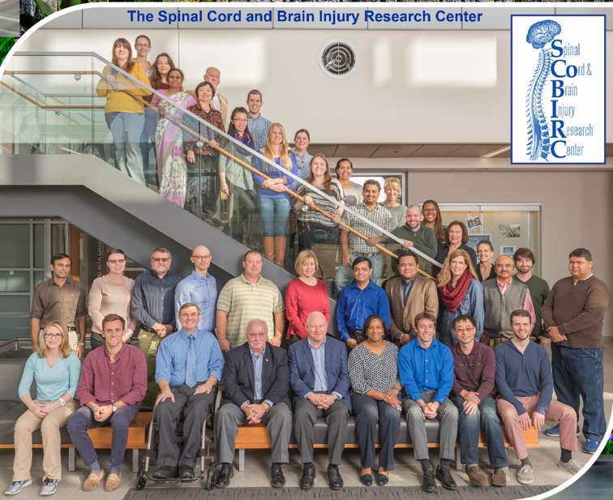
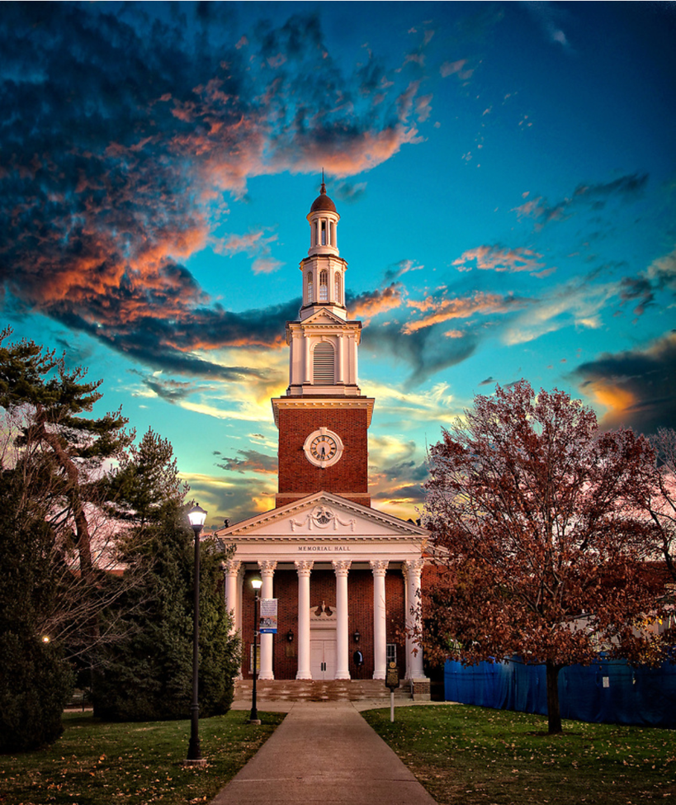

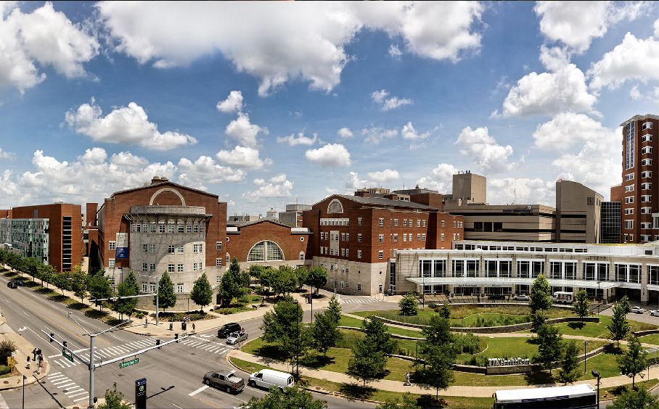

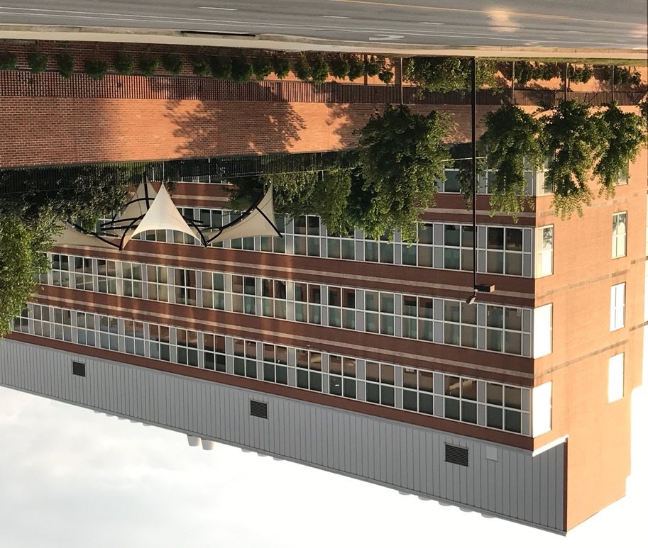
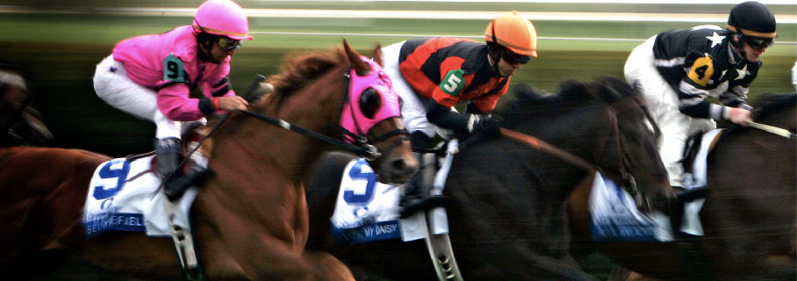
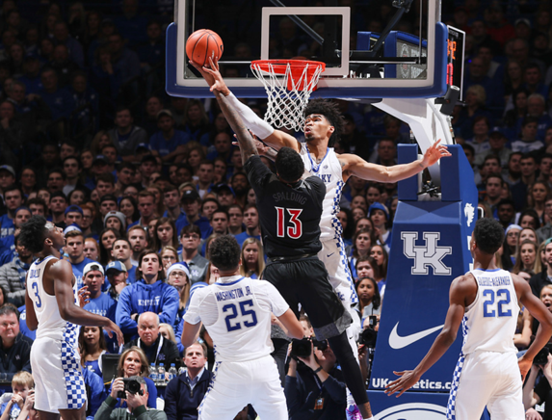

Slide 12
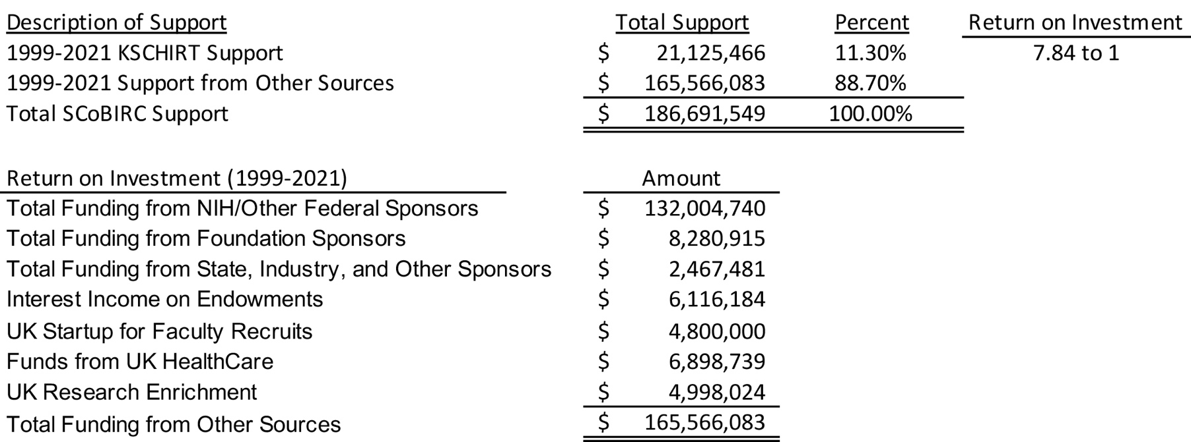
Kentucky Spinal Cord and Head Injury Research Trust
University of Kentucky – Return on Investment
Reporting Period – 1999-2021

Slide 13
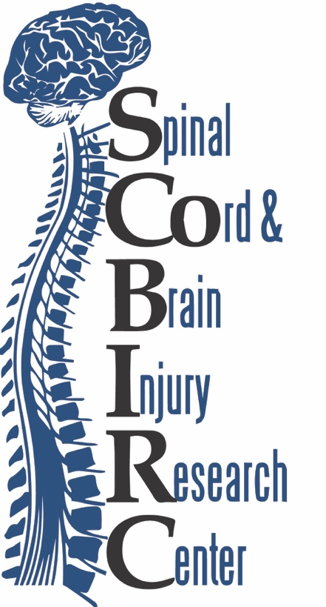
Clinically relevant studies resulting from KSCHIRT funding
Riluzole for the treatment of acute spinal cord injury
MW-151 for the treatment of acute traumatic brain injury
Development of a biomarker panel for predicting follow-up pathological events following brain hemorrhage

Slide 14
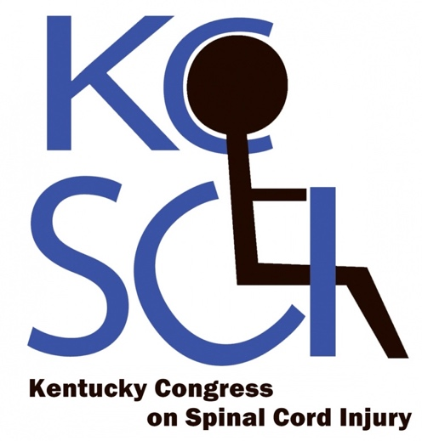
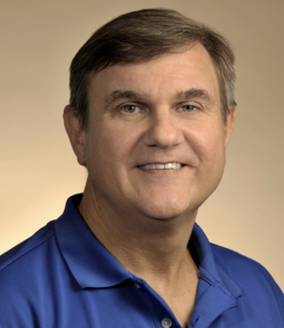
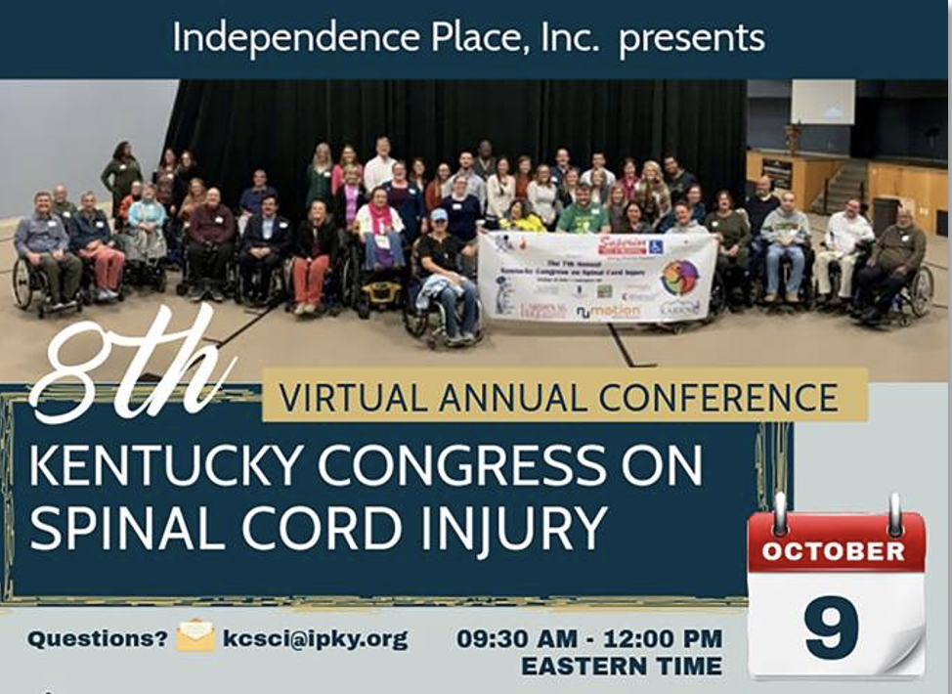
Dr. Sasha Rabchevsky
KSCHIRT Sponsored
Outreach and Advocacy in the Commonwealth
Brings together like-minded individuals to improve care and policies impacting people living with spinal cord injury, their families, and the community.

Slide 15
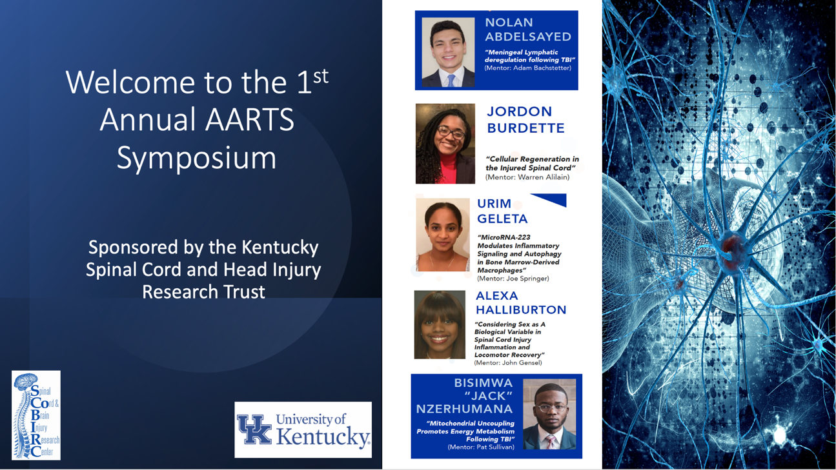
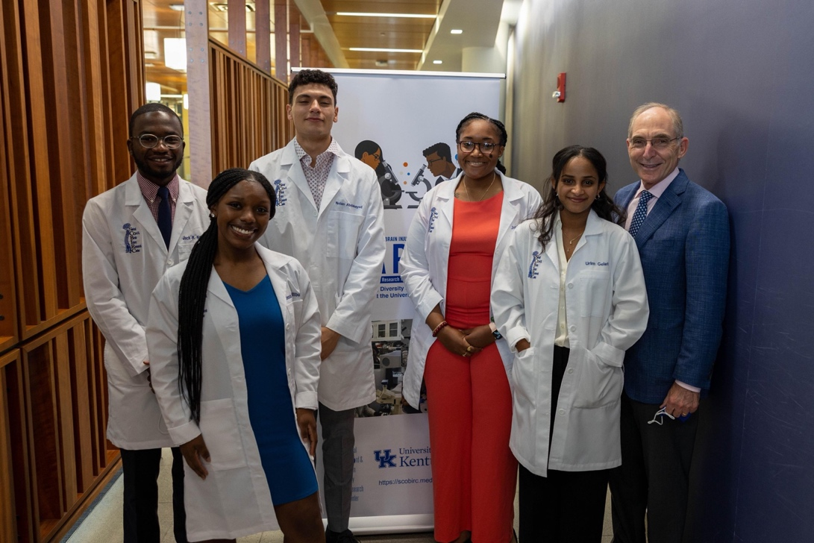
African American Research Training Scholars Program (AARTS)
“I was overwhelmed today…” Dr. Eli Capilouto, UK President

Slide 16
For both KSCIRC and SCoBIRC, as well as the Commonwealth of Kentucky, the KSCHIRT program has been a major success in our mission areas of:
  Promoting health in Kentucky
  Research into traumatic brain and spinal cord injury
  Advocacy and community outreach
  Education and training
  Job creation and facilitating economic growth
Future discoveries, treatments, programmatic planning, training the next generation of researchers, and further economic contribution will require a sustainable level of funding similar to that received prior to 2010.

