Slide 1
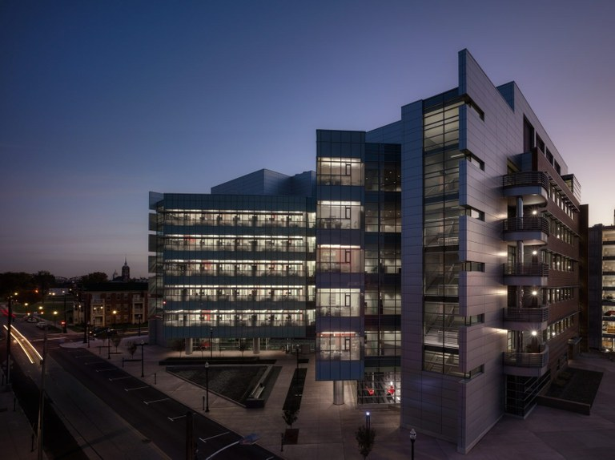

Jason Chesney, M.D., Ph.D.
Director and Chief Administrative Officer
UofL Health Brown Cancer Center/Oncology Service Line

Slide 2
Decreasing Cancer Deaths In Kentucky
A Presentation to the
Tobacco MSA Oversight Committee Meeting
December 9, 2021
Jason Chesney, M.D., Ph.D.
Director and Chief Administrative Officer
UofL Health Brown Cancer Center/Oncology Service Line

Slide 3
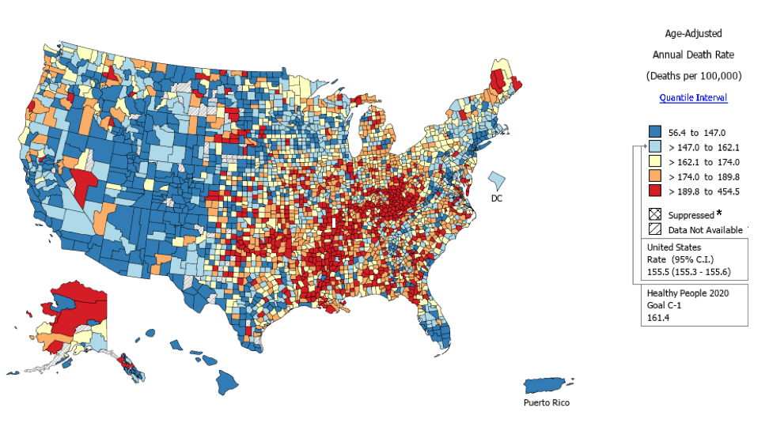
Kentucky is Ground Zero for Cancer in the US
2020-2021
KY COVID Deaths: 11,434
KY CANCER Deaths: 20,090

Slide 4
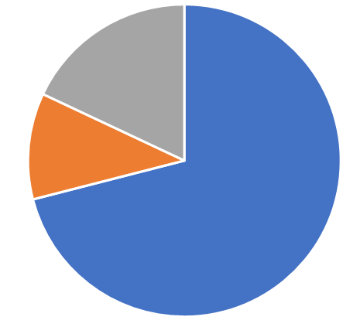
The Tobacco Master Settlement Agreement Is Saving the Lives of Kentuckians Suffering From Cancer
$3.4M Per Annum Supports:
Expenditures (2018 – present):
Life-saving first-in-human trials: clinical trialists, research nurses and staff
Cutting-edge drug development programs: cancer researchers and lab instruments (CyTOF, NMR, etc)
Innovative cancer screening programs: research staff
Lab Instrumentation
(18%)
Lab Researchers
(11%)
Human Trials of Novel Therapeutics & Diagnostics (71%)

Slide 5
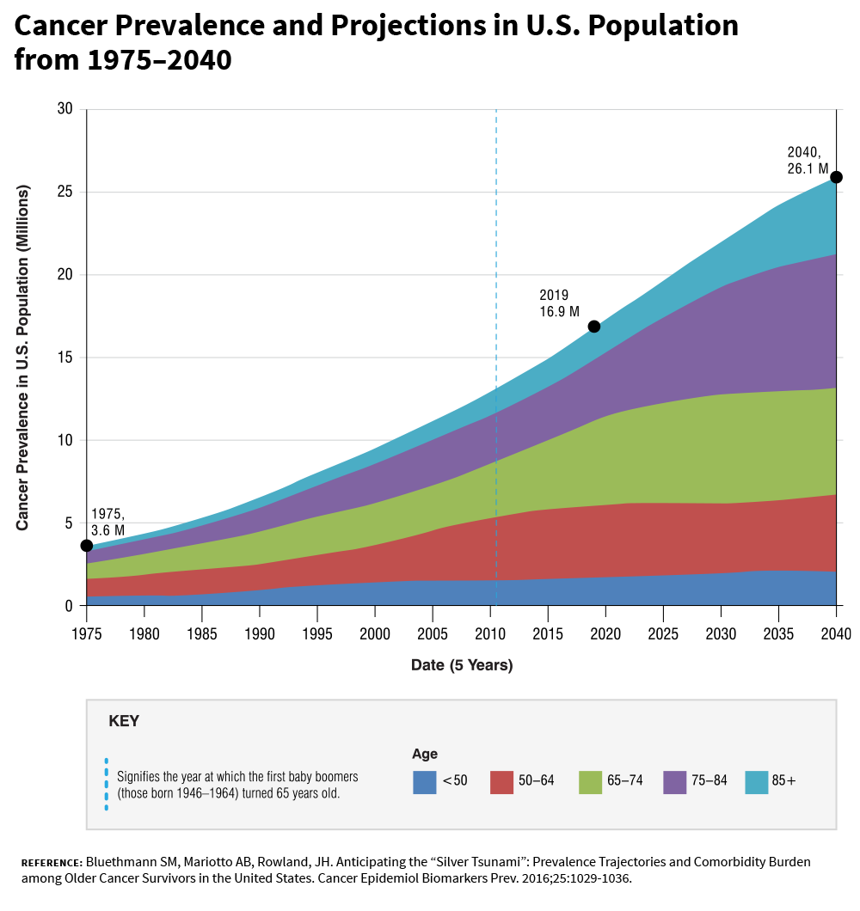
Cancer Patients Will Increase 50% by 2040
Cancer Prevalence and Projections in the US Population from 1975 - 2040
1
2
males get cancer
1
2
3
females get cancer

Slide 6
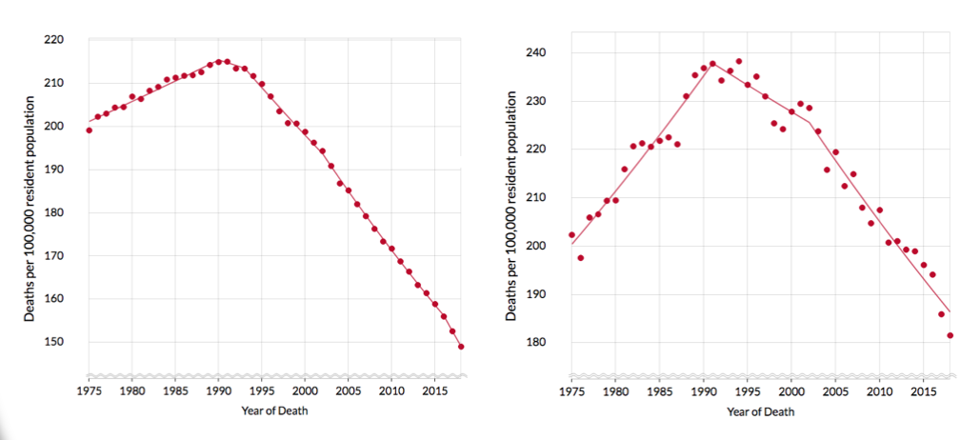
THE GOOD NEWS:
The US Cancer Death Rate Dropped 30% in the Past 30 Years
US Death Rate
KY Death Rate

Slide 7

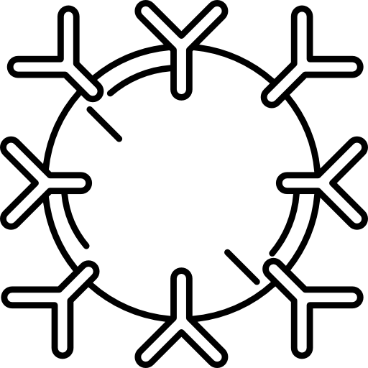


OUR GOAL:
Drop Cancer Deaths by Another 30% in the Next 5 Years
Increase and Improve CANCER SCREENING
Develop Novel TARGETED THERAPIES
Conduct Trials of IMMUNOTHERAPIES

Slide 8
Increase and Improve Cancer Screening
Cancer screening:
Low screening rates:
Cancer caught earlier is nearly always curable
Many common cancers can be detected with proven screening technologies but low participation is a problem
Our goals are to increase cancer screening rates and to develop less invasive approaches to detect cancer for better compliance
Mammography: 70%
Colonoscopy: 62%
Pap smears: 62%
PSA: variable
Low dose chest CT: 2%

Slide 9
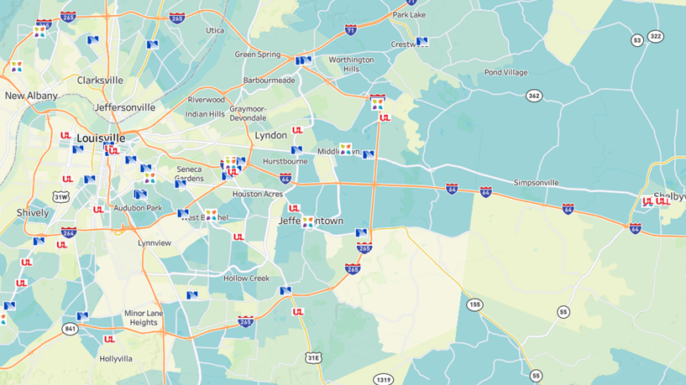
Increase and Improve Cancer Screening
2018: 1 Lung Cancer Screening Facility

Slide 10
Increase and Improve Cancer Screening
2021: 8 Lung Cancer Screening Facilities

Slide 11
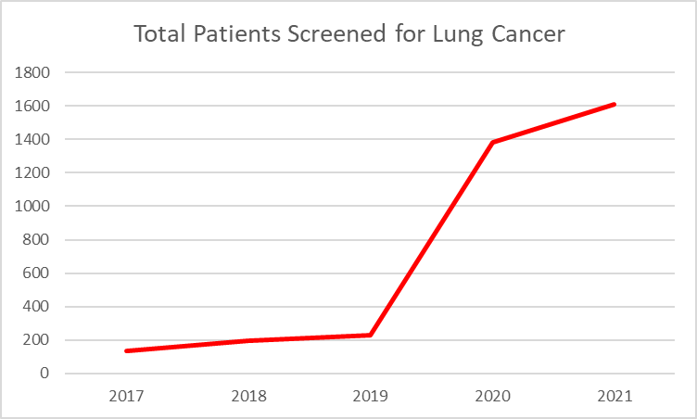
Increase and Improve Cancer Screening
The addition of multiple screening sites throughout the community has markedly increased lung cancer screening
All positive low dose chest CTs are reviewed by a central multi-disciplinary lung tumor board at UofL Health – Brown Cancer Center in downtown Louisville

Slide 12
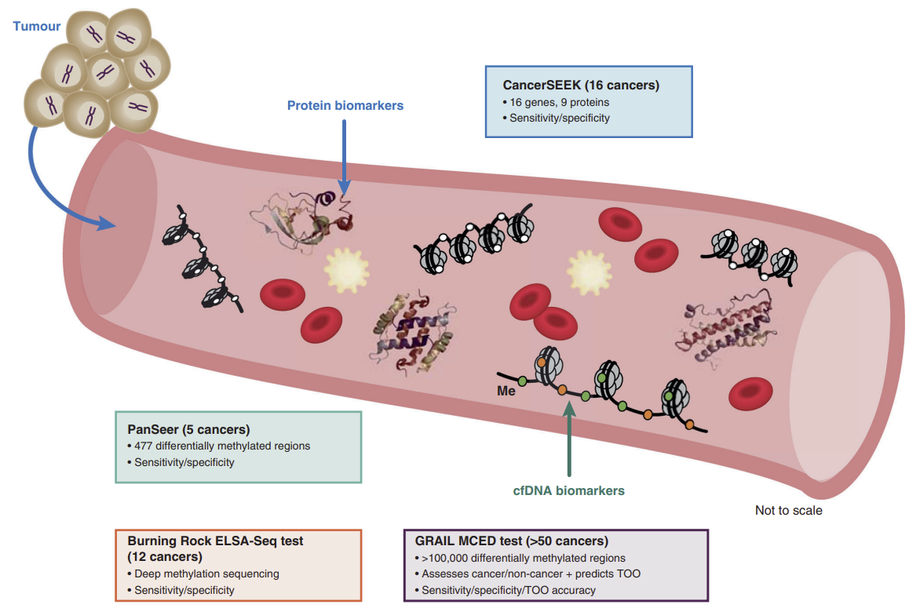
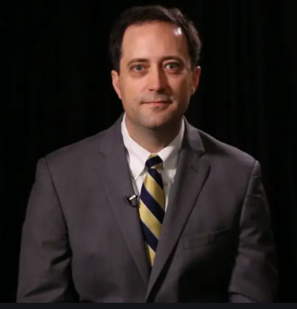
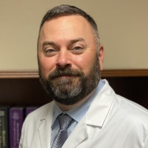
Increase and Improve Cancer Screening
Egger
Smith

Slide 13
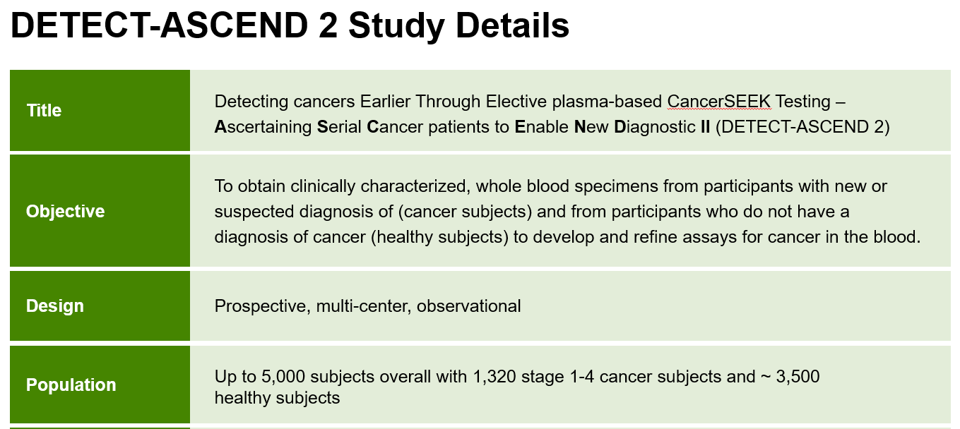
Increase and Improve Cancer Screening
Egger
Smith

Slide 14
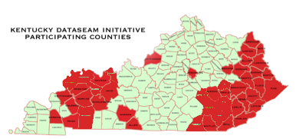
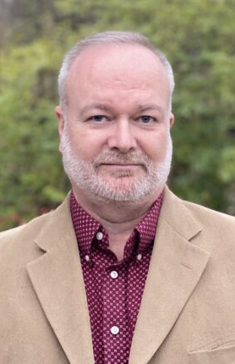
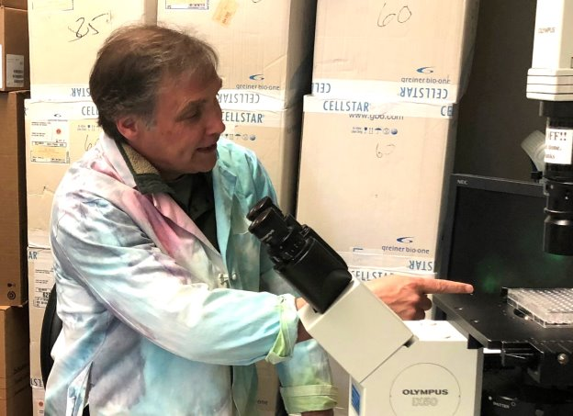
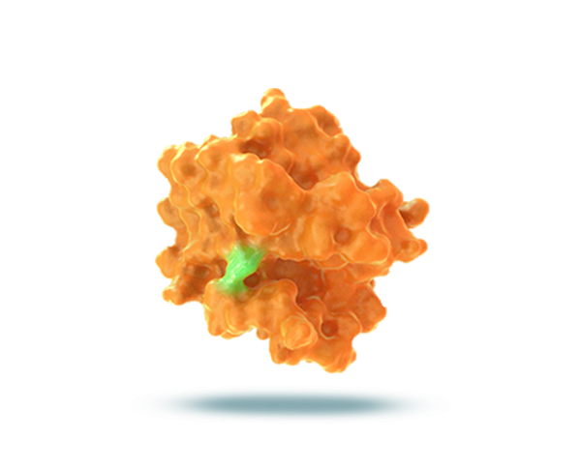
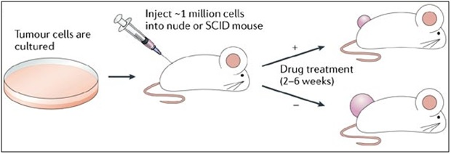
Develop Novel Targeted Therapies
Grid Computing in 52 K-12 Kentucky School Districts
Virtual drug screening on over
24,000 processors 24/7
Trent
Clark
U of L anti-RAS drug (F3 series) binds here to block RAS function
800
RAS
600
carrier
Tum Vol mm³
400
200
0
F3-8-60
80mg/kg po 5/2
DAYS
Qualigen Therapeutics LLC (San Diego CA) has licensed F3-8-60 from the UofL

Slide 15
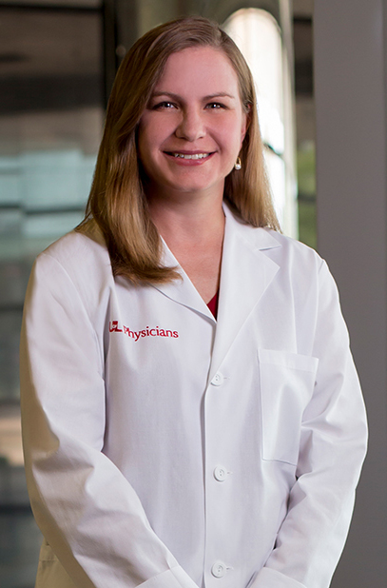
Impact of phase 1 trials at BCC
Develop Novel Targeted Therapies
2021: 18 active phase 1, first-in-human trials
Phase 1 First-In-Human Study of DS-8201A in Subjects With Advanced Solid Malignant Tumors
  Lancet Oncol. 2019 Jun;20(6):816-826.
  HER2 antibody linked to topoisomerase I inhibitor
  First-in-human phase 1 trial open in Japan and 8 sites in the US, including UofL Health – Brown Cancer Center
  66/111 patients had confirmed objective responses; FDA granted accelerated approval in December 2019
Redman

Slide 16
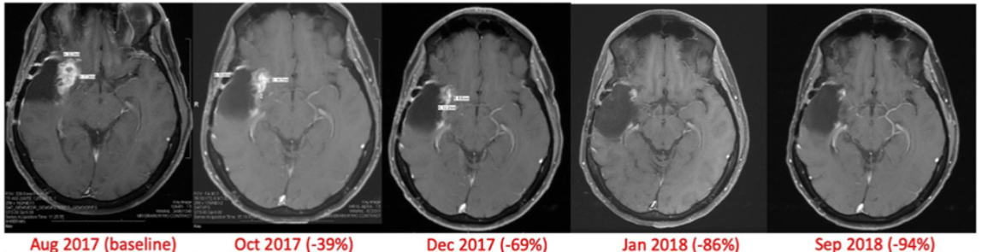
Impact of phase 1 trials at BCC
Develop Novel Targeted Therapies
First-In-Human Phase I Study of a TGFβ Receptor 1 Inhibitor, LY3200882, in Patients with Advanced Cancer
  Clin Cancer Res. 2021 Sept 21.
  Patient with grade 4 glioma (transferred care from MD Anderson to BCC when trial opened) had 94% tumor reduction and remained on trial for 30 months.
Redman

Slide 17
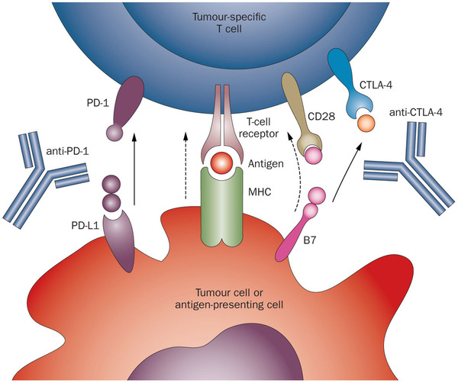
Conduct Human Trials of Targeted Immunotherapies
Immune cells have two brakes called immune checkpoint proteins (CTLA4 and PD1) that prevent excessive inflammation and autoimmune disorders
Antibodies that block these brakes allow immune cells to
become activated against the cancer cells
Brake 1
Brake 2

Slide 18
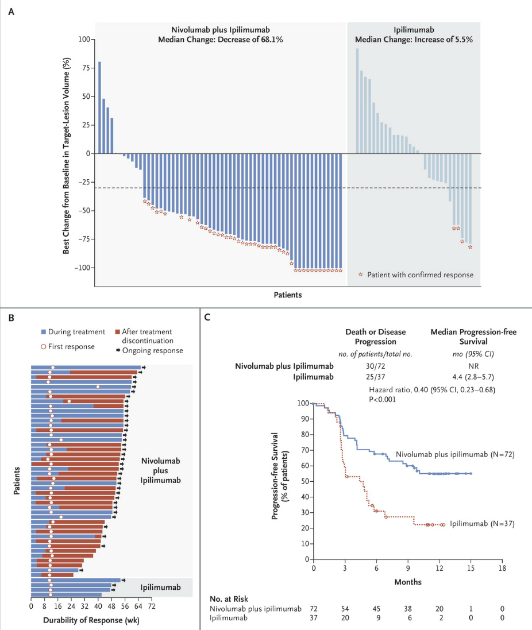
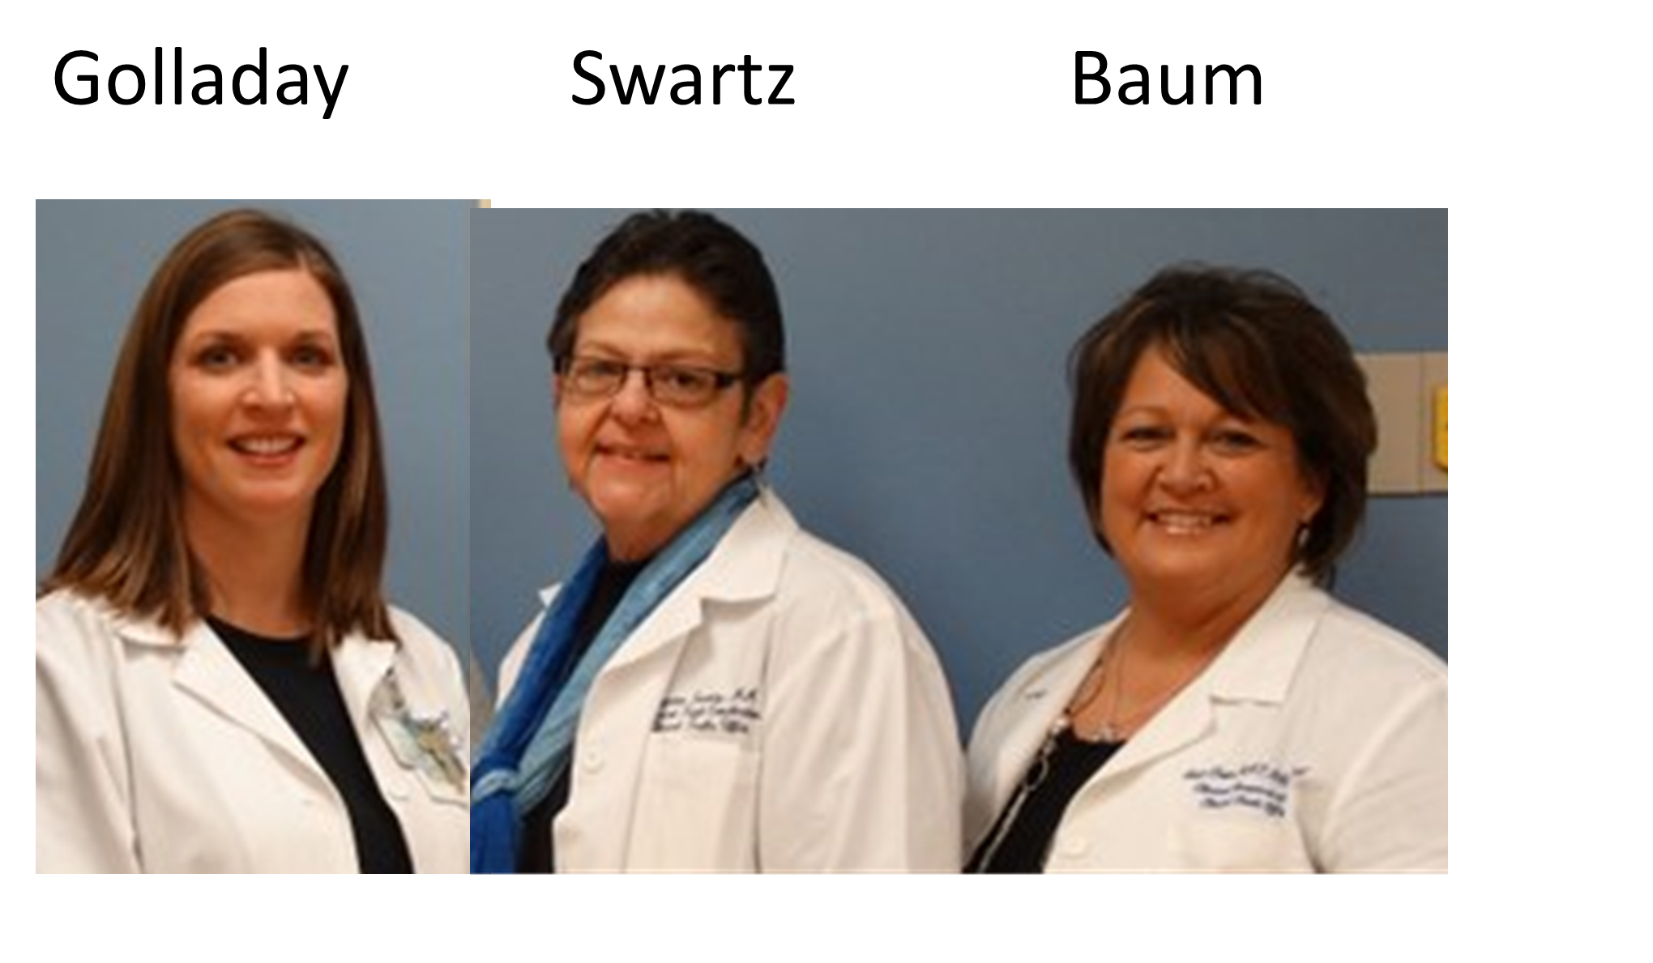
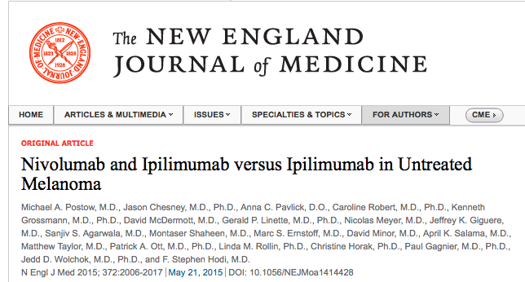
Conduct Human Trials of Targeted Immunotherapies
18

Slide 19
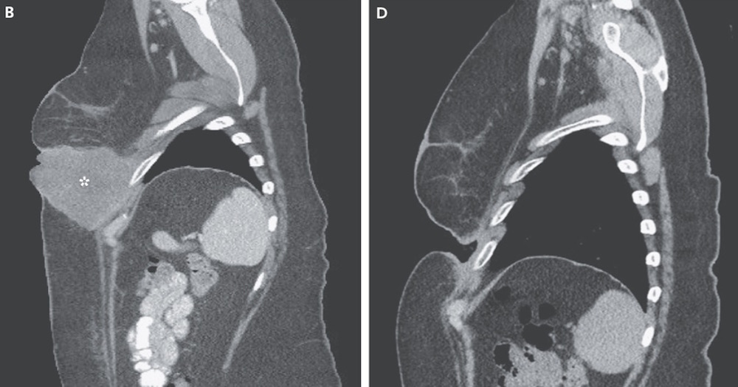
Conduct Human Trials of Targeted Immunotherapies
19

Slide 20
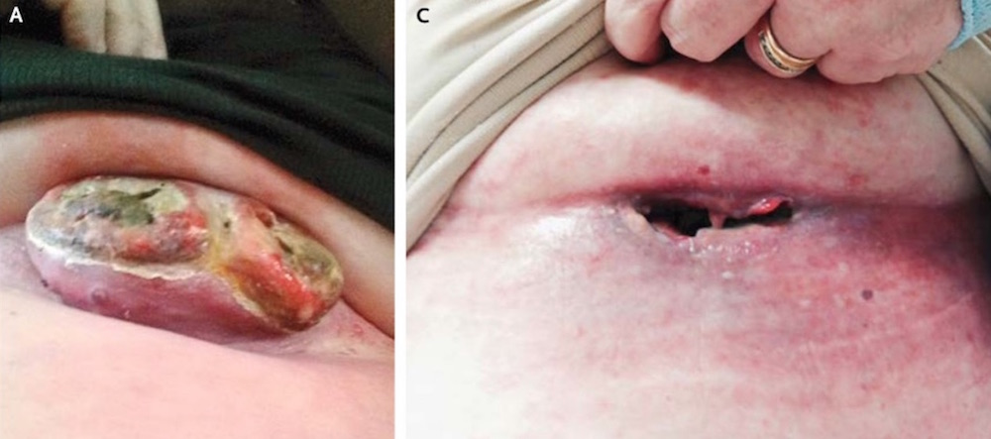
Conduct Human Trials of Targeted Immunotherapies
20

Slide 21
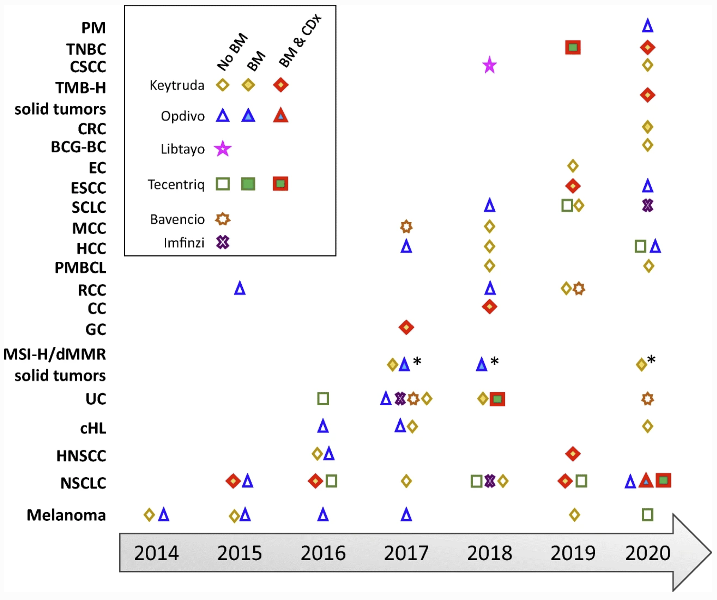
Conduct Human Trials of Targeted Immunotherapies
Immunotherapies Have Activity Against a Broad Spectrum of Cancers
Pleural Mesothelioma
Triple Neg Breast Cancer
Cutaneous SCC
TMB-High
Solid Tumors
Colorectal Cancer
BCG Bladder Cancer
Endometrial Cancer
Esophageal SCC
Small Cell Lung Cancer
Merkel Cell Carcinoma
Hepatocellular Carcinoma
Pri Med B Cell Lymphoma
Renal Cell Carcinoma
Cervical Cancer
Gastric Cancer
MSI-High/dMMR
Solid Tumors
Urothelial Carcinoma
Hodgkin’s Lymphoma
H&N SCC
Non-Small Cell Lung Cancer
Melanoma
21
Pembro
Nivolumab
Cemiplimab
Atizolizumab
Avelumab
Durvalumab
21

Slide 22

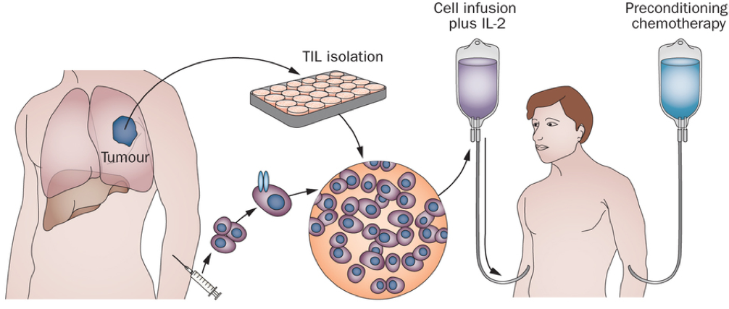
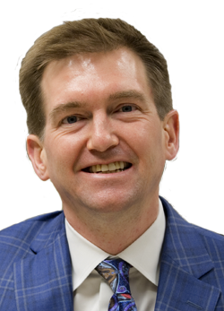
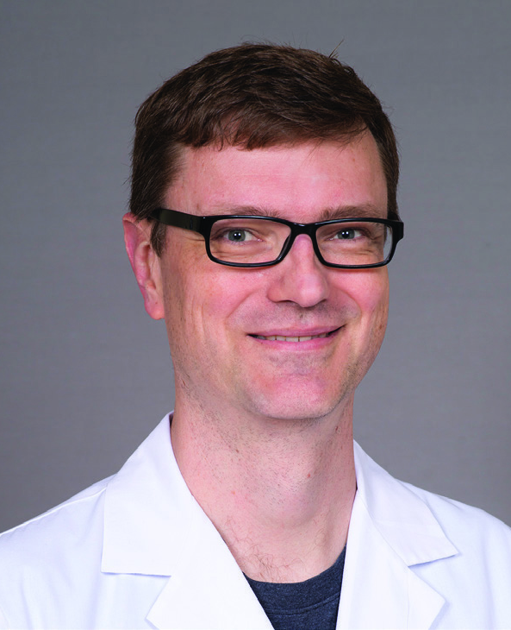
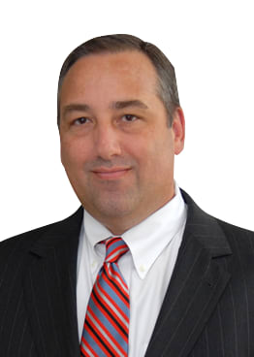
Develop Novel Cellular Immunotherapies
Tumor Infiltrating Lymphocytes (TILs)
Surgical oncologists resect patients’ tumors and then the tumor-specific immune cells are grown in the lab and infused back into the patient
This complex cellular immunotherapy was only available on the coasts until we opened human trials at UofL Health Brown Cancer Center in 2016
Once FDA-approved, we will be one of only ten sites in the world certified to offer this life-saving therapy
22

Slide 23
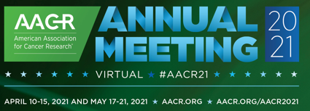
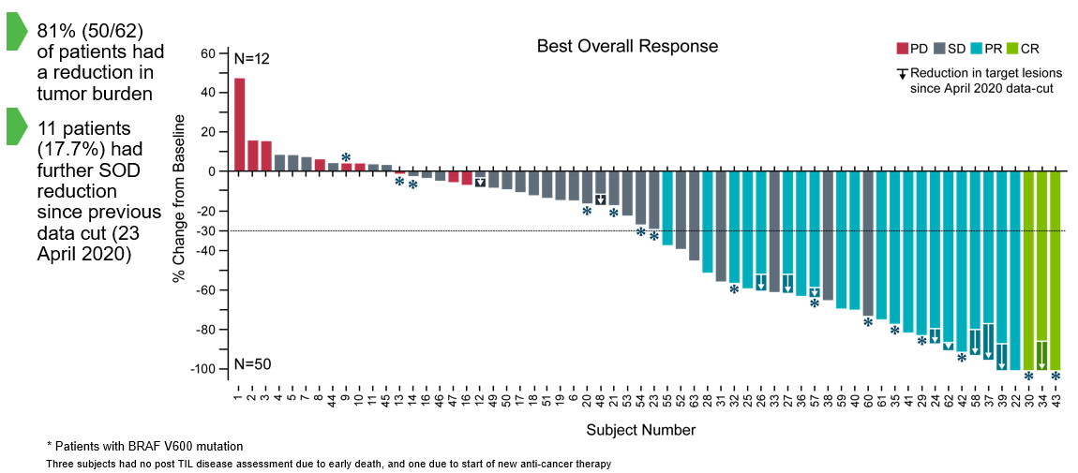
Develop Novel Cellular Immunotherapies
Tumor Infiltrating Lymphocytes (TILs)
23

Slide 24
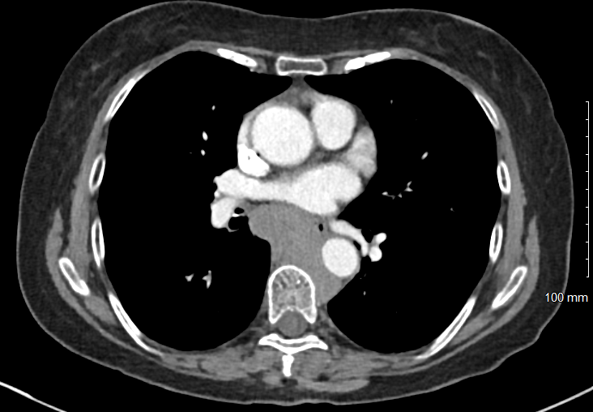
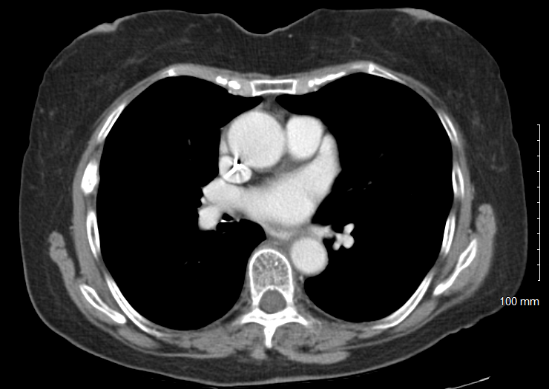
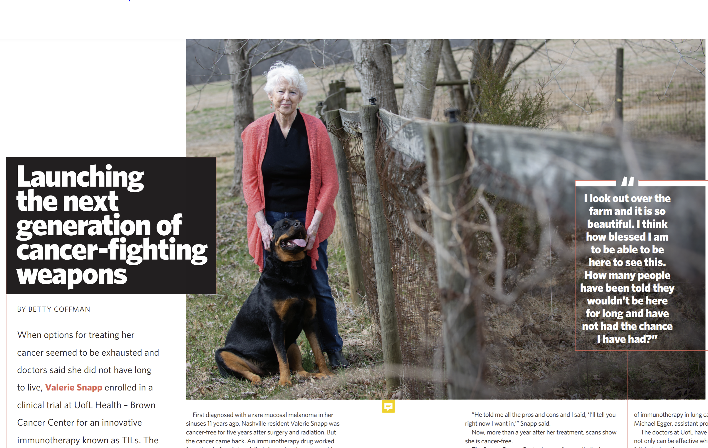
Develop Novel Cellular Immunotherapies
Tumor Infiltrating Lymphocytes (TILs)
Melanoma
24
24

Slide 25
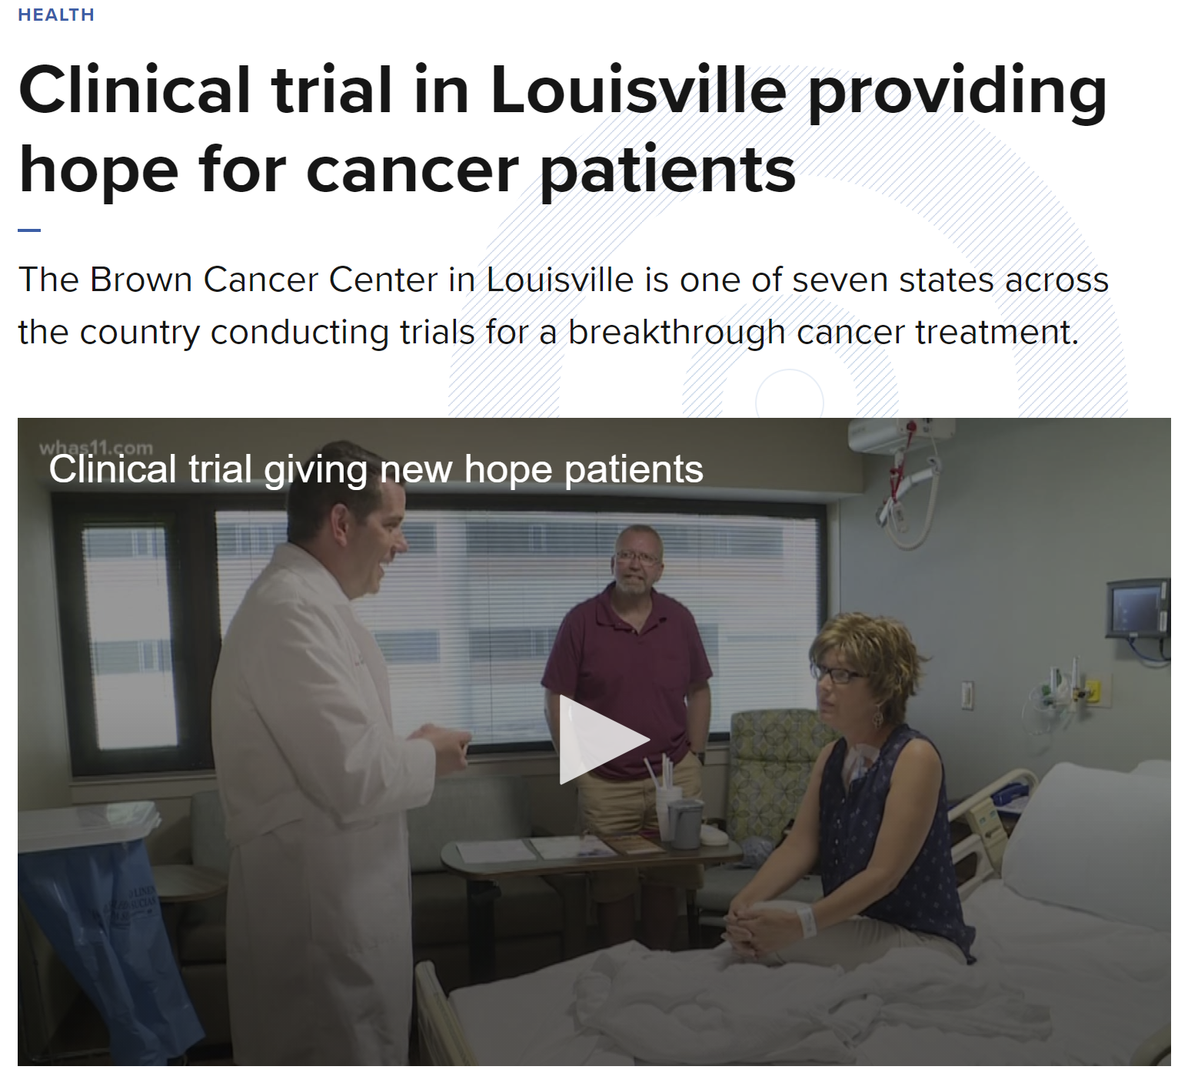
Develop Novel Cellular Immunotherapies
Tumor Infiltrating Lymphocytes (TILs)
Cervical Cancer

Slide 26
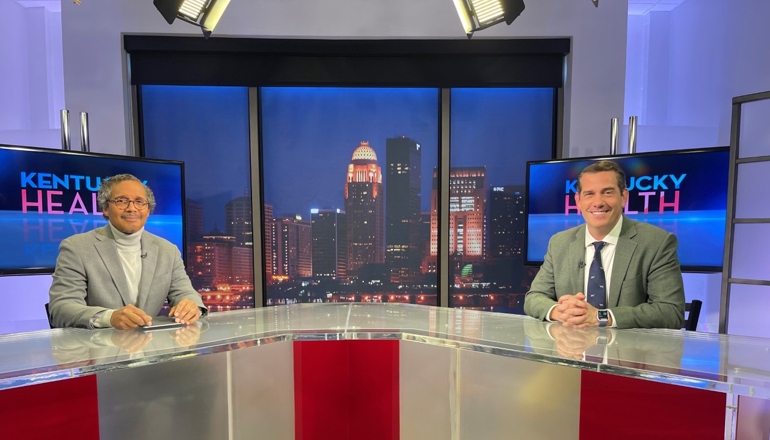
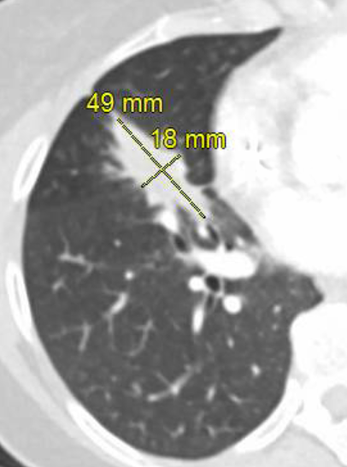
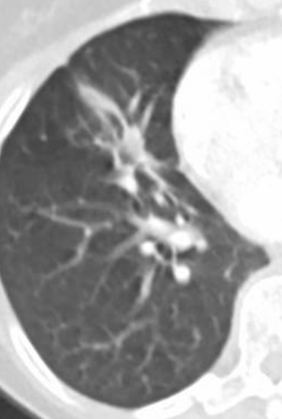

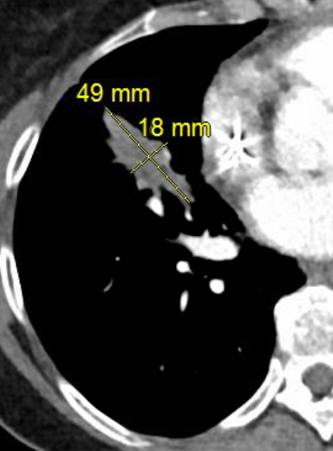
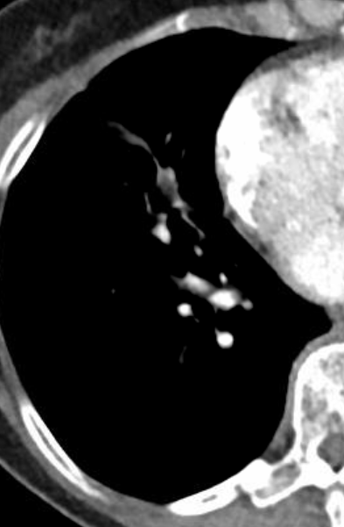
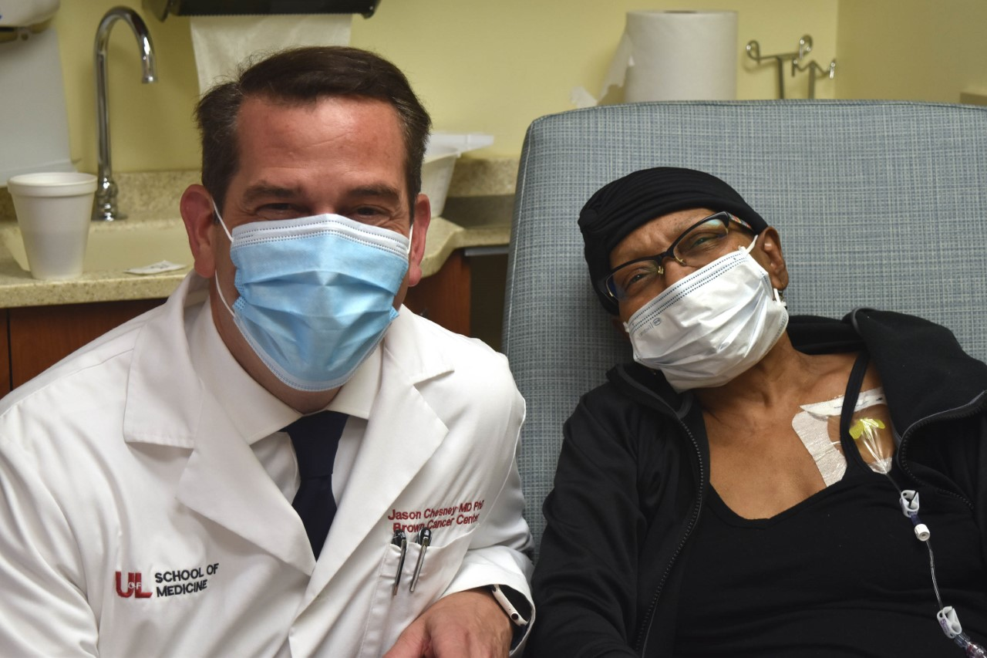
Develop Novel Cellular Immunotherapies
Tumor Infiltrating Lymphocytes (TILs)
Lung Cancer
June 2021
Nov 2021

Slide 27
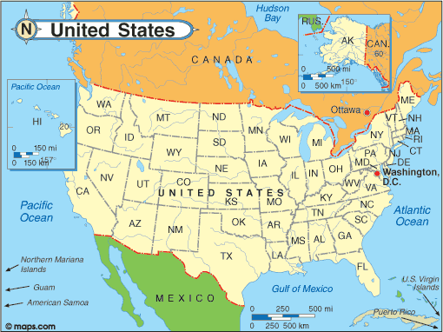
Develop Novel Cellular Immunotherapies
Tumor Infiltrating Lymphocytes (TILs)
X
X
X
X
X
X
X
X
X
X
X
X
X
X
X
25% of Patients Come From Other States

Slide 28
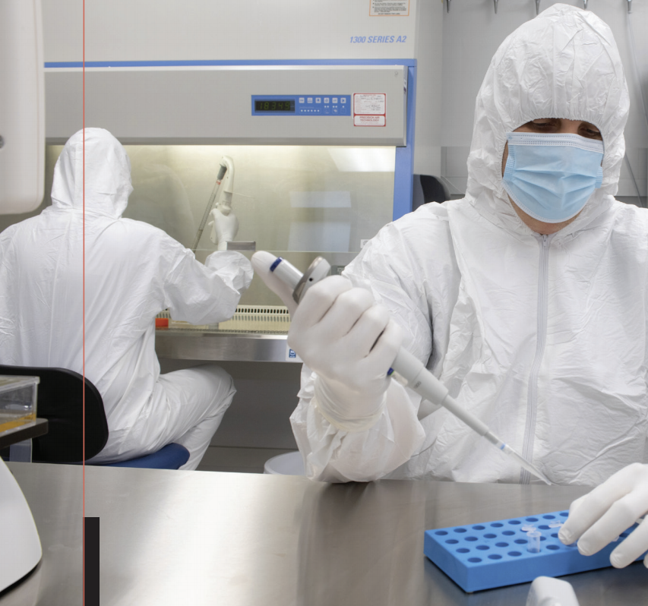
Develop Novel Cellular Immunotherapies
Including TILs and CAR T Cells
TILs for cervical cancer, H&N, new NSCLC cohorts,
Phase 1 testing PD-1 KO TILs in multiple solid tumors (using talen)
CAR T cells specific for CD4+ T cell leukemias/lymphomas, B cell malignancies, ALL, multiple myeloma, neuroblastoma/melanoma
  UofL Health BCC now has dedicated CAR T cell GMP lab
  First-in-class anti-CD4 CAR T cell human trial initiated
  Expanding to five trials targeting six cancers over next 3 years
30/30

Slide 29
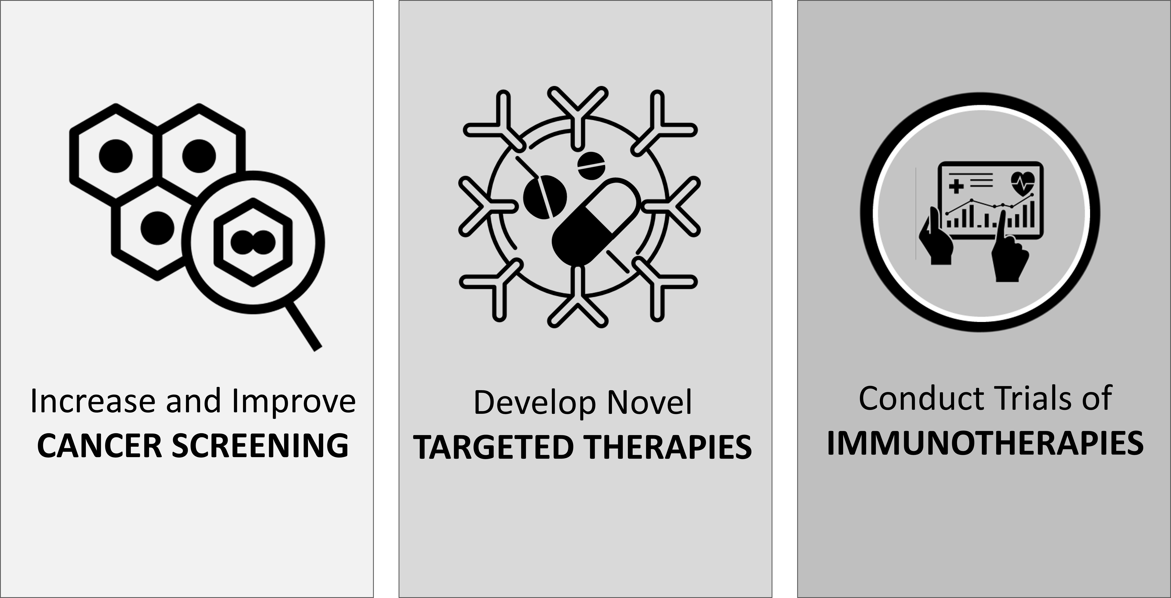
Your Support Is Needed to Reduce the Cancer Death Rate in Kentucky by 30% Over the Next Five Years
Thank You!
Without the $3.4M from the Tobacco MSA we will not meet our goal

