Slide 1
Kentucky Office of the Attorney General Involvement in Tobacco Enforcement and the Master Settlement Agreement Tobacco Settlement Agreement Fund Oversight Committee May 18, 2021

Slide 2
Master Settlement Agreement Background
Kentucky and 51 other states and territories signed the Master Settlement Agreement(“MSA”) in November 1998 with the major US tobacco companies.
Four states have their own MSAs: MS, MN, TX and FL.
States dropped lawsuits over smoking-related costs in return for annual payments from the companies to address these expenditures, as well as marketing restrictions to reduce youth smoking.
Allegations in the state suits included youth targeting, fraud regarding the health effects of cigarettes and nicotine, conspiracy and defective design.

Slide 3
MSA Background (cont.)
MSA payments are based on cigarettes sold in the US by the participating manufacturers.
The payments are calculated by an independent auditor, currently Price Waterhouse.
Kentucky has received $2.4 billion so far.
Payments will continue as long as MSA companies sell traditional cigarettes or Roll Your Own(“RYO”), but money was not the only goal of the MSA.

Slide 4
MSA Background (cont.)
MSA marketing restrictions included limits on advertising only possible through agreement without years of litigation.
The MSA parties “are committed to reducing underage tobacco use by discouraging such use and by preventing Youth access to Tobacco Products.”
Attacking youth smoking reduces health costs in the long run as well as improving health as most smokers become addicted by age 20.
The MSA created and funded a foundation(first “American Legacy,” now “Truth”) with the purpose of reducing youth smoking.
Substantial reductions in youth smoking as well as adult rates have occurred (now 10-15% compared to 30-35% in 1998).
State funding for Kentucky's tobacco control programs comes from annual MSA payments, along with agricultural diversification and other important programs.

Slide 5
MSA Background (cont.)
MSA marketing restrictions include:
Prohibiting “youth targeting” by tobacco companies
Ban on cartoons in ads
Limitations on brand name sponsorships
Ban on outdoor advertising/billboards
Ban on brand name merchandise, free samples, misrepresentation of the health effects of smoking

Slide 6
MSA Background (cont.)
The Attorneys General from MSA states have working groups designed to investigate and enforce MSA violations as well as to maximize payments from the companies.
Marketing, nationally and at retail, is reviewed to look for compliance issues and some cases have been filed by states.
Ad placement in magazines, Kool Mixx, Camel Farmrocks, and Eclipse are some examples of state actions.
With FDA authority expanded since 2010, some enforcement has moved to the federal level.

Slide 7
Kentucky MSA-Related Legislation
2000: ALLOCATION OF MSA FUNDS (KRS 248.654)
ESCROW STATUTE (KRS 131.600-131.602)
MSA COMPLIANCE ADVISORY BOARD (KRS 15.300)
2003: DIRECTORY STATUTE (KRS 131.604-131.630)
2015: ENHANCED ESCROW ENFORCEMENT (various KRS)

Slide 8
Kentucky MSA-related legislation (cont.)
ALLOCATION OF MSA FUNDS:
Divided MSA proceeds into three accounts:
50%-agricultural development/diversification,
25%-early childhood development,
25%-health care improvement.
ESCROW STATUTE:
Required non-MSA cigarette makers to escrow about the same per carton as MSA companies pay to the states per carton;
Currently over $100 million deposited in escrow accounts for KY sales.
MSA COMPLIANCE ADVISORY BOARD:
Created a six-member board to review and discuss potential MSA violations in quarterly meetings (OAG, Health, Public Protection and Agriculture agencies represented, along with two citizen members).

Slide 9
Kentucky MSA-Related Legislation (cont.)
DIRECTORY STATUTE:
Created tobacco directory to require manufacturers to certify each year to be listed on the approved list of brands to be stamped. (Currently 18 MSA companies and 10 non-MSA companies are listed).
OAG reviews and approves changes.
DOR and OAG jointly enforce and coordinate to create and post the directory of approved brands with changes to it as needed.
ENHANCED ESCROW ENFORCEMENT AMENDMENTS:
Bonding for all non-MSA companies to ensure compliance ($50k+)
Made delisted cigarettes contraband after 30 day notice of removal
Joint liability for importers must be agreed to for certification

Slide 10
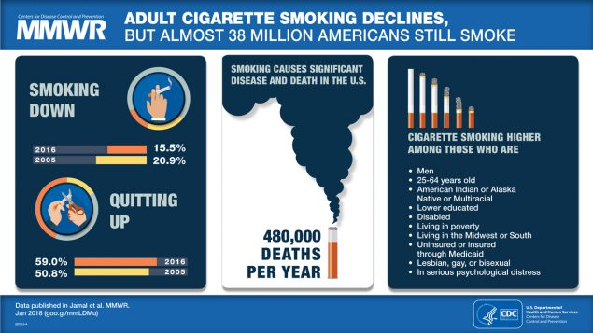

Slide 11
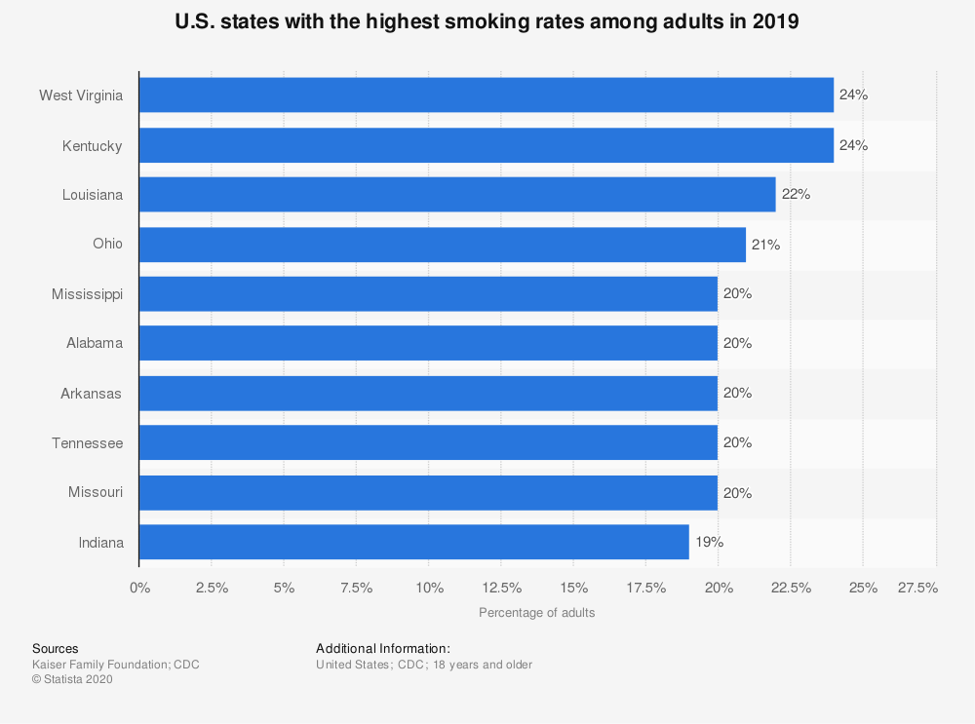

Slide 12
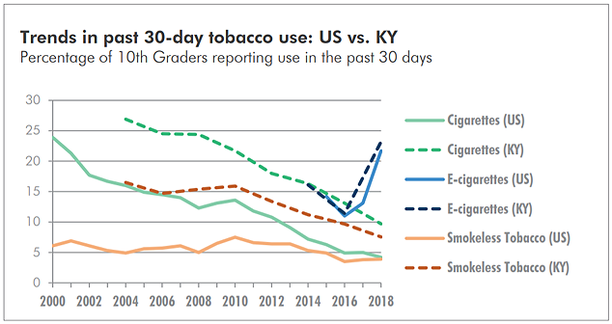

Slide 13
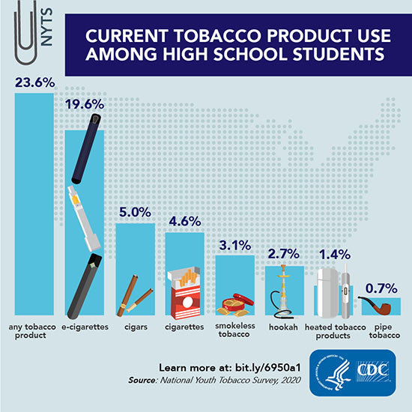
https://www.cdc.gov/tobacco/data_statistics/fact_sheets/youth_data/tobacco_use/index.htm

Slide 14
The Toll of Tobacco in Kentucky
High school students who smoke: 8.9% (21,000)
High school students who use e-cigarettes: 26.1%
Kids (under 18) who become new daily smokers each year: 1,800
Adults in Kentucky who smoke: 23.6% (817,900)
Proportion of cancer deaths attributable to smoking: 34.0%
Adults who die each year from their own smoking: 8,900
Annual health care costs in Kentucky directly caused by smoking: $1.92 billion
Source: Campaign for Tobacco-Free Kids

Slide 15
Recent Kentucky Annual MSA Payments
2021: $127 million
2020: $112 million
2019: $117 million
2018: $102 million
2017: $93 million
2016: $90 million

Slide 16
Potential Causes of Future Declines in MSA Payments
MSA brand sales decline.
MSA payments are based on national excise tax-paid cigarette volumes of the participating companies.
Reductions in the volume of those sales in the future will reduce MSA payments. Such sales had been declining 2-4% each year, until 2020 when sales stayed the same as the prior year.
Sales of non-MSA brands also reduce state payments.

Slide 17
Potential Causes of Future Declines in MSA Payments
E-cigarettes/vapor/”Heat not burn” product sales growth.
These products which are generally not covered by MSA payments are estimated to displace a growing share of the traditional cigarette market.
Altria has obtained FDA approval for sale of IQOS products (heat not burn). https://csnews.com/heat-not-burn-next-big-thing-tobacco.
Other non-MSA products include e-cigarettes, oral pouches/SNUS and little cigars.

Slide 18
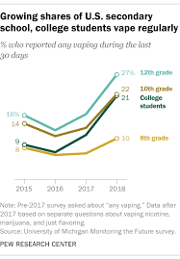
E-cigarette use increasing

Slide 19
The Future of MSA Payments
MSA payments will continue as long as cigarettes are sold by the party tobacco companies.
As sales of traditional cigarettes decline, that trend will lower future payments.
Kentucky must continue to enforce the escrow statutes against non-party companies to avoid and reduce NPM adjustments.
Payments have averaged $110 million over the twenty years of the agreement so far.
There is no limit in years of payments in the agreement.

Slide 20
Office of the Attorney General
Michael Plumley
Assistant Attorney General
Michael.Plumley@ky.gov
(502) 696-5613
Carmine Iaccarino General Counsel Carmine.Iaccarino@ky.gov (502) 696-5369
Vic Maddox Associate Attorney General Victor.Maddox@ky.gov (502) 696-5336

