Slide 1


TOBACCO SETTLEMENT FUND UPDATE
B. Mark Evers, MD
December 19, 2022

Slide 2

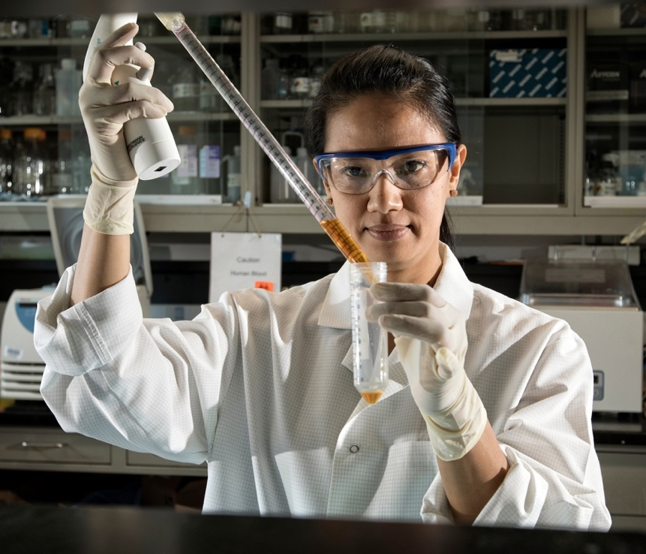

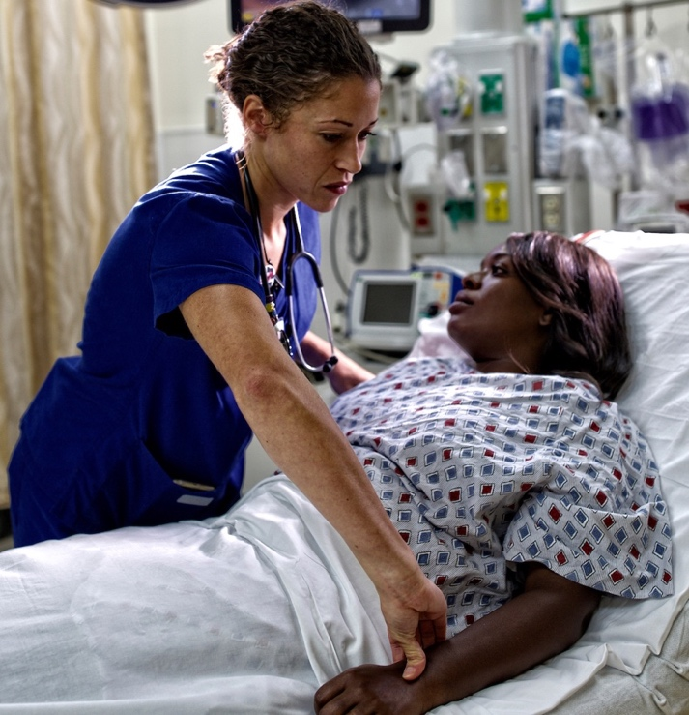
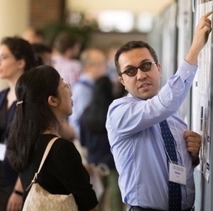
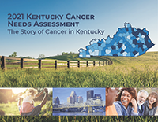
Our Mission
To reduce the cancer burden with a focus on Kentucky and its most vulnerable populations through research, prevention, treatment, education and community engagement.

Slide 3
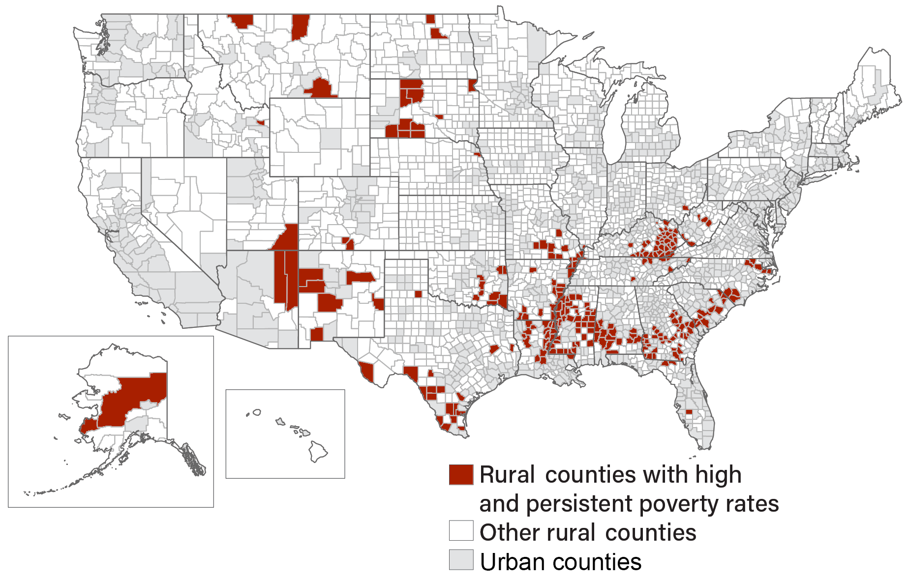
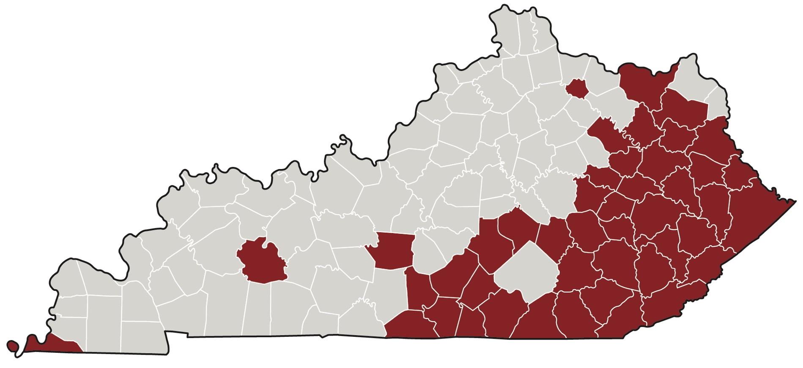
Kentucky Challenges
Persistent Poverty
17% Live in poverty
45 counties with persistent poverty
Smoking
Obesity
Low education
Cancer burden
Source: USDA, Economic Research Service using data from U.S. Census Bureau

Slide 4
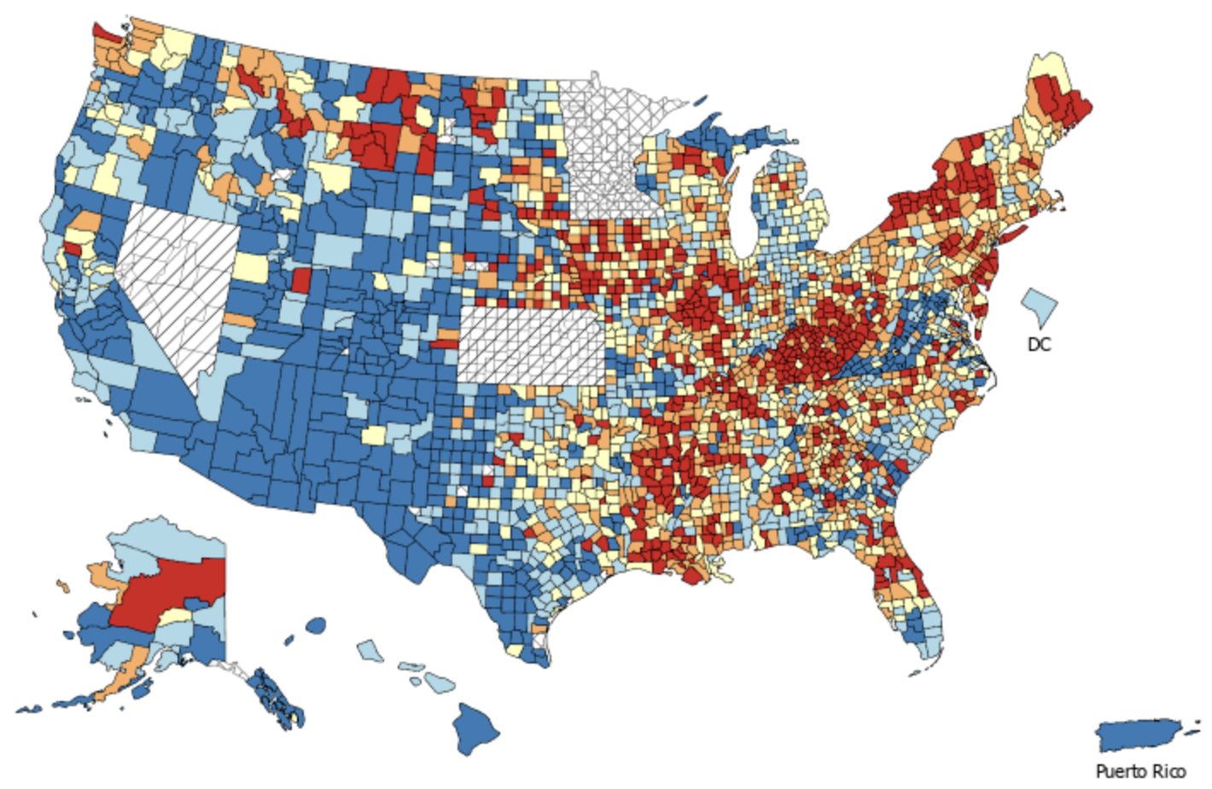
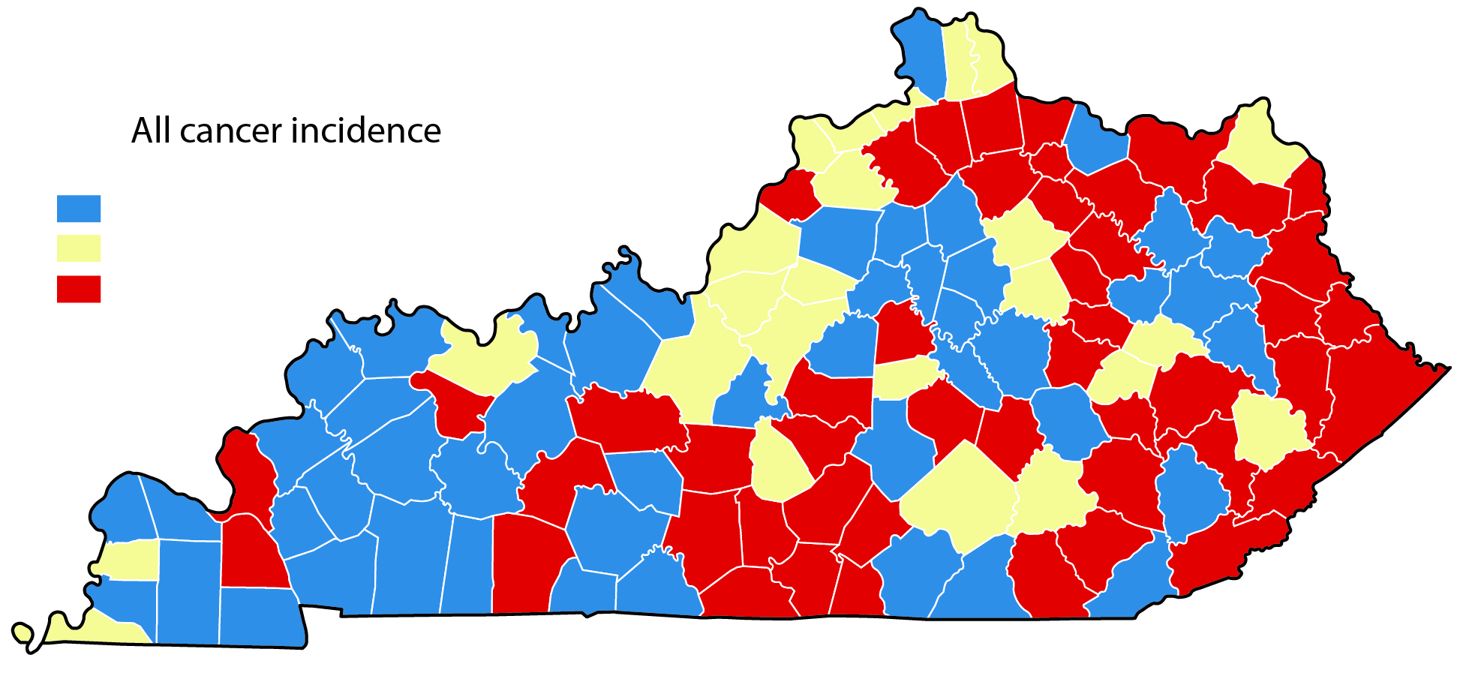
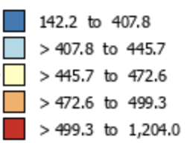
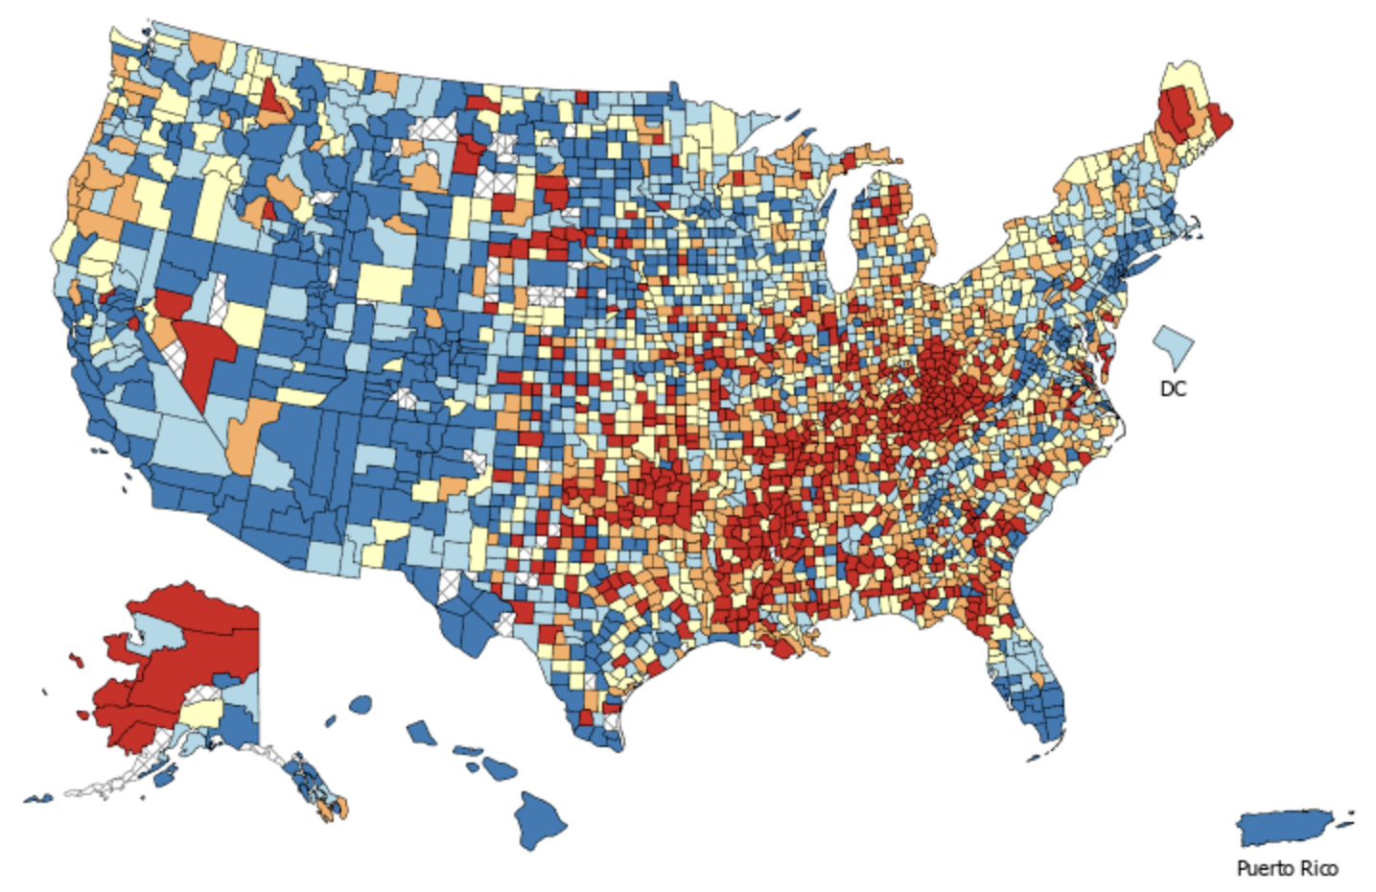
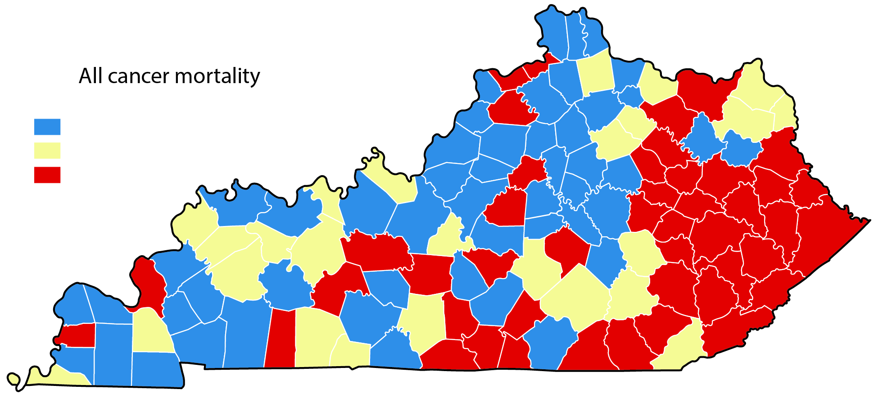
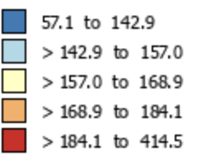
Kentucky’s Cancer Burden
#1
All Cancer Incidence
2015 -2019
All Cancer Incidence
2015-2019
353.7 to 506.7
506.8 to 530.6
530.7 to 620.5
All Cancer Mortality
2016-2020
#1
All Cancer Mortality
2016-2020
143.5 to 190.9
190.1 to 202.6
202.7 to 267.4
Source: NIH NCI State Cancer Profiles
Notes:
Kentucky’s cancer burden has recently been highlighted in several national reports:
[ANIMATE] 6 of the 10 U.S. counties with the highest cancer death rates are in Kentucky
[ANIMATE] We have very high colorectal and lung cancer mortality rates
[ANIMATE] And we have the highest incidence of HPV-related cancers among men and women in the U.S.

Slide 5

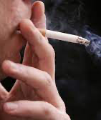
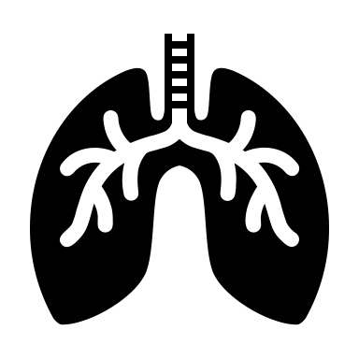




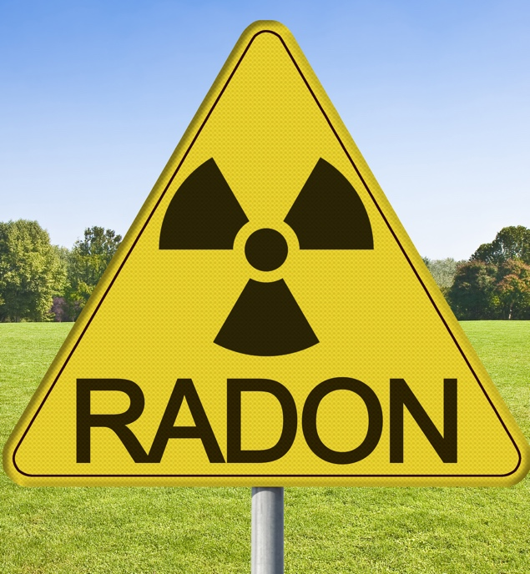
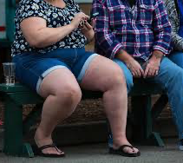





Addressing Kentucky’s Challenges
MCC Research Priorities FY19–FY23
Cancers
Risk Factors
Lung
Colorectal
Head & Neck
Cervical
Melanoma
Tobacco
Obesity
Viruses: HPV, HCV
Environmental
Exposures
Geographic and Racial/Ethnic Disparities*
(*Including prostate and breast cancers)

Slide 6

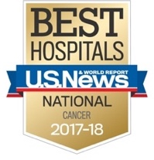
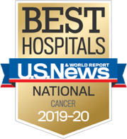
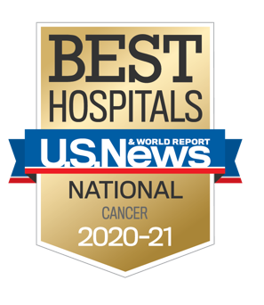
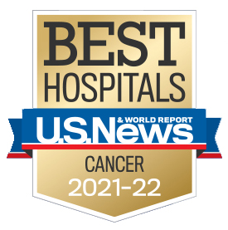
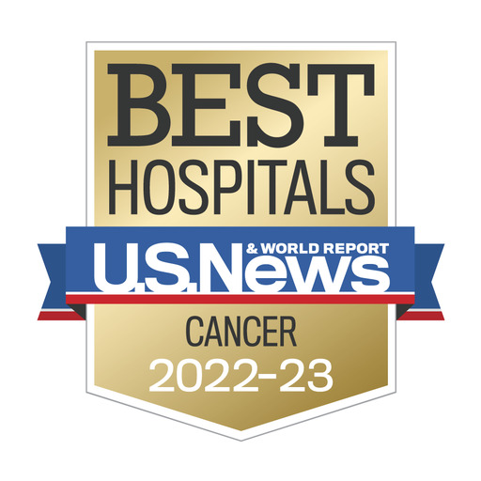

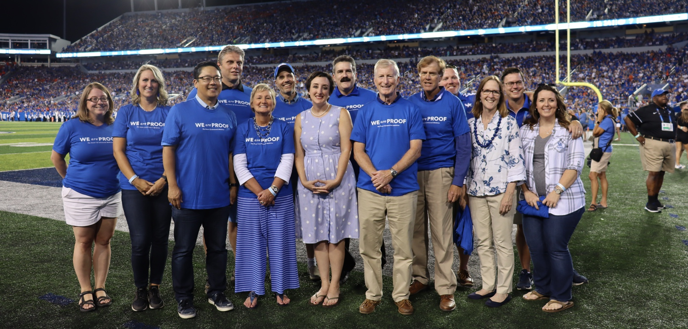
IMPACT OF STATE FUNDING:
Achieving NCI Designation and National Recognition
Ranked in the Top 50 Best Hospitals for Cancer Care for 6 Straight Years

Slide 7
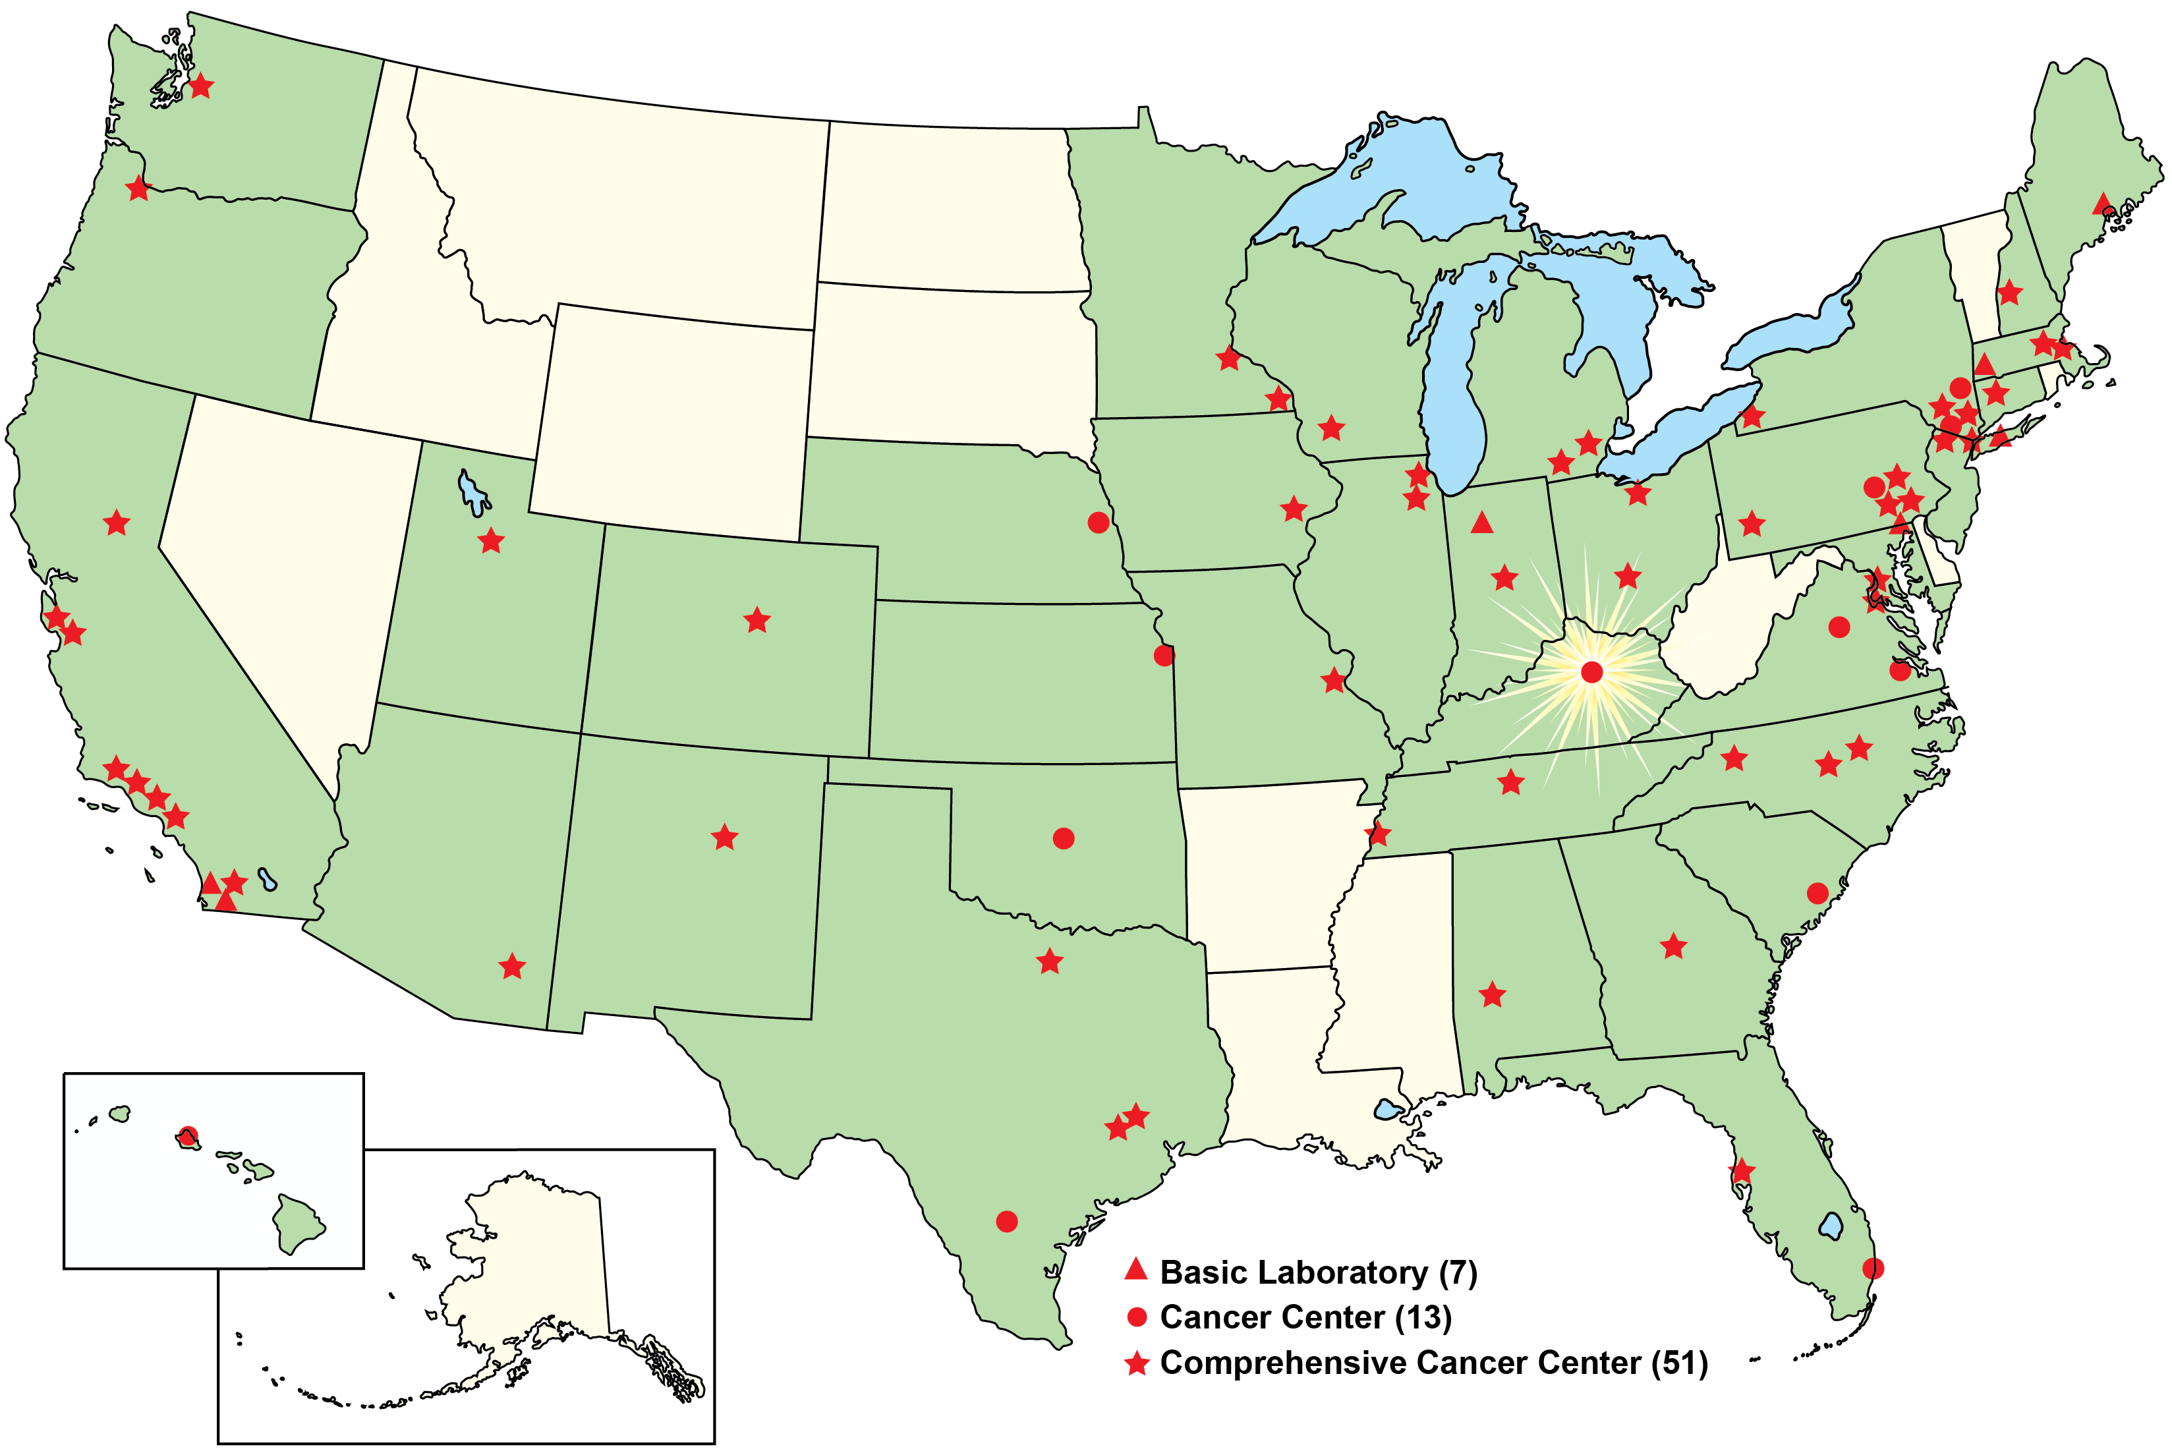
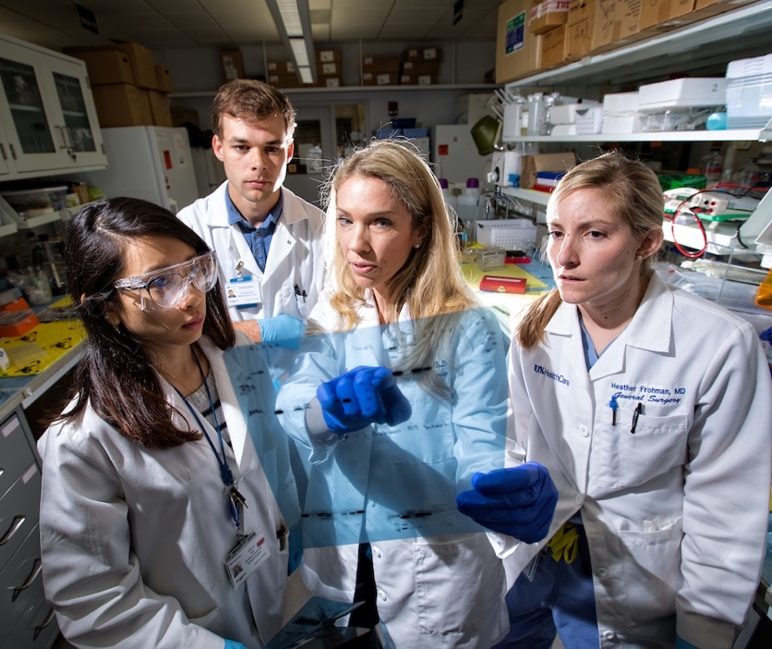
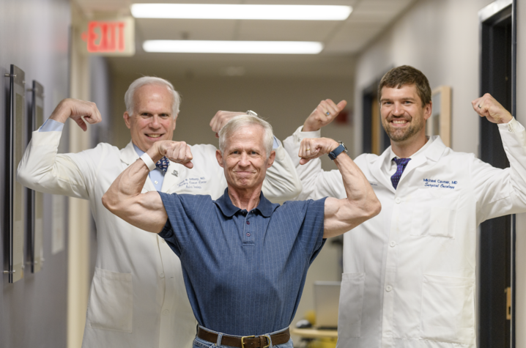
Markey Cancer Center (MCC) National Cancer Institute (NCI) Designation Path
July 2013
Awarded initial designation (five years)
July 2018
Successful renewal for another five years
October 3, 2022
Application for Comprehensive Status
February 7, 2023
Site visit for Comprehensive Status
July 12, 2013
MCC became the
68th NCI-Designated
Cancer Center
in the United States

Slide 8

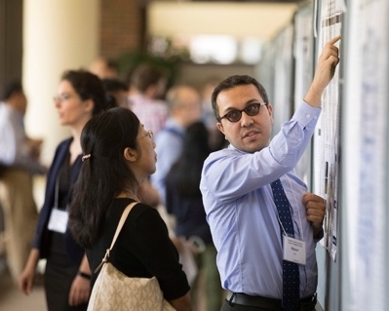
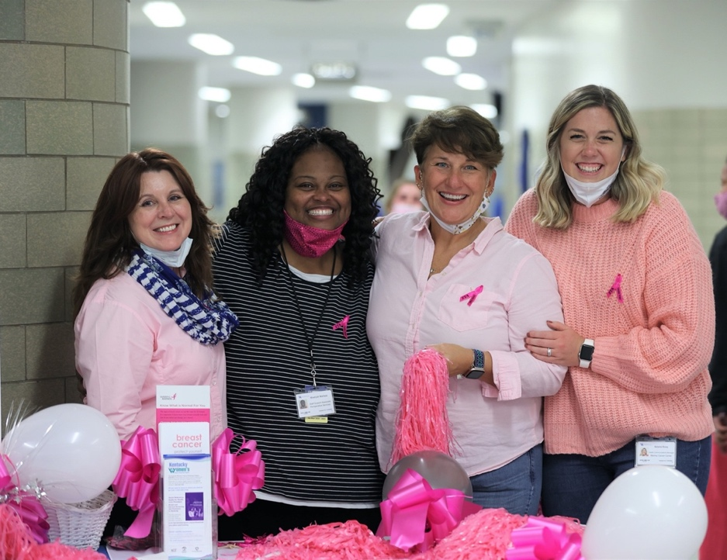
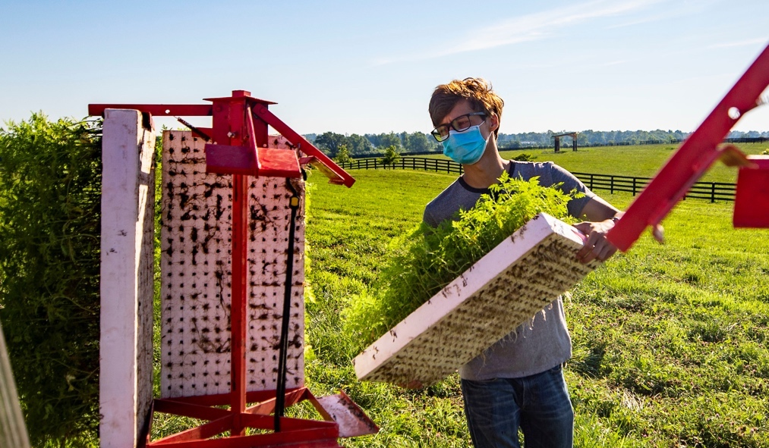
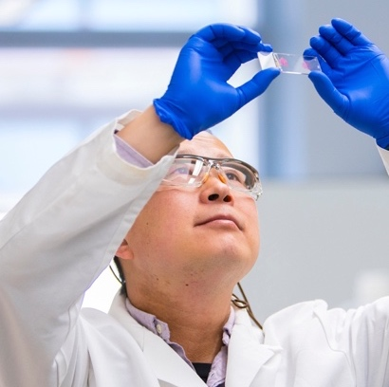

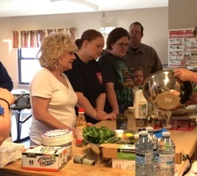
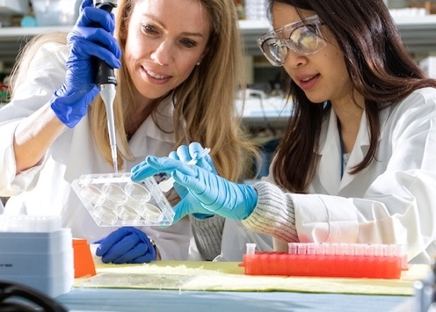
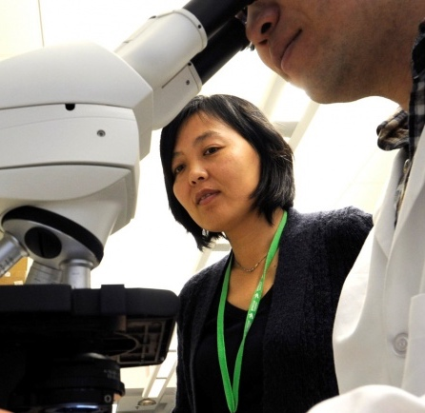
What Achieving NCI Designation Has Meant to Kentucky

Slide 9
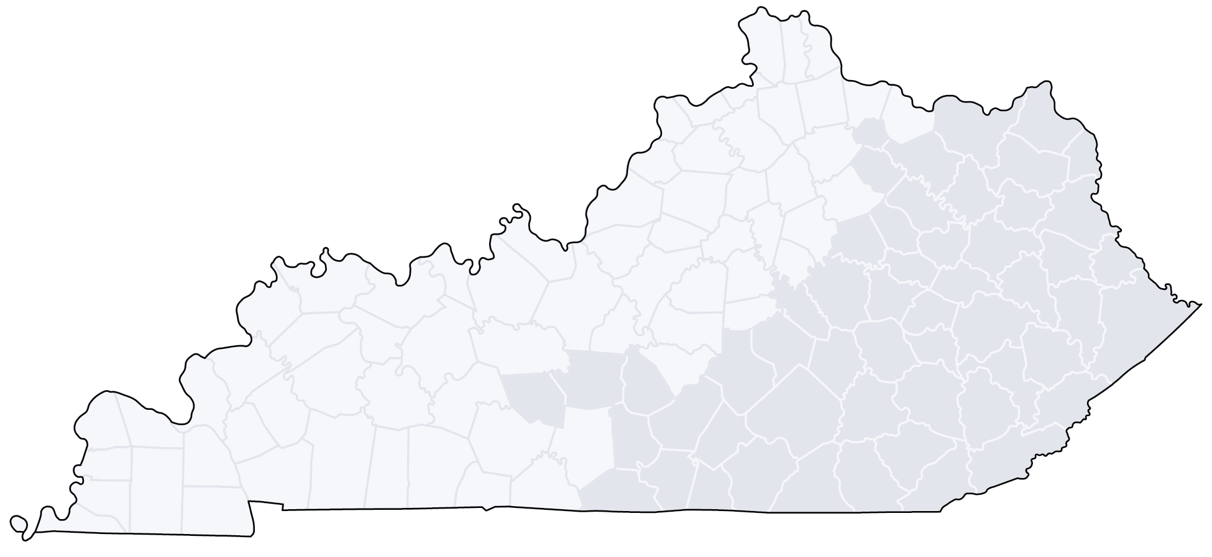
MCC Impact
MCC NETWORK SITES
MCC NETWORK SITES
~47% of all new cancer cases in KY (2020) were directly or indirectly cared for by MCC
~47% of all new cancer cases in KY (2020) were directly or indirectly cared for by MCC
19 MCC Affiliate Sites
19 MCC Affiliate Sites
CLINICAL TRIAL ACCRUALS
CANCER CARE
CLINICAL TRIAL ACCRUALS
CANCER CARE
Patients from 120/120
Kentucky counties
in 2020
Patients from 120/120
Kentucky counties
in 2020
Individuals enrolled from 105/120
Kentucky counties
in 2020
Individuals enrolled from 98/120
Kentucky counties
in 2020

Slide 10
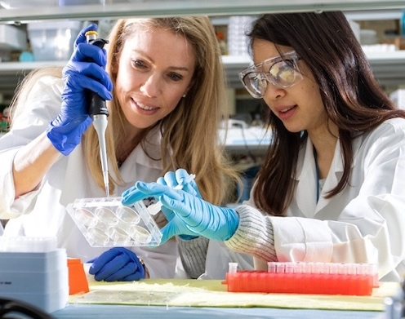
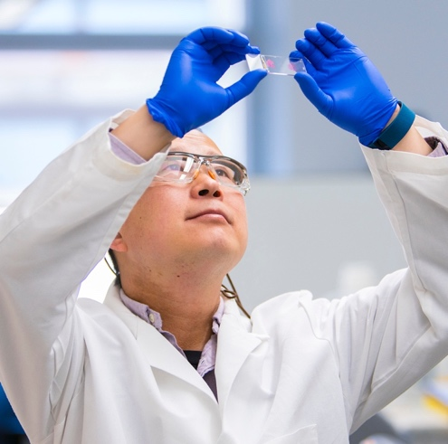
What does it mean to be an
NCI Comprehensive Cancer Center?
Taking it to the Next Level
More funding, which equates to more research, more cancer screening and prevention and more clinical trials
Increased draw of patients from the region and nationally
Increased ability to attract nationally and internationally recognized cancer researchers and oncologists
More opportunities to offer cutting-edge, early phase trials with the latest cancer treatments
Expanded opportunities for special initiative grants
Increased private donations
Increased community engagement (volunteers, patient advisory groups, education and intervention programs)

Slide 11
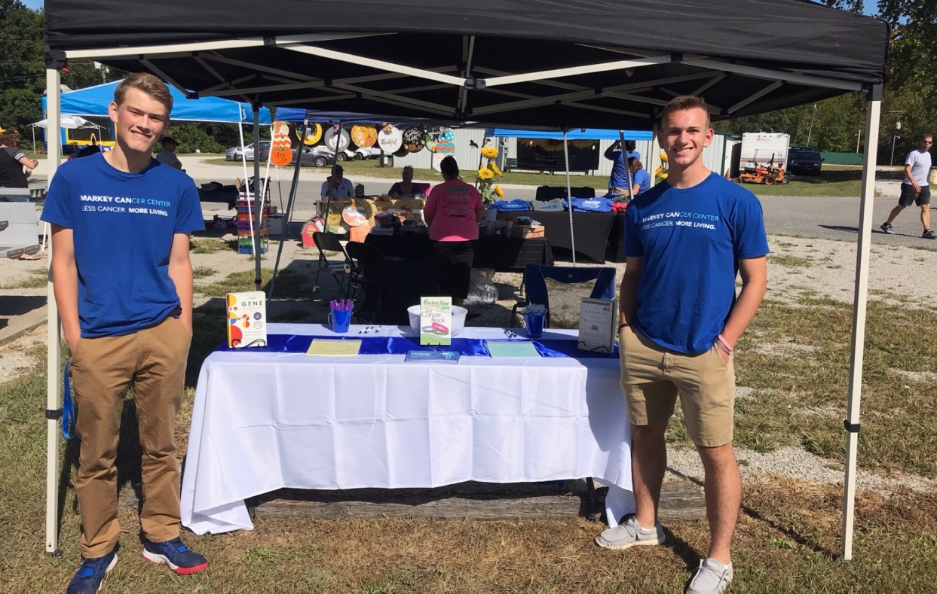
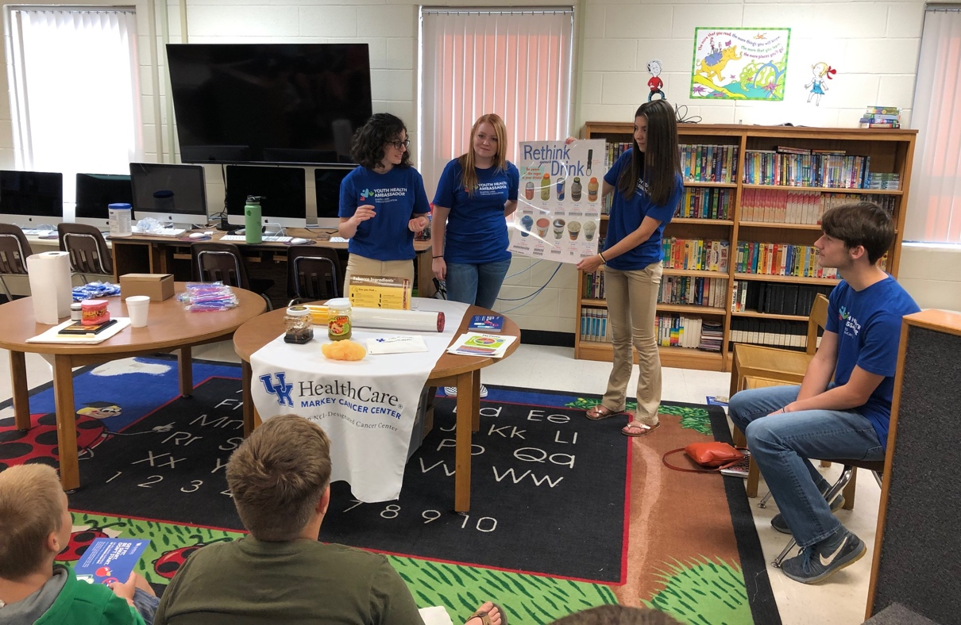
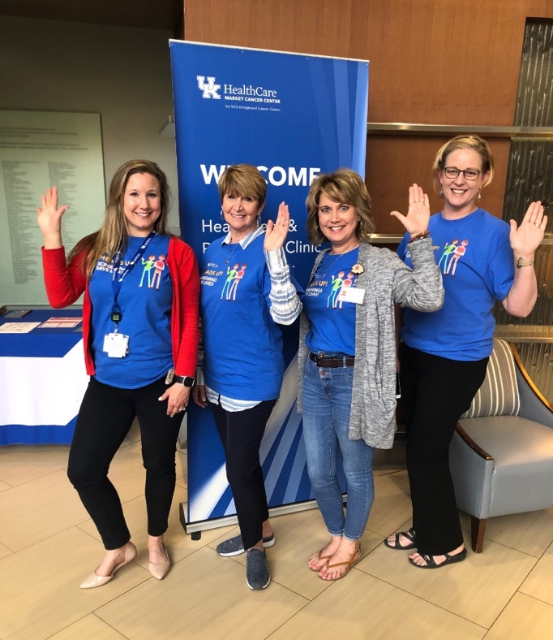
Impact of 2022-2023
state cancer prevention and research funding to MCC

Slide 12
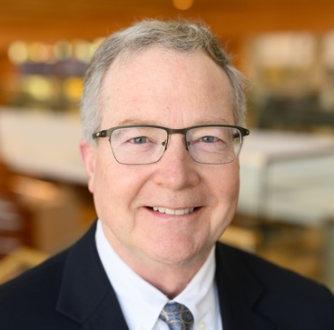

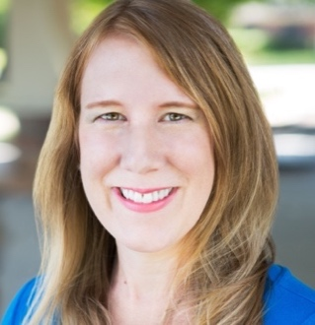
Leading the Nation in Lung Cancer Screening
20
Lung Cancer Screening Rate,
by state (2020)
KY is #2!
90
Appalachian
KY
19% drop
MA
3x faster decline than US
KY
15
80
ME
KY
MULLETT
ND
NH
Proportion of eligible adults screened for lung cancer
WI
IA
10
Late-Stage Incidence
VT
SD
70
US Average
ID
VA
MO
PA
KS
OR
MI
NC
DE
IL
MT
TN
WA
MN
IN
CT
OH
5
GA
AL
NY
MS
AK
MD
RI
CA
2x faster decline than US
WV
ME
60
HI
NJ
FL
CO
LA
AR
NM
UT
TX
OK
AZ
BURRIS
0
CA
50
States
2009
2011
2013
2015
2017
2019
“Kentucky, which has supported screening implementation efforts, is unique as its screening rates are over twice the national average and four times that of other high lung cancer burden states, like West Virginia and Arkansas.”
—ASCO post, 2021
Policy changes:
2018 | Cigarette tax increased from $0.60 to $1.10 (House Bill 366)
2019 | 100% Tobacco-Free Schools policy (House Bill 11)
2022 | Kentucky Lung Cancer Screening Program created (House Bill 219)
KNIGHT
FUNDING
  R01 CA254734; Bristol Myers Squibb; CDC NU58 DP0063130-04-02; CDC NU58 DP007144-01-00

Slide 13
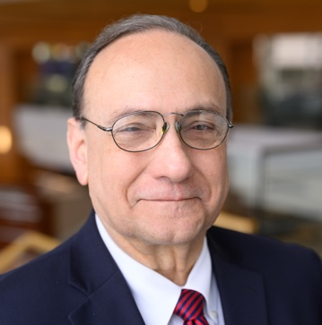
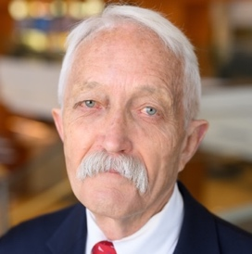

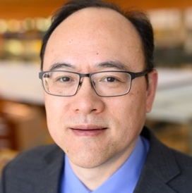
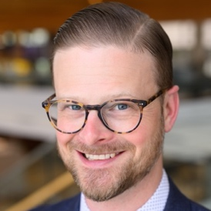
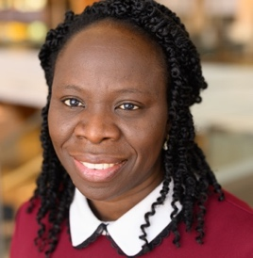
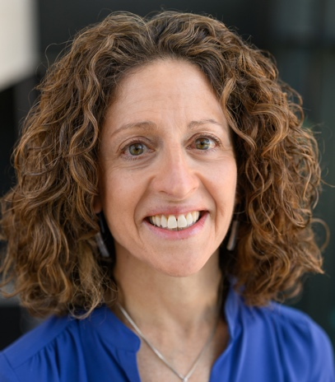
Impacting Colorectal Cancer (CRC) Mortality
Screening
17th
1 of 5 Accelerating Colorectal Cancer Screening and Follow-Up Through Implementation Science (ACCSIS) grants funded
TUCKER
DIGNAN
Age-Adjusted Rate
per 100,000
KNIGHT
HUANG
49th
KRUSE-
DIEHR
ADEGBOYEGA
Impact
CRC incidence rate decreased by 30% and mortality by 34%.
650 fewer Kentuckians are diagnosed with CRC and 275 fewer die from this disease every year.
Incidence
Mortality
30%
34%
SCHOENBERG
FUNDING
  UH3 CA233282
PUBLICATIONS
  Implement Sci Comm (2021); J Cancer Edu (2021)
Notes:
Dr. Mark Dignan is co-leading a NCI Moonshot project as part of the Accelerating Colorectal Cancer Screening Through Implementation Science program (also known as ACCSIS). This program is designed to implement evidence-based screening efforts simultaneously with the community, clinical providers, and health care delivery systems in rural Appalachian counties throughout Kentucky and Ohio and in a manner that is sustainable after the project ends. In their initial publications, Dr. Dignan and colleagues describe how community partners provided guidance that led to critical project design decisions. For example, they have developed a menu of strategies for clinical and community partners to implement, rather than a single multi-level intervention, to account for differences in capacity and community needs. They also describe the need for flexible approaches to collecting outcome metrics to account for differences in reporting capacity for partner hospitals. As one of the first large-scale trials of a multi-level community intervention for cancer screening implementation, the guidance and lessons learned go well beyond this study to contribute significant insights into our understanding of the nascent field of cancer D & I science.
LEFT: Led by Dr. Tucker, the MCC worked with its community partners to implement evidence-based programs designed to increase CRC screening. These efforts raised the CRC screening rate (Click) from 34.7% of the eligible population in 2000 to (Click) 75.4% of the eligible population in 2018 and Kentucky rose from 49th in CRC screening to 17th. (Please note the BRFSS questions about CRC screening are ask every 2 years. I did not include the CRC screening rates for 2020 because the are artificially low due to COVID. This is the same for the CRC incidence rates for 2020).
MIDDLE: Following the implementation of our efforts to increase CRC screening, the CRC incidence rate has dropped (Click) from 68.8 per 100,000in 2021 to (Click) 48 per 100,000 in 2019. This represents a 30% decrease in the CRC incidence rate.
RIGHT: As a result of these efforts (Click) the CRC mortality rate also declined dramatically resulting in a 34% decrease in the CRC mortality rate. To put this in perspective, a 30% decrease in the CRC incidence rate means that more than 650 Kentuckians are no longer diagnosed with CRC each year and a 34% decrease in the mortality rate means that 275 fewer Kentuckians die from CRC each year.

Slide 14
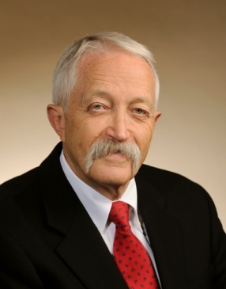
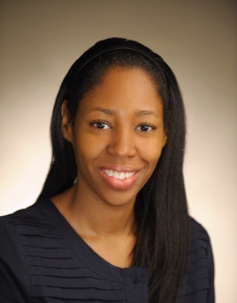

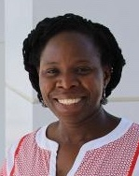
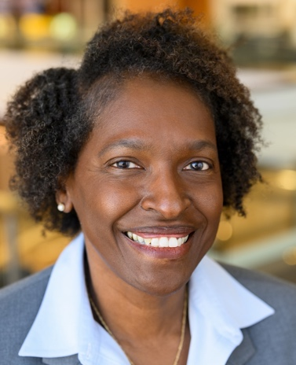



Cervical Cancer Prevention in Appalachia
OSU
WVU
DIGNAN
BURRIS
MCC
APPALACHIA
UVA
ADEGBOYEGA
WILLIAMS
CANEDO
HULL
FUNDING
P01 CA229143; R01 CA207401

Slide 15









Addressing the Burden of Hepatitis C Virus Infection in Rural Appalachian Kentucky
Kentucky has the 5th highest rate of new HCV infections in the U.S.
Positive Confirmatory HCV Results
(Jan. 2017 – June 2019)
Medication
HAVENS
93%
Sustained virologic response
Case
Management
Mid-level
Providers
MCC
Substance
Use Disorder
RPA
Syringe
Services
Rate per 100,000
62.3–353.3
353.4–703.9
704.0–1142.1
1142.2–2609.9
Removing structural barriers to treatment
Impact
One of the first U.S. “micro-elimination” trials
Eradicating HCV in one of the highest risk counties in the US
Model of HCV treatment for rural areas impacted by the opioid epidemic
  FUNDING
  R01 DA047952; R01 DA033862
Notes:
Since 2009, Kentucky has the highest incidence of acute hepatitis C infections in the nation driven by an increase of injection of opioids in rural Appalachia. Dr. Jennifer Havens leads a 13 year cohort study of over 500 rural individuals who use drugs in rural Perry County -- a rural Appalachia county ranked among the top 5 US counties at highest risk for HCV outbreaks. She found that 50% of participants were HCV seropositive at enrollment; yet, only 8% received treatment. To address this, Dr. Havens launched the KeY Treat study -- a phase IV single arm, community-level trial testing the implementation and cost-effectiveness of multi-pronged implementation strategies such as free medication, syringe services, case management, mid-level providers to remove structural barriers to treatment. KeY Treat is unique in that National Institute on Drug Abuse and NCI jointly funded the study, while Gilead Sciences donated $50M worth of medication. To date, 338 residents have been enrolled, 75% completed treatment and 93% achieved sustained virologic response. KeY Treat is one of the first “micro-elimination” trials in the US and is using cost-effective strategies that can be disseminated to other rural areas impacted by the opioid epidemic.
Old Script:
Kentucky has the 5th highest rate of new hepatitis c virus infections in the country as a result of an opioid epidemic that negatively impacts our state and nation. Perry county in far eastern kentucky has one of the highest rates of hcv infection in the us, and while the statewide incidence rates of new hepatocellular cancers have doubled over the last 10 years, rates in perry county have increased at an even faster pace. These alarming increases prompted dr. Jennifer havens in our cp program to engage investigators in the drug and alcohol abuse rpa, to develop a plan to address this crisis. With enthusiastic support from dr. Doug lowy, interim director of nci at the time, and dr. Nora volkow, director of the national institute on drug abuse, a plan was formulated that culminated in the awarding of a multi-million dollar grant from nci and nida and donation of drug from gilead sciences for an exciting and first of its kind micro-elimination project, led by dr. Havens. Perry county residents, ages 18 and over who are hcv rna-positive, are eligible for no-cost treatment, and to date, 338 residents have been treated with 93% achieving sustained virologic response. This project offers the potential to eradicate hcv in one of the highest risk counties in the u.s. and within a high-need, yet underserved population.

Slide 16











Working with Community Partners to Address Concerns over Safe Drinking Water
Martin County
UNRINE
HOOVER
Letcher County
CHRISTIAN
HAHN
MCC
UK CARES
Community
Partners
Impact
Combining citizen science and multi-directional stakeholder engagement to reduce exposure to carcinogenic drinking water in this economically distressed Kentucky county.
FUNDING
  P30 ES026529; R01 ES032396
Notes:
Project Description:
The Martin County Kentucky Coal Slurry Spill in October 2000 released 300 million gallons of coal slurry into local waterways marking one of the largest disasters east of the Mississippi River. Martin County residents became distrustful that the poorly maintained drinking water treatment plant would be able to fully treat the contaminated water. For may years residents had periodically noticed discolored, foul smelling water emanating from their faucets due to line breaks and began receiving warnings on their water bills that their tap water was not in compliance with the Safe Drinking Water Act for disinfection byproducts (DBPs). Concerned for their health, residents worked with the Appalachian Citizen’s Law Center to form Martin County Concerned Citizen organization approached the UK Center for Appalachian Research in Environmental Sciences (UK-CARES) led by Ellen Hahn (CP). Dr. Hahn brought in Jason Unrine (CP), an environmental toxicologist, to help the residents assess the problem. With pilot funding from UK-CARES, Dr. Unrine (CP) led a study that sample drinking water from 97 randomly selected homes and found high levels of disinfection byproducts (DBPs). DBPs are the most common drinking water violation in the United States and in Kentucky and are associated with development of urinary and digestive cancers as well as cardiac birth defects. Drs. Unrine and Anna Hoover were recently awarded an MPI R01 to work directly with community partners to expand this study through-out Martin and Lechner County. This project focuses on increasing environmental health literacy among stakeholders, engaging citizen scientists to simultaneously sample drinking water across the counties and to model the drinking water systems to identify points of intervention to improve water quality.

Slide 17





Taking ACTION Appalachian Career Training In Oncology to Train Appalachian Students
Impact
116 Appalachian students trained (60 high schoolers; 56 undergraduates)
  25 attending medical schools
  3 in pharmacy school
  1 in graduate school (PhD)
  3 in physician assistant Master’s program
  18/20 of eligible high school students have matriculated to college
VANDERFORD
MCC
36 of 54 Appalachian counties
FUNDING
R25 CA221765
Markey Cancer Foundation
Notes:
Bocklage is also a collaborator.

Slide 18
Support From the State has Provided:
Critical funding for cancer screenings throughout the state
Funding for new recruitment and retention of cancer investigators
Pilot funding for new cancer research projects
Funding for new clinical trials

Slide 19
WE NEED YOUR
CONTINUED SUPPORT!

Slide 20

Thank you!

