Slide 1
KY Tobacco Prevention & Cessation Program
A Presentation for the Tobacco Settlement Agreement Fund Oversight Committee
September 15, 2022

Slide 2
The Human Toll of Tobacco Use in Kentucky
Tobacco use is Kentucky’s #1 cause of preventable death and disease.
8,900 Kentucky adults die from smoking-related illnesses each year.

Slide 3
The Financial Toll of Tobacco Use in Kentucky
Kentucky’s Tobacco-Use-Related Revenue and Expenses (Annual)
Tobacco Tax Revenue
Medicaid

Slide 4
How the Kentucky Tobacco Prevention & Cessation Program has responded:
Preventing youth from ever becoming addicted to nicotine
Protecting Kentuckians from exposure to secondhand smoke
Helping people who want to quit using tobacco products

Slide 5
FY23 Funding Sources (Budgeted)
Media
Local Health Departments
MSA
$2 Million
Personnel
CDC
$1.6 Million
Quitlines
Partners
Travel & Supplies

Slide 6
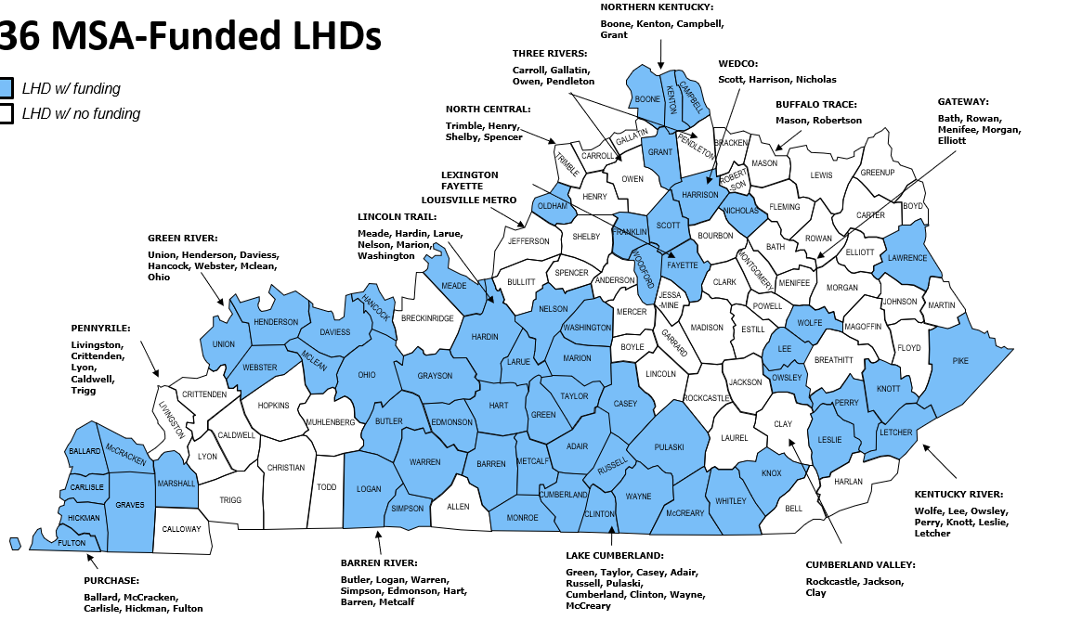
Health Departments with MSA funding for Tobacco Prevention & Cessation (FY23)

Slide 7
Goal 1: Prevention
9 in 10 smokers are addicted to nicotine by age 18.
If current trends continue, 119,000 Kentucky kids
will ultimately die prematurely from smoking.

Slide 8
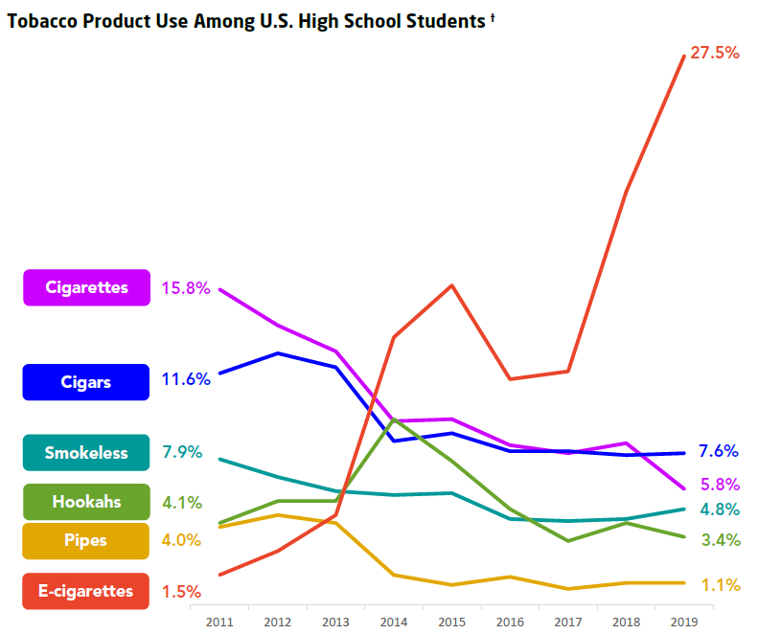
The Youth Vaping Crisis
Tobacco Product Use Among U.S. High School Students
According to the 2021 Kentucky Incentives for Prevention Survey, over 1 in 5 Kentucky 10th and 12th graders used e-cigarettes.
Source: National Youth Tobacco Survey, 2019

Slide 9
The Youth Vaping Crisis
Ever using e-cigarettes increases the likelihood of smoking cigarettes among young people.
One study found young people in the U.S. who had ever used e-cigarettes had 8x higher odds of currently using cigarettes a year later.
E-cigarettes may be responsible for 22% of new people ever trying a cigarette— totaling nearly 200,000 new smokers.

Slide 10
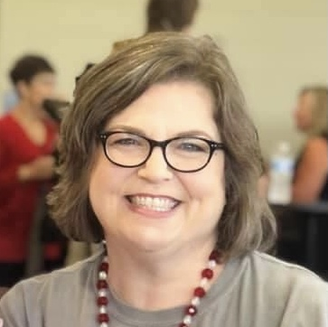
Success Story: Community Education with McCracken County Family, Career & Community Leaders of America (FCCLA)
“I feel better equipped to talk to youth about vaping [after hearing Lauren Williams’ presentation]!”
- 2022 Kentucky Tobacco Control Conference Attendee
Lauren Williams (above)
2021 KY FCCLA Outstanding Advisor of the Year,
McCracken County High School
Katherine Morrison
2022 Campaign for Tobacco-Free Kids National Youth Advocate of the Year from Paducah, KY

Slide 11
Kentucky’s Tobacco-Free Schools Toolkit
Mailed to every public school serving 6th grade and older, and every private school in the state before the 2021-2022 school year.
Additional information was requested from more than 90 schools and organizations.

Slide 12
Success Story: #iCANendthetrend Peer Education Helps Students
“I had a [Jessamine County] student come up to me after one of my presentations and tell me that he had just gotten out of the hospital from a collapsed lung from vaping. He said that he hasn’t used an e-cig in about two weeks and is having a very hard time dealing with the cravings/withdrawals. As we were talking his friend came up to us and told me that they had been keeping him accountable and have stopped using themselves since this has happened. They said they were happy for our program because most tobacco lessons they get are
‘e-cigs are bad - don’t use them.’ They said it was refreshing hearing our perspectives.”
Dillon Lay Former #iCANendthetrend Facilitator from London, KY

Slide 13
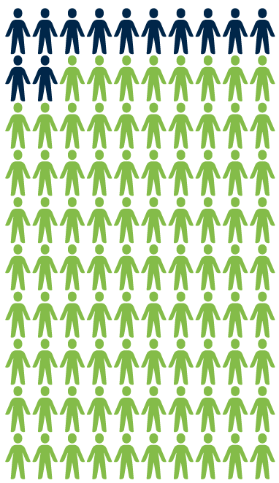
Goal 2: Cessation Over 88% of Kentucky adults who smoke say they want to quit.
That’s over 660,000 Kentuckians!
Source: Kentucky Behavioral Risk Factor Surveillance System (BRFSS) 2019

Slide 14
Goal 2: Cessation Over 88% of Kentucky adults who smoke say they want to quit.
That’s over 660,000 Kentuckians!
Unfortunately, fewer than half of them (40%) know about 1-800-QUIT-NOW.
Source: Kentucky Behavioral Risk Factor Surveillance System (BRFSS) 2019

Slide 15
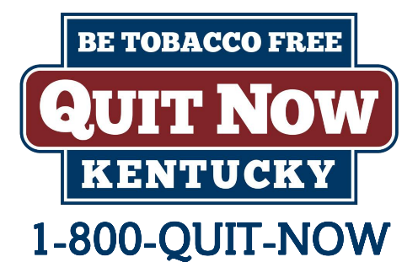
Quitlines are a cost-effective and evidence-based way to help people quit.
A recent return on investment (ROI) analysis of data from 2015 to 2020 showed that
for every $1 invested in
Quit Now Kentucky,
$4.03 was returned
in future cost savings.
+
Free to callers · Doubles chances of quitting successfully · Available 24/7

Slide 16
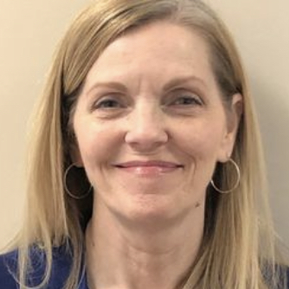
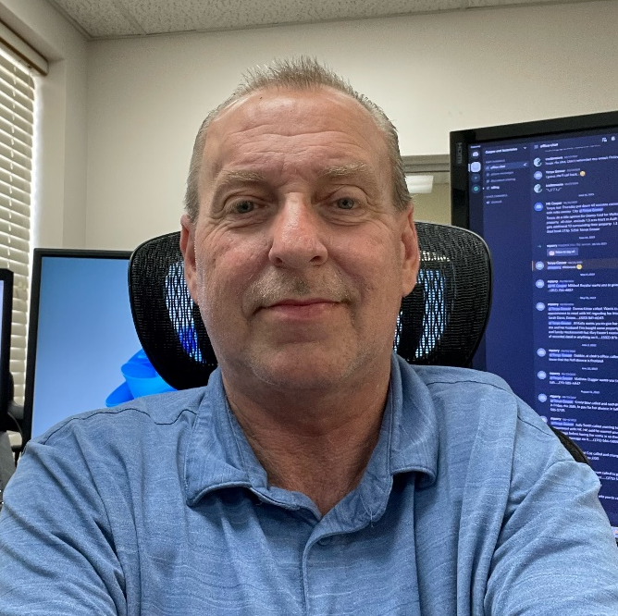
Success Story: Health Department Classes Work!
“I had smoked for 35+ years and finally decided it was time to quit. […] A week into the class, I smoked my last cigarette. That was October 1, 2019, and I've been smoke free ever since. I feel so much better, I breathe better, and my blood pressure is the best it's been in over 30 years. I'm so glad today I made that decision to give the Freedom From Smoking® classes a shot. I've recommended it many of my friends
and relatives who smoke and will
continue to recommend it to
ANYONE who wants to quit
smoking. […] It's worth it and
it definitely works!”
- Mark Perry, Russell County, KY
Teresa Spaw (top) and
Shirley Roberson Daulton (bottom)
Freedom From Smoking Instructors
Lake Cumberland Dist. Health Dept.

Slide 17
Success Story: Scholarships for Professional Training
3 Freedom From Smoking® Facilitators (Cessation)
17 CATCH® My Breath Train-the-Trainers (Prevention)
17 Not On Tobacco (N-O-T®) Facilitators (Youth Cessation)
16 SCRIPT® Facilitators (Cessation During Pregnancy)
12 Tobacco Treatment Specialists (Cessation)
In May 2022, 17 different health departments completed a virtual train-the-trainer certification course for CATCH My Breath.

Slide 18
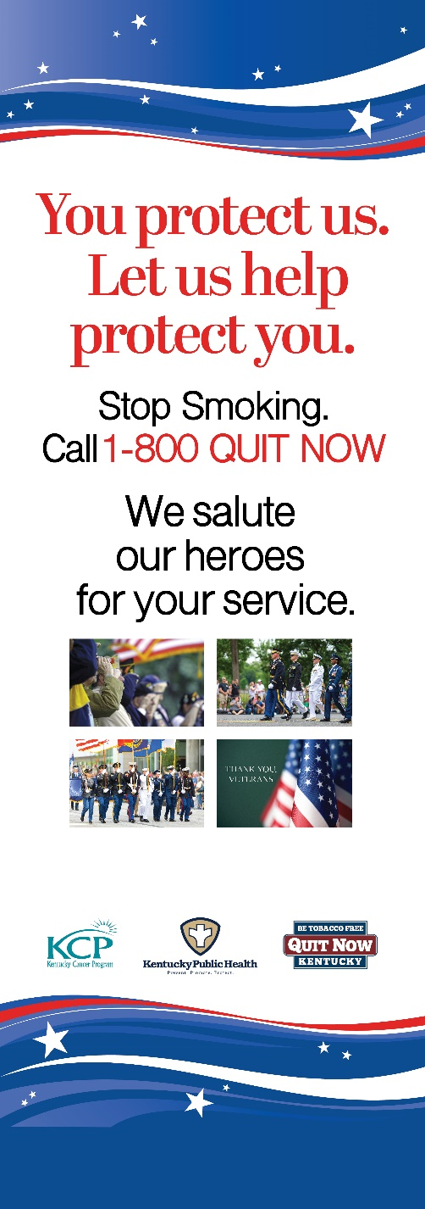
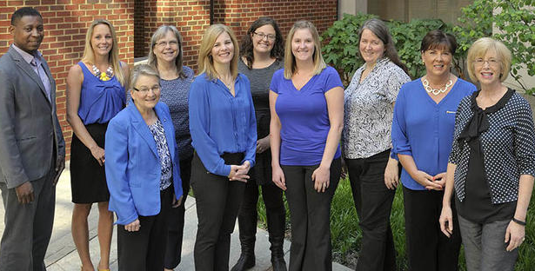
Success Story: Work with Special Populations
The number of tobacco treatment specialists working in community mental health centers in Kentucky has risen from 0 in July 2020 to 33 in July 2022.
The health behavior coordinators at the Louisville and Lexington Veterans Affairs Medical Centers are both now tobacco treatment specialists.
University of Kentucky tobacco treatment training program specialist staff, 2017
Kentucky Cancer Program Banner, 2022

Slide 19
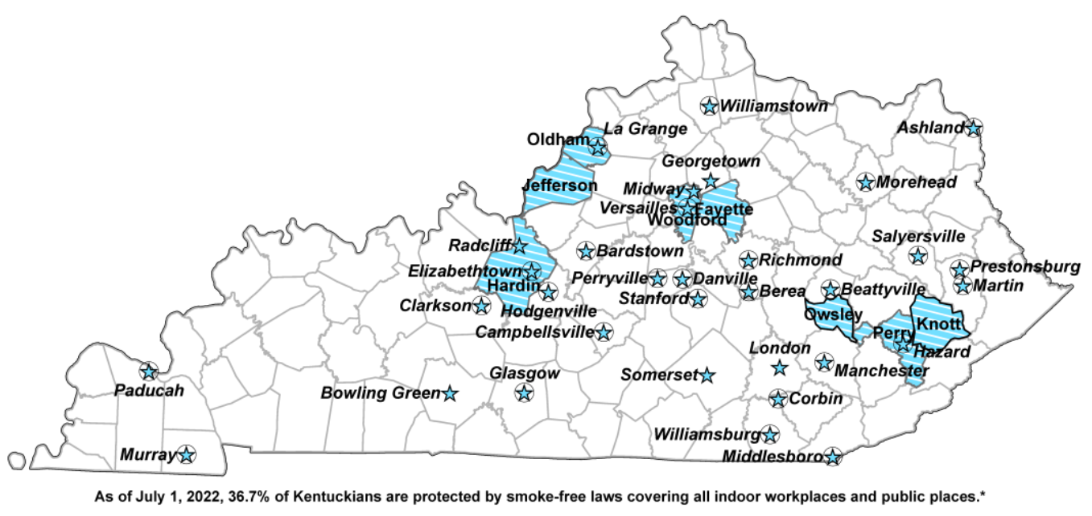
Goal 3: Protecting People from Secondhand Smoke
Only 36.7% of Kentuckians are protected from secondhand smoke at work by a comprehensive smoke-free ordinance.
Kentucky youth living in communities with comprehensive smoke-free ordinances are less likely to smoke cigarettes.
Kentucky Communities Protected by
Comprehensive Smoke-Free Ordinances
Source: Kentucky Center for Smoke-free Policy, 2022

Slide 20
Success Story: Knott County Schools Go 100% Tobacco-Free
“I had started talks with them back in 2019 […] This year, with vaping being such a big issue, [Knott County Schools] had it on their agenda already when we contacted them with assistance.
“[In July 2022] it passed unanimously, and we look forward to working with them with prevention classes, teacher education, etc.”
Public School Health Liaison Sherrie Stidham (left)
and Health Promotions Specialist Tara Vostad (right)
Kentucky River District Health Department

Slide 21
Tobacco Prevention & Cessation Program Budget for FY23 MSA Funds
Local Health Departments ($1,000,000)
Prevention Media for Youth ($172,100)
Quitlines ($262,500)
Partners ($565,400)
Kentucky Cancer Program
#iCANendthetrend Peer Education
UK BH WELL (Behavioral Health)
Kentucky Center for Smoke-Free Policy
etc.
13%
28%
MSA
$2 Million
9%
50%

Slide 22
According to the CDC, for every $1 spent on
a comprehensive tobacco control program,
Kentucky will get a $55 return on investment.

Slide 23
Ellen H. Cartmell
Tobacco Prevention & Cessation Program Manager
Kentucky Department for Public Health
EllenH.Cartmell@ky.gov

