Slide 1
24 years of….

Slide 6
Historic Investment:
In 2000, Kentucky Legislature invested 50% of Kentucky’s Master Settlement Agreement (MSA) Funds to establish the Kentucky Agricultural Development Fund (KADF).
The Kentucky Agricultural Development Board (KADB) was created to administer the KADF.
In 2021, Senate Bill 3 moved the KADB staff to the Kentucky Office of Agricultural Policy.
KADB invests funds in an array of county, regional, & state projects designed to increase net farm income & create sustainable business enterprises.

Slide 10
State of KAFC
Recommending a Strategy:
Taking Kentucky’s Agricultural Development Efforts to the Next Level
___________________________________________
Ideas for Today and Tomorrow
By John-Mark Hack
Executive Director/CEO
October 18, 2002

Slide 11
State of KAFC – Available Options
Alternative strategies
Stay the course, no change, keep plugging
Abandon the effort, say we’ve done what we can, head to the house
Create a new entity, and embrace a new way of doing business, moving from cost-sharing grants to revolving loans (SAVING THE SEED CORN!)
Advantages & Disadvantages of each:
No change to communicate vs. depleting resources
New money for other uses vs. numerous unaddressed needs in the farm economy
Explaining the change vs. eating the seed corn

Slide 12
State of KAFC- Advantages of the approach
Streamlined state staff, coordinating with field agencies for program and service delivery, building on present approach
Logical structure of business development assistance, capital access and IT assistance for business implementation
Broader impact on larger number of farmers, value added processors, new market development
Revolving finance, ensuring a permanent source of agricultural diversification capital into perpetuity (the seed corn!)
Enhance credit worthiness of farmers, enhanced involvement of leaders in agricultural finance.

Slide 14
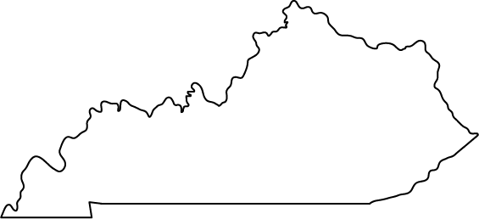
Investments in Kentucky
1,451
KAFC Loans Approved
totaling over
$217,677,410
Notes:
Along with investments by the Kentucky Agricultural Development Board, over $186 million has been approved in loans across Kentucky to help beginning farmers, agribusinesses, agriculture infrastructure, and more.

Slide 18
Available KAFC Loan Programs
Agricultural Infrastructure (AILP)
Agricultural Processing (APLP)
Beginning Farmer (BFLP)
Diversification through Entrepreneurship in Agribusiness (DEALP)
Large/Food Animal Veterinary (LFAVLP)
KAFC Rate is 2%, Lender Servicing Fee is 0.75%;
Maximum term not to exceed 15 years or remaining economic life;
Loans secured by real estate may be amortized over 25 years

Slide 21
Investments in Kentucky
$747,843,085
Notes:
Over $683 million in Kentucky Agricultural Development Funds have been invested in projects over 20 years. Along with county level programs such as CAIP, these funds have been invested in projects that have impacted a wide range of agriculture endeavors including many in or impacting Eastern Kentucky: Grow Appalachian, KSU Small Grant Program, KY Highlands, Kentucky Beef Network, Kentucky Horticulture, Kentucky Proud, KCARD, and many more.

Slide 25
KADF Programs and Initiatives
County Ag Investment Program
Youth Ag Investment Program
Next Generation Farmer Program
Deceased Farm Animal Removal Program (DAR)
Shared-Use Equipment Program
On-Farm Energy Incentives Program
Large & Food Animal Veterinary Incentives Program
Food Safety & Efficiency Incentives Program
KADF project grants/loans

Slide 26
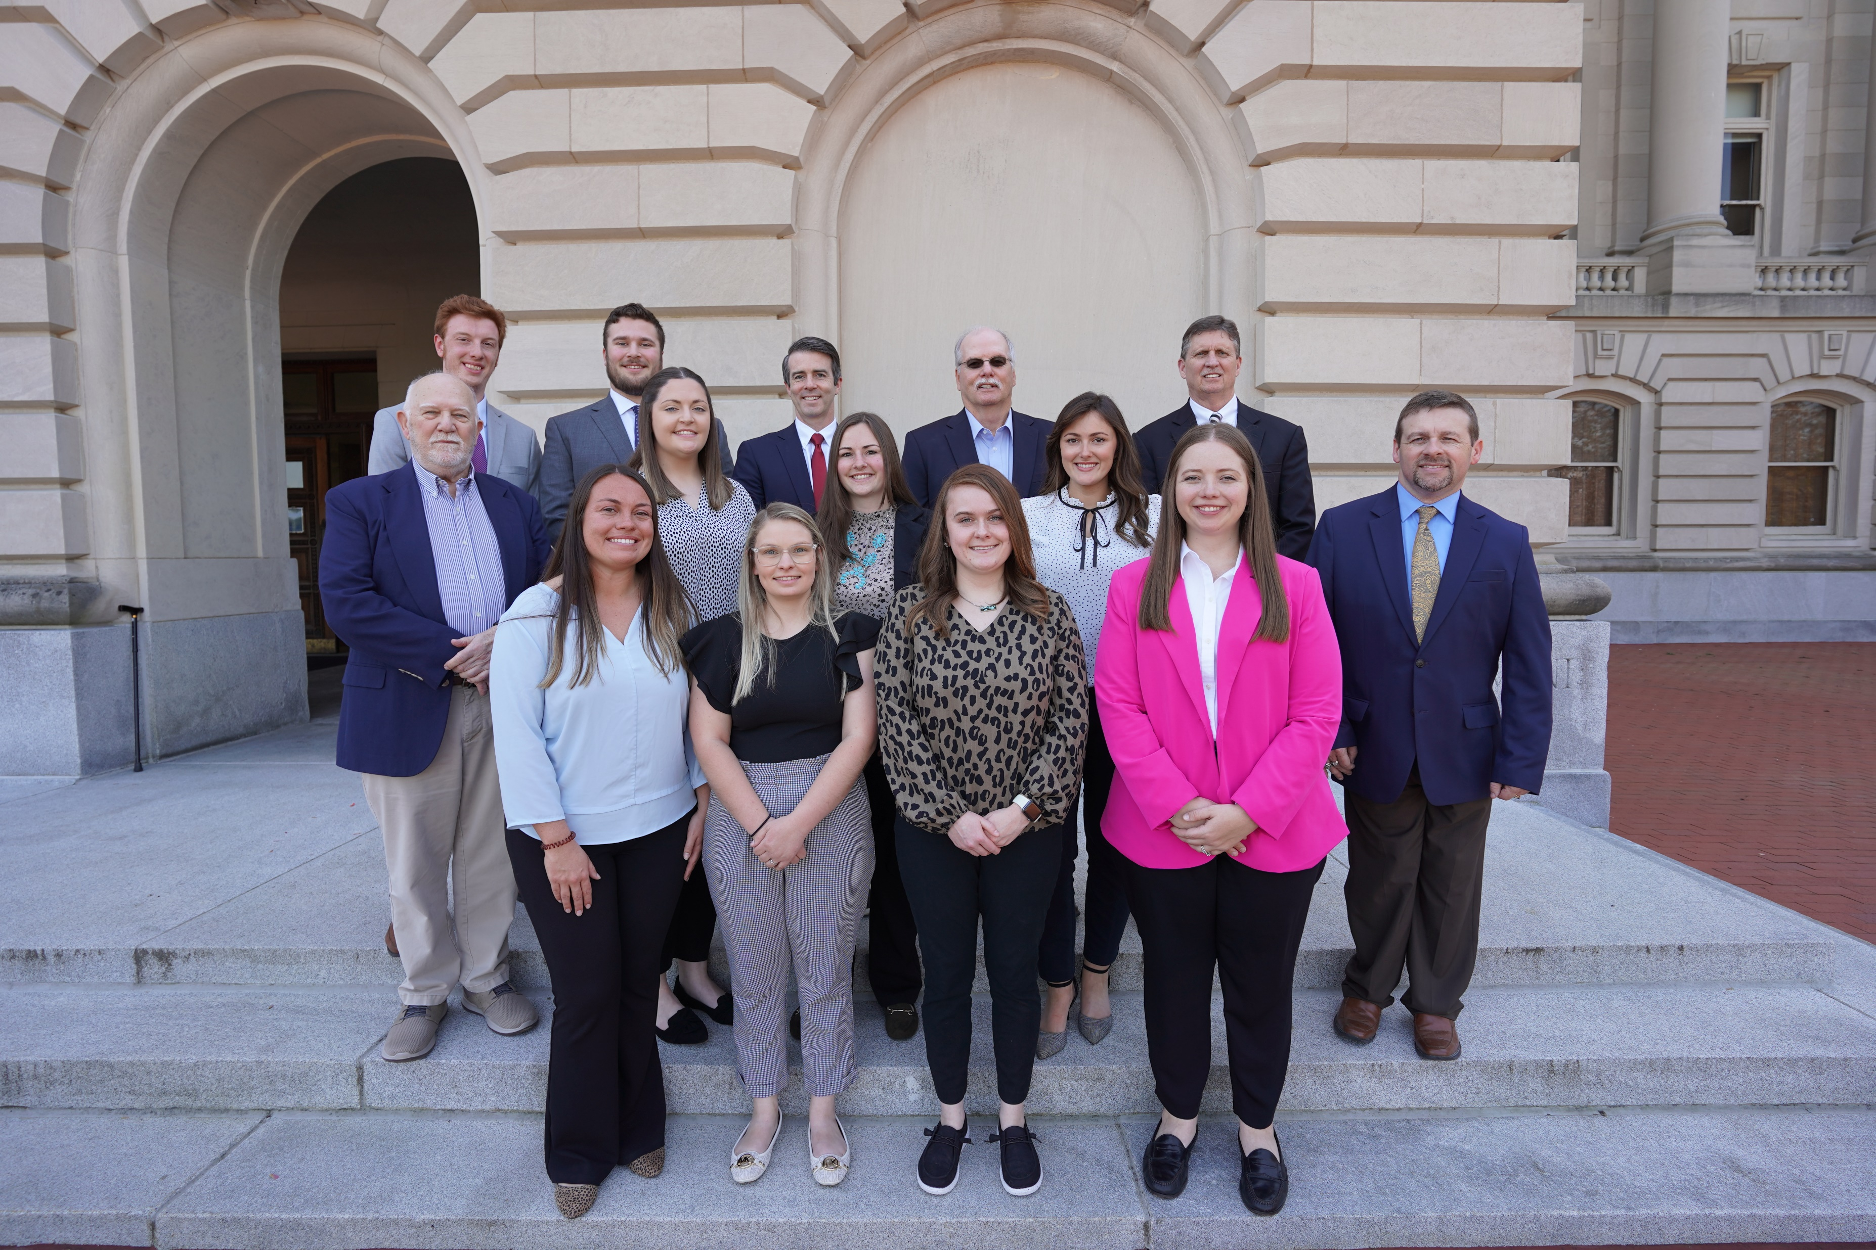
KOAP Staff

