Slide 1
Kentucky Double Dollars and Farmers Market Support Program
July 11, 2024
Myrisa K. Christy

Slide 2
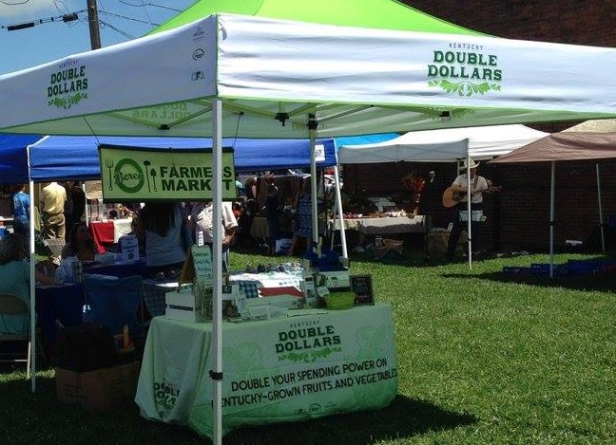
Increase sales and income for Kentucky farmers
Developing new farm customer by introducing local food for low-income populations
Leverage federal food and nutrition program funds

Slide 3
Program updates
CFA was awarded a GusNIP of $1.1 million
Appalachian Regional Food Business Center over $1 million for 5 years to continue farmers and farmers market support activities
10 markets on-boarding to accept SNAP benefits
Record number of retail markets in 2024
Working with KDA/KHA for “Food is Medicine” initiative
Incentives redeemed since KDD started $1.1 million

Slide 4
Lifetime Economic Impact

Slide 5
Jessamine County
The Kirschbaum family is always excited to come to the market. They let each of their kids choose something to buy.

Slide 7
2023 Farm Business Impacts
Over $350,000 direct farm impact last year
80% of farms surveyed attributed increased farmers market sales to KDD from 2020 to 2023
Average farm sales increased about $3,000 per farm in 2023.
Small to Mid-size farms saw 16% increase in sales, while large farms saw 10% increase in sales
(CEDIK 2023)

Slide 8
Kentucky Double Dollars Programs
SNAP, WIC, and Senior Farmers Market Nutrition Program benefits
Farmers markets each come up with a 25% match for their benefits

Slide 9
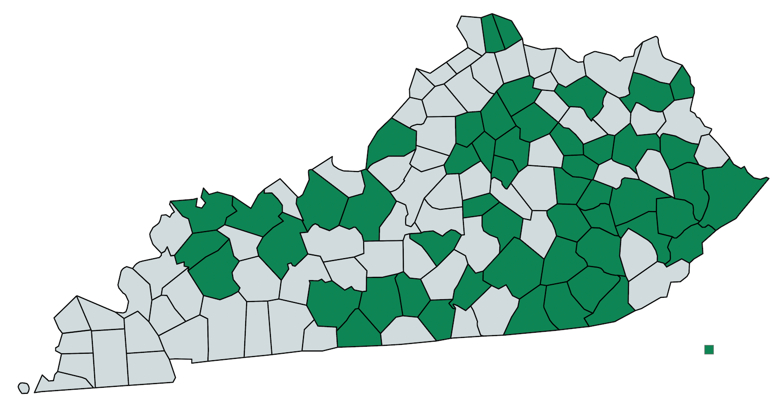
Notes:
52 counties

Slide 10
London Laurel County Farmers Market
The Double Dollars program has helped many of my own personal friends get some financial help to buy produce for them to freeze or can and help last them all winter. –Caleb

Slide 11
Hardin County
Having KDD offered at our Market, is a great community outreach that highlights the wholesome, locally-produced choices we offer – Ben Smith, Smith Family Farm

Slide 12
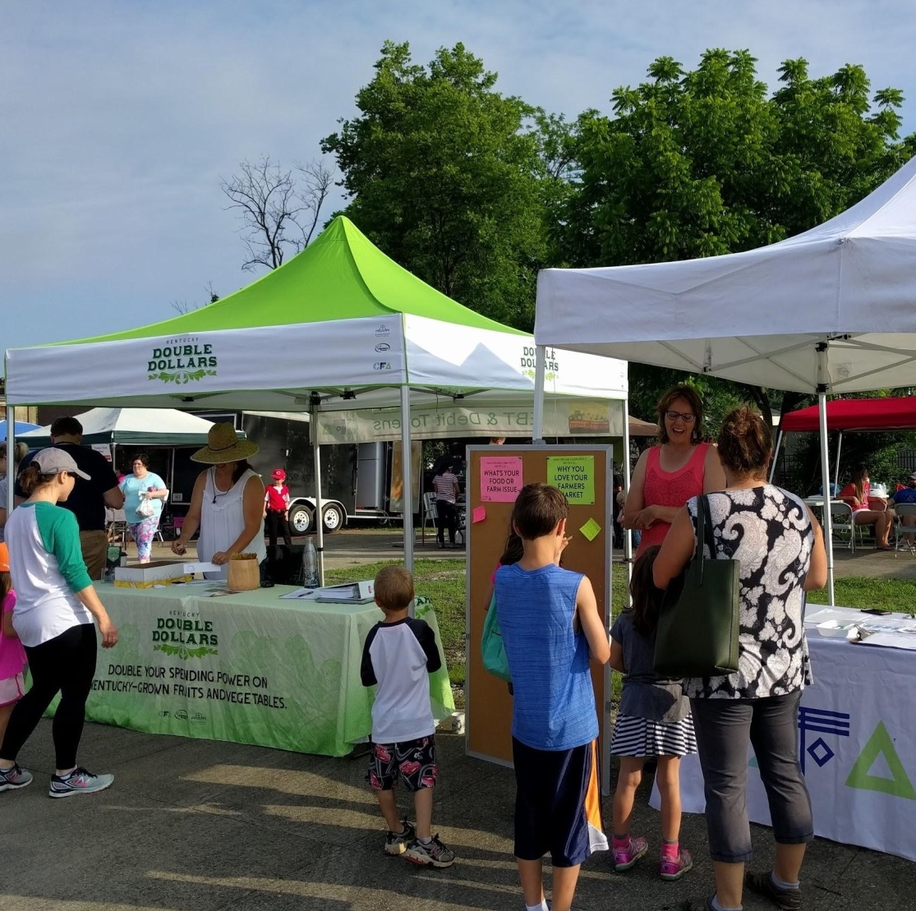
FARMERS MARKET SUPPORT PROGRAM
Create profitable market outlet for farmers with the tools, resources and network development
Access to fresh food to all members of the community
Path to market sustainability

Slide 13
CFA Farmers Market Support Program: Technical Assistance and Market Manager Cost Share
Market Manager
Stable Organizational Structure
Access to federal programs
Nutritional incentives
Physical location
Community Support

Slide 14
Farmers Market Support Program
2023
2024
$58,000 committed to markets
Each market must raise matching funds
37 markets participating
$39,250 funds dispersed
$46,050 matching funds raised by markets for cost share
31 markets participated
Notes:
Margie

Slide 15
Pathway to Future Impact
Increased capacity to bring retailers on board
Expanding FreshRx
Supporting Innovation

Slide 16
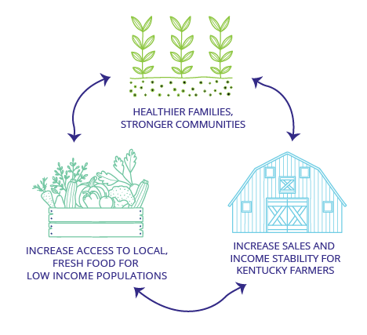
Farmers build community
“Since the Double Dollars program was implemented, the effect on the community seems broader. We have seen an increase in locals from our county, with lower means, that normally may not be able to shop local or purchase good quality produce.”
~Knott County farmer

Slide 17
Owensboro Regional Farmers Market
From the Greer family: The program helps us tremendously to put fresh food on the table for our children. Doubling the benefits gives us more opportunity to spend more money at the farmers' market. We always have a wonderful time with the family shopping at the market and picking out our produce direct from local families who grew it themselves.

Slide 18
Northfork Fresh Stop, Hazard, KY
We are thankful for the opportunity to be a part of the Northfork Fresh Stop Market and their Double Dollars Program. The Double Dollars Program has enabled our farm, the Happy Hens Homestead, to increase our sales and help us reach more people in our community with food grown right here in the mountains. We are proud to be a part of this program which gives more people the opportunity to have naturally grown, healthy food choices. - Andee Stevens, Happy Hens Homestead, LLC

Slide 19
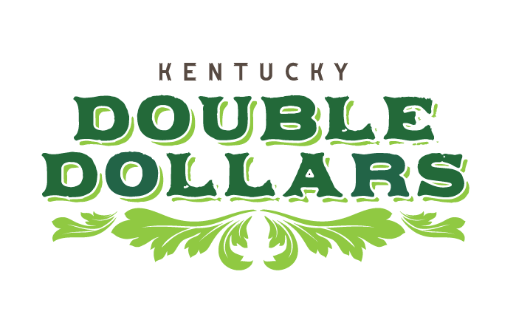

Slide 20
Thank you!
Myrisa Christy
Myrisa@cfaky.org
859-302-6304

