Slide 1
KOAP’s Report of
June 2024
As of 6/24/2024

Slide 2
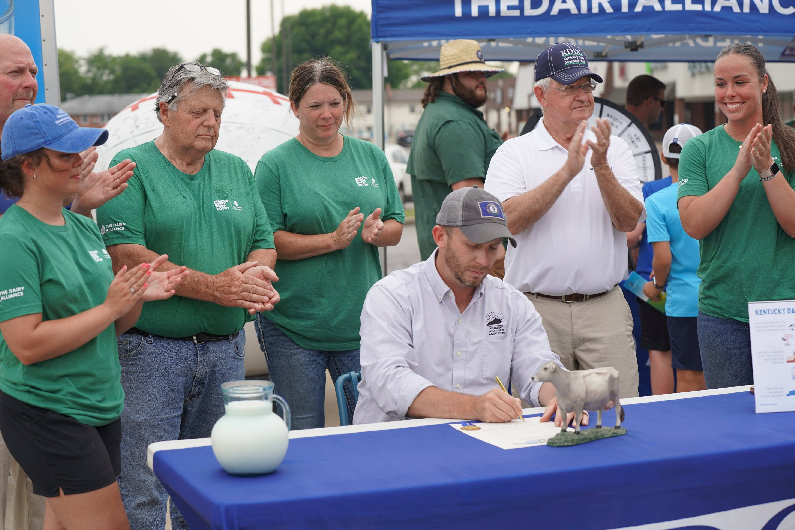
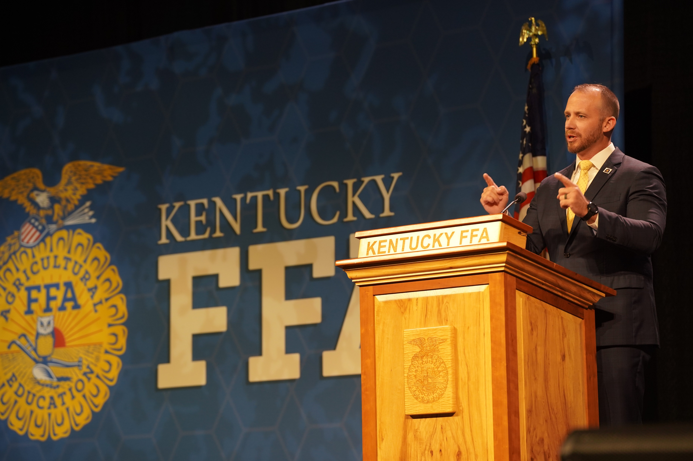
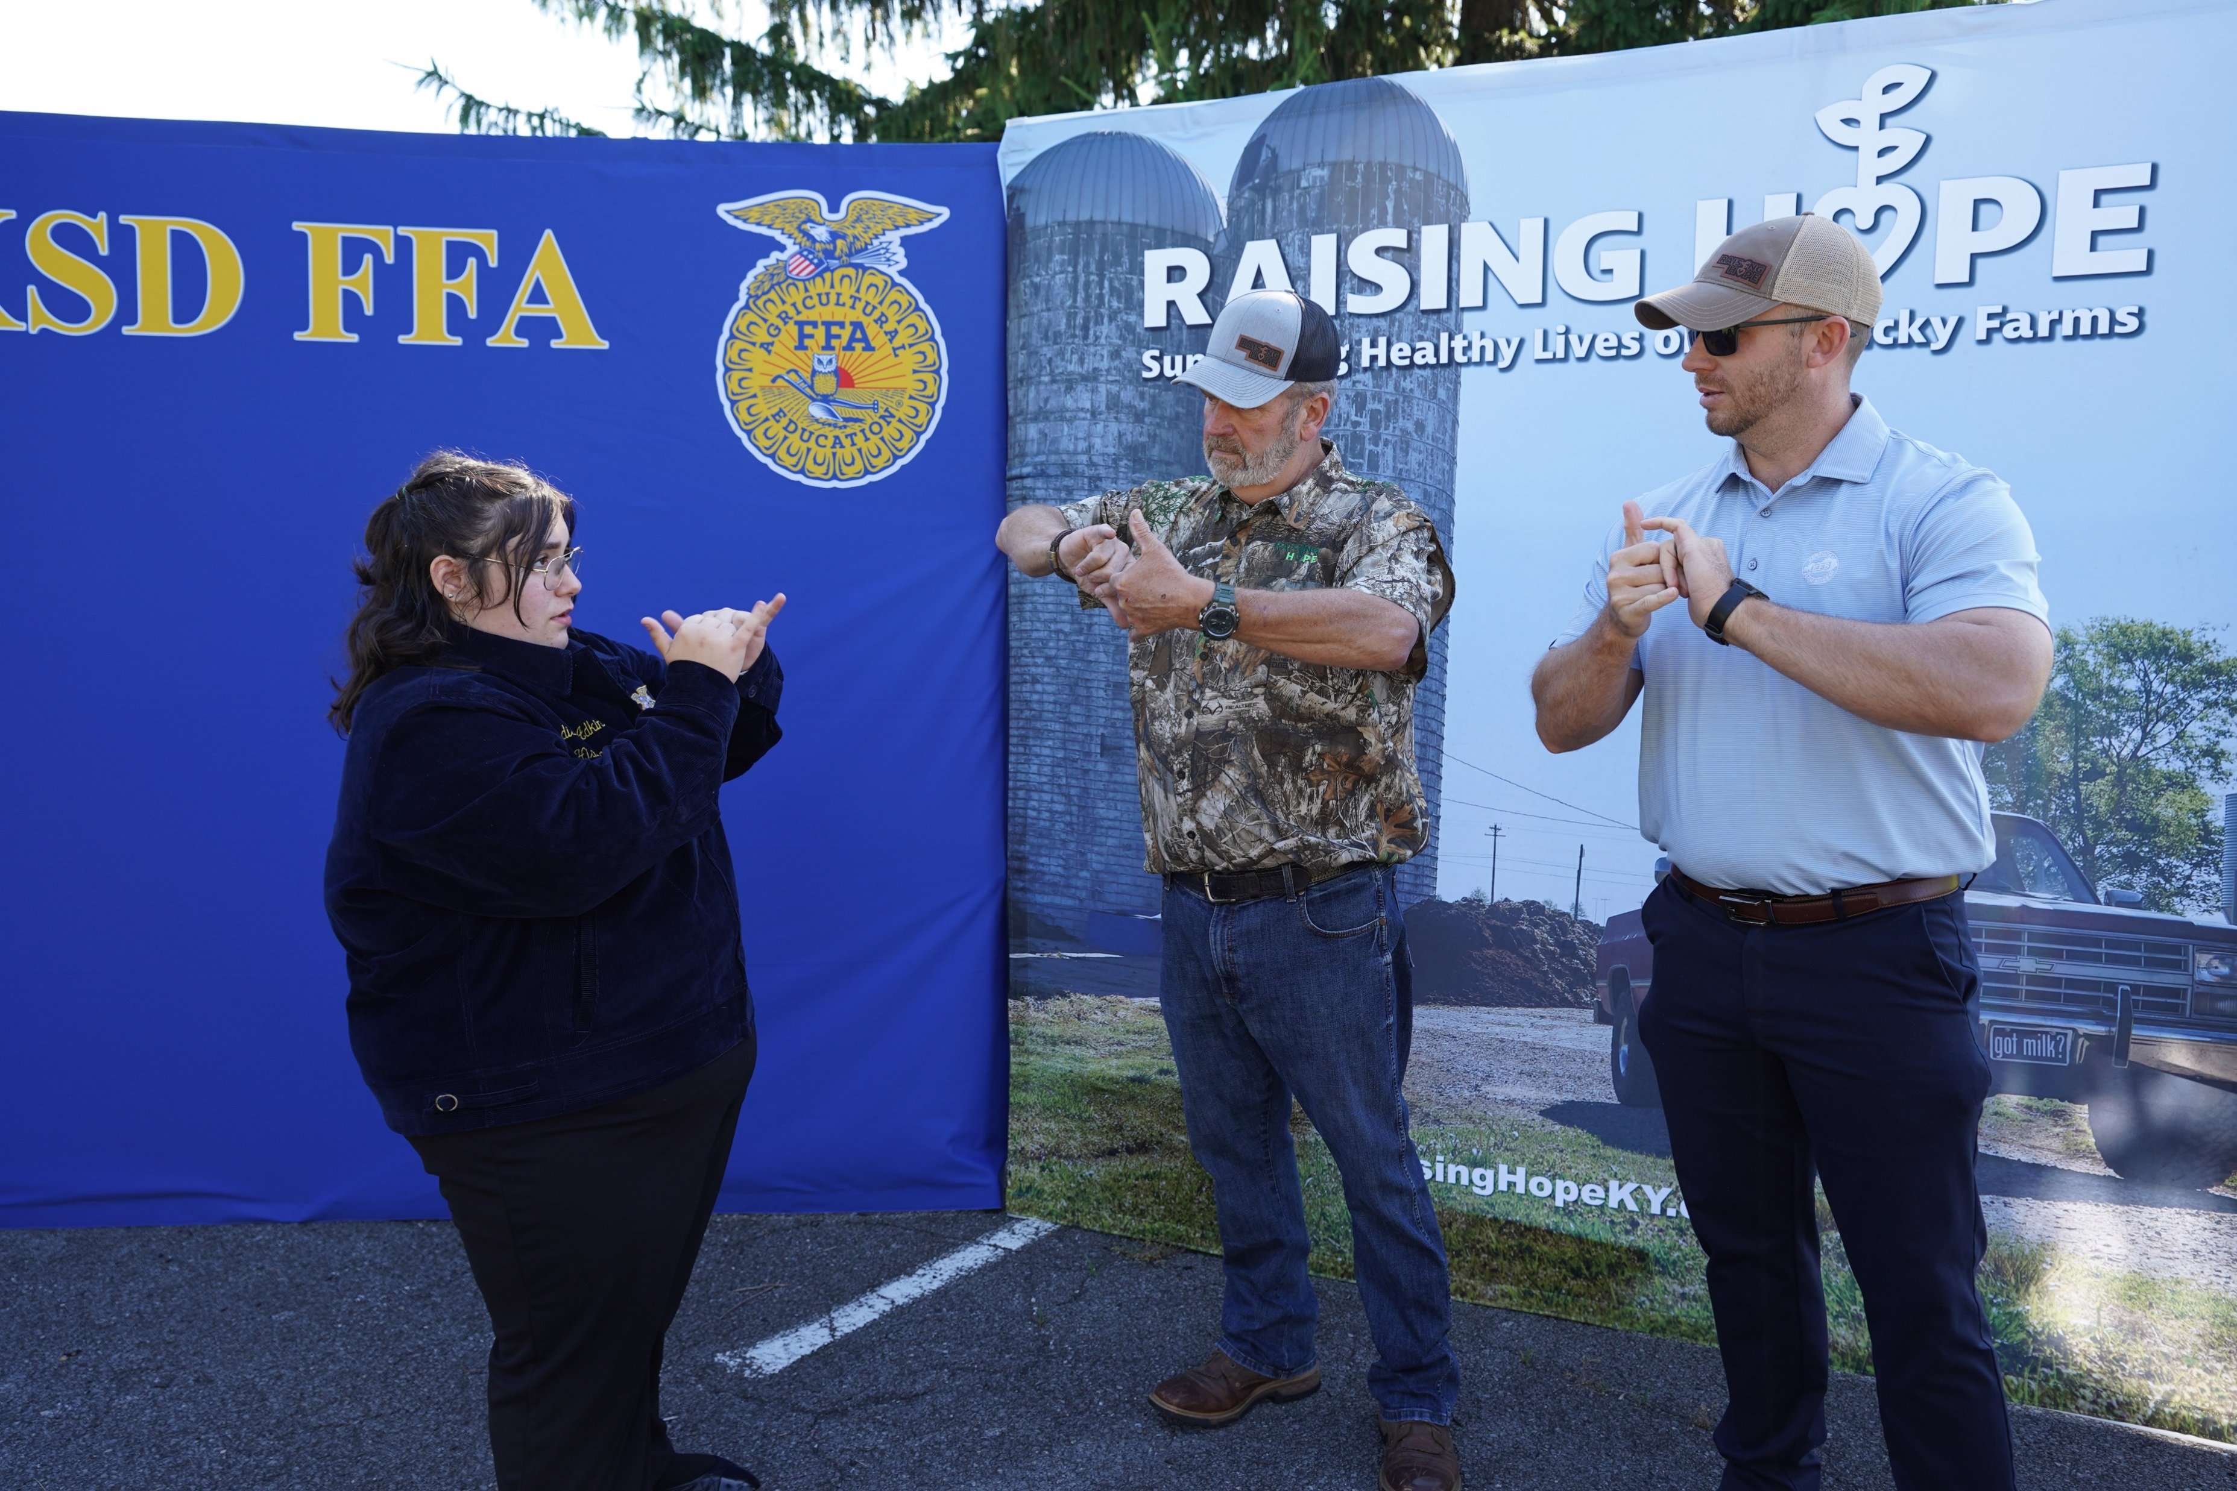
“Agriculture is Economic Development”
Commissioner of Agriculture,
Jonathan Shell

Slide 3
KOAP Staff
Brandon Reed
Executive Director
Bill McCloskey
Deputy Executive Director
Bill Hearn
Fiscal Officer
Brian Murphy
General Counsel
Chelsea Smither
KADF Project Manager
Hannah Sharp-Johnson
Boards & Special Events Manager
Hunter Jones
KADF Project Manager
Jeff Parman
KADF Program Compliance Manager
Jesslyn Watson
KADF Project Manager
Olivia Randolph
KAFC Loan Programs Manager
Rebecca Besok
KADF Project Manager
Sarah Bryant
KADF Programs Manager
Savanna Hill
KADF Project Manager
Tera Roberts
KAFC Loan Programs Manager

Slide 4
Monthly Board Approvals:
June
KADB KAFC
$8.5 MM $3.3 MM

Slide 5
KOAP Highlights of June:
Final CAIP Administer Training held virtually; total trainings were 6 in-person & 2 virtual
Staff organized a day of tours & Recipient Review Committee highlighting KY Horticulture Council in London, KY
26 County Agricultural Development Councils attended by staff
Two additional interns joined us this month to compose reports on KAFC & KADF meat processor projects; Caroline Groth & Karissa Hamilton

Slide 6
Approved Breakdown
KADB Approvals:
2 Large and Food Animal Veterinary Incentives Programs totaling $75,395
18 County Agricultural Investment Programs totaling $2,775,475
4 Deceased Farm Animal Removal Programs totaling $42,750
1 Shared-Use Equipment Programs totaling $17,500
4 Youth Agricultural Incentives Programs totaling $45,000
6 County & State Projects totaling $5,520,749
KAFC Approvals:
3 Agricultural Infrastructure Loan Programs totaling $614,183
1 Agricultural Processing Loan Program totaling $170,000
18 Beginning Farmer Loan Programs totaling $2,837,518

Slide 7
Bill & Brandon’s Top Picks
AppleAtcha Agritech KY - $3.5 MM KADF Participation Loan
Green County High School - $15,000 Green Co. funds
3. Jemstar Properties, LLC - $15,000 Montgomery Co. funds + $250,000 Forgivable Loan + $1 MM KADF Participation Loan

