Slide 1
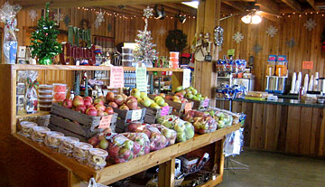
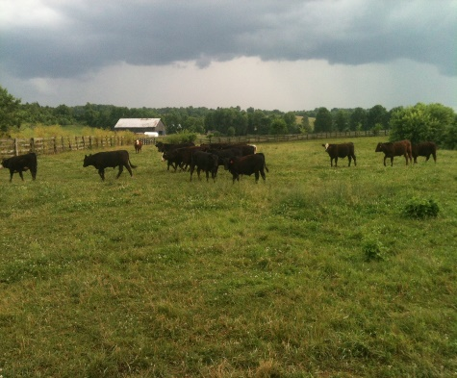
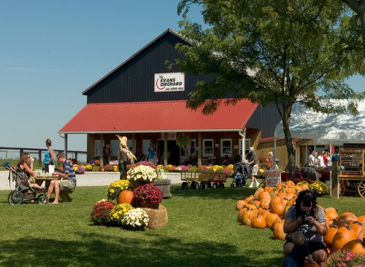
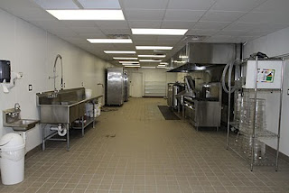
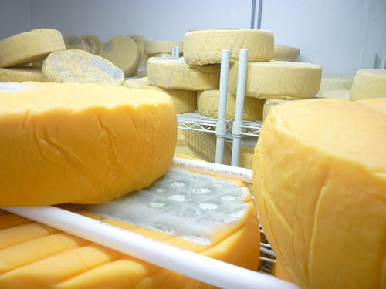
The Kentucky Center for
Agriculture & Rural Development
KCARD is an independent non-profit organization that facilitates agricultural and rural businesses in Kentucky. We provide educational opportunities and one-to-one technical assistance to new and existing agribusinesses.

Slide 2
How KCARD Works
Independent non-profit organization
14 staff members who work remotely across the state
Majority of services are free of charge thanks to funding received from KADF and USDA
Prefer to meet with clients at their location or business
“Our success is our client’s success”
Third party advisor
“Make informed decisions”

Slide 3
What Do We Do?
Assist with business plans
Review marketing
Analyze feasibility of new ventures, new ideas
Help businesses figure out what loans and grants are good fits
Answer questions
Evaluate financials
ArcGIS, tech/website questions, employee issues, management questions, and more
Cooperative Development

Slide 4
Key Business Development & Planning Topics
Goals
Marketing plan
Target Customers
Key products/services features and benefits
Sales and promotion strategies
Management & operations plan
Financials
Performance measures
“Cannot manage what you do not measure”

Slide 5
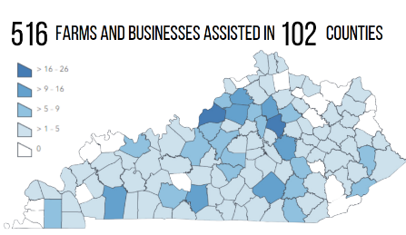
KCARD Clients
All Sectors of AG including:
Meat Processing
Value-added dairy
Farmers Markets
Agritourism & on-farm markets
Grain Elevators
Feed Mills
Produce marketing and distribution
Beginning farmers

Slide 6
Examples of KCARD Clients
AW Meats (Greenup County)
Four Hills Farms (Mercer County)
Lexington Farmers Market (Fayette County)
Solway Farm (Hardin County)
Alvio’s Cuban Meats (Jefferson County)
Food Chain (Fayette County)
Franklin Grain (Simpson County)
Chaney’s Dairy Barn (Warren County)
Obenchain Farms (Hancock County)
Central KY Growers Association (Scott County)
Logan Street Market (Jefferson County)
Hampton Premium Meats (Christian County)
Green Terrace Market (Daviess County)
Country View Creamery (Todd County)
Drury’s Custom Processing (Mercer County)
Bearfruit & Grow (Jefferson County)
On Tapp Dairy (Washington County)
Need More Acres (Allen County)
Happy Hills Farmstead (Greenup County)
Elmwood Stock Farm (Scott County)
Kentucky Organic Farm and Feed (Todd County)

Slide 7
Expansion of Services as Needs Develop
Planning Your Farm Diversification workshop
Disaster Assistance
Meat Processing Business Development
AgVets Program
Beginning Farmer Video Series

Slide 8
Diversification of KCARD Funding Streams
KADF Smaller % of KCARD Budget: KADF accounted for 35% of KCARD funds in 2023
More Federal Funds: KCARD is primary awardee on three large federal grants
Increase in Funds from Partners: KCARD is a sub-awardee on 12 federal grants with organizational partners.
Growth in Fee-for-Service Funds: KCARD earned over $121,000 in contracted fees for service in 2023, which was a 39% increase from 2021.

Slide 9
KCARD Performance Measures (2023)
Number of Farms and Businesses Assisted: 516
Job Created: 114
Jobs Saved: 790
Federal Funds Attracted for Clients and Partners: $2.56 million
Growth in Clients Sales Revenue: $7.7 million
KCARD Client Success Rate: 90%
Economic Impact: $14.5 million

Slide 10
KCARD has always and will continue to work hard, work smart, and work together to serve all of Kentucky agriculture Contact us at: kcard@kcard.info or 859-550-3972

