Slide 1
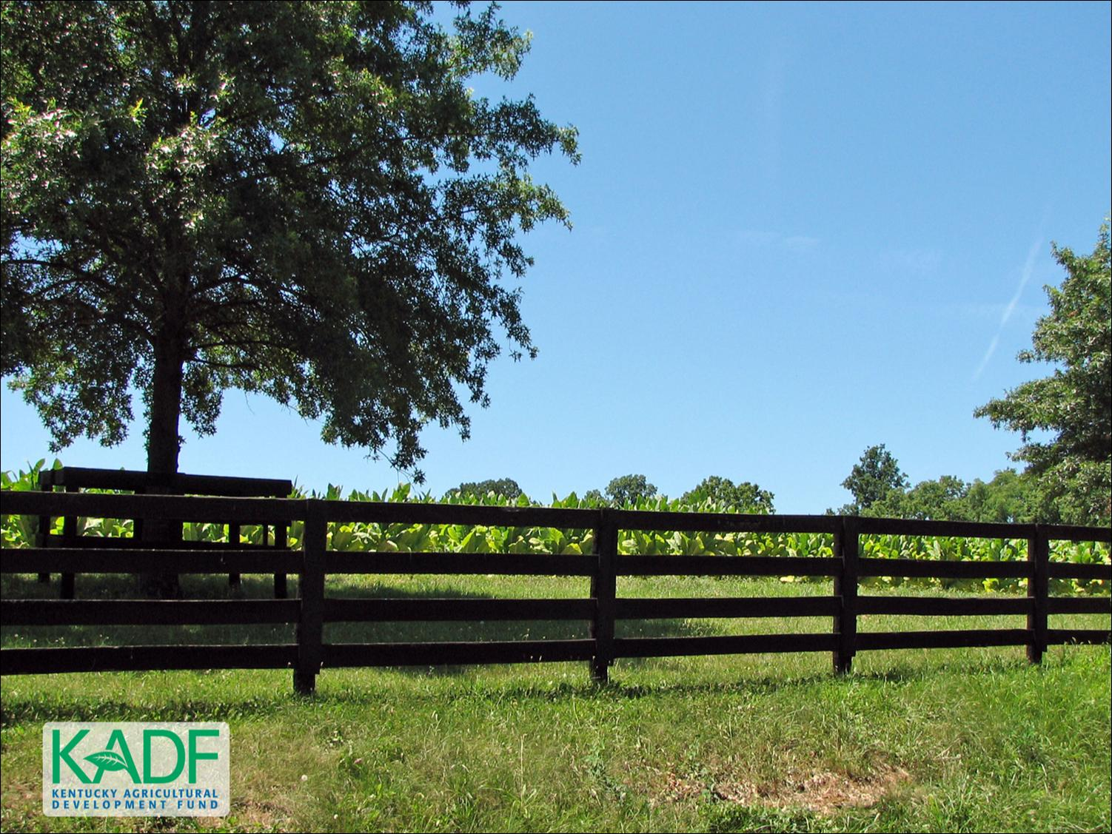
KOAP’s Report of
September 2024
As of 9/4/2024

Slide 2
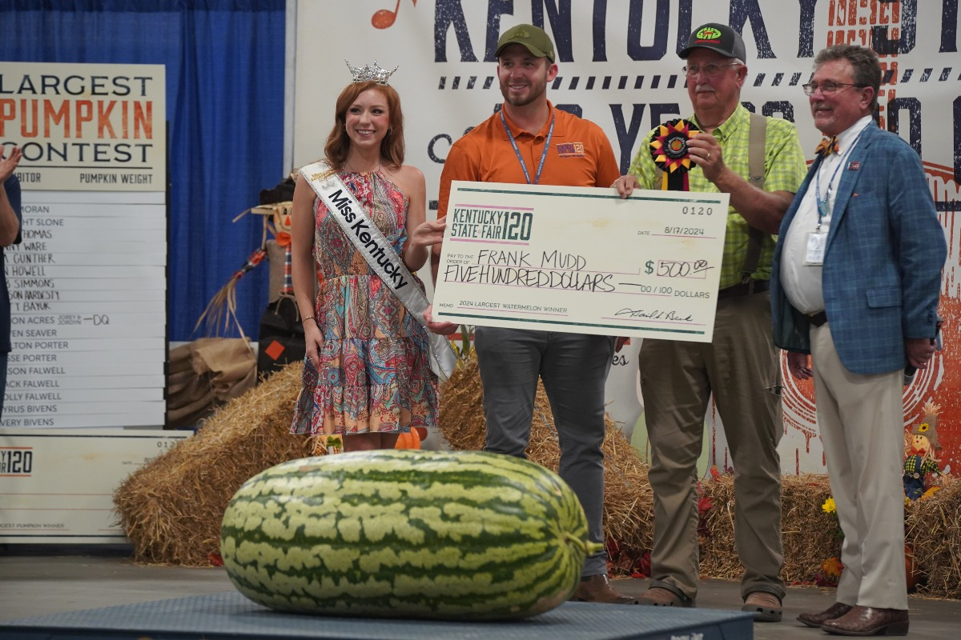
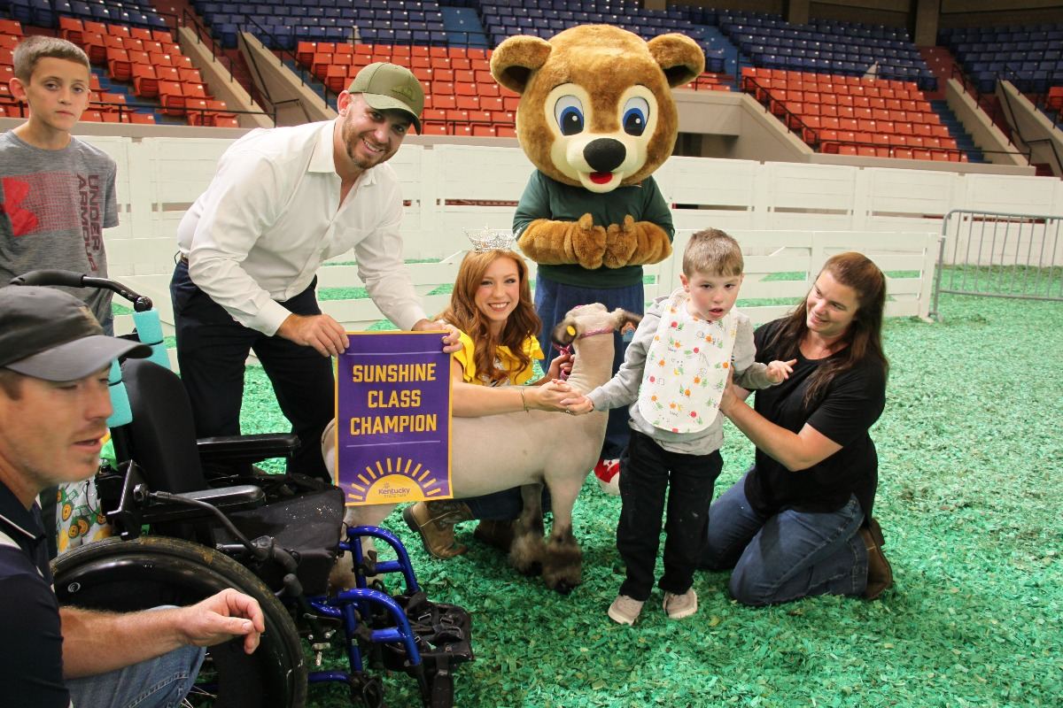
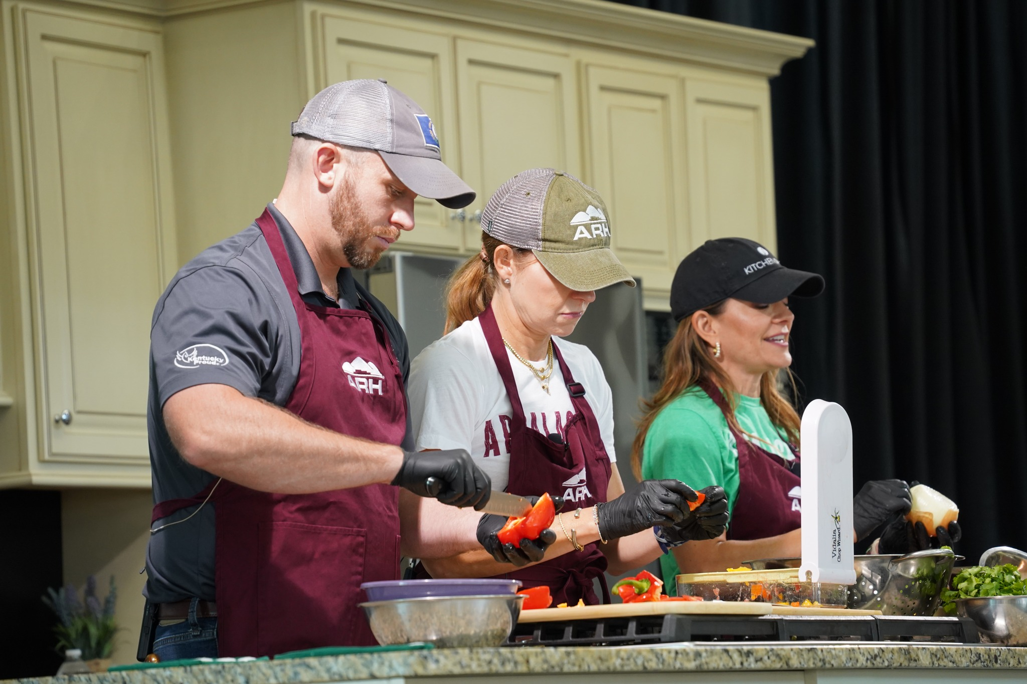
“Agriculture is Economic Development”
Commissioner of Agriculture,
Jonathan Shell

Slide 3
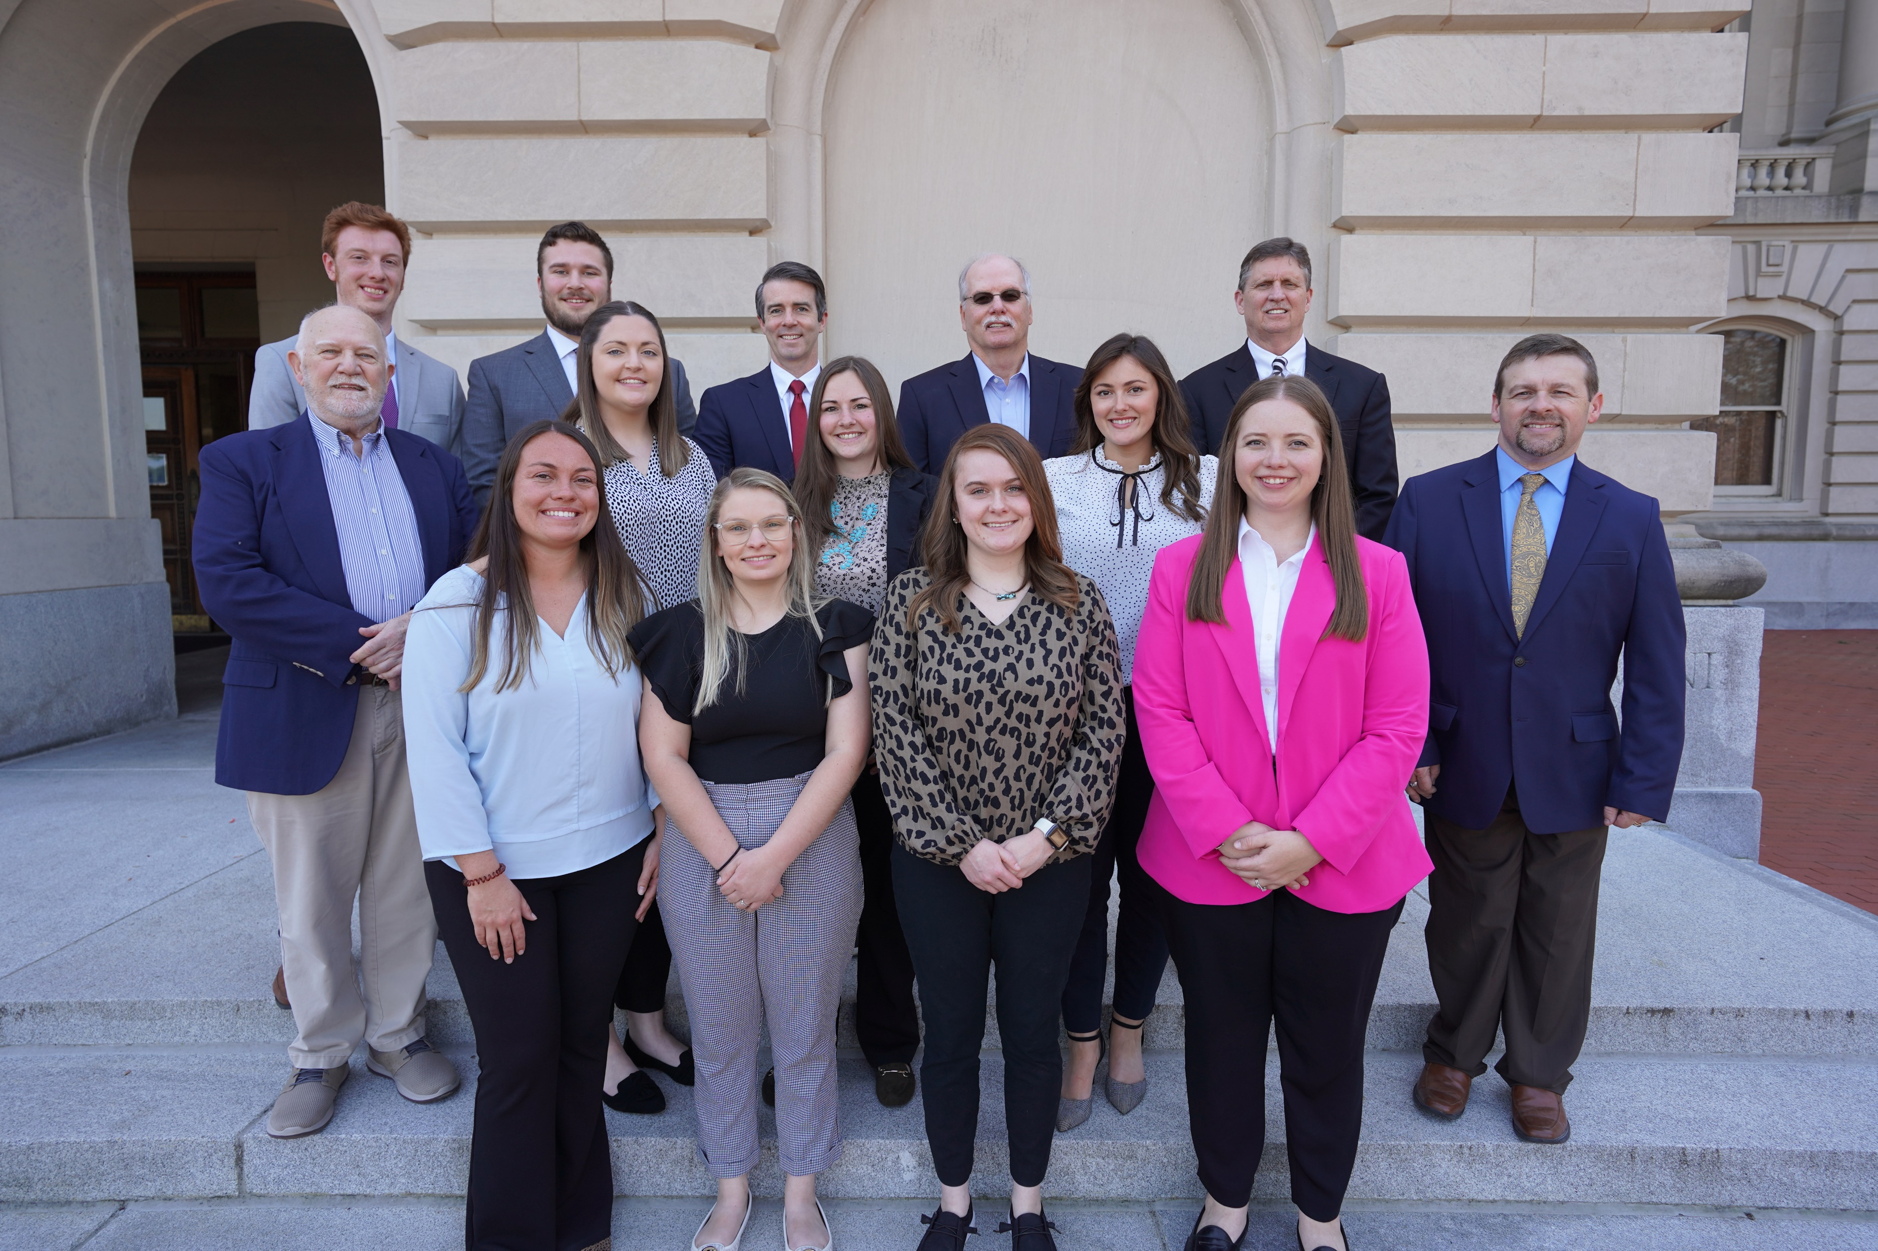
KOAP Staff
Brandon Reed
  Executive Director
Bill McCloskey
  Deputy Executive Director
Bill Hearn
  Fiscal Officer
Brian Murphy
  General Counsel
Chelsea Smither
  KADF Project Manager
Hannah Sharp-Johnson
  Boards & Special Events Manager
Alexis Scheidt
  KADF Project Manager
Jeff Parman
  KADF Program Compliance Manager
Landon Peach
  KADF Project Manager
Hunter Jones
  KAFC Loan Programs Manager
Bailey Siry-Crowder
  KADF Project Compliance Manager
Rebecca Besok
  KADF Project Manager
Sarah Bryant
  KADF Programs Manager
Savanna Hill
  KADF Project Manager
Tera Roberts
  KAFC Loan Programs Manager

Slide 4


Monthly Board Approvals:
August
KADB KAFC
$390,000 $2.0 MM

Slide 5
KOAP Highlights of August:
  2 staff members attended competitive leadership program: Kentucky Cattlemen’s Assoc. Leadership Program
  Staff attended WAVE Ag Day at Columbus-Belmont State Park.
  13 County Agricultural Development Councils attended by staff
  KOAP staff members worked and attended numerous events at the 120th Kentucky State Fair.

Slide 6
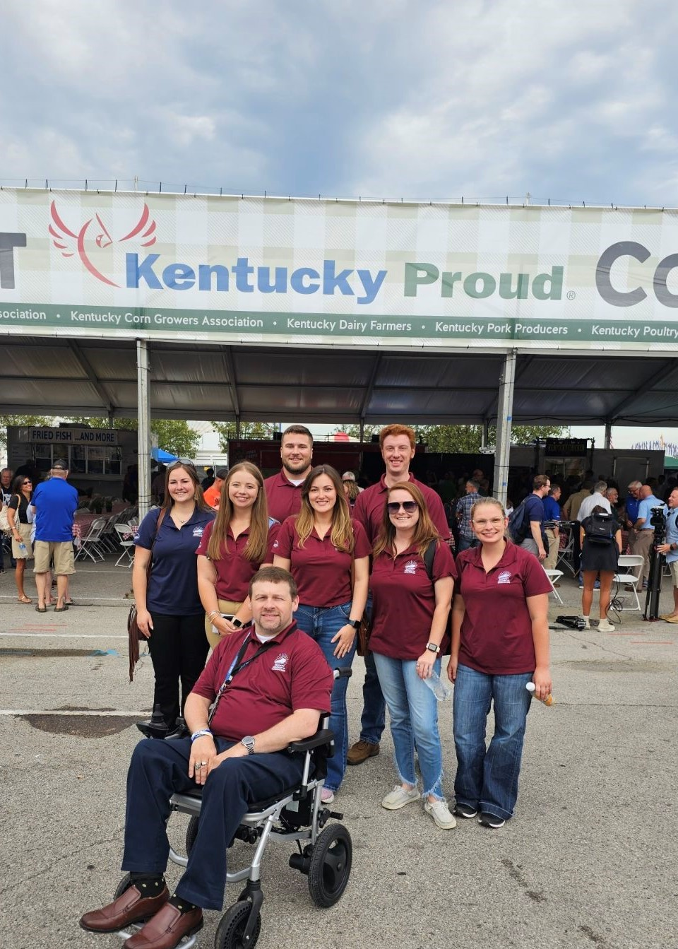
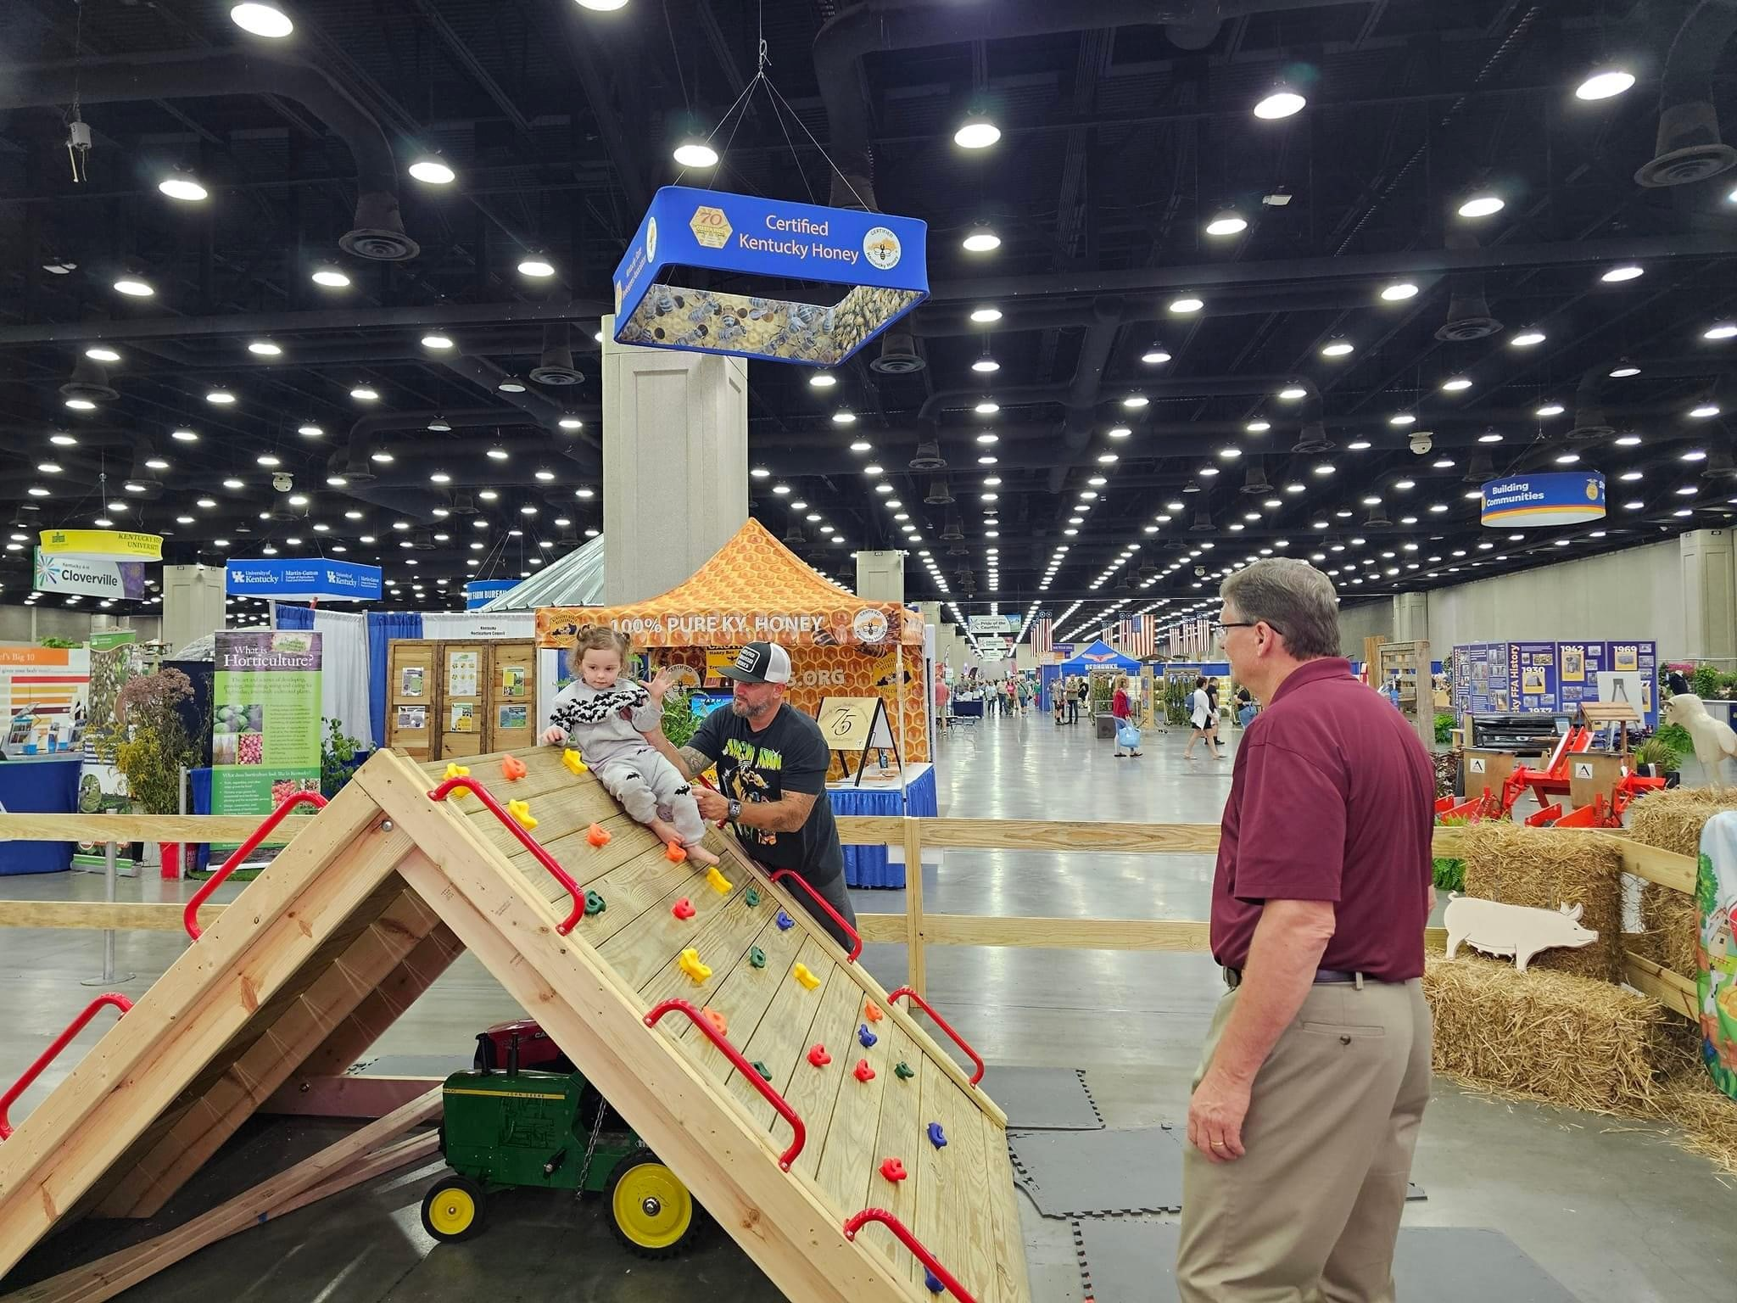
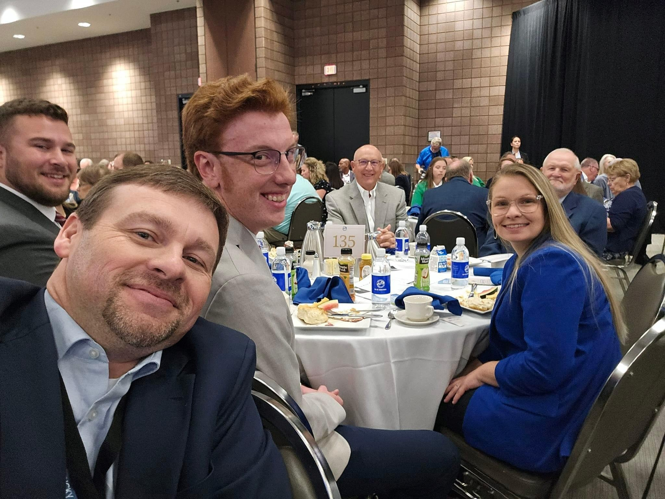

Slide 7
Approval Breakdown
KADB Approvals:
  1 County Agricultural Investment Programs totaling $157,500
  1 Deceased Farm Animal Removal Programs totaling $15,000
  1 Shared-Use Equipment Programs totaling $21,375
  3 County & State Projects totaling $53,734
KAFC Approvals:
  8 Beginning Farmer Loan Programs totaling $1,565,453
  2 Diversification through Entrepreneurship in Agribusiness Programs totaling $472,500

Slide 8
Bill & Brandon’s Top Picks
Hancock County Cattleman’s Association LTD. - $5,000 in Hancock County funds
Taylor County Fair Association - $34,029 in Taylor County funds
Sugarloaf Mountain Meats & Processing -$14,705 in multi-county and state funds

