Slide 1
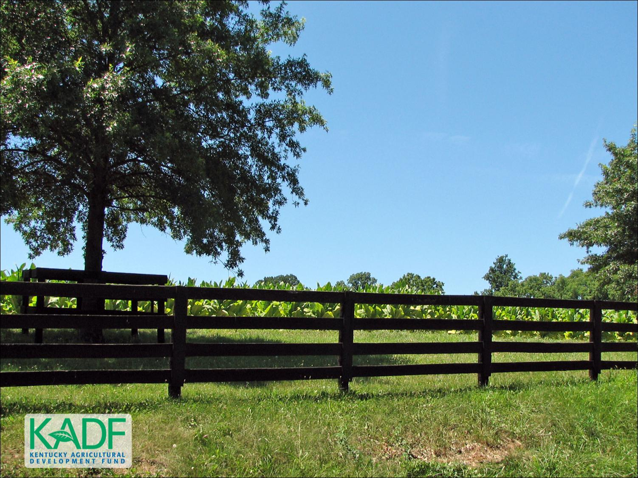
KOAP’s Report of
July 2024
As of 8/7/2024

Slide 2
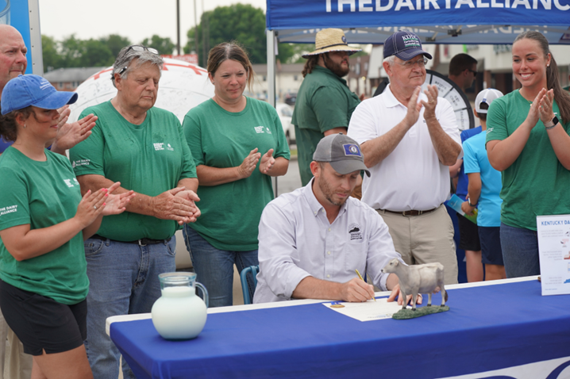
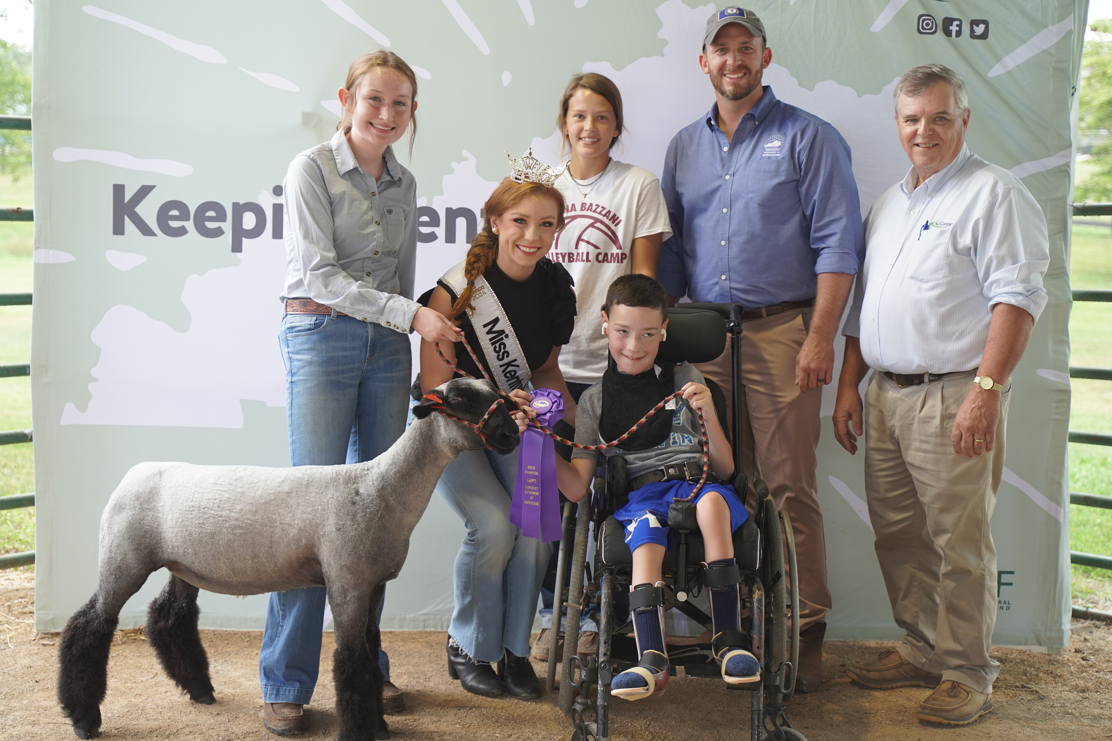
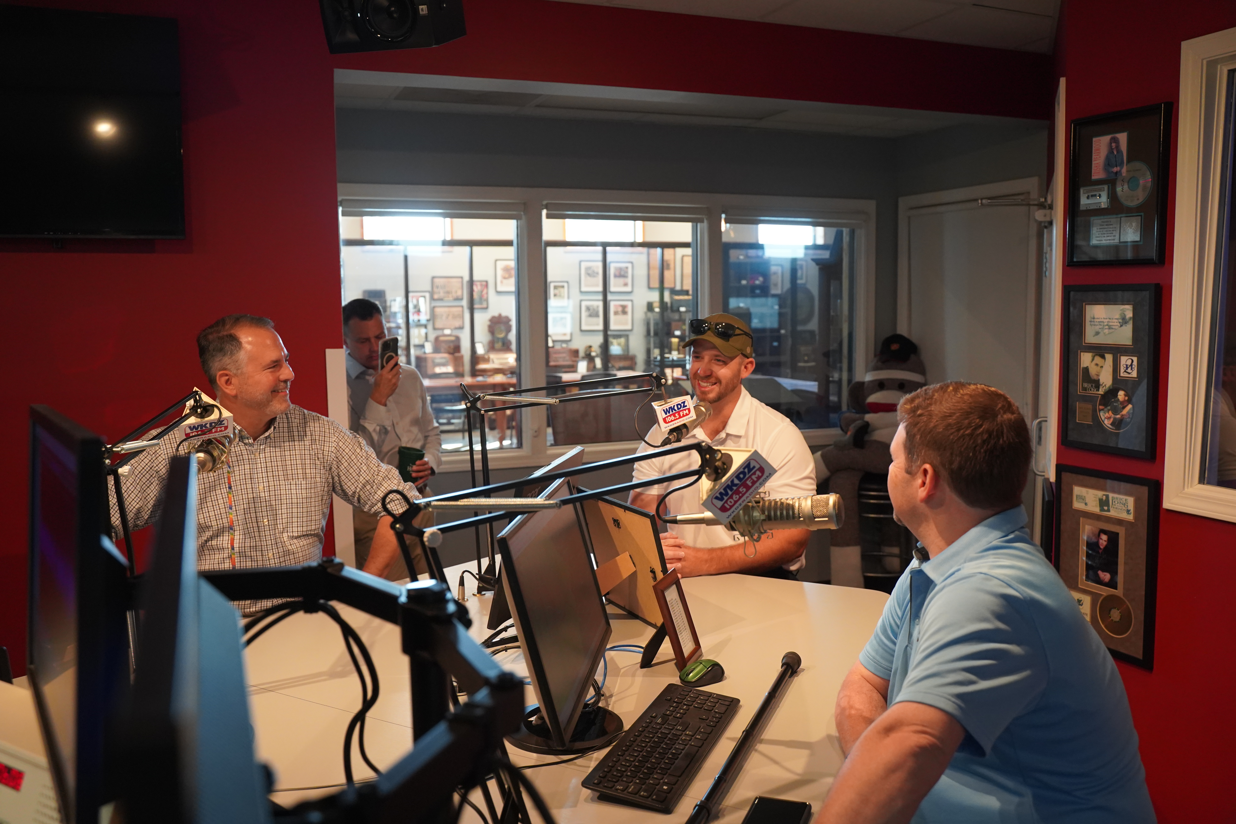
“Agriculture is Economic Development”
Commissioner of Agriculture,
Jonathan Shell

Slide 3
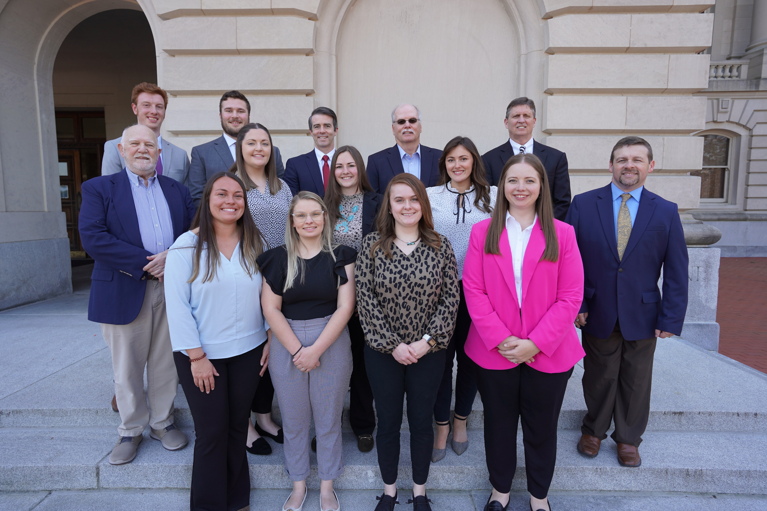
KOAP Staff
Brandon Reed
  Executive Director
Bill McCloskey
  Deputy Executive Director
Bill Hearn
  Fiscal Officer
Brian Murphy
  General Counsel
Chelsea Smither
  KADF Project Manager
Hannah Sharp-Johnson
  Boards & Special Events Manager
Alexis Scheidt
  KADF Project Manager
Jeff Parman
  KADF Program Compliance Manager
Jesslyn Watson
  KADF Project Manager
Hunter Jones
  KAFC Loan Programs Manager
Bailey Siry-Crowder
  KADF Project Compliance Manager
Rebecca Besok
  KADF Project Manager
Sarah Bryant
  KADF Programs Manager
Savanna Hill
  KADF Project Manager
Tera Roberts
  KAFC Loan Programs Manager

Slide 4


Monthly Board Approvals:
July
KADB KAFC
$3.5 MM $1.5 MM

Slide 5
KOAP Highlights of July:
  3 staff members attended competitive leadership programs: Kentucky Agriculture Leadership Program & Kentucky Cattlemen’s Assoc. Leadership Program
  Staff presented at the 80th Annual Kentucky Association of Conservation Districts Meeting
  12 County Agricultural Development Councils attended by staff
  The summer interns completed their summer with us: Angelina Sonoqui, Wade Carrington, Caroline Groth & Karissa Hamilton

Slide 6
Approval Breakdown
KADB Approvals:
  10 On-Farm Energy Efficiency Incentives Programs totaling $67,839
  16 County Agricultural Investment Programs totaling $2,114,029
  3 Deceased Farm Animal Removal Programs totaling $45,000
  1 Shared-Use Equipment Programs totaling $5,588
  3 Youth Agricultural Incentives Programs totaling $48,115
  7 County & State Projects totaling $1,247,177
KAFC Approvals:
  5 Agricultural Infrastructure Loan Programs totaling $817,790
  5 Beginning Farmer Loan Programs totaling $772,475

Slide 7
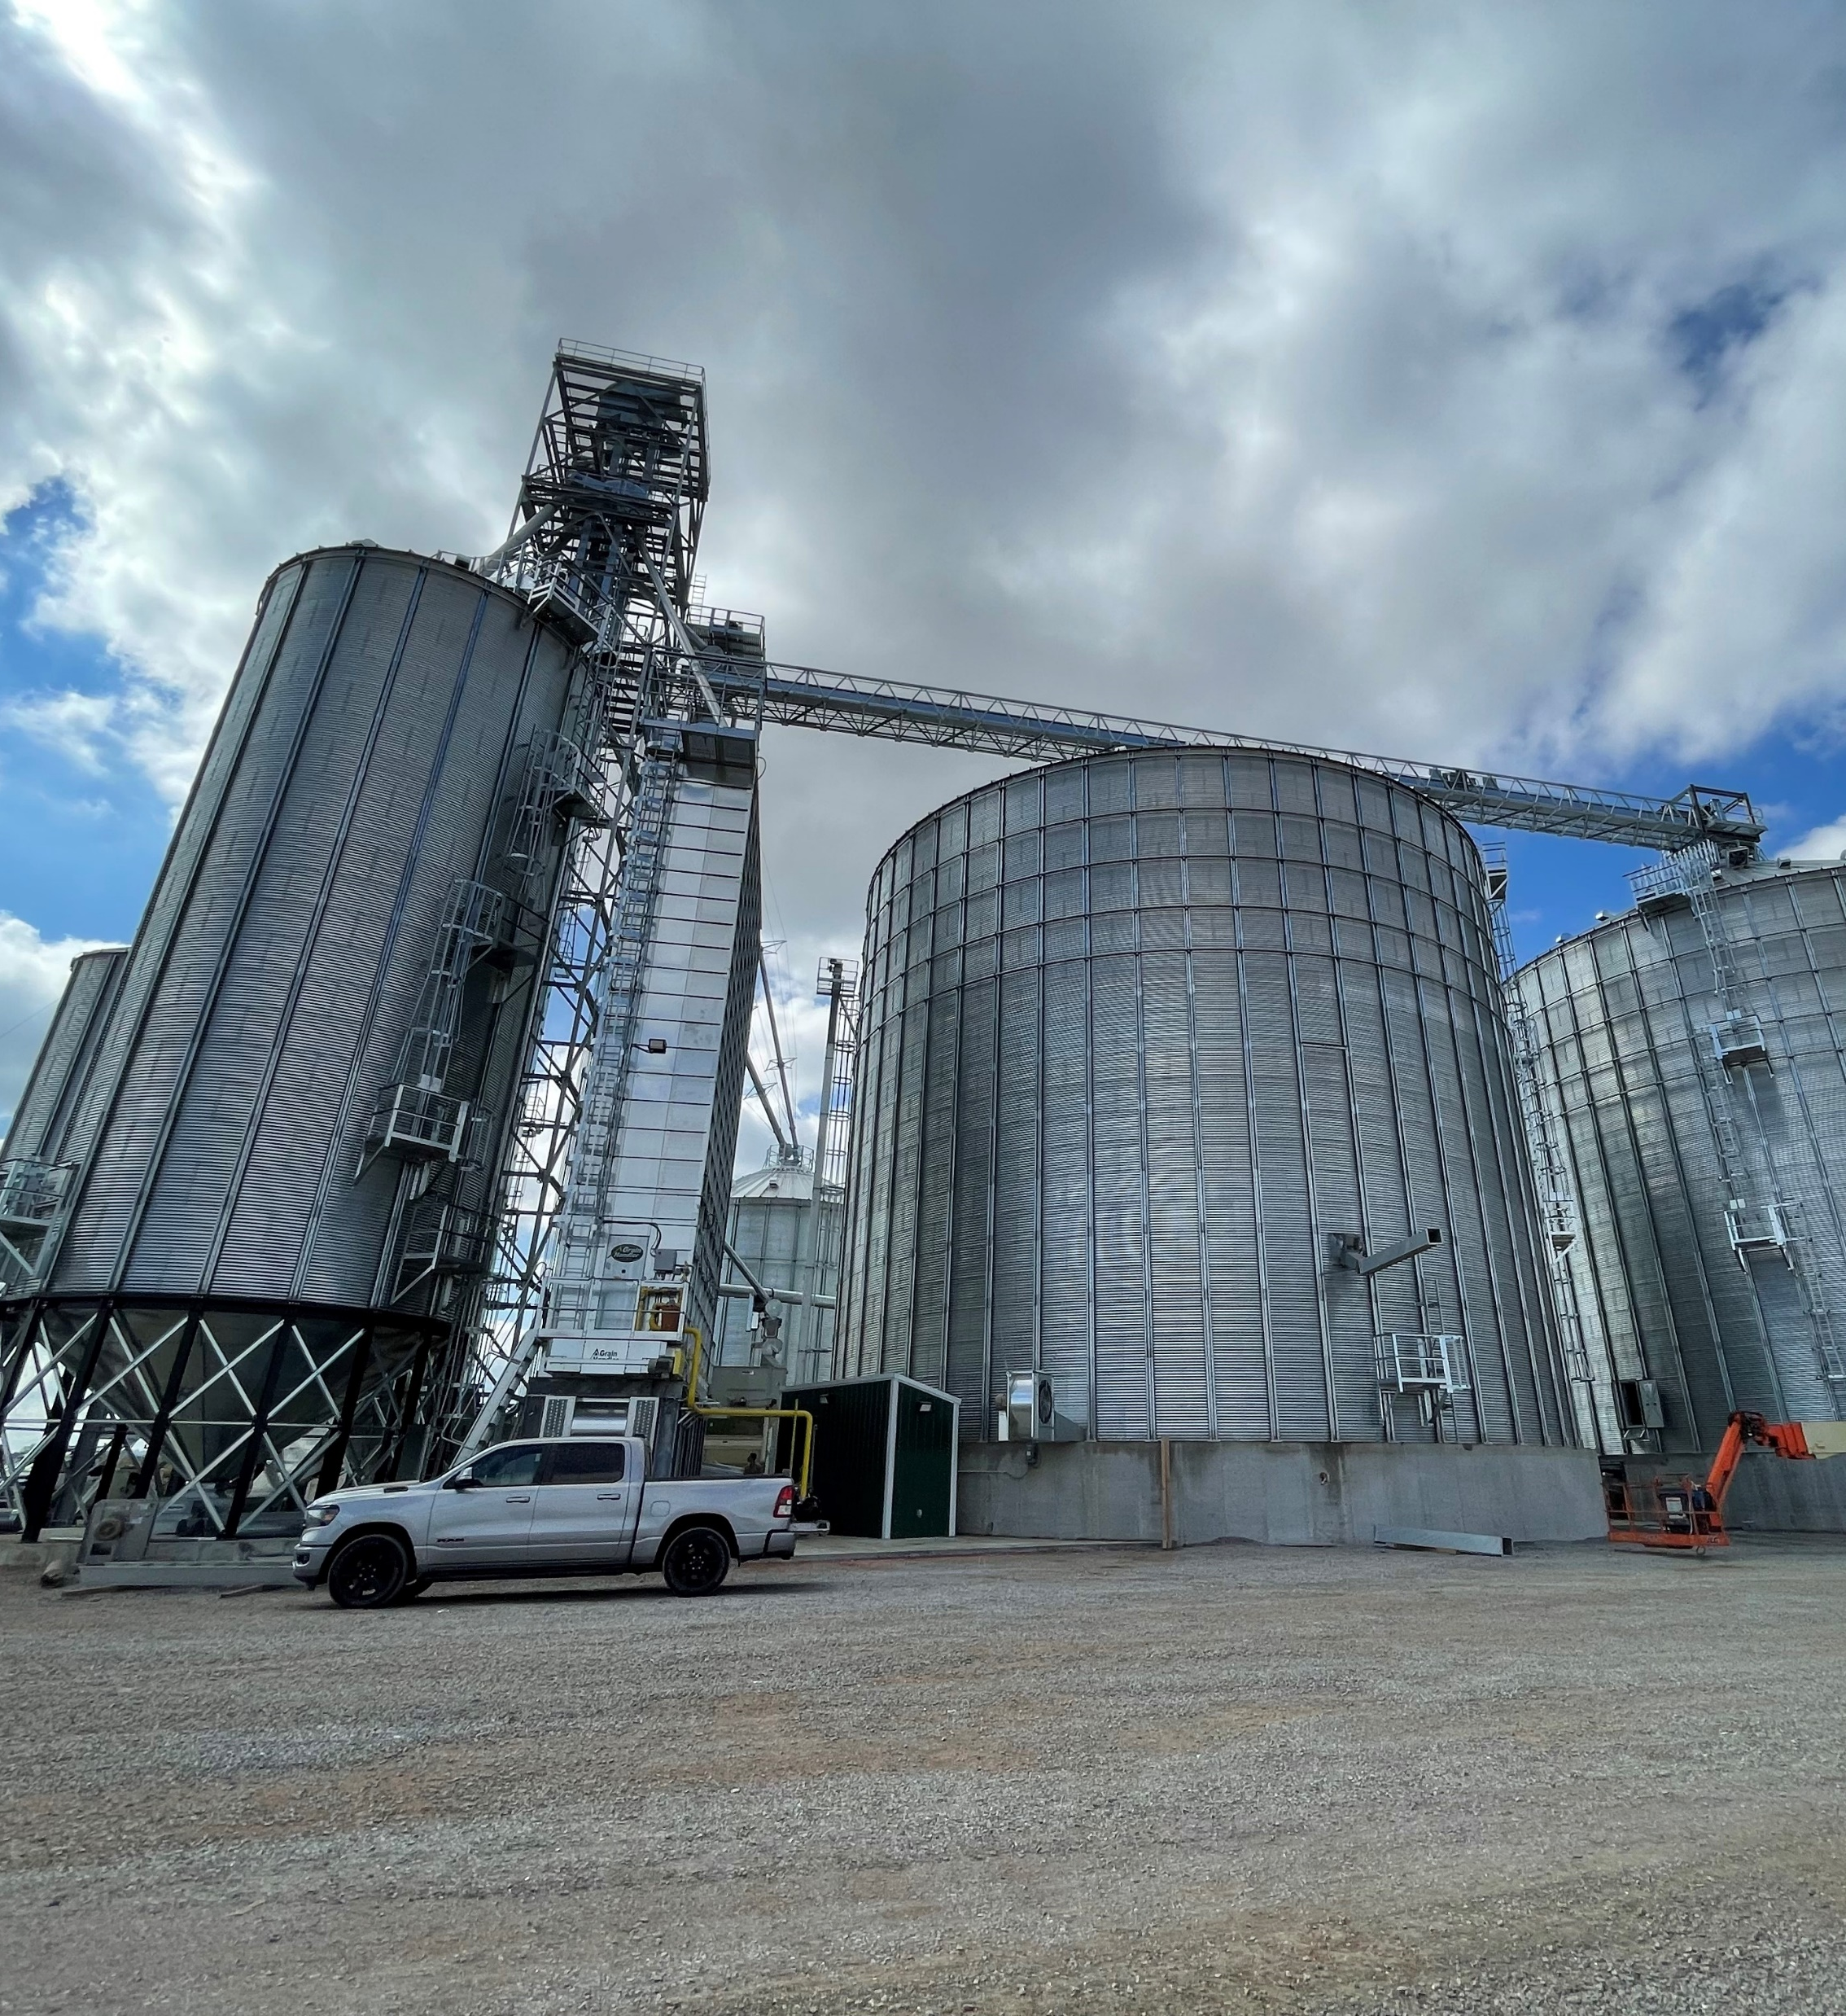
Bill & Brandon’s Top Picks
Clark County Fiscal Court - $7,250 in Clark County funds
Orlinda Melon Company - $84,968 in multi-county funds matched by state funds with an option of a KADF participation loan
Loretto Grain -$750,000 KADF participation loan (pictured right)

