Slide 1
Tobacco Settlement Agreement Fund Oversight Committee
Jay Nelson, Director
Kentucky Division of Conservation
August 15, 2024

Slide 2
FY24 Tobacco Settlement Allocation
Direct Aid $900,000
State Cost Share $2,500,000
State Cost Share $
Notes:
- Good things that this funding is used for in the Commonwealth
- DOC/SWCC portion of TSAF is from the Ag Development Fund. (which is 50% of total).
- Mention the SWCC (Soil & Water Quality Conservation Commission) and DOC relationship. DOC administers programs with SWCC oversight.
- SWCC is made up of 9 commissioners from 9 areas across the state.
- Be sure to delineate that the graph is for SCS only. Also point out that the dashed line is for the next two-year budget cycle. Steady decline since high of $9m in 2008.

Slide 3
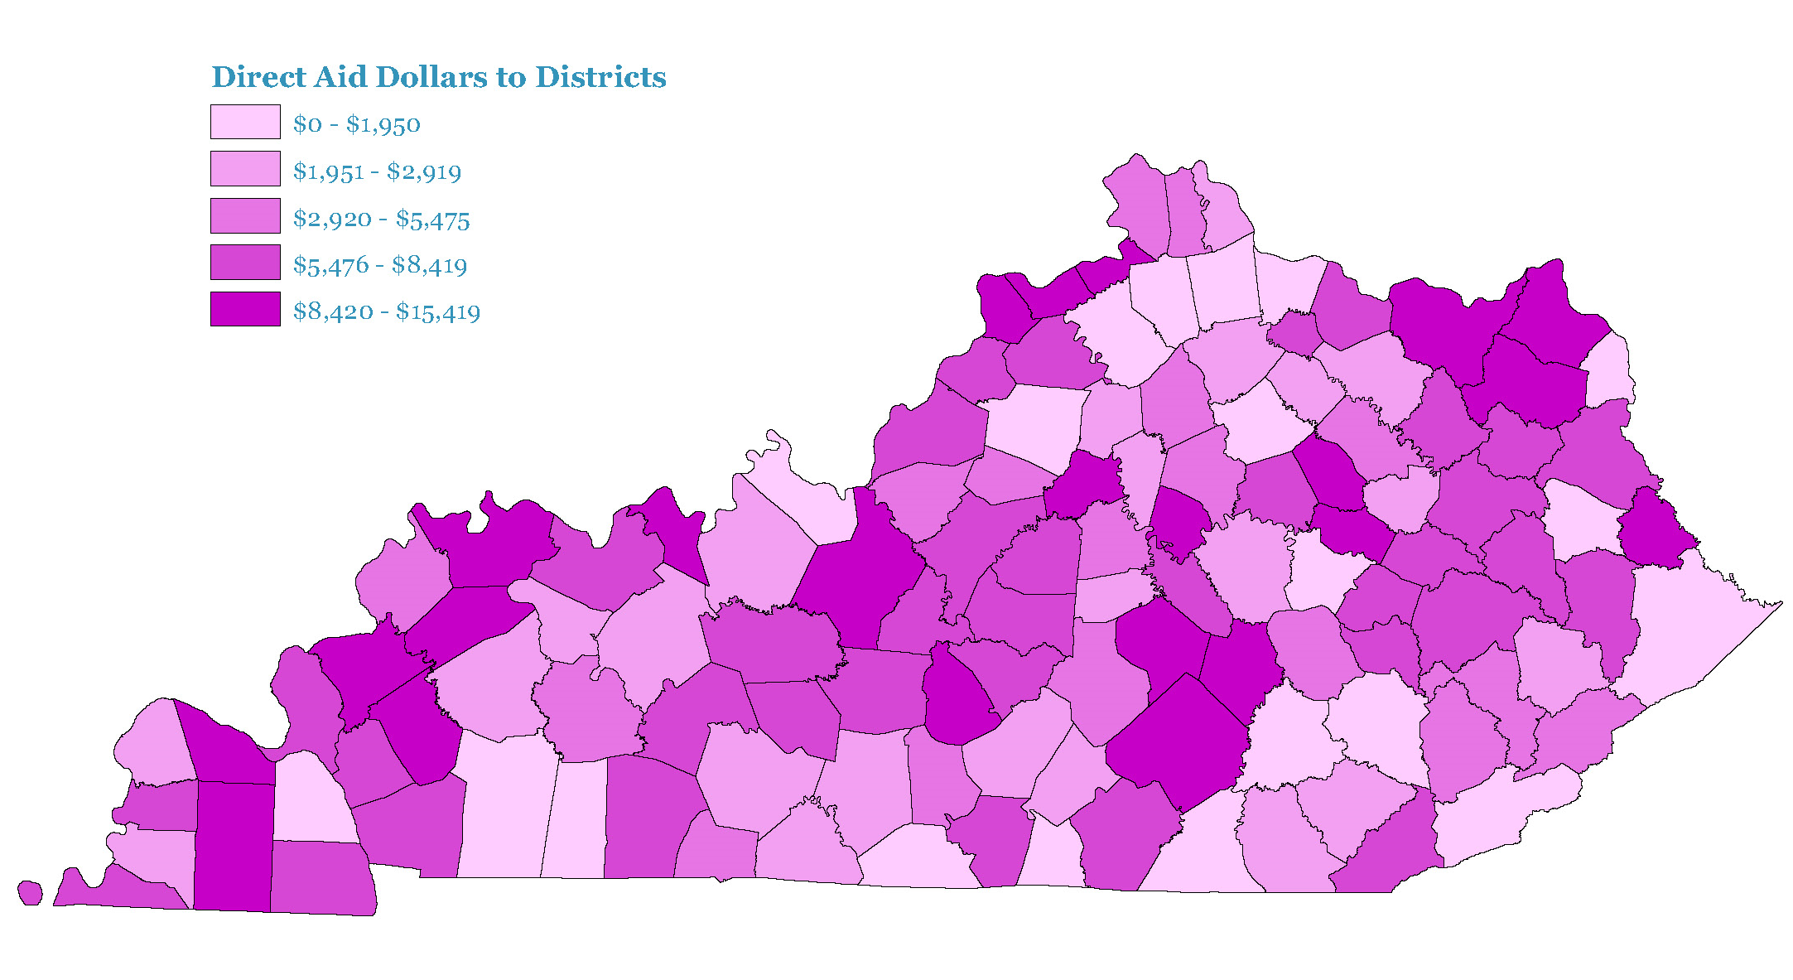
FY24 Direct Aid to Conservation Districts
Notes:
Pays for audits required by KRS 65A and then distributed on a sliding scale based on:
CD balance at end of FY
If they are on millage (ad valorum) tax (72 on, 48 are not)
Number of employees
Completion of regulatory requirements (DIGS).
FY25: $1 million - $250,000= $750,000 / 121 counties = ~$6,200. The extra million gave an increase of just over $400/year per conservation district. $6,198 vs. $5,785 on average.

Slide 4
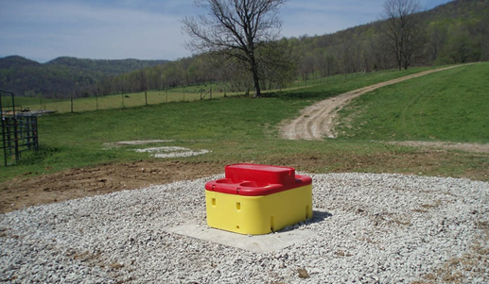
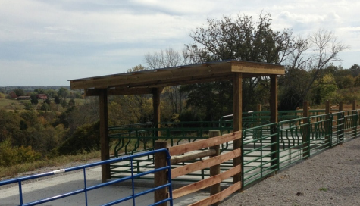
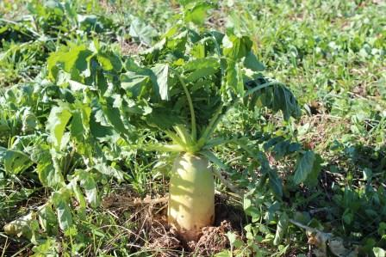
State Cost Share Summary
Originally established in 1994 and funded from General Funds and pesticide Product Registration Fees
Starting in 2000, the program was funded through Tobacco Master Settlement Agreement Funds
Provides financial assistance to farmers at a 75% reimbursement rate for those implementing best management practices on their farms with the assistance of local conservation districts
Notes:
We will look at the last two fiscal years, then show a cumulative map of SCS. Give examples of a few specific practices.
Useful practices: Livestock: heavy use areas, riparian buffers, water systems
Crop: cover crop, grassed waterways

Slide 5
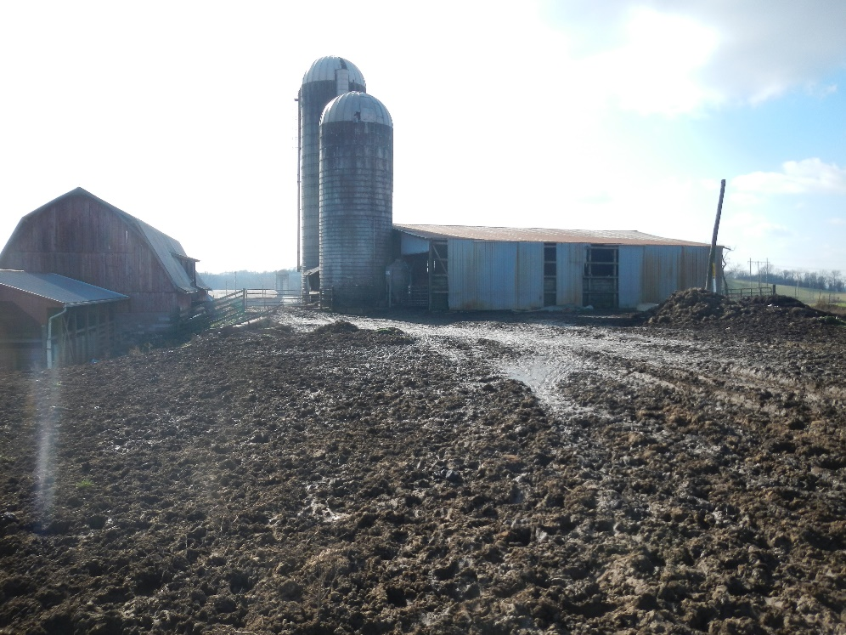
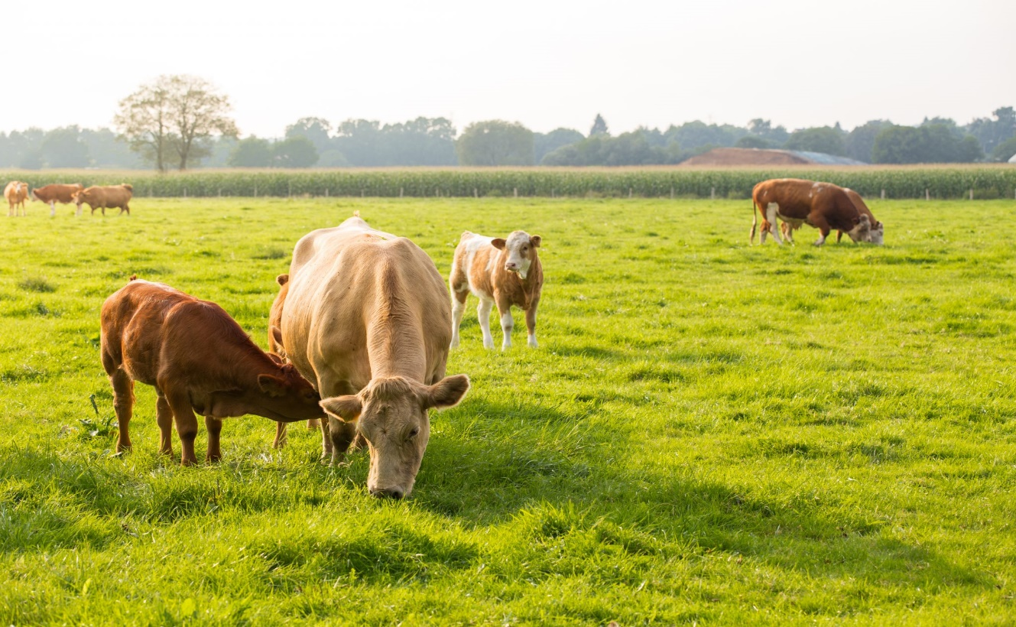
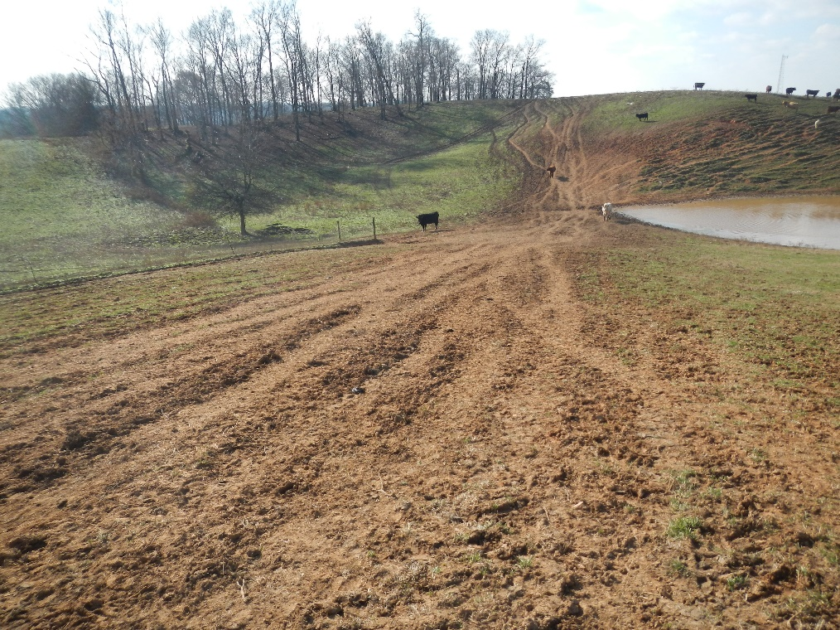
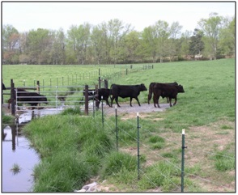
Notes:
- Examples of goals. Give brief description of fenced animals out of stream; benefits.
- 2 SCS Practices in bottom right photo, fencing animals out of a stream and stream crossing for controlled access.
- Mention KyNMPs; and in ALL cases, what is best for resource conservation is also best for the financial gains of farmers.

Slide 6
FY24 Approved in January 2024
Requests from 876 individuals and $11,364,981
Approved 319 individuals and $3,870,784
34% approval rate

Slide 7
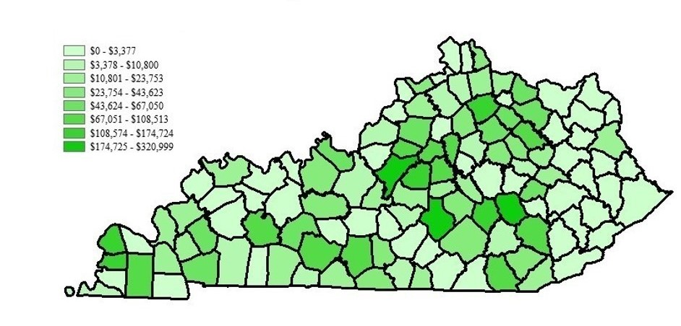
State Cost Share Projects Approved
FY 24 Funds
Dollars Approved
Notes:
SCS financial distribution. Darker color equals more funding.
Scoring criteria taken from KAR/KRS, set by SWCC. Based primarily on BMP type. Animal waste is highest priority per 416 KAR 1:010
No consideration given to geographic distribution, county, etc. All in same “pot” and all compete with one another.
Maps show trends that the program is fulfilling regulatory objective.

Slide 8
FY23 Approved in February 2023
Requests from 960 individuals and $11,659,640
Approved 345 individuals and $4,203,631
36% approval rate
Notes:
Similar approval rates from year to year.

Slide 9
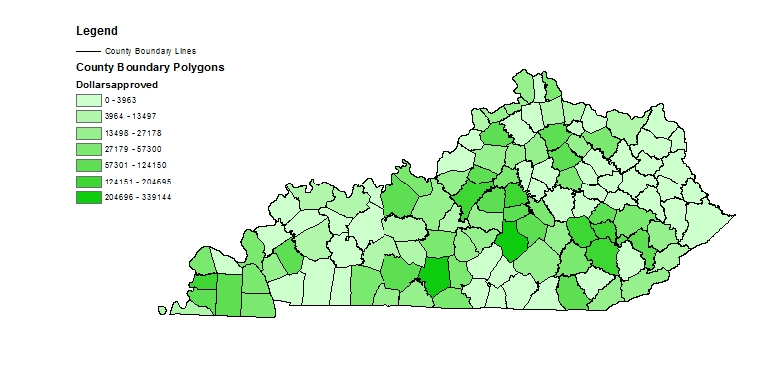
State Cost Share Projects Approved
FY 23 Funds
Dollars Approved
$0 - $3,963
$3,964 - $13,497
$13,498 - $27,178
$27,179 - $57,300
$57,301 - $124,150
$124,151 - $204,695
$204,696 - $339,144

Slide 10
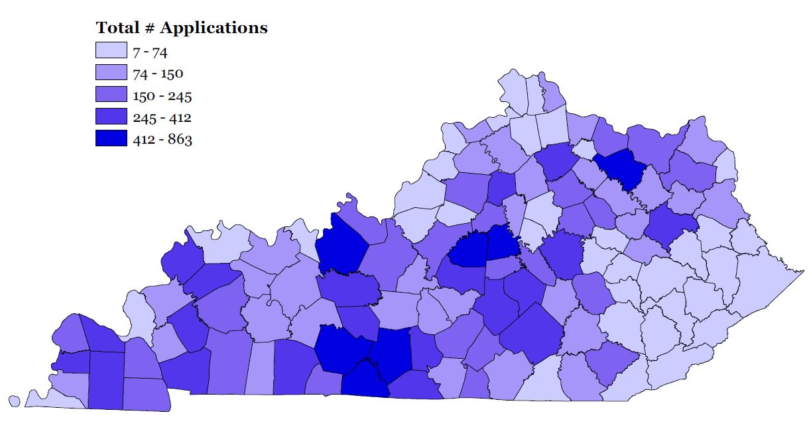
Program Total Applications Approved
1994-2024
Notes:
Review of lifetime of program.
Trends still show fulfillment of regulatory objectives.

Slide 11
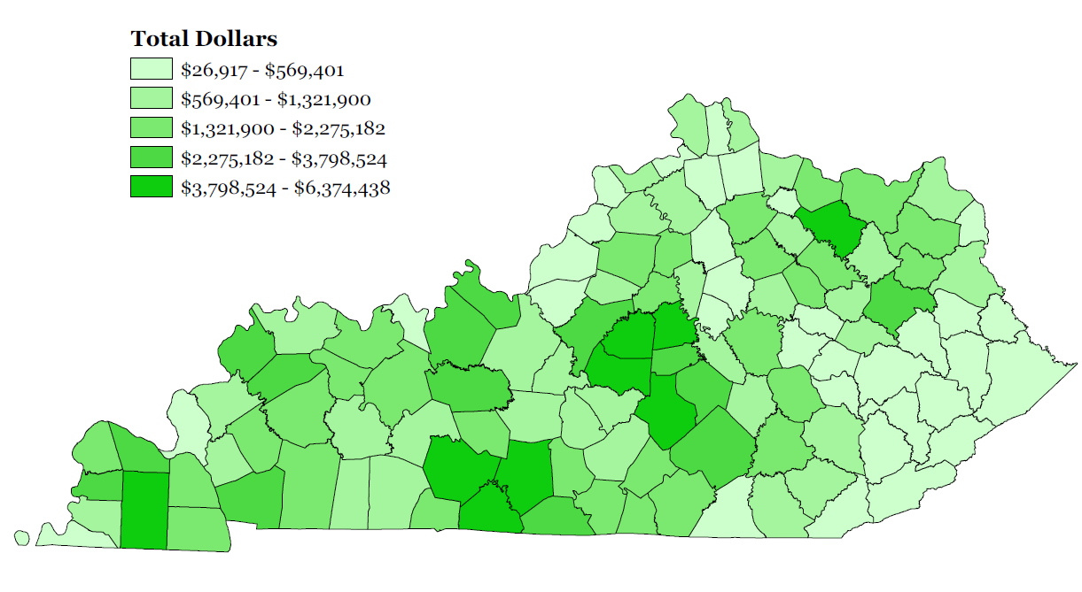
Program Total Dollars Approved
1994-2024
Notes:
Slightly different since animal waste structures are funded at a higher rate than other practices, so areas of animal ag may receive more money with an equal number of projects.

Slide 12
Account Balance
$10,205,751 currently in the account
  $1,000,000 obligated Direct Aid to Conservation Districts
    Approximately $250,000 will be paid to contracted auditor during FY25
    Remaining $750,000 will be distributed to conservation districts in September 2024
  $1,748,563 obligated from FY23
  $3,585,152 obligated from FY24
  $300,000 required contingency fund set aside
      $20,000 has been obligated
Notes:
Snapshot of TSAF account.
May mention audits here.

Slide 13
Demonstration of Need
The Kentucky Soil & Water Quality State Cost Share Program continues to have significant interest with agricultural producers across the Commonwealth.
Annually, approximately one third of total funding requests are approved.
Cut off for FY25 funding will be November 15, 2024
  Approval in February 2025
Remaining funding that is unobligated $3,572,035
Notes:
Only approximate one third approval rate in recent years since funding was dropped to $2.5 million. Project that to be less in coming cycle.
Unobligated funding is due to modifications, cancellations, etc. This number may go up or down, depending on remaining contracts to be paid.

Slide 14
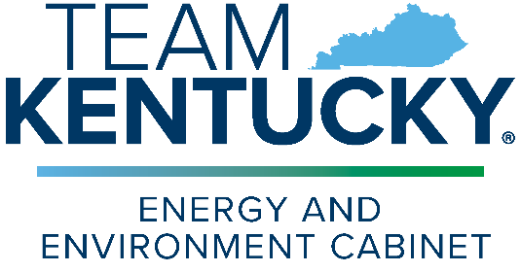
Contact Information
Jay Nelson, Division Director
Jay.nelson@ky.gov
502-782-5761
Kentucky Division of Conservation
  300 Sower Blvd, 2nd floor

