Slide 1
CHFS Tobacco Master Settlement Agreement Funded Programs
Prepared for the Tobacco Settlement Agreement Fund Oversight Committee
Elizabeth Goode, Department for Public Health, Division Director
Holly LaFavers, Department for Public Health, Branch Manager
Sarah Johnson, Department for Behavioral Health, Developmental and Intellectual Disabilities, Division Director
Andrea Day, Department for Community Based Services, Division Director
November 14, 2024

Slide 2
Tobacco Settlement Agreement Enacted Funding
Program | FY 2025 | FY 2026
Smoking Cessation | $1,869,300 | $2,000,000
Lung Cancer Screening Program | $500,000 | $500,000
Early Childhood Oral Health | $700,000 | $700,000
HANDS | $5,634,000 | $5,980,000
Early Childhood Mental Health | $700,000 | $700,000
Substance Abuse Prevention and Treatment for Pregnant Women | $1,300,000 | $1,300,000
Early Childhood Development Program | $9,800,000 | $9,500,000
Healthy Start | $700,000 | $700,000
Early Childhood Adoption and Foster Care Supports Program | $2,000,000 | $2,000,000
Total Settlement Funds | $23,203,300 | $23,380,000

Slide 3
Tobacco Prevention and Cessation

Slide 4
KY Tobacco Prevention & Cessation Program Highlights
Vaping prevention for schools and youth groups
Resources for schools who find students vaping at school
Support through over 40 local health departments
Two quitlines with no-cost help quitting smoking or vaping for Kentucky residents of all ages, 24/7.

Slide 5
KY Tobacco Prevention & Cessation Program Major Successes in FY24
Prevention: 10,789 students and 14 new counties received vaping prevention education from the University of Kentucky’s #iCANendthetrend (funded by this program) in the 2023-2024 school year.
Cessation: 4,466 Kentucky residents enrolled in Quit Now Kentucky in FY24. Quitlines double a person’s chances of quitting!
“The presenter was wonderful and did a great job on teaching our students about nicotine/vapes. The information was great and easy to follow and understand.”
- 2023-2024 Feedback from a Kentucky School

Slide 6
Lung Cancer Screening

Slide 7
Lung Cancer Screening Program Progress
2022
2023
2024
2025
Establishment
Planning
Implementation
Evaluation
HB 219: Program establishment
Goal setting
Advisory committee
HB 180: Biomarker-testing legislation
Program administration
Partnerships
Launch projects
Enhance program visibility & impact
Performance monitoring
Feedback & evaluation
New partnerships
New grant endeavors

Slide 8
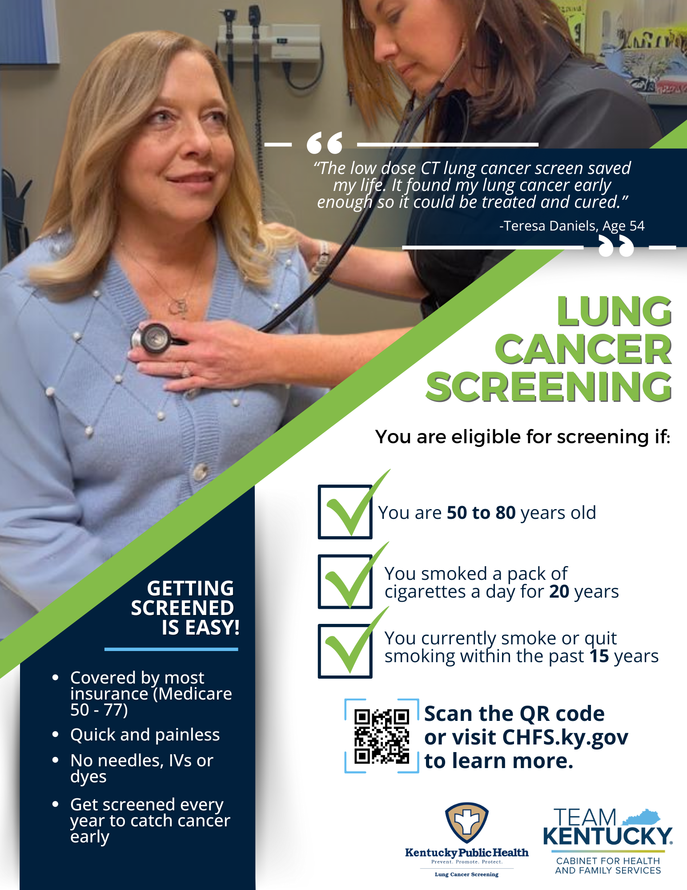
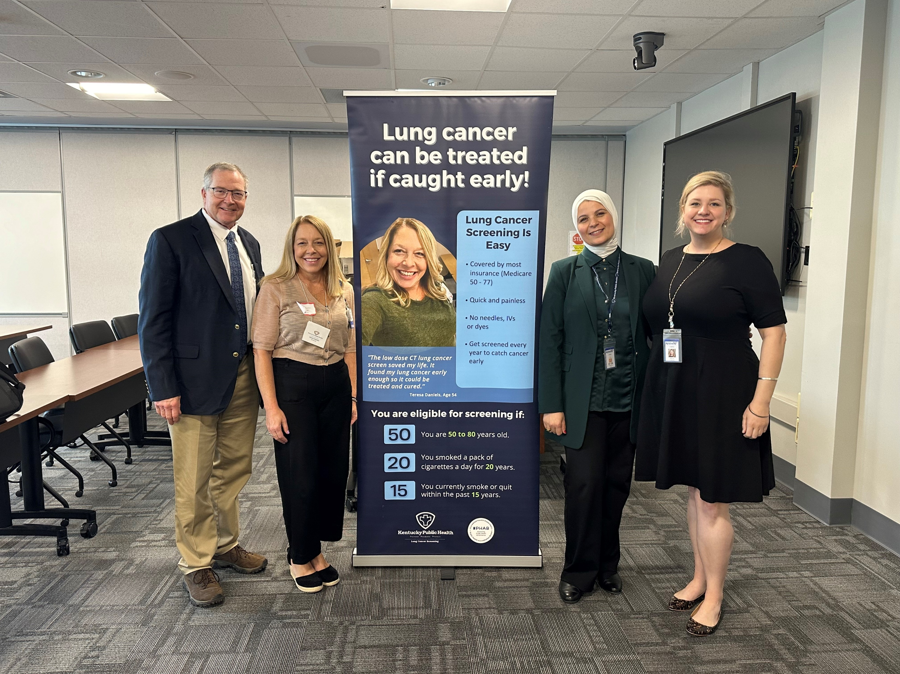
Lung Cancer Screening Program Success

Slide 9
Early Childhood Oral Health

Slide 10
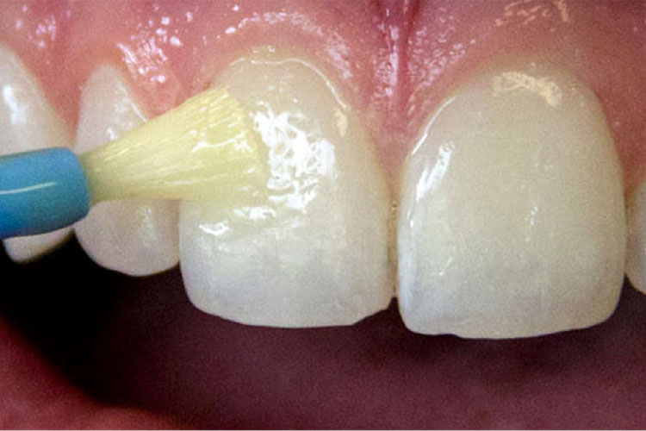
Early Childhood Oral Health
36 health departments are supported with tobacco funds for dental varnish
There has been a significant increase in varnish services provided since the pandemic:
In FY22, 13,000 varnish services were provided; and
In FY24, over 23,365 varnish services were provided

Slide 11
Early Childhood Oral Health
20 training sessions were provided during FY24, training approximately 200 nurses
Varnish kit ordering is up over FY23, reflecting the resumption of clinical services post-pandemic
Supporting 8 recent dental school graduates for debt repayment who serve in dentally underserved areas
Supported a survey of the dental status of children under six years of age
Expanded the number of Public Health Dental Hygiene teams by six, for a total of ten teams

Slide 12
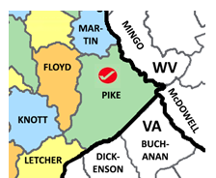
Early Childhood Oral Health
Provided fluoridation equipment to smaller municipal water plants
Assisted in sustaining the UK dental clinic in western Kentucky
Supported special construction and equipment projects in both dental schools to improve dental care for children under six years of age
Allocated funds for Pike County Health Department to revitalize their dental suite to better serve children in Pike County. This is a partnership between the health department, UPIKE and Big Sandy Community and Technical College (CTC)
Sponsored the parent-facing pages of the Kentucky Oral Health Coalition’s webpage to improve literacy and access to care

Slide 13
Health Access Nurturing Development Services (HANDS)

Slide 14
Health Access Nurturing Development Services (HANDS)
Voluntary home visitation program administered primarily by local health departments.
Designed to assist parents/caregivers during the prenatal period until the child’s third birthday, improve health outcomes for both mother and child, and improve social outcomes for child and family.

Slide 15
Goals of HANDS
Healthy pregnancies and births
Optimal child growth and development
Children live in healthy and safe homes
Family self-sufficiency

Slide 16
HANDS Accomplishments FY24
Fulltime employee – 349
Families served – 6,293
Home visits completed – 139,943 (in-person and virtual)

Slide 17
Early childhood mental health

Slide 18
Early Childhood Mental Health (ECMH)
Purpose: to build capacity to meet the mental health needs of young children and their families by partnering with the Departments for Public Health and Behavioral Health, Developmental and Intellectual Disabilities
Structure: funds support early childhood mental health specialists in the 14 regional community mental health centers
Purpose
and Structure
3,232 hours billed to private insurance and Medicaid
Specialists provided 100 trainings to child-serving agencies
Provided training to 2,267 early care and education staff in Head Start, childcare, and other community partners
2,719 hours of consultation around emotional/behavioral issues, classroom management and screening/assessment
Accomplishments

Slide 19
Early Childhood Consultants (ECC)
In an average year, the ECCs provide approximately 3,000 billable, clinical, or supportive services (screening, assessment, therapy, community support, peer support, evaluation, etc.) and 4,000 non-billable clinical or supportive services (observation, consultation, training, outreach, coaching, and connection to other services).
A Closer
Look at Services
Community early childhood councils
Primary care providers/pediatricians
DCBS – Division of Protection & Permanency- child welfare and prevention such as Community Collaboration for Children
Local health departments- WIC, breastfeeding, immunizations, safe sleep
Child Care Aware
Licensed child care centers and certified family home providers
Faith-based initiatives
Family and child behavioral health services
Adult behavioral health services
Prevention services
Substance use treatment services
KY-Moms MATR (Maternal Assistance Toward Recovery)
Kentucky Partnership for Families and Children (statewide family organization) & other family advocates
Parent support groups
Partnerships

Slide 20
Substance Abuse Prevention and Treatment for Pregnant Women

Slide 21
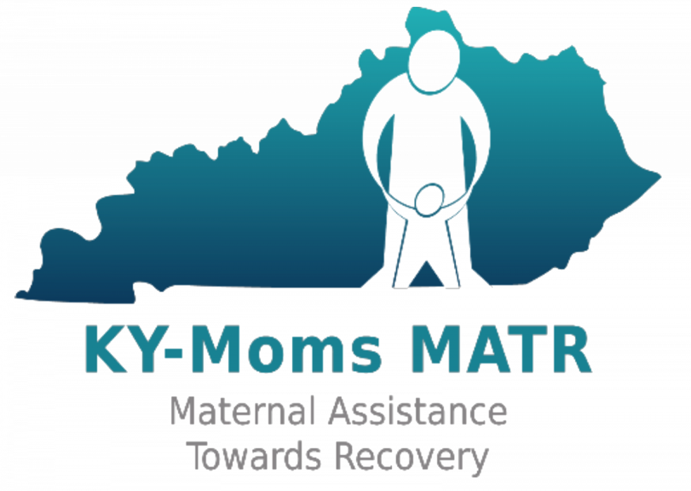
Pregnant and Parenting Services for Persons with Substance Use Disorder (SUD)
KY-Moms Maternal Assistance Towards Recovery (MATR)
Located statewide
SUD prevention education: 2,899 activities conducted reaching 49,910 persons
SUD case management: 68 pregnant and 26 postpartum persons
Offers services up to 1 year postpartum
St. Elizabeth Baby Steps
Located in Northern Kentucky
204 individuals assisted with services
Provides recovery, employment, and housing supports
Nurses provide a 12-week education class to 4 recovery centers in Kentucky

Slide 22
Pregnant and Parenting Services for Persons with Substance Use Disorder (SUD), cont.
Haven 4 Change
Located in Bowling Green
Transitional living environment for women and their children
Recovery supports, job training, and childcare assistance
Chrysalis House
Located in Lexington
3 residential treatment facilities for women and their children
NARR Certified Serenity Recovery Apartments for women and their families

Slide 23
Pregnant and Parenting Services for Persons with Substance Use Disorder (SUD) cont.
Independence House
Located in Corbin
Residential treatment facility
Provides recovery, higher education, employment, and housing supports
SKY Hope Women's Recovery Center
Located in Somerset
100 bed recovery center
Recovery programming, higher education, employment training, supports, and assistance

Slide 24
Division of Child Care Quality Initiatives

Slide 25
Child Care and Development Funds (CCDF)
This federal grant is designed to promote success for children, employment for parents, and economic security for parents by ensuring stable, high quality childcare.
CCDF funds support the following initiatives in Kentucky:
Childcare subsidies for 23,260 families and 39,827 children
Monitoring and supports for approximately 1,996 childcare centers and family childcare homes at any given time
Professional development supports and background checks
Special initiatives for infant and toddler care, disaster preparedness training and response, and consumer education

Slide 26
What is Kentucky All STARS?
Kentucky All STARS is Kentucky's five-star quality rating and improvement system for early childhood education programs.
Childcare programs participating in Kentucky All STARS demonstrate a commitment to quality by focusing on the following indicators:
Family and community engagement
Classroom and instructional quality
Staff qualifications and professional development
Administrative and leadership practices

Slide 27
Kentucky All STARS Levels by Provider Type
 | Level 1 | Level 2 | Level 3 | Level 4 | Level 5 | Total
Certified | 161 | 23 | 14 | 15 | 2 | 215
Licensed Type I | 980 | 106 | 343 | 168 | 123 | 1,720
Licensed Type II | 25 | 6 | 3 | 2 | 1 | 37
Total | 1,166 | 135 | 360 | 185 | 126 | 1,972

Slide 28
Professional Development Activities
In SFY24 tobacco settlement funds helped to support the following:
996 scholarships for Commonwealth Child Care Credential
278 mini grants for Child Development Associates
222 Milestone Achievement Awards
95 education reimbursement grants

Slide 29
High Quality Classrooms
Healthy and safe facilities
Low adult to child ratios
Trained and experienced teachers
Parent and family involvement
Planned curriculum and developmental assessments
Language-rich classrooms

Slide 30
How Does Kentucky Stand Out?
ECE-TRIS (Early Care and Education Training Records Information System) – Comprehensive Professional Development Registry
Integrated systems to support quality
Monetary incentives for high quality child care
Staffed Family Child Care Network to recruit and support home-based child care
Brightwheel offered to regulated child care programs
Balanced approach to Child Care and Development Fund (CCDF) mandated activities
Employee Child Care Assistance Partnership (ECCAP)
Child care employees classified as a protected population
Scholarships for continuing education

Slide 31
Questions?

