Slide 1
Governor’s Office of Early Childhood
November 14th, 2024
Tobacco Master Settlement Oversight and Advisory Committee Meeting

Slide 2
Presenters
Lynn Baker, Executive Director, Governor’s Office of Early Childhood
Megan Greenwell, Project Specialist, Governor’s Office of Early Childhood

Slide 3
Early Childhood Advisory Council (ECAC)
Vision Statement:
All children in Kentucky will have the foundation that enables school and personal success and are supported by strong families and communities.
Mission Statement:
The ECAC provides leadership and direction for the Commonwealth of Kentucky by providing a comprehensive and sustainable prenatal to age five early childhood system that will ensure a strong foundation for all children.
Notes:
The Early Childhood Advisory Council was established in 2011 to promote program accountability and provide guidance on state services impacting children and families.
The vision and mission statements are in alignment with the ECAC’s strategic plan.
Our Mission is to provide leadership and direction for the Commonwealth with the goal of maintaining a comprehensive and sustainable prenatal to age five early childhood system that ensures a strong foundation for all children.

Slide 4
Governor’s Office of Early Childhood
The Governor’s Office of Early Childhood (GOEC) is the support office of the Early Childhood Advisory Council.
The GOEC is the umbrella organization that unifies partners to overcome fragmented funding and programs with better alignment, coordination, efficiencies, and messaging for a positive impact upon early childhood policy and practice.

Slide 5
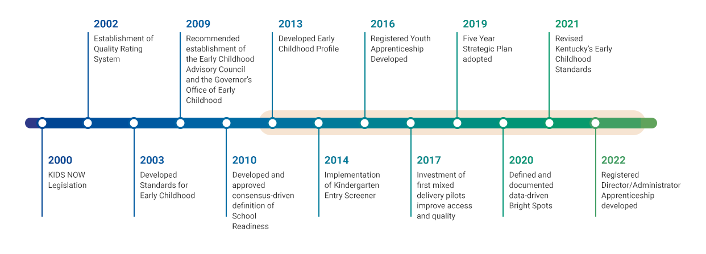
Historical Overview
Quality Rating System revised to All STARS
First round of Preschool Partnership Grants Funded for full-day, year-round preschool
Notes:
This slide provides a historical perspective of the work of the Governor’s Office of Early Childhood since the KIDS NOW legislation of 2000. We will talk in the next slide about the office’s most recent accomplishments, but as a summary of the overall activities of this office since its inception:
The state’s Early Childhood Standards were developed and revised in 2021, including a guide for families aligned to the benchmarks of development from birth to four.
The Early Childhood Profile has been developed and refreshed with kindergarten readiness data for regions and districts
Bright Spots of Data proven strategies have been identified as implemented by the Regional Collaborative Network
Registered Apprenticeship opportunities have been launched for early care and education

Slide 6
Accomplishments
Administering the Early Childhood Registered Apprenticeship Program
67 graduates of the program
105 currently in the program
70 current applicants for cohort 4
Growing the Regional Collaborative Network
35 currently active Regional Collaboratives
Unification of the Early Care and Education Landscape
37 state agencies that touch early care and education in Kentucky
Notes:
Early Childhood Registered Apprenticeship
The GOEC is the intermediary for the Early Childhood Registered Apprenticeship through the Office of Employer and Apprenticeship Services.
There are 67 graduates
105 currently in the program
70 applicants for cohort 4 beginning in January
Regional Collaboratives
Formerly known as Community Early Childhood Councils, state and local partnerships were created to meet the locally identified needs of children and set the foundation for the Community Early Childhood Councils. In 2019, the Early Childhood Advisory Council voted to merge the councils based upon geographical location and in alignment with the 10 workforce areas. Regional Collaboratives engage in data-driven strategies, known as Bright Spots, that ensure that more children in Kentucky have a strong start.
There are 35 regions currently active; the GOEC is sustaining and growing local and regional strategies through the Regional Collaboratives. We will share more about the “boots on the ground” strategies of the Regional Collaborative Network in a few slides.
Unification of landscape
The Early Childhood Advisory Council and the Governor’s Office of Early Childhood works in partnership and facilitates unification between state agencies across the early childhood landscape to strengthen and expand services for children and families. We continue to partner with state agencies, including the Division of Child Care, Kentucky Department of Education, Head Start, and the Department for Public Health to support and expand programs across the state. We will discuss specific strategies in the next slide.

Slide 7
FY25 Goals
Developmental Screening
Career Pathway
Coordination and Collaboration Between Agencies
Family Engagement
Notes:
Developmental screening: collaboration on expanding and supporting Help Me Grow Division of Child Care
Career Pathway: collaboration on Early Childhood Institute to align with revisions to joint professional standards, career pathway models. Will advance knowledge of revisions to career pathways through professional development/institutes
Coordination and collaboration between agencies (Early Childhood Institutes, Help Me Grow Developmental Screening); alignment of behavioral framework supports across public preschool, child care, Head Start through a state leadership team and associated training and technical assistance
Communications plans for multigenerational literacy and learning and family engagement; family child care homes across the state through Regional Collaboratives

Slide 8
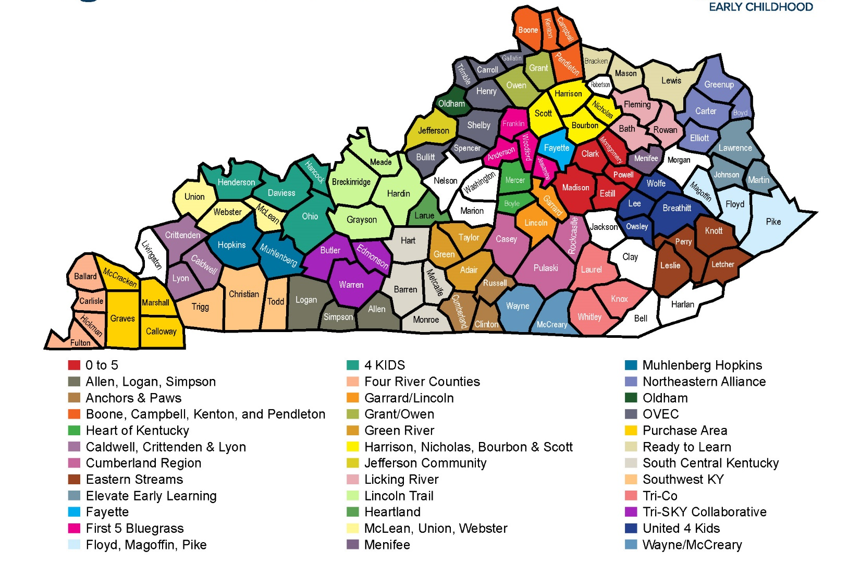
Regional Collaborative Network
Notes:
Megan Greenwell
35 active Regional Collaboratives
Bell, Clay, Harlan, Jackson Counties only ones not currently participating
Bright Spots
These #s are based on investments being made in Bright Spots.
Born Learning Academies – 6 / 35 – 17%
Blending Funding – 7 / 35 – 20%
Transitions – 31 / 35 – 89%
High Quality – 18 / 25 – 51%
Early Literacy – 32 / 35 – 91%
Monitoring Growth, Learning and Development (Developmental Screening) – 12 / 35 – 34%
Building Vocabulary – 5 / 35 – 14%
Home Visitation – 16 / 35 – 46%

Slide 9
Thank You!

