Slide 1
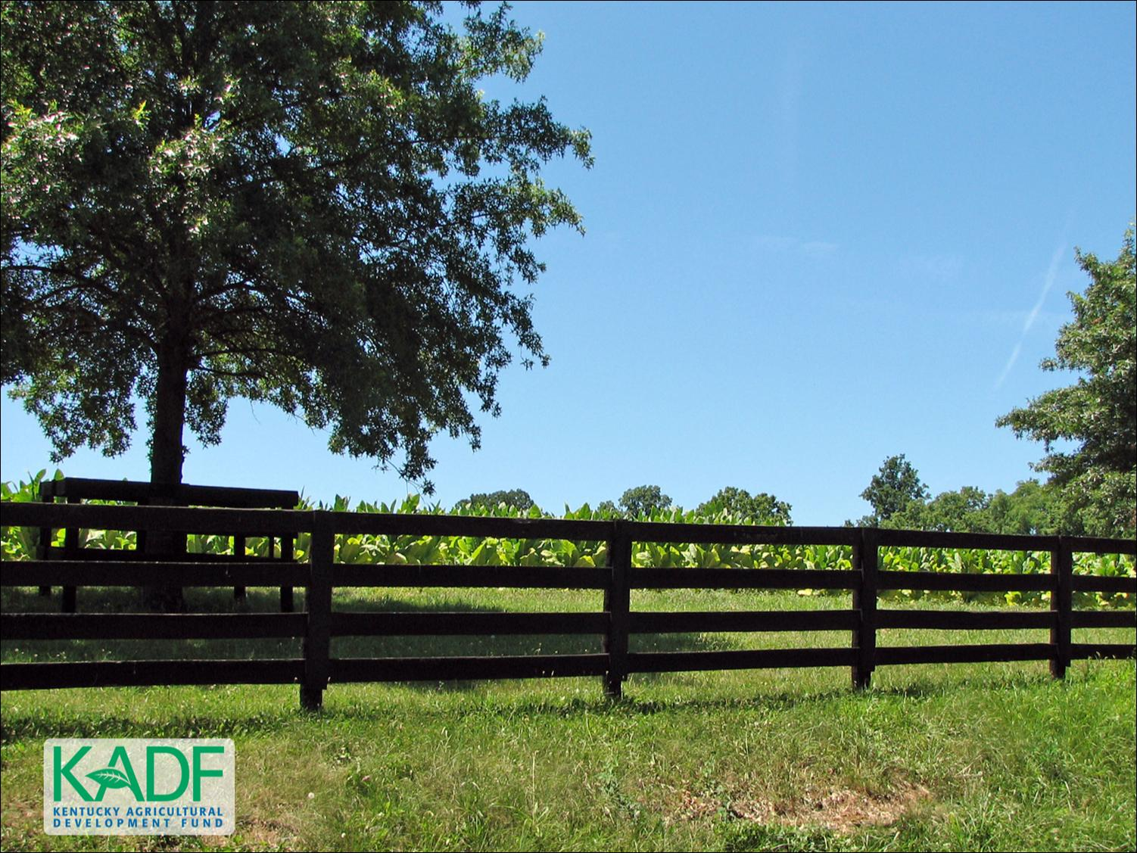
KOAP’s Report of
October 2024

Slide 2

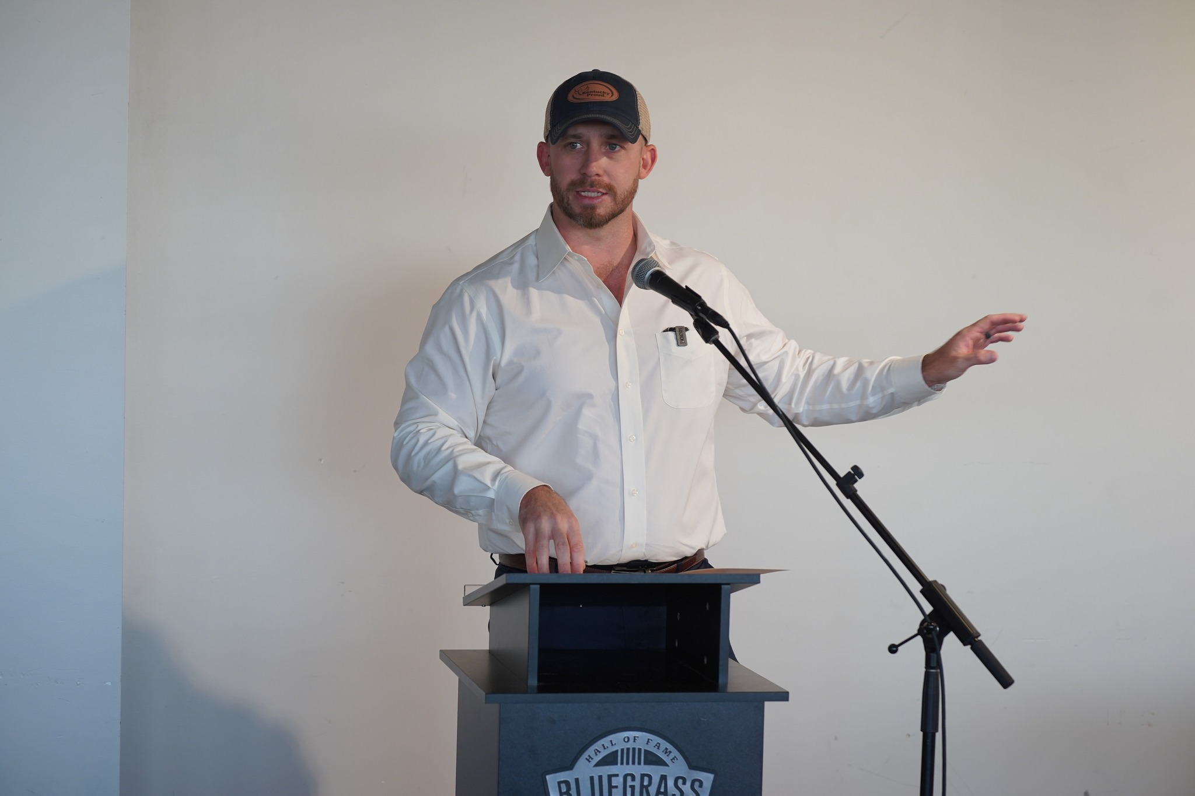
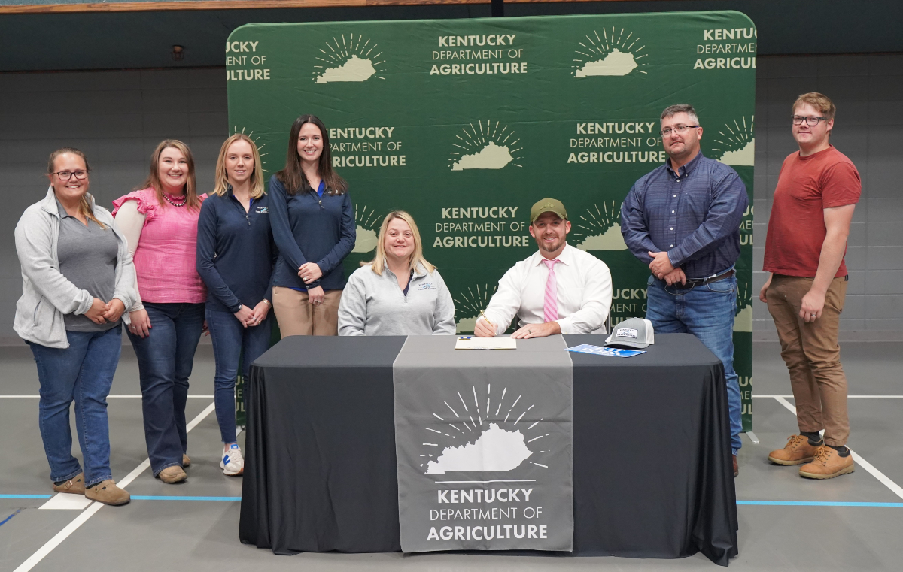
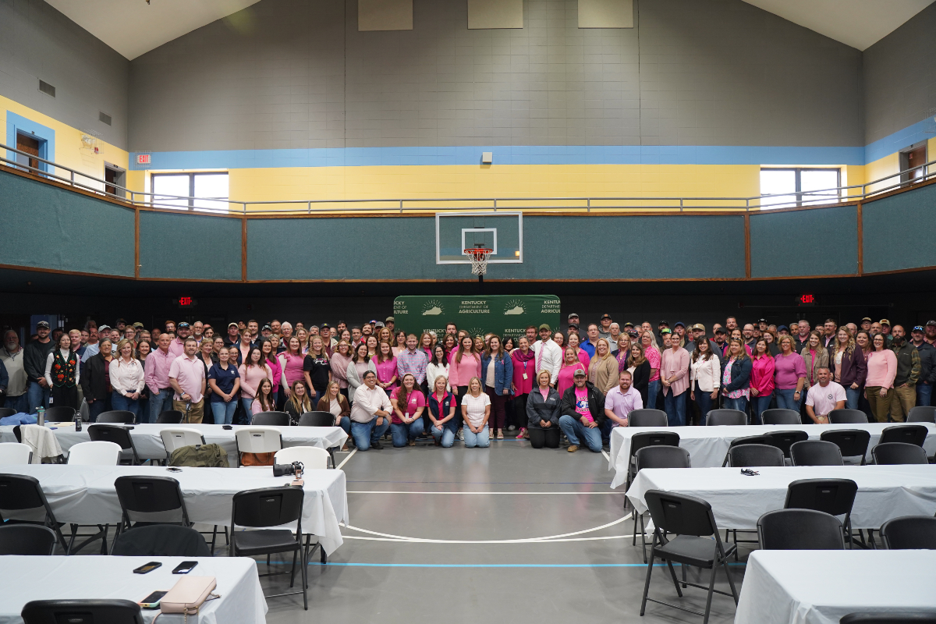
“Agriculture is Economic Development”
Commissioner of Agriculture,
Jonathan Shell

Slide 3
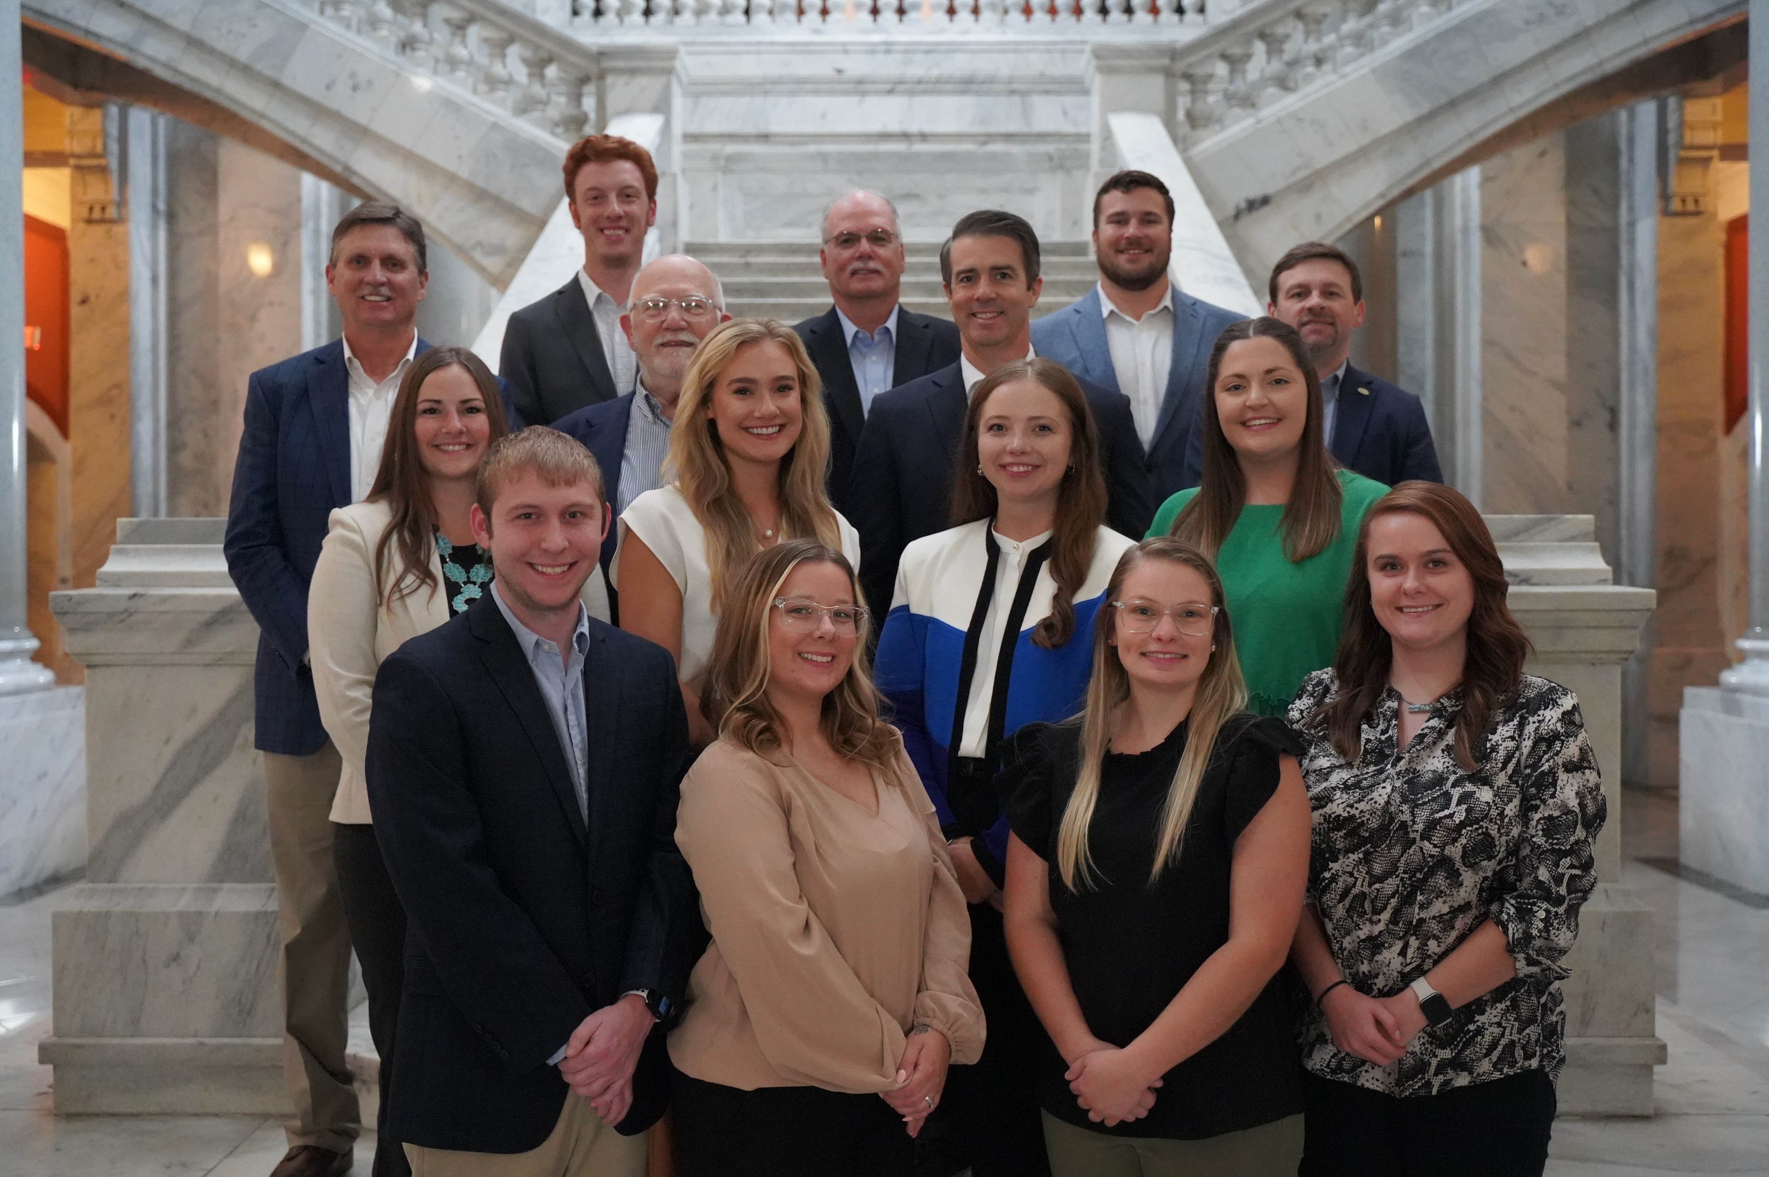
KOAP Staff
Brandon Reed
  Executive Director
Bill McCloskey
  Deputy Executive Director
Bill Hearn
  Fiscal Officer
Brian Murphy
  General Counsel
Chelsea Smither
  KADF Project Manager
Hannah Sharp-Johnson
  Boards & Special Events Manager
Alexis Scheidt
  KADF Project Manager
Jeff Parman
  KADF Program Compliance Manager
Landon Peach
  KADF Project Manager
Hunter Jones
  KAFC Loan Programs Manager
Bailey Siry-Crowder
  KADF Project Compliance Manager
Rebecca Besok
  KADF Project Manager
Sarah Bryant
  KADF Programs Manager
Savanna Hill
  KADF Project Manager
Tera Roberts
  KAFC Loan Programs Manager

Slide 4


Monthly Board Approvals:
October
KADB KAFC
$1 MM $2.9 MM

Slide 5
KOAP Highlights of October:
  Staff Hosted the National Council of State Ag Finance Programs Annual Conference
  KOAP hosted a KADB & KAFC Joint Strategic Planning Session at Lake Barkley State Resort Park
  15 County Agricultural Development Councils attended by staff

Slide 6
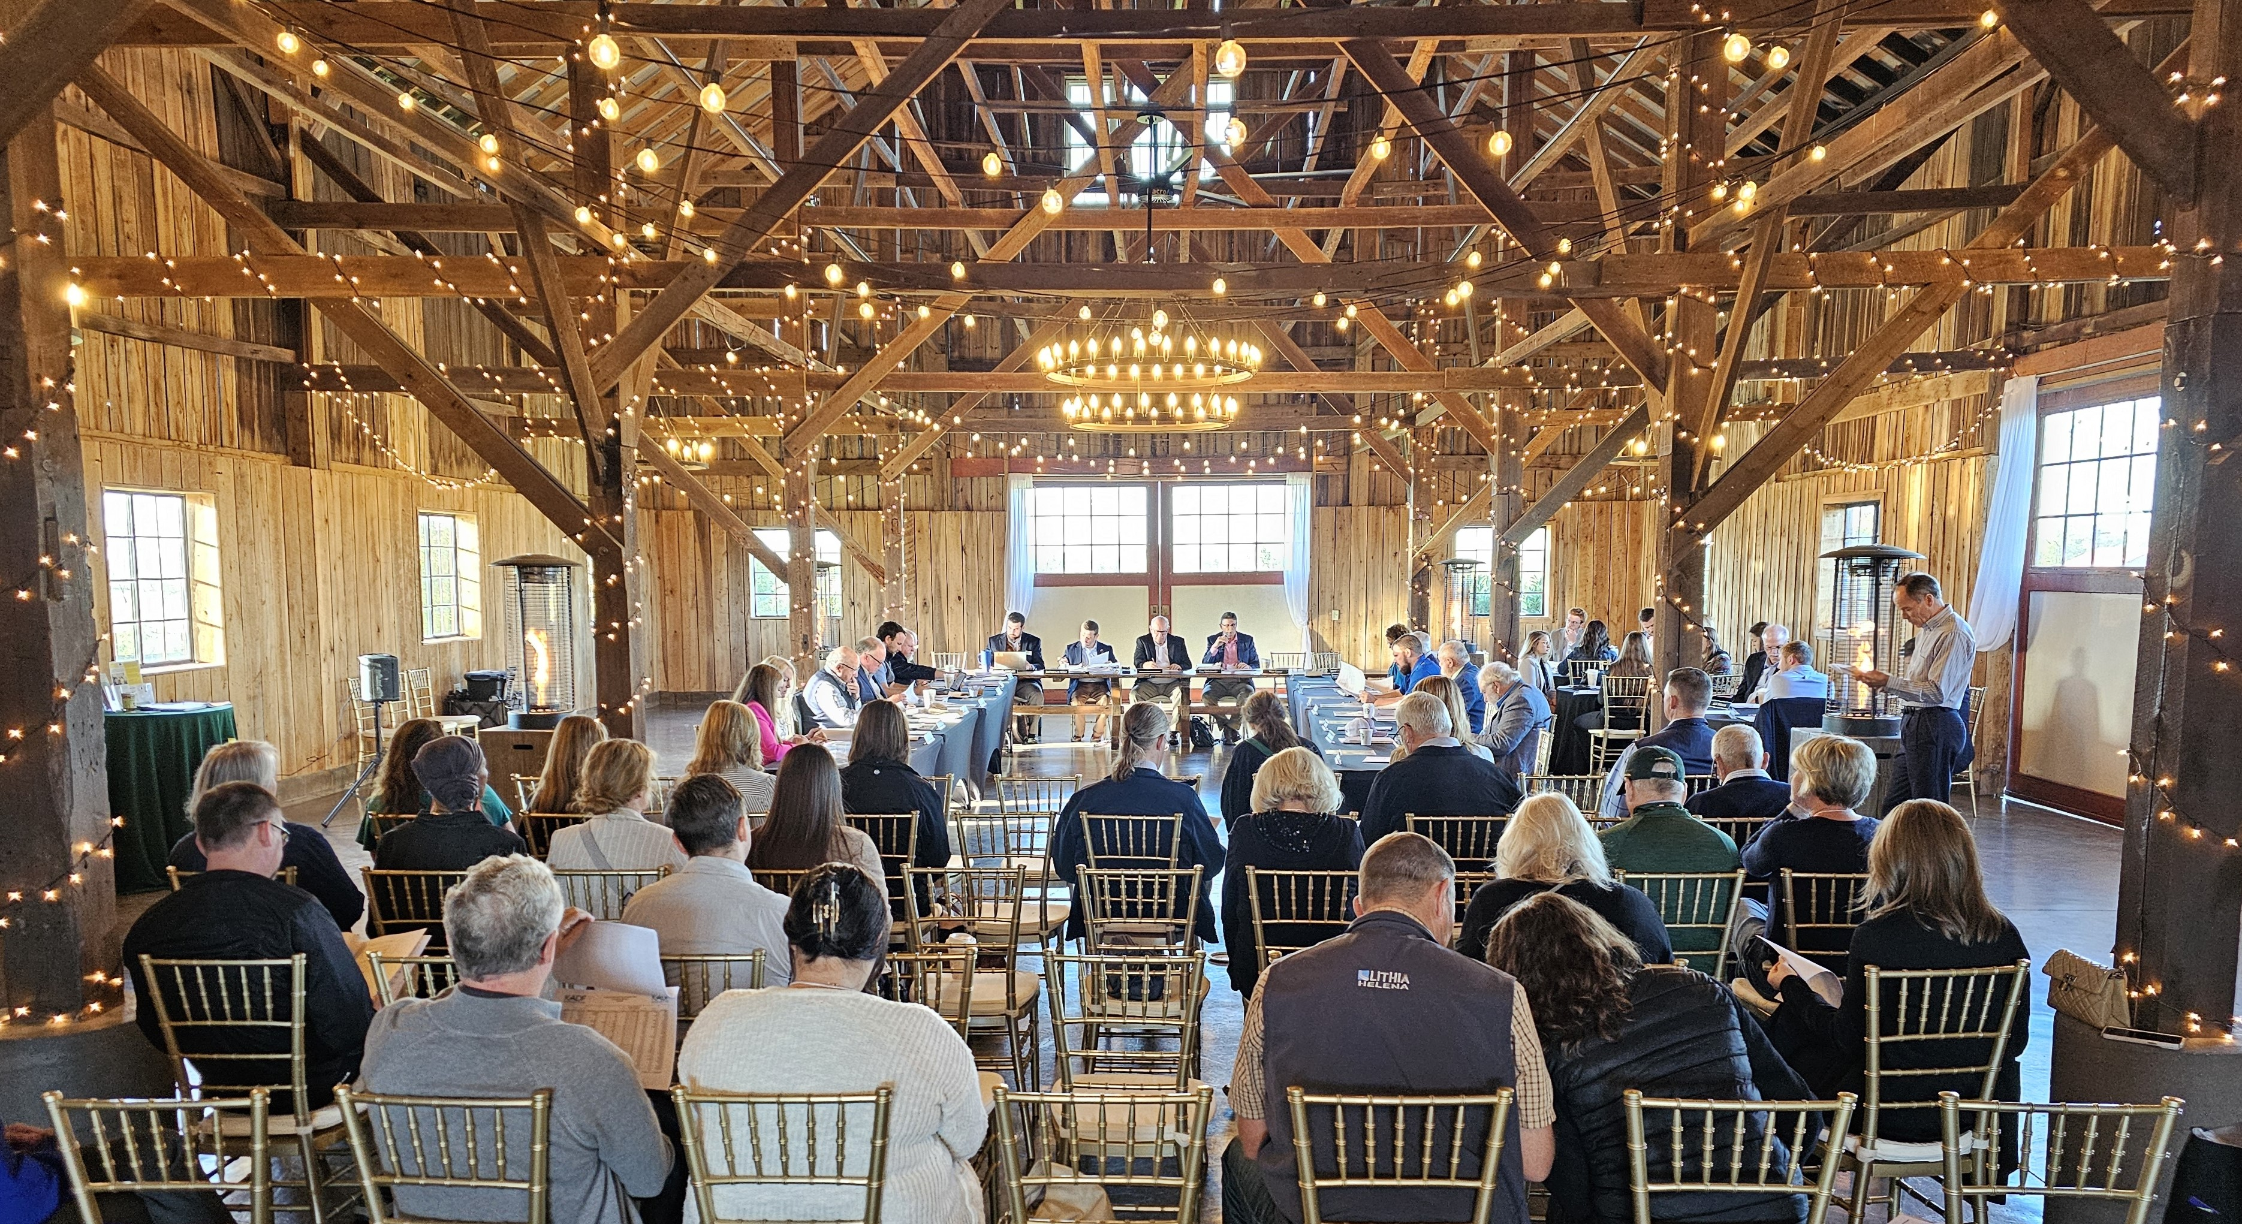
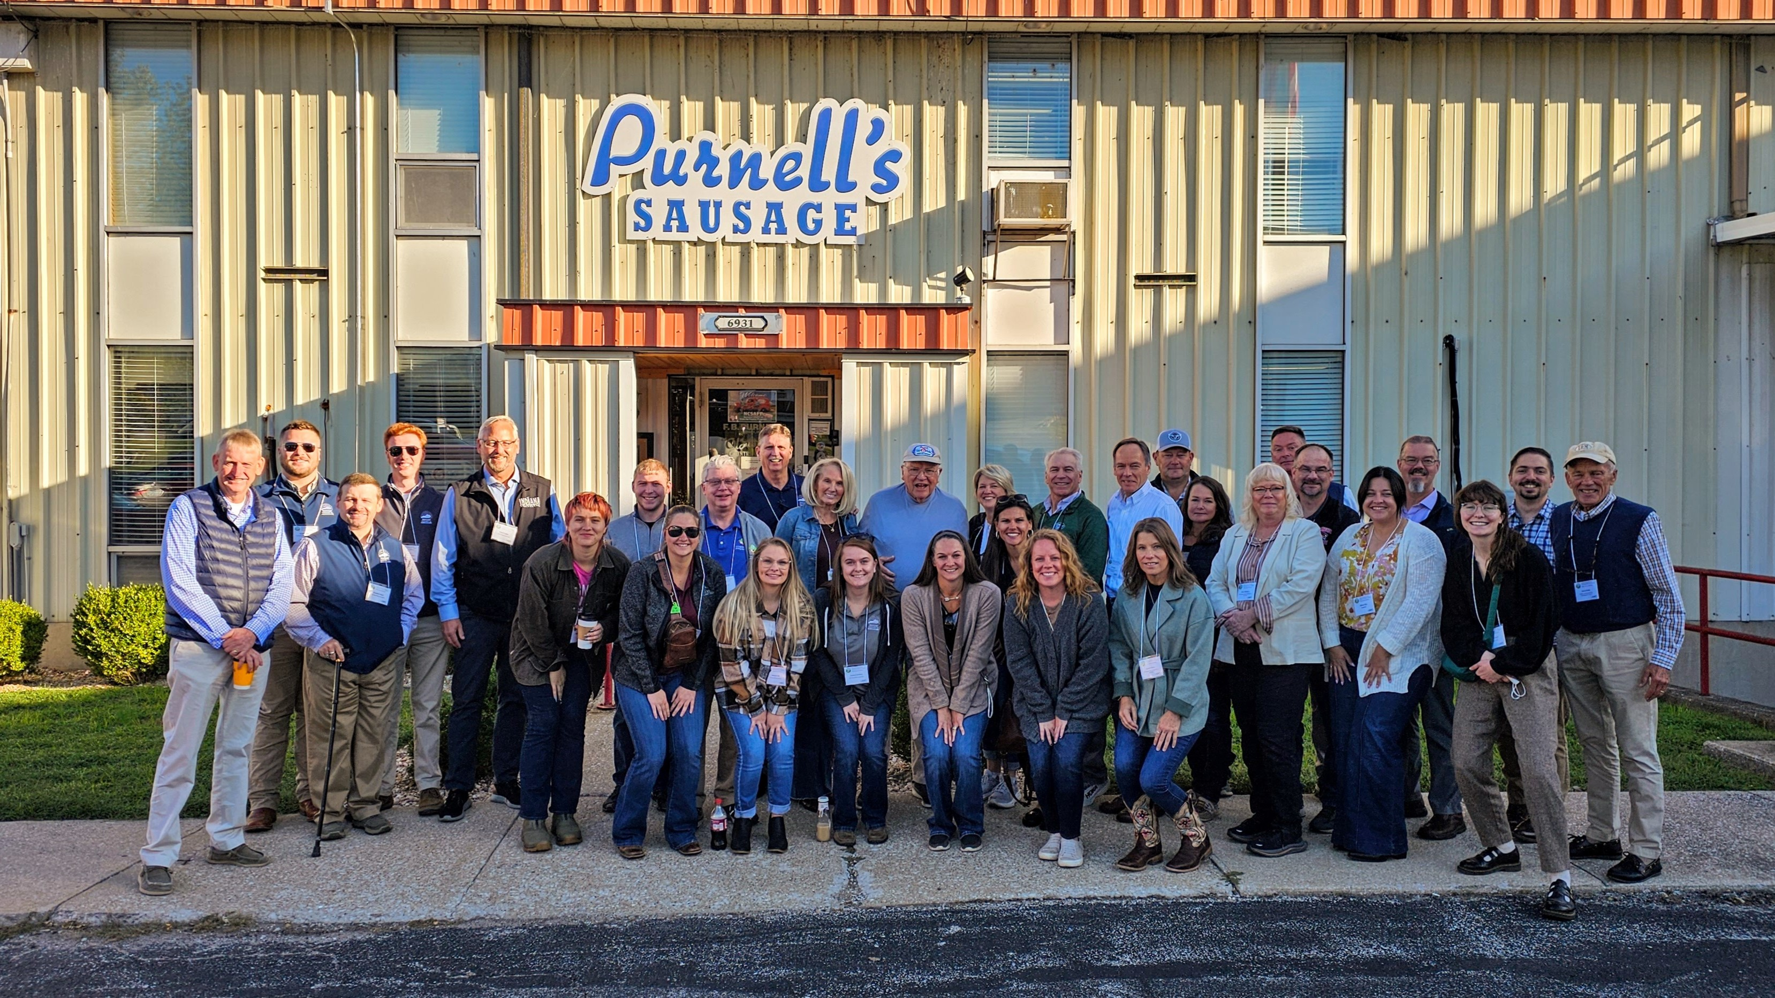
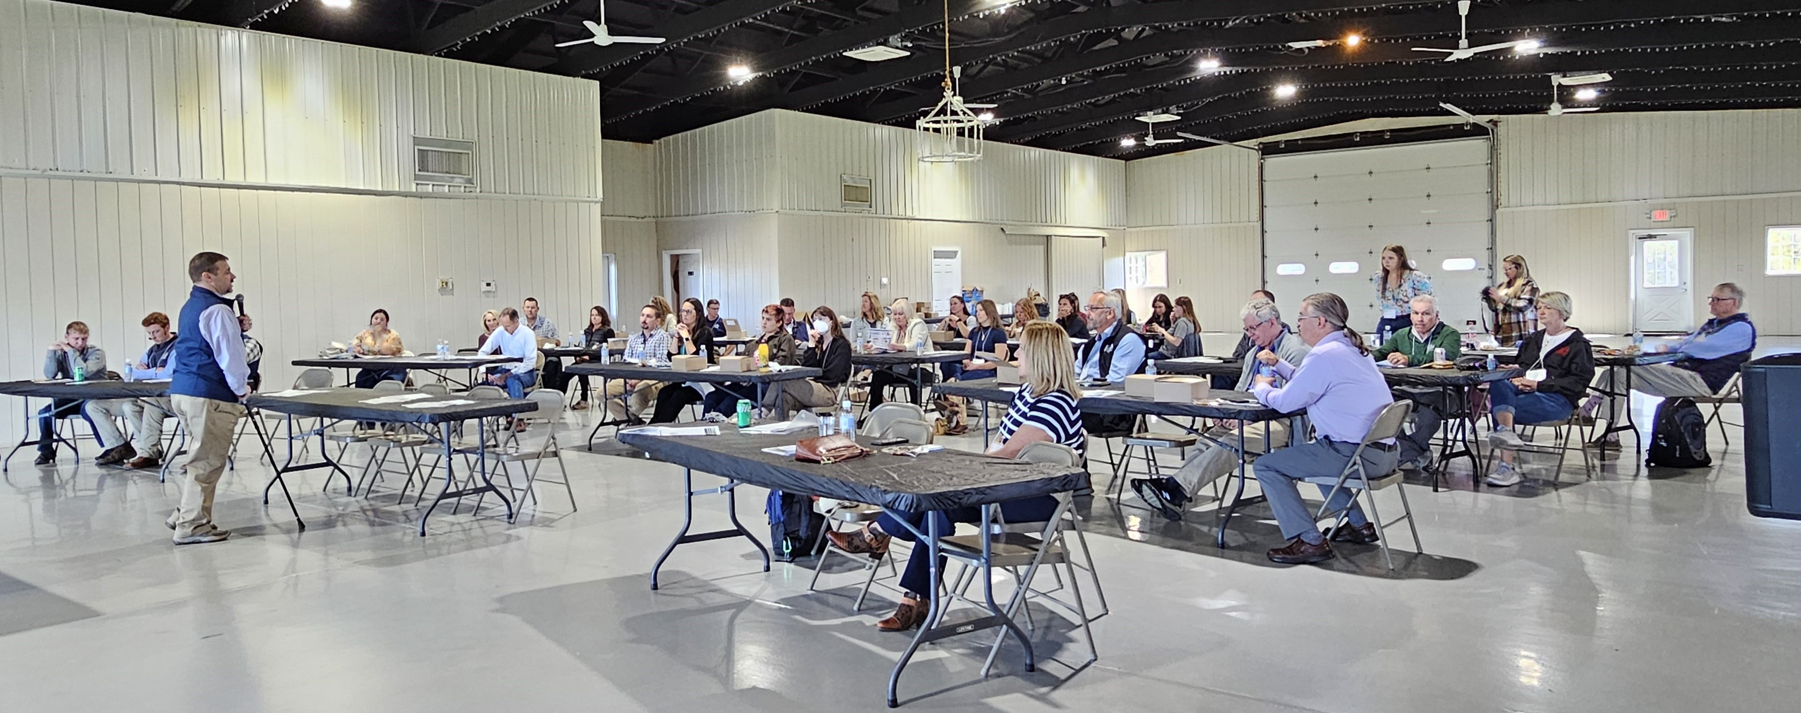

Slide 7
Approval Breakdown
KADB Approvals:
  3 County Agricultural Investment Programs totaling $511,769
  1 Next Generation Farmer (NextGen) Programs totaling $25,000
  1 Youth Ag Incentives Programs(Youth) totaling $10,000
  4 County & State Projects totaling $362,161
KAFC Approvals:
  4 Agricultural Infrastructure Loan Programs total $675,000
  10 Beginning Farmer Loan Programs totaling $2,275,475

Slide 8
Bill & Brandon’s Top Picks
Legacy Mobile Veterinary Services- $7,205 in multi-county funds and up to & $36,025 in state funds
Skinner Farms LLC- $10,000 in Shelby County funds and $6,175 in state funds
Alvios Cuban Meats, LLLP-$2,243 in state funds

