Slide 1
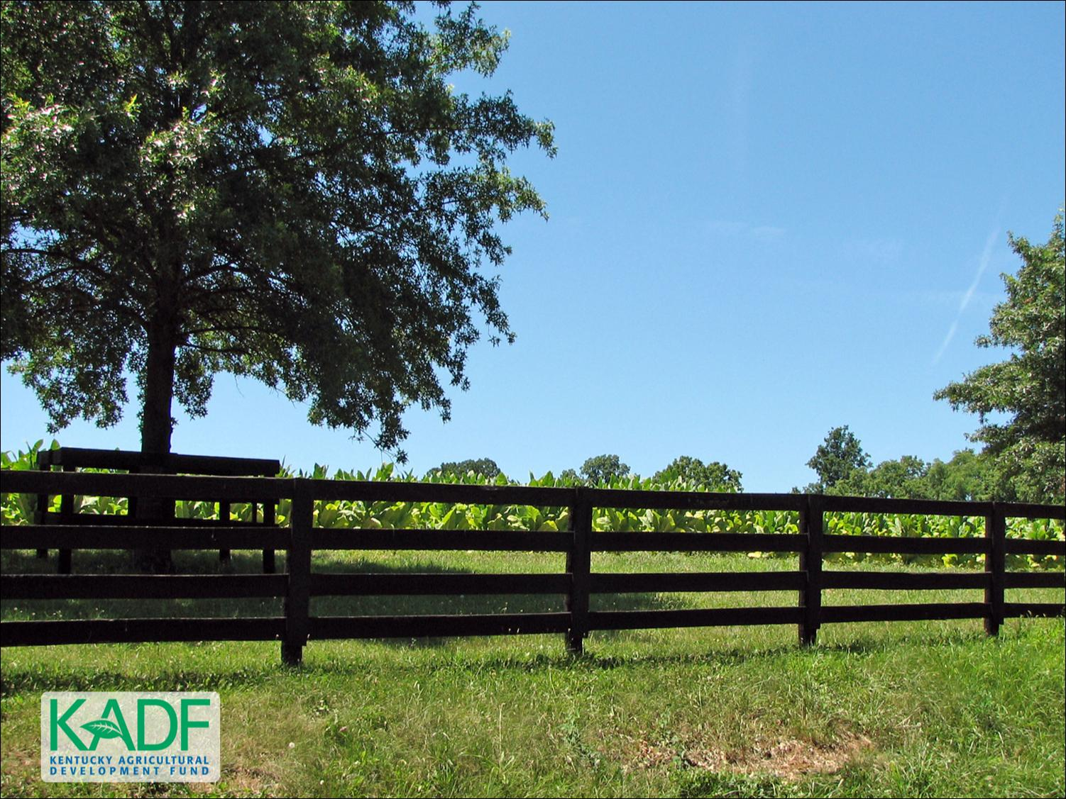
KOAP’s Report of
September 2024

Slide 2
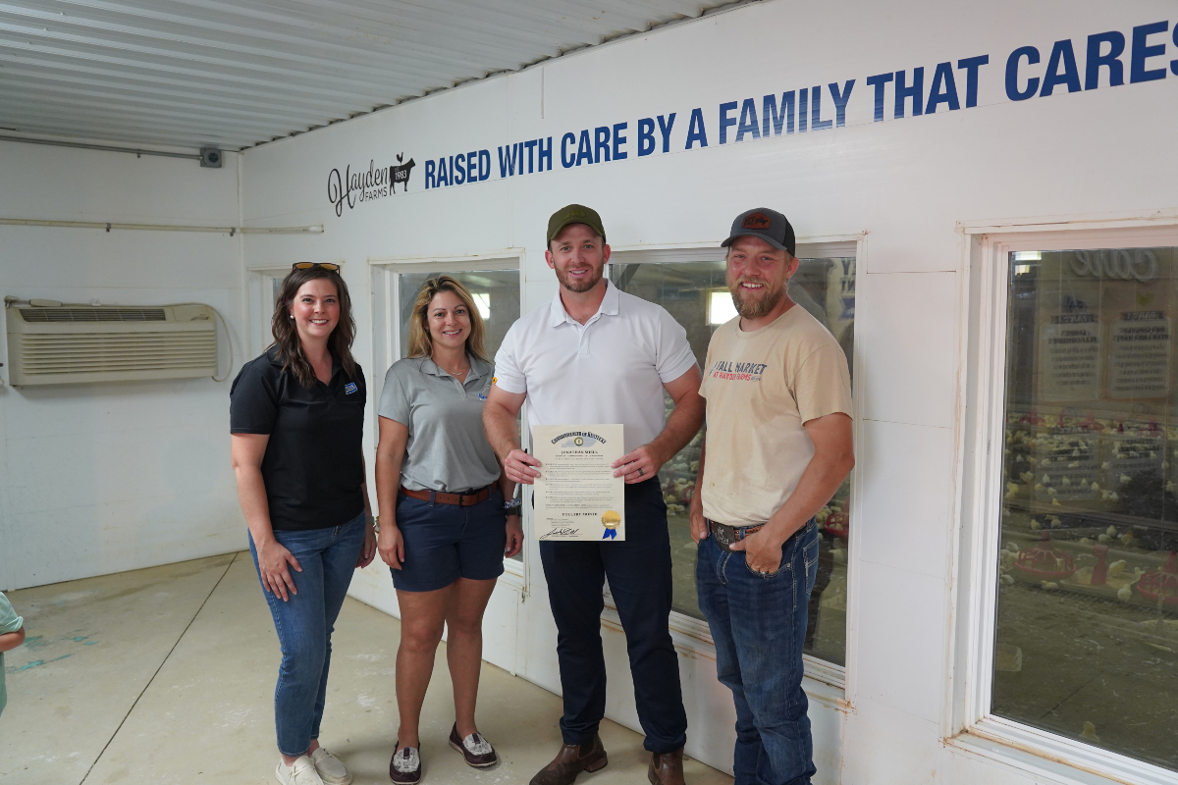
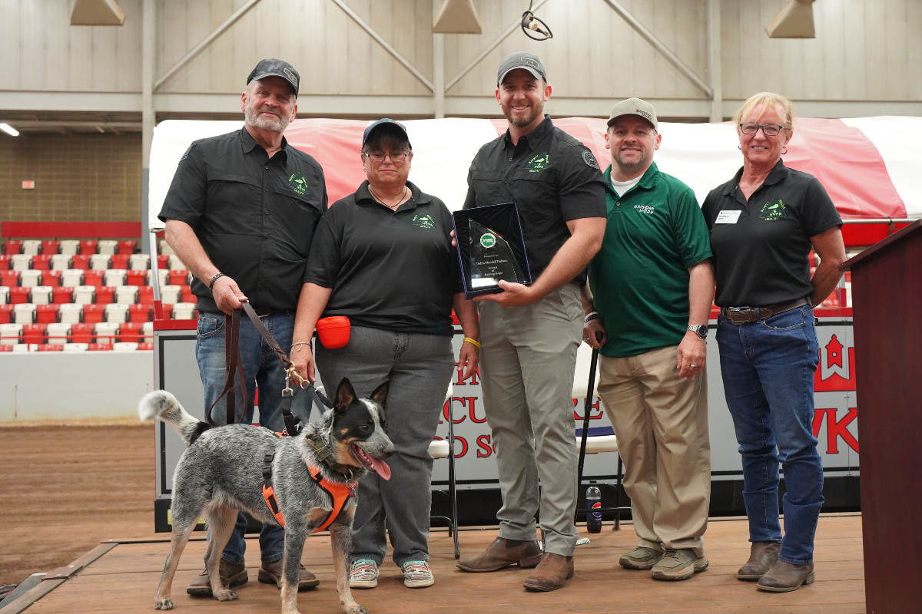
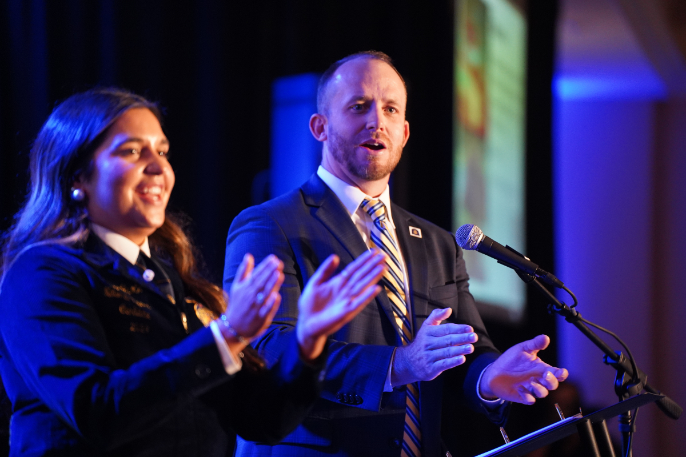
“Agriculture is Economic Development”
Commissioner of Agriculture,
Jonathan Shell

Slide 3
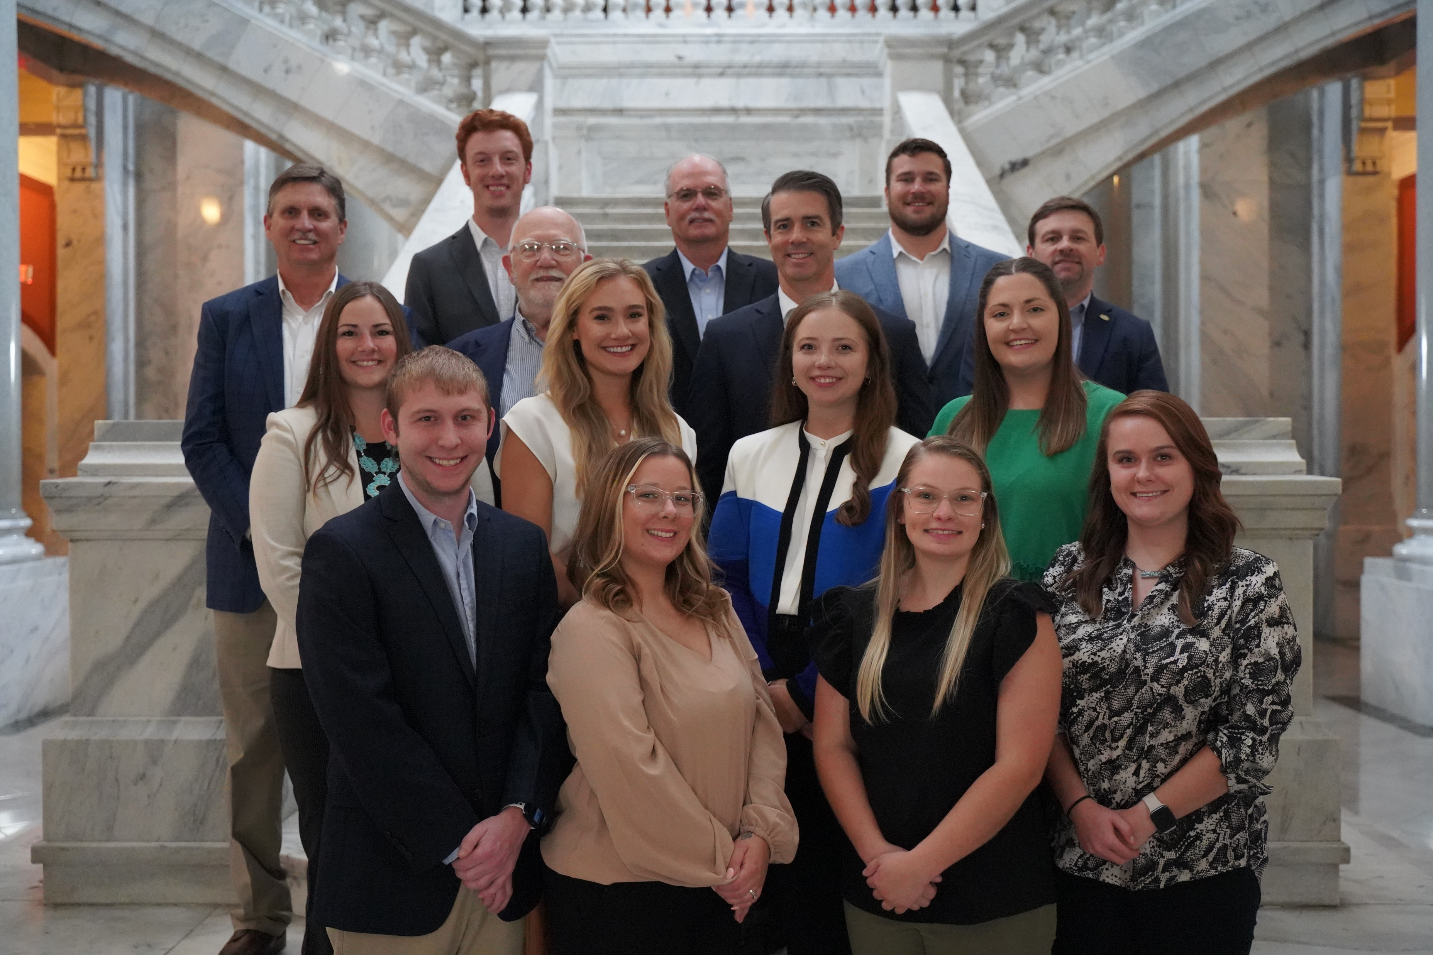
KOAP Staff
Brandon Reed
  Executive Director
Bill McCloskey
  Deputy Executive Director
Bill Hearn
  Fiscal Officer
Brian Murphy
  General Counsel
Chelsea Smither
  KADF Project Manager
Hannah Sharp-Johnson
  Boards & Special Events Manager
Alexis Scheidt
  KADF Project Manager
Jeff Parman
  KADF Program Compliance Manager
Landon Peach
  KADF Project Manager
Hunter Jones
  KAFC Loan Programs Manager
Bailey Siry-Crowder
  KADF Project Compliance Manager
Rebecca Besok
  KADF Project Manager
Sarah Bryant
  KADF Programs Manager
Savanna Hill
  KADF Project Manager
Tera Roberts
  KAFC Loan Programs Manager

Slide 4


Monthly Board Approvals:
September
KADB KAFC
$2.4 MM $2.7 MM

Slide 5
KOAP Highlights of September:
  Staff hosted four KADF Board Members for a New Board Member Orientation in Frankfort
  KOAP/UK CES Partnership Panel
  12 County Agricultural Development Councils attended by staff
  7 Site Visits Conducted by Staff

Slide 6
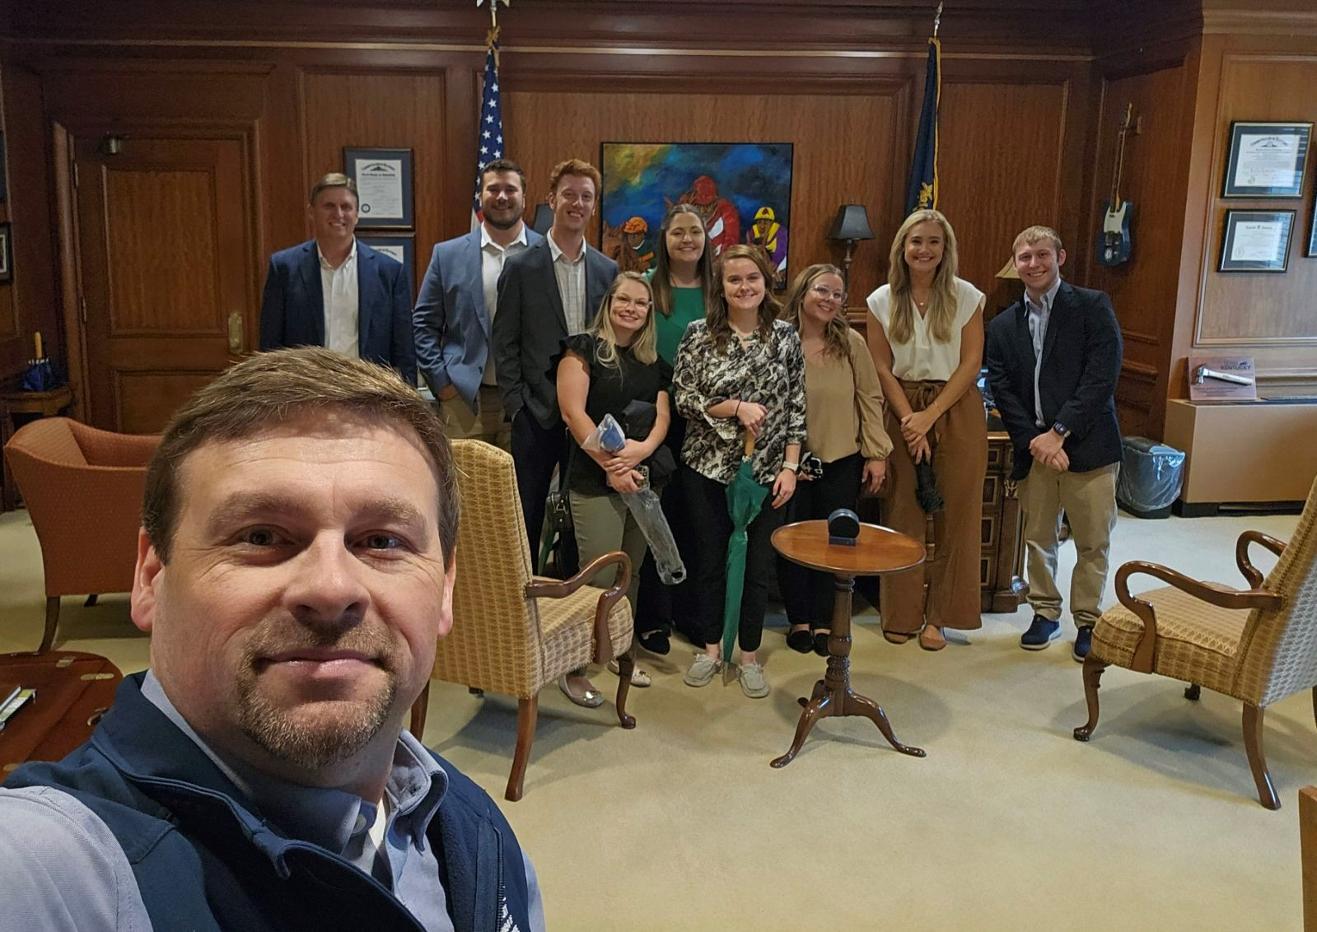
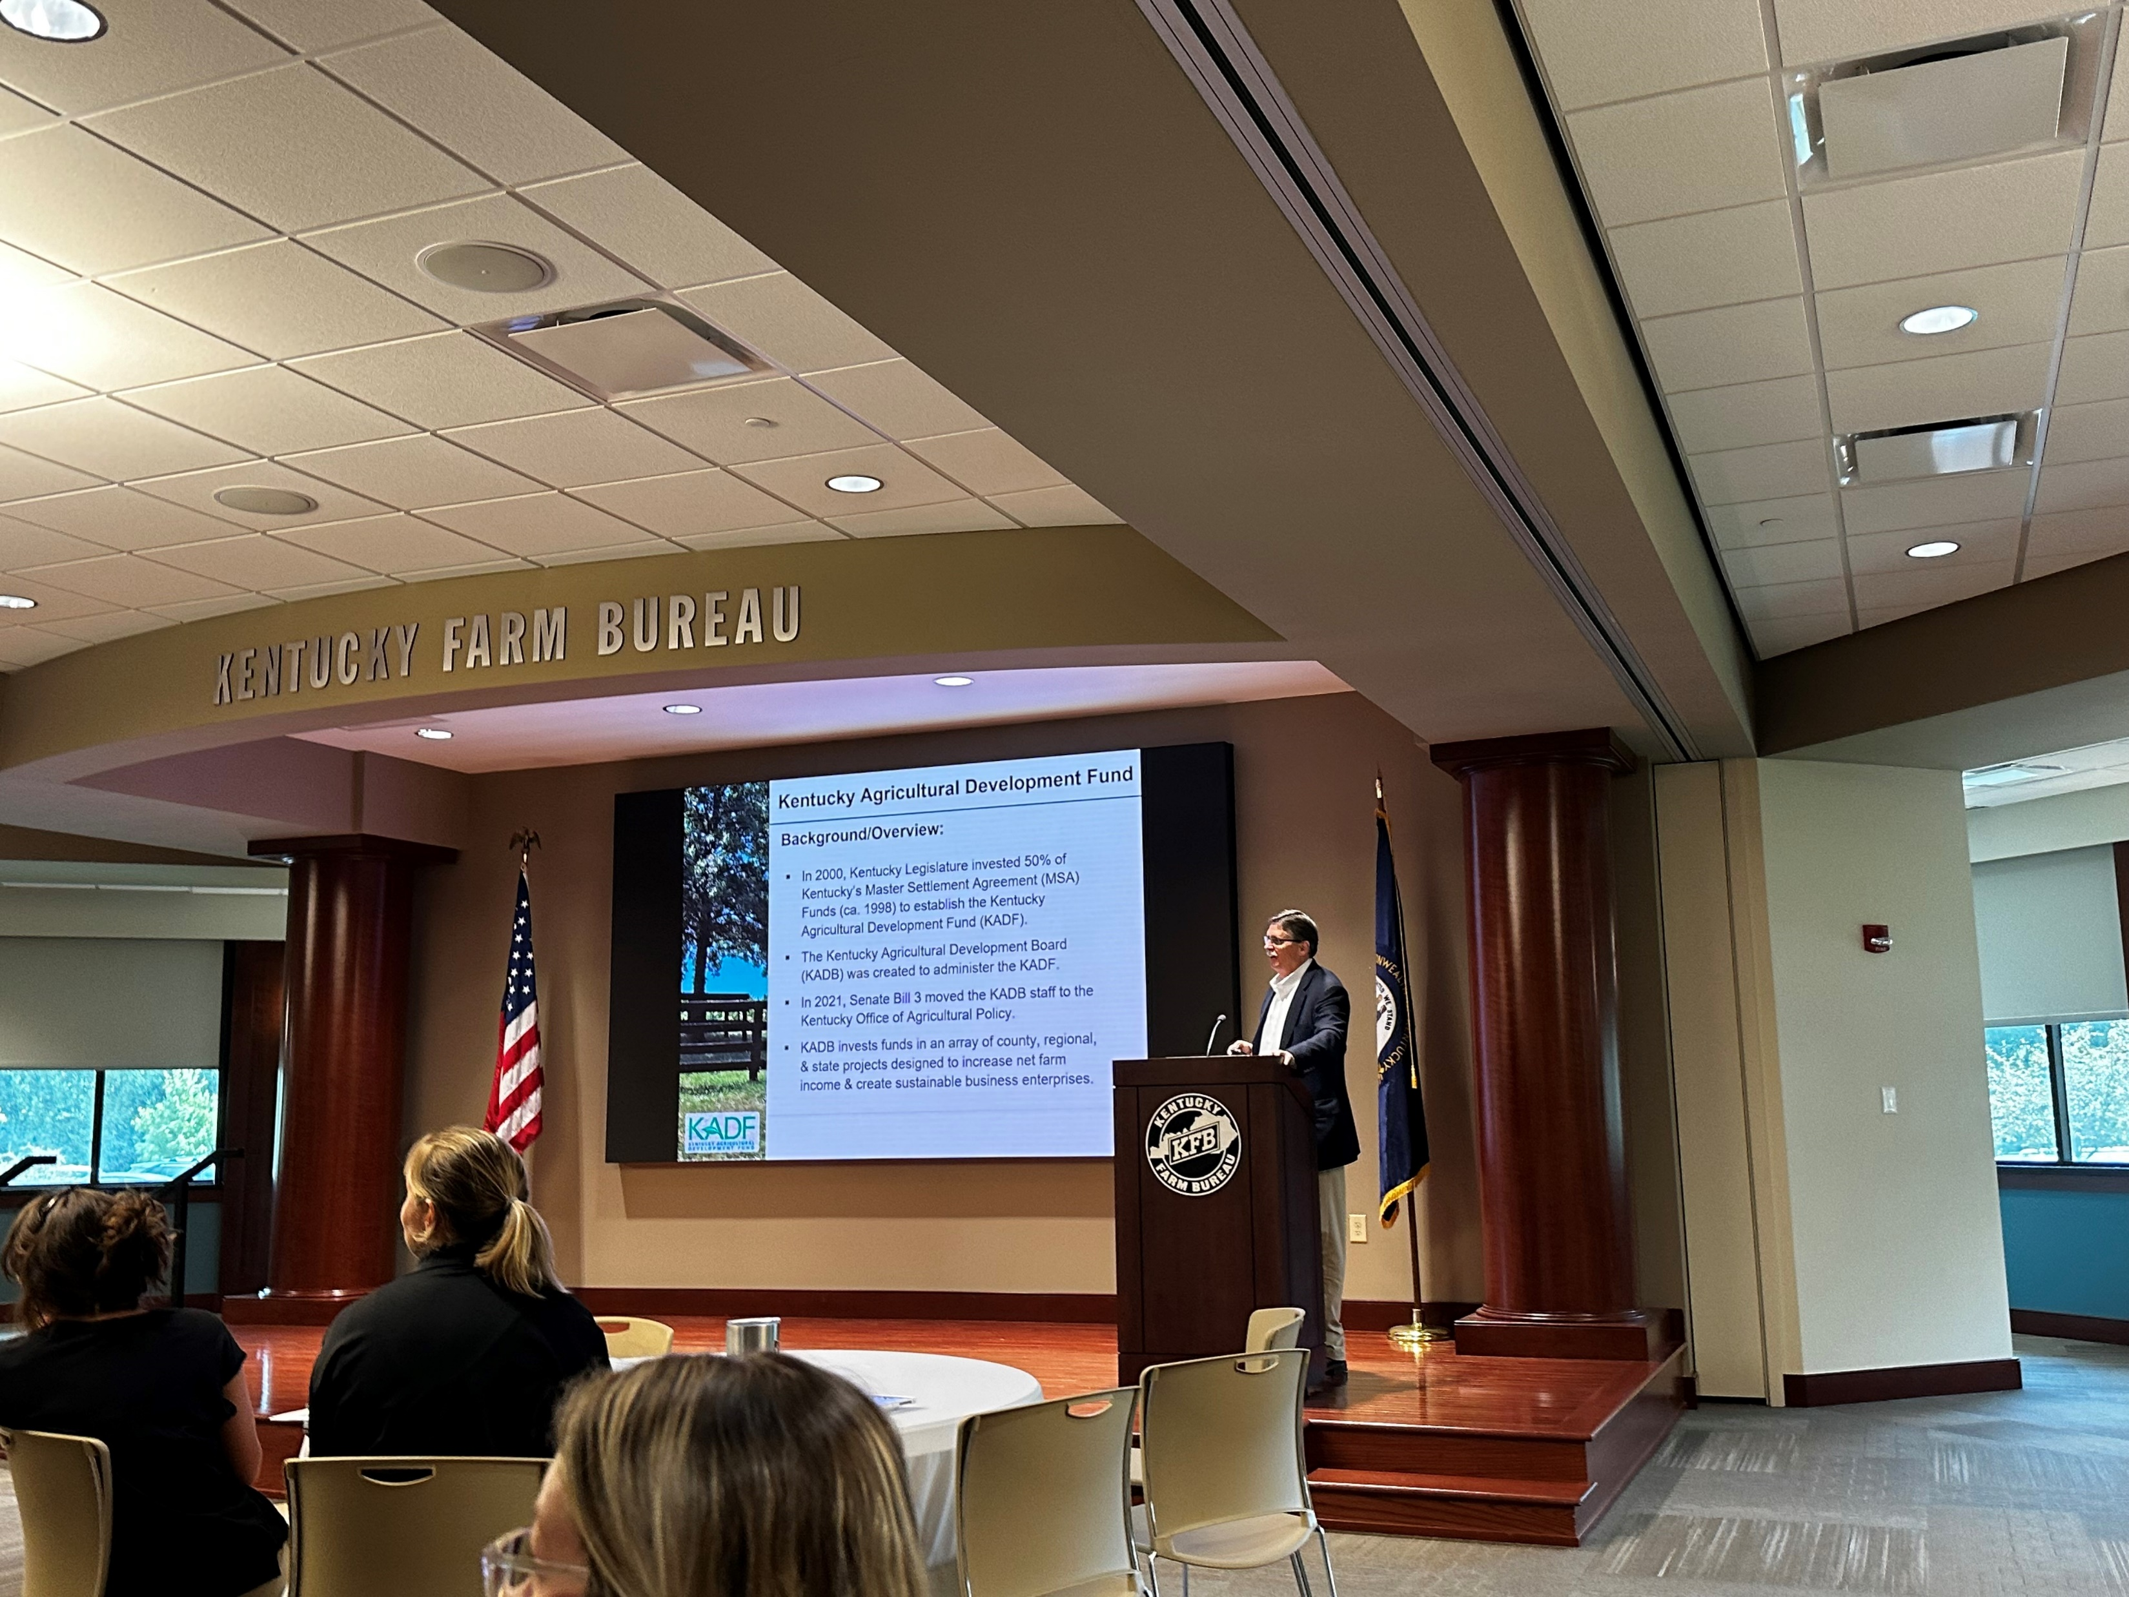


Slide 7
Approval Breakdown
KADB Approvals:
  7 County Agricultural Investment Programs totaling $1,092,514
  2 Deceased Farm Animal Removal Programs totaling $17,500
  3 Youth Ag Incentives Programs (Youth) totaling $60,100
  4 County & State Projects totaling $714,260
KAFC Approvals:
  5 Agricultural Infrastructure Loan Programs total $931,500
  10 Beginning Farmer Loan Programs totaling $1,768,598
  1 Diversification through Entrepreneurship in Agribusiness Programs totaling $250,000

Slide 8
Bill & Brandon’s Top Picks
Logan Premium Meats and Processing LLC- $500,000 in Forgivable loan
Wonderlich Veterinary Services, PLLC- $12,790 in state funds and $2,557 in Shelby County funds
University of Kentucky Research Foundation-$176,073 in state funds

