Slide 1
KOAP’s Report of
November 2024

Slide 2
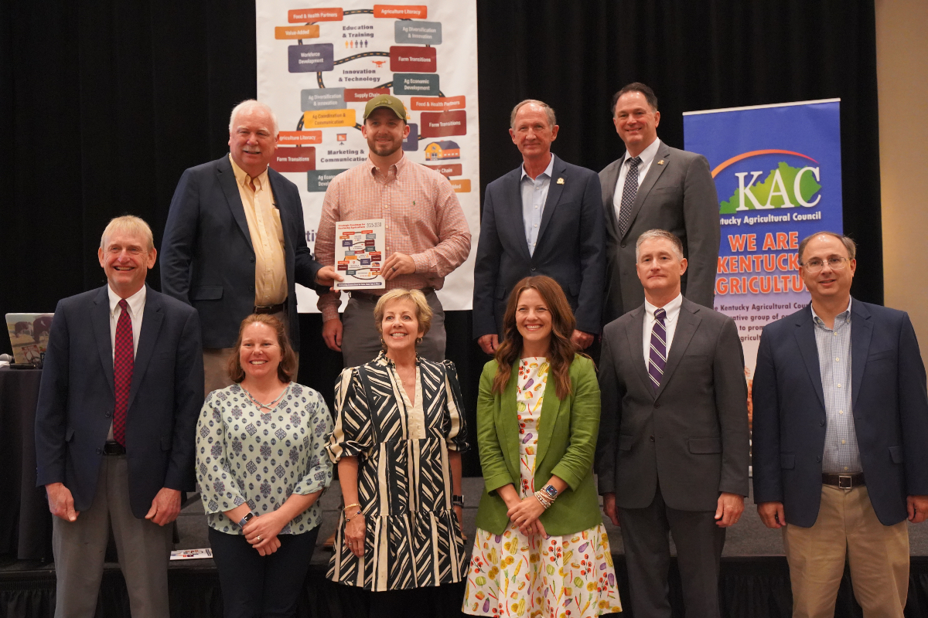
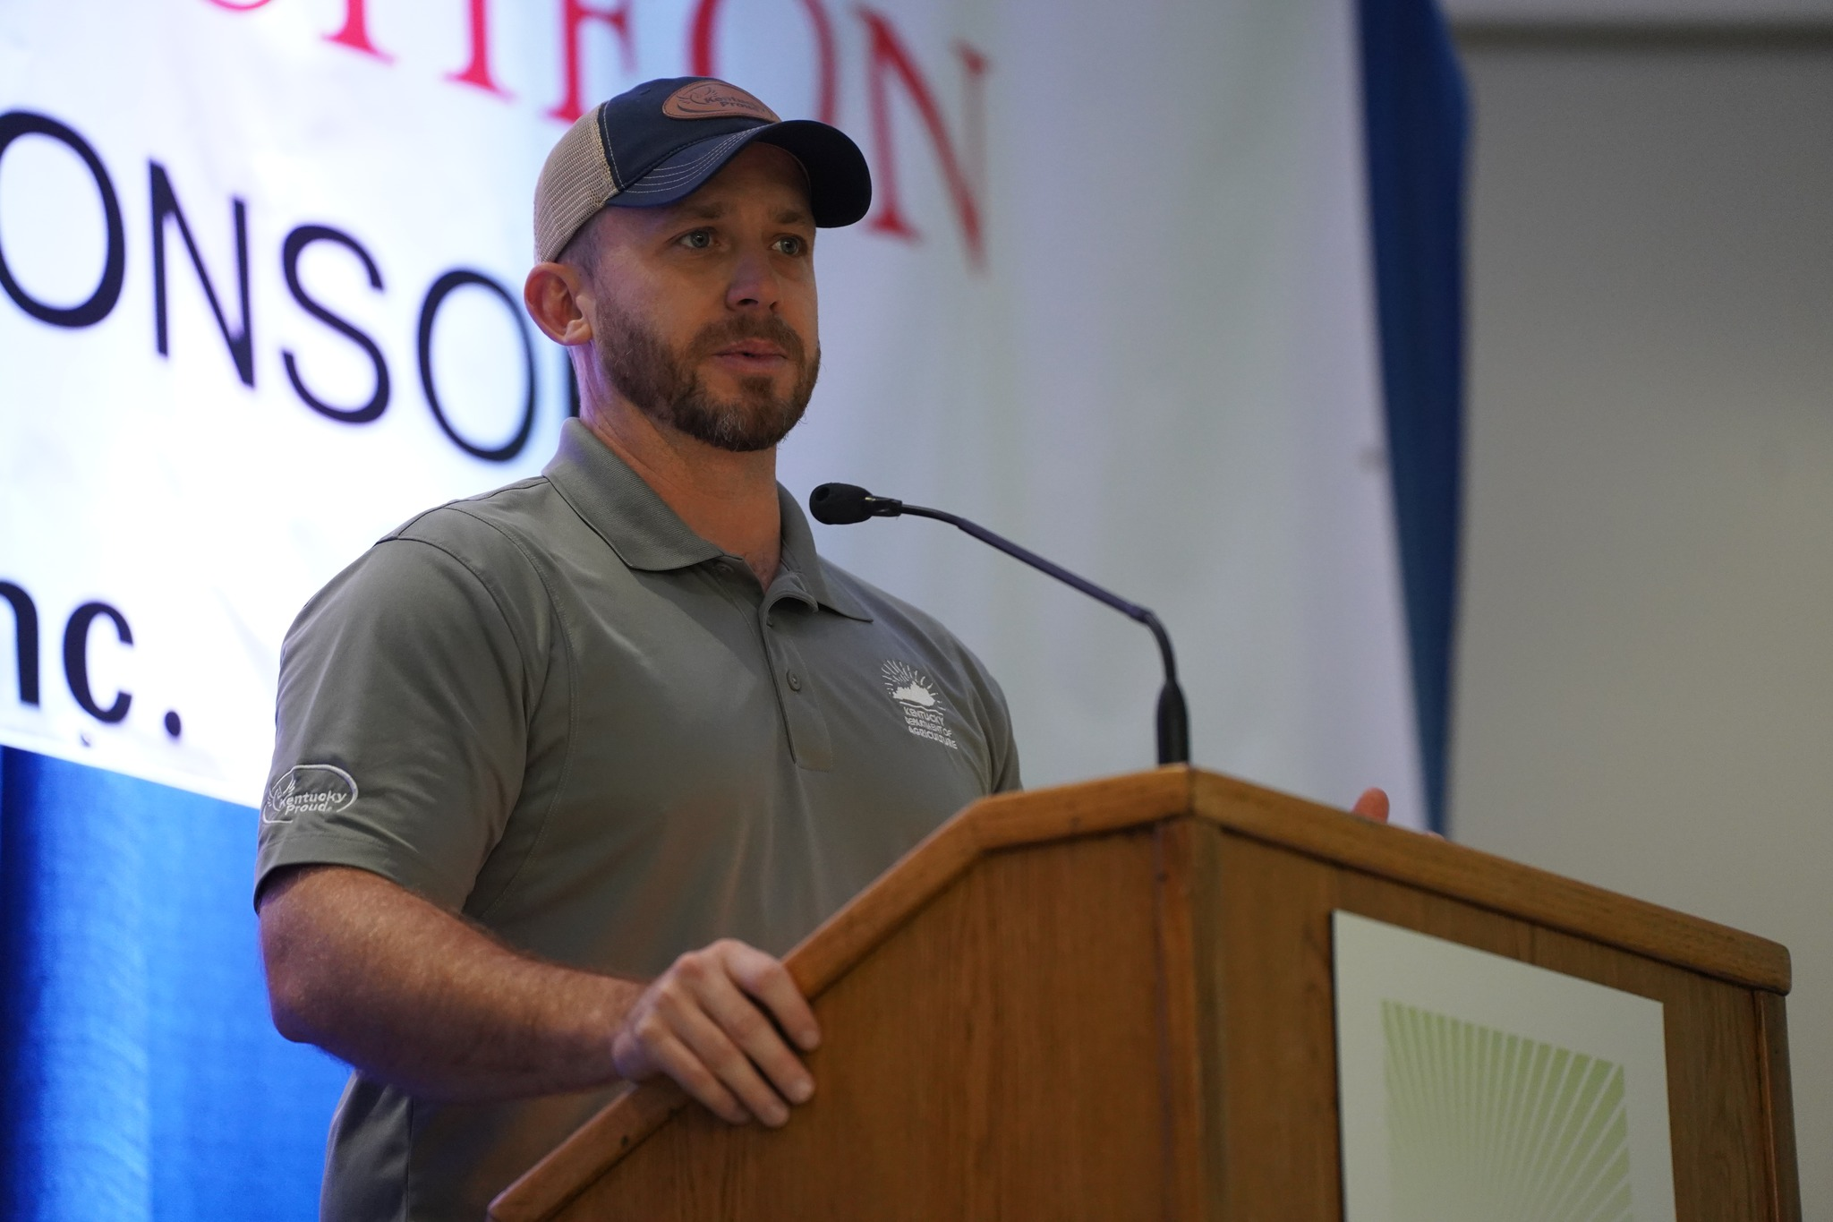
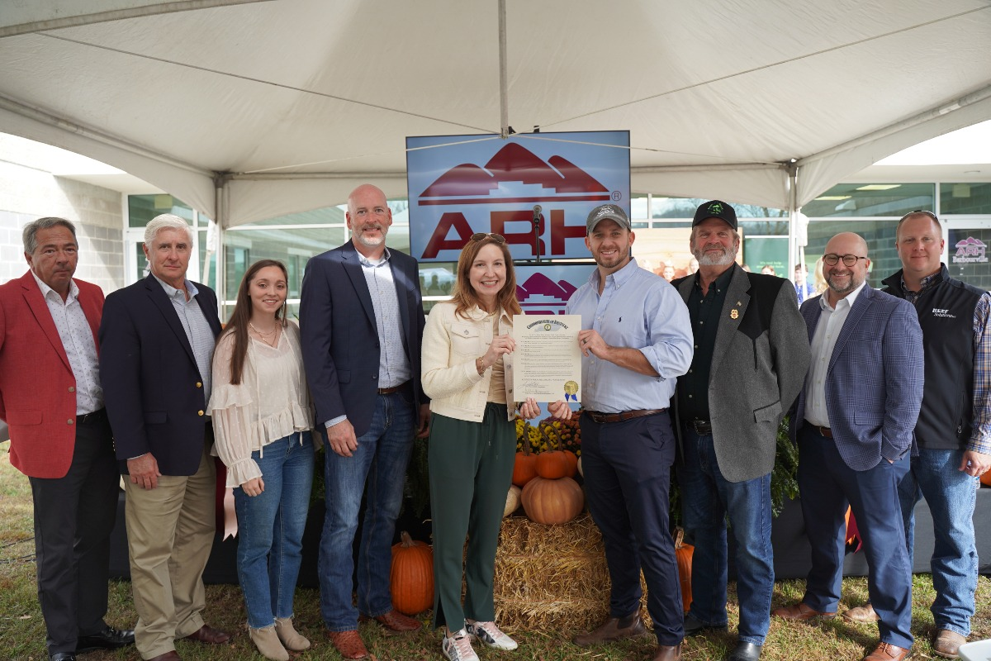
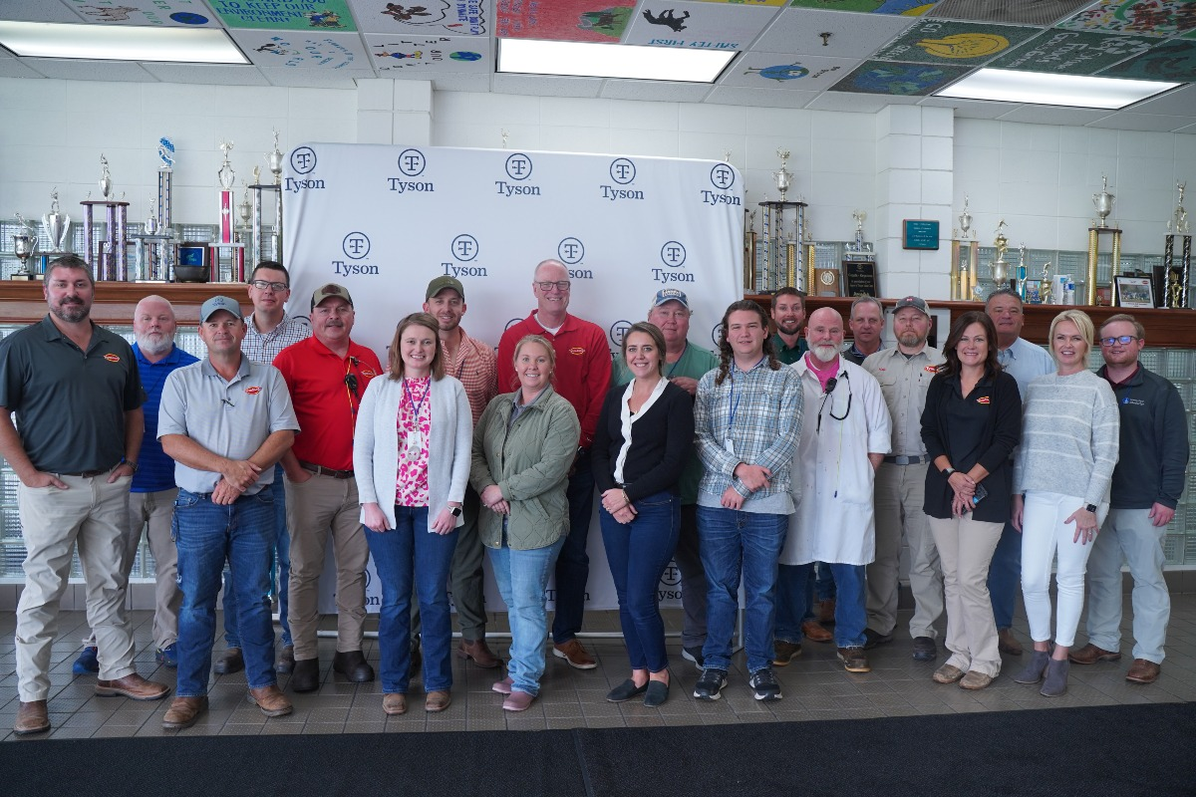
“Agriculture is Economic Development”
Commissioner of Agriculture,
Jonathan Shell

Slide 3
KOAP Staff
Brandon Reed
Executive Director
Bill McCloskey
Deputy Executive Director
Bill Hearn
Fiscal Officer
Brian Murphy
General Counsel
Chelsea Smither
KADF Project Manager
Hannah Sharp-Johnson
Boards & Special Events Manager
Alexis Scheidt
KADF Project Manager
Jeff Parman
KADF Program Compliance Manager
Landon Peach
KADF Project Manager
Hunter Jones
KAFC Loan Programs Manager
Bailey Siry-Crowder
KADF Project Compliance Manager
Rebecca Besok
KADF Project Manager
Sarah Bryant
KADF Programs Manager
Savanna Hill
KADF Project Manager
Tera Roberts
KAFC Loan Programs Manager

Slide 4
Monthly Board Approvals:
November
KADB KAFC
$4.8 MM $3.4 MM

Slide 5
KOAP Highlights of November:
3 staff members attended competitive leadership programs: Kentucky Agriculture Leadership Program & Kentucky Cattlemen’s Assoc. Leadership Program
Staff attended the 25th Annual Kentucky Women In Agriculture Conference
12 County Agricultural Development Councils attended by staff

Slide 6
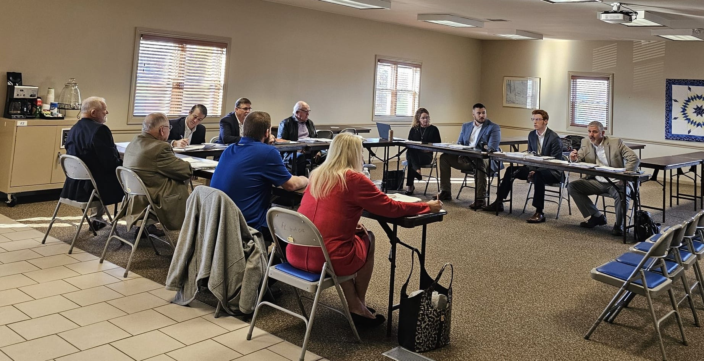

Slide 7
Approval Breakdown
KADB Approvals:
8 County Agricultural Investment Programs totaling $1,368,966
2 Deceased Farm Animal Removal (DAR) Programs total $16,660
1 Next Generation Farmer (NextGen) Programs totaling $40,000
1 Youth Ag Incentives Programs(Youth) totaling $60,000
1 Shared-Use Equipment Programs totaling $8,100
7 County & State Projects totaling $3,379,208
KAFC Approvals:
3 Agricultural Infrastructure Loan Programs total $3,407,175
14 Beginning Farmer Loan Programs totaling $2,657,175

Slide 8
Bill & Brandon’s Top Picks
Kentucky Horticulture Council- $2,061,362 in state funds over a two-year period
Keeneland Sustainability, LLC-$1,000,000 KADF participation loan
Jingleheim Ranch & Gardens, LLC-$89,500 in multi-county funds matched by state

