Slide 1
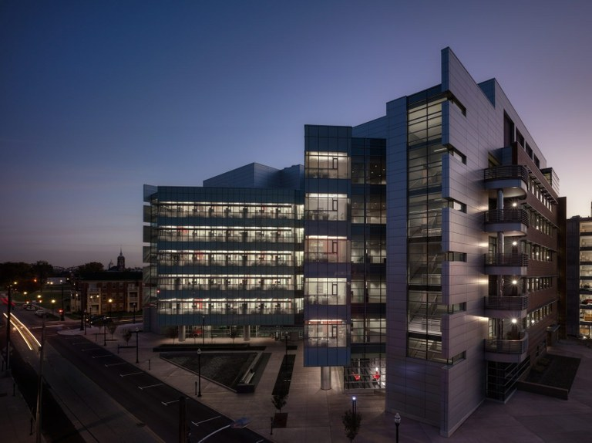

Reducing Cancer Deaths in Kentucky Now
Jason Chesney, M.D., Ph.D.
Director and Chief Administrative Officer

Slide 2
40 Ton Humpback Whale (Iceland, August 2024)

Slide 3
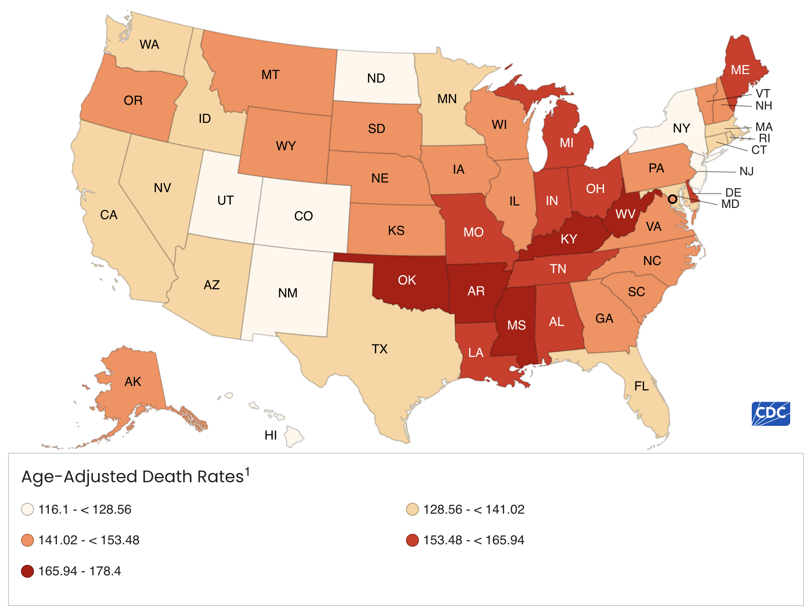
Kentucky Has Dropped to #2 Out of 50 States for Cancer Deaths Per 100,000 (2022 Data)
#2
#17
#1
#37

Slide 4
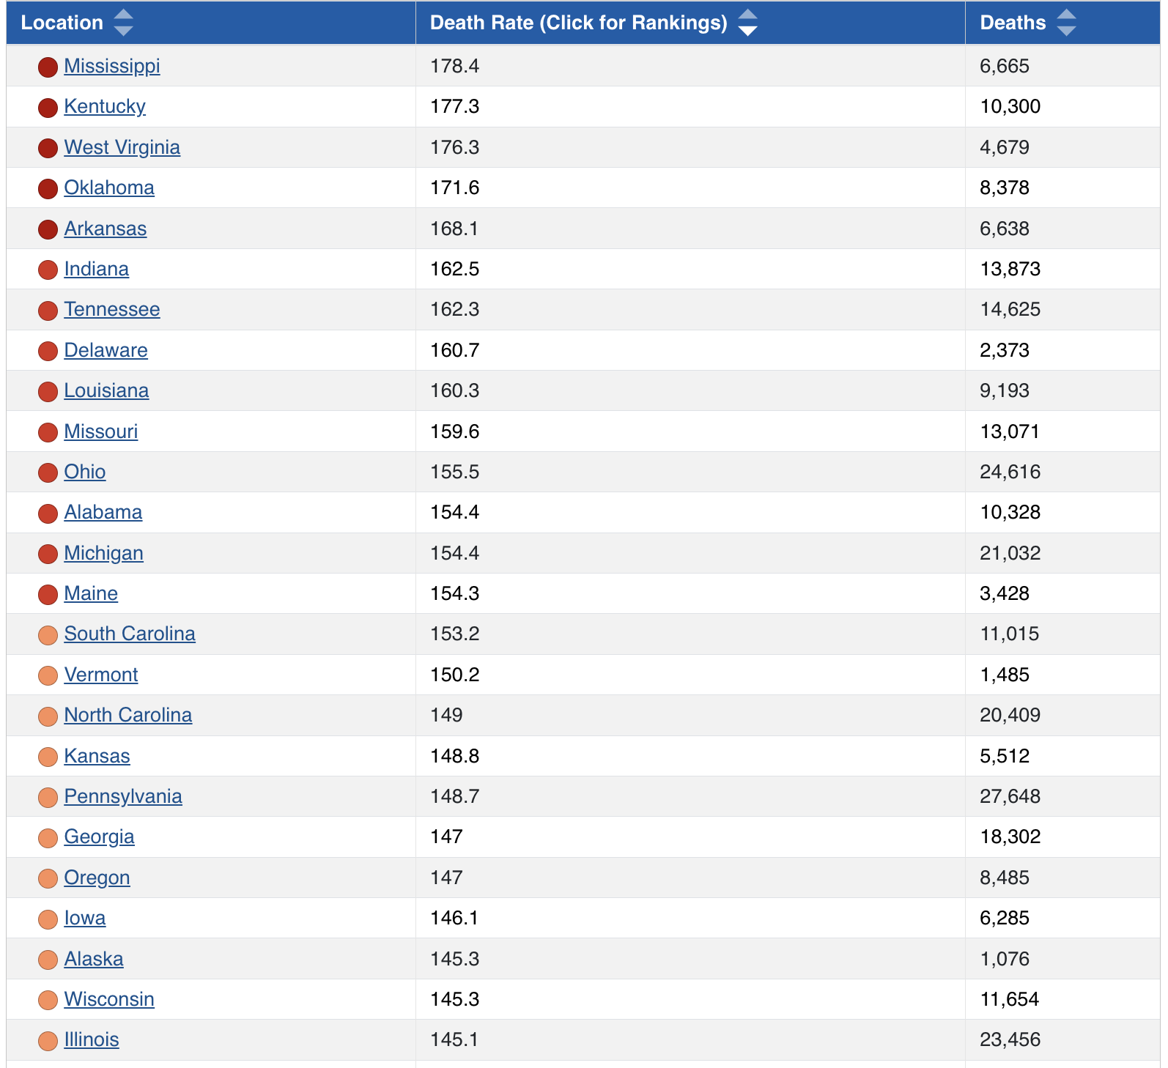
State Funding
$8.8M
$60M

Slide 5
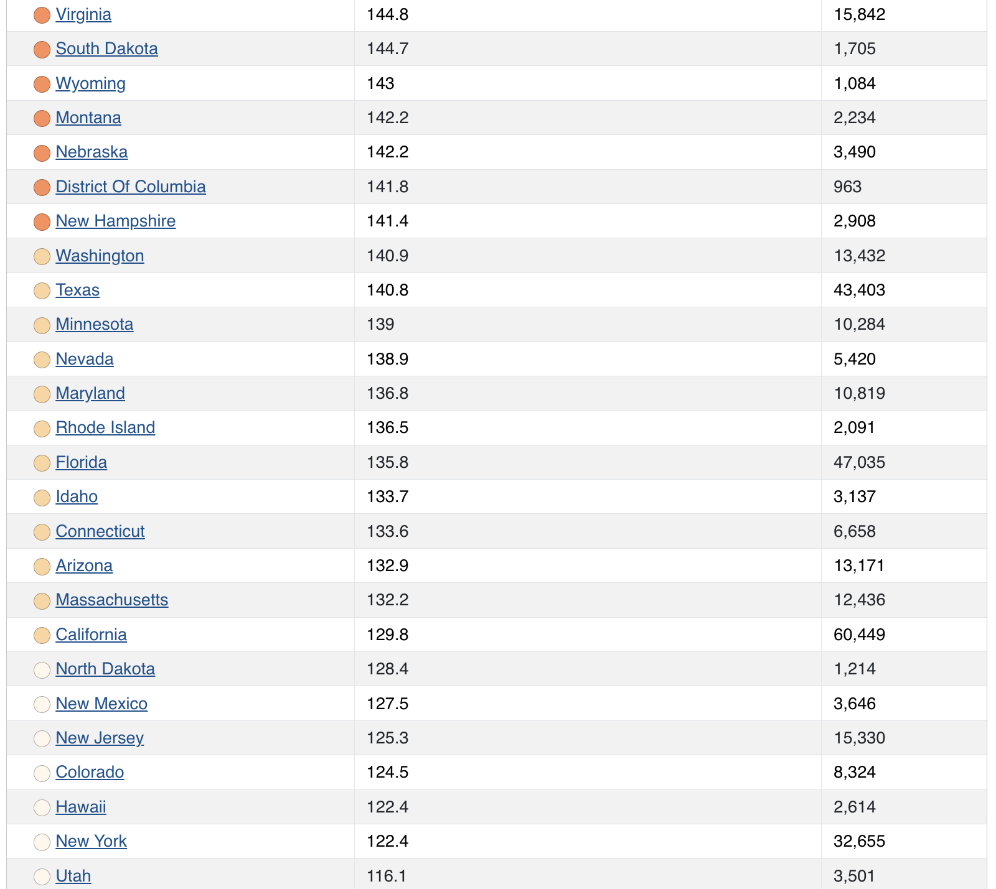
State Funding
$127M

Slide 6
What Is the Impact of Cancer Deaths In KY?
Deaths from COVID, 2020-2024: 19,183; Deaths from Cancer, 2020-2024: 51,500
Average number of close family members and acquaintances is 10 –new cancer deaths affect >100,000 additional Kentuckians each year
ACS Cancer Atlas: “Cancer is a leading cause of premature death in every country in the world”
ACS Cancer Atlas: 10,300 cancer-related deaths in Kentucky translates into $3.1B in lost productivity each year
ACS Cancer Atlas: 10,300 cancer-related deaths in Kentucky translates into $2.7B in health care costs
Many Kentuckians are needlessly dying of cancer and their suffering and deaths cumulatively affect the emotional and financial welfare of hundreds of thousands of Kentuckians and their families each year
We are currently spending $8.8M ($4.4M for each academic cancer center) to tackle a $5.8B problem

Slide 7
What Are We Doing to Reduce Cancer Deaths?
Cancer Screenings: Lung, 2266 (CY24 YTD) 1771 (CY23); Colon, 1258 (CY24 YTD); Breast, 3218 (CY24 YTD)
Cancer Outreach: Over 5000 separate outreach/educational events
Cancer Laboratory Research: By leveraging the $4.4M in state funding we have procured $5.3M in philanthropic funding and $26M in extramural grant funding to develop novel diagnostic and therapeutic approaches to reduce cancer deaths, ROI >6
Cancer Multi-Disciplinary Clinics: Gastrointestinal, Colorectal, Melanoma, Sarcoma, Breast, Neuro-Oncology, Head and Neck, Lung, etc.
Cancer Trials: >100 trials open; doubled NCI cooperative trials in CY24; nationally-recognized for targeted and cellular immunotherapies
Cancer Education: Training the next generation of oncologists, nurses and cancer researchers
Center for Rural Cancer Education & Research: Building a new center that focuses on Central and Western Kentucky emphasizing outreach, education and access to cancer care & trials

Slide 8
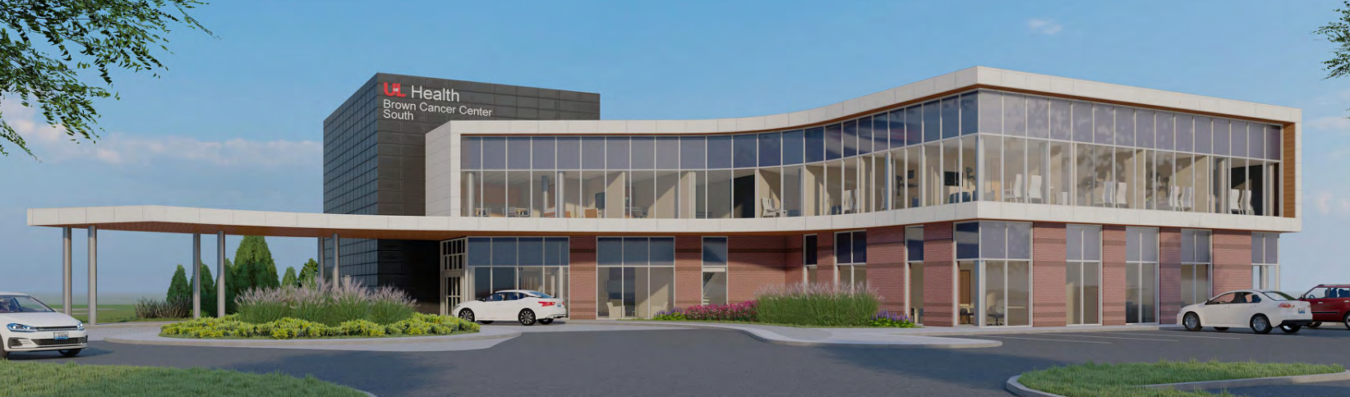
What Are We Doing to Reduce Cancer Deaths?
With grateful support from the state legislature, we are building a Center for Rural Cancer Education and Research In Bullitt County
This center will focus on cancer outreach, education, access to clinical trials for rural Kentuckians throughout the Central and Western Kentucky

Slide 9
UofL’s Brown Cancer Center’s Multi-Disciplinary Teams Take Care of Patients From Throughout Kentucky
>15,000 Patient Encounters From Central and Western Kentucky Each Year
BCC

Slide 10
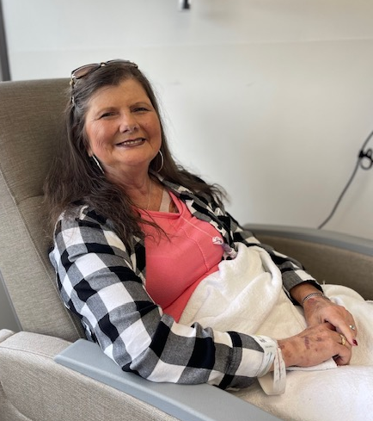
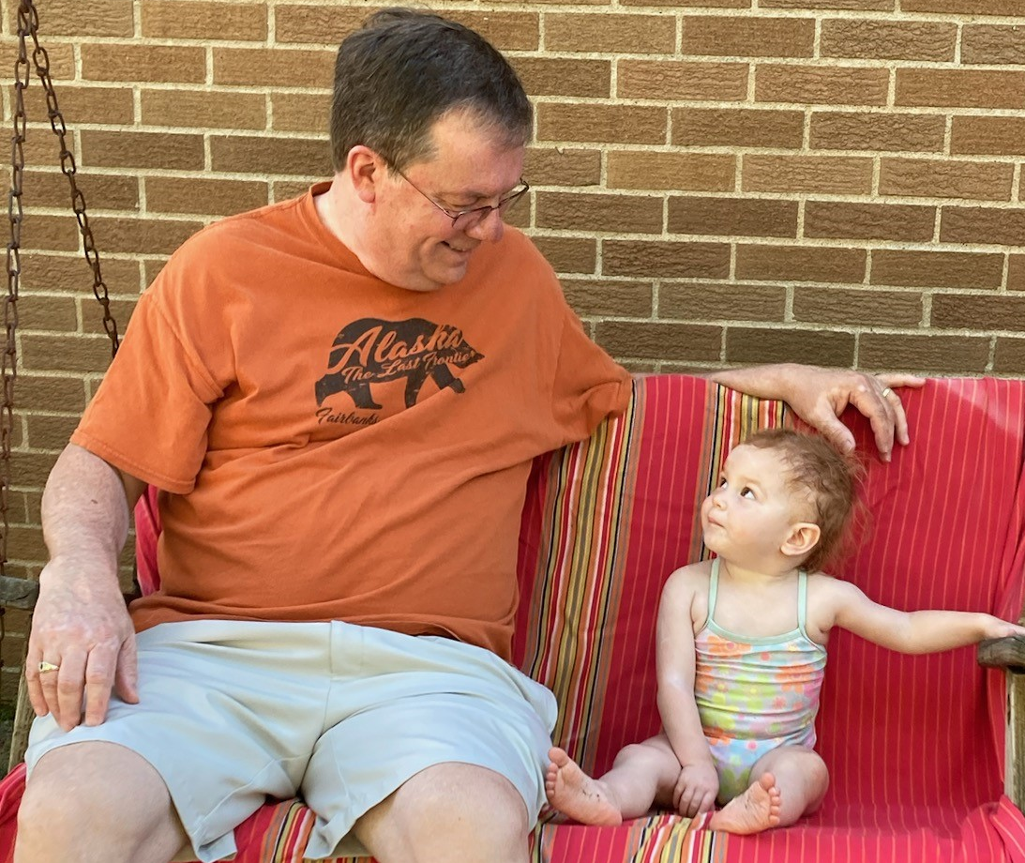
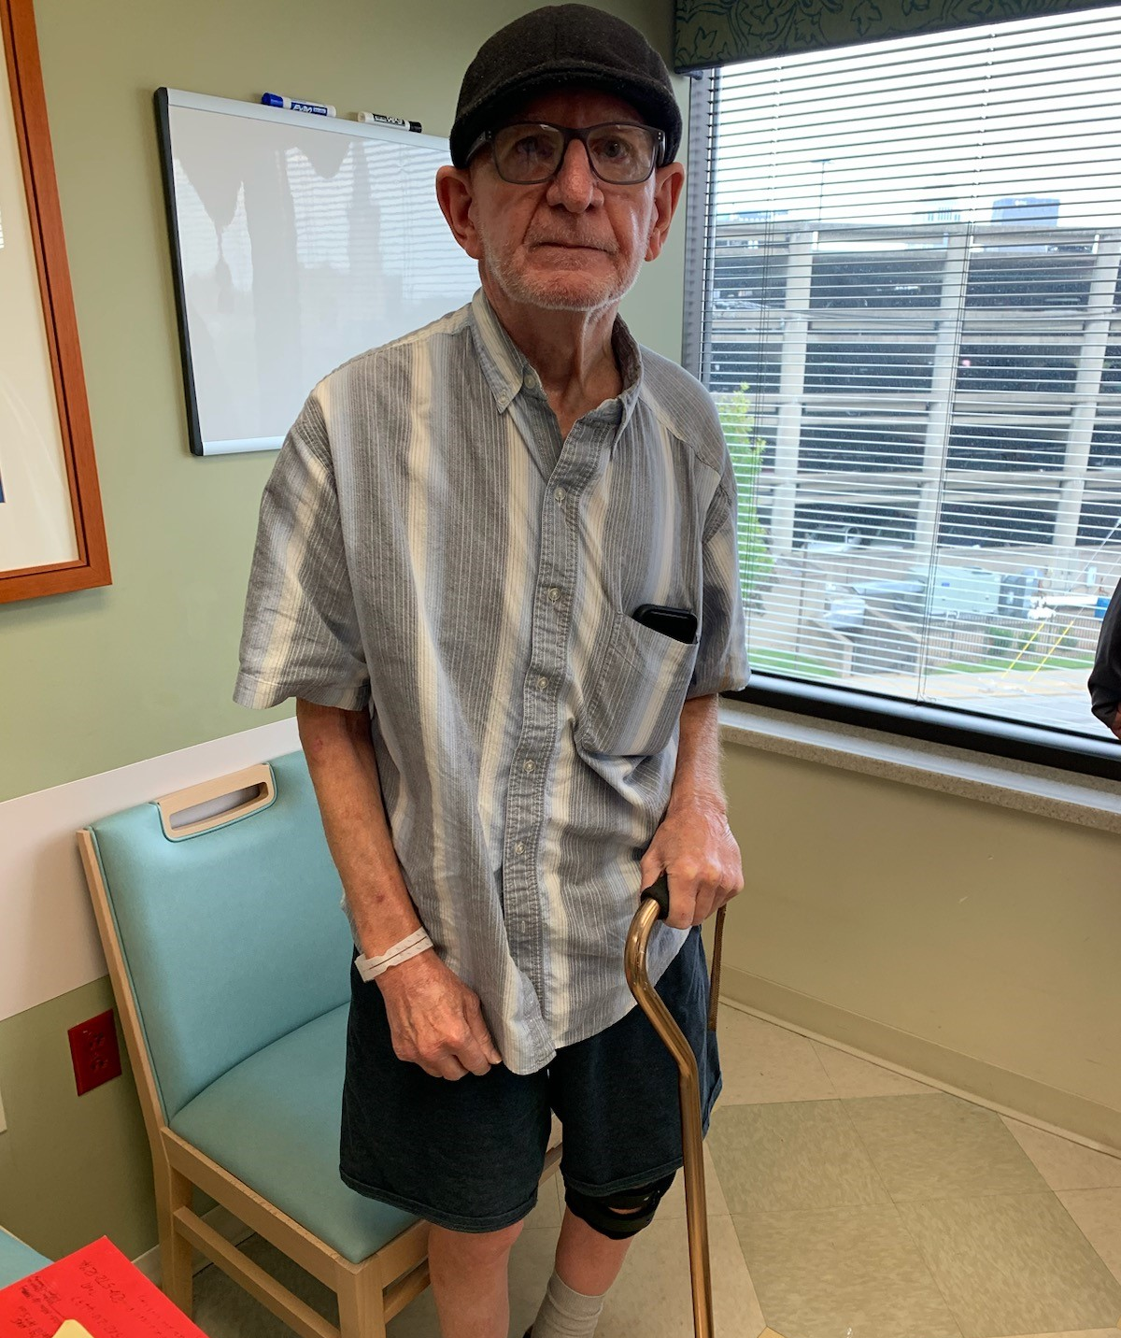
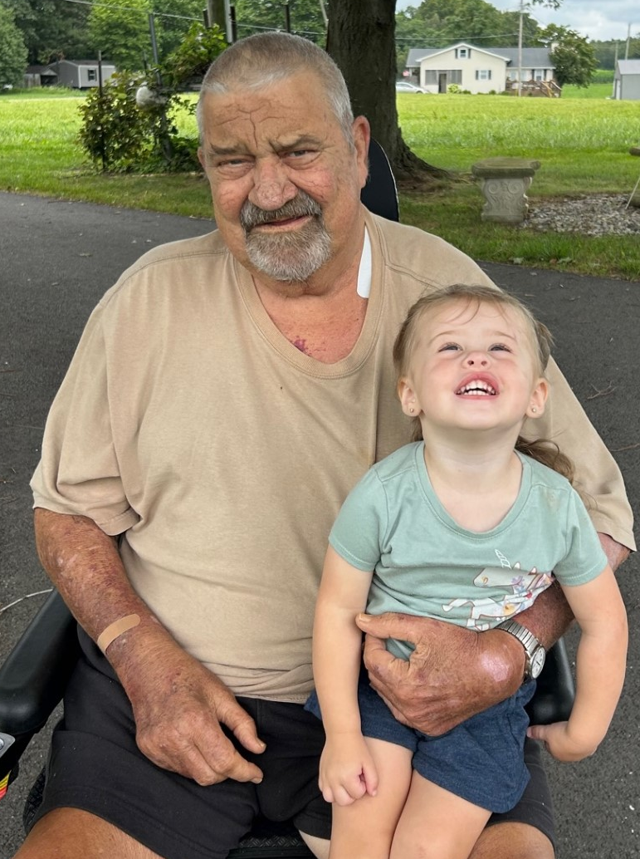

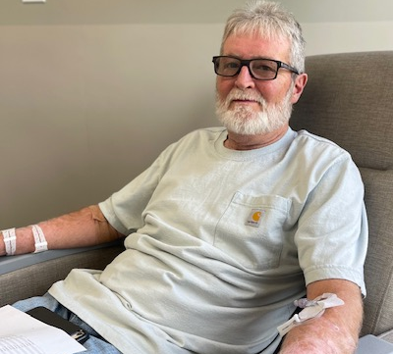
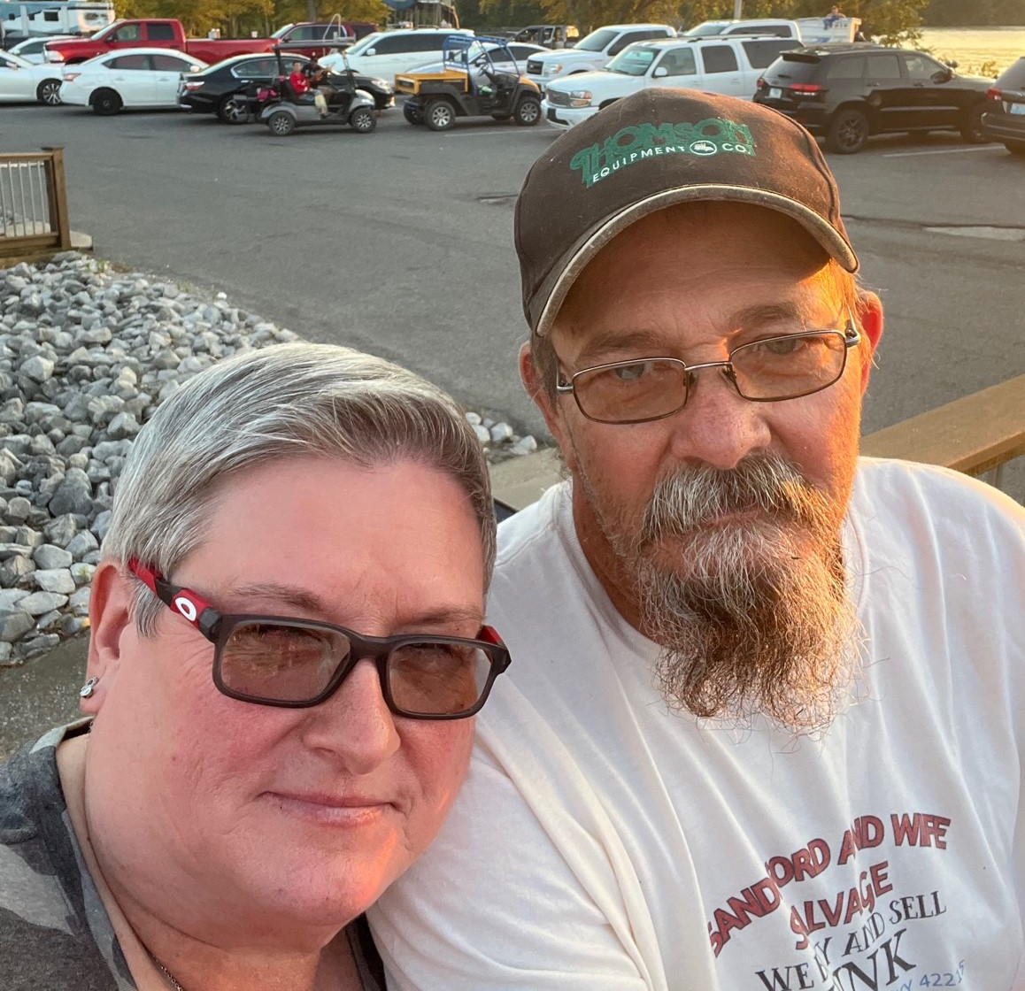
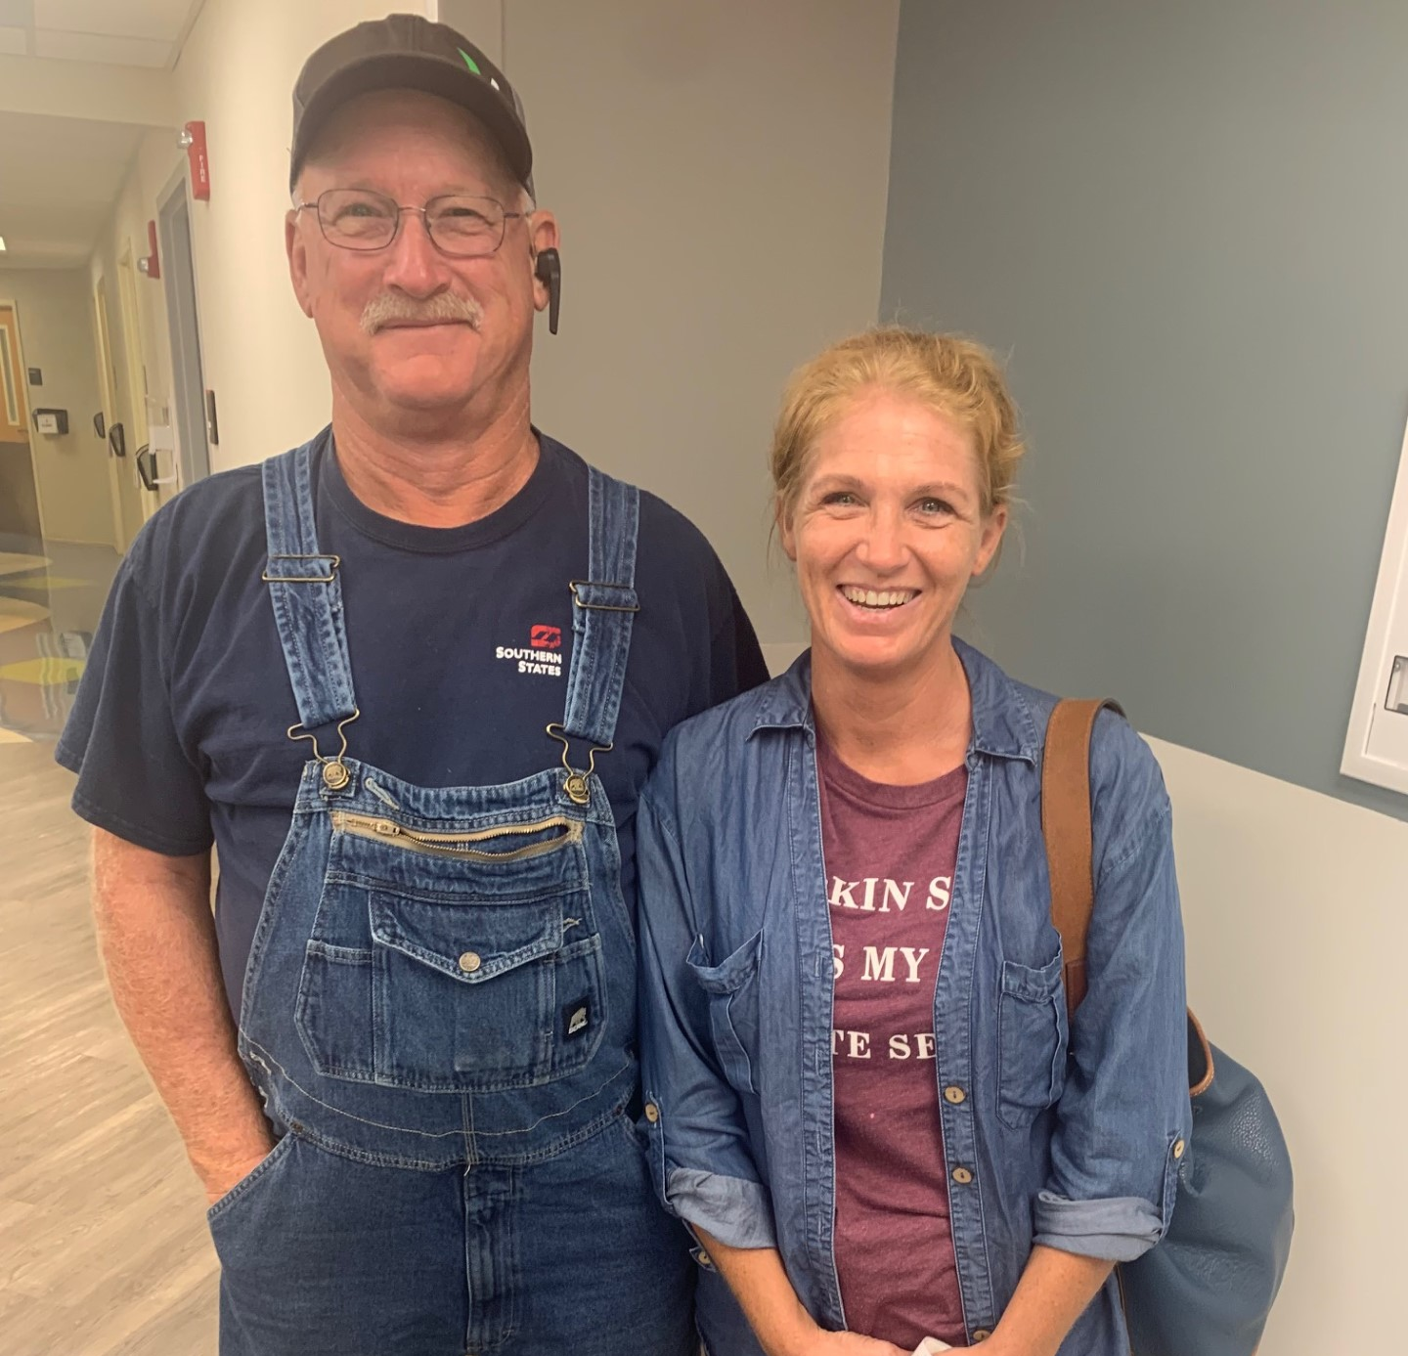
Patients’ Comments From Central and Western Kentucky
“Coming from Leitchfield, it takes me an entire day to get a 30 min infusion – moving the Brown Cancer Center closer would be great.” Marie N, Grayson Co
“Brown Cancer Center saved my life but having them closer to E-Town would really help.” John P, Hardin Co
“Takes me about 2 hrs up I65 from Campbellsville – would prefer to stay out of downtown but the nurses are awesome.”
Robert F, Green Co
“I just want to spend the little time I have with my grand daughter – I need to get treated closer to home.” Phillip R, Adair Co
“They saved me – I’ll drive anywhere but having their nurses and doctors closer would really help.” Tina M., Warren Co
“I’ll drive as far as it takes to get the kind of care I get at the Brown.” Charles H, Bullitt Co
“My cancer just came back and I’m worried about the cost of gas and the pain that the long drives give me.” Traci M, Christian Co
“They saved my arm and my life – I owe everything to Drs. McMasters and Chesney.” Laura B, Larue Co

Slide 11
Example of the Impact of Kentucky’s Support
Immuno-Oncology
UofL Health Brown Cancer Center was an early adopter of novel immunotherapies starting in 2002 (interleukin 2), 2006 (ipilimumab), 2009 (TVEC), 2012 (ipilimumab with nivolumab), 2013 (TVEC with ipilimumab), 2015 (TVEC with pembrolizumab) and 2016 (TILs)
UofL Health Brown Cancer Center clinical trials have led to FDA approvals of these and other immunotherapies that have reduced the cancer death rate in Kentucky
UofL Health Brown Cancer Center has the only COBRE Center for Cancer Immunology and Immunotherapy in the United States
UofL Health Brown Cancer Center was the lead center that led to the FDA approval of TILs for melanoma, has patients coming from across the US and is developing novel, genetically-engineered TILs for multiple cancer types

Slide 12
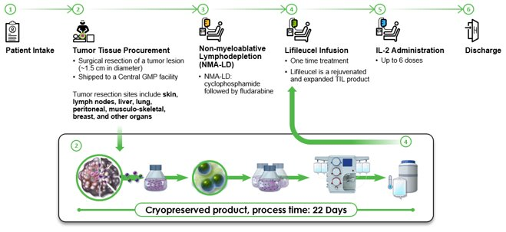




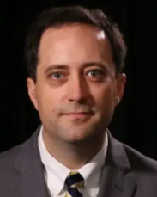
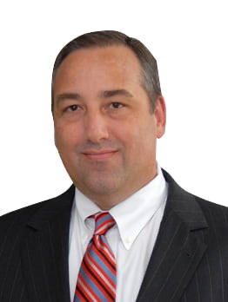
Tumor Infiltrating Lymphocytes (TILs)
Surgical oncologists resect patients’ tumors and then the tumor-specific immune cells are grown in the lab and infused back into the patient
TILs was only available on the coasts until we opened human trials at UofL Health - Brown Cancer Center in 2016
12

Slide 13
TILs Have Proven Efficacy in Anti-PD1 Refractory Stage IV Melanoma Patients
Efficacy and safety of a one-time autologous TIL cell therapy in patients with advanced melanoma after progression on immune checkpoint inhibitors and targeted therapies
153 patients treated
Median of 3 lines of prior therapy (100% received anti-PD-1; 82% received both anti–PD-1 and anti–CTLA-4)
High disease burden at baseline (median target lesion sum of diameters [SOD]: 98 mm
Objective Response Rate was 31% (95% CI: 24%, 39%), with 8 complete and 40 partial responses
The median duration of response was not reached at a median study follow-up of 27.6 months
13
Chesney et al. Dec;10(12), 2022

Slide 14
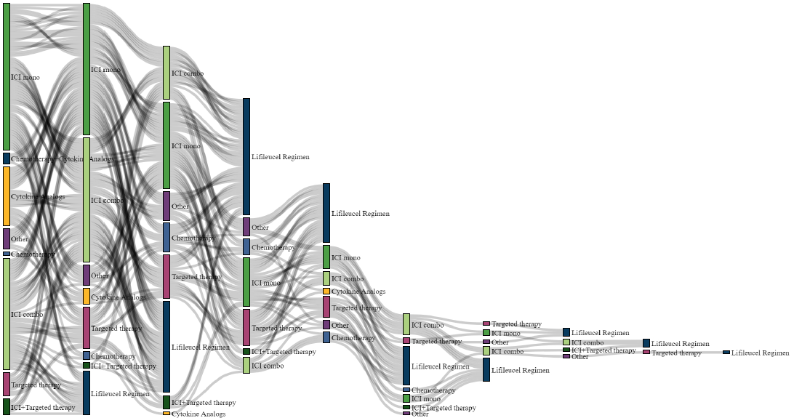
TILs Have Proven Efficacy in Anti-PD1 Refractory Stage IV Melanoma Patients
Sankey plot
14
Chesney et al. Dec;10(12), 2022

Slide 15
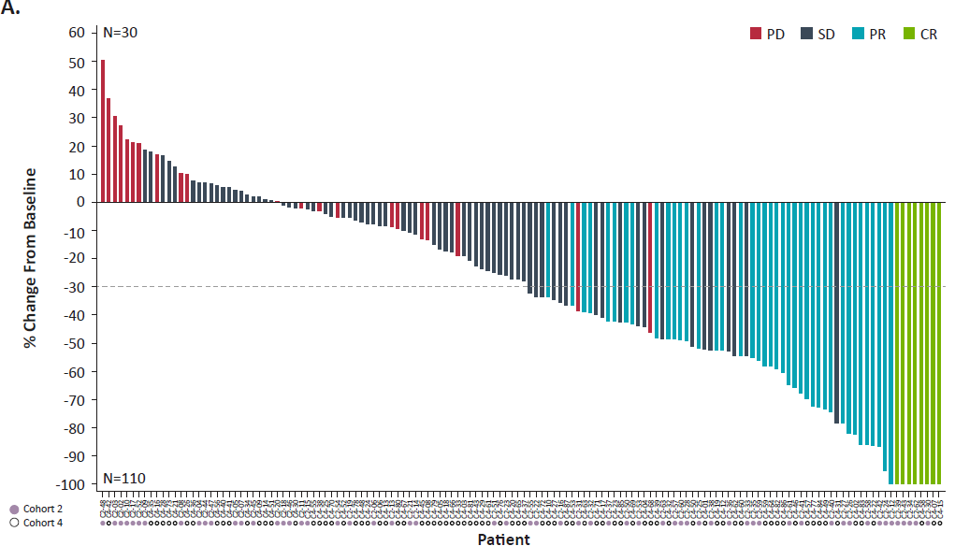
TILs Have Proven Efficacy in Anti-PD1 Refractory Stage IV Melanoma Patients
Waterfall plot
15
Chesney et al. Dec;10(12), 2022

Slide 16
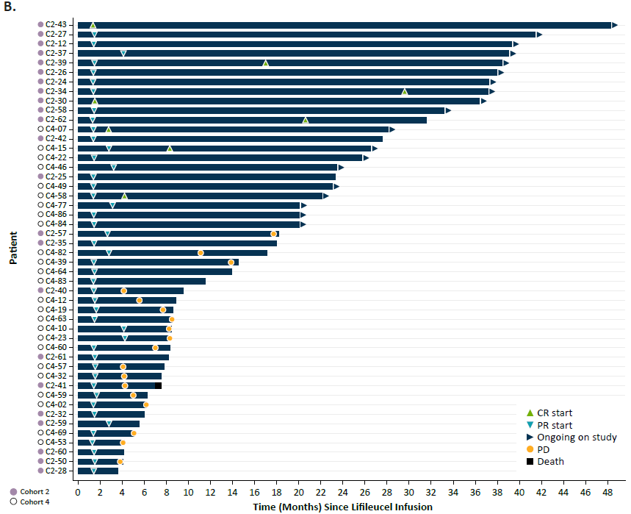
TILs Have Proven Efficacy in Anti-PD1 Refractory Stage IV Melanoma Patients
Swimmer plot
16
Chesney et al. Dec;10(12), 2022

Slide 17
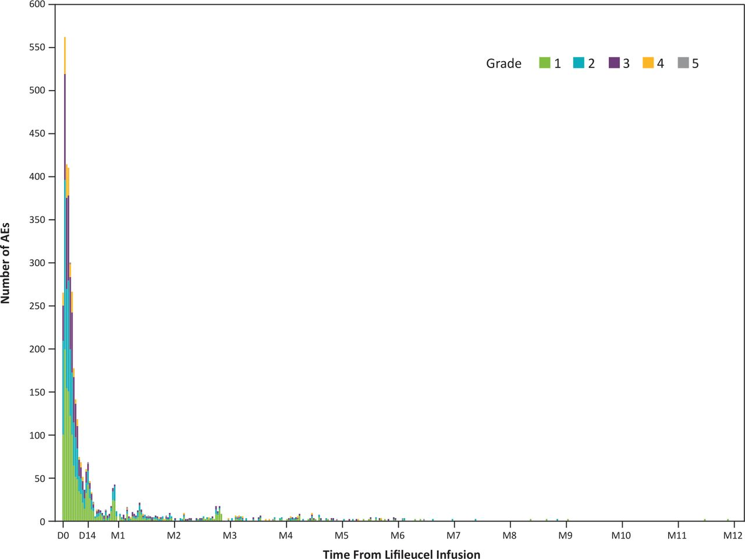
Toxicity Is Limited to First 2-3 Weeks
17
Chesney et al. Dec;10(12), 2022

Slide 18
Iovance’s TIL Product Was FDA-Approved for Anti-PD1 Refractory Melanoma in 2024
The University of Louisville’s Brown Cancer Center was the lead site from 2016-2022 for the first multi-center trial of TILs in melanoma patients
TILs for melanoma patients were FDA-approved in February 2024 and we are now studying genetically engineered TILs and exploring additional indications including lung and endometrial cancers.
2-16-24 Press Release – Iovance’s AMTAGVI™ (lifileucel) Receives U.S. FDA Accelerated Approval for Advanced Melanoma. “The FDA approval is based on safety and efficacy results from the C-144-01 clinical trial. C-144-01 is a global, multicenter trial investigating AMTAGVI in patients with advanced melanoma previously treated with anti-PD-1 therapy and targeted therapy, where applicable. AMTAGVI demonstrated deep and durable responses. The detailed results of clinical trial C-144-01 are published in The Journal for ImmunoTherapy of Cancer (Chesney 2022).”
18
Chesney et al. Dec;10(12), 2022

Slide 19
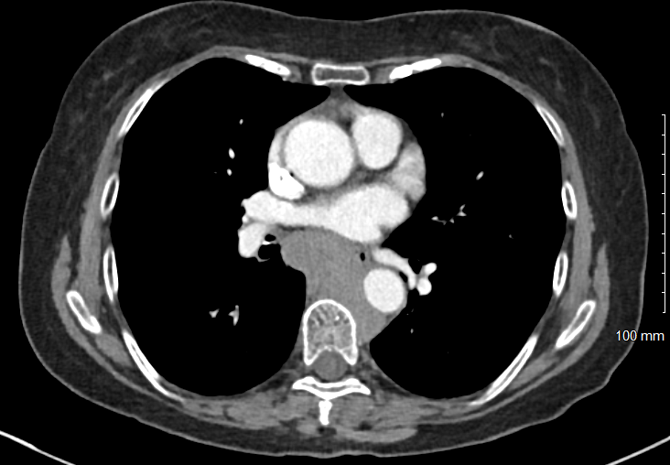
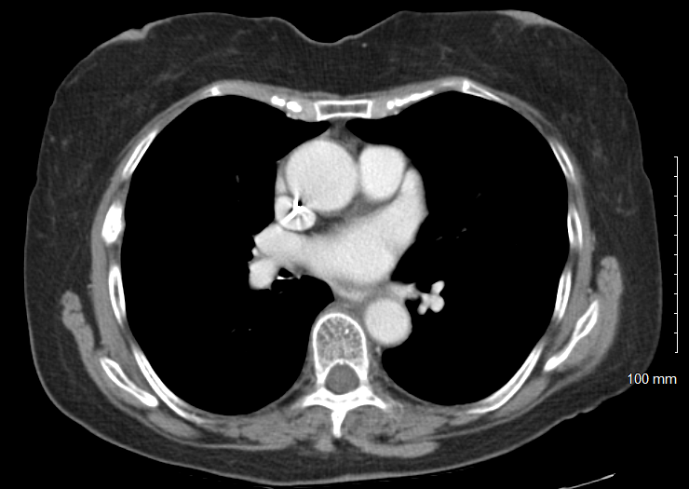

Tumor Infiltrating Lymphocytes (TILs)
19
19

Slide 20
Clinical Example – Melanoma
2019: Left nasal mucosal melanoma
Surgical resection
Adjuvant left nasal cavity radiation
2020: Recurrence in the left submandibular LN
Neoadjuvant Ipi/Nivo x 2 cycles
Left neck dissection
2021: Recurrence in C5 vertebral body
SBRT to C5
Pembrolizumab (anti-PD1)
2022: Recurrence in left nasopharynx
Endoscopic resection of the nasopharyngeal mass
2023: New RUL lung lesion and hepatic met
Referred for TILs at UofL Health BCC

Slide 21
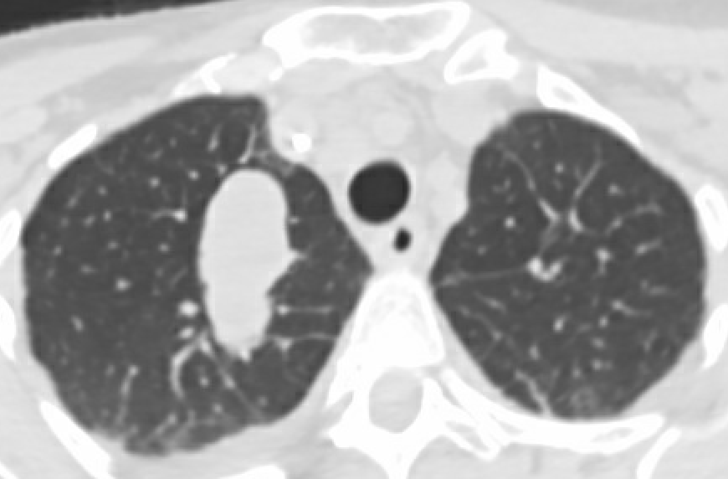
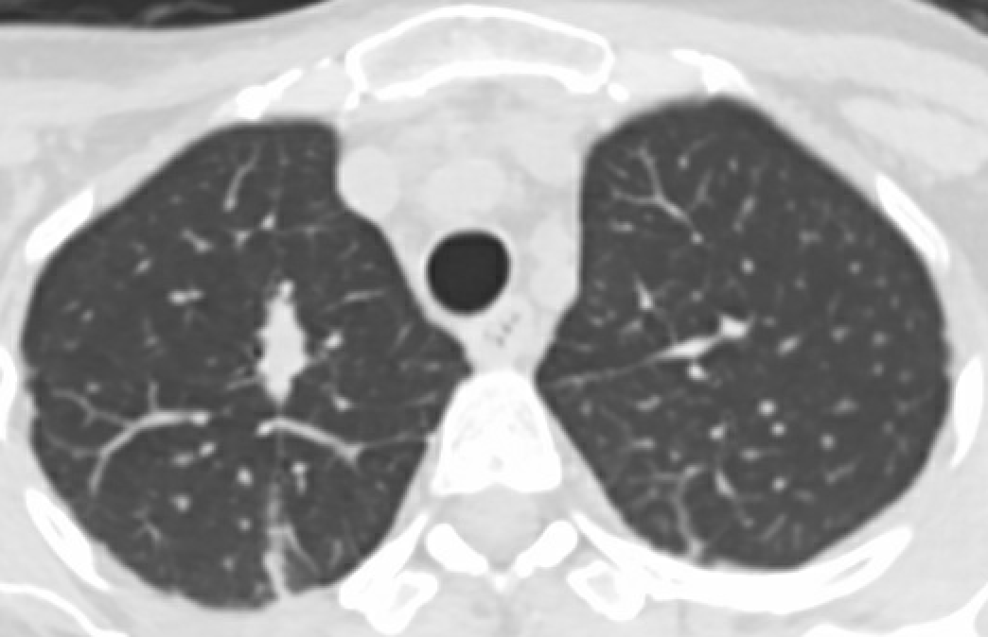
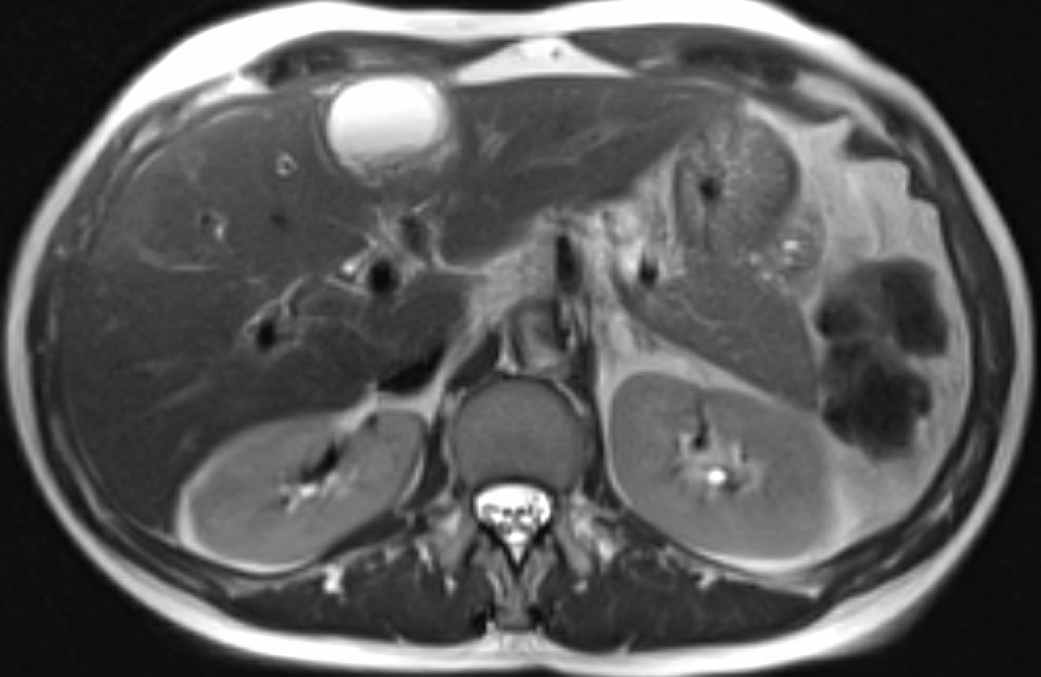
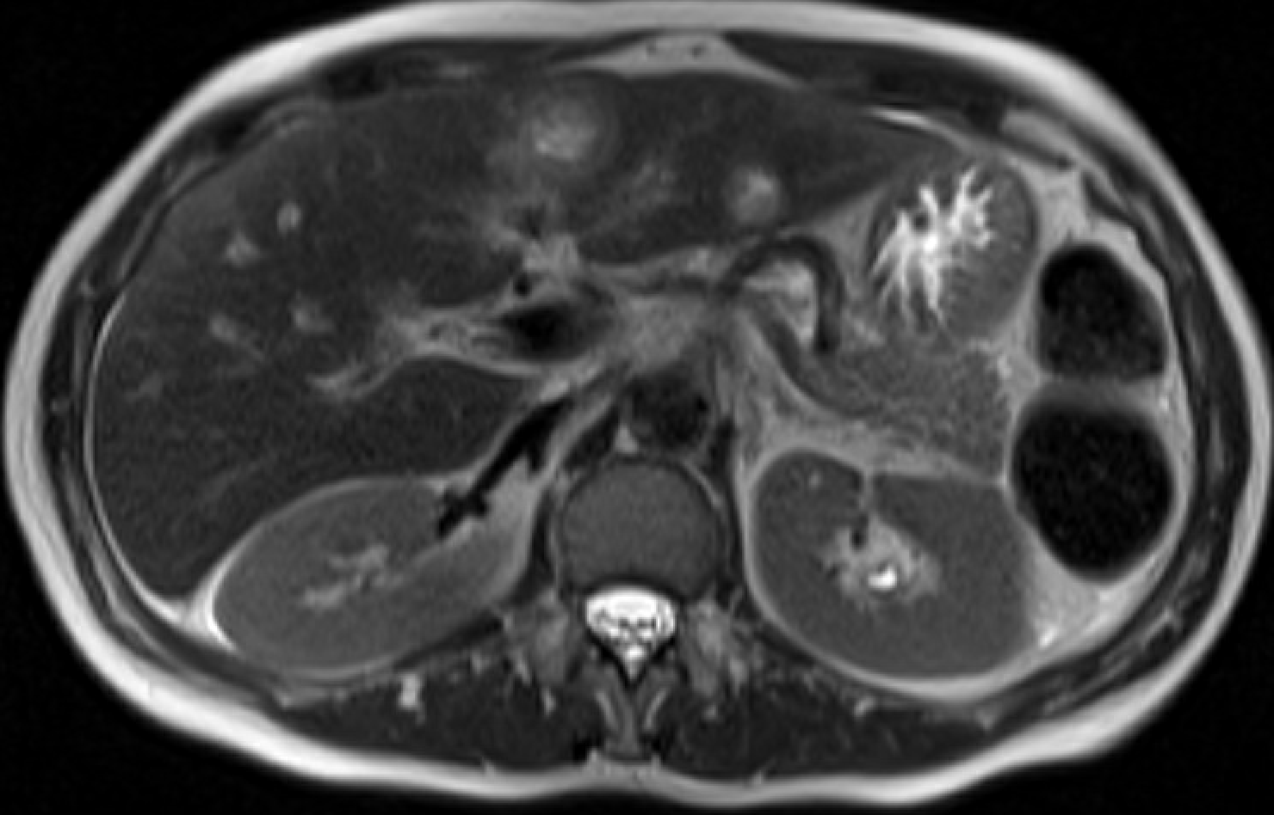
2023
Clinical Example – Melanoma
Day +42
+TILs

Slide 22
Clinical Example – Non-Small Cell Lung Cancer
2020: New right upper lobe NSCLC-AdenoCa
Pembrolizumab (PDL1 100%)
2020: MRI brain with 2 new subcentimeter brain mets
24 Gy in 3 fractions radiotherapy to the two brain metastases
2021: CT C/A/P: progression of disease with interval growth of splenic lesions, intrathoracic lymphadenopathy, and RUL mass
Referred for TILs at UofL Health BCC

Slide 23
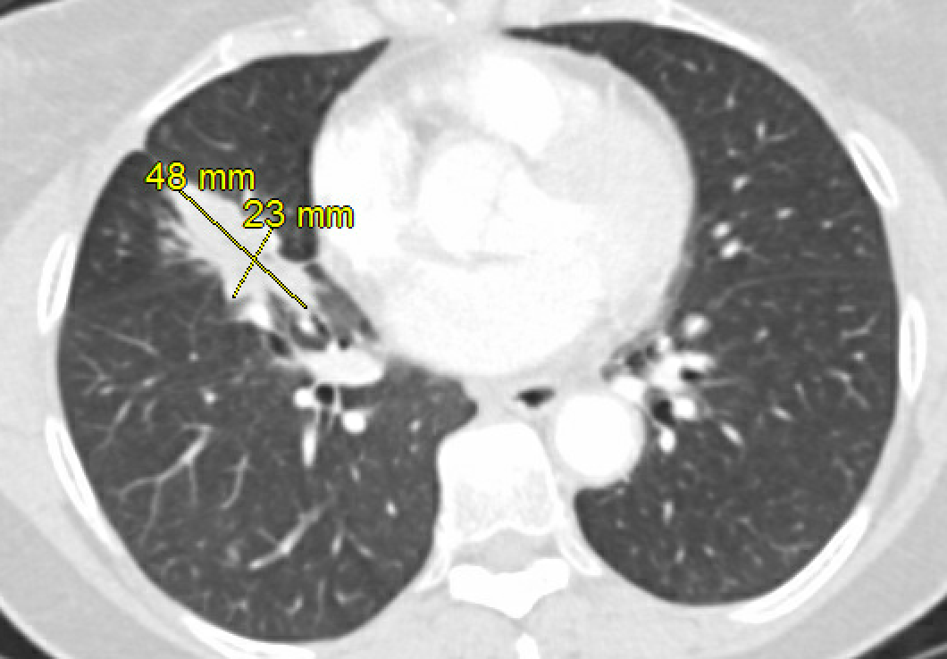
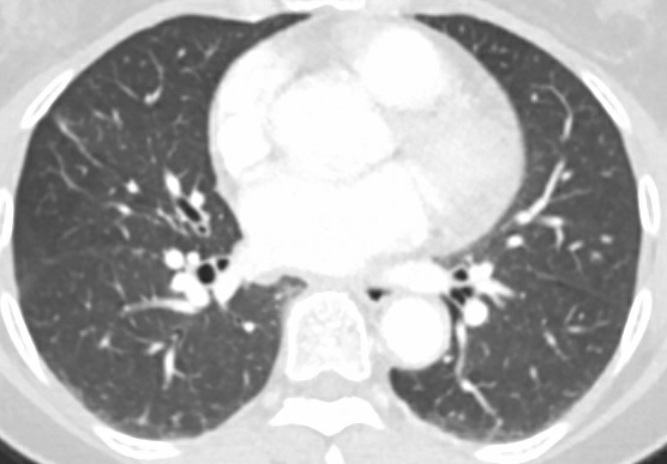
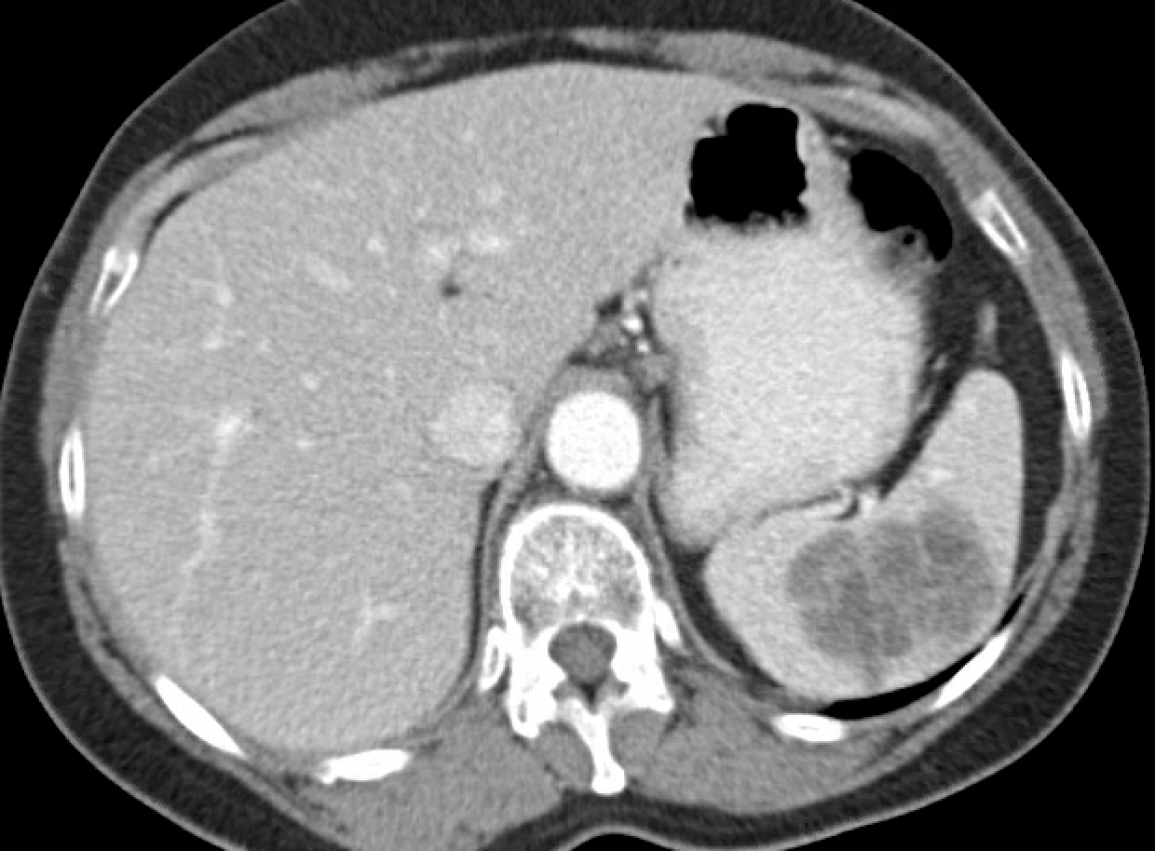
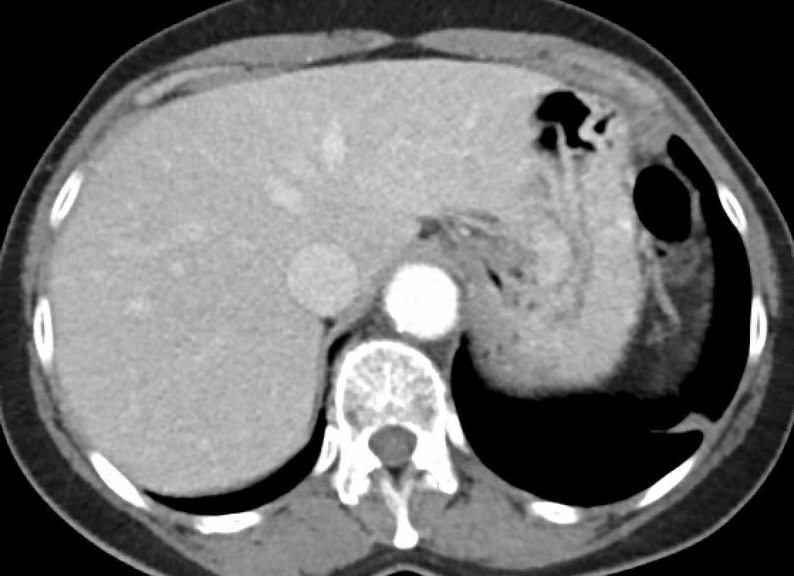
Clinical Example – Non-Small Cell Lung Cancer
+TILs
April 2021
April 2023

Slide 24
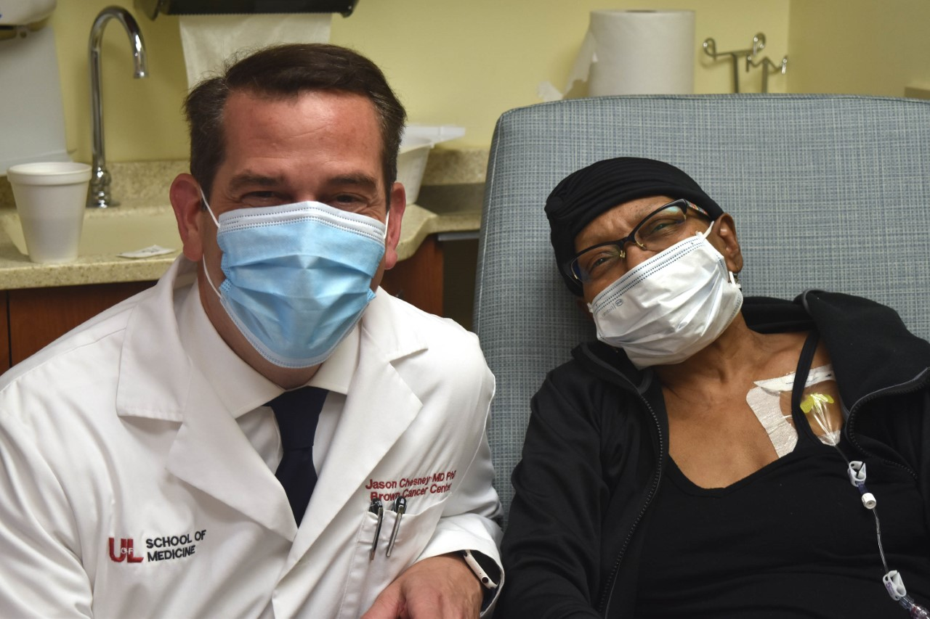
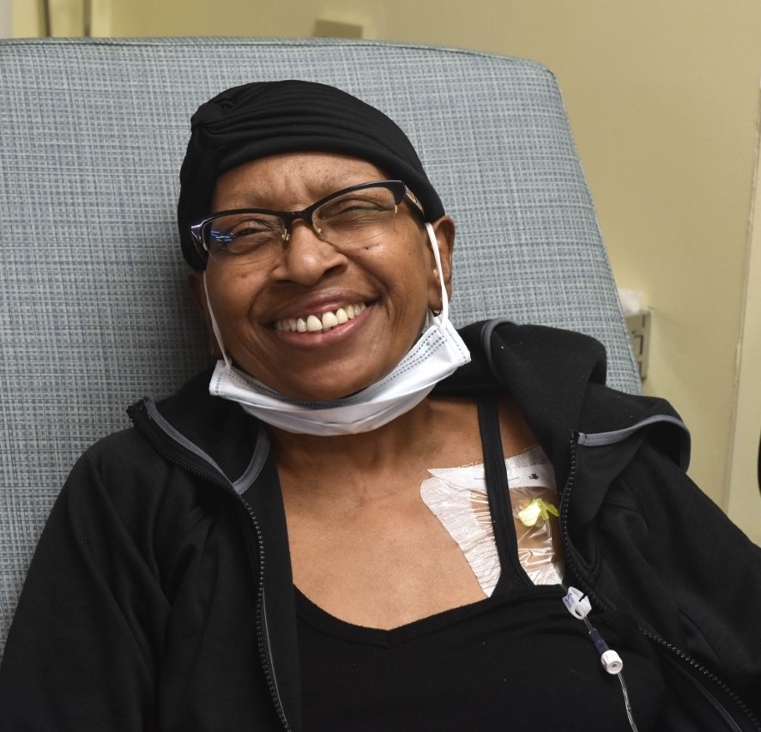
Clinical Example – Non-Small Cell Lung Cancer

Slide 25
Conclusions
A $10M annual increase in funding to Kentucky’s two academic cancer centers would be transformative by reducing the cancer death rate and the associated $5B+ in economic consequences of cancer
In 2017, the general assembly, increased the tobacco excise tax by 50c - none of this revenue was appropriated for lung cancer research or to care for tobacco-smoking lung cancer patients (5c for each academic cancer center would translate into $12M/year)
The TMSA was settled to address the health issues caused by tobacco companies – currently less than 10% is used by Kentucky to support the care of those who develop lung cancer
Medical marijuana predominantly helps cancer patients, and Arkansas has appropriated $50M in related tax revenue per year to its academic cancer center to reduce cancer-related deaths
Our goals are to drop to #5 in cancer deaths in the US in the next 5 years and to drop the cancer death rate by 50% in the next 10 years – but we need your help

