Slide 1
Kentucky Double Dollars and Farmers Market Support Program
June 12, 2025
Myrisa K. Christy Jamie Fitzwater
Notes:
Thank them for the opportunity to present
Introduce myself:
I’ve been working with
agribusinesses,
project development and implementation,
business plans, and
funding
for over a decade, including the last 10 years at KCARD. MSA funds literally paid for my college textbooks and part of my tuition.
Responsible oversight of public funds
Using those funds to create an impact for farmers
Strengthening our communities by strengthening farms

Slide 2
Who is Community Farm Alliance?
CFA started in 1985 during the farm credit crisis
We implement programs to overcome barriers for farmers

Slide 3
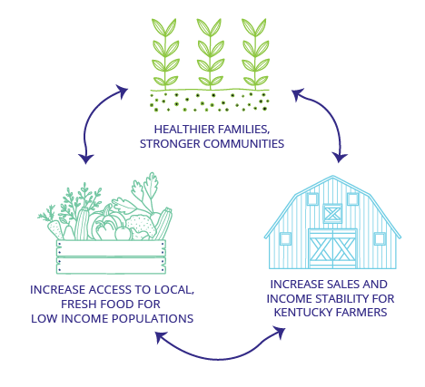
Farmers build community
The program has been a lifeline for customers seeking healthy, locally grown produce who might otherwise struggle to afford it. We’ve seen a lot of gratitude from them. As farmers, we also gain from this partnership through increased sales, and it’s been a great opportunity to meet new customers, while seeing many return week after week. It’s an incredible program all around!-Magoffin Co Farmer
Notes:
Without food, communities die.

Slide 4
Program updates
CFA is piloting working with KFB certified roadside stands
CFA has more retail stores on-boarding than any previous year
FreshRx for MOMs has expanded to parents on WIC
We are matching KADF funds with over $2.2 million in federal and private funds for the 2-year project
With KFAN, are developing a toolkit for practitioners who want a Local Food as Medicine program
Senior Health Bucks developed as a pilot program and privately funded
Over $4.5 million in economic impact

Slide 6
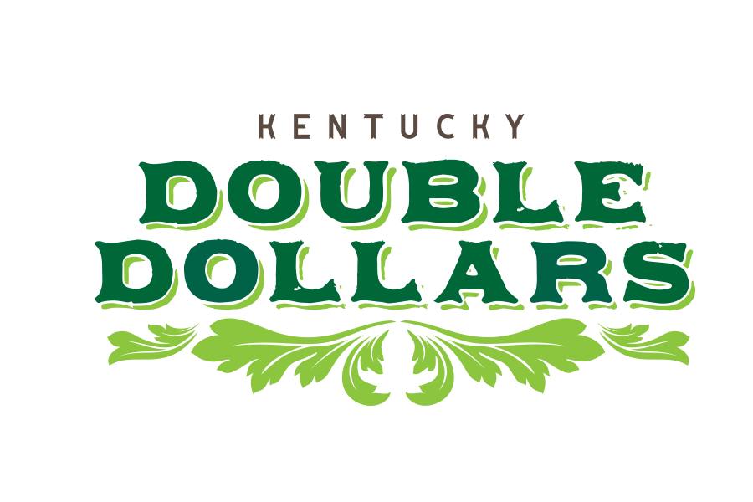
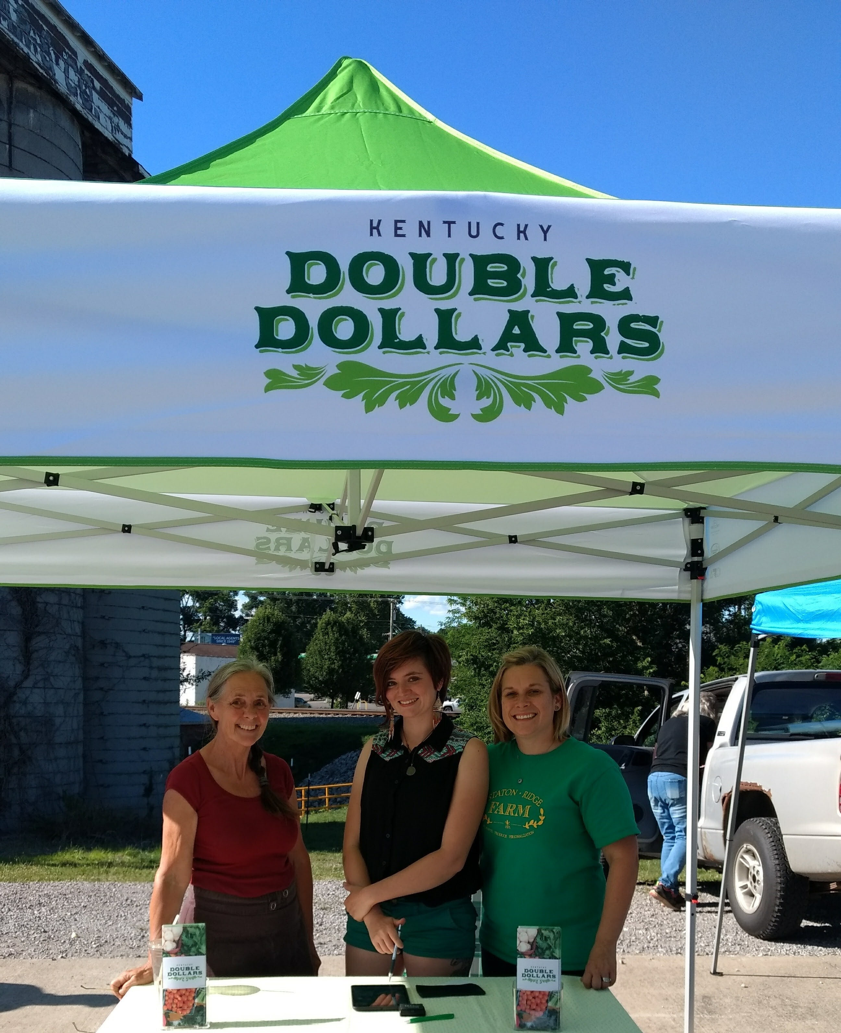
Increase sales, markets and profitability for Kentucky farmers
Develop new farm customers
Leverage federal and private funds for food and nutrition programs
Notes:
CFA began the program in 2017, bringing multiple initiatives in the state under one umbrella.
Unlike other programs, CFA is able to incentive more than fruits and vegetables with the support of KADF funds. Our incentives go to support WIC and Seniors Farmers Market Nutrition Program, as well as providing MED to SNAP participants.

Slide 7
2024 Farm Business Impacts
Over $350,000 direct farm impact last year
86% of farms surveyed attributed increased farmers market sales to KDD from 2020 to 2024
Average farm sales increased about $2,500 per farm in 2024.
Small to Mid-size farms saw 16% increase in sales, while large farms saw 10% increase in sales
(CEDIK 2024)

Slide 8
Community Farmers Market
For me here on Tuesday, and also for my dad, it makes up a big majority of our income, sometimes up to 50% for us. It also allows us to feed people who need it.
Notes:
Carter Howell

Slide 9
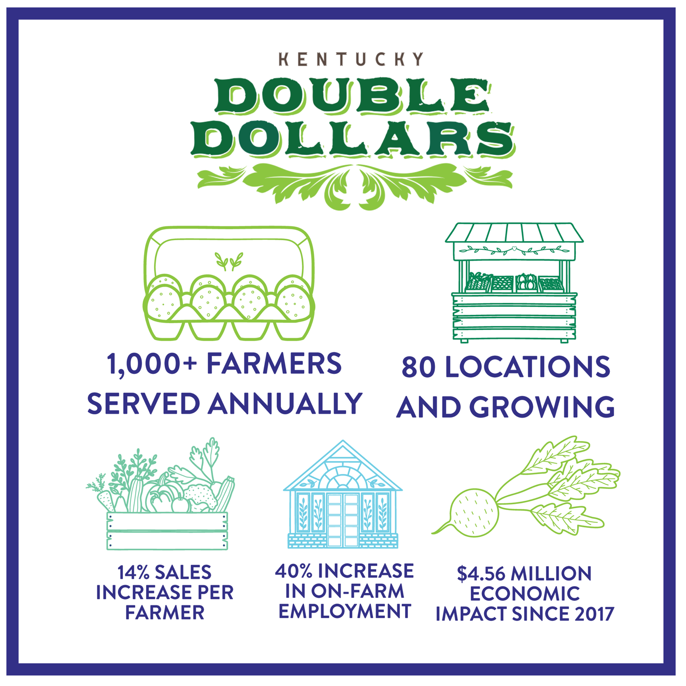
Notes:
In 2025, going from 71 outlets to 80!

Slide 10
Ohio County
I raise and sell beef, maple syrup, and produce at our market. The Double Dollars program helps increase our sales and profit. I was especially pleased with our new SNAP program and Double Dollars match, as I was able to secure new customers who previously couldn't purchase some of my items. But SNAP allows them to do so and still have Double Dollars from that match to purchase fruits and vegetables. Keep up the good work. - Bekki Hitchel
Notes:
Brings new customers to the market. Not only does it create community, but it’s training a new generation of folks about how to purchase and prepare local farm products.

Slide 11
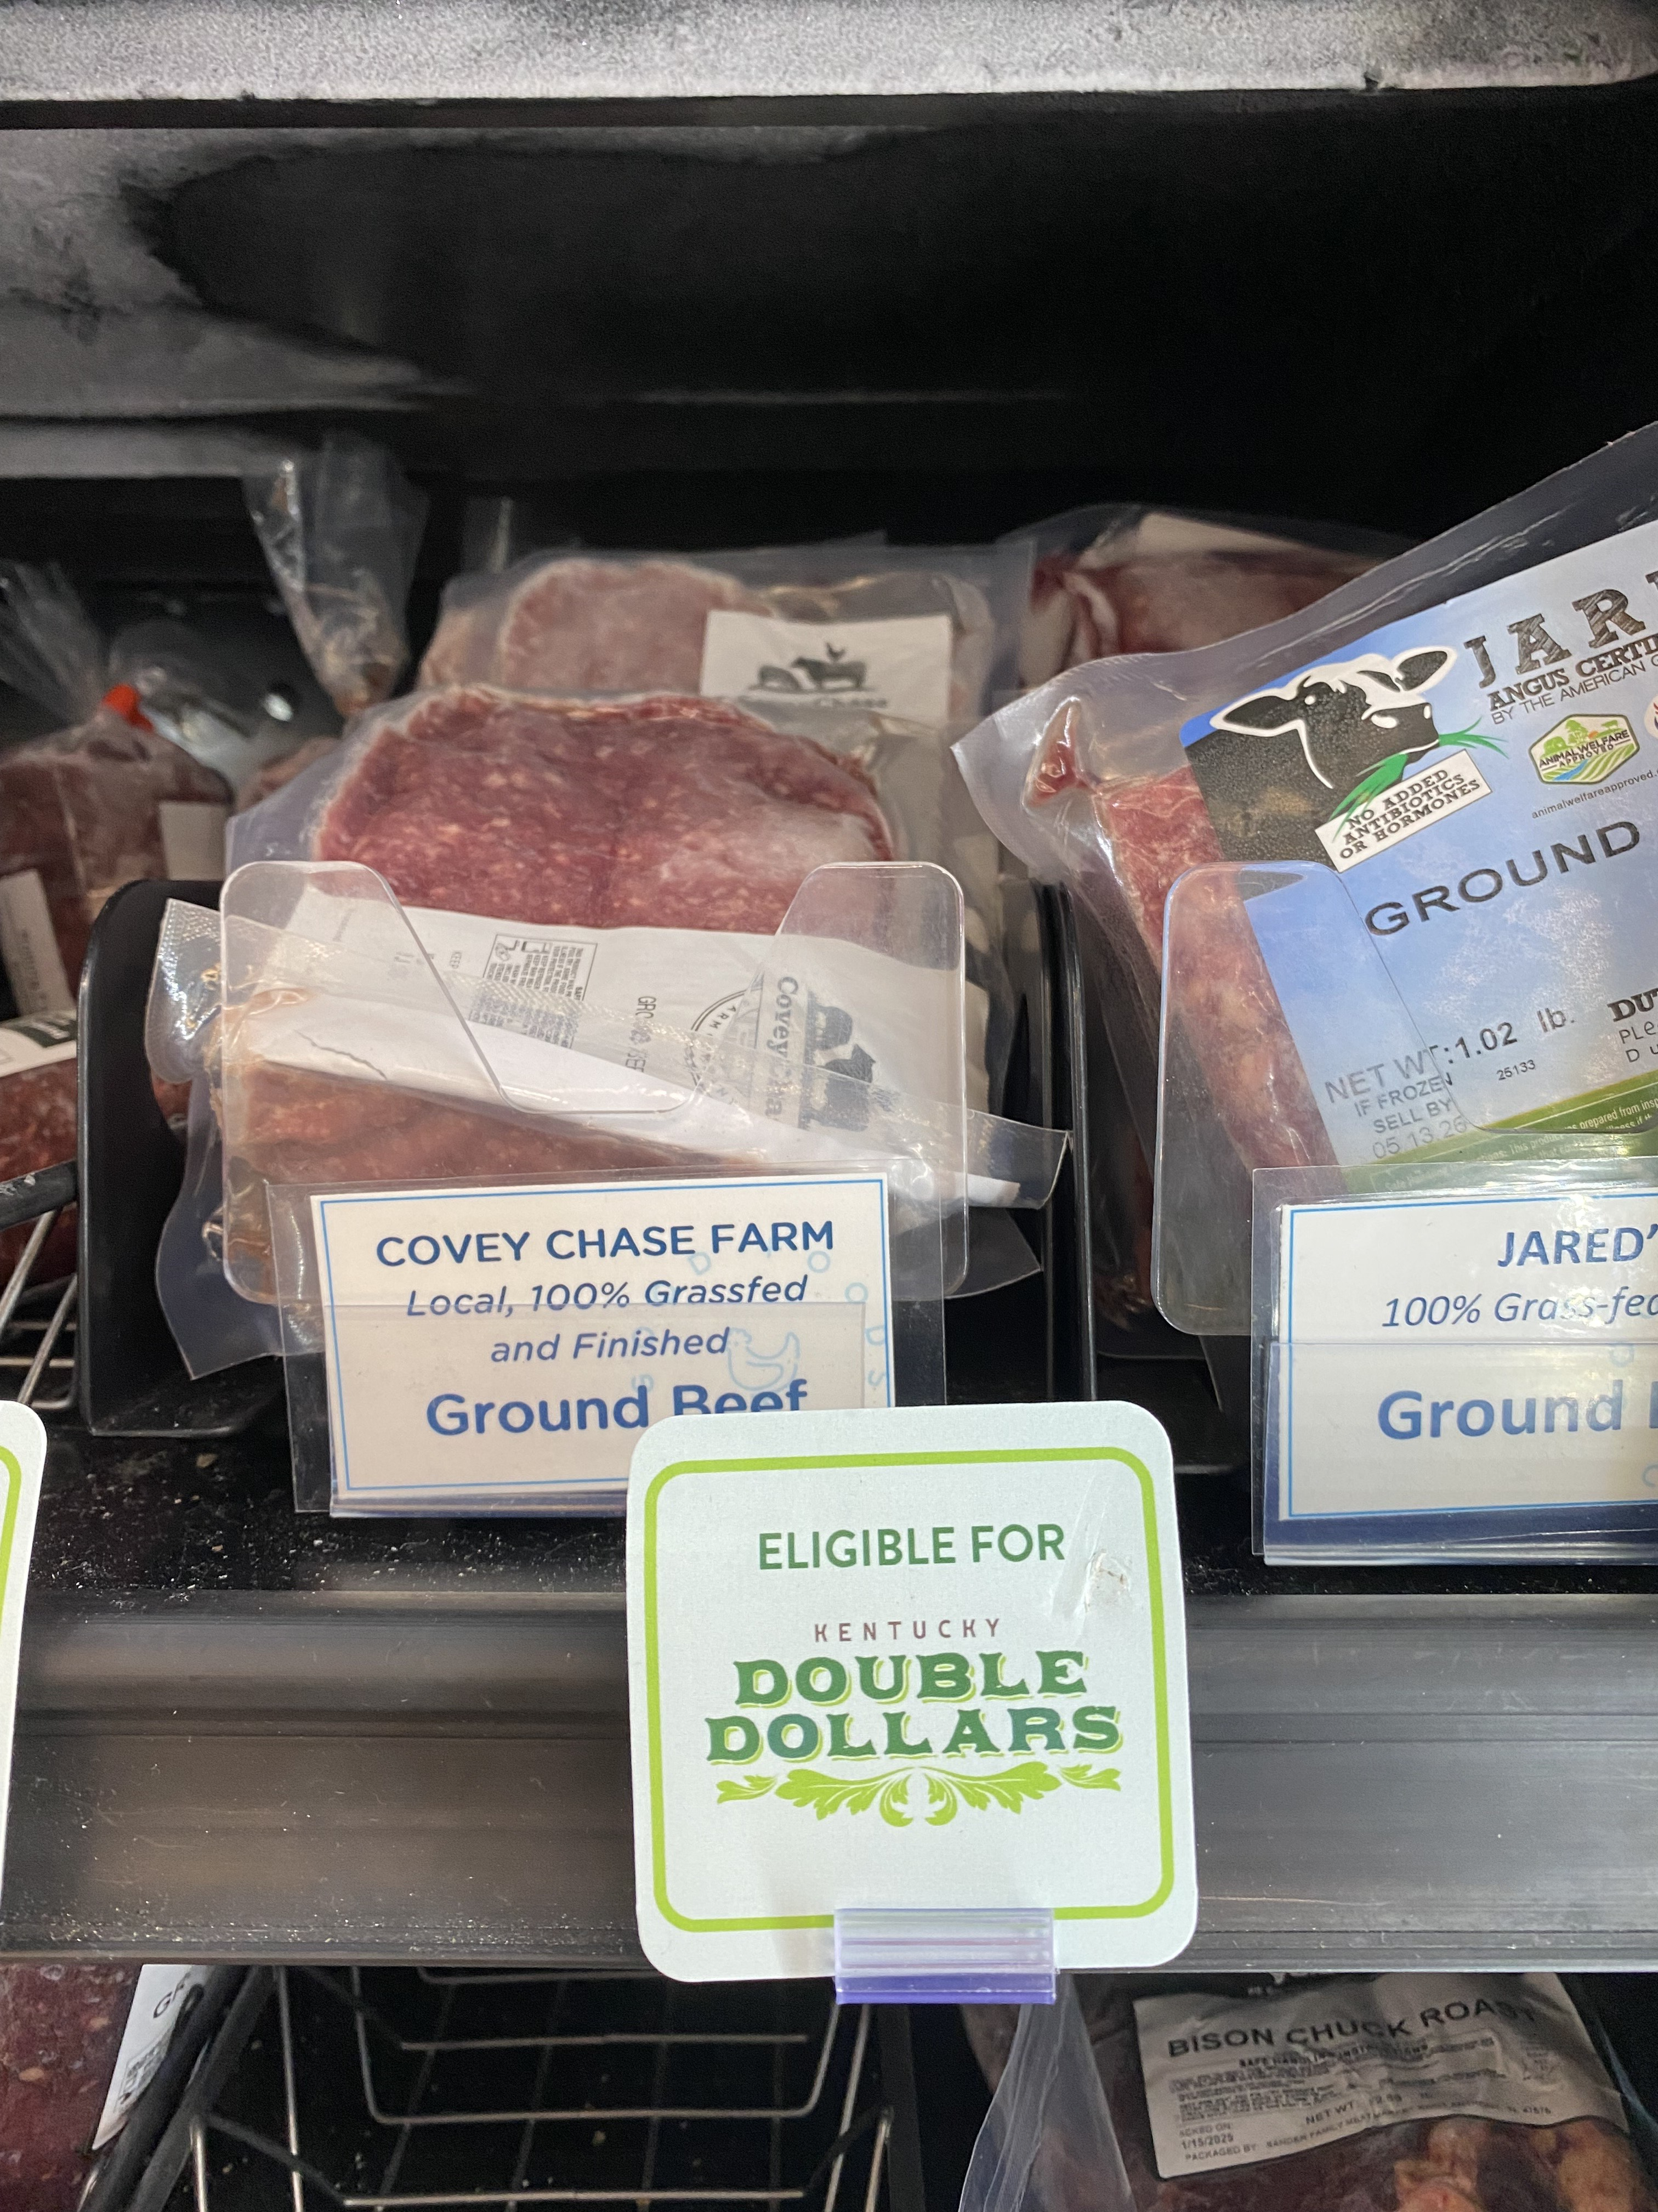
Kentucky Double Dollars Programs
SNAP, WIC, and Senior Farmers Market Nutrition Program benefits
Farmers markets each come up with a 25% match for their benefits
Proteins and specialty crops are included
Expanded to 3 roadside stands in 2025

Slide 13
Golden Bell Farms
Last year was Tina Badgett’s first year selling produce and fresh cut herbs from her high tunnel the KDD customers really helped out. Not only did customers spend more with her on her produce and fresh herbs but it helped to boost sales of her value-added products as well.
Notes:
Boyd County

Slide 14
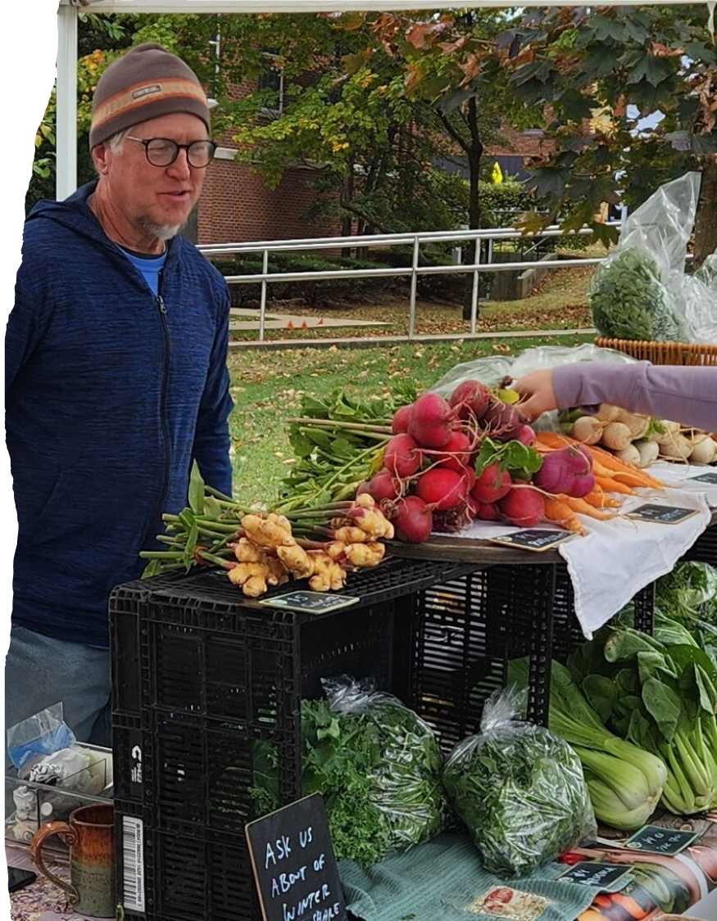
FARMERS MARKET SUPPORT PROGRAM
Create profitable market outlet for farmers with the tools, resources and network development
Access to fresh food to all members of the community
Path to market sustainability
Notes:
Market Manager
Stable Organizational Structure
Access to federal programs
Nutritional incentives
Physical location
Community Support

Slide 15
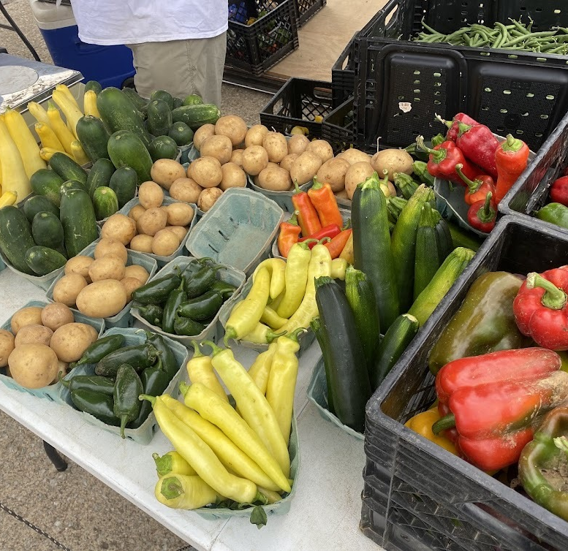
Farmers Market Resiliency
In 2024, 11 markets were part of the Farmers Market Resilience Program, impacting at least 100 farmers.
Already in 2025, we have worked with over 29 markets, serving over 300 farmers

Slide 16
Farmers Market Support
2023
2024
$55,700 funds dispersed
$56,600 matching funds raised by markets for cost share
37 markets participating
$39,250 funds dispersed
$46,050 matching funds raised by markets for cost share
31 markets participated
2025
42 markets participating
$65,000 committed to markets
Each market must raise matching funds
Notes:
Having farmer’s markets come up with match gives them a better ability to support themselves long term. Each year, they provide us with a final report on the ways they raised the match. It varies from vendor fees to getting banks, local businesses, churches, and medical offices to support the market. A potential expansion of FMSP would be intensive planning for markets around their long-term funding strategies to increase market support and success.

Slide 17
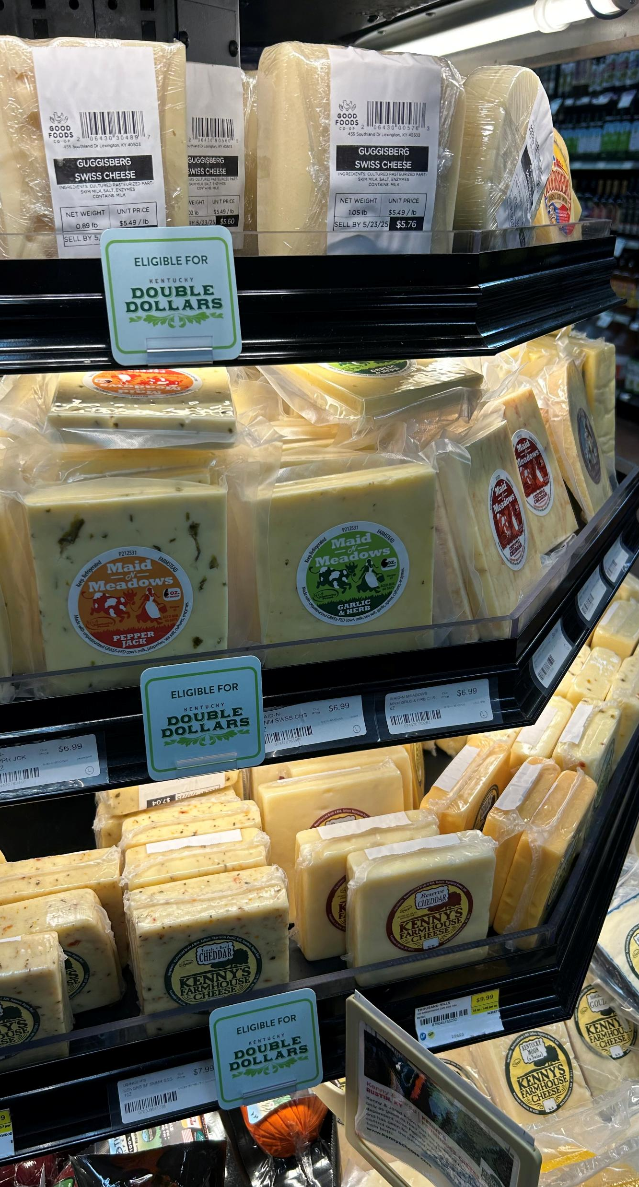
Pathway to Future Impact
Increased capacity to bring retailers on board
Leveraging KDD dollars locally
Growing local community Food as Medicine Programs
Piloting delivery and bundled boxes for easy customer purchases.

Slide 18
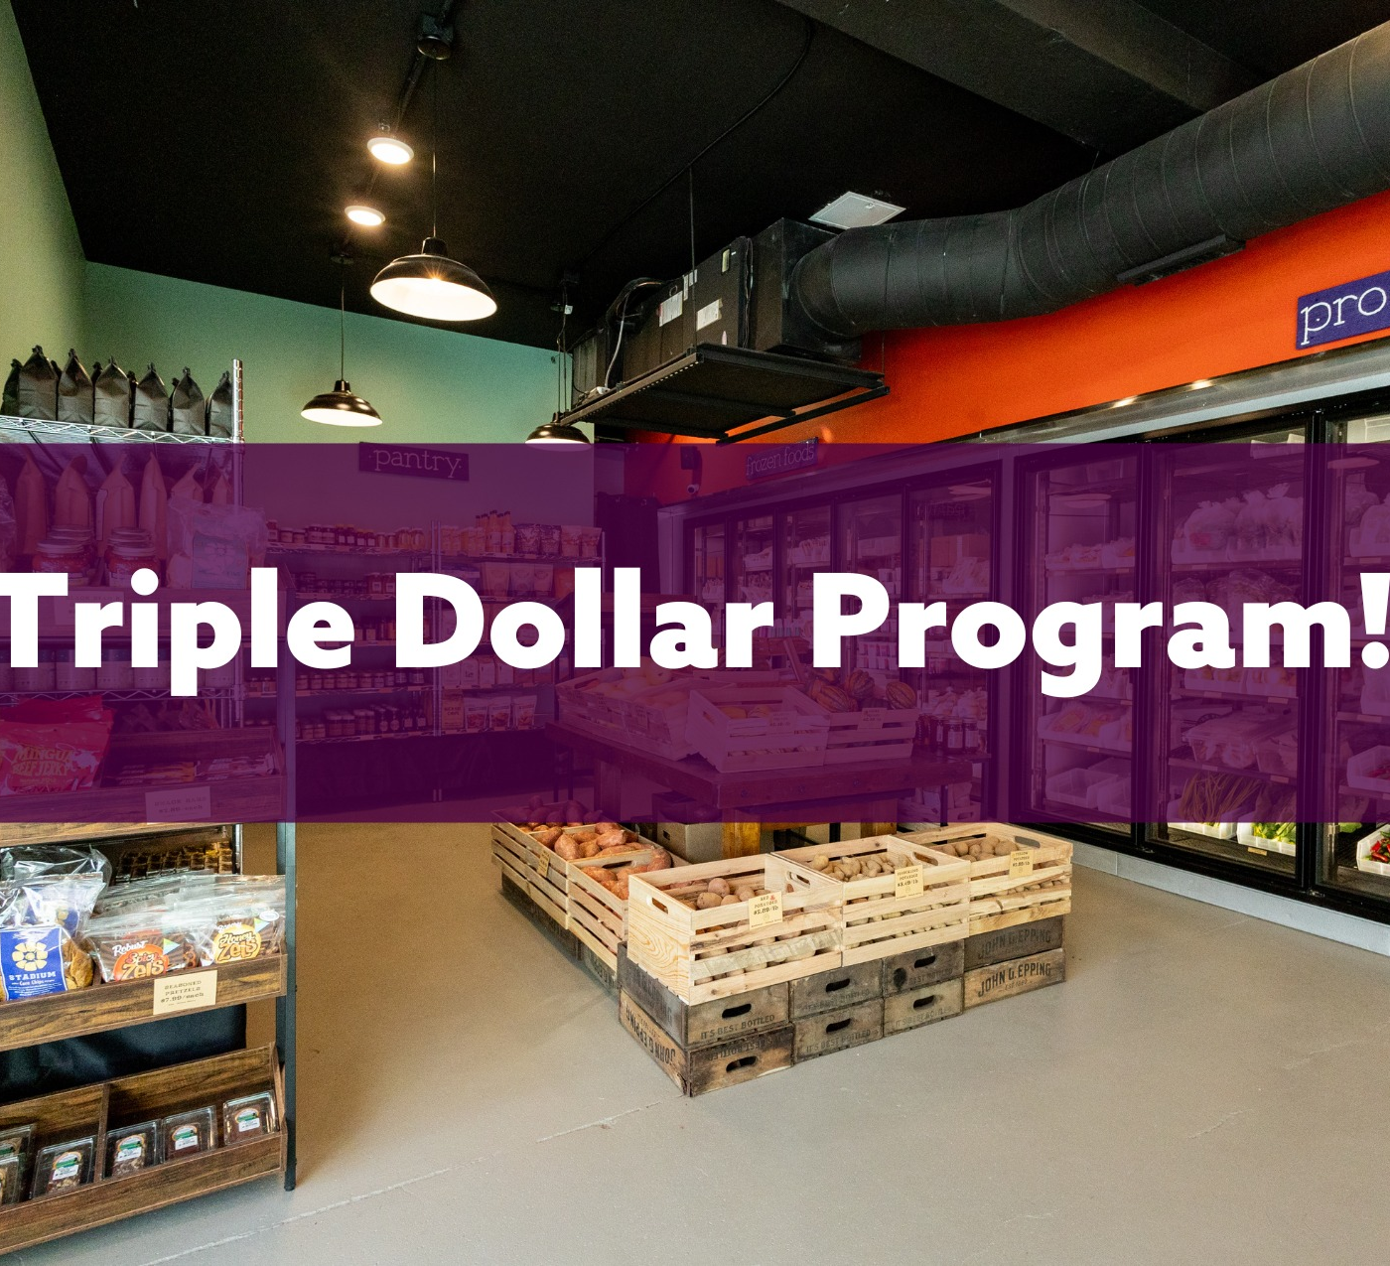
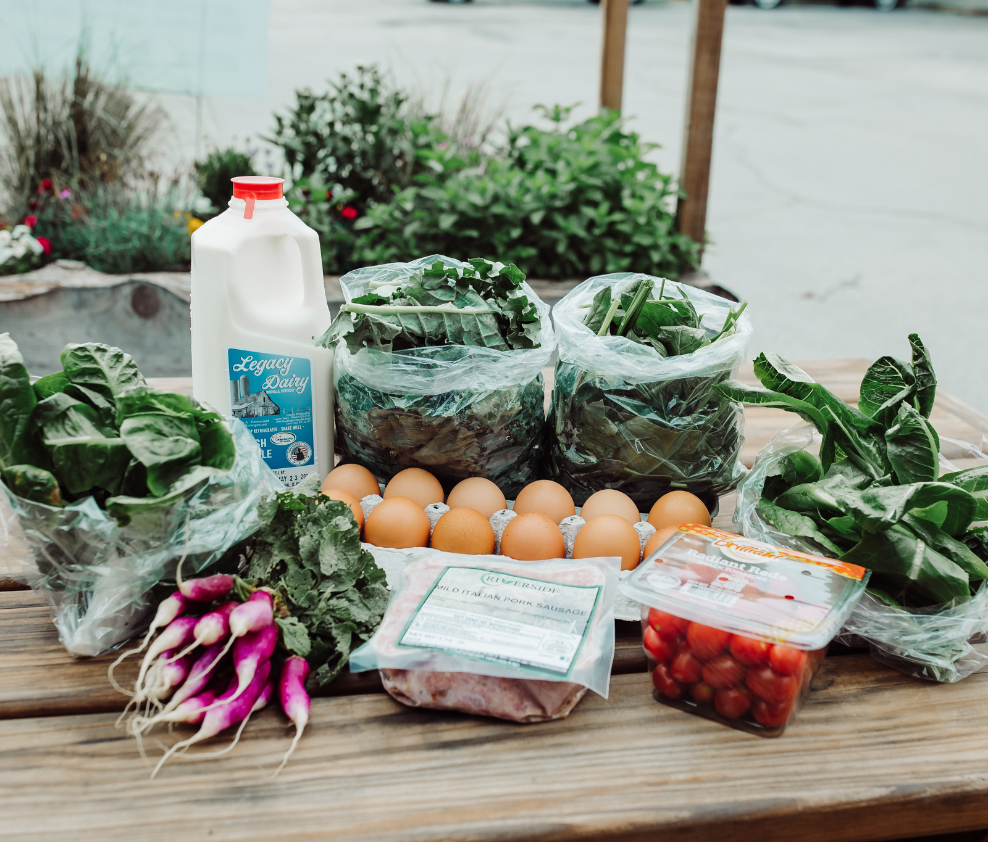
Innovation: Locals Food Hub and Pizza Pub
SNAP users can turn $20 into $60 worth of fresh, local groceries.

Slide 19
Woodford County
Arielle, a customer, said the Double Dollars are helpful for spending on healthful products. She likes that the Double Dollars are paper so her kids can hand them to the vendor like they are using cash
Notes:
Brings new customers to the market. Not only does it create community, but it’s training a new generation of folks about how to purchase and prepare local farm products.

Slide 20
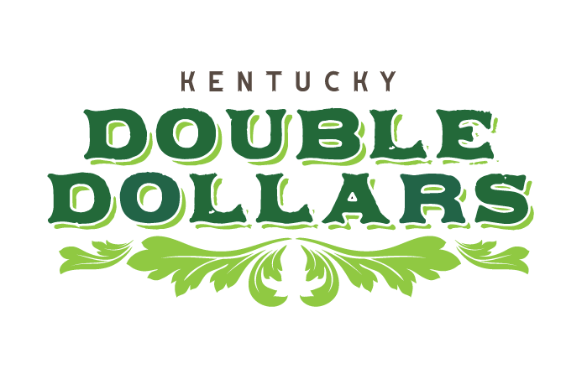

Slide 21
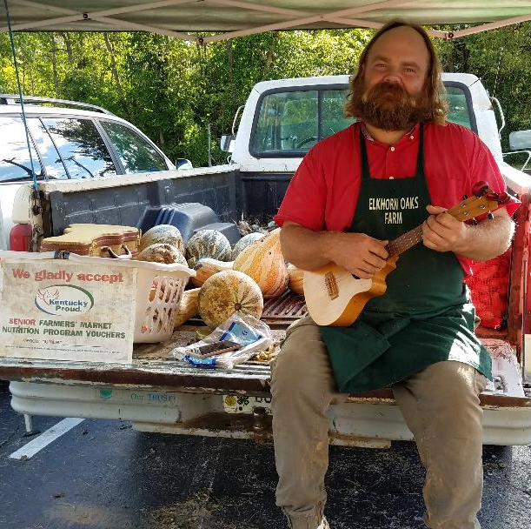
Michael Greathouse, serenades customers with his ukelele to bring attention to his table.
Notes:
Michael Greathouse, a vendor, is newer to the program (this may be his 2nd year). He serenades customers with his ukelele and voice which brings attention to his table. He told me that Double Dollars have come in handy when his Solimarket app didn't work a couple of times. He was still able to complete the customer sale.

Slide 22
Thank you!
Myrisa Christy
Myrisa@cfaky.org
859-302-6304

