Slide 1
June 12, 2025
Melissa McDonald and Sarah Vaughn

Slide 2
01
Who we are
Feeding Kentucky is the state’s largest charitable response to hunger, working collectively to create a hunger-free Kentucky. Our network of seven Feeding America food banks provides food and groceries to Kentuckians facing hunger in all 120 counties.
Our main programs:
Farmers Feeding Kentucky (Farms to Food Bank and Purchase Program- LFPA)
Kentucky Kids Eat
Advocacy
Disaster Relief
04

Slide 3
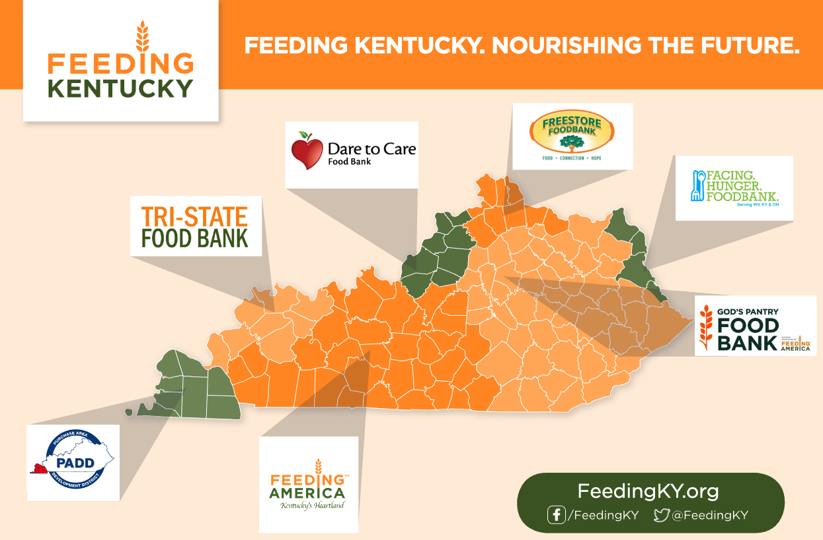

Slide 4
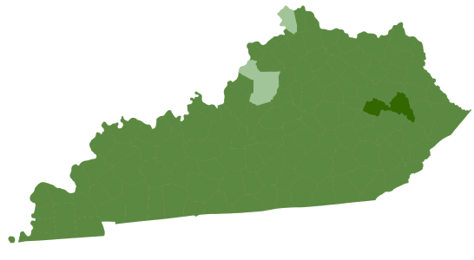
Food Insecurity in Kentucky
As of 2023, 753,410 people are facing hunger in Kentucky.
213,830 are children
131,410 are seniors (60+)
Top Counties with the highest food insecurity rates:
Breathitt
Owsley
Knox
Magoffin
Wolfe

Slide 5
Farms to Food Banks
For more than a decade, Farms to Food Banks has helped Kentucky farmers get surplus produce into the hands of families in need. Operated with support from the Kentucky Department of Agriculture and the Tobacco Settlement Oversight Committee, this program has created lasting impact for both agriculture and hunger relief in all 120 counties.
Program Highlights (2011-2024)
37.2 million pounds of KY-grown produce distributed
4,473 farmers supported (repeat participants counted across years)
$8.9 million reimbursed to Kentucky farmers
04

Slide 6
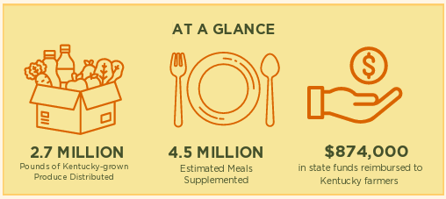
Impact Summary 2024-2025

Slide 7
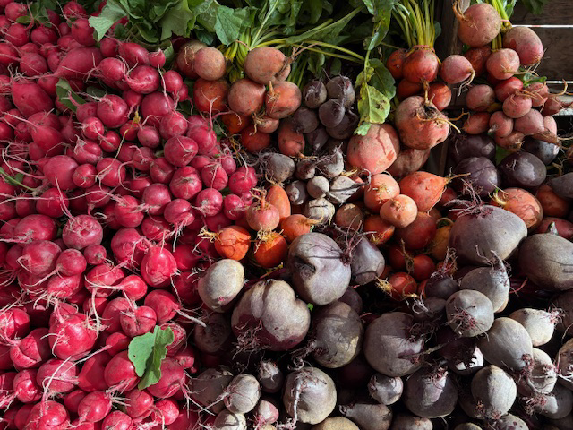
“The food banks have provided us a way to distribute our overages and recoup the costs associated with production. We can still feed people without as much waste.” -Lisa Wurth, Wurth Farms | Paducah, KY

Slide 8
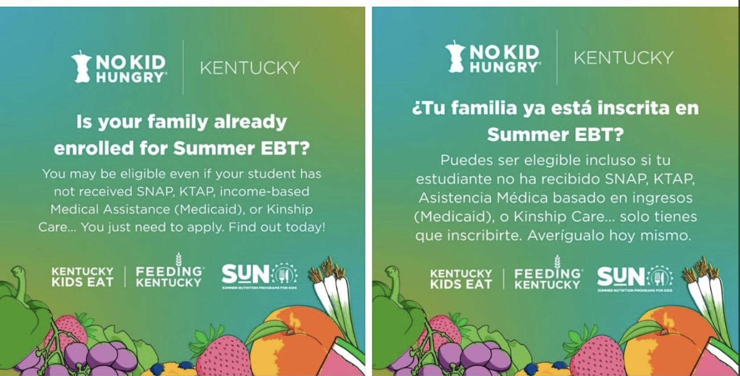
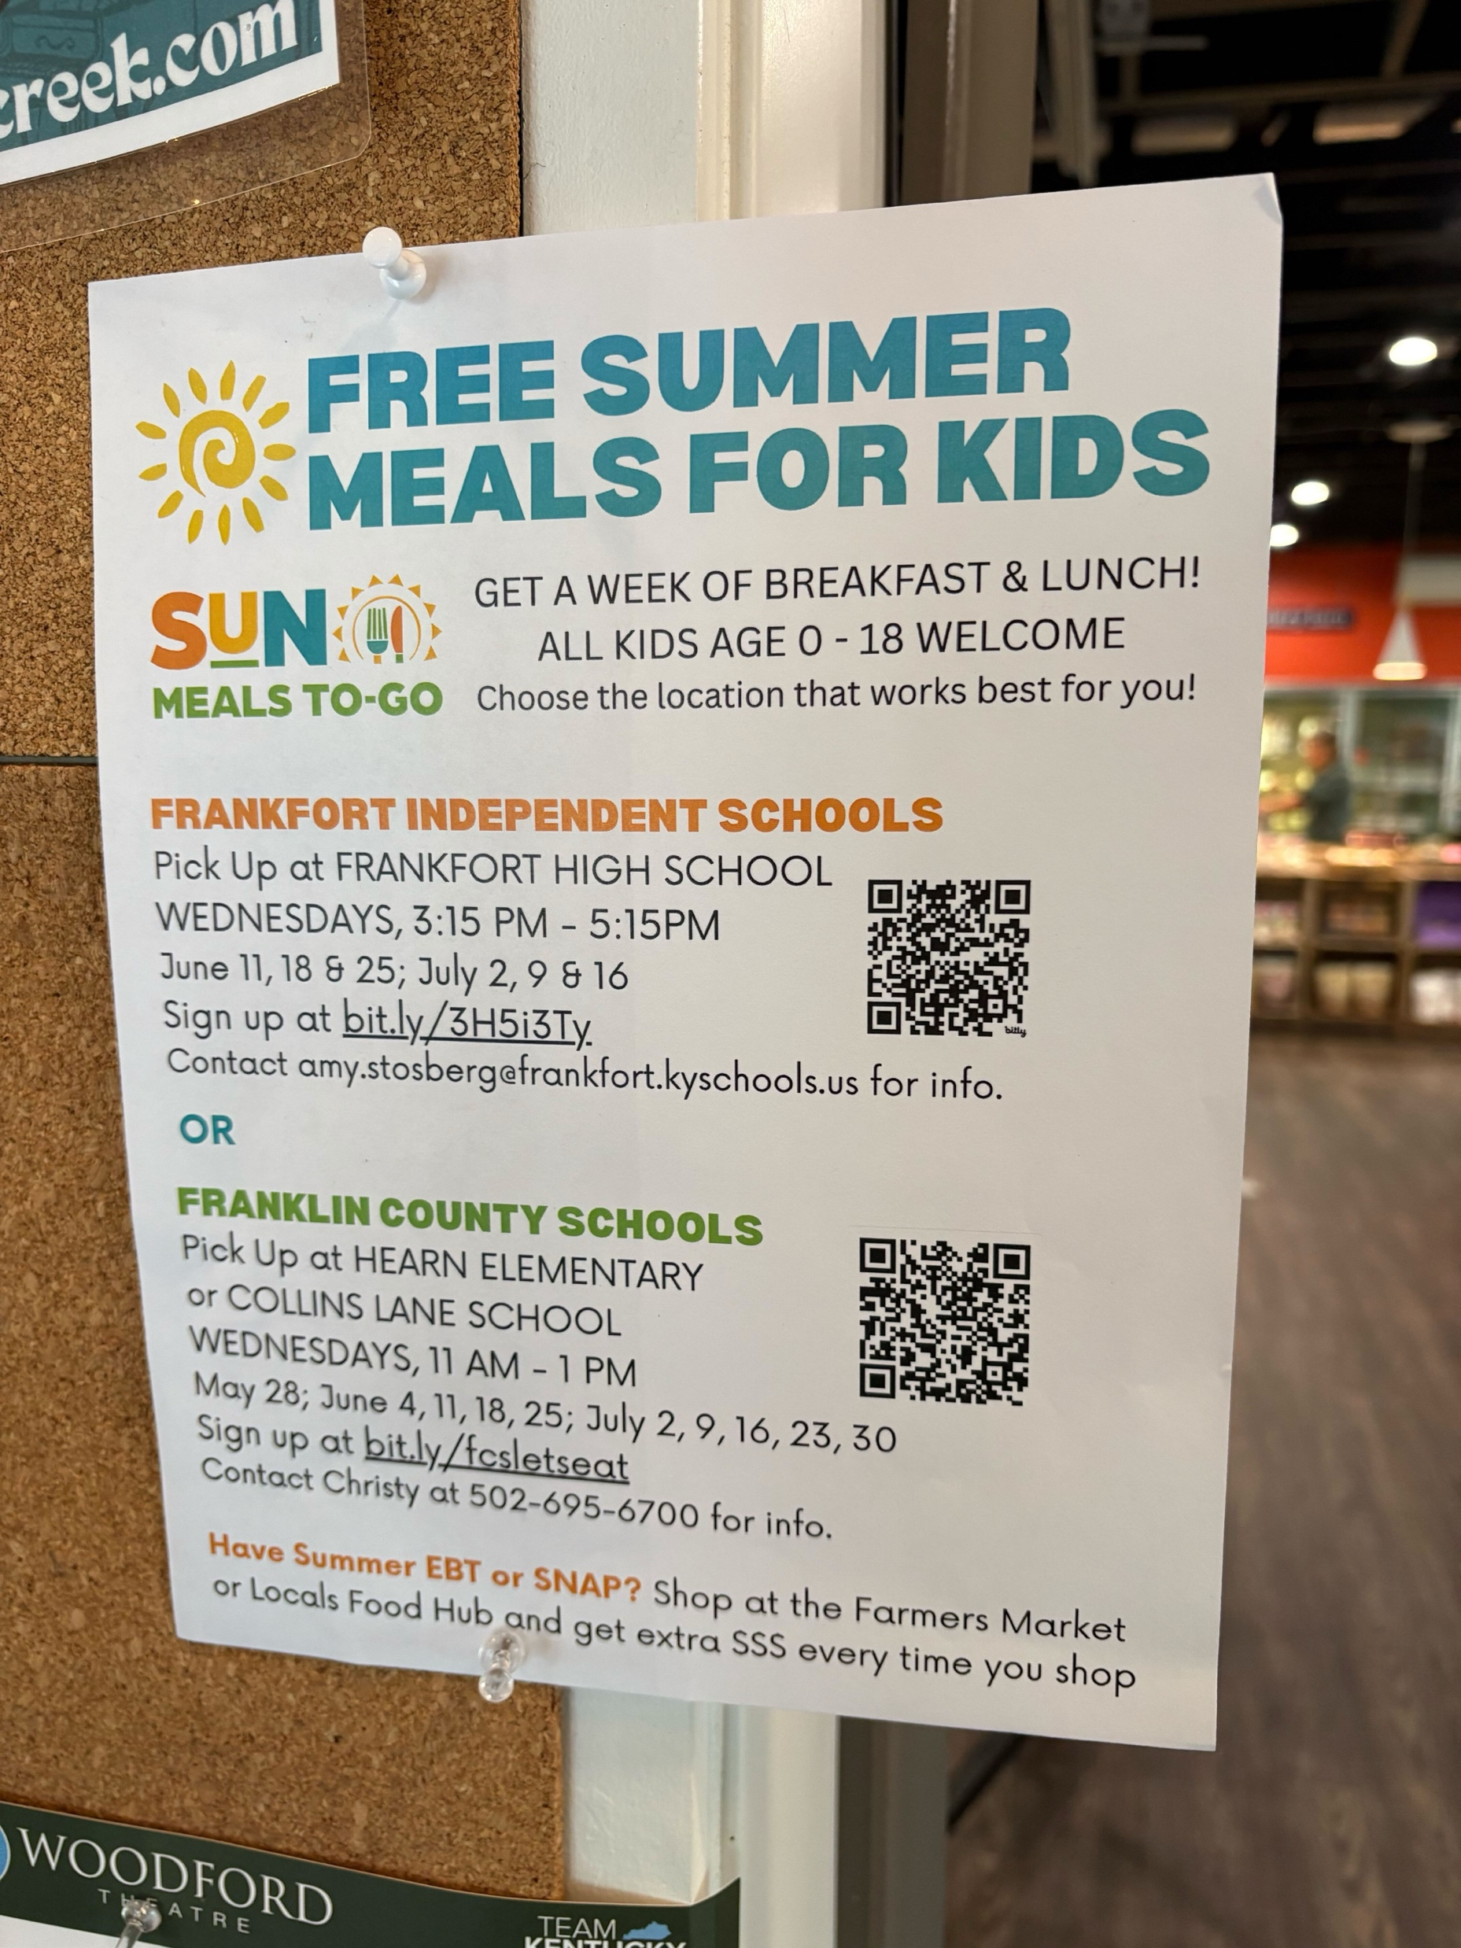
01
Kentucky Kids Eat
The No Kid Hungry Kentucky campaign, a partnership between Share Our Strength and Feeding Kentucky, is the key strategy to ensuring kids get the food they need by increasing access to school breakfast and lunch, summer meals, and afterschool meals.
We partner with the Department of Education and the Department of Community Based Services to help get the word out about summer feeding opportunities
The Kentucky School Nutrition Department and Feeding Kentucky work collaboratively to advocate for supportive policies to ensure that kids have access to health food all year long.
Training
04

Slide 9
Additional Highlights :
March 2025, Feeding Kentucky took over as the administrator and oversight for the Kentucky Food Action Network (KFAN).
As part of KFAN, we are collaborating with CFA on a Humana Foundation grant to focus on Food is Medicine.
KFAN has establishment of a peer support network to identify gaps and best practices for operations and evaluation in Food is Medicine Programming by developing a FIM Roadmap.
04

Slide 10
01
Resources
Advocacy
Thank you to the Kentucky General Assembly and funders for collectively joining together to help end hunger in Kentucky!
04

Slide 11
Melissa McDonald, Executive Director
melissa@feedingky.org
Sarah Vaughn, Programs Director
sarah@feedingky.org

