Slide 1
KOAP’s Report of
May 2025

Slide 2
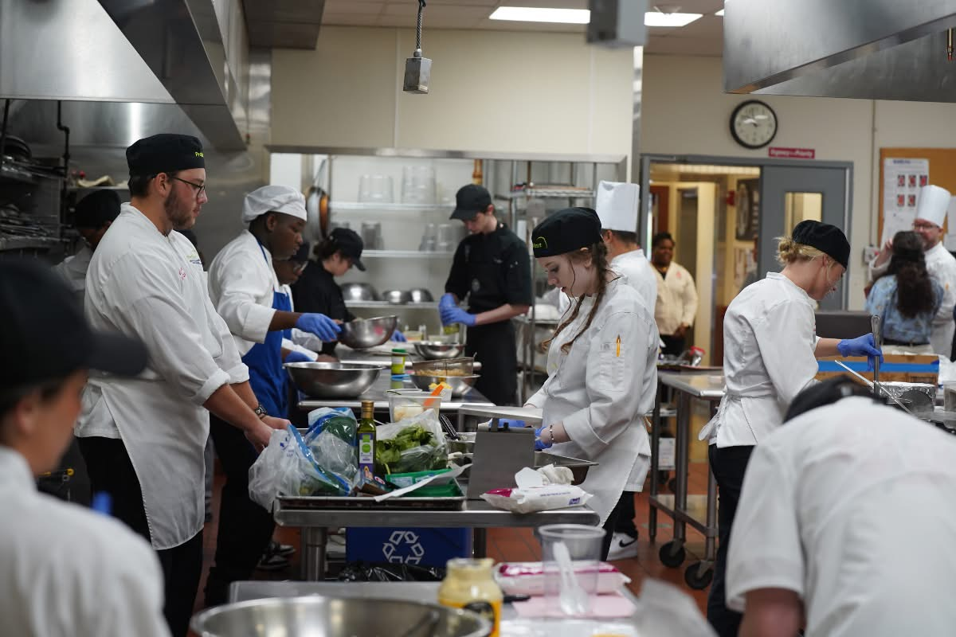
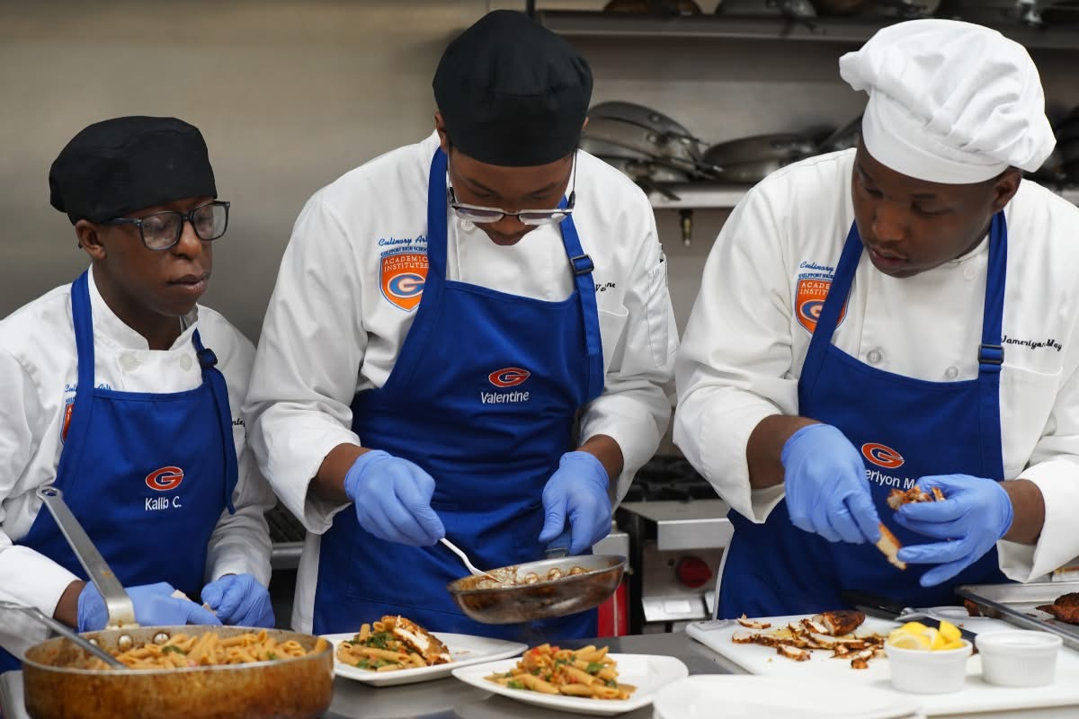
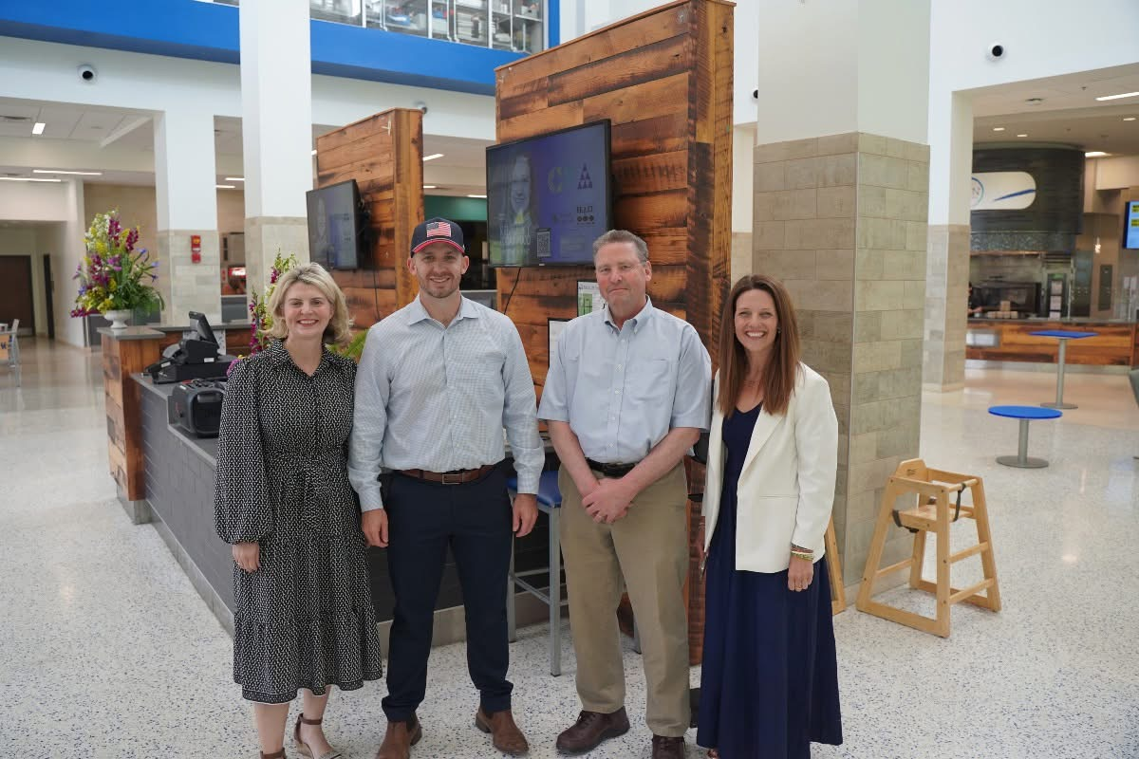
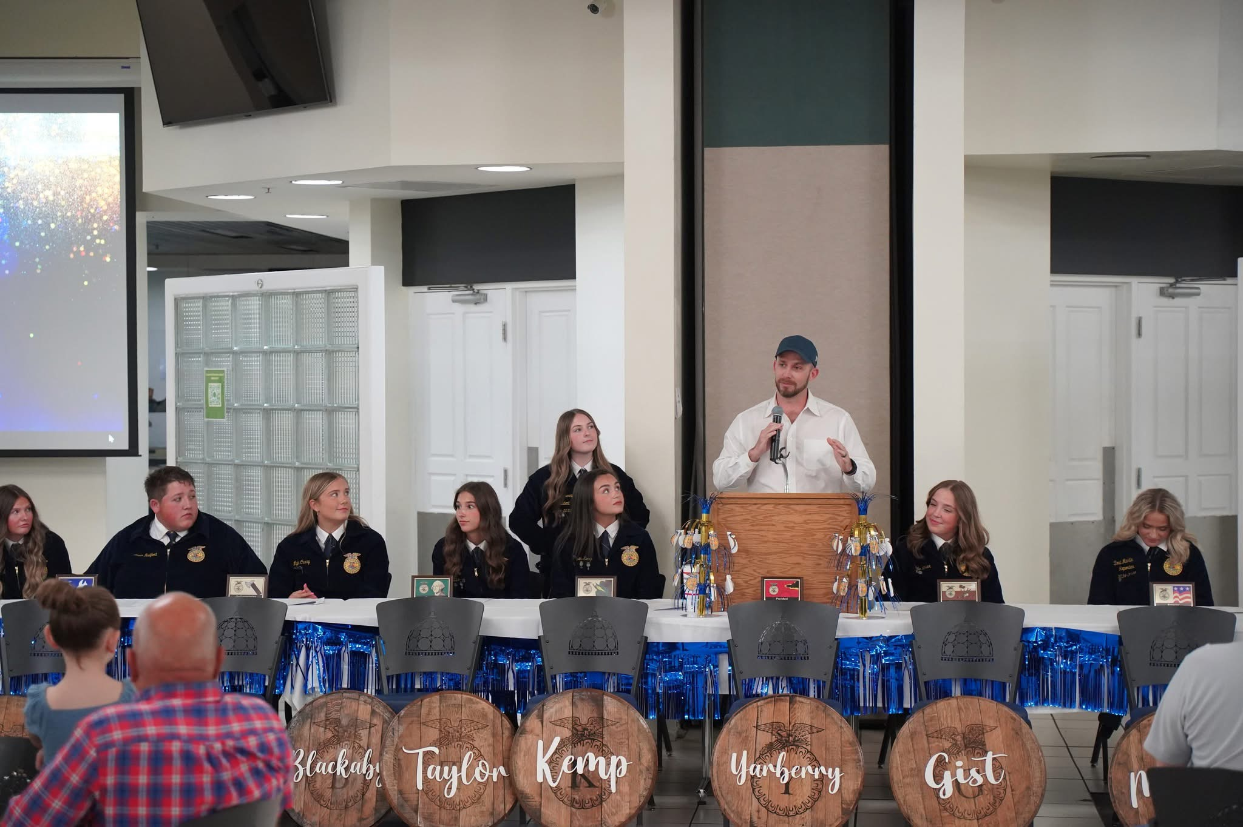
Kentucky Department of Agriculture

Slide 3
KOAP Staff
Brandon Reed
Executive Director
Bill McCloskey
Deputy Executive Director
Bill Hearn
Fiscal Officer
Brian Murphy
General Counsel
Chelsea Smither
KADF Project Manager
Hannah Sharp-Johnson
Boards & Special Events Manager
Alexis Scheidt
KADF Project Manager
Jeff Parman
KADF Program Compliance Manager
Landon Peach
KADF Project Manager
Hunter Jones
KAFC Loan Programs Manager
Bailey Siry-Crowder
KADF Project Compliance Manager
Rebecca Besok
KADF Project Manager
Sarah Bryant
KADF Programs Manager
Savanna Hill
KADF Project Manager
Tera Roberts
KAFC Loan Programs Manager

Slide 4
Monthly Board Approvals:
May
KADB KAFC
$4.3 MM $3.4 MM

Slide 5
KOAP Highlights of May:
2 staff members attended competitive leadership programs: Kentuckiana Agribusiness Leadership Academy (KALA)
Staff attended the Kentucky Local Food Systems Summit in Lexington, KY
19 County Agricultural Development Councils attended by staff

Slide 6
Approval Breakdown
KADB Approvals:
25 County Agricultural Investment Programs totaling $2,421,880.00
4 Deceased Farm Animal Removal (DAR) Programs total $37,500.00
11 Youth Ag Incentives Programs(Youth) totaling $160,250.00
10 County & State Projects totaling $1,038,214.00
KAFC Approvals:
3 Agricultural Infrastructure Loan Programs total $595,00.00
2 Agricultural Processing Loan Programs totaling $430,000.00
11 Beginning Farmer Loan Programs totaling $2,387,125.00

Slide 7
Bill & Brandon’s Top Picks
(page 12) Bourbon County Fire & Rescue - $10,000 in Bourbon County funds
(page 21) KCARD -$837,000 in state funds
(page 22) Mt Vernon Animal Clinic LLC -$66,115 in state funds and $13,327 in Rockcastle County funds

Slide 8
June 20, 2025
at the Kentucky Historical Society in Frankfort, KY at 9:00 a.m. (EDT)

