Slide 1
KOAP’s Report of
June 2025

Slide 2
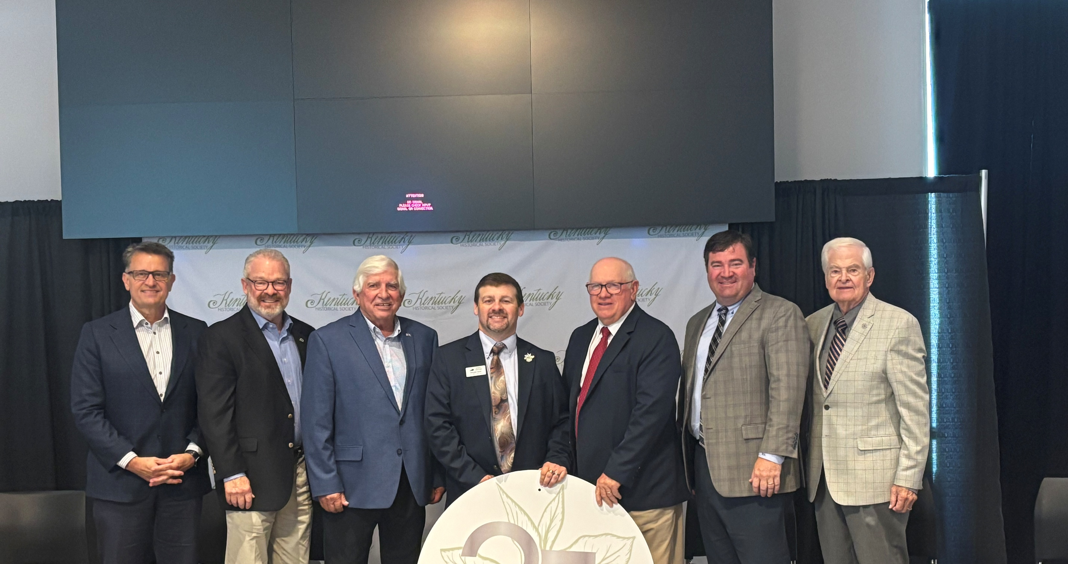
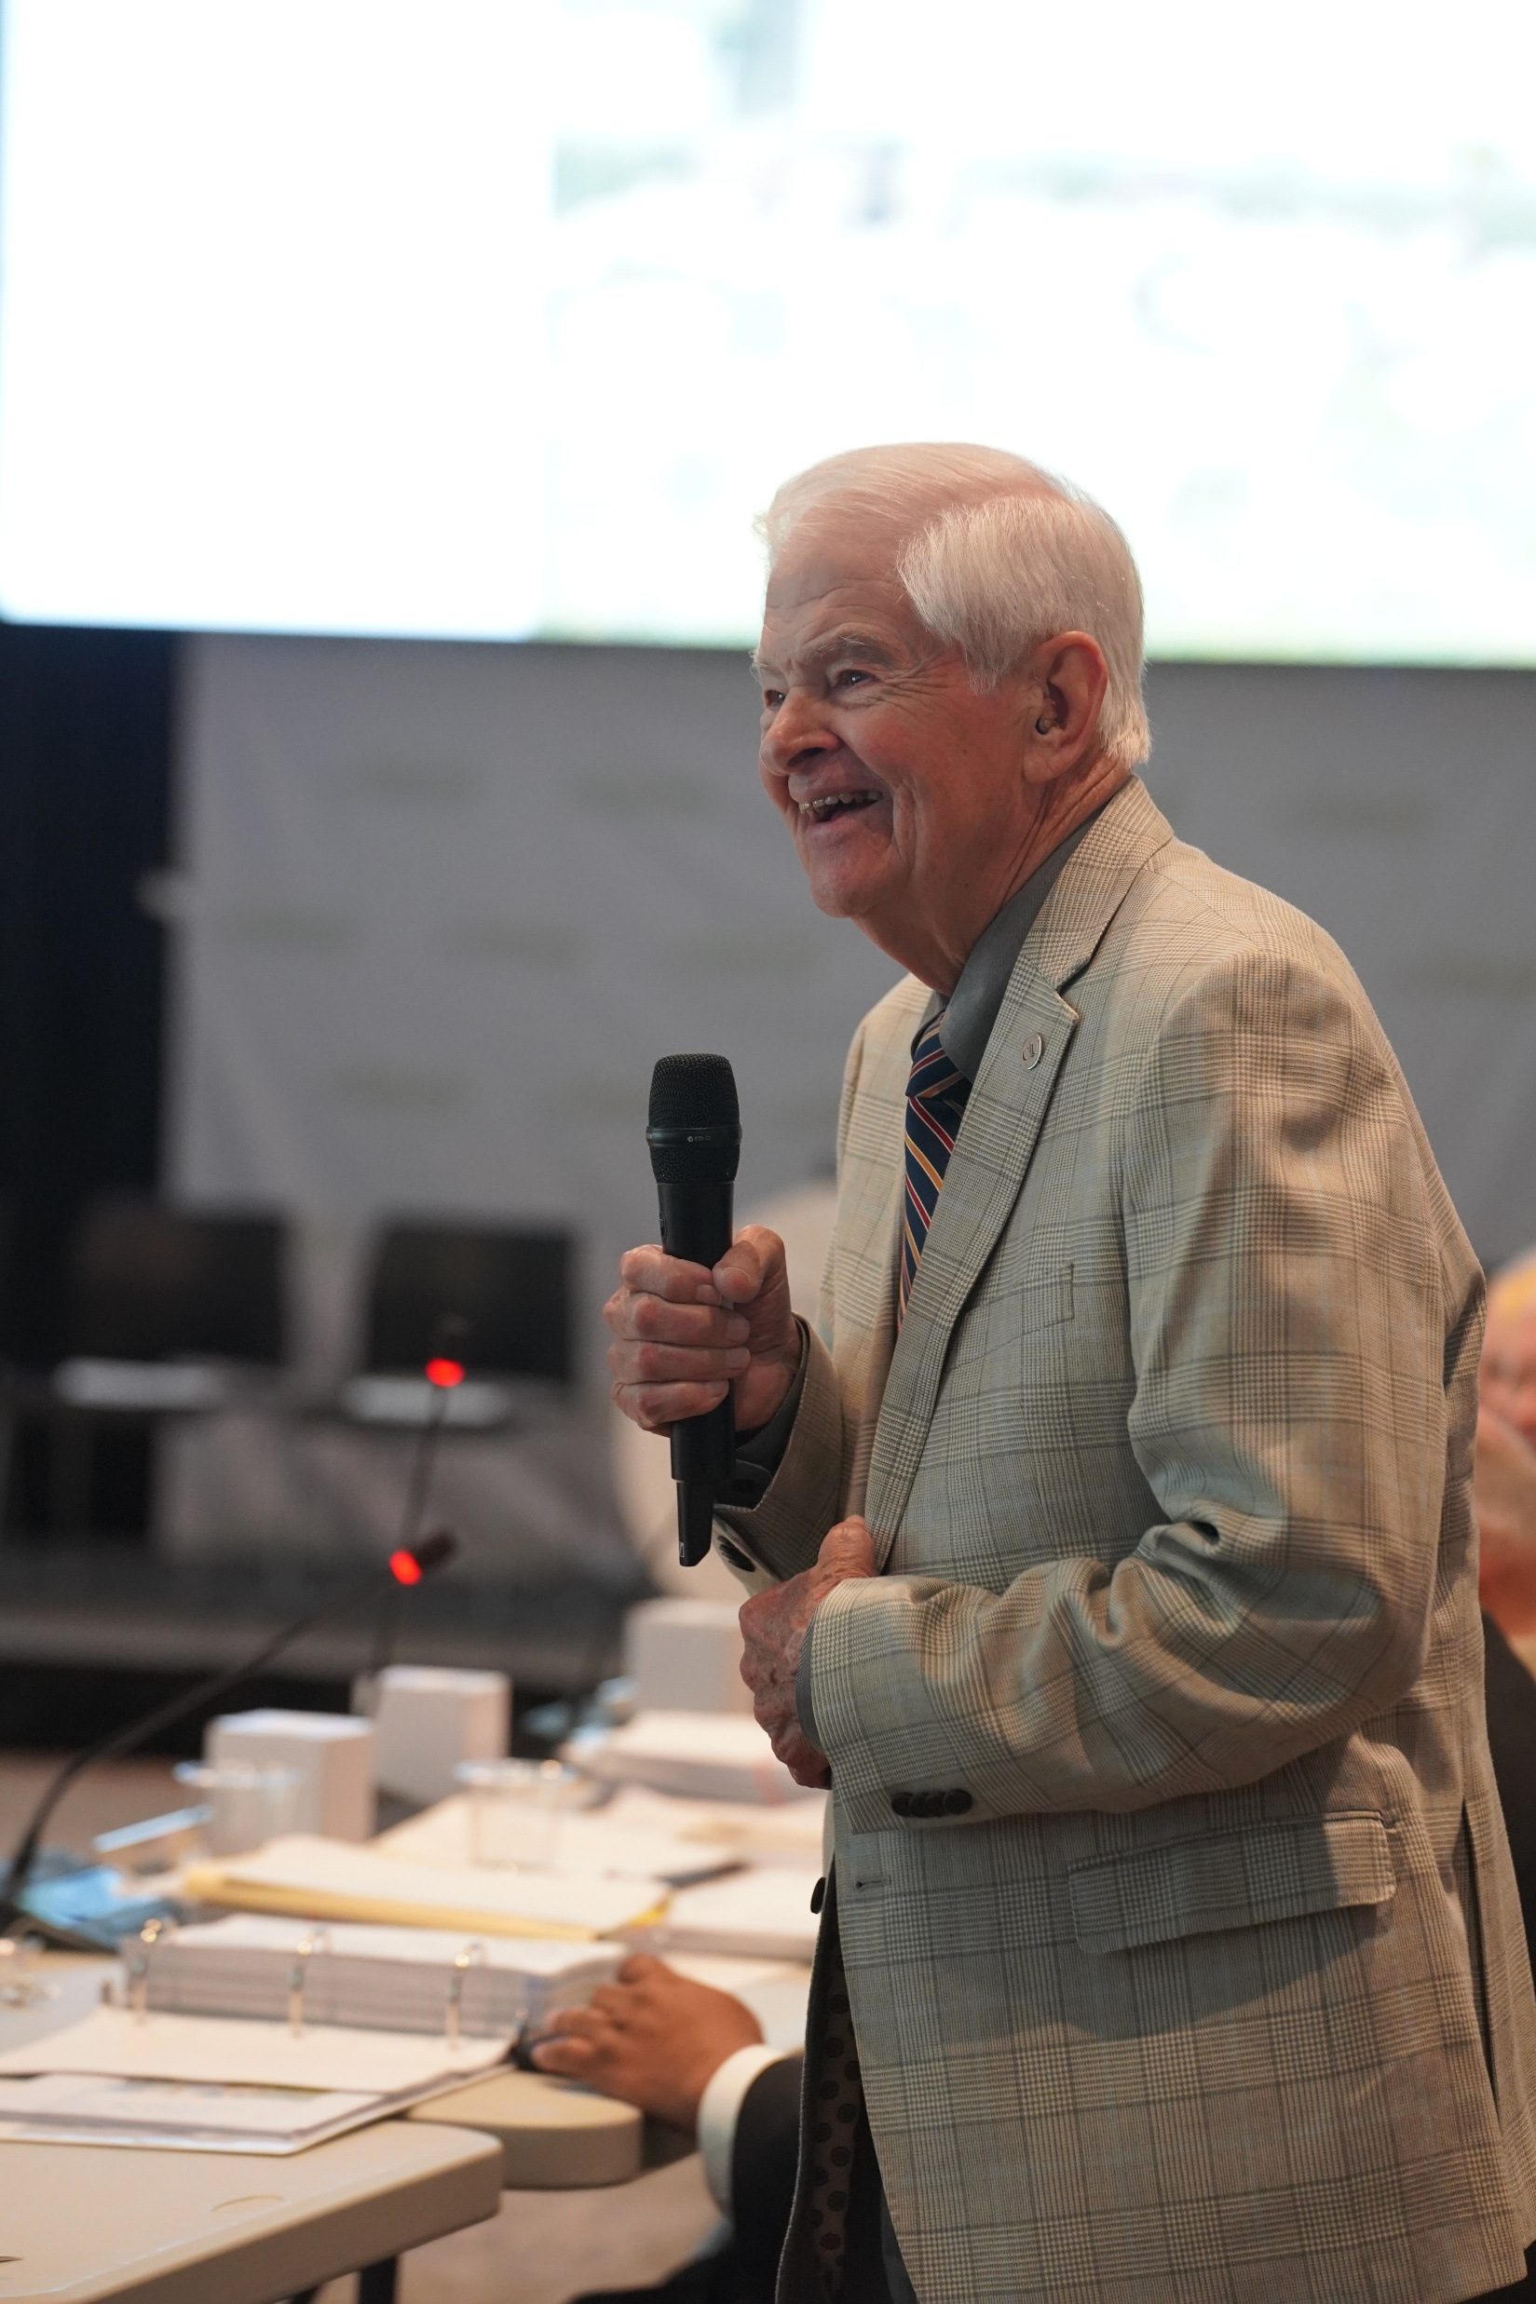
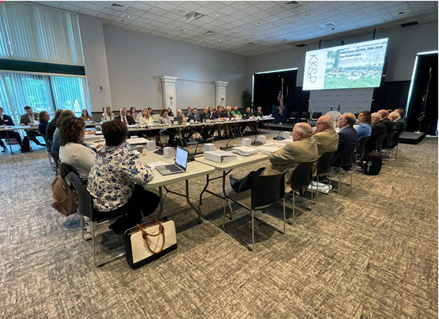
Kentucky Office of Agricultural Policy

Slide 3
KOAP Staff
Brandon Reed
Executive Director
Bill McCloskey
Deputy Executive Director
Bill Hearn
Fiscal Officer
Brian Murphy
General Counsel
Chelsea Smither
KAFC Loan Programs Manager
Hannah Sharp-Johnson
Boards & Special Projects Manager
Alexis Scheidt
KADF Regional Manager
Jeff Parman
KADF Program Compliance Manager
Landon Peach
KADF Regional Manager
Hunter Jones
KAFC Loan Programs Manager
Bailey Siry-Crowder
KADF Project Compliance Manager
Rebecca Besok
KADF Regional Manager
Sarah Charles
KADF Programs Manager
Savanna Hill
KADF Regional Manager

Slide 4
Monthly Board Approvals:
June
KADB KAFC
$3.3 MM $5 MM

Slide 5
KOAP Highlights of June:
2 staff members attended competitive leadership programs: Kentuckiana Agribusiness Leadership Academy (KALA)
KOAP interns conducted 10 interviews for the 2026 KOAP Annual Report
22 County Agricultural Development Councils attended by staff
27 Site visits conducted by staff
17 KADF programs cl0sed out
17 KADF project reports received

Slide 6
Approval Breakdown
KADB Approvals:
22 County Agricultural Incentive Programs totaling $2,849,568.00
5 Deceased Farm Animal Removal (DAR) Programs total $58,550.00
2 Next Generation Farmer Program (NextGen) Programs totaling $100,000.00
3 Shared-Use Equipment Programs totaling $37,863
3 Youth Ag Incentives Programs(Youth) totaling $65,000.00
6 County & State Projects totaling $165,635.00
- 4 On-Farm Energy Efficiency Incentives Programs totaling $34,308
KAFC Approvals:
7 Agricultural Infrastructure Loan Programs total $1,545,000.00
1 Agricultural Processing Loan Programs totaling $250,000.00
15 Beginning Farmer Loan Programs totaling $3,248,076.00

Slide 7
Bill & Brandon’s Top Picks
(page 14 ) FoodChain, Inc. - $45,463 in County funds matched by state funds
(page 17 ) Miller Rockbridge Farms LLC -$52,402 in multi-county funds
(page 18 ) Thompson Family Farm -$13,840 in county funds

