Slide 1
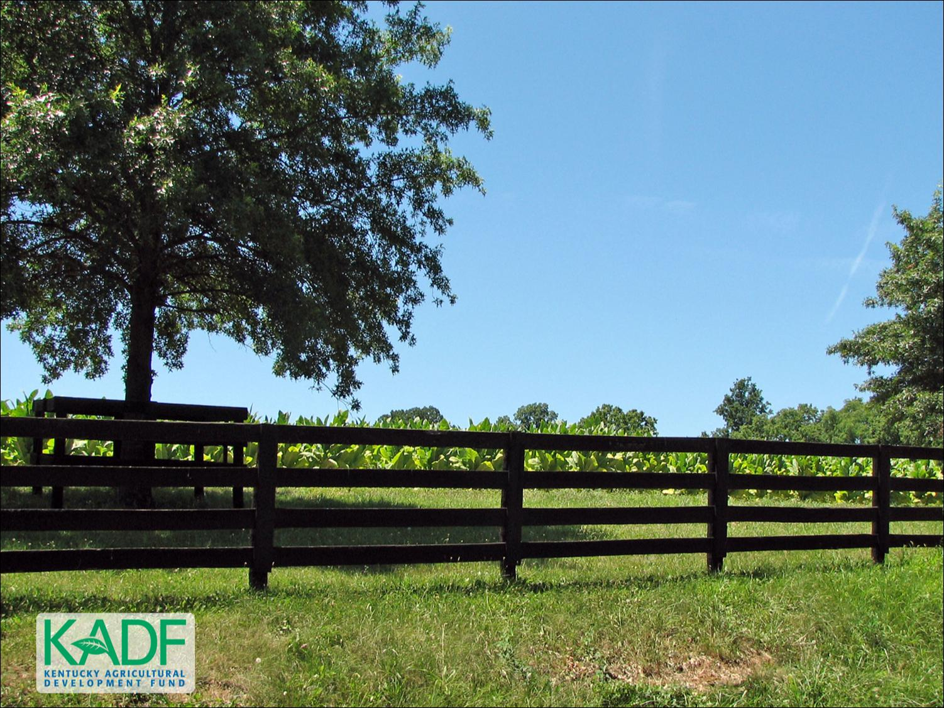
KOAP’s Report of
July & August 2025

Slide 2
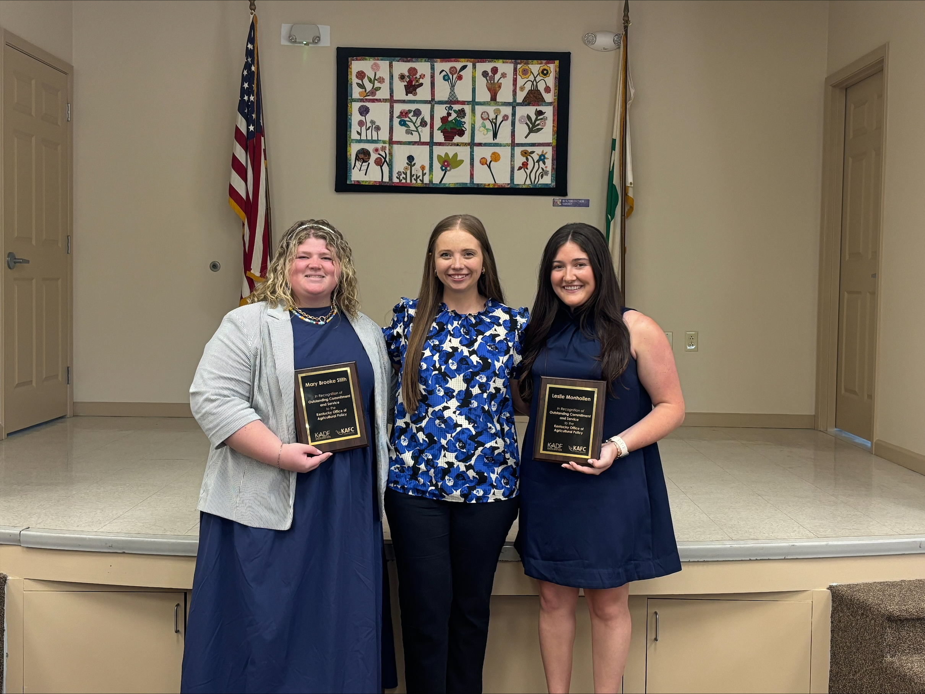
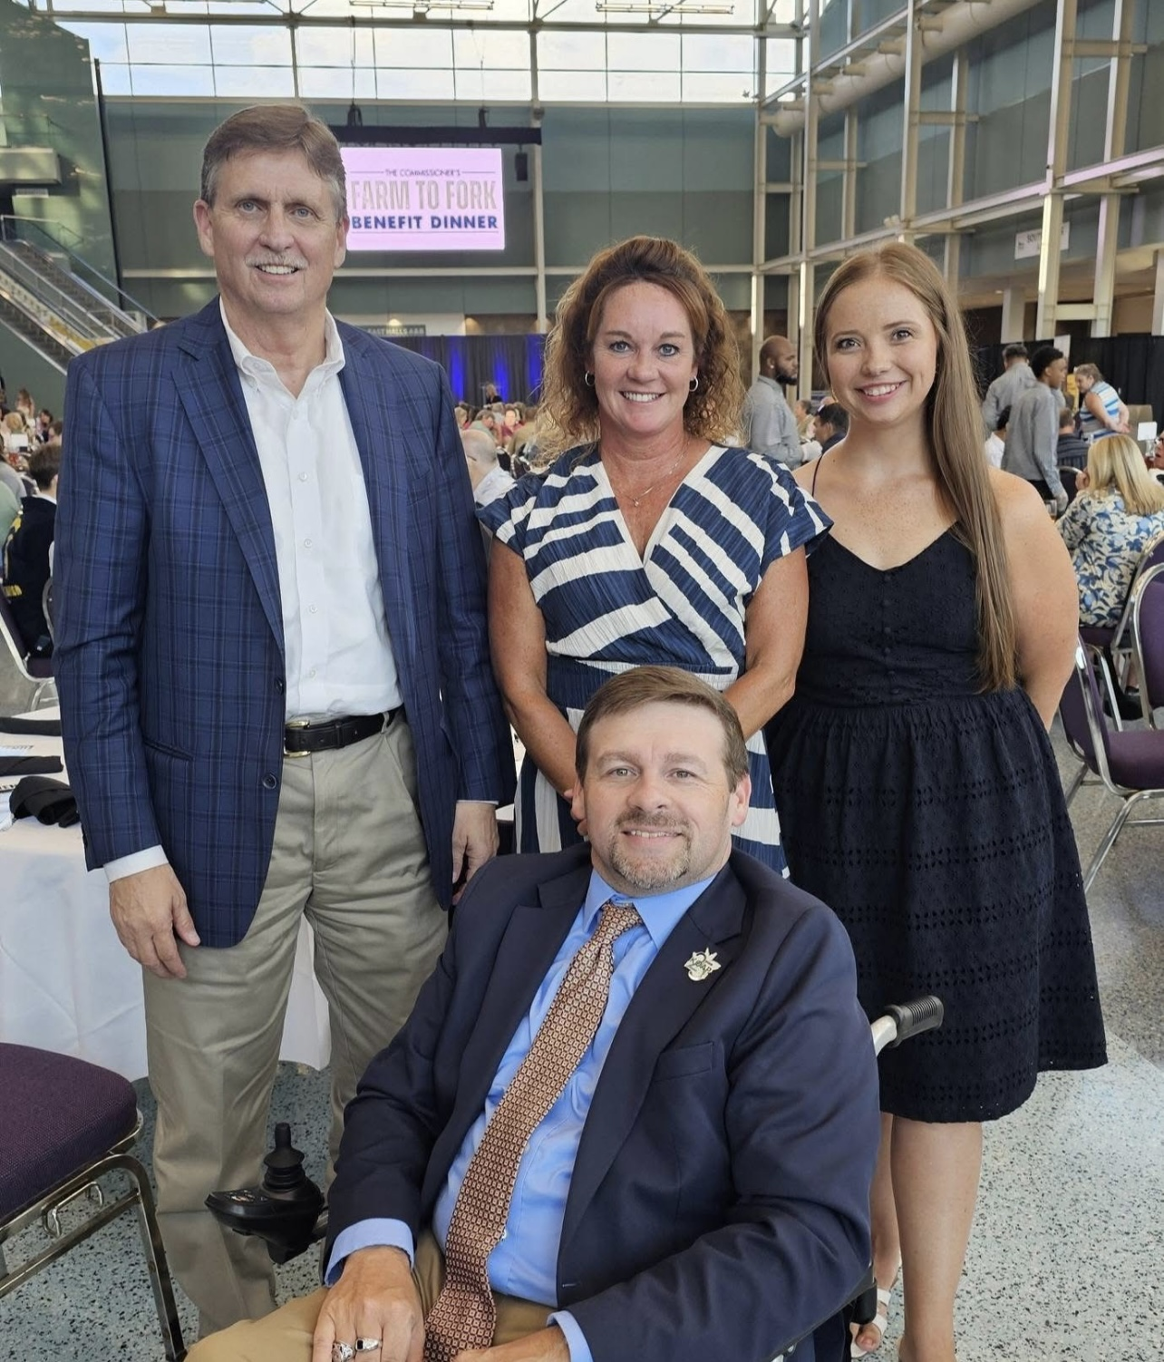
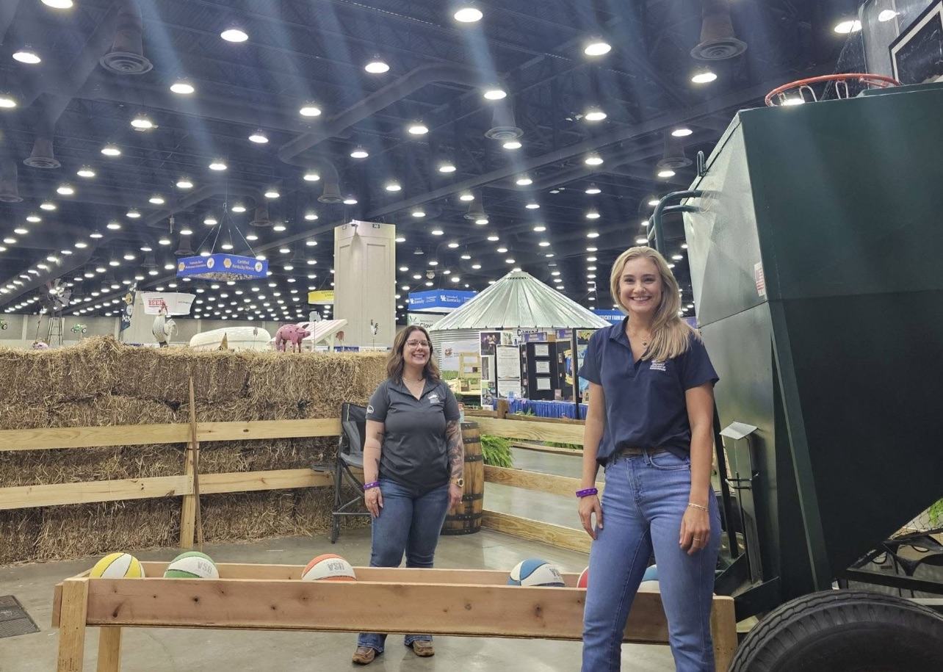
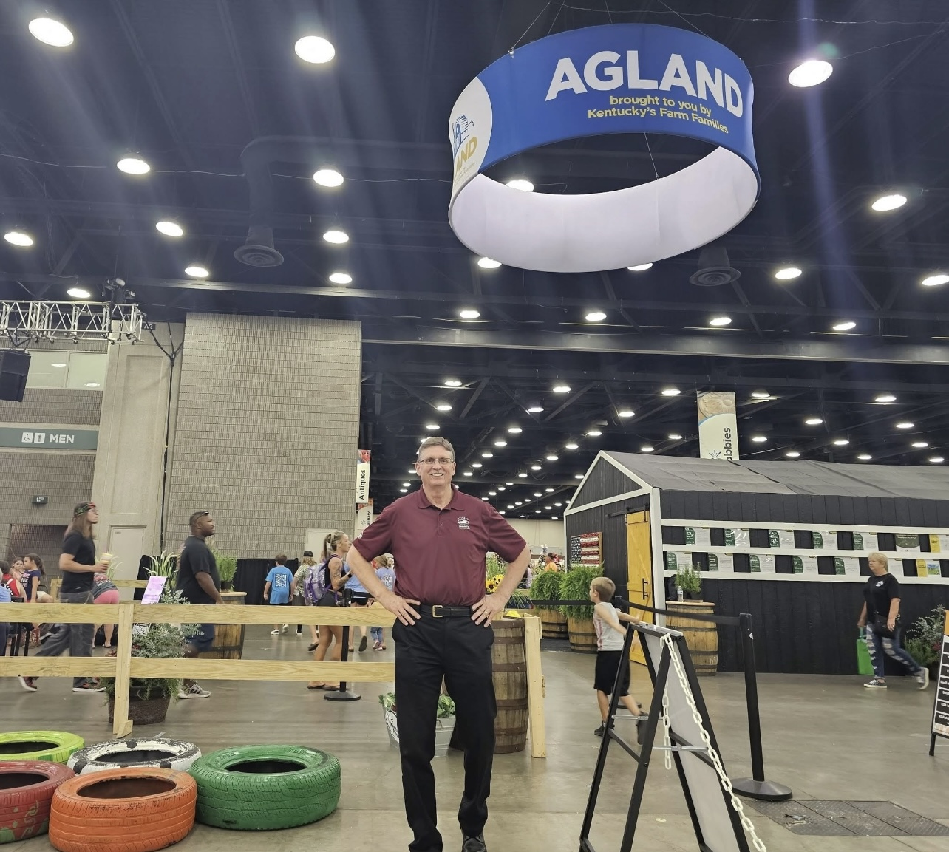
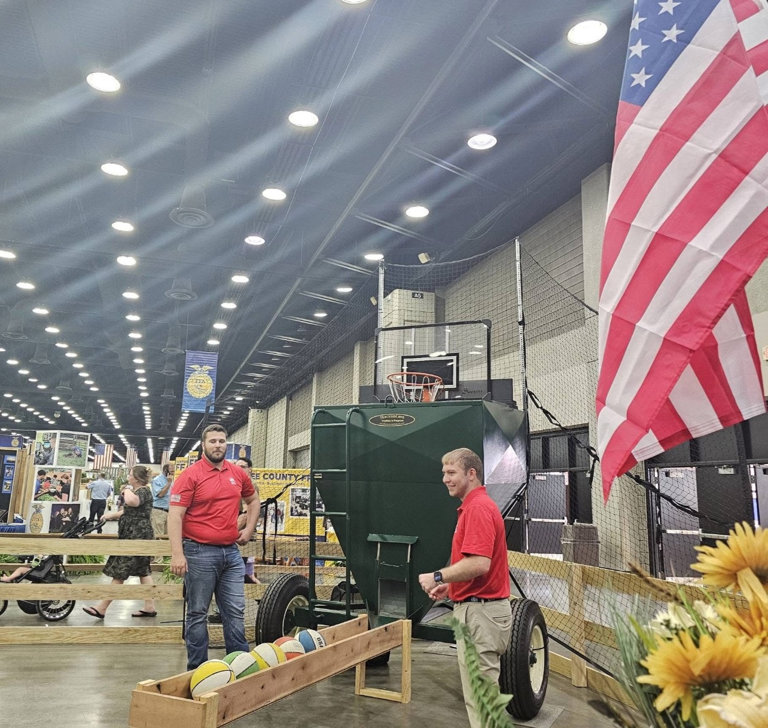
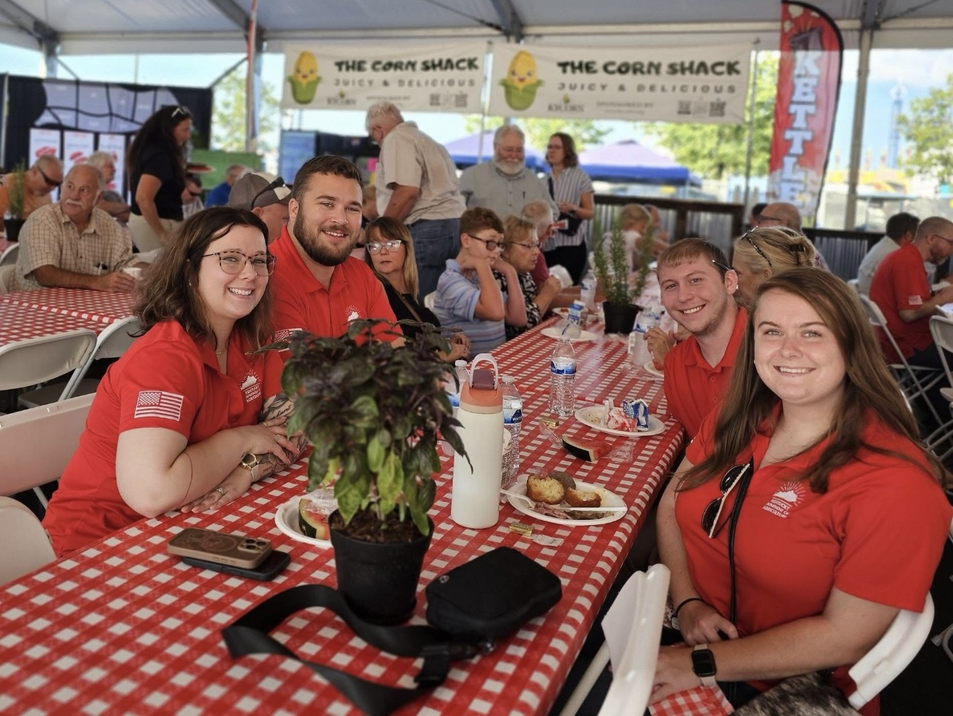
Kentucky Office of Agricultural Policy
Sent from my iPhone

Slide 3
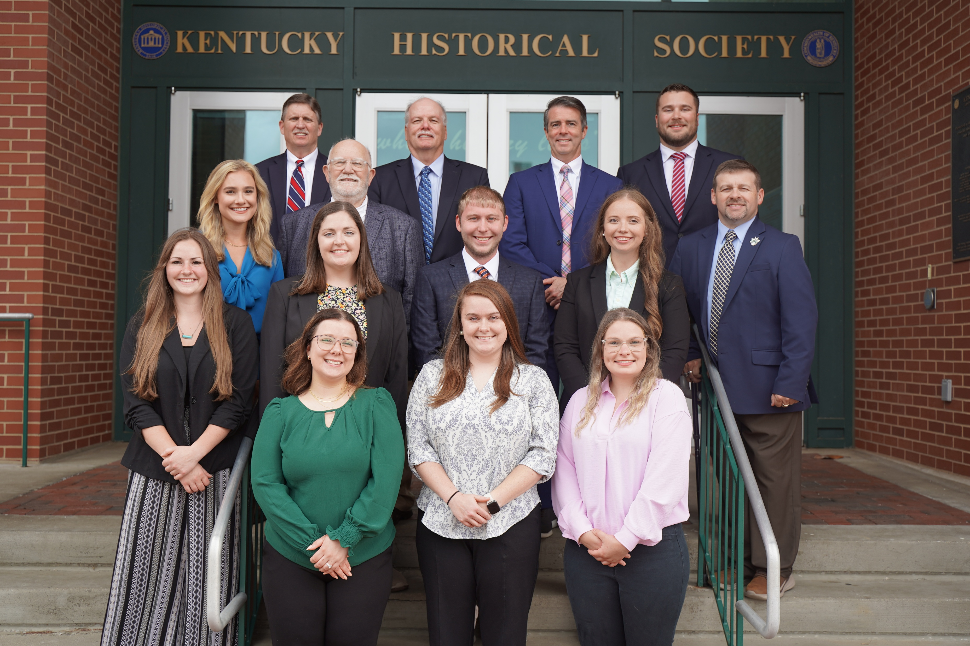
KOAP Staff
Brandon Reed
  Executive Director
Bill McCloskey
  Deputy Executive Director
Bill Hearn
  Fiscal Officer
Brian Murphy
  General Counsel
Chelsea Smither
  KAFC Loan Programs Manager
Hannah Sharp-Johnson
  Boards & Special Projects Manager
Alexis Scheidt
  KADF Regional Manager
Jeff Parman
  KADF Program Compliance Manager
Landon Peach
  KADF Regional Manager
Hunter Jones
  KAFC Loan Programs Manager
Bailey Siry-Crowder
  KADF Project Compliance Manager
Rebecca Besok
  KAFC Loan Programs Manager
Sarah Charles
  KADF Programs Manager
Jesse Moore
  KADF Regional Manager
Savanna Hill
  KADF Regional Manager
Alandria Lee
  KAFC Loan Programs Manager

Slide 4


Monthly Board Approvals:
July
KADB KAFC
$3.4 MM $3.1 MM

Slide 5
KOAP Highlights of July :
  4 staff members attended competitive leadership programs: Kentuckiana Agribusiness Leadership Academy (KALA), Kentucky Agricultural Leadership Program (KALP), & Kentucky Cattlemen’s Assoc. Leadership Program
  11 County Agricultural Development Councils attended by staff
  1 Site visits conducted by staff
  12 KADF programs cl0sed out
  3 KADF program reviews conducted
  18 KADF project reports received

Slide 6
July Approval Breakdown
KADB Approvals:
  16 County Agricultural Incentive Programs totaling $2,101,423.00
  3 Deceased Farm Animal Removal (DAR) Programs total $39,625.00
  1 Shared-Use Equipment Program totaling $26,063.00
  4 Youth Ag Incentives Programs(Youth) totaling $67,750.00
  4 County & State Projects totaling $751,233.00
KAFC Approvals:
  3 Agricultural Infrastructure Loan Programs total $650,000.00
  1 Agricultural Processing Loan Programs totaling $150,000.00
  12 Beginning Farmer Loan Programs totaling $2,323,625.00

Slide 7
Bill & Brandon’s Top July Picks
(page 14) Dino’s Farm LLC - $250,000 in forgivable loan and $10,000 in county funds
(page 15 ) Creekside Veterinary Clinic, LLC -$55,280 in state and $11,056 in multi-county funds
(page 17 ) Berea College, Grow Appalachia -$440,953 in state funds

Slide 8
Monthly Board Approvals:
August
KADB KAFC
$ 500,000 $ 3.1MM

Slide 9
KOAP Highlights of August:
  3 staff members attended competitive leadership programs: Kentuckiana Agribusiness Leadership Academy (KALA), Kentucky Agricultural Leadership Program (KALP).
  KOAP interns concluded 2026 Annual Report Interviews
  9 County Agricultural Development Councils attended by staff
  6 Site visits conducted by staff
  14 KADF programs cl0sed out
  25 KADF project reports received

Slide 10
August Approval Breakdown
KADB Approvals:
  3 County Agricultural Incentive Programs totaling $254,873.00
  3 Deceased Farm Animal Removal (DAR) Programs total $34,400.00
  2 Youth Ag Incentives Programs(Youth) totaling $25,100.00
  5 County & State Projects totaling $199,238.00
KAFC Approvals:
  4 Agricultural Infrastructure Loan Programs total $808,613.00
  9 Beginning Farmer Loan Programs totaling $2,074,950.00
  1 Horticulture Incentives Loan Programs totaling $250,000.00

Slide 11
Bill & Brandon’s Top August Picks
(page 12) Animal Care Veterinary Center, LLC -$60,191 in state and $12,038 multi-county funds
(page 14 ) Graves County Farm Bureau - $5,000 in county funds
(page 16 ) Jarrod Cornett -$3,750 in state funds

