Slide 1
CHFS Tobacco Master Settlement Agreement Funded Programs
Prepared for the Tobacco Settlement Agreement Fund Oversight Committee
Sarah Johnson, Department for Behavioral Health, Developmental and Intellectual Disabilities, Division Director
Julie Brooks, Department for Public Health, Policy Specialist
Andrea Day, Department for Community Based Services, Division Director
October 9, 2025

Slide 2



Health Access Nurturing Development Services (HANDS)
FY25 Tobacco Settlement Funds: $5,634,000

Slide 3


Health Access Nurturing Development Services (HANDS)
Voluntary program administered primarily by local health departments.
Designed to assist parents/caregivers during the prenatal period until the child’s third birthday, improve health outcomes for both mother and child, and improve social outcomes for child and family.

Slide 4

Goals of HANDS
Healthy pregnancies and births
Optimal child growth and development
Children live in healthy and safe homes
Family self-sufficiency

Slide 5



HANDS Accomplishments FY25
Fulltime employees – 349
Families served – 6,715
Home visits completed – 143,261 (in-person and virtual)

Slide 6
Tobacco Prevention and Cessation
FY25 Tobacco Settlement Funds: $1,869,300

Slide 7






KY Tobacco Prevention & Cessation Program Highlights
Tobacco Free Schools Playbook released
Support through over 40 local health departments
Unfortunate loss of federal funding
Two quitlines with no-cost help quitting smoking or vaping for Kentucky residents of all ages, 24/7.

Slide 8

KY Tobacco Prevention & Cessation Program Major Successes in FY25
Prevention: 8,929 students and 9 new counties received vaping prevention education from the University of Kentucky’s #iCANendthetrend (funded by this program) in the 2024-2025 school year.
Cessation: 1,771 Kentucky residents enrolled in Quit Now Kentucky in FY25. Quitlines double a person’s chances of quitting!
“The number of discipline referrals due to on campus vaping has decreased. We contribute the #ICANendthetrend presentations to this decrease.”
- 2024-2025 Feedback from a Kentucky School

Slide 9
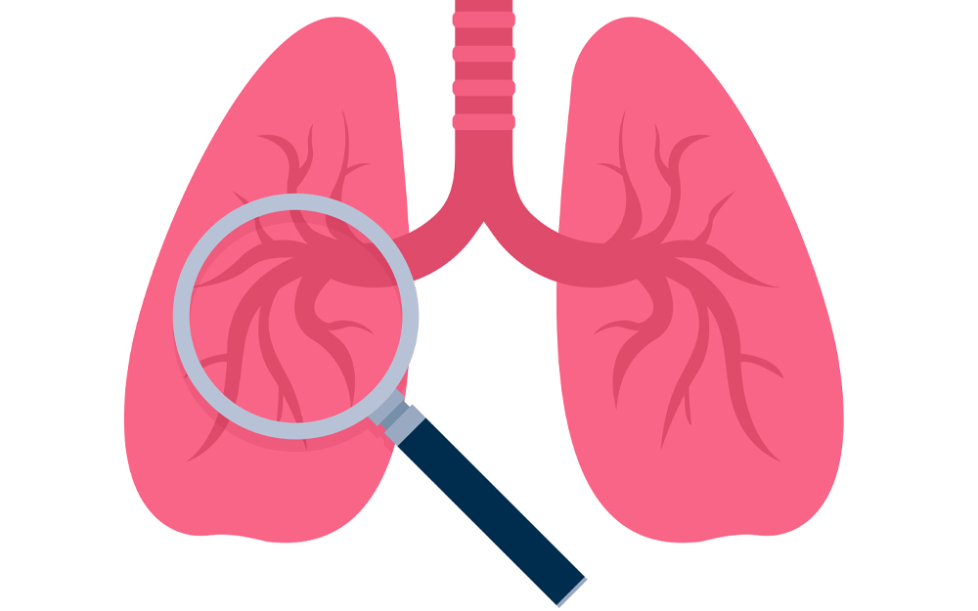
Lung Cancer Screening
FY25 Tobacco Settlement Funds: $500,000

Slide 10
Lung Cancer Screening Program Progress
Screenings
Quality Improvement
Learning Collaboratives
Community Outreach
Kentucky Cancer Link
55 scans
Uninsured or some Medicare
Quality Implementation of Lung Cancer Screening (QUILS)
18 healthcare facilities enrolled
39 programs represented
Quality, affordability, workforce and data
Community and healthcare providers
Referral to tobacco cessation and screening

Slide 11
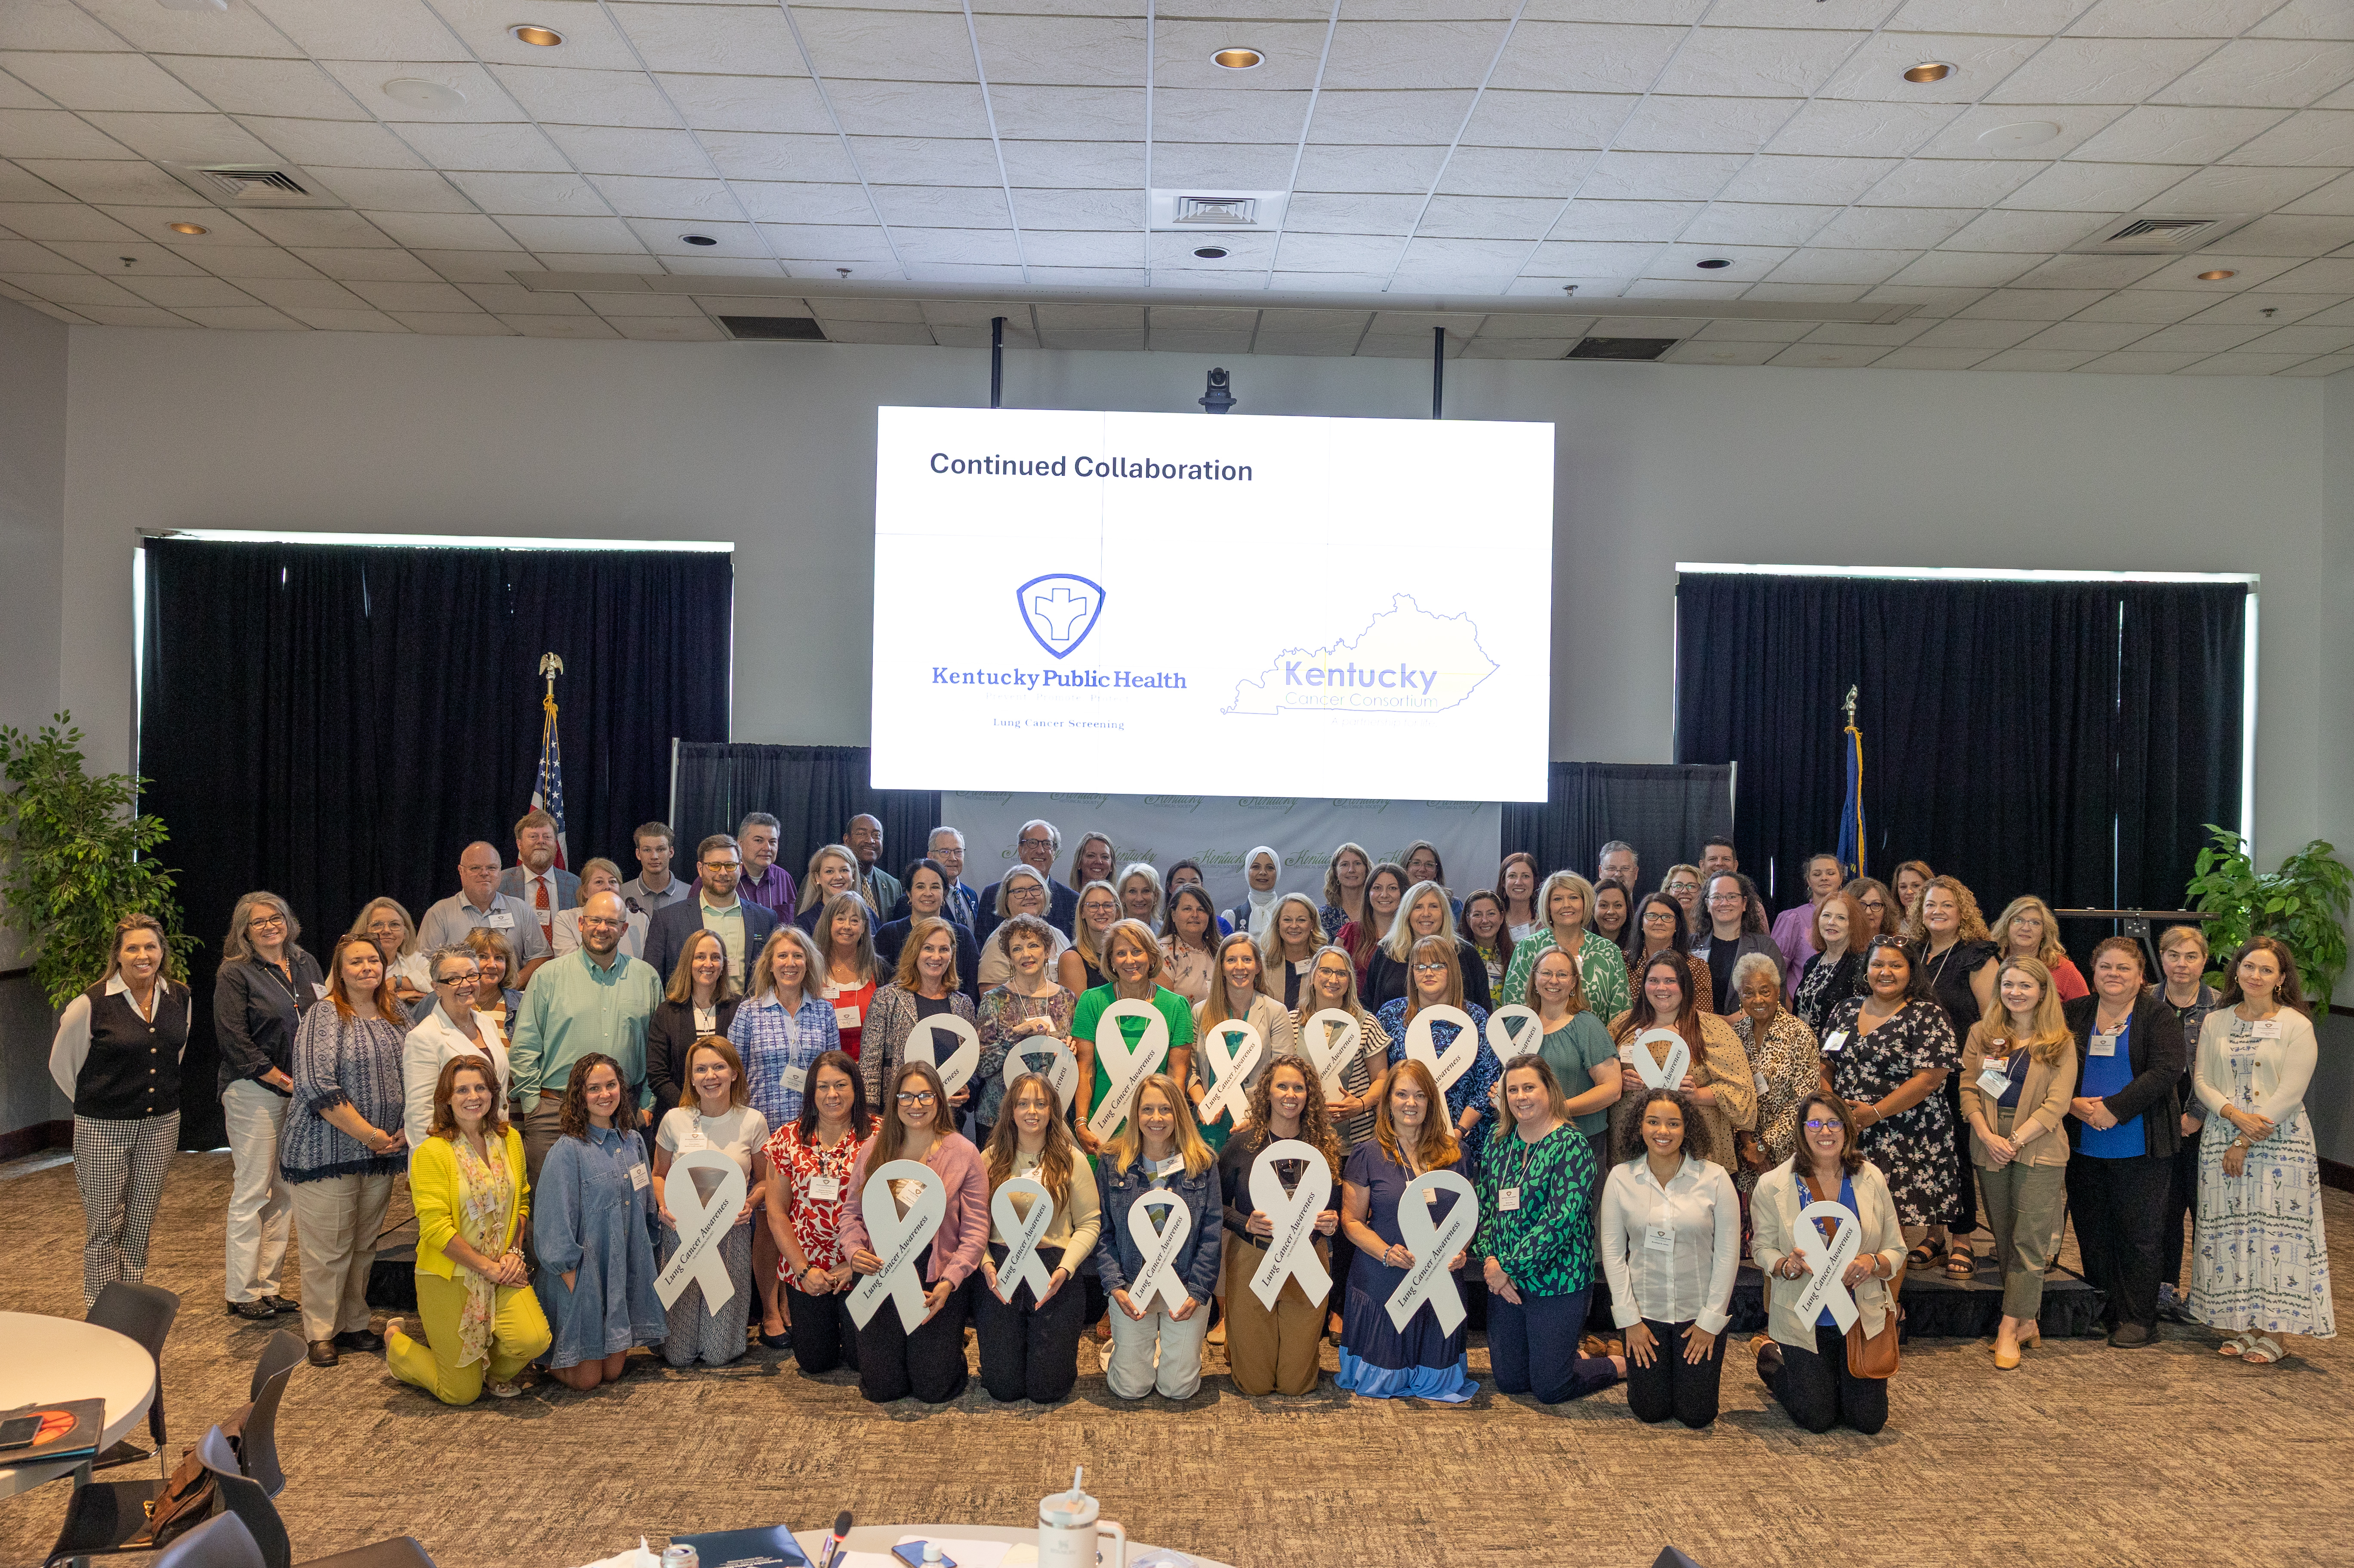
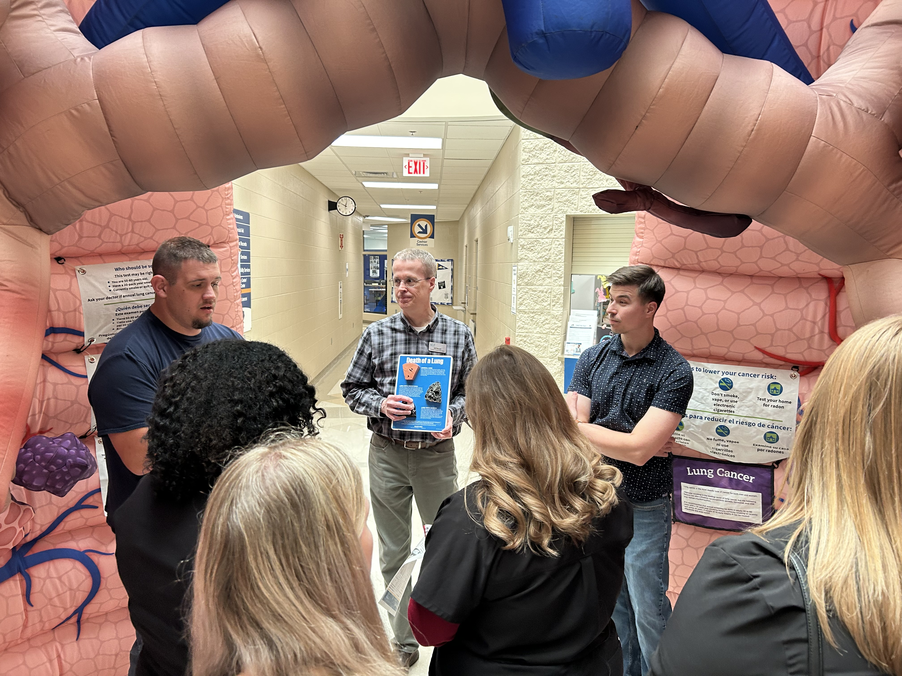
Lung Cancer Screening Program Success

Slide 12

Early Childhood Oral Health
FY25 Tobacco Settlement Funds: $700,000

Slide 13
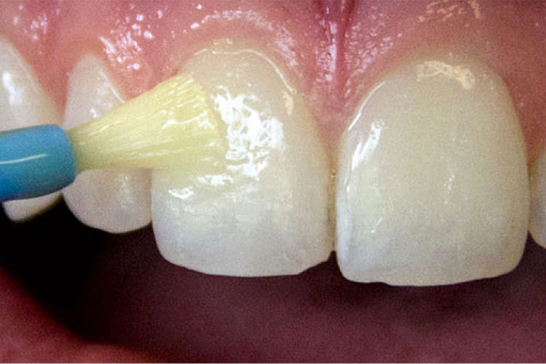
Early Childhood Oral Health
36 health departments are supported with tobacco funds for dental varnish
  There has been a significant increase in varnish services provided since the pandemic:
    In FY24, over 23,365 varnish services were provided
    In FY25, over 21,628 varnish services were provided

Slide 14


Early Childhood Oral Health
20 training sessions were provided during FY24 and FY25, training over 400 nurses
Varnish kit ordering is up over FY24, reflecting the resumption of clinical services post-pandemic
Supporting 10 recent dental school graduates for debt repayment who serve in dentally underserved areas
Supported a survey of the dental status of children under six years of age
Expanded the number of Public Health Dental Hygiene teams by four for a total of 14 teams

Slide 15

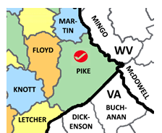
Early Childhood Oral Health
Provided fluoridation equipment to smaller municipal water plants
Assisted in sustaining the UK dental clinic in western Kentucky
Supported special construction and equipment projects in both dental schools to improve dental care for children under six years of age
Allocated funds for Pike County Health Department to revitalize their dental suite to better serve children in Pike County. This is a partnership between the health department, UPIKE and Big Sandy Community and Technical College (CTC)
Sponsored the parent-facing pages of the Kentucky Oral Health Coalition’s webpage to improve literacy and access to care

Slide 16

Early childhood mental health
FY 25 Tobacco Settlement Funds: $700,000

Slide 17
Early Childhood Mental Health (ECMH)
Purpose: to build capacity to meet the mental health needs of young children and their families by partnering with the Departments for Public Health and Behavioral Health, Developmental and Intellectual Disabilities
Structure: funds support early childhood mental health specialists in the 15 regional community mental health centers
Purpose
and Structure
3,422 hours billed to private insurance and Medicaid
Specialists provided 134 trainings to child-serving agencies
Provided training to 3,080 early care and education staff in Head Start, childcare, and other community partners
2,921 hours of consultation around emotional/behavioral issues, classroom management and screening/assessment
Accomplishments

Slide 18
Early Childhood Consultants (ECC)
Purpose: to provide trauma-informed, evidence-based intervention
and support to infants, young children, and their families impacted by opioid and
other substance addictions
Structure: funds support Early Childhood Consultants in the 14 regional community mental health centers
Purpose
and Structure
  Hours billed to Medicaid and private insurance: 2,472
  Non-billable clinical or supportive services (observations, consultation, training, outreach, coaching, and connection to other services): 5,312
  Pregnant and parenting women served: 1,755
  Children served: 562
  Mental Health Centers
Accomplishments

Slide 19

Substance Use Prevention and Treatment for Pregnant Women
FY25 Tobacco Settlement Funds: $1,300,000

Slide 20
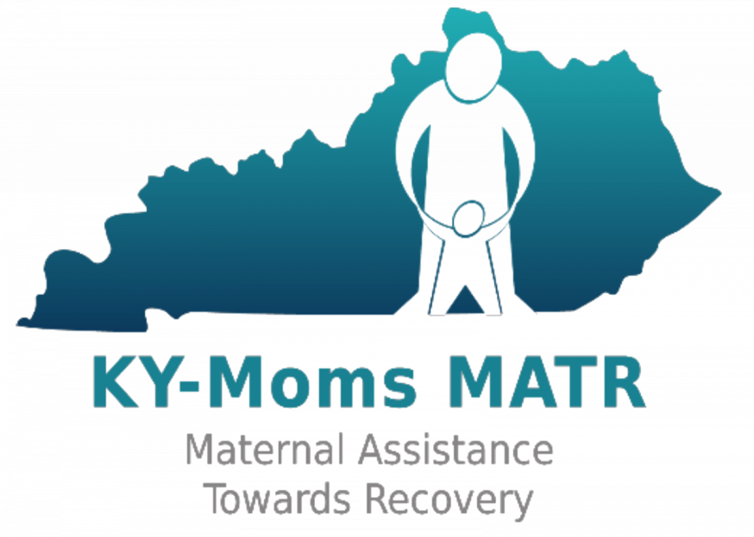

Addiction Pregnant and Parenting Services
KY-Moms Maternal Assistance Towards Recovery (MATR)
Located statewide
Addiction prevention education: 3,195 activities conducted reaching 215,481 persons
Pregnant and/or post partum case management for individuals with addiction issues: 129 individuals completed a baseline survey
Offers services up to 1 year postpartum
St. Elizabeth Baby Steps
Located in Northern Kentucky
204 individuals assisted with services
Provides recovery, employment, and housing supports
Nurses provide a 12-week education class to 4 recovery centers in Kentucky

Slide 21


Pregnant and Parenting Services for Persons with Addiction Issues, cont.
Haven 4 Change
Located in Bowling Green
Transitional living environment for women and their children
Recovery supports, job training, and childcare assistance
Chrysalis House
Located in Lexington
3 residential treatment facilities for women and their children
NARR Certified Serenity Recovery Apartments for women and their families

Slide 22


Pregnant and Parenting Services for Persons with Addiction Issues, cont.
Independence House
Located in Corbin
Residential treatment facility
Provides recovery, higher education, employment, and housing supports
SKY Hope Women's Recovery Center
Located in Somerset
100 bed recovery center
Recovery programming, higher education, employment training, supports, and assistance

Slide 23

Early Childhood Development Program
FY 25 Tobacco Settlement Funds: $9,800,000

Slide 24

Child Care and Development Funds (CCDF)
This federal grant is designed to promote success for children, employment for parents, and economic security for parents by ensuring stable, high quality childcare.
CCDF funds support the following initiatives in Kentucky:
Childcare subsidies for 23,080 families and 39,170 children
Monitoring and supports for approximately 1,993 childcare centers and family childcare homes at any given time
Professional development supports and background checks
Special initiatives for infant and toddler care, disaster preparedness training and response, and consumer education

Slide 25

What is Kentucky All STARS?
Kentucky All STARS is Kentucky's five-star quality rating and improvement system for early childhood education programs.
Childcare programs participating in Kentucky All STARS demonstrate a commitment to quality by focusing on the following indicators:
  Family and community engagement
  Classroom and instructional quality
  Staff qualifications and professional development
  Administrative and leadership practices

Slide 26
Kentucky All STARS Levels by Provider Type
 | Level 1 | Level 2 | Level 3 | Level 4 | Level 5 | Total
Certified | 168 | 18 | 17 | 16 | 2 | 221
Licensed Type I | 995 | 101 | 326 | 172 | 142 | 1,736
Licensed Type II | 26 | 5 | 3 | 1 | 1 | 36
Total | 1,189 | 124 | 346 | 189 | 145 | 1,993

Slide 27



Professional Development Activities
In SFY25 tobacco settlement funds helped to support the following:
1,426 scholarships for Commonwealth Child Care Credential
418 mini grants for Child Development Associates
292 Milestone Achievement Awards
130 education reimbursement grants

Slide 28

High Quality Classrooms
Healthy and safe facilities
Low adult to child ratios
Trained and experienced teachers
Parent and family involvement
Planned curriculum and developmental assessments
Language-rich classrooms

Slide 29
How Does Kentucky Stand Out?
ECE-TRIS (Early Care and Education Training Records Information System) – Comprehensive Professional Development Registry
Integrated systems to support quality
Monetary incentives for high quality child care
Staffed Family Child Care Network to recruit and support home-based child care
Brightwheel offered to regulated child care programs
Balanced approach to Child Care and Development Fund (CCDF) mandated activities
Employee Child Care Assistance Partnership (ECCAP)
Child care employees classified as a protected population
Scholarships for continuing education

Slide 30

Questions?

