Slide 1
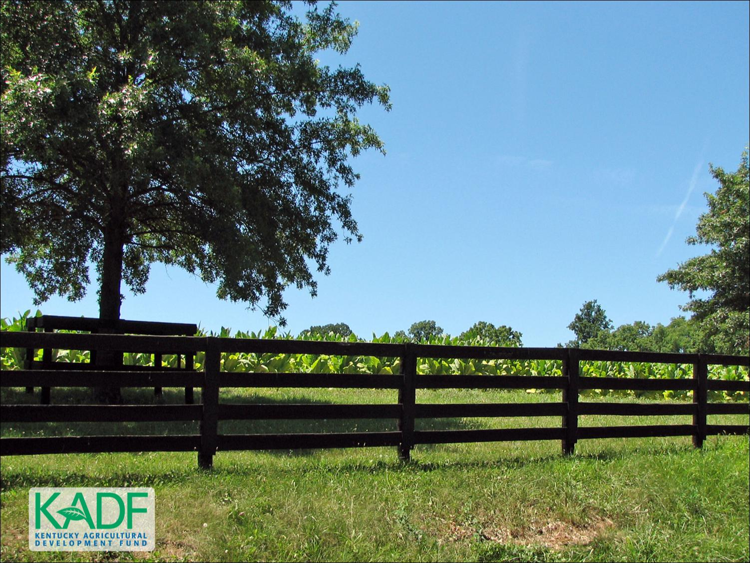
KOAP’s Report of
September 2025

Slide 2
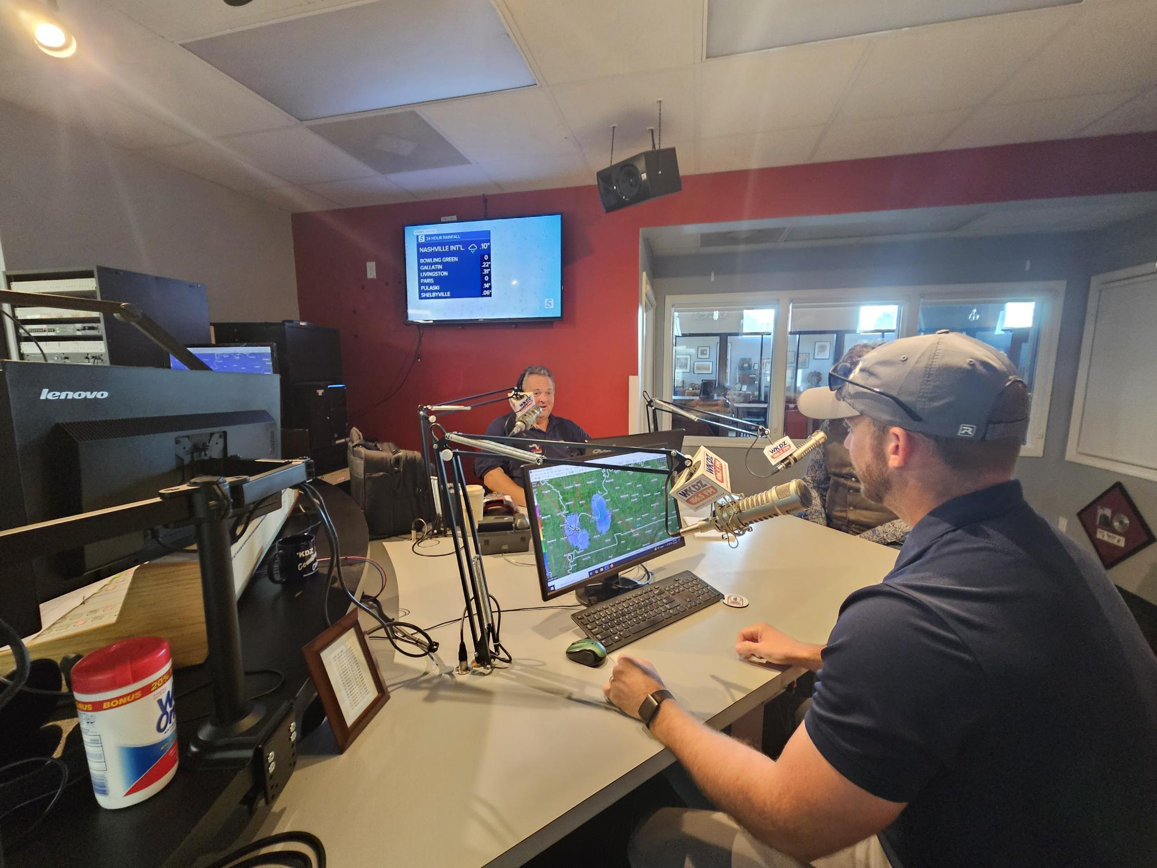
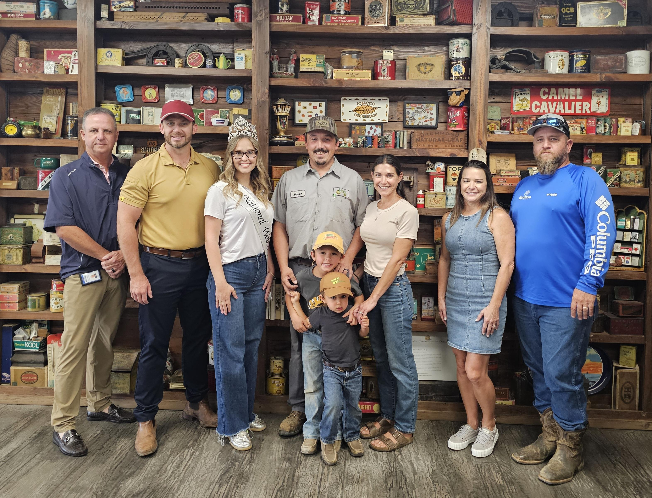
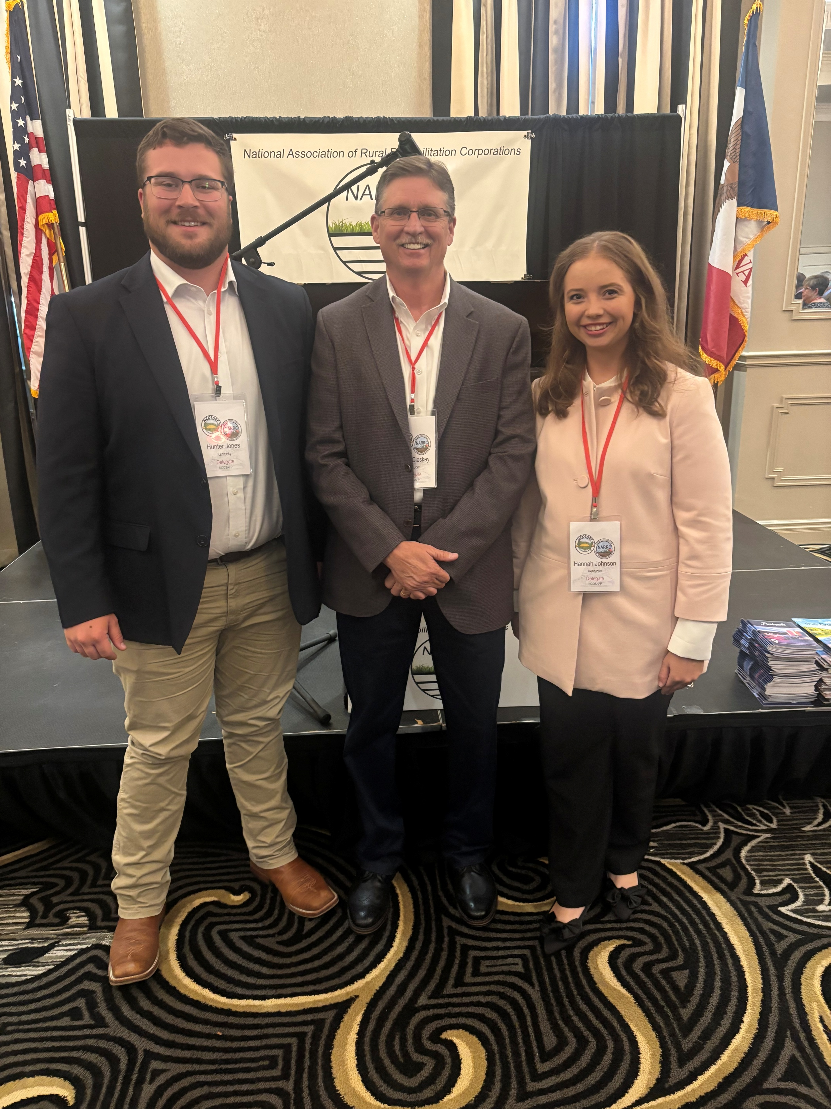
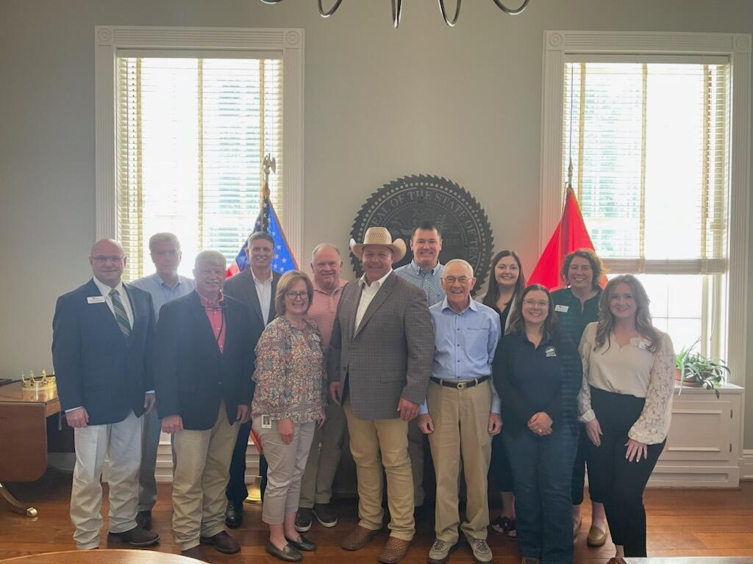
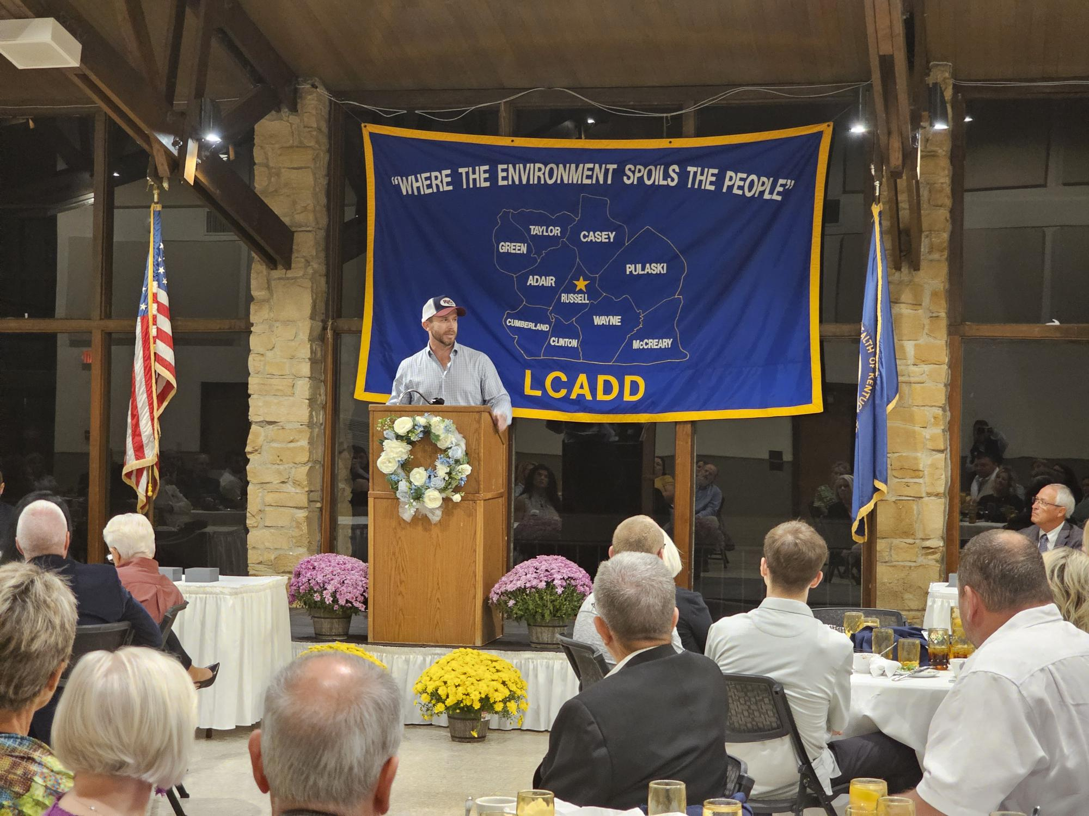
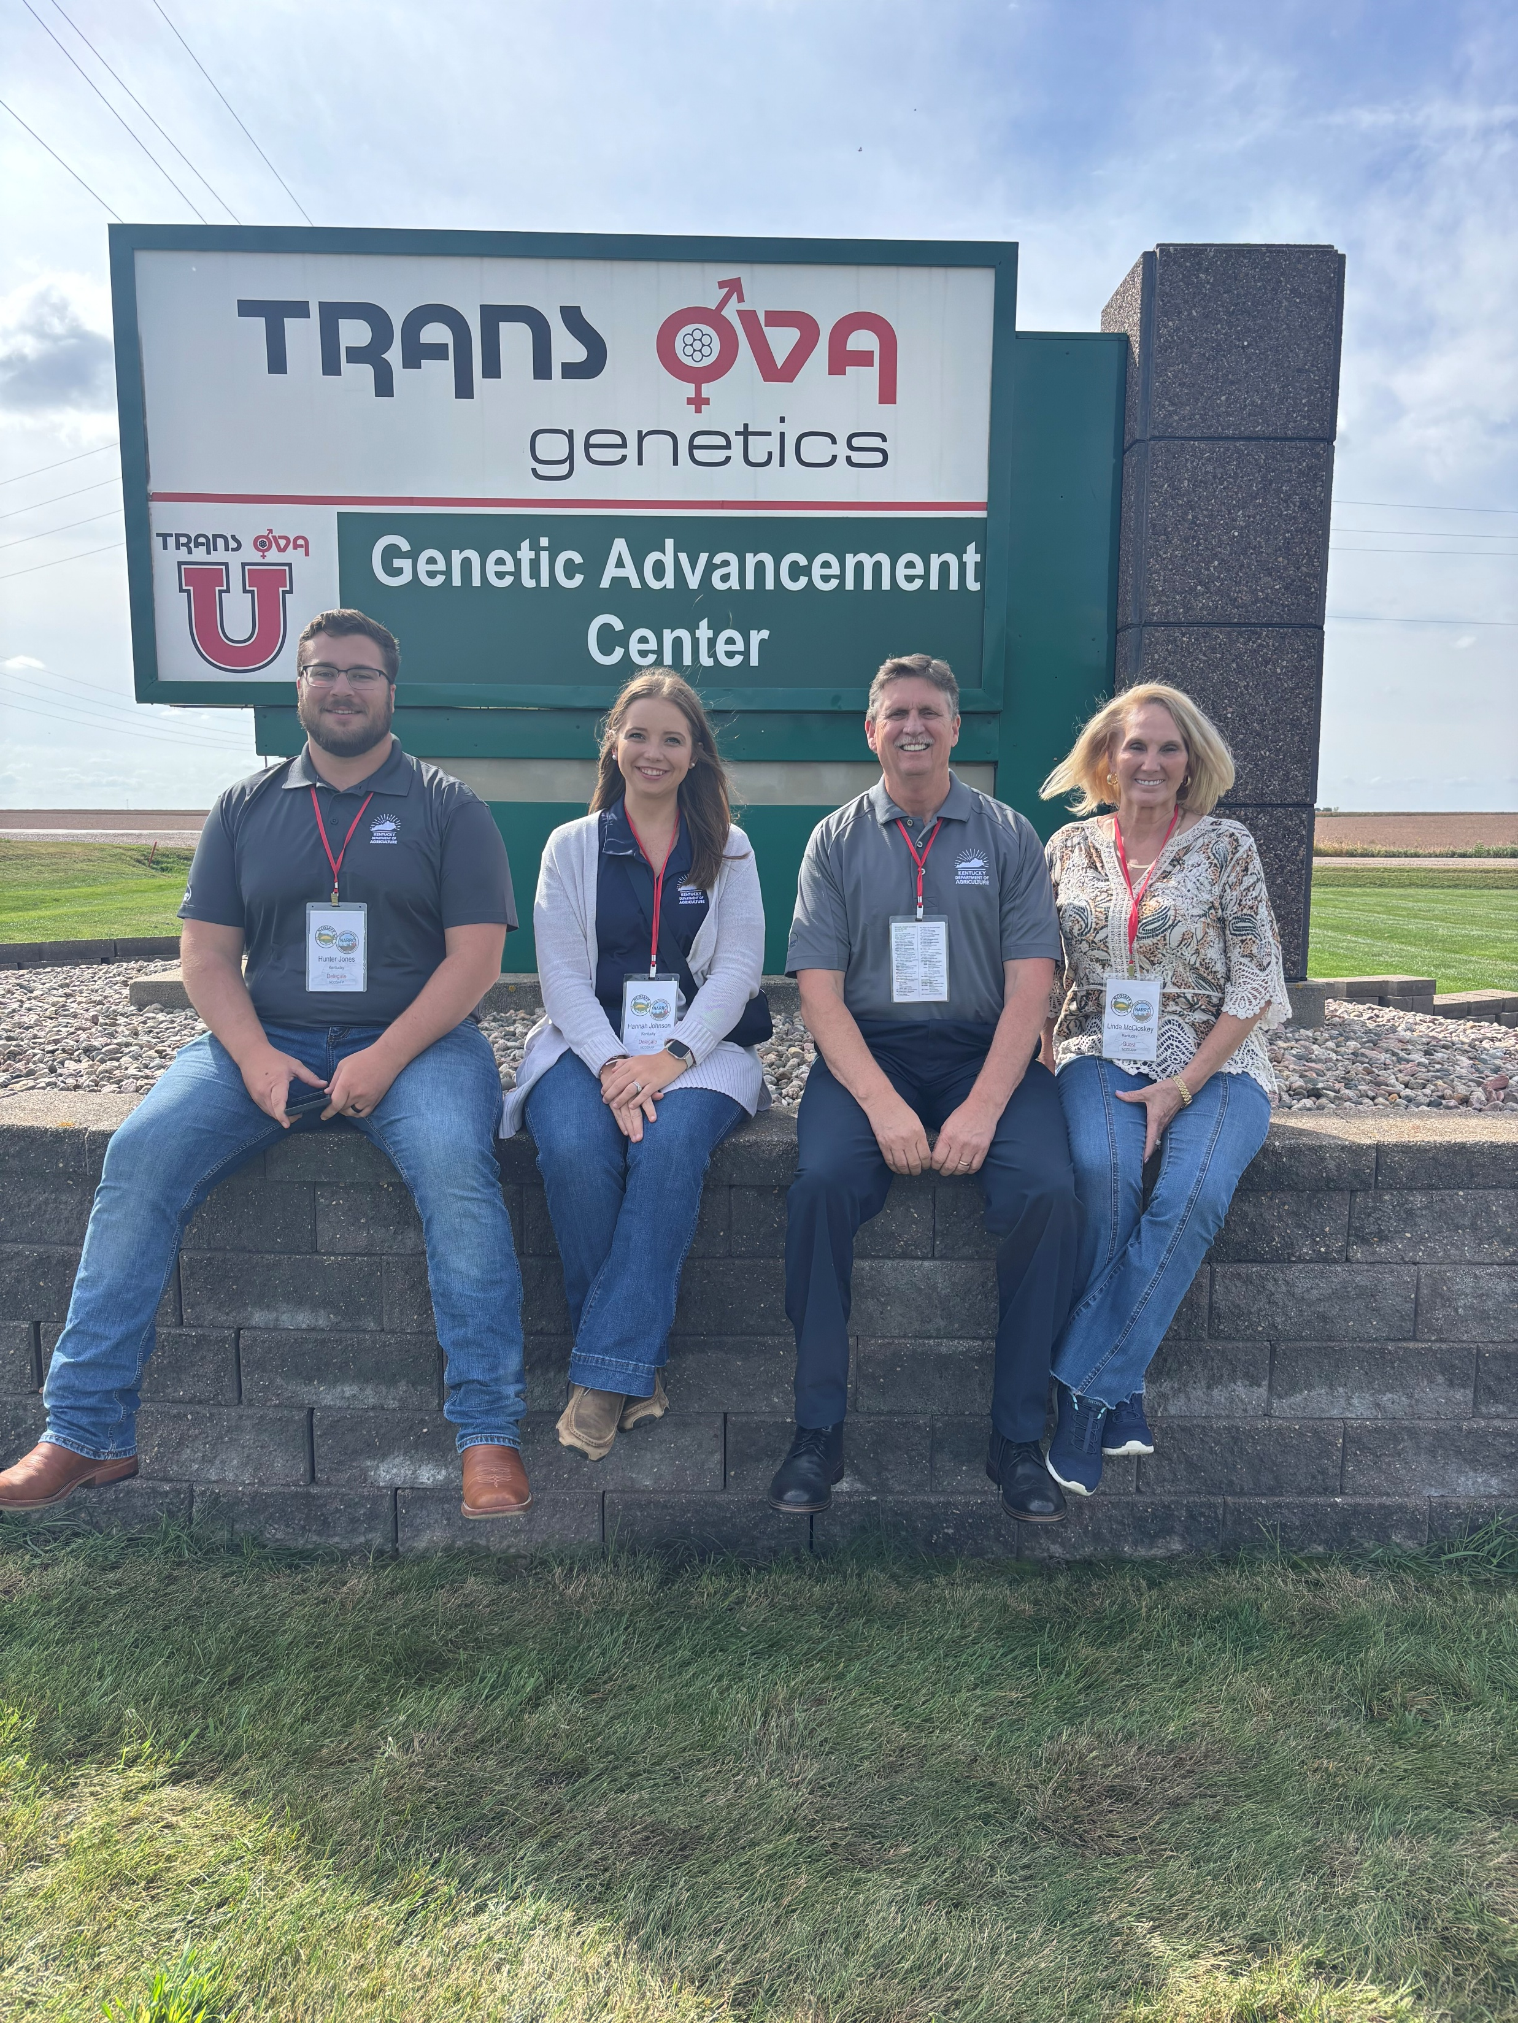
Kentucky Office of Agricultural Policy
Sent from my iPhone

Slide 3
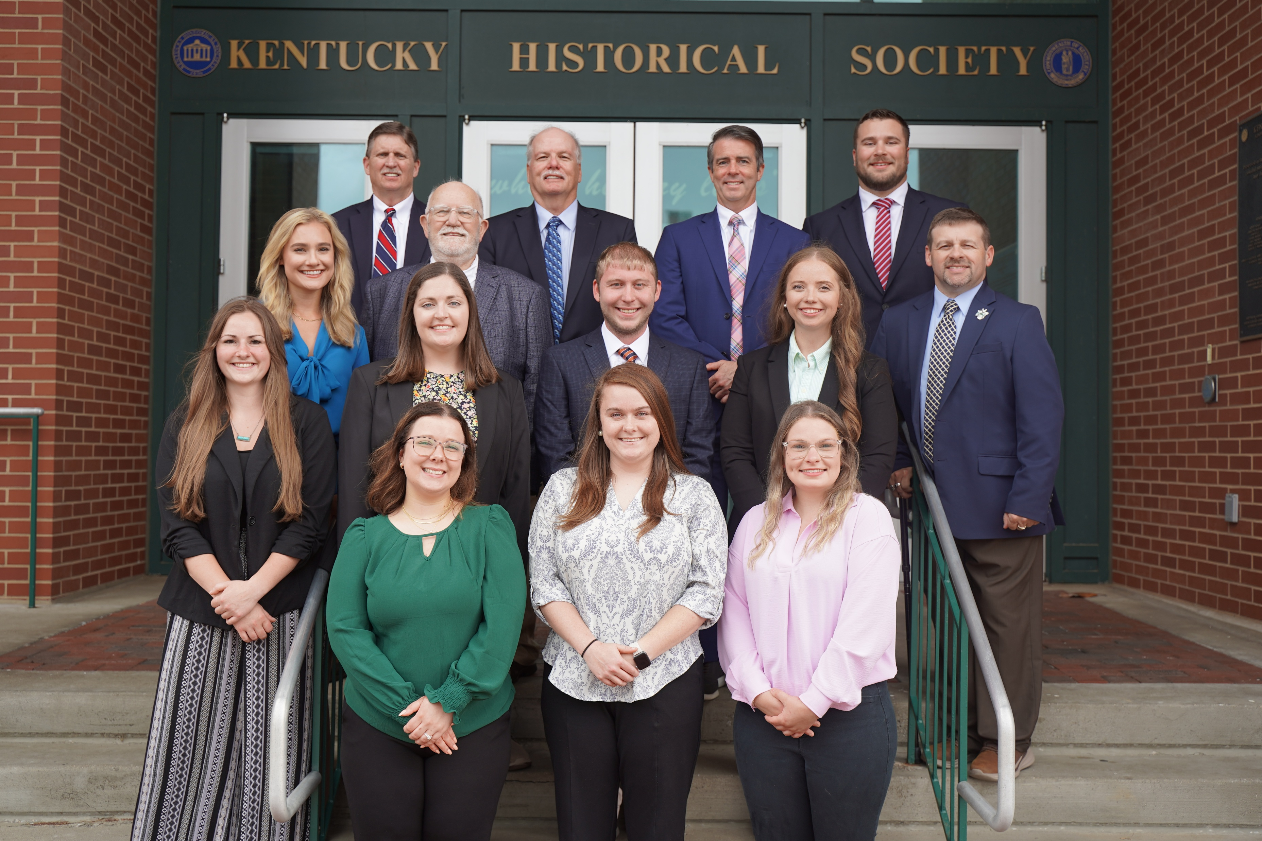
KOAP Staff
Brandon Reed
Executive Director
Bill McCloskey
Deputy Executive Director
Bill Hearn
Fiscal Officer
Brian Murphy
General Counsel
Chelsea Smither
KAFC Loan Programs Manager
Hannah Sharp-Johnson
Boards & Special Projects Manager
Alexis Scheidt
KADF Regional Manager
Jeff Parman
KADF Program Compliance Manager
Landon Peach
KADF Regional Manager
Hunter Jones
KAFC Loan Programs Manager
Bailey Siry-Crowder
KADF Project Compliance Manager
Rebecca Besok
KAFC Loan Programs Manager
Sarah Charles
KADF Programs Manager
Jesse Moore
KADF Regional Manager
Savanna Hill
KADF Regional Manager
Alandria Lee
KAFC Loan Programs Manager

Slide 4


Monthly Board Approvals:
September
KADB KAFC
$950,000 $3.3 MM

Slide 5
KOAP Highlights of September :
2 staff members attended competitive leadership programs: Kentuckiana Agribusiness Leadership Academy (KALA).
9 County Agricultural Development Councils attended by staff
6 Site visits conducted by staff
14 KADF programs cl0sed out
25 KADF project reports received

Slide 6
September Approval Breakdown
KADB Approvals:
4 County Agricultural Incentive Programs totaling $487,838.00
1 Deceased Farm Animal Removal (DAR) Programs total $15,000.00
3 Shared-Use Equipment Program totaling $31,625.00
1 Youth Ag Incentives Programs(Youth) totaling $10,000.00
2 County & State Projects totaling $260,300.00
KAFC Approvals:
9 Agricultural Infrastructure Loan Programs totaling $1,324,438.00
1 Agricultural Processing Loan Programs totaling $40,000.00
10 Beginning Farmer Loan Programs totaling $2,005,125.00

Slide 7
Bill & Brandon’s Top September Picks
(Page 14) Organic Association of Kentucky - $209,000 in state funds
(Page 15) Joseph Dale Bentley - $51,300 in state funds

