Slide 1
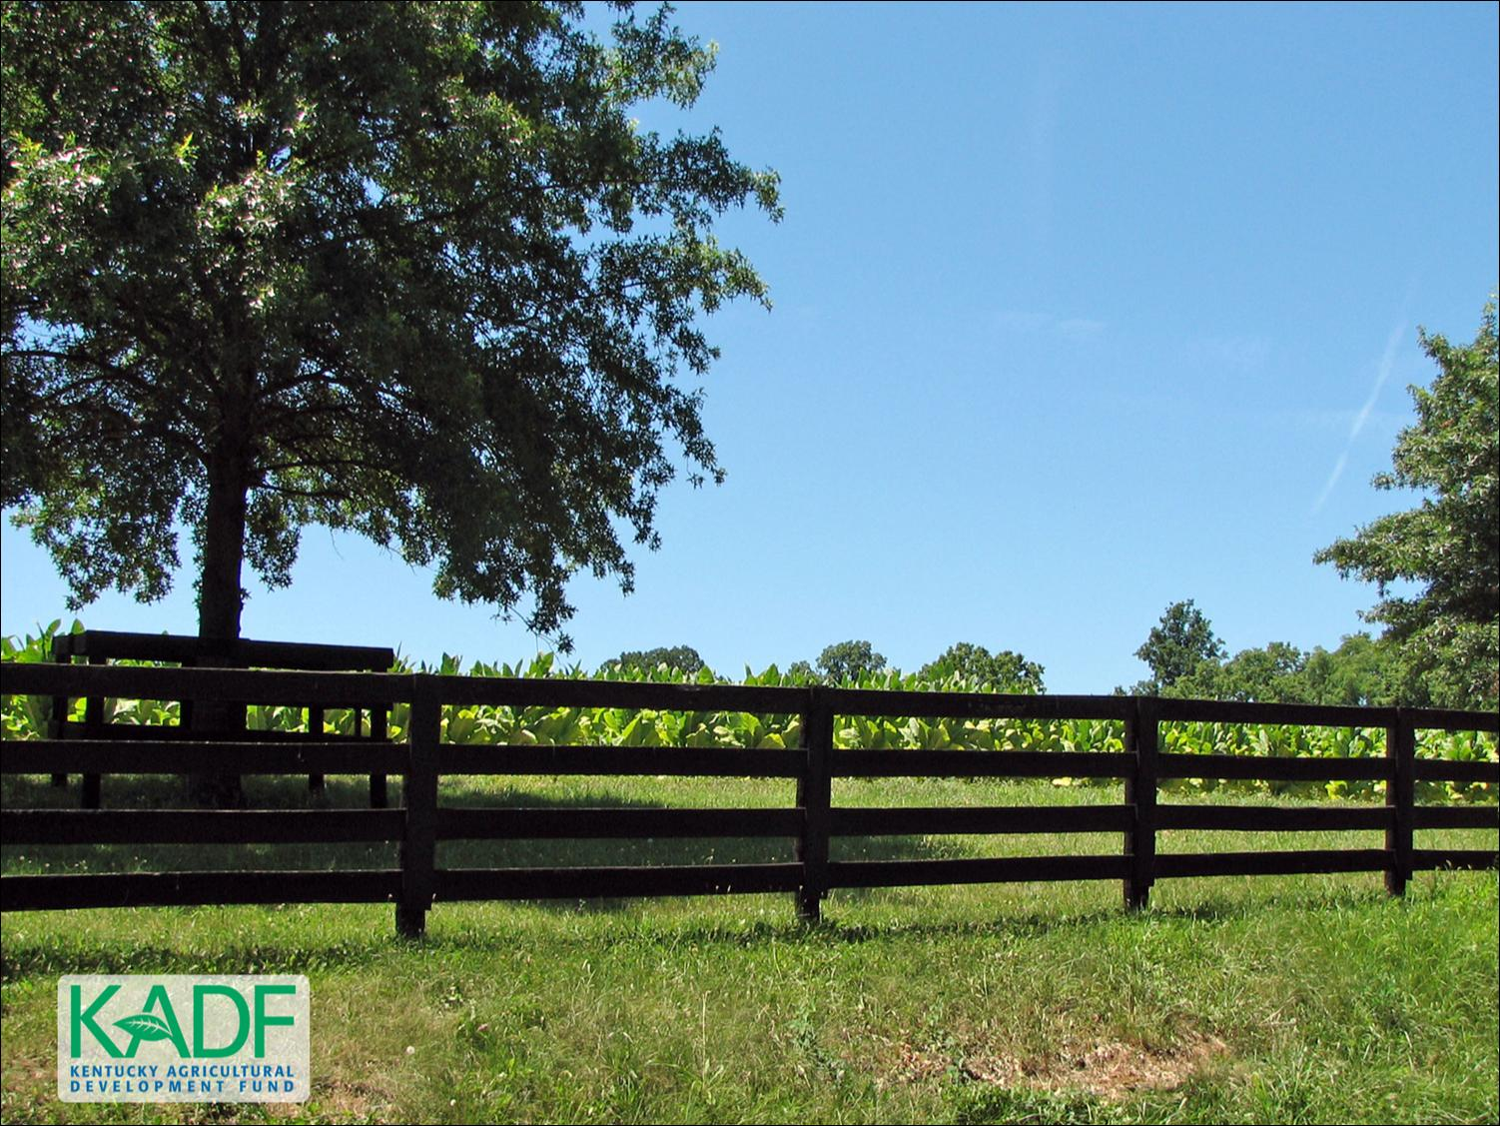
KOAP’s Report of
October & November 2025

Slide 2
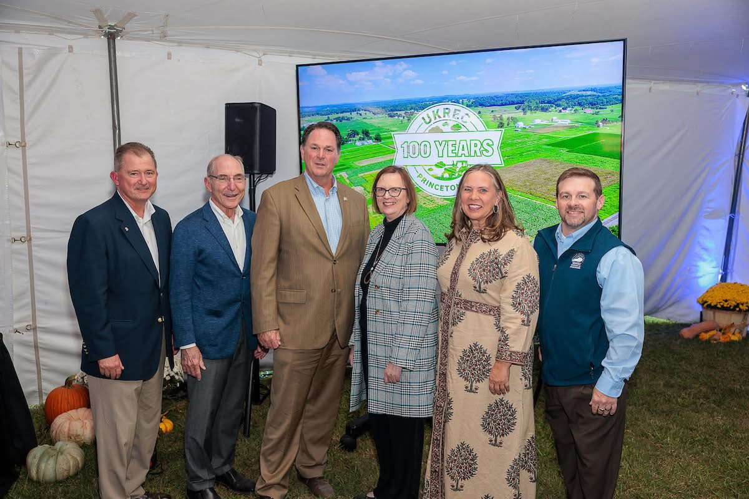
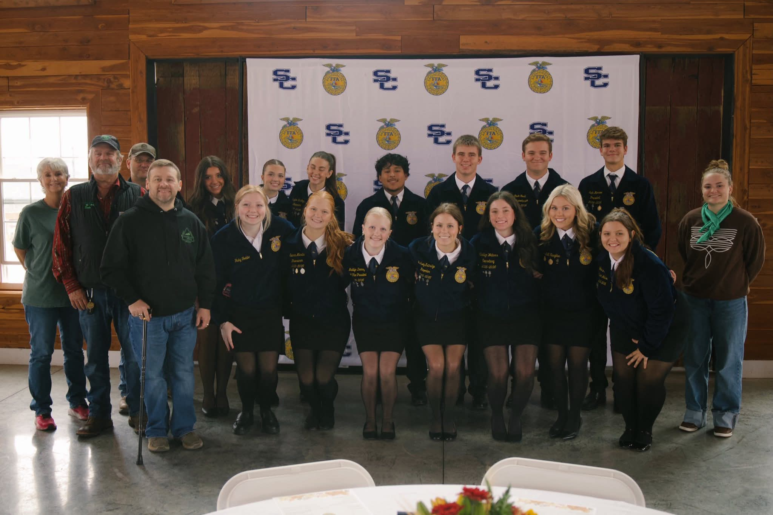
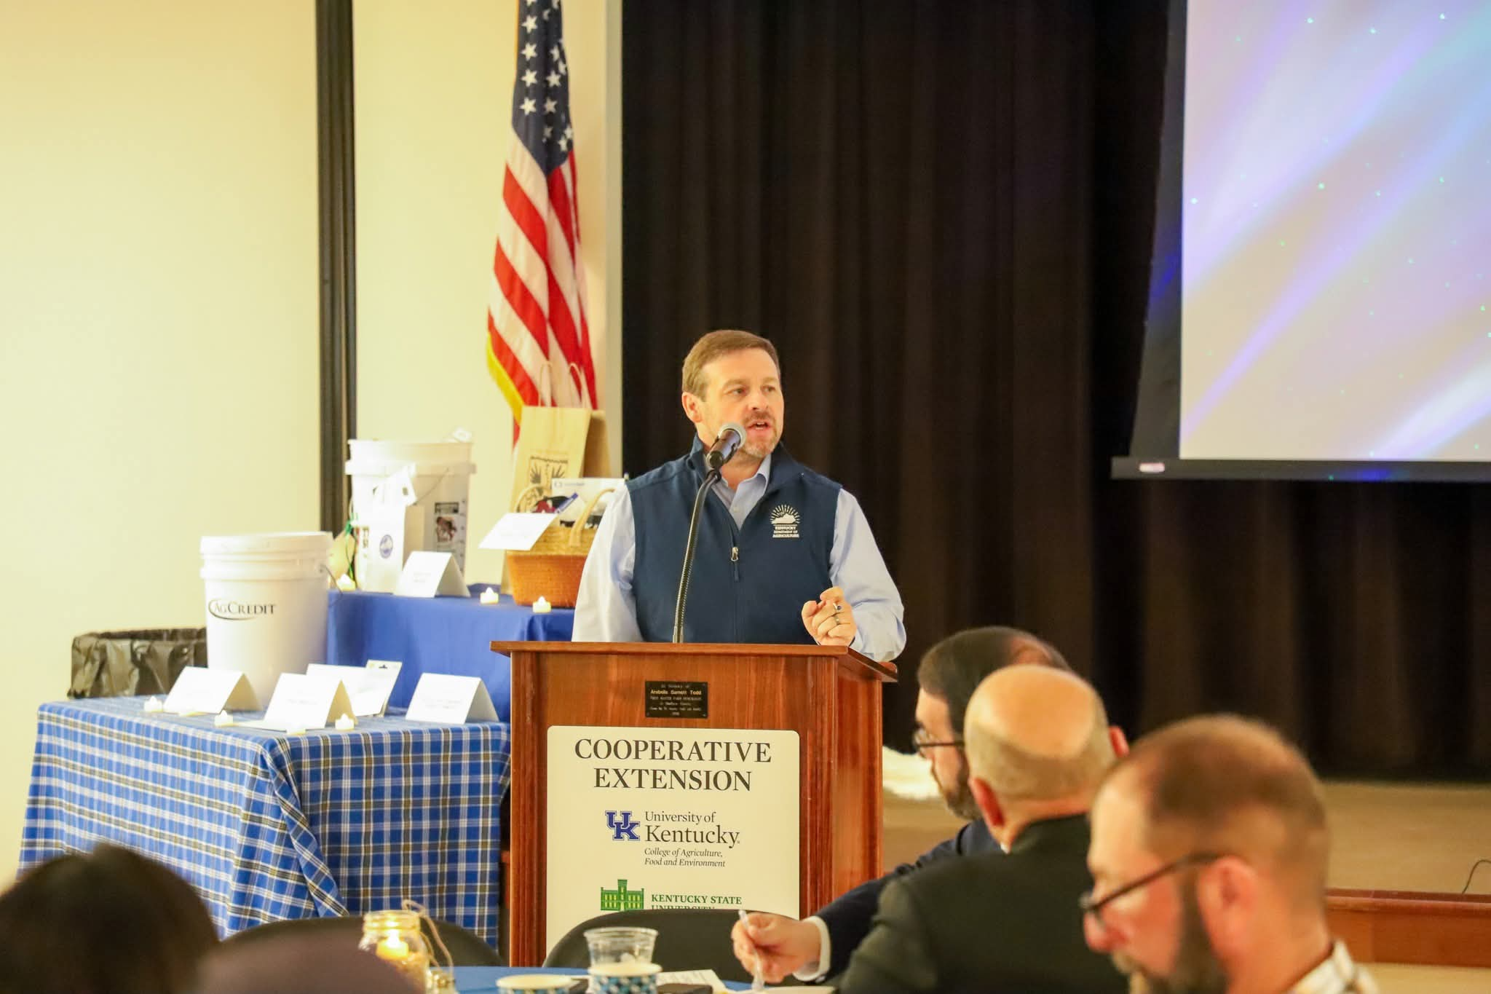
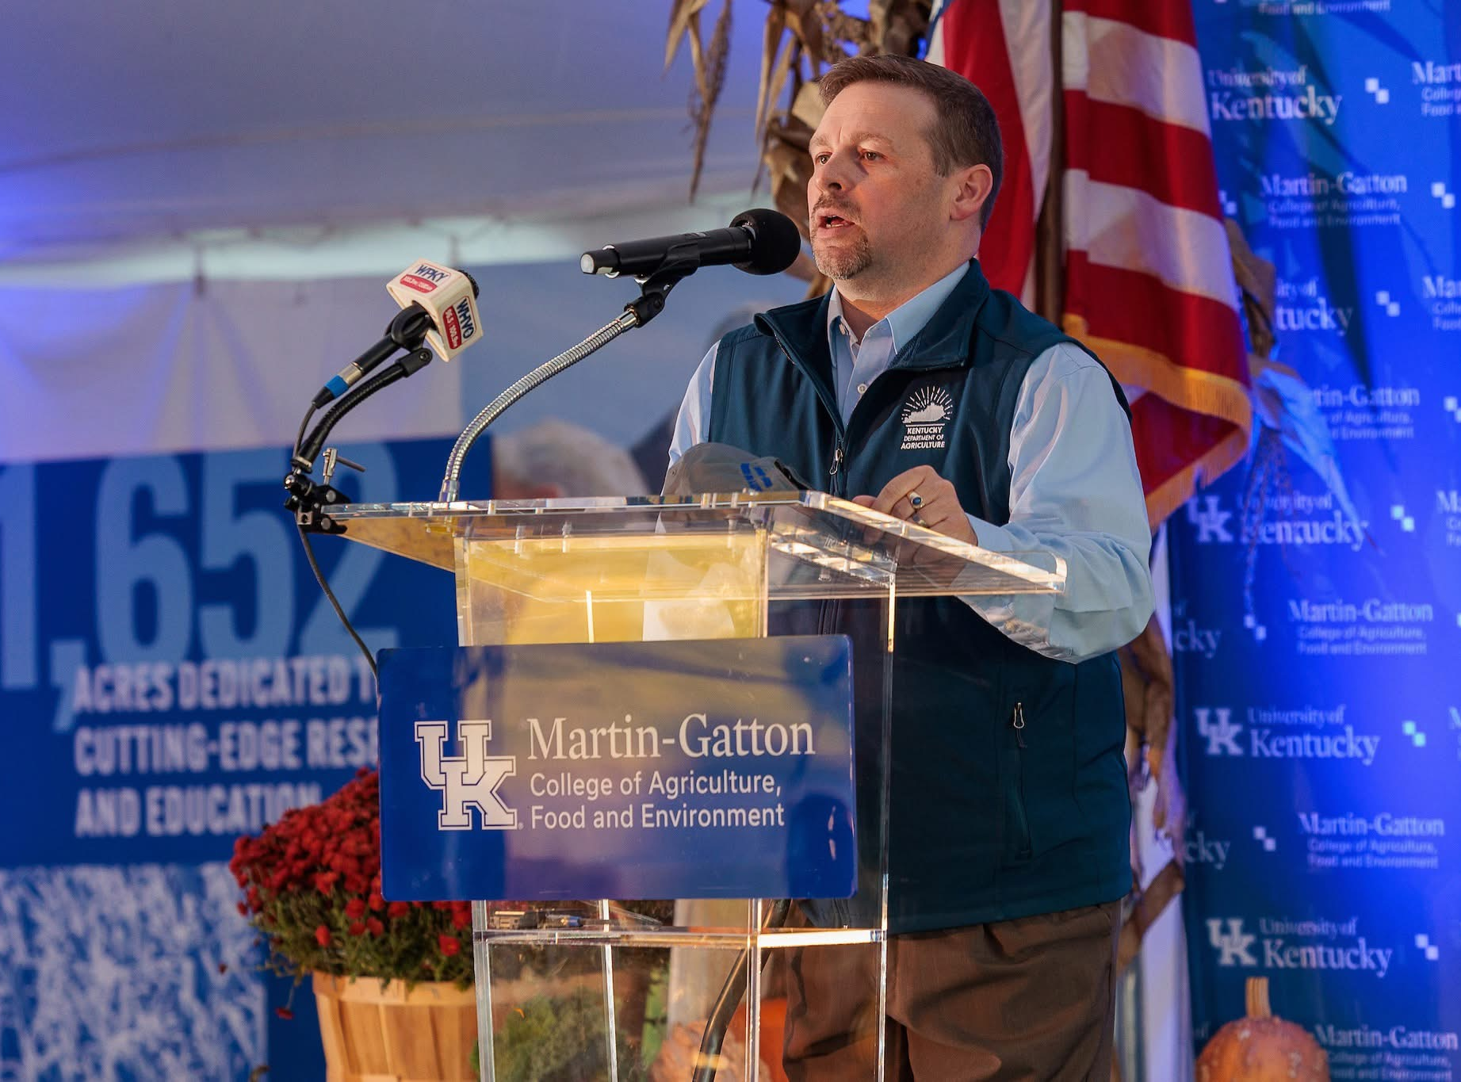
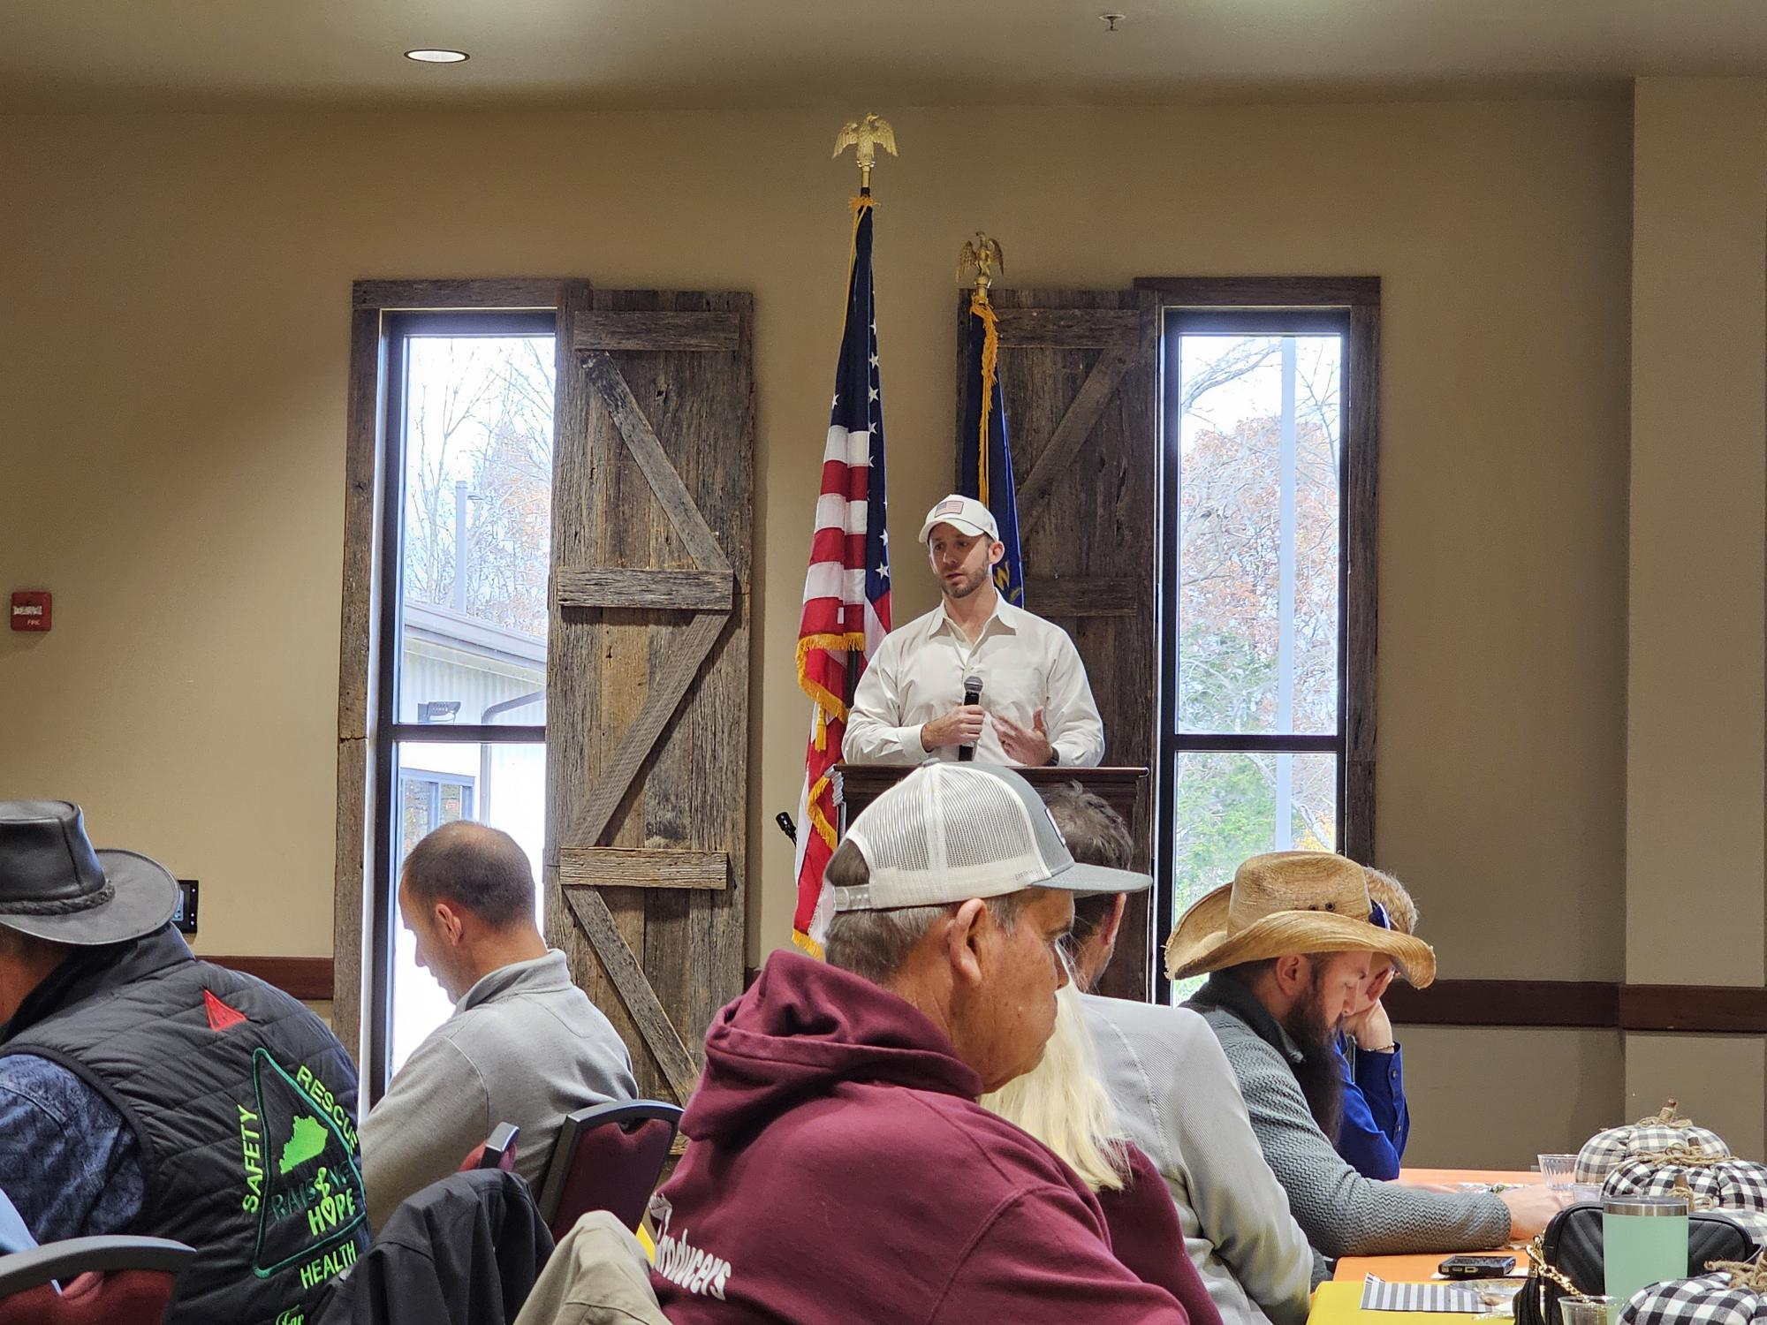
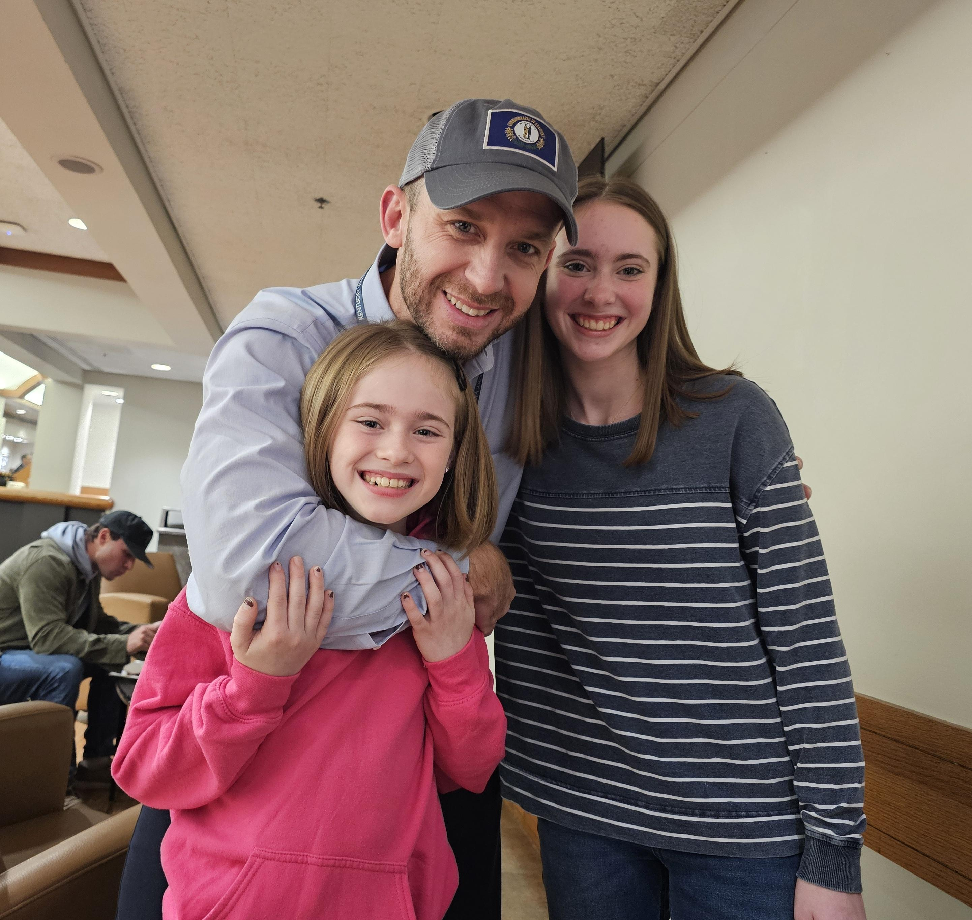
Kentucky Office of Agricultural Policy
Sent from my iPhone

Slide 3
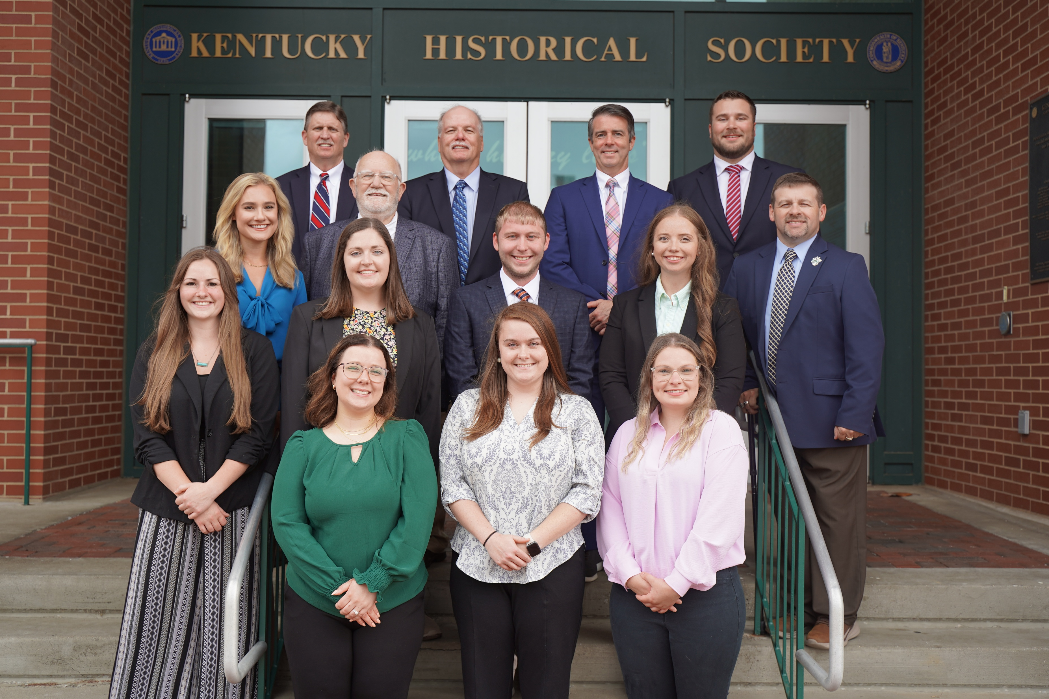
KOAP Staff
Brandon Reed
Executive Director
Bill McCloskey
Deputy Executive Director
Bill Hearn
Fiscal Officer
Brian Murphy
General Counsel
Chelsea Smither
KAFC Loan Programs Manager
Hannah Sharp-Johnson
Boards & Special Projects Manager
Alexis Scheidt
KADF Regional Manager
Jeff Parman
KADF Program Compliance Manager
Landon Peach
KADF Regional Manager
Hunter Jones
KAFC Loan Programs Manager
Bailey Siry-Crowder
KADF Project Compliance Manager
Rebecca Besok
KAFC Loan Programs Manager
Sarah Charles
KADF Programs Manager
Jesse Moore
KADF Regional Manager
Savanna Hill
KADF Regional Manager
Alandria Lee
KAFC Loan Programs Manager

Slide 4


Monthly Board Approvals:
October
KADB KAFC
$1.2 MM $4.5 MM

Slide 5
KOAP Highlights of October :
4 staff members attended competitive leadership programs: Kentuckiana Agribusiness Leadership Academy KALA) & Kentucky Cattlemen’s Assoc. Leadership Program
3 County Agricultural Development Councils attended by staff
3 Site visits conducted by staff
10 KADF programs cl0sed out
17 KADF project reports received

Slide 6
October Approval Breakdown
KADB Approvals:
2 County Agricultural Incentive Programs totaling $585,000.00
1 Next Generation Farmer Program (NextGen) totaling $30,000.00
5 County & State Projects totaling $504,481.00
7 On-Farm Energy Efficiency Incentives Program $71,340.00
KAFC Approvals:
5 Agricultural Infrastructure Loan Programs total $1,004,350.00
15 Beginning Farmer Loan Programs totaling $2,821,855.00
2 Diversification through Entrepreneurship in Agribusiness Program (DEALP) totaling $500,000.00
1 Large/Food Animal Veterinary Loan Program (LFAVLP) totaling $250,000.00

Slide 7
Bill & Brandon’s Top October Picks
(page 19) University of Kentucky Research Foundation - $147,000 in state funds
(page 18) Kentucky Highlands Investment Corporation -$250,000 in state funds
(page 20 ) Owen County Animal Clinic -$100,000 in state funds

Slide 8
Monthly Board Approvals:
November
KADB KAFC
$ 2.3MM $ 4.1MM

Slide 9
KOAP Highlights of November:
2 staff members attended competitive leadership programs: Kentuckiana Agribusiness Leadership Academy (KALA).
5 County Agricultural Development Councils attended by staff
4 Site visits conducted by staff
9 KADF programs cl0sed out
24 KADF project reports received

Slide 10
November Approval Breakdown
KADB Approvals:
6 County Agricultural Incentive Programs totaling $498,690.00
1 Next Generation Farmer Program (NextGen) totaling $30,000.00
1 Shared-Use Equipment Program totaling $26,063
3 Youth Ag Incentives Programs(Youth) totaling $46,200.00
3 County & State Projects totaling $1,645,152.00
KAFC Approvals:
6 Agricultural Infrastructure Loan Programs total $1,380,000.00
13 Beginning Farmer Loan Programs totaling $2,732,135.00

Slide 11
Bill & Brandon’s Top November Picks
(page 12) Kentucky State University - $1,400,000 in state funds
(page 13 ) Kentucky Community and Technical College System Foundation, Inc. - $63,200 in state funds
(page 14 ) University of Kentucky Research Foundation -$363,903 in state funds

