Slide 1


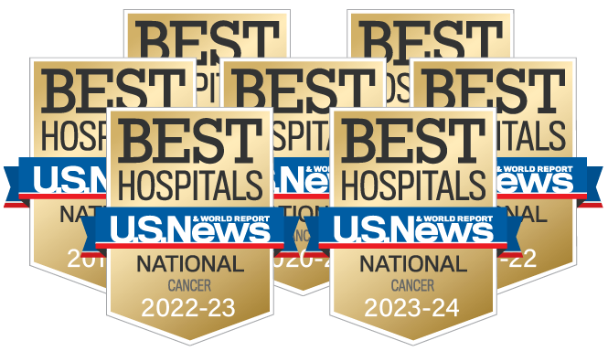


Tobacco Settlement Fund
Update
B. Mark Evers, MD, FACS
December 22, 2025

Slide 2
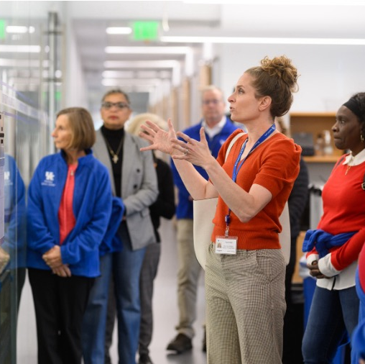

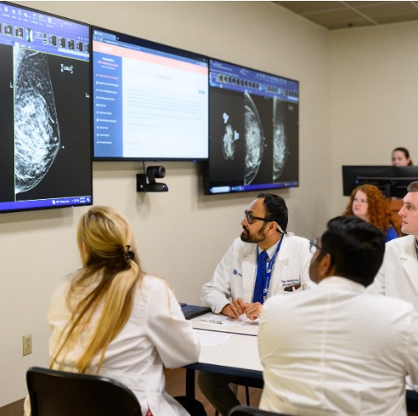
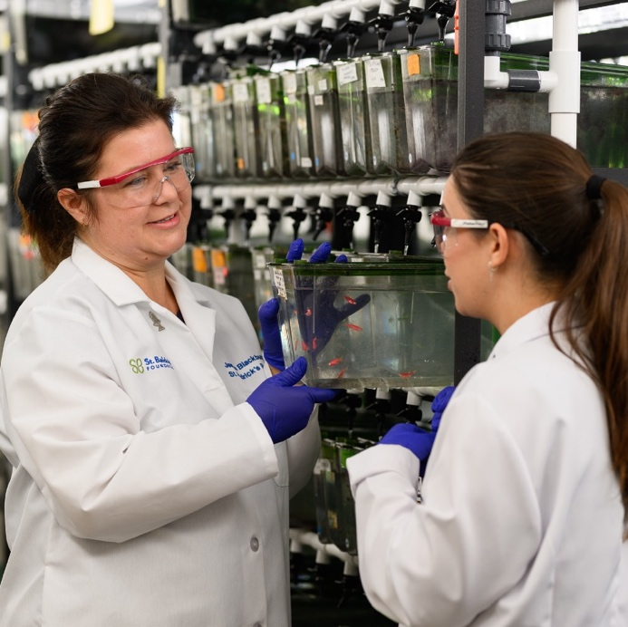

To reduce the cancer burden with a focus on Kentucky and its most vulnerable populations through research, prevention, treatment, education and community engagement.
Our Mission:

Slide 3


Impact of State Funding:
Achieving NCI Comprehensive Designation and National Recognition

Slide 4


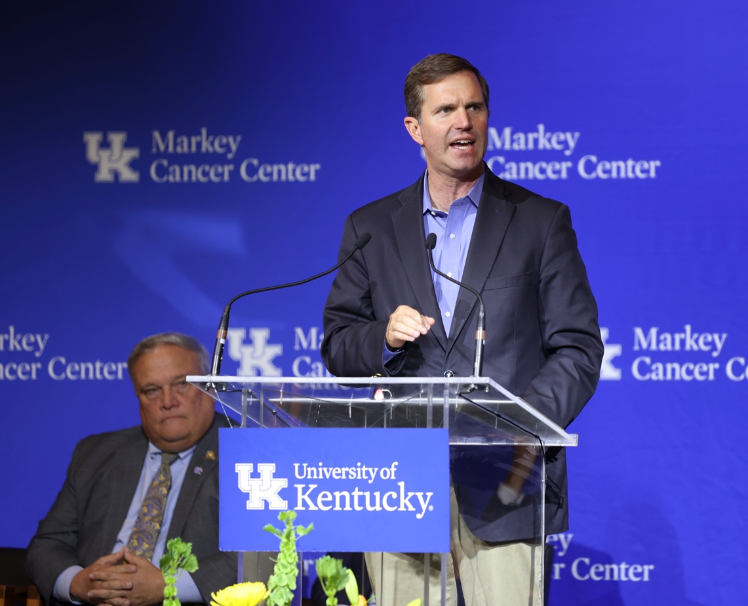
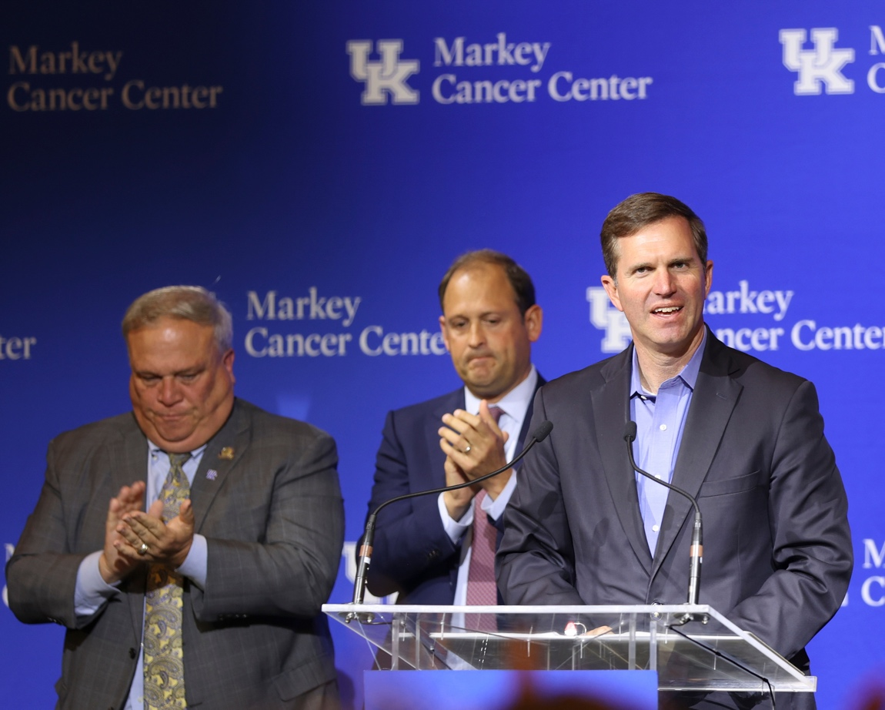
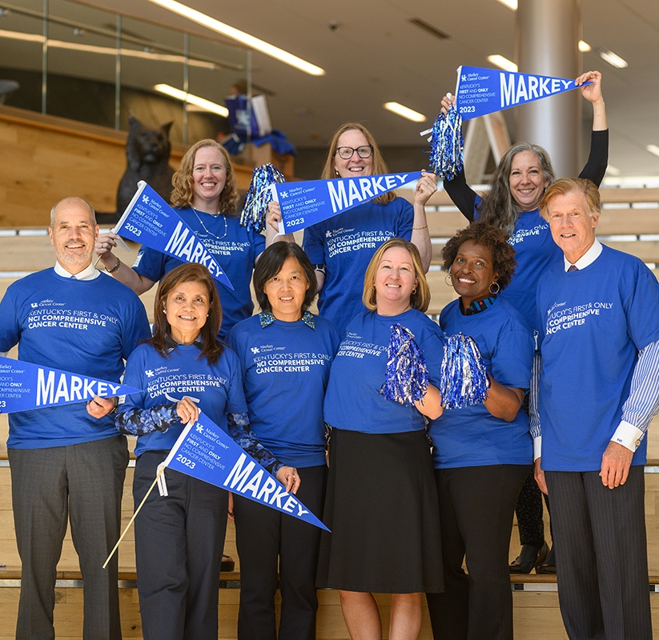

Renewing our Commitment to Kentucky
2013
NCI Designation
2018
Renewal
2023
NCI Comprehensive Designation
Sept. 25, 2027
CCSG
Renewal

Slide 5
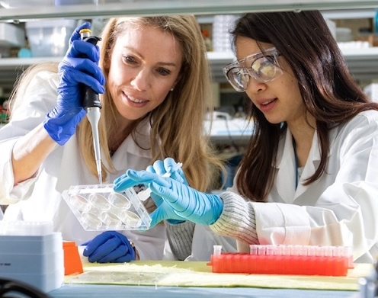
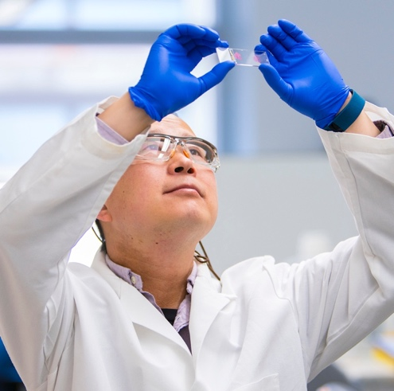
What does it mean to be an NCI Comprehensive Cancer Center?
Taking it to the Next Level
More funding, which equates to more research, more cancer screening and prevention and more clinical trials
Increased draw of patients from the region and nationally
Increased ability to attract nationally and internationally recognized cancer researchers and oncologists
More opportunities to offer cutting-edge, early phase trials with the latest cancer treatments
Expanded opportunities for special initiative grants
Increased private donations
Increased community engagement (volunteers, patient advisory groups, education and intervention programs)

Slide 6

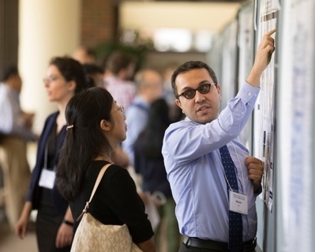
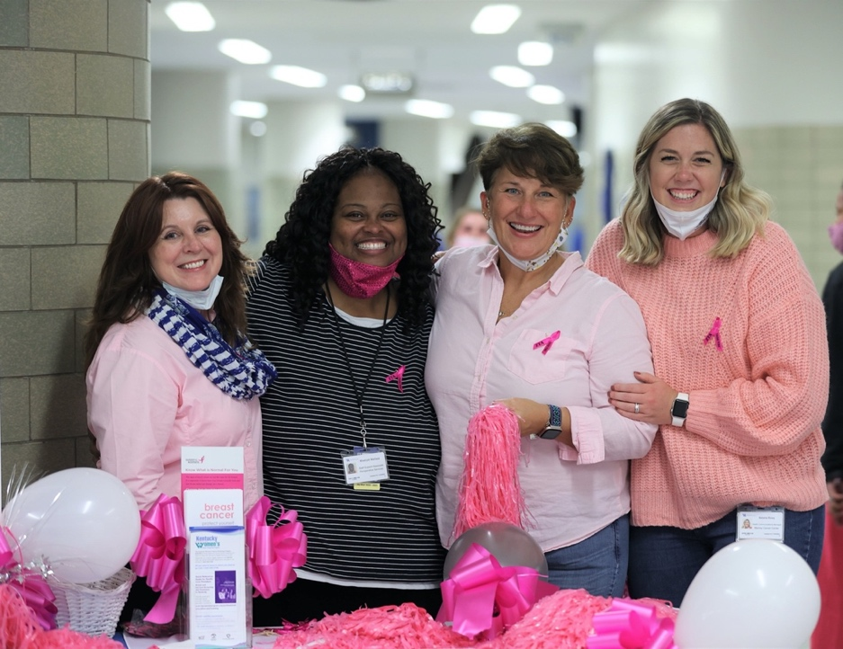
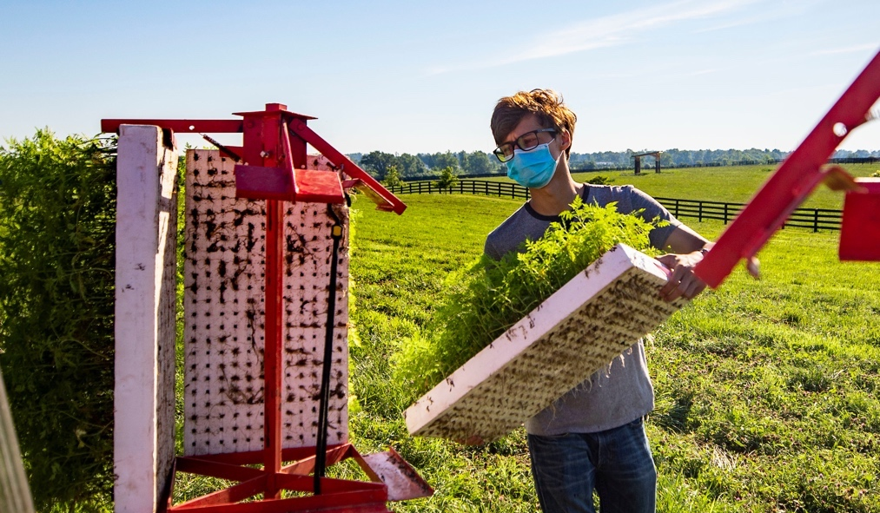
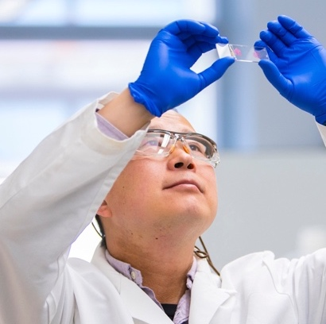

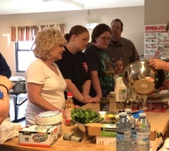
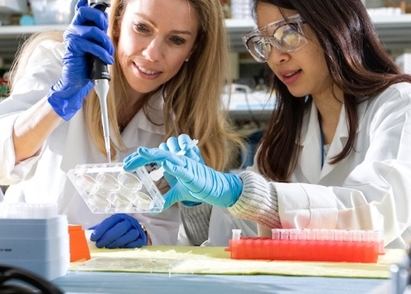
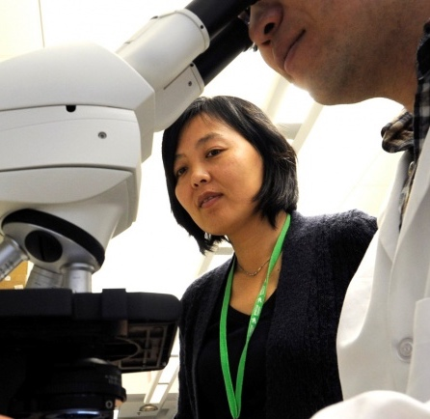
What Achieving NCI Designation Has Meant to Kentucky

Slide 7
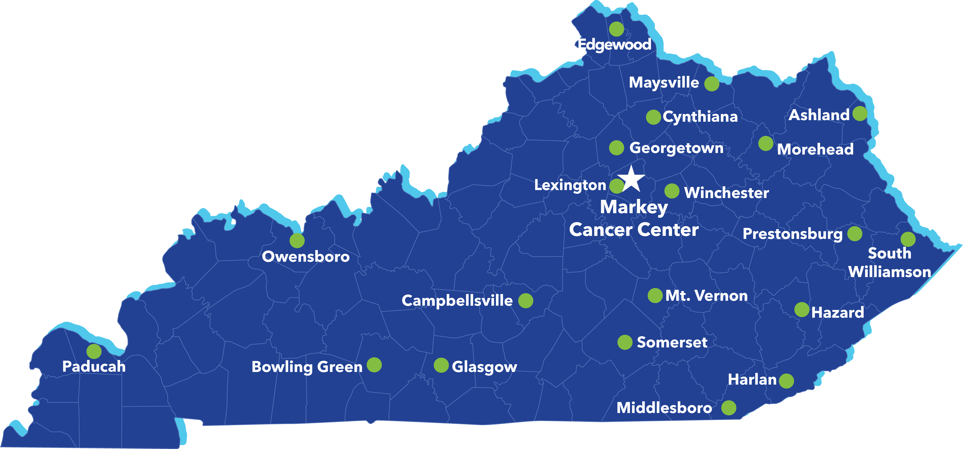

Markey Cancer Network: The Network for Kentucky’s Future
Affiliate Network Sites
Research Network Sites
Markey Cancer Network
Notes:
Until today, Markey has maintained two “arms” to its network structure: affiliate sites focused on education and outreach, and research sites focused on interventional work at limited sites with those capabilities
Strategic planning process this year to reimagine the Markey network as a singular entity expanding service to all Kentuckians
Will enhance Markey’s ability to foster research capabilities of all kinds at network sites – both interventional and non-interventional, at every site
Will streamline network site contracts to more clearly outline service packages and consolidate fee structures
Will rebrand into one network, simplifying co-marketing and co-branding with network sites and aligning with the direction of a long-term, center-wide branding and messaging project rolling out in early 2026
CCSG impact
Considering how best to present the full impact of the network in COE, including mentioning accruals to trials that network sites open at their facilities (i.e., not Markey accruals) as part of a strong narrative around statewide outreach and education efforts

Slide 8


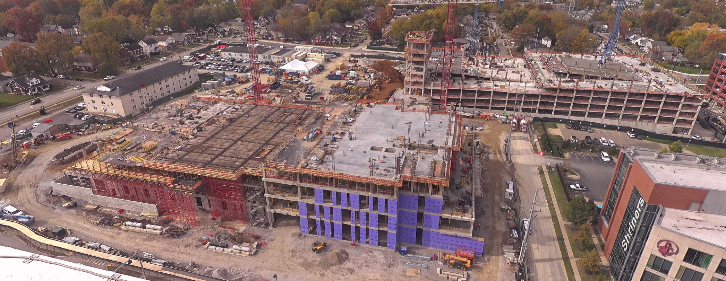
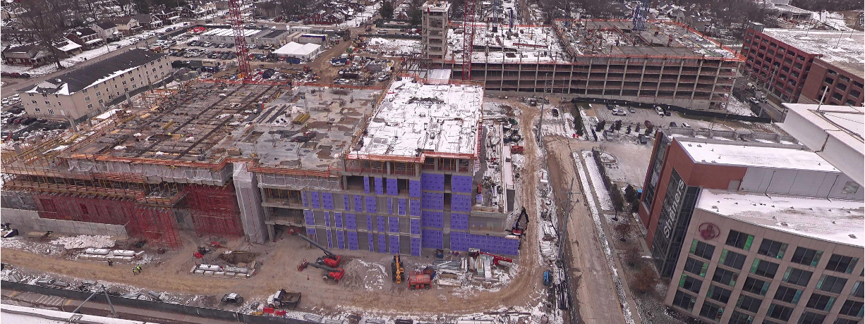
Continuing the Vision New Cancer Ambulatory Care Building
Projected completion: end of 2027 Opening: early 2028
Approx. 550,000 sq ft
All cancer services co-located
Multi-disciplinary clinics
Laboratory
Imaging
Radiation Medicine
Precision Medicine/Infusion suites
Ambulatory surgery
Shelled floor for future growth
Conference space
Dec. 17, 2025

Slide 9
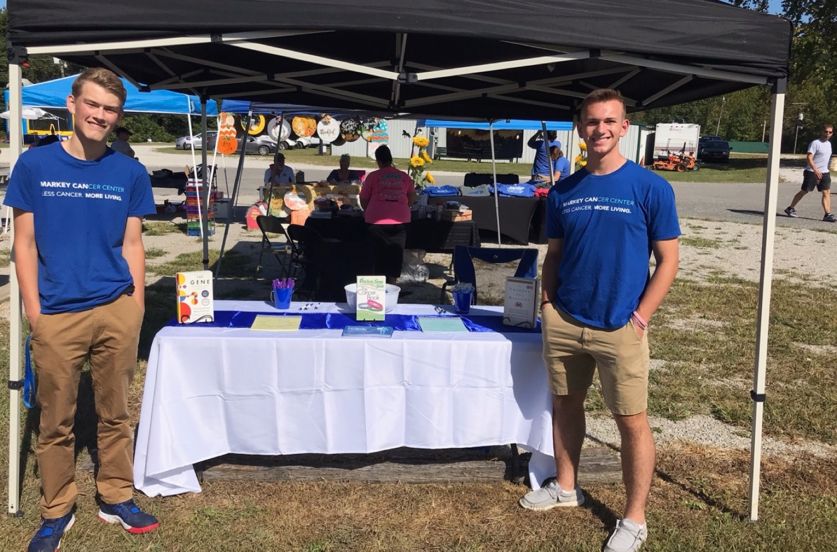
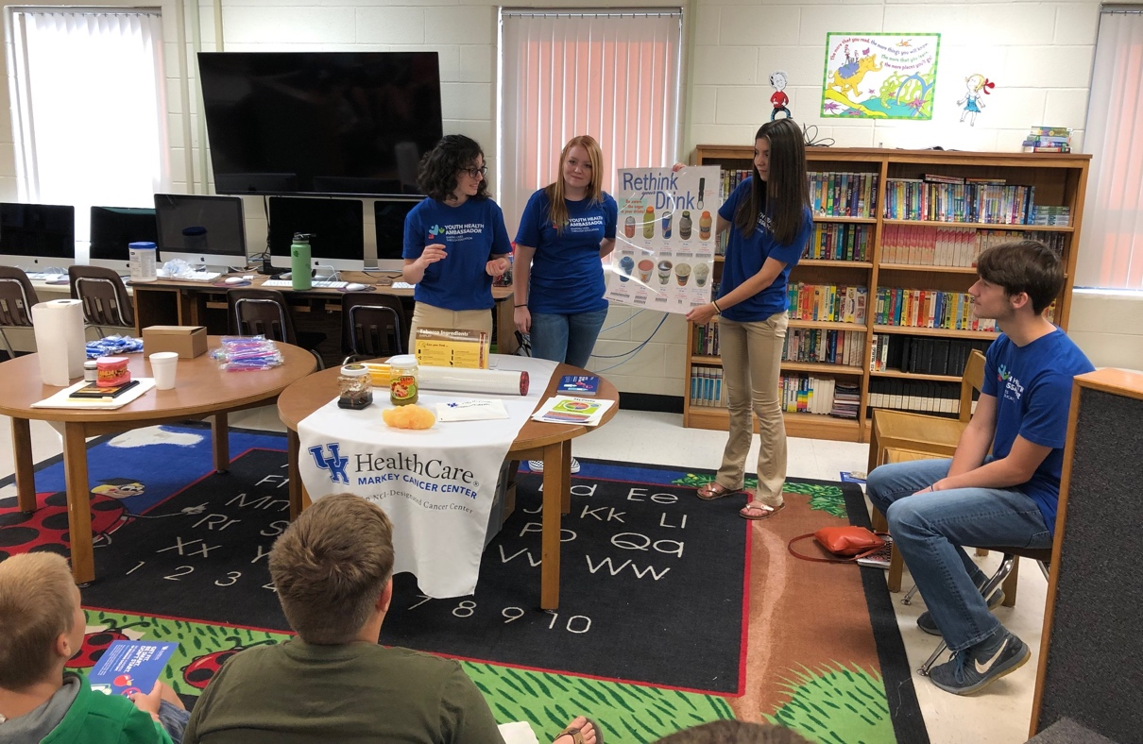
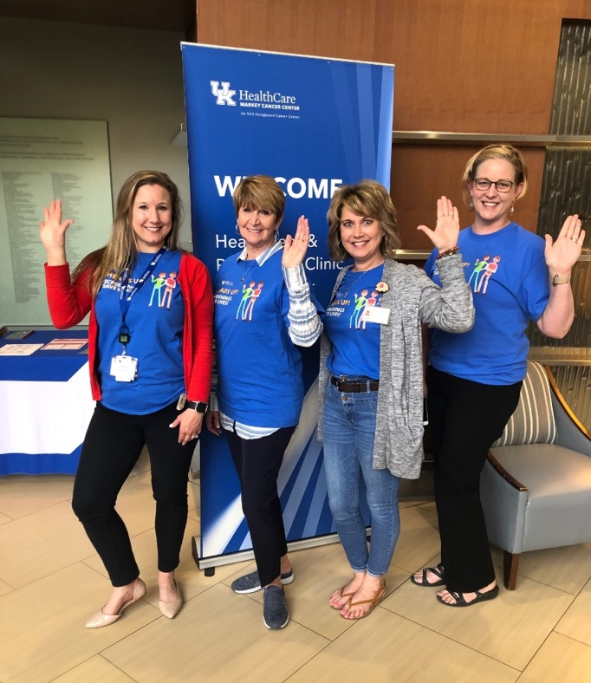
Impact of 2024-2025 state cancer prevention and research funding to Markey

Slide 10
Support From the State has Provided:
Critical funding for cancer screenings throughout the state
Funding for new recruitment and retention of cancer investigators
Pilot funding for new cancer research projects
Funding for new clinical trials

Slide 11
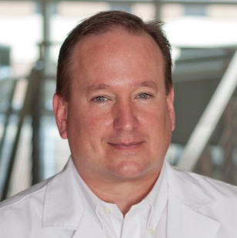
Creating Cancer-Free Tomorrows
Kentucky native—bachelor’s degree from WKU; MD and PhD from UK
International expert in addressing tobacco use by cancer patients at the institutional, state, regional, national, and economic level
Recruitment of a nationally recognized expert in tobacco cessation who is creating the TRUST (Tobacco, Research, Universal Screening and Treatment) program at UK
Graham Warren, MD, PhD
Professor and Vice-Chair of Research, Department of Radiation Medicine
Director of Tobacco, Research, Universal Screening, and Treatment (TRUST) initiative

Slide 12
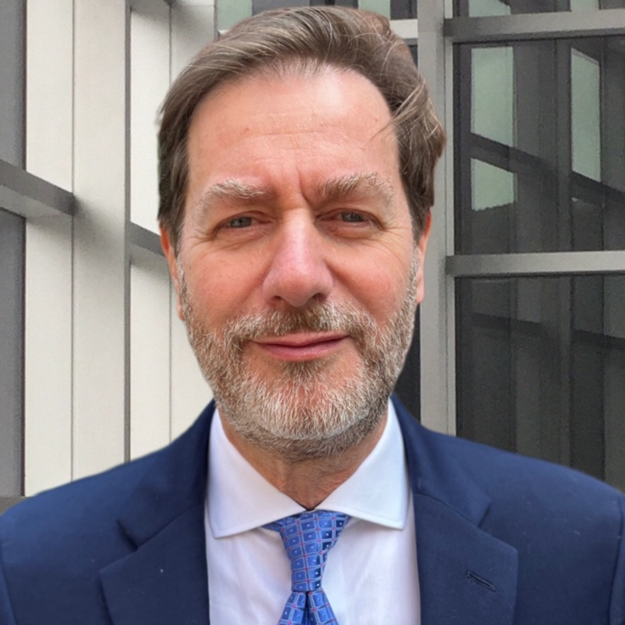
Creating Cancer-Free Tomorrows
Recruitment of a new Associate Director for Clinical Translation and Division Chief of Heme/BMT
22+ years as a clinician scientist and hematologist
Transformative leadership to Heme/BMT program, and renewed vigor for Markey’s clinical research capabilities
Pierluigi Porcu, MD
Division Chief for Heme/BMT, Department of Internal Medicine
Associate Director for Clinical Translation

Slide 13
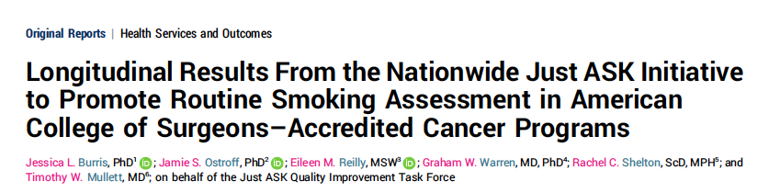

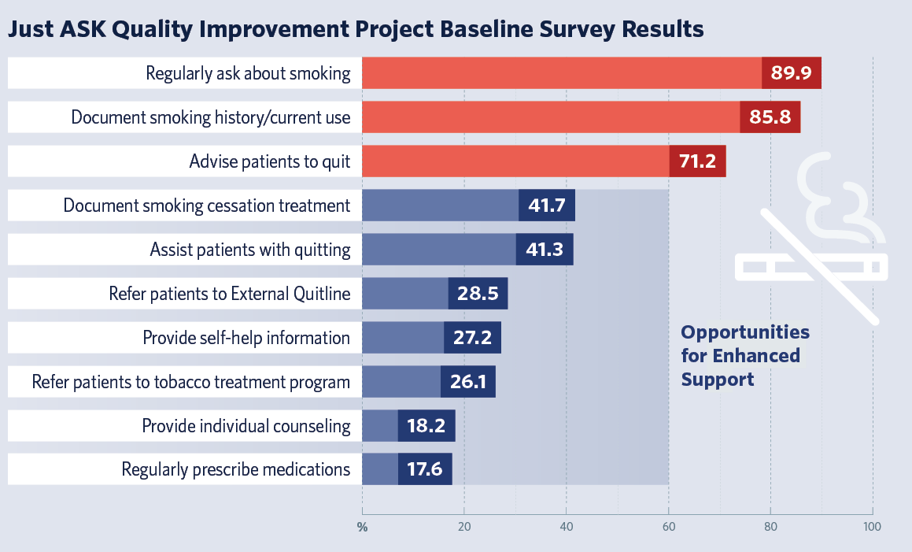
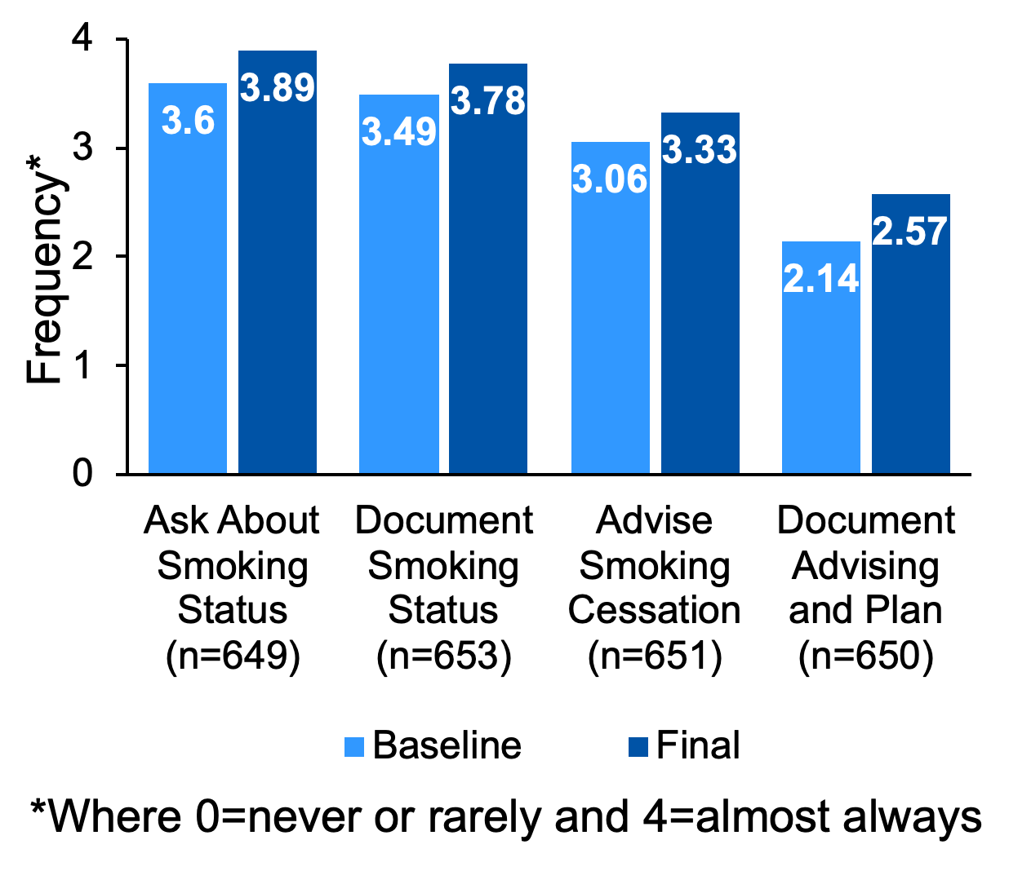

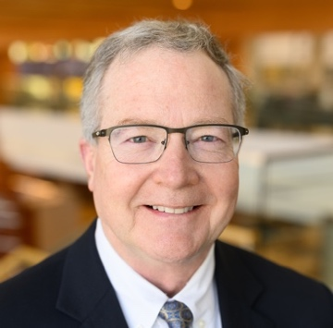
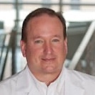


Leading the Nation in Tobacco Treatment Delivery
BURRIS
MULLETT
WARREN
American College of Surgeons
Impact
This large quality improvement project demonstrates the feasibility of implementing smoking assessment as standard cancer care, doing so in a diverse sample of 762 accredited programs nationwide
Participants reported significant advances within a short time span and study results underscore the potential for national accreditation organizations to transform oncology practice

Slide 14

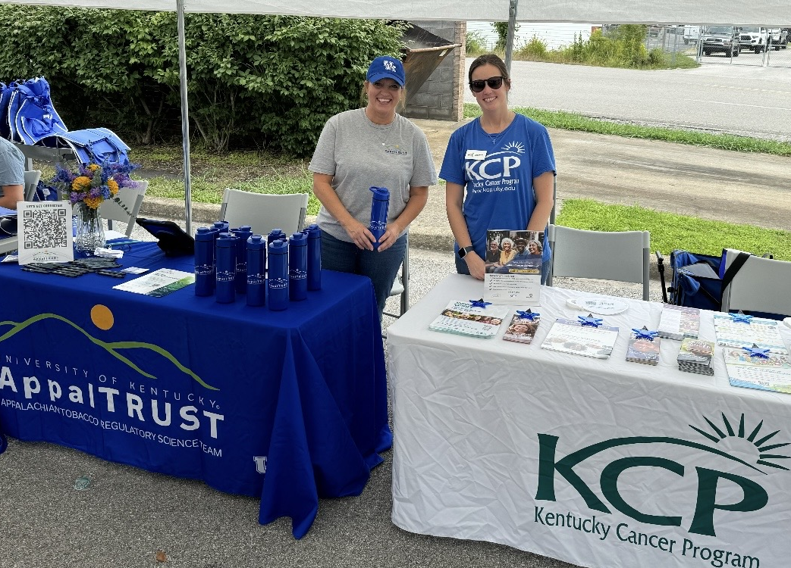
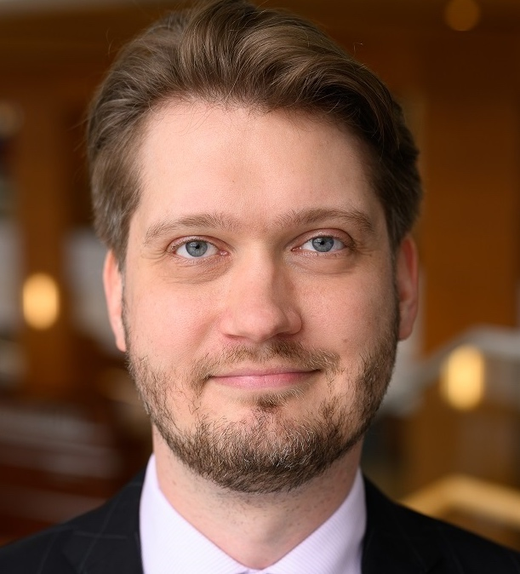

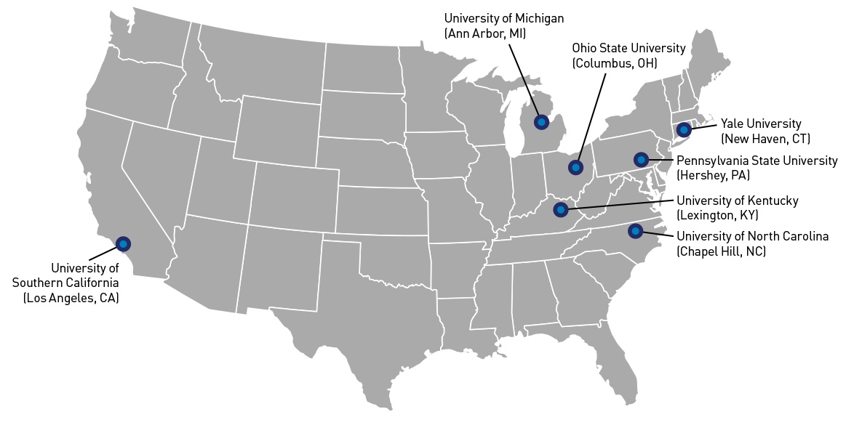
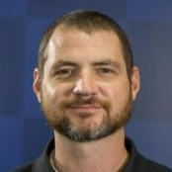
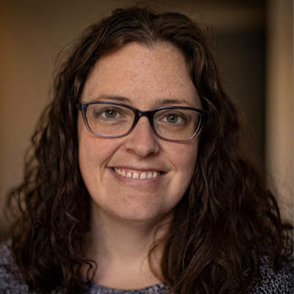

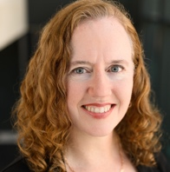
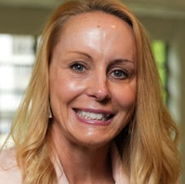
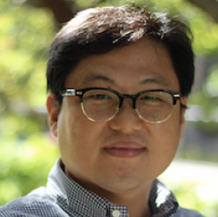
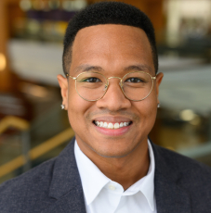
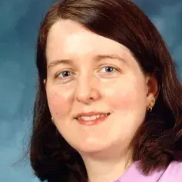
New Major Grants U54 Appalachian Tobacco Regulatory Science Team (AppalTRUST)
Funding is >$19M over 5 years
U Michigan, Ann Arbor
Ohio State U
Funded TCORS
Yale
KOFFARNUS
ROSE
Penn State U
UK
UNC, Chapel Hill
USC, Los Angeles
CHRISTIAN
FALLIN- BENNETT
HAYNES
Investigating the effects of regulatory actions on tobacco product use in rural Appalachian communities, examining variation based on relative rurality.
HULL
ICKES
JEONG
Impact
Currently recruited n=964 Appalachian adults of planned 2000
Completing Wave 3 of a longitudinal survey
FUNDING
U54 DA058256
MATTINGLY
RAYENS
Notes:
We are happy to report that we recently became one of only 7 Tobacco Centers of Regulatory Science in the country – a program funded jointly by the FDA, NIDA, NCI and other NIH institutes. This U54, led by Drs. Mikhail Koffarnus and Shyanika Rose (MPIs), provides over $19 million dollars in funding to investigate the effects of FDA regulatory actions on tobacco product use in Appalachian rural communities. The team works with COE to leverage existing partnerships in two communities in Eastern Kentucky to establish a cohort of 2,000 adults (currently recruited n=968) for innovative research projects that examine differences in tobacco marketing, purchasing, and use across varying levels of rurality.

Slide 15

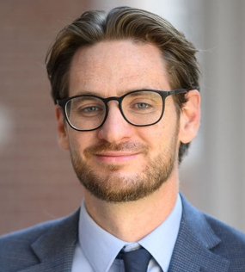
Impacting Late-Stage Lung Cancer Diagnoses in Kentucky
90
Appalachian
KY
20
Lung Cancer Screening Rate,
by state (2020)
KY is #2!
2.3x faster decline than US
MULLETT
15
80
KY
Proportion of eligible adults screened for lung cancer
Late-Stage Incidence
10
70
US Average
BURRIS
5
60
1.7x faster decline than US
0
=
=
=
=
50
States
2009
2011
2013
2015
2017
2019
2021
KNIGHT
“Kentucky, which has supported screening implementation efforts, is unique as its screening rates are over twice the national average and four times that of other high lung cancer burden states, like West Virginia and Arkansas.”
—ASCO post, 2021
Impact
Lung cancers identified at earlier stages with notable progress in KY and Appalachian KY
STAPLETON
FUNDING
R01 CA254734; Bristol Myers Squibb Foundation
SR SUPPORT
Biostatistics; Informatics; Population

Slide 16


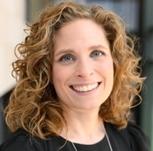
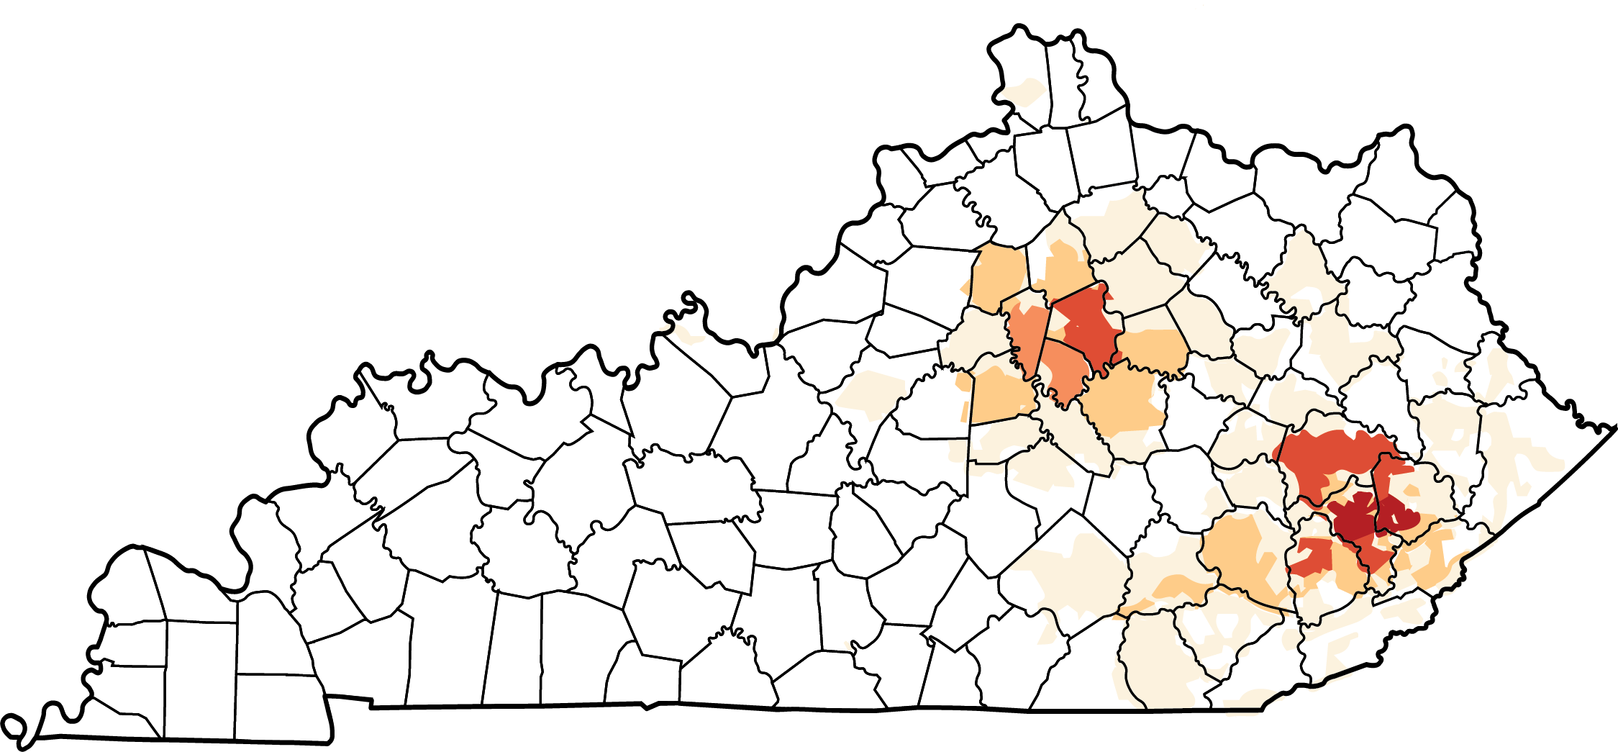


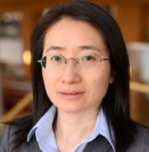
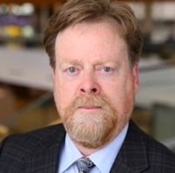
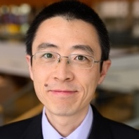
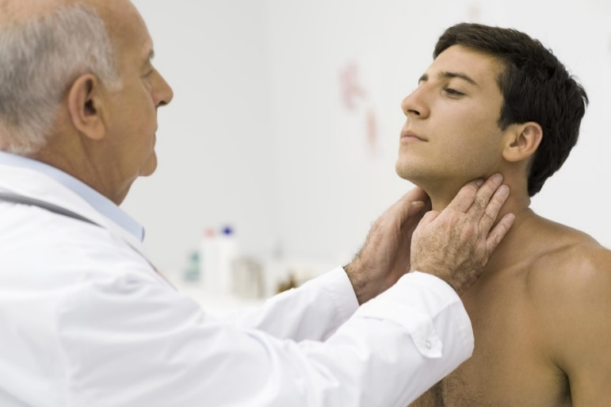
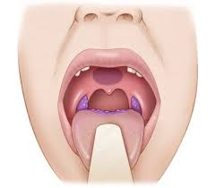
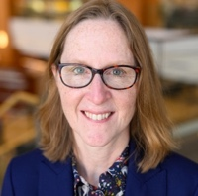
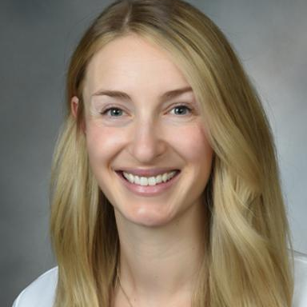
Novel Biomarker-based Screening for Oropharyngeal Cancer
Risk Factors: Observational study of markers of oropharyngeal cancer risk
2,700+ Enrolled
1,500 KY veterans
Oral HPV16
HPV16 E6 Abs
3%
1.3%
Lexington
Percent
Percent
KUHS
Hindman
1%
0.5%
Hazard
55% Ever Smokers
US
KY
US
KY
L. CHEN
DURBIN
C. WANG
Cancer Screening: Testing new methods for early detection
17 HPV16 E6+
Screened
ARNOLD
WINDON New recruit
Head and Neck Cancer Screening
T1N1 (Stage 1) HPV+OPSCC
T2N1 (Stage 1) HPV+OPSCC
Mass Detected
(biopsy planned)
FUNDING
R01 DE029650; R21 CA267152; American Cancer Society SPA-RFA-TEAM-24-1076353-; Department of Defense HT94252411027
Impact
Practice changing: largest U.S.-based study to evaluate HPV16 E6 antibodies for early detection of oropharyngeal cancer
Potential to develop first screening method for oropharyngeal cancer
Notes:
Oropharyngeal cancer incidence is rapidly increasing within the US, and there are no methods for early detection. Kentucky has one of the highest incidence rates in the nation. Funded by the American Cancer Society, a transdisciplinary team of CP researchers is leading the first large study to evaluate the HPV16 E6 biomarker for the early detection of oropharyngeal cancer. Among the more than 2,700 participants enrolled to date, the team has found a prevalence of oral HPV16 three times higher than national estimates and an HPV16 E6 marker prevalence nearly 3 times higher than previous studies. To date, 17 HPV16 E6 seropositive participants have undergone head and neck cancer screening, of which, two have been diagnosed with asymptomatic early-stage oropharyngeal cancer, with a third participant currently undergoing biopsy. While preliminary, these early results suggest that this new screening method may two to three times more accurate than cervical cancer screening. Investigators recently received funding from the Department of Defense to expand this study to our veteran population in a historic collaboration with the Lexington Veterans Administration. This practice-changing work could help develop methods for early detection of oropharyngeal cancer.

Slide 17
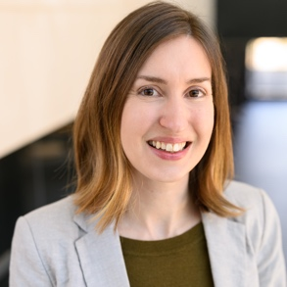








Survivorship for Patients with Advanced Stage Lung Cancer
Survival has improved; unmet care needs persist
Unmet supportive care needs related to psychological well-being, physical and daily living
“Hope”-based interventions as a promising approach to support mental health and quality of life during treatment
55%
MCLOUTH
“Pathways,” A Hope-Based Intervention for Patients with Advanced Stage Lung Cancer
Theory-based psychological intervention embedded in cancer care, designed with patient and provider input
Definitive Efficacy Trial:
1. Efficacy – depression symptoms (primary), quality of life, positive affect
2. Mechanisms
3. Intervention completion and benefit (≥ 65 yrs vs. <65; rural vs. urban; male vs. female)
2025 Citation Award
Notes:
As recognized by several NCI reports and a recent NOSI, addressing the survivorship needs of the growing population of patients living longer with advanced stage lung cancer is major priority for cancer prevention and control. Dr. McLouth has been leading efforts to understand and meet the care needs of this population. Through an NCI-funded R03, she developed and piloted a novel psychosocial intervention delivered at the point of cancer care to increase patients’ cognitive behavioral skills that support hope. She is currently conducting a definitive efficacy trial of the intervention to evaluate its effects on depression symptoms, as well as determine whether older, rural, and male patients are reached through delivery at infusion. Her work has generated positive commentary from leaders in the field and her R01 is supported by the Cancer Moonshot Initiative.

Slide 18







Taking ACTION Appalachian Career Training In Oncology to Train Appalachian Students
Impact
157 Appalachian students trained (80 high schoolers; 77 undergraduates)
51/55 of eligible high school students have matriculated to college
44 matriculated into medical school
15 graduates (all in residency) with 6 planning to practice in KY
4 matriculated into pharmacy school
4 matriculated into physician assistant (PA) Master’s program
1 achieved a cancer biology PhD
27 peer-reviewed manuscripts
4 published books of student essays
VANDERFORD
CP
41 of 54 Appalachian counties

Slide 19

Impact of MCC’s Growth on Kentucky: Investing in Kentucky’s Economy
From 2011 to 2023, Markey increased the number of jobs it directly employed or funded by 172%.
Statewide growth was only 13%.
For every 1 job the Markey Cancer Center supports, 0.89 of a new job is created in Kentucky—nearly a1:1 ratio.

Slide 20
WE NEED YOUR
CONTINUED SUPPORT!

Slide 21

Thank you!

