Slide 1

A Presentation to the Tobacco Settlement Oversight Committee December 22, 2025 Jason Chesney, M.D., Ph.D. Brown Cancer Center Director

Slide 2
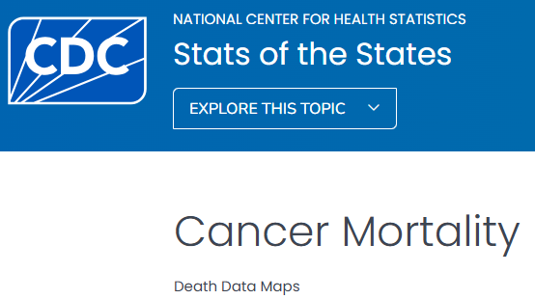
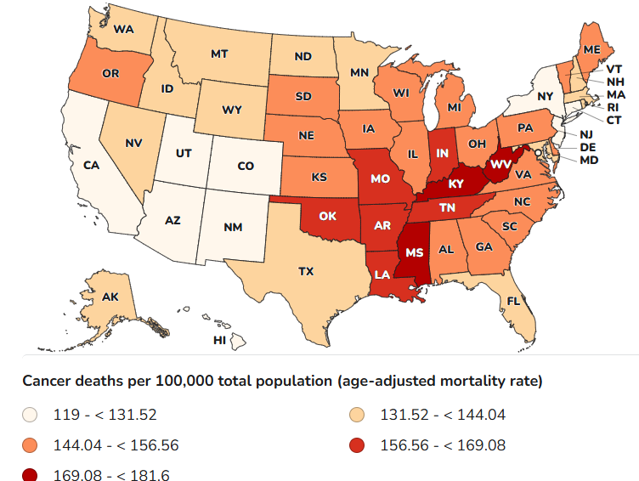
Kentuckians Suffer From the Highest Cancer Death Rate in the United States 181.6 deaths/100,000 (>10,000 deaths/year)
#2
#17
#1
#37

Slide 3
What Is the Economic Impact of Cancer Deaths In KY?
American Cancer Society Cancer Atlas:
10,300 cancer-related deaths in Kentucky translates into $3.1B in lost productivity and $2.7B in health care costs each year
The average number of close family members and acquaintances who are intimately affect by a cancer-related death is 10
Many Kentuckians are needlessly dying of cancer and their suffering and deaths affect the emotional and financial welfare of >100,000 Kentuckians each year as well as Kentucky’s economy (total = $5.8B/year)

Slide 4
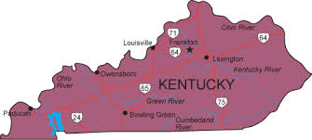
Why Is Kentucky #1 in Cancer-Related Deaths in the U.S.?
Kentucky has only two academic cancer centers within 70 miles of each other in the Northern part of the state
This limits access to comprehensive multi-disciplinary cancer care and screening programs for rural Kentuckians including:
Subspecialists who focus on one type of cancer
Multi-disciplinary teams with medical, radiation and surgical oncologists
Outreach and cancer screening programs
Education programs for healthcare staff and providers
Life-saving clinical and translational research programs
#2
#17
#1
#37

Slide 5
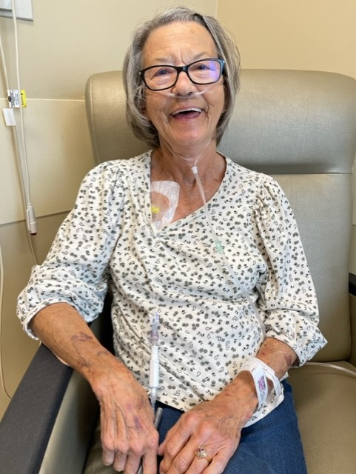
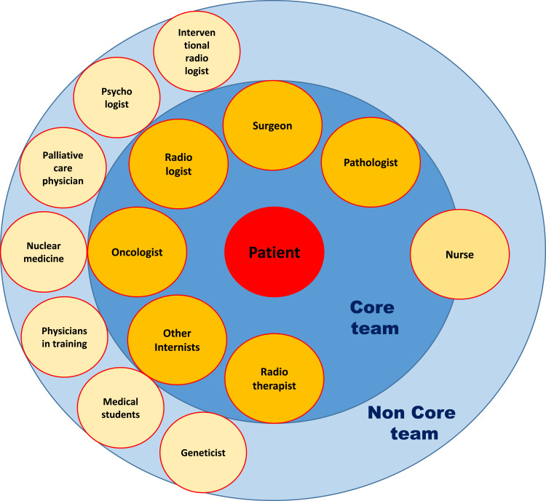
Multi-Disciplinary Teams That Focus on One Type of Cancer Have Been Proven to Increase the Survival of Cancer Patients¹
Example: UofL’s Brown Cancer Center’s Multi-Disciplinary Lung Cancer Team meets weekly to formulate comprehensive treatment plans and to evaluate screening results from low dose chest CT diagnostic imaging
Three thoracic surgical oncologists: Matt Fox, Victor Van Berkel and Matt Black
Three medical oncologists: Goetz Kloecker, Phuong Ngo and Jason Chesney
Two radiation oncologists: Neal Dunlap and Craig Silverman
Nurse navigators, social workers, pharmacists, dieticians, and research nurses
#2
“I wouldn’t be here if it weren’t for Drs. Van Berkel, Dunlap and Chesney.” Shirley Hatfield, Hardin Co
#17
#1
#37
1. Benefits of a Multidisciplinary Approach in Cancer Patient Management. Cancer Management Research. 2020; 12: 9363–9374.

Slide 6
UofL’s Brown Cancer Center’s Multi-Disciplinary Teams Deliver Comprehensive Care to Patients Across Kentucky
>15,000 Patient Encounters From Central and Western Kentucky Each Year
#2
BCC
#17
#1
#37

Slide 7
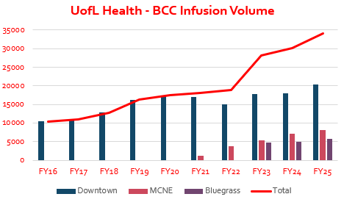
Outpatient Infusion Volume at UofL’s Brown Cancer Center Has Nearly Quadrupled Since 2017 Due to a Rise in Cancer Cases
#2
#17
#1
#37

Slide 8
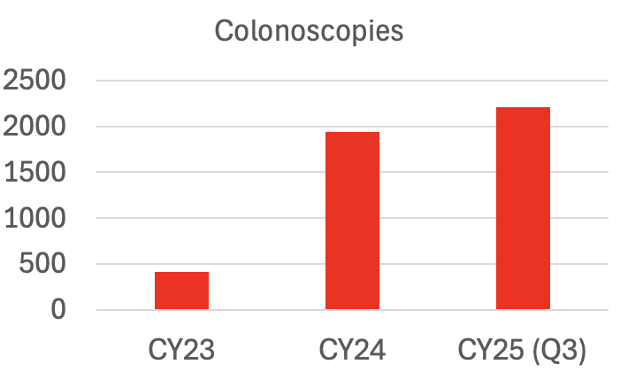
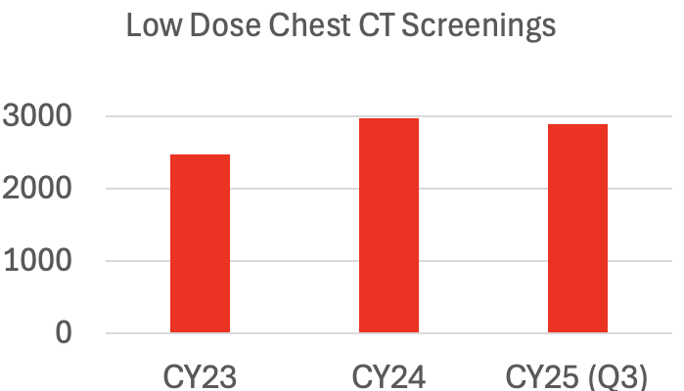
UofL’s Brown Cancer Center Has Markedly Increased Cancer Screenings
Although mammography data from CY23 and CY24 are not comprehensive, UofL’s Brown Cancer Center conducted 17,921 breast cancer screenings in FY25

Slide 9
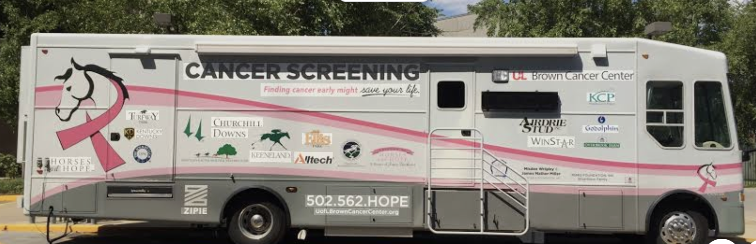
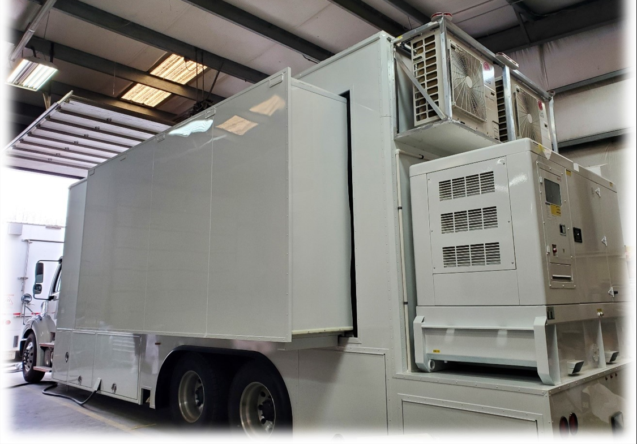
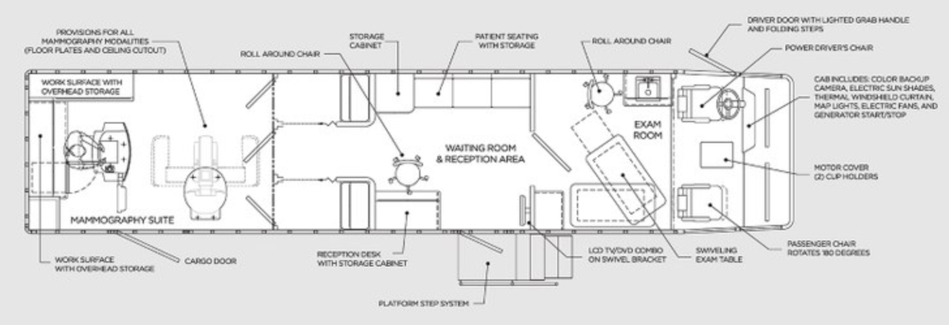
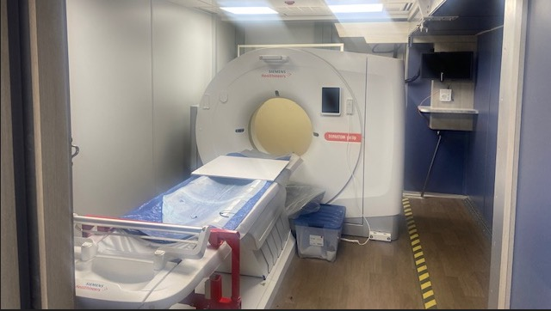
>2,000 Breast Cancer Screenings Were Conducted by Our Mobile Mammography Unit in CY25 at Churches, the Kentucky State Fair and Community Outreach Events
Mobile Mammography Unit
New Mobile Chest CT Unit

Slide 10
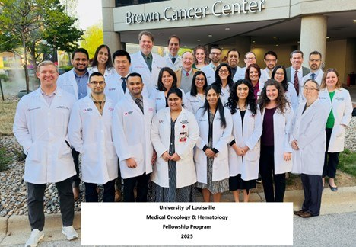
We Are Training the Next Generation of Oncologists and Cancer Researchers
Four medical oncology and hematology fellows are accepted into this 3-year training program each year resulting in a total of twelve fellows
Graduates practice oncology across Kentucky including in Paducah, Lexington, Owensboro, and Bowling Green
UofL’s Brown Cancer Center is currently training 16 graduate students and 23 post-doctoral fellows to conduct cancer research

Slide 11
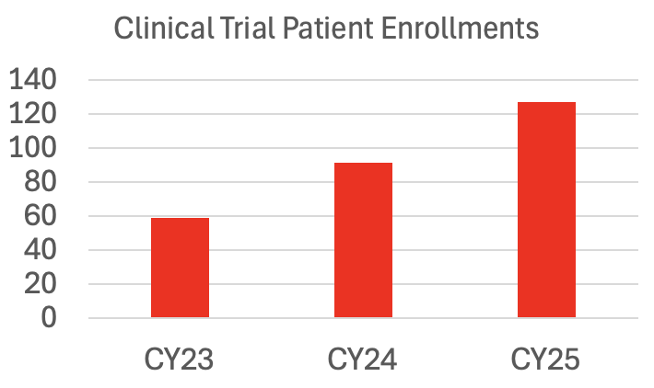
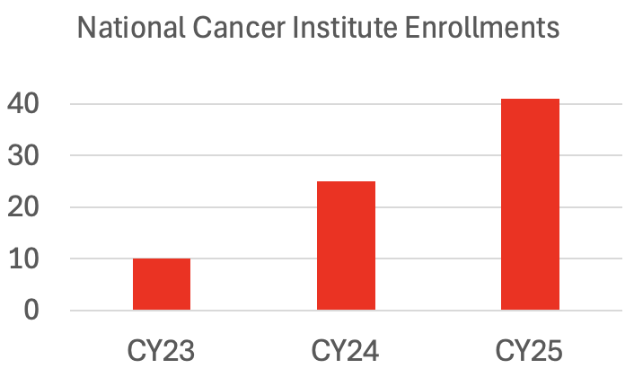
We Are Expanding Actively Enrolling Clinical Trials to Reduce the Cancer Death Rate In Kentucky
86 Actively Enrolling Clinical Trials
321 Additional Non-Interventional Patient Enrollments in CY25 (YTD)

Slide 12
Funding from the TMSA Has Facilitated the Development of New Life-Saving Immunotherapies for Cancer Patients
UofL’s Brown Cancer Center clinical trials have resulted in five FDA approvals of immunotherapies that have saved countless lives in Kentucky and across the United States
UofL’s Brown Cancer Center was the lead center that led to the FDA approval of a cell therapy called TILs for melanoma, has patients coming from across the U.S. for this cellular therapy and is developing novel, genetically-engineered TILs for multiple cancer types
UofL’s Brown Cancer Center developed the first and only NIH-funded COBRE Center for Cancer Immunology and Immunotherapy in the United States

Slide 13
Clinical Trials of Novel Cancer Therapies Save the Lives of Not Only Participating Patients But Also Future Generations
With TMSA support, the UofL’s Brown Cancer Center focuses on the development of novel immunotherapies that activate T cells to kill cancer cells and is a nationally-recognized leader in the clinical testing of novel immunotherapies
Trials FDA/NCCN Approval
First In Class ICI Ipilimumab, 2006-2009 2011
First In Class OV TVEC, 2009-2012 2015
First In Human ICI Combo Ipi + Nivo, 2012-present 2015
First In Human ICI/OV Combo Ipi + TVEC 2013-2018 2016
First In Class TILs Lifileucel, 2016-2024 2024
Expanded FDA-Approved Indications
Ipilimumab + Nivolumab: HCC, CRC, NSCLC, RCC, SCLC, Meso, Melanoma
TILs: FDA registration trials currently enrolling for NSCLC and EndoMe Ca
#2
#17
#1
#37

Slide 14
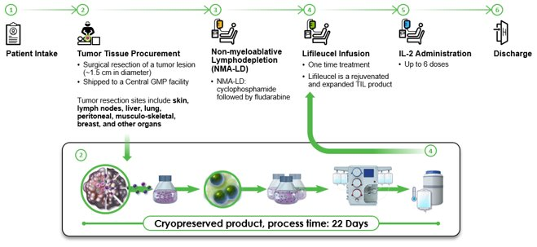

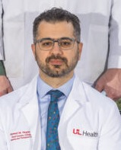
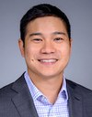
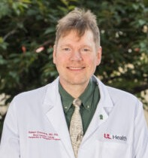
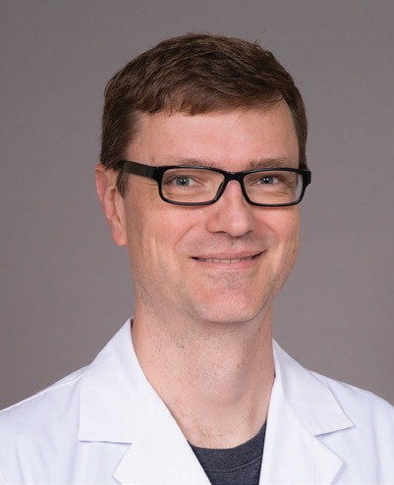
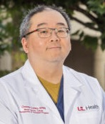
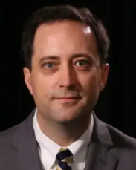
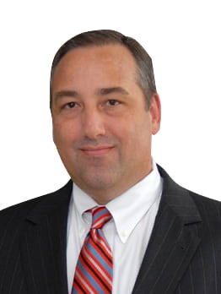
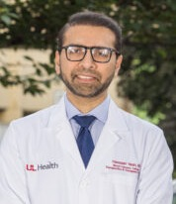
Tumor Infiltrating Lymphocytes (TILs)
Surgical oncologists resect patients’ tumors and then cancer-specific immune cells are grown in the lab and infused back into the patient by BCT oncologists
TILs were only available on the coasts until we began human trials at UofL’s Brown Cancer Center in 2016
14

Slide 15
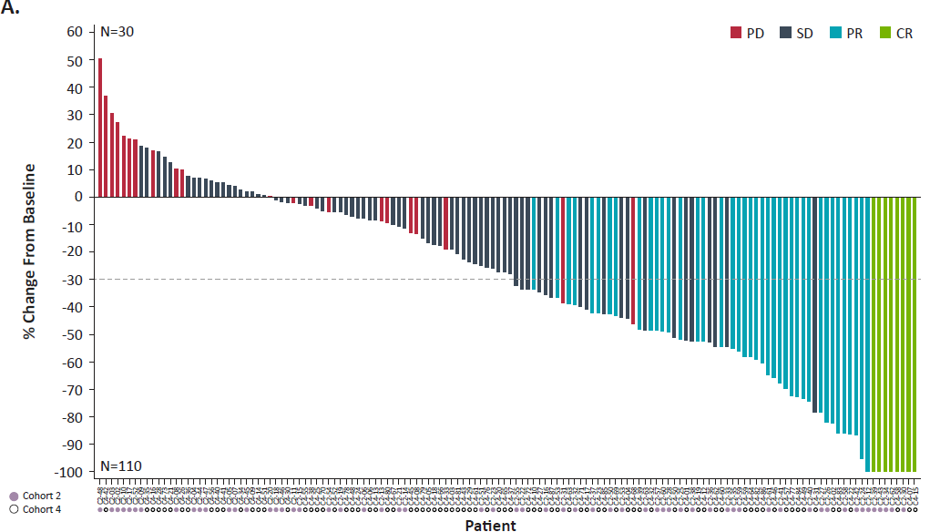
TILs Have Proven Efficacy in Anti-PD1 Refractory Stage IV Melanoma Patients
Waterfall plot
15
Chesney et al. Dec;10(12), 2022

Slide 16
TILs Were FDA-Approved for Anti-PD1 Refractory Melanoma in 2024
The University of Louisville’s Brown Cancer Center served as the lead site for the first multi-center trial of TILs from 2016-2022
TILs for melanoma patients received FDA-approval in February 2024 and we are now studying genetically engineered TILs and evaluating their efficacy in lung, melanoma, cervical, head and neck and endometrial cancer patients
2-16-24 Press Release – Iovance’s AMTAGVI™ (lifileucel) Receives U.S. FDA Accelerated Approval for Advanced Melanoma. “The detailed results of clinical trial C-144-01 are published in The Journal for Immunotherapy of Cancer (Chesney et al 2022)”
The British Broadcasting Company (BBC) produced a documentary in Kentucky this year highlighting the efficacy of TILs in cancer patients
16
Chesney et al. Dec;10(12), 2022

Slide 17
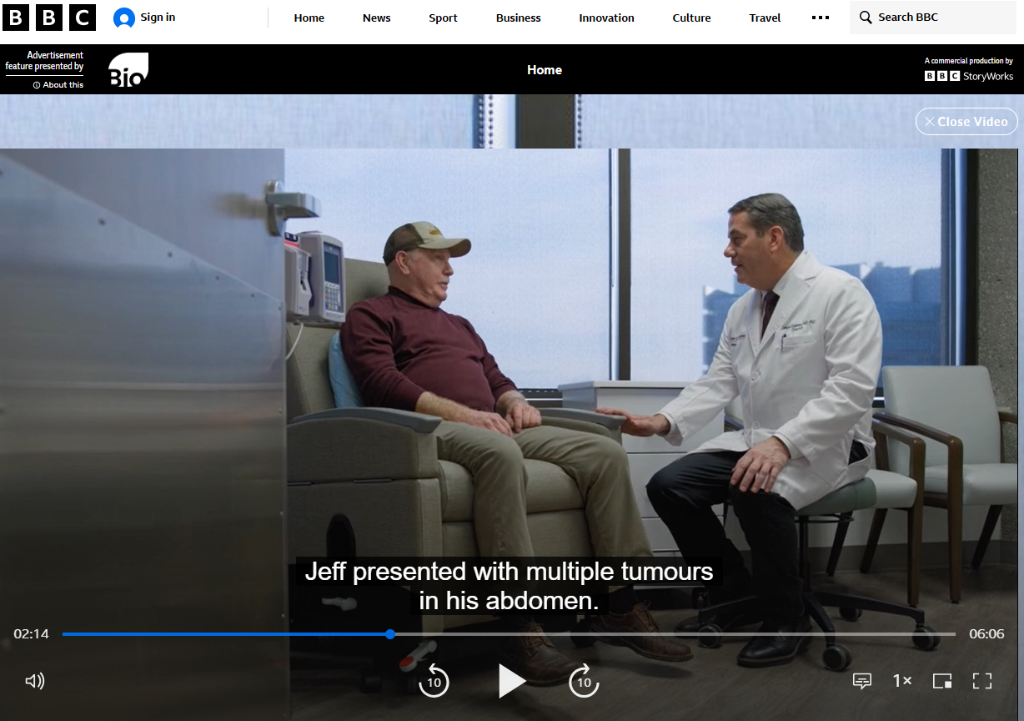
The British Broadcasting Company (BBC) produced a documentary in Kentucky this year highlighting the efficacy of TILs in cancer patients
17
Chesney et al. Dec;10(12), 2022

Slide 18
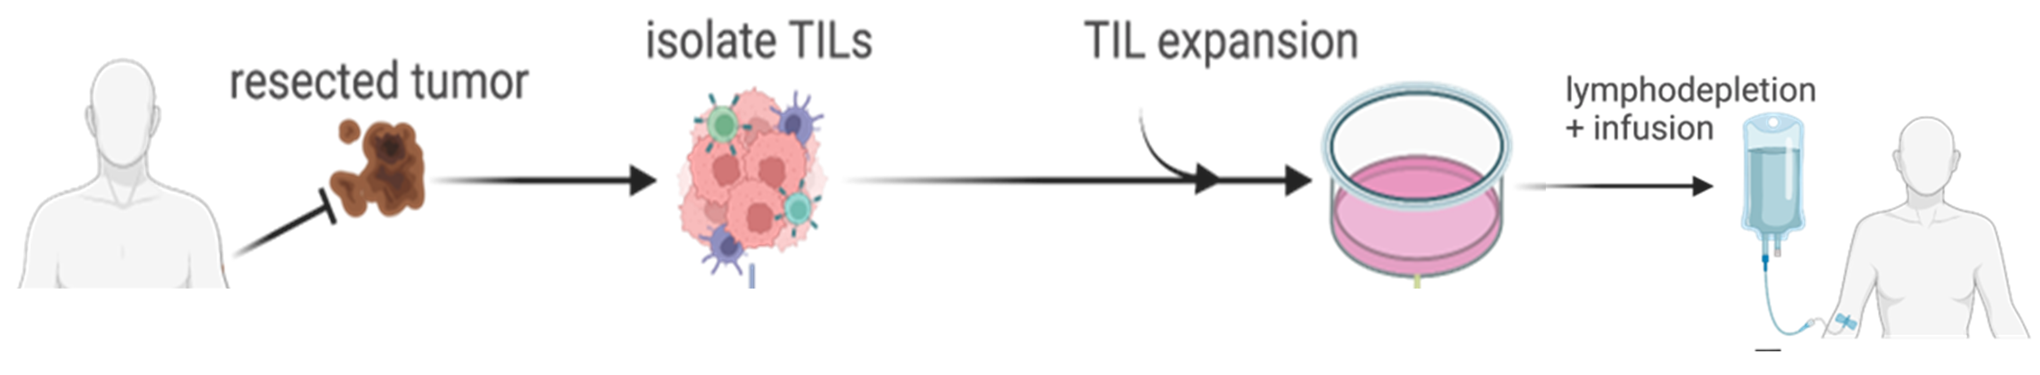
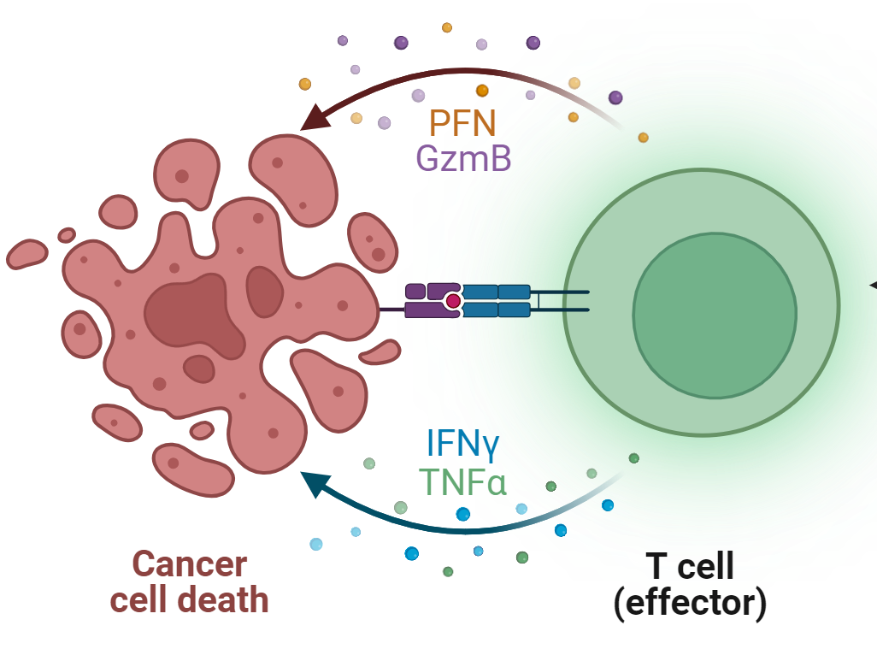
TIL Therapy

Slide 19
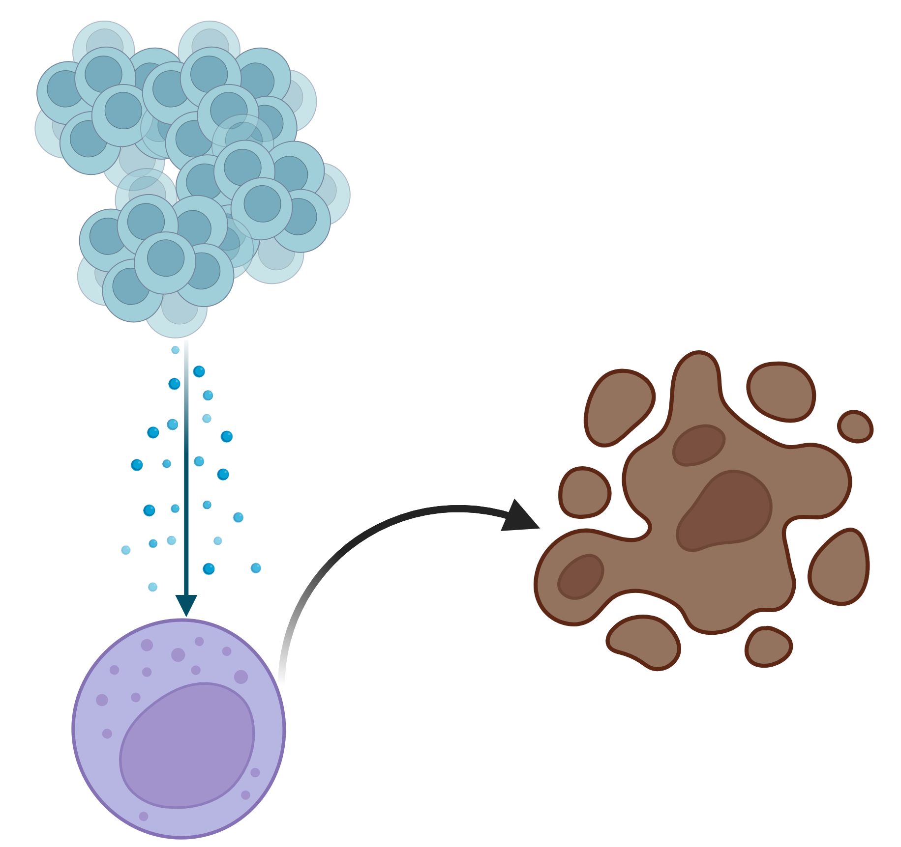
IL-15 produced by TILs can activate Cytotoxic T cells
TILs
Tumor
IL-15
Cytotoxic
T cells

Slide 20
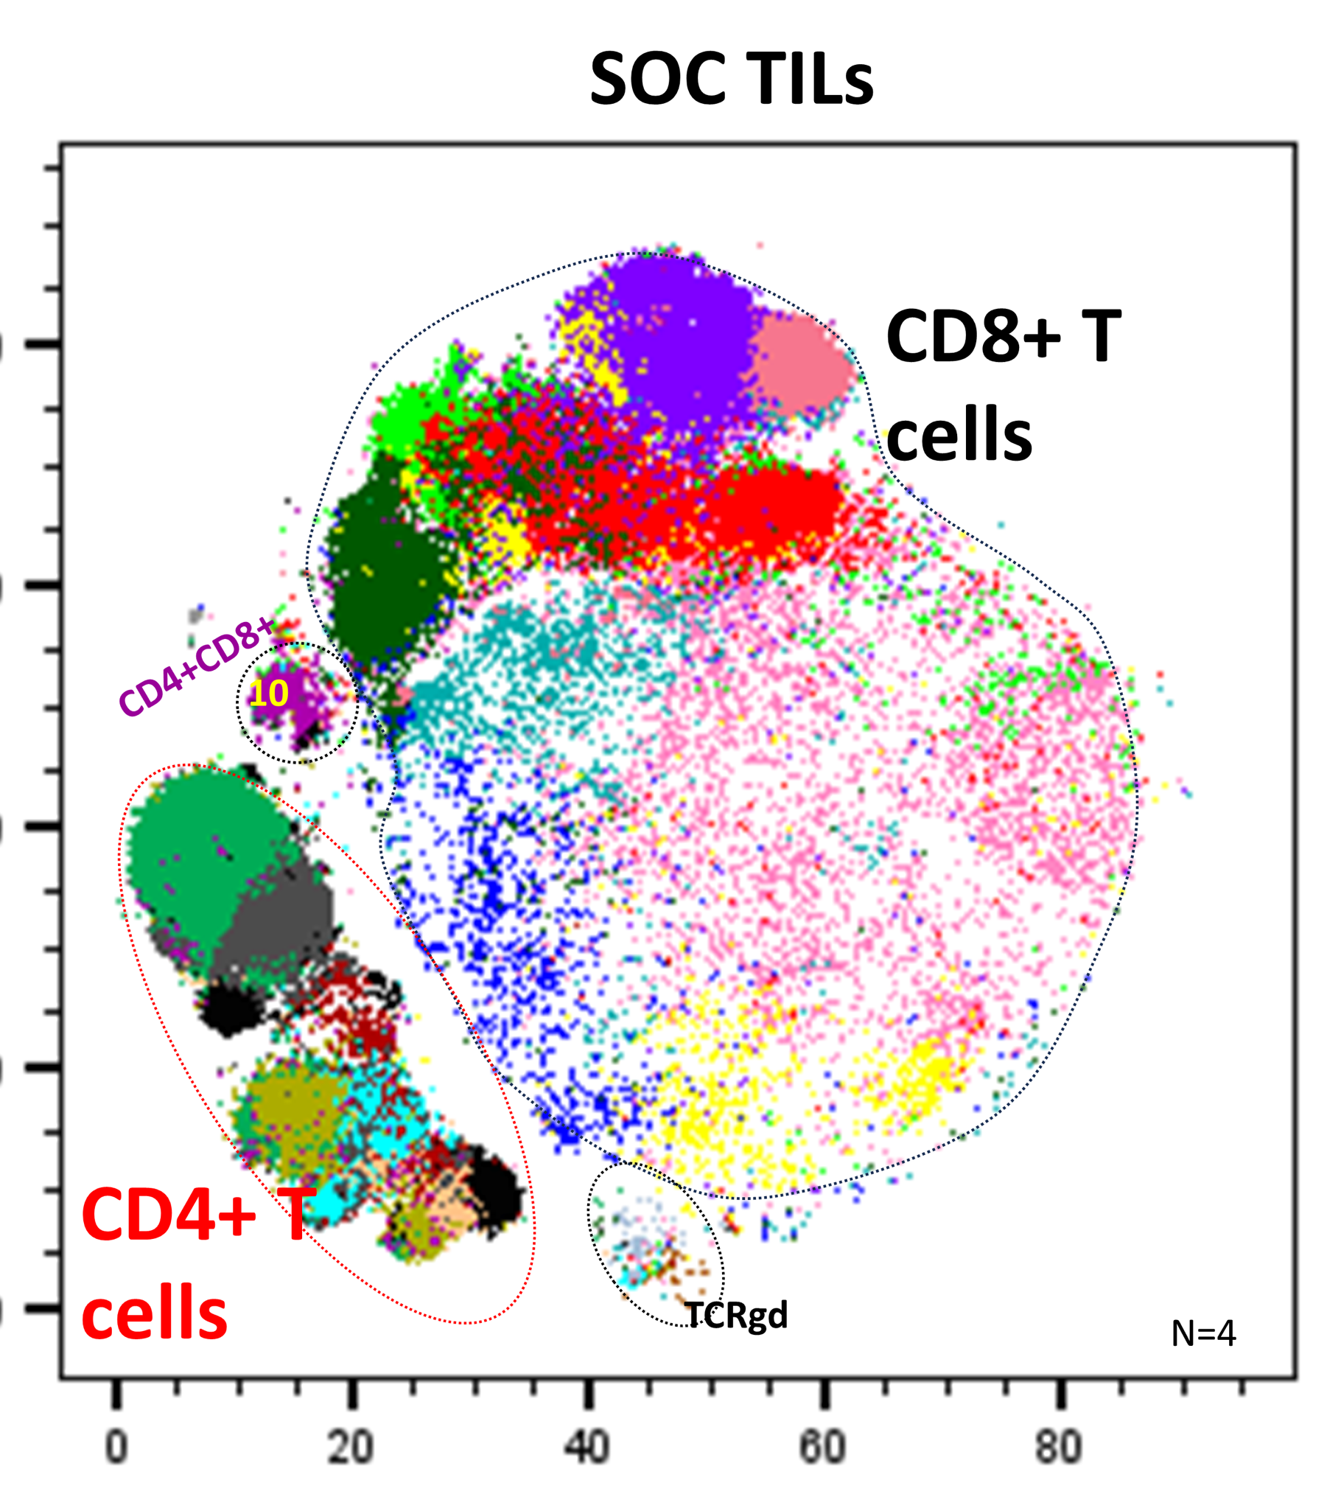
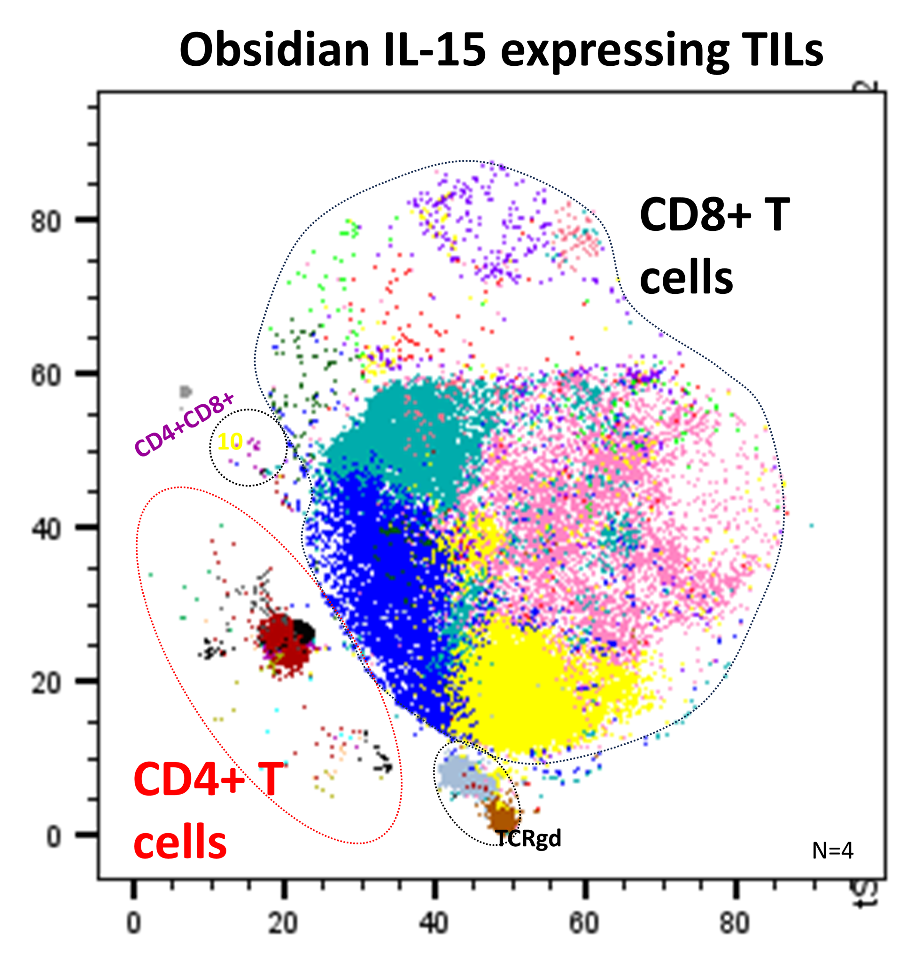
IL-15-producing TILs harbor fewer CD4⁺ T cells
and more activated CD8⁺ T cells

Slide 21
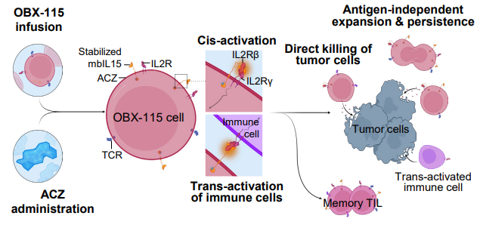
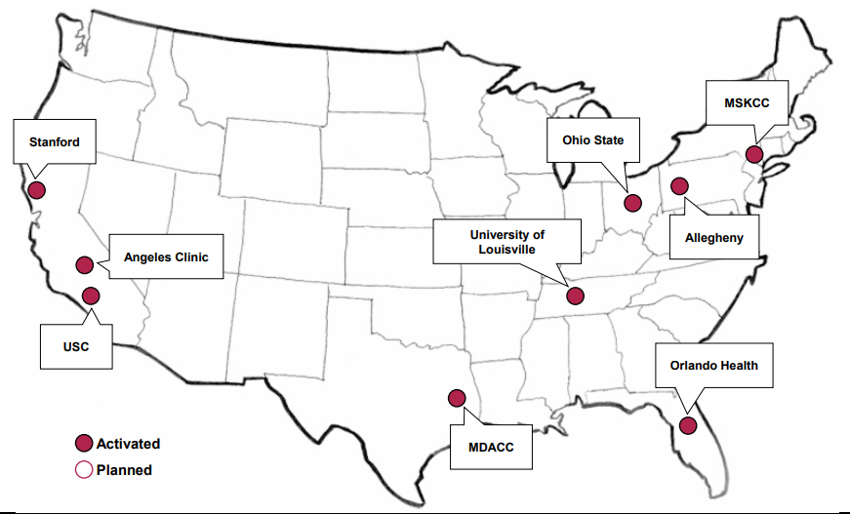
Inducible IL-15 TILs in Melanoma & Lung Cancer Patients
#2
#17
#1
#37

Slide 22
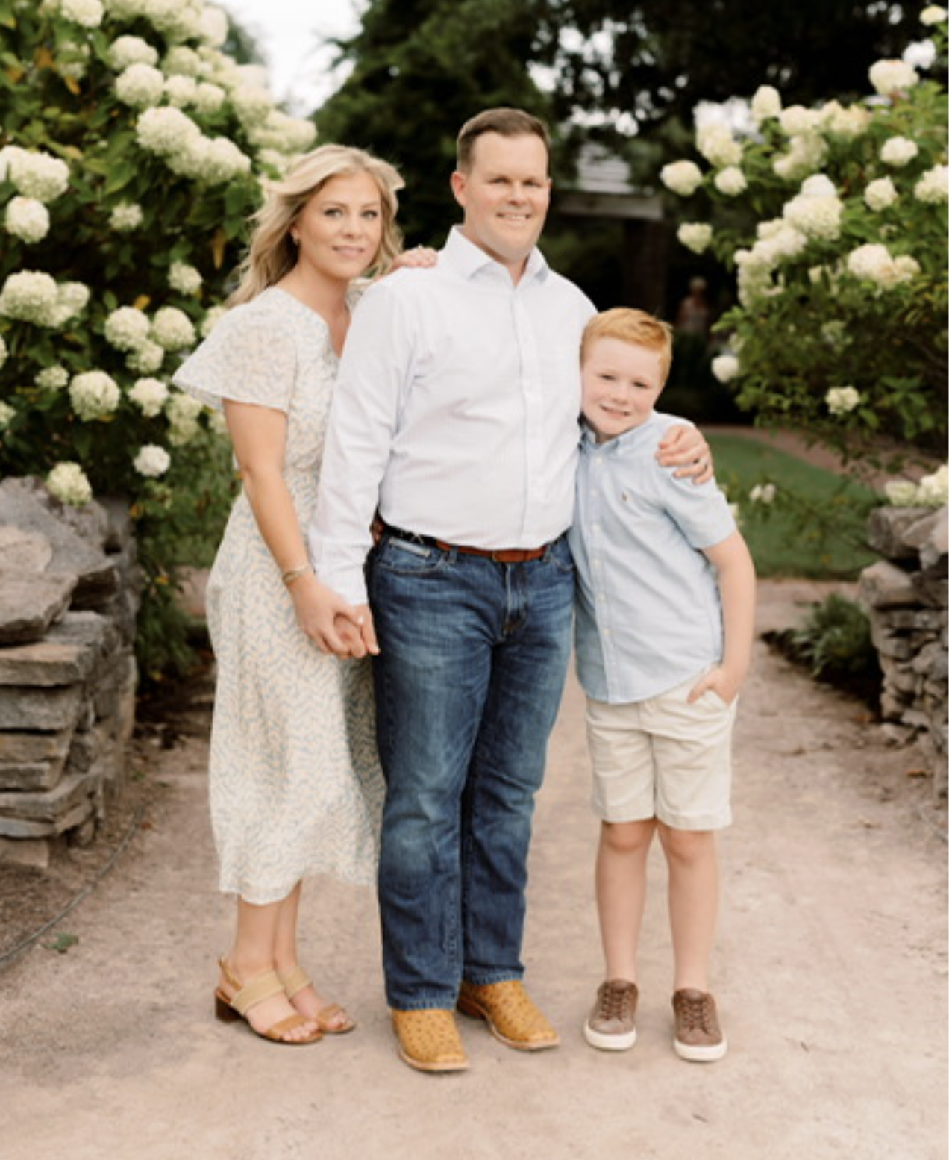
Kenneth Osborne, Age 41 – Lexington, Kentucky

Slide 23
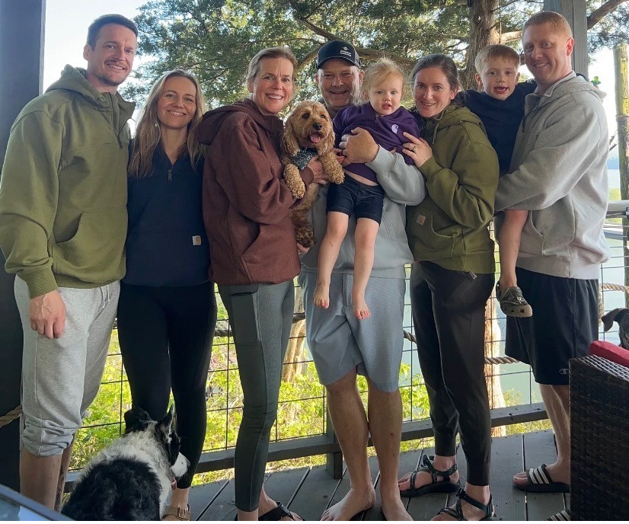
Beth Coleman, Age 62 – Butler, Illinois

Slide 24
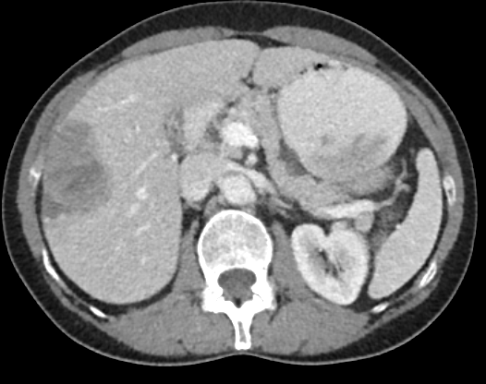
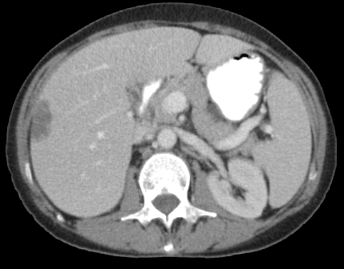
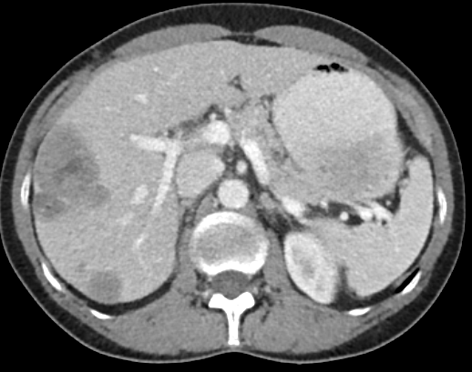
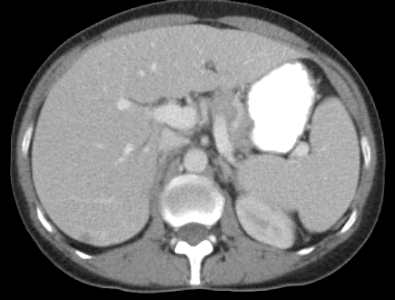
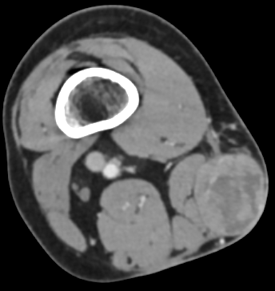
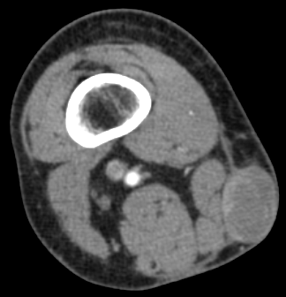
+ OBX-115
(Day 42)
59mm
33mm
TL1: Segments 5/6 Inferior Right Hepatic Lobe
22mm
8mm
TL2: Segment 7, Right Hepatic Lobe
38mm
30mm
TL4: Right Thigh

Slide 25
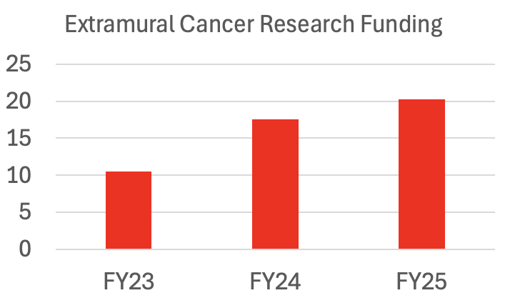
UofL’s Brown Cancer Center Has Doubled It’s Annual Cancer Research Funding from $10.5M to $20.3M in the Past 3 Years

Slide 26
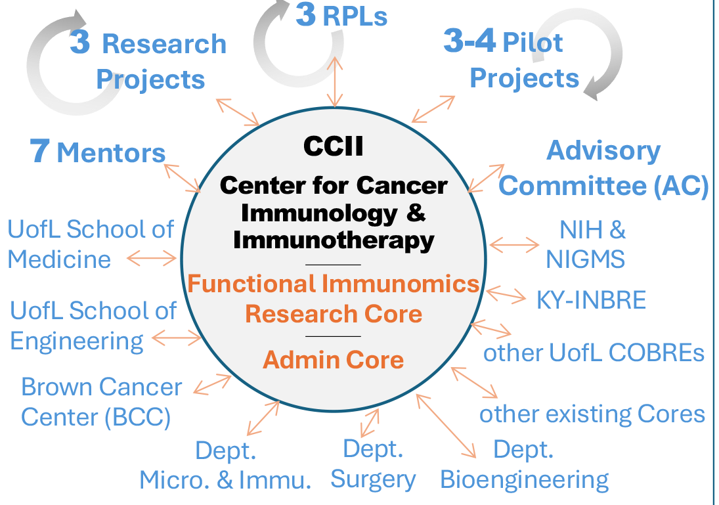
Center for Cancer Immunology and Immunotherapy (CCII) Renewed by the National Institutes of Health
Co-Directors: Jun Yan (PI) and Chesney - $11.71M (FY26-FY31)
Expands a multidisciplinary program in cancer research, training, mentoring, and career development
Enhances research resources to promote and expand thematic cancer research
Expands the CCII pilot project program that supports new R01/R21 grants
Supports the long-term financial sustainability of the CCII

Slide 27
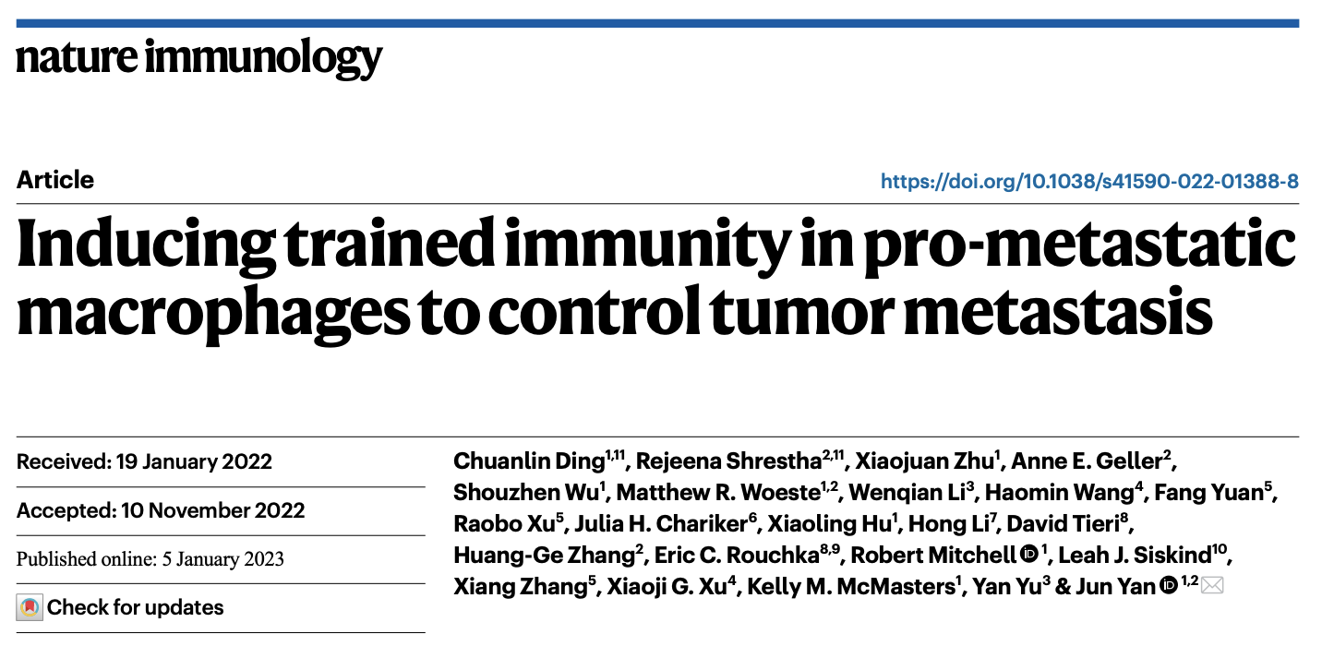
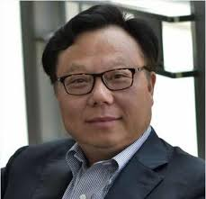
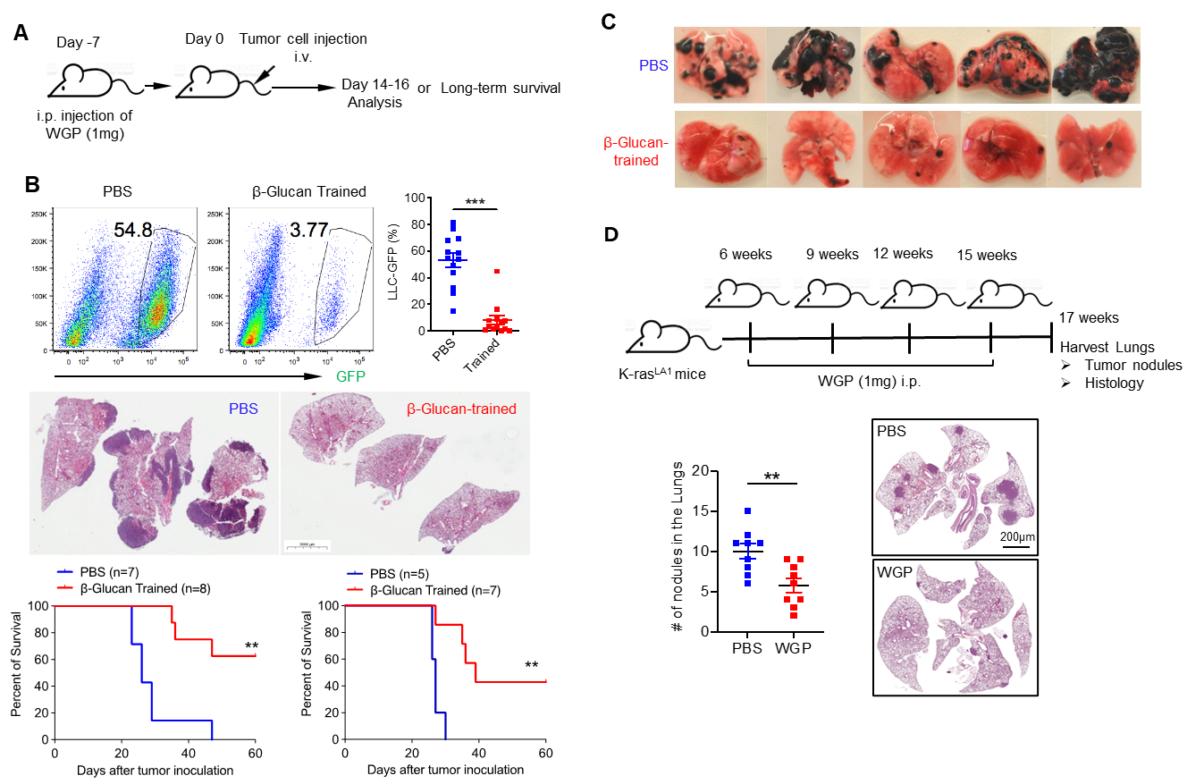
Jun Yan, M.D., Ph.D.

Slide 28
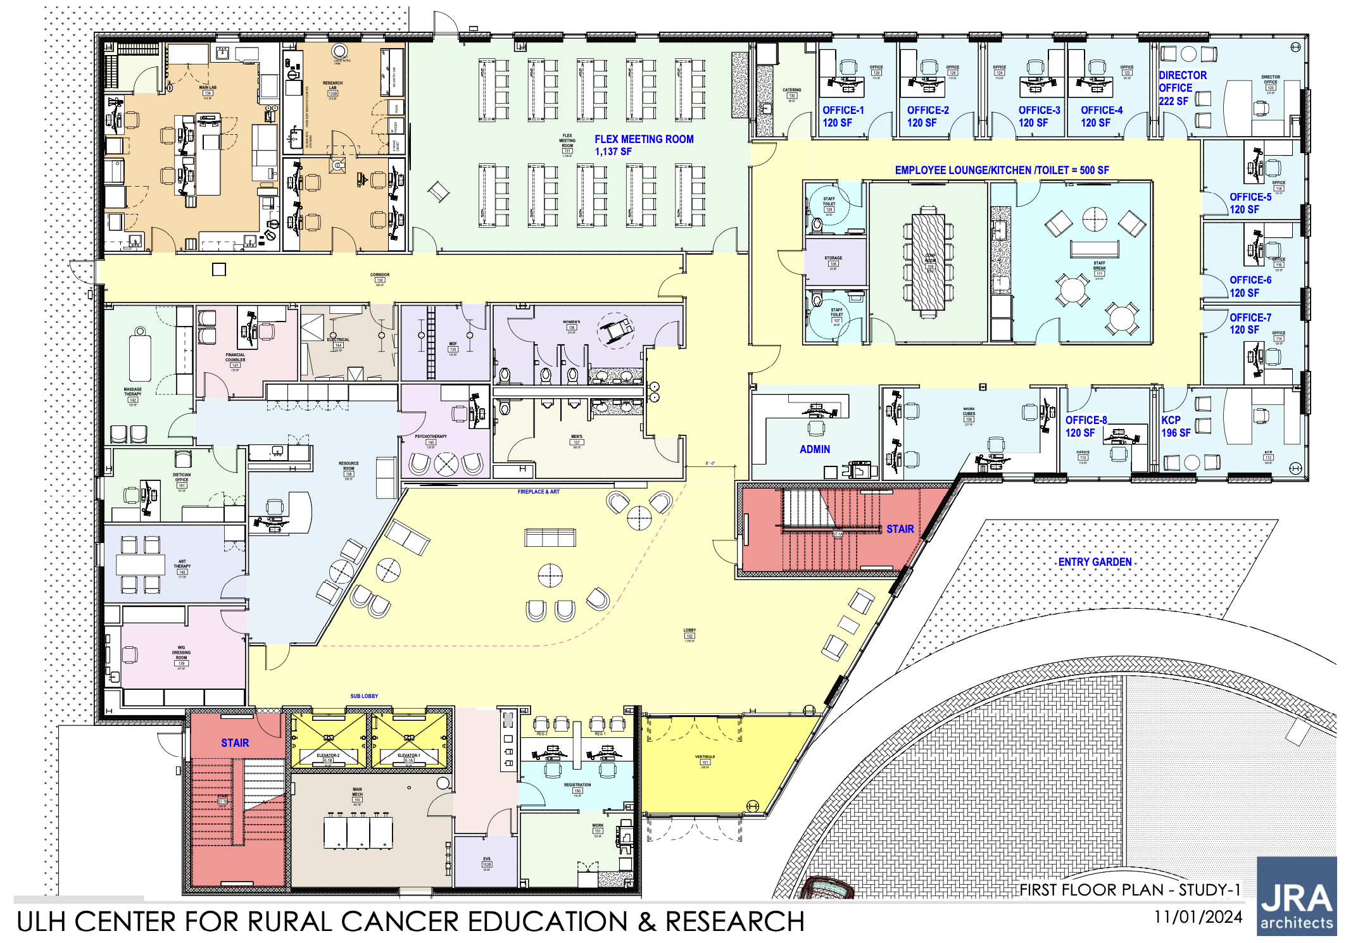
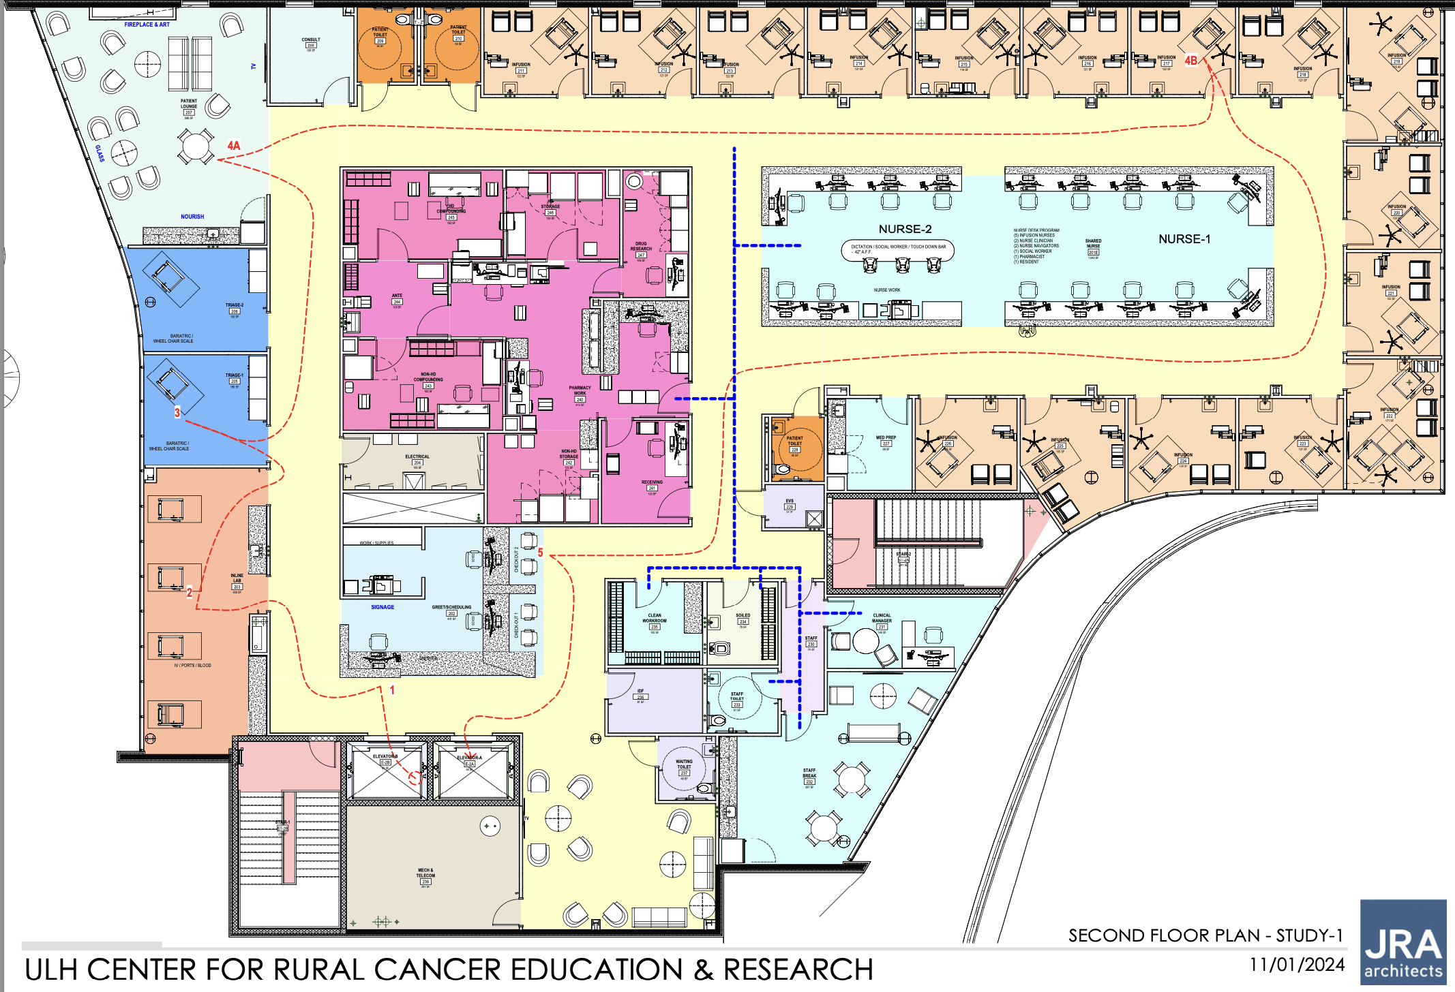
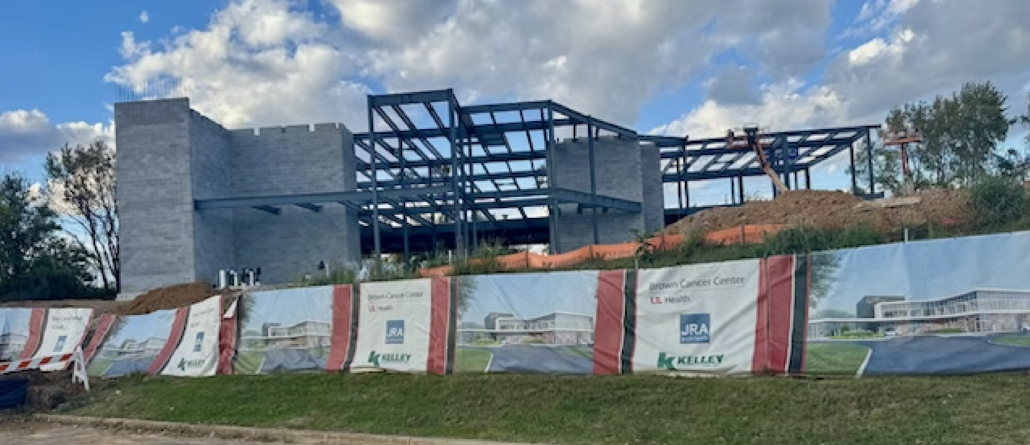
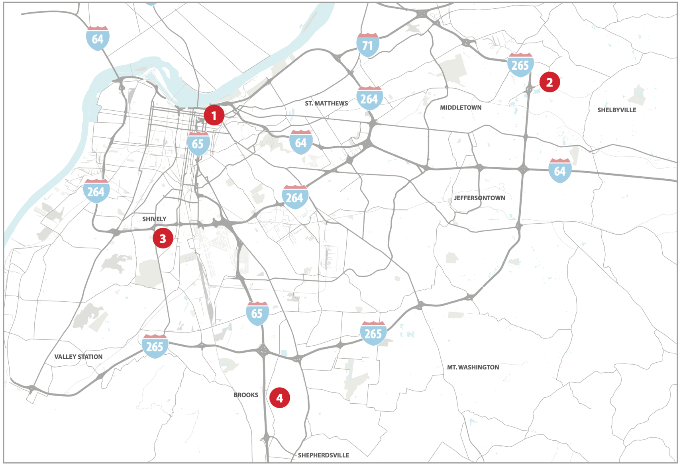

With Support From the Commonwealth of Kentucky, UofL Is Expanding the Reach of Our Multi-Disciplinary Teams, Cancer Screening Programs and Clinical Trials Into Rural Kentucky

Slide 29

With Support From UofL Health, the Brown Cancer Center Is Expanding our Life-Saving Cellular Therapy Programs Into University Hospital’s New West Tower

Slide 30

With Support From UofL Health, the Brown Cancer Center Is Expanding our Life-Saving Cellular Therapy Programs Into University Hospital’s New West Tower

Slide 31
Kentuckians Suffer From the Highest Cancer Death Rate in the U.S. (181.6 deaths/100,000)
#2
#17
#1
#37

Slide 32

Over the Past 20 Years, the U.S. Cancer Death Rate Declined by 26% While Kentucky’s Cancer Death Rate Declined by Only 4%
181.6
141.8
~1800 Preventable Deaths from Cancer Per Year in KY

Slide 33

Annual State Funding for Cancer Research and Screening
Kentucky
UK Markey Cancer Center $4.2M
UofL Brown Cancer Center $4.2M
Cancer Funding Per Capita $1.83
Cancer Death Rate 181.6/100,000
North Carolina
UNC Lineberger Cancer Center $59.5M
Cancer Funding Per Capita $5.39 (3-fold higher)
Cancer Death Rate 151.1/100,000

Slide 34
It Takes a Village
In 2017, the general assembly increased the tobacco excise tax by 50c to $1.10/pack but none of this new revenue was appropriated for smokers who need lung cancer screenings, outreach, clinical trials and care
10c/pack to support our two academic cancer centers would improve Kentuckians’ health and welfare, the state’s economy (recall that cancer causes $5B+ in economic consequences), and reduce the nation’s highest cancer-related death rate
The TMSA was settled to address the health issues caused by tobacco companies – currently, less than 10% of this annual funding is used to support the care of smokers who develop lung cancer
Our collective goal is to drop the cancer death rate by 50% in the next 10 years – we greatly appreciate the $8.4M in state support to Kentucky’s two academic cancer centers but need your help to prevent thousands of cancer deaths in Kentucky each year
Thank you!!!

