Slide 1
KOAP’s Reports of
December 2024 - April 2025

Slide 2
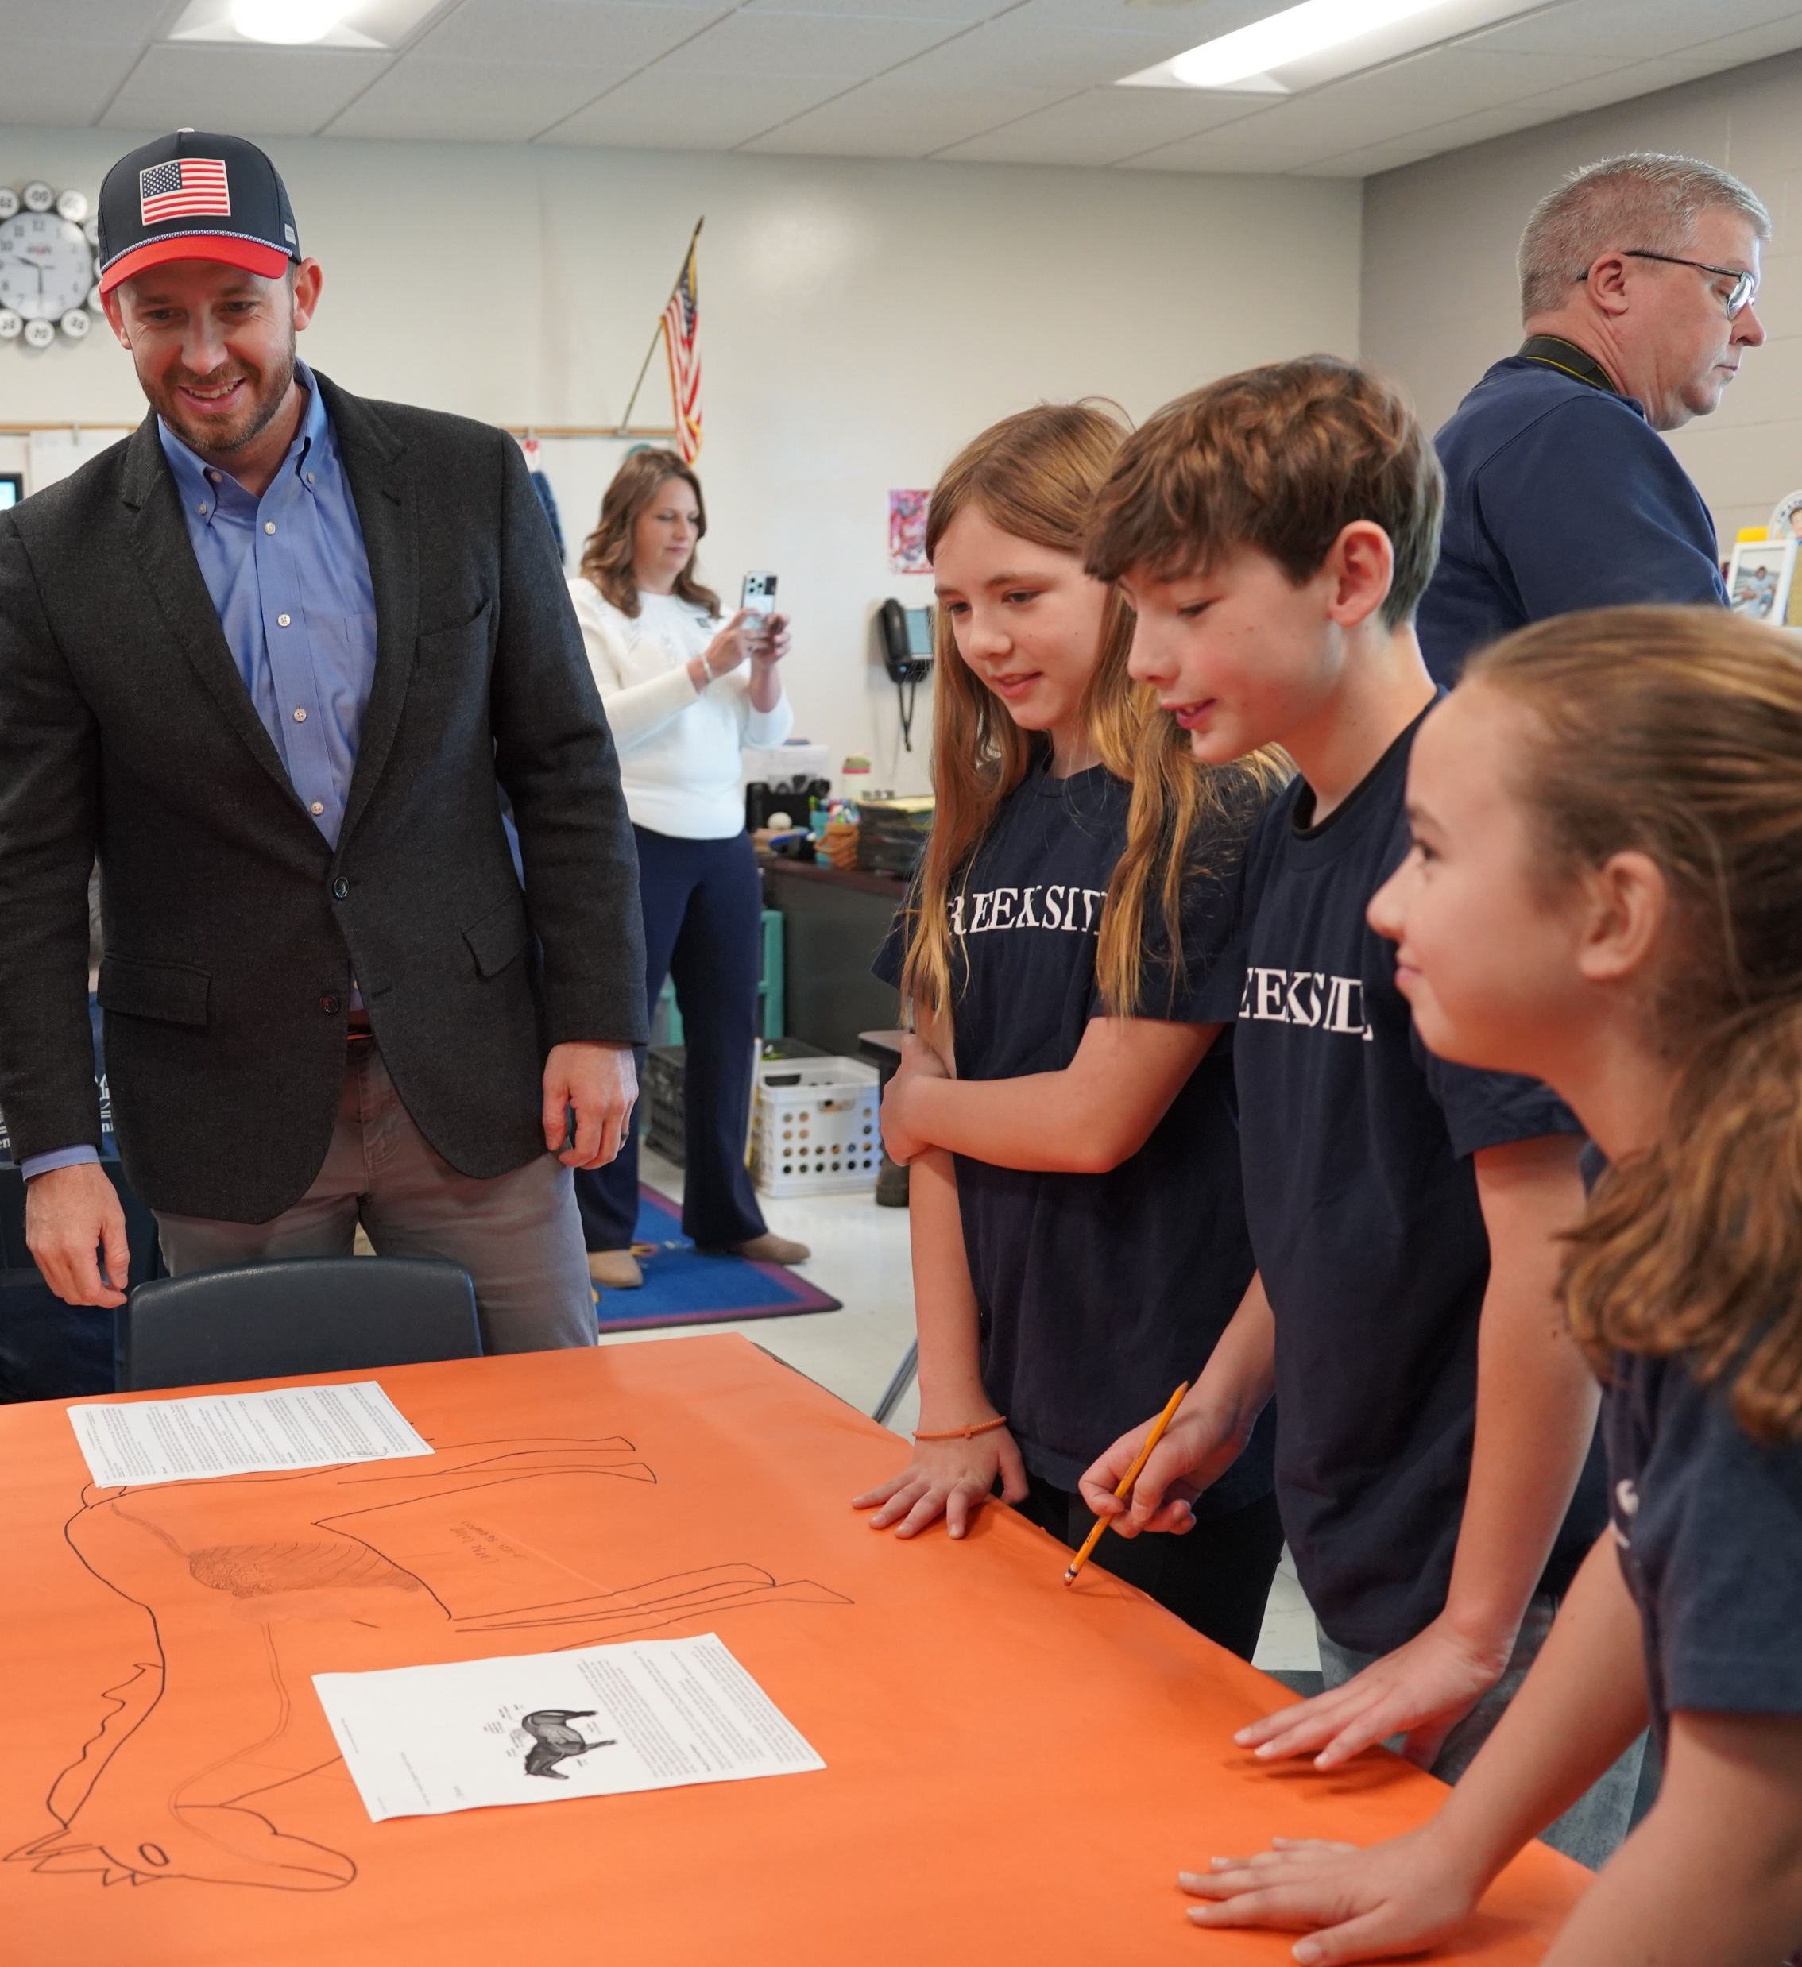
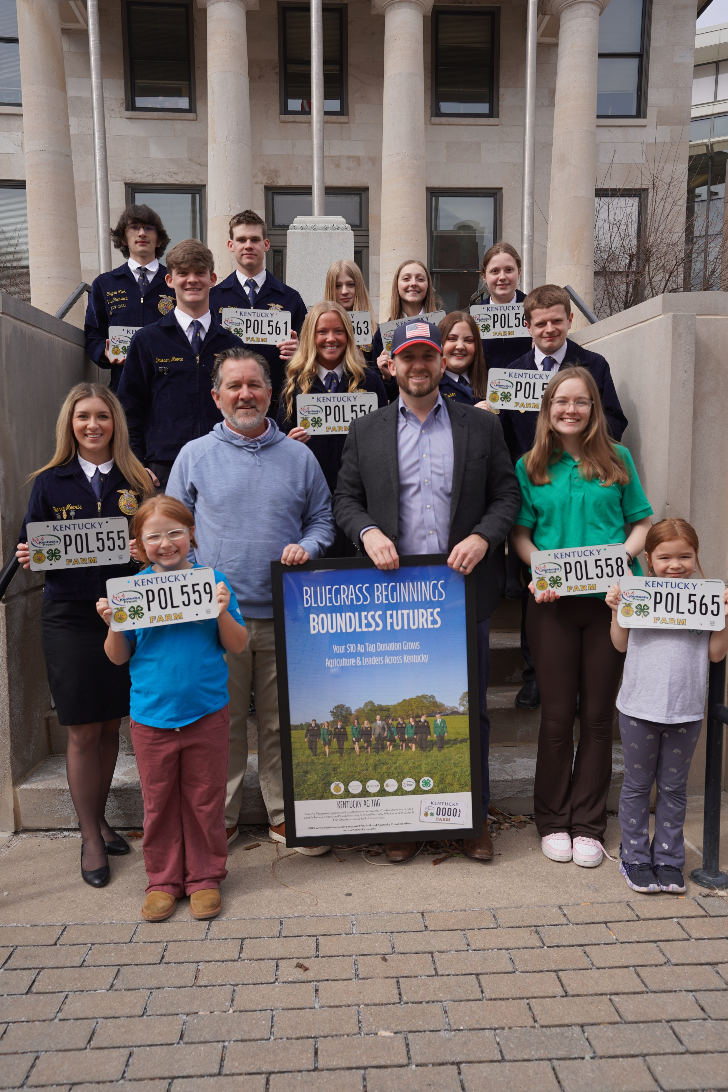
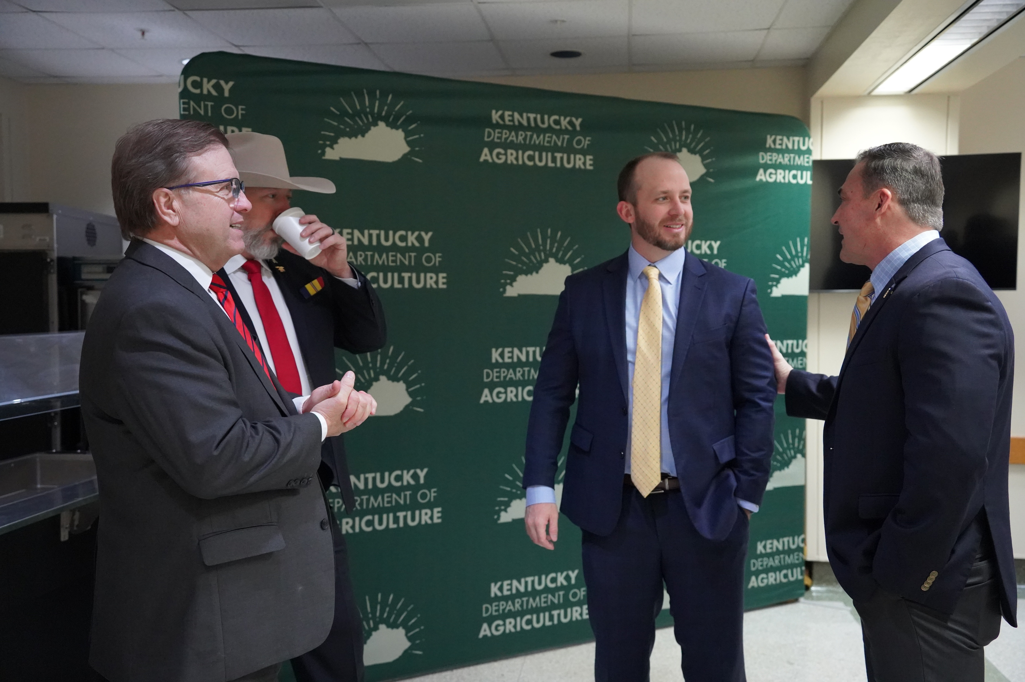
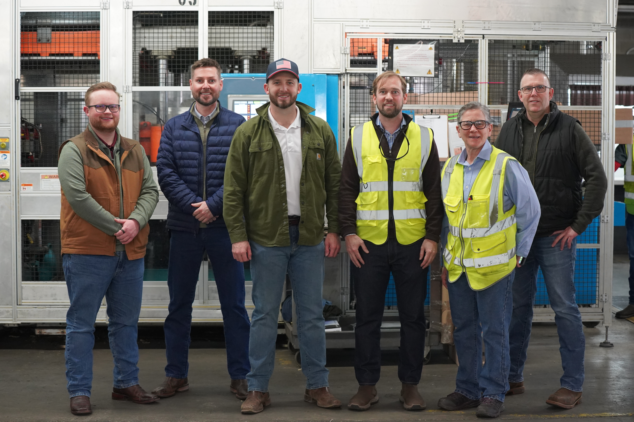
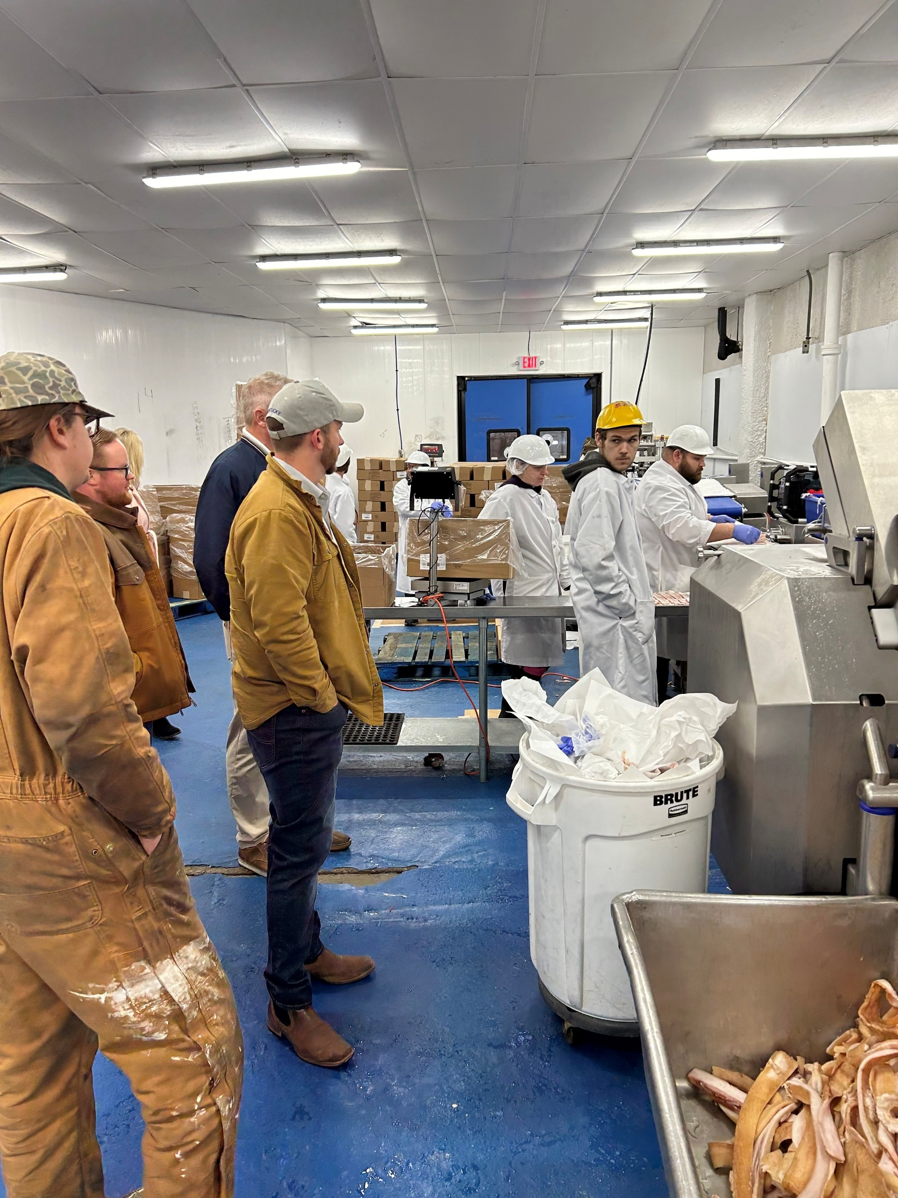
Kentucky Department of Agriculture

Slide 3
KOAP Staff
Brandon Reed
Executive Director
Bill McCloskey
Deputy Executive Director
Bill Hearn
Fiscal Officer
Brian Murphy
General Counsel
Chelsea Smither
KADF Project Manager
Hannah Sharp-Johnson
Boards & Special Events Manager
Alexis Scheidt
KADF Project Manager
Jeff Parman
KADF Program Compliance Manager
Landon Peach
KADF Project Manager
Hunter Jones
KAFC Loan Programs Manager
Bailey Siry-Crowder
KADF Project Compliance Manager
Rebecca Besok
KADF Project Manager
Sarah Bryant
KADF Programs Manager
Savanna Hill
KADF Project Manager
Tera Roberts
KAFC Loan Programs Manager

Slide 4
Monthly Board Approvals:
December
KADB KAFC
$7.8 Million $3.3 Million
January
KADB KAFC
$2.5 Million $2.9 Million
February
KADB KAFC
$300,000 $1.2 Million
March
KADB KAFC
$2.1 Million $2.4 Million
April
KADB KAFC
$1.3 Million $2.1 Million

Slide 5
KOAP Highlights:
5 staff members attended competitive leadership programs: Kentucky Agriculture Leadership Program, Kentucky Cattlemen’s Assoc. Leadership Program, & Kentuckiana Agribusiness Leadership Academy
Staff traveled to six locations around the state to present at the FSA Guaranteed Lender Trainings
Staff attended the Kentucky Dairy Development Councils Annual Meeting in Bowling Green, KY
Staff attended the Eastern Kentucky Farmer Conference in London, KY
6 out of 8 CAIP Administrator Trainings have been completed & hosted by staff
County Agricultural Development Councils attended by staff –
(11) November, (11) December,
(7) January, (15) February, (24) March, & (19) April.

Slide 6
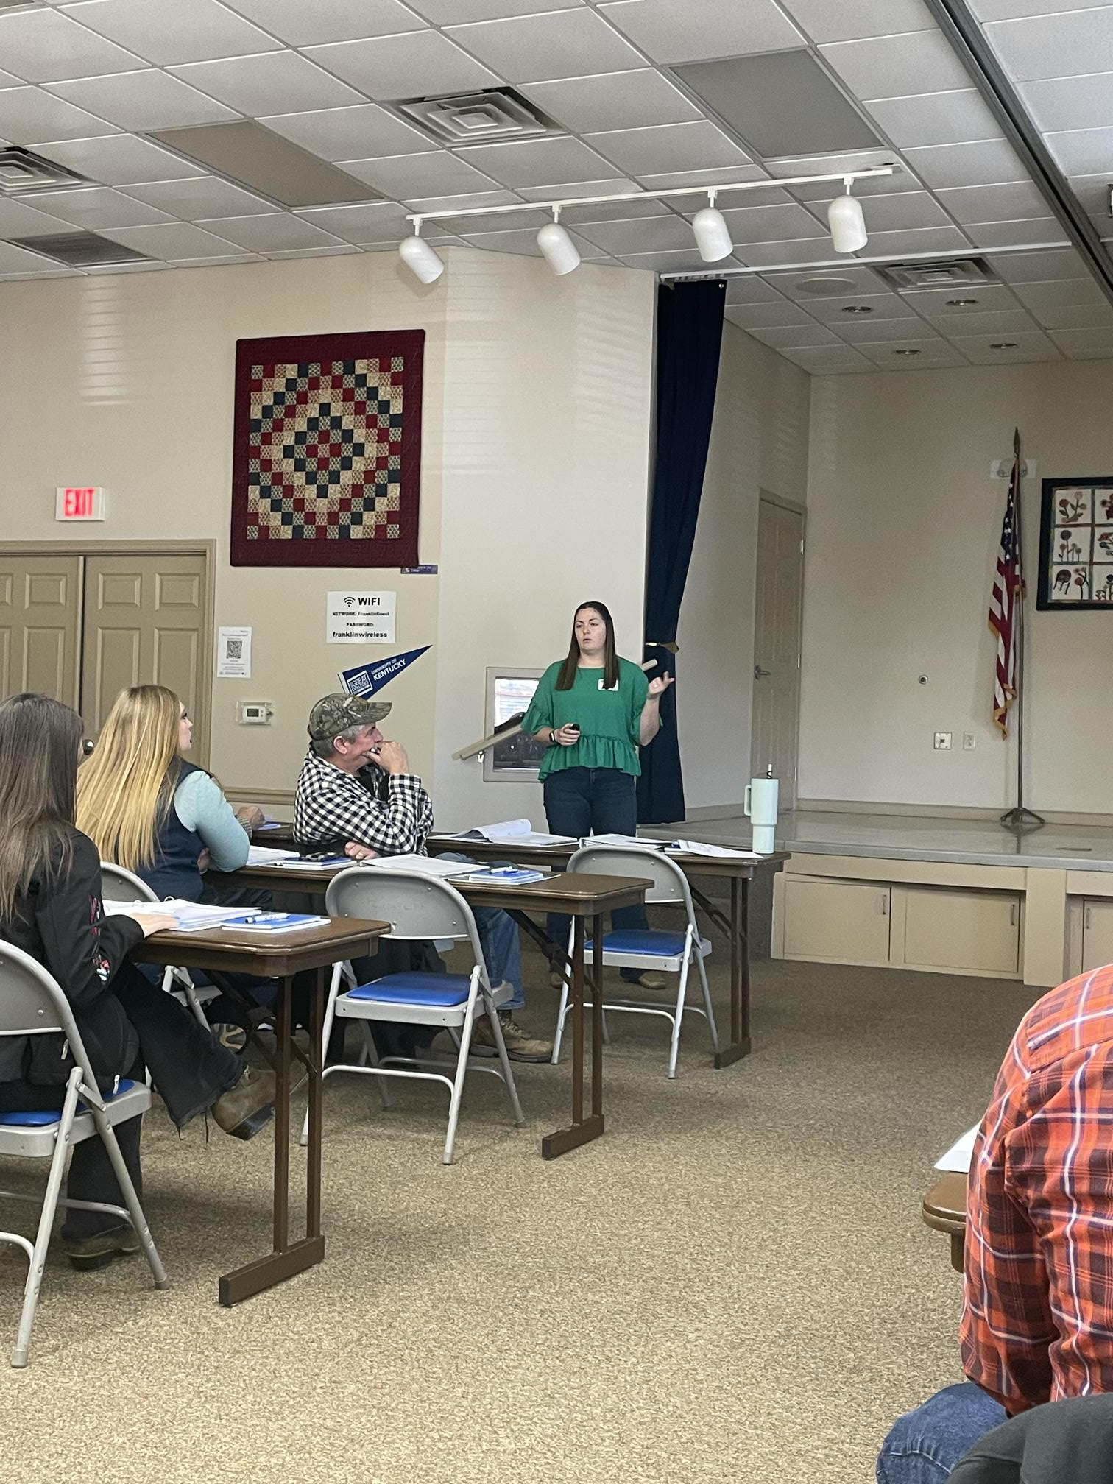
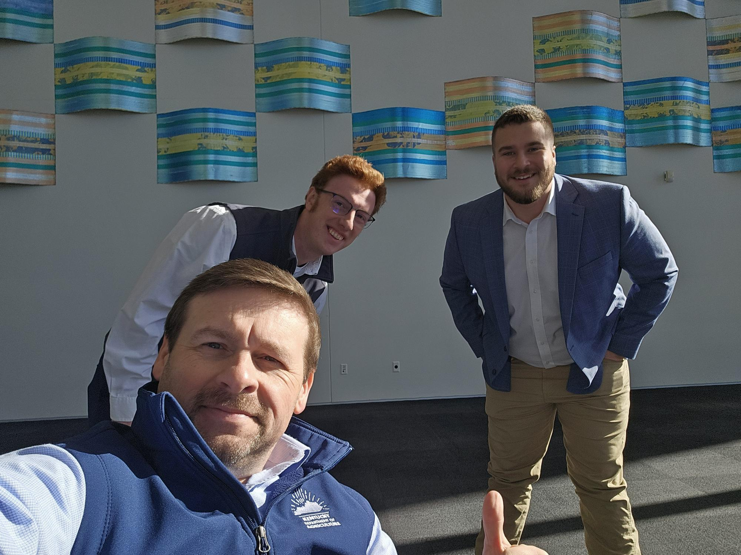

Slide 7
Bill & Brandon’s Top Picks
December
Cowan Community Action Group, Inc-$251,000 in state and Letcher County funds
January
Community Farm Alliance, Inc.-$868,008 in state funds over a two-year period
February
Metcalfe County 4-H Council, Incorporated-$2,063 in Metcalfe County funds
March
Hopkinsville Elevator Company, Inc.- $300,000 in multi-county funds
April
W&W Veterinary Services, PLLC-$66,241 in state and Madison County funds

Slide 8
June 20, 2025
at the Kentucky Historical Society in Frankfort, KY at 9:00 a.m. (EDT)

