Slide 1

KOAP’s Report of 2024 & 2025

Slide 2
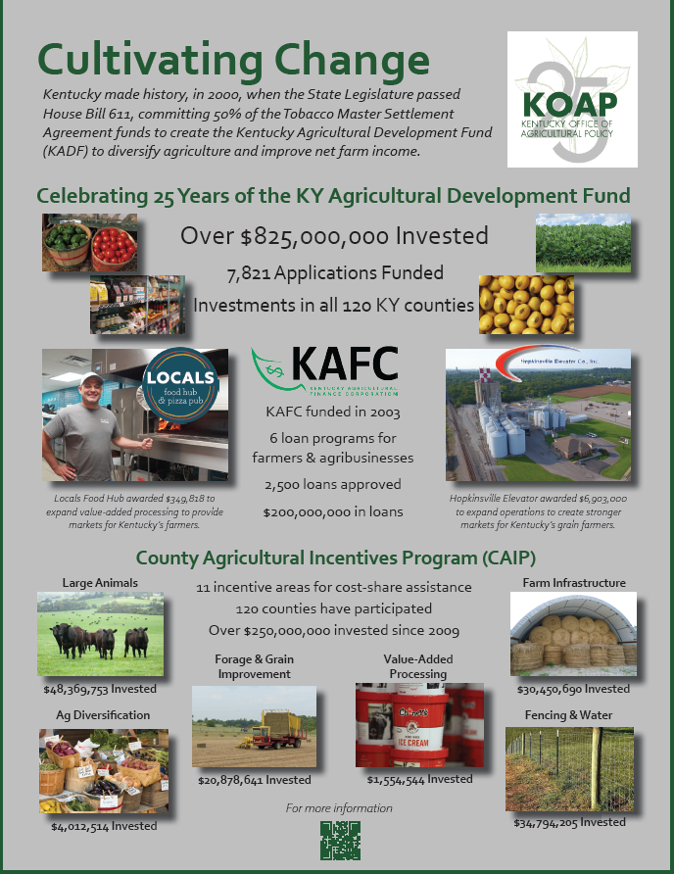


Slide 3
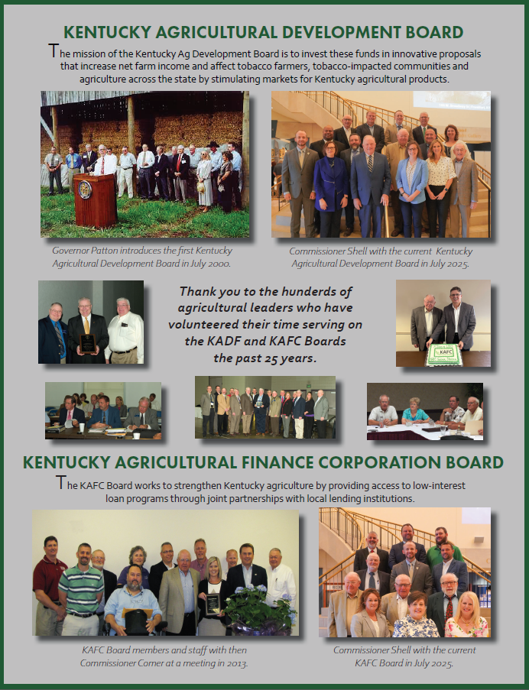


Slide 4
Master Settlement Agreement Breakdown:
2024 MSA:
State $27,199,270.00
County $15,051,606.00
Total $42,250,876.00
2025 MSA:
State $24,867,043.00
County $13,389,508.00
Total $38,256,551.00

Slide 5
2024 Administrative & Office:
Administrative Cost Total: $1,678,647.75
Office Expenses Total: $282,167.37

Slide 6
2025 Administrative & Office:
Administrative Cost Total: $1,737,830.56
Office Expenses Total: $368,163.42

Slide 7
Application Type | Total Approved | # of Awards | # of Counties
CAIP | $14,740,391.97 | 98 | 98
County Council 4% Admin | $342.61 | 1 | 1
Deceased Farm Animal Removal (DAR) | $218,332.50 | 21 | 21
Farmers Market Project | $1,141,000.00 | 4 | 4
Food Safety & Efficiency Incentives Program | $19,975.00 | 6 | 5
Large & Food Animal Veterinary Incentives Program | $761,168.20 | 16 | 12
Next Generation Farmer (NextGen) | $81,107.16 | 4 | 4
On-Farm Energy Program | $193,136.00 | 24 | 15
Project | $17,993,705.42 | 51 | 33
Shared-Use Equipment Program | $232,705.00 | 15 | 11
Youth Ag Incentives Program (YAIP) | $473,774.20 | 32 | 32
Total | $35,855,638.06 | 272 | 106
2024 KADF:

Slide 8
2024 KAFC:
Application Type | Total Approved | # of Awards
Agricultural Infrastructure Loan Program (AILP) | $8,274,180.50 | 47
Agricultural Processing Loan Program (APLP) | $374,500.00 | 2
Beginning Farmer Loan Program (BFLP) | $27,452,313.00 | 147
Diversification Through Entrpreneurship in Agribusiness Loan Program (DEALP) | $1,272,500.00 | 6

Slide 9
2025 KADF:
Application Type | Total Approved | # of Awards | # of Counties
CAIP | $14,222,764.06 | 100 | 100
County Council 4% Admin | $4,500.00 | 1 | 1
Deceased Farm Animal Removal (DAR) | $239,986.77 | 21 | 21
Food Safety & Efficiency Incentives Program | $23,334.00 | 7 | 5
Horticulture Incentives Loan (Pilot) | $1,080,419.00 | 6 | 4
Large & Food Animal Veterinary Incentives Program | $438,572.00 | 8 | 7
Next Generation Farmer (NextGen) | $190,000.00 | 5 | 5
On-Farm Energy Program | $158,839.00 | 17 | 12
Project | $5,854,775.51 | 38 | 25
Shared-Use Equipment Program | $188,808.00 | 11 | 8
Youth Ag Incentives Program (YAIP) | $600,600.40 | 30 | 30
Total | $23,002,598.74 | 244 | 107

Slide 10
2025 KAFC:
Application Type | Total Approved | # of Awards
Agricultural Infrastructure Loan Program (AILP) | $10,137,320.50 | 55
Agricultural Processing Loan Program (APLP) | $870,000.00 | 5
Beginning Farmer Loan Program (BFLP) | $23,115,276.00 | 118
Diversification Through Entrpreneurship in Agribusiness Loan Program (DEALP) | $837,500.00 | 4
Horticulture Incentives Loan Program (HILP) | $250,000.00 | 1
Large/Food Animal Veterinary Loan Program (LFAVLP) | $250,000.00 | 1

Slide 11
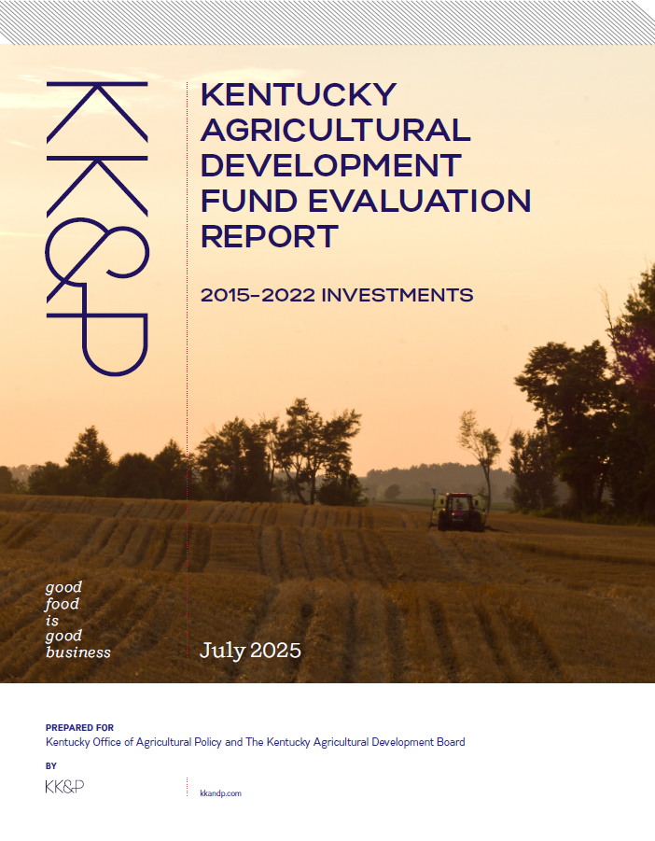

Slide 12
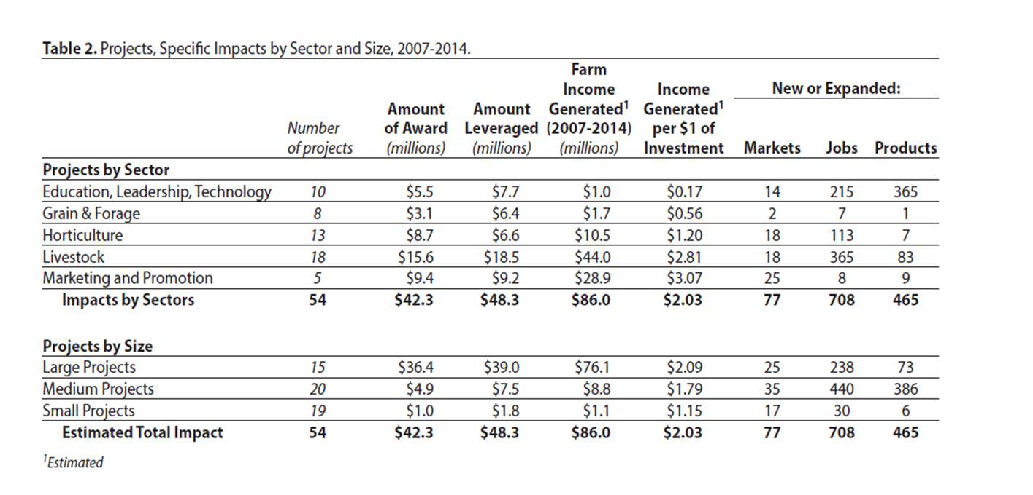
An Evaluation of Agricultural Development Board Investments in Kentucky Agriculture 2007-2014
KADF Projects, Programs, & the Kentucky Agricultural Finance Corporation

Slide 13
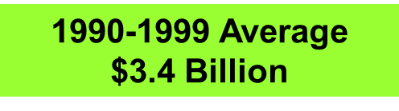
Distribution of KY Agricultural Cash Receipts
1990s vs 2025
2025 Estimate
$8.3 billion
Livestock Receipts Account for 65% of Total Ag Cash Receipts
Source: AEC/UK Estimates (December 2025)

Slide 14

2025 Annual Report

Slide 15

Farms To
Food Banks

Slide 16
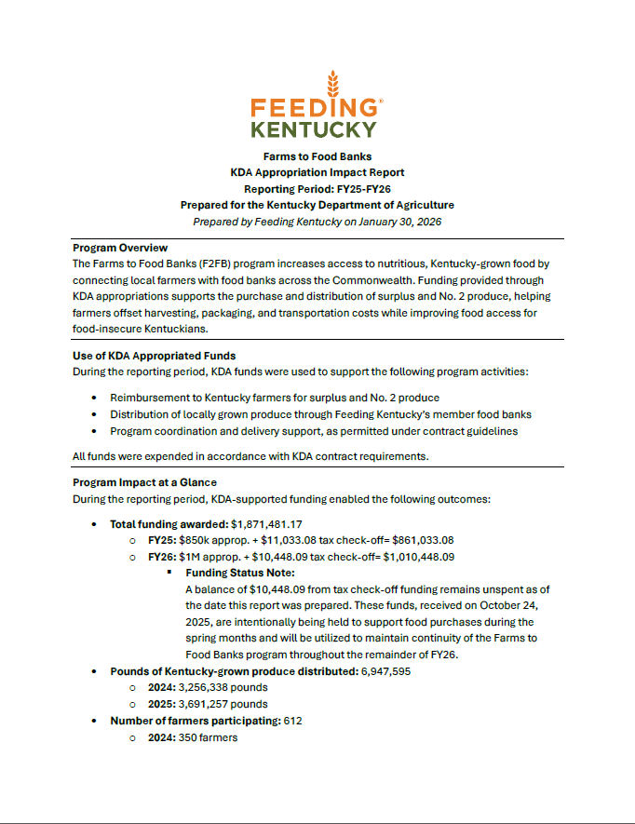

Impact Report FY25-FY26

Slide 17
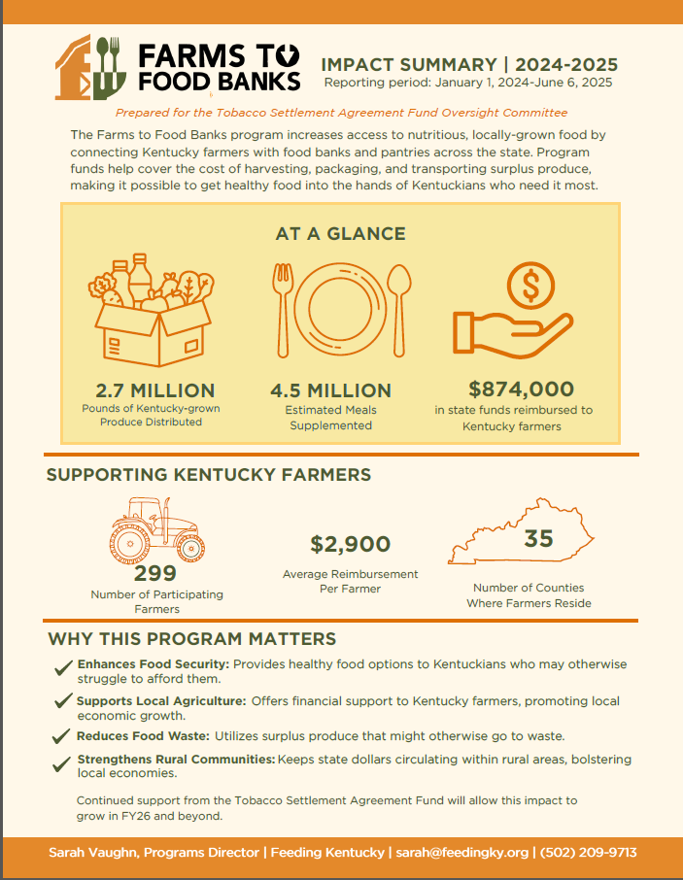
Impact Summary
2024-2025

Slide 18

Raising Hope

Slide 19
Master Settlement Agreement Breakdown
Tobacco Fund: $1 Million FY25, $1 Million FY26
W/Carry Forward Language
General Fund/KDA General/Admin.
Operations
(100K per year allowed for Admin)

Slide 20

Total Tobacco Expenditures FY25
Total Tobacco Expenditures for FY25: $677,008.60
Admin., Advertising, Medical Supplies, Vehicle Infrastructure, MASH Unit, Materials, Micro Grants, etc.

Slide 21
Total Tobacco Expenditures FY26
Total Tobacco Expenditures for FY26 up to
Jan. 21, 2026: $530,129.75
Admin., Advertising, Medical Supplies, Vehicle Infrastructure, MASH Unit, Materials, & Micro Grants.
Total: $1,207,138.35
Left: $792,861.65

Slide 22
Since 2021: 30 Lives Forever Impacted
8 persons referred to a vascular surgeon for a significant amount of carotid stenosis
1 hypertensive crisis, and 1 person with hypertension who were referred to their primary physician
2 people with potentially new onset diabetes
1 new atrial fibrillation (Appalachian Regional Health)
1 dehydrated patient referred to EMS
6 Grain entrapments, 5 alive
1 early intervention save sudden cardiac death
4 known successful suicide interventions
Raising Hope 854 Health Screenings (doesn’t include those in partnership with ARH)

Slide 23
Appalachian Regional Healthcare Partnership
11 Screening Events (January - December 2025)
• 55 cholesterol screenings
• 418 blood pressure screenings
• 504 A1Cs
• 110 BMIs
• 3 FIT Kits
• 36 hearing screenings
• 17 mental Health screenings
• 16 flu shots
• 25 hands only CPR certifications
• 432 Narcan units distributed
• 15 skin cancer screenings
• 27 dental screenings
• 1,571 total screenings/certifications

Slide 24
2025-2026
41 Individual Events
Total Attendees: 3,082
Major Events: North American International Livestock Expo, National Farm Machinery Show and Kentucky State Fair.

