Slide 1

Tobacco Settlement Agreement Fund Oversight Committee
Jay Nelson, Director
Kentucky Division of Conservation
Cori Troutman, Director
Division of Financial Management
Energy and Environment Cabinet
February 23, 2026

Slide 2
Tobacco Fund Utilization
Direct Aid $1,000,000
$851k awarded to districts for operational functions; utilities, rent, employee salary, etc.
$149k used for required district audits per KRS 65A.030
Cost Share $2,000,000
Money is used to fund projects that support best management practice projects that protect soil and water and enhance ag producers’ profit margins.
Supports administrative transfer to Division of Conservation (KRS 146.115)
FY26 allocation will be awarded in late February
Paid out $1.65M in FY26 for projects from FY24 & FY25

Slide 3
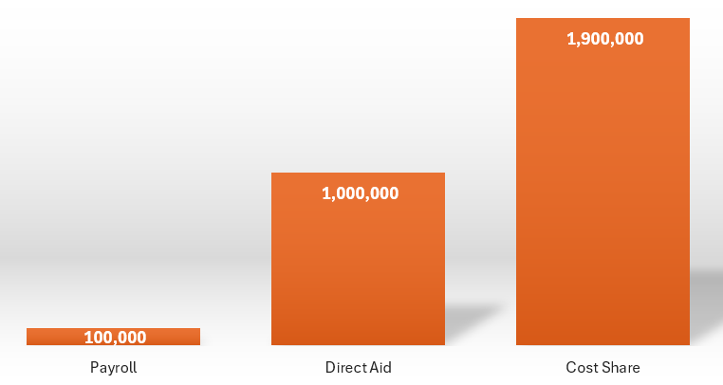
Division of Conservation FY26 Tobacco Fund Budget
Payroll | Direct Aid | Cost Share | Total
100,000 | 1,000,000 | 1,900,000 | 3,000,000
KRS 146.115 allows 5% of the appropriated Cost Share Tobacco Funds ($100k) to be used for administration costs of Conservation’s 13 staff members
Division of Conservation administers the Environmental Stewardship/Direct Aid funds per KRS 248.717 /KRS 146.080

Slide 4
Historical Tobacco Settlement Appropriation

Slide 5
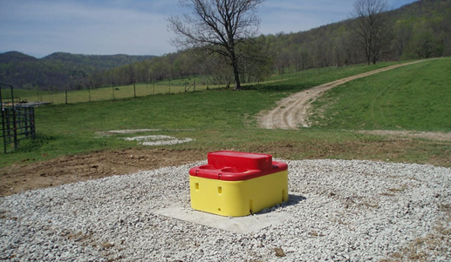
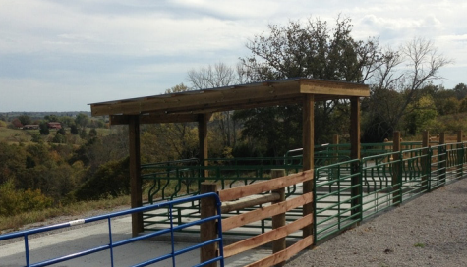
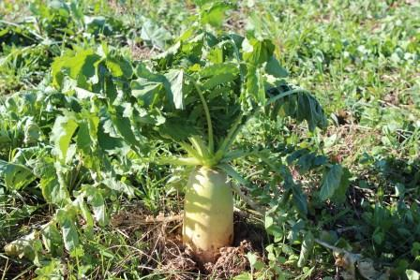
Example Timeline for FY24 Cost Share Application
1 Jan. – 15 Nov. 2023
Producers may apply for FY24 funding
February 1, 2024
Soil & Water Conservation Commission approves project applications (approved for 1 year with options for two 6-month extensions available)
February 1, 2025
1-Year deadline for Best Management Practice installation of project
August 1, 2025
Deadline after 1st 6-month extension request
February 1, 2026
Final deadline after 2nd 6-month extension
*The life of one project can range from 2-3 years from application period to final installation depending on how long it takes the producer to implement the project.

Slide 6
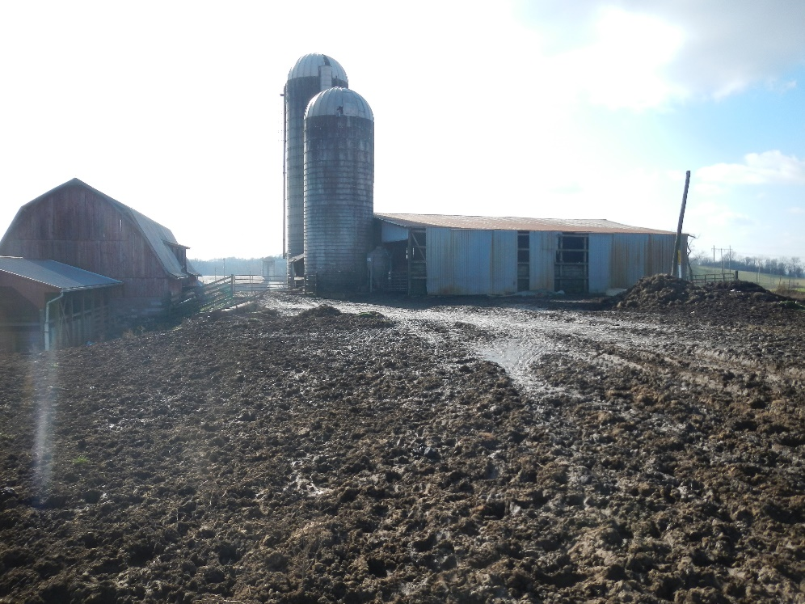
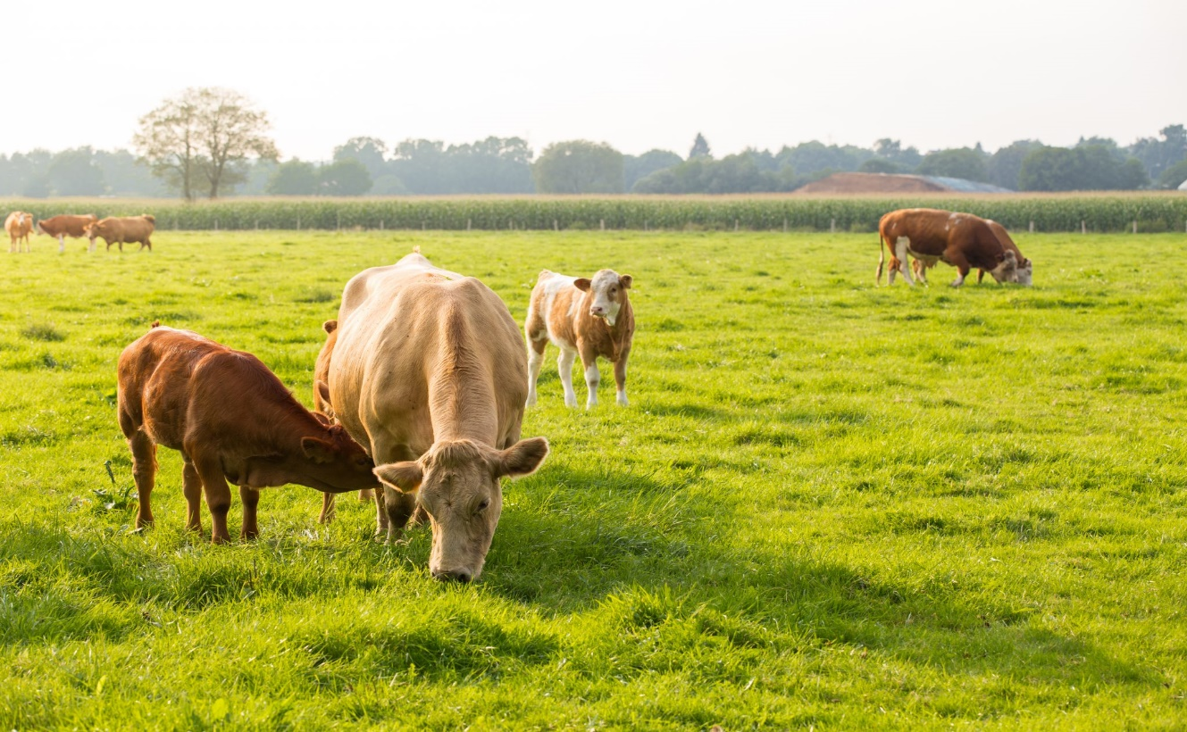
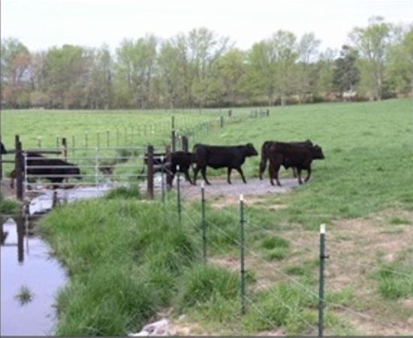
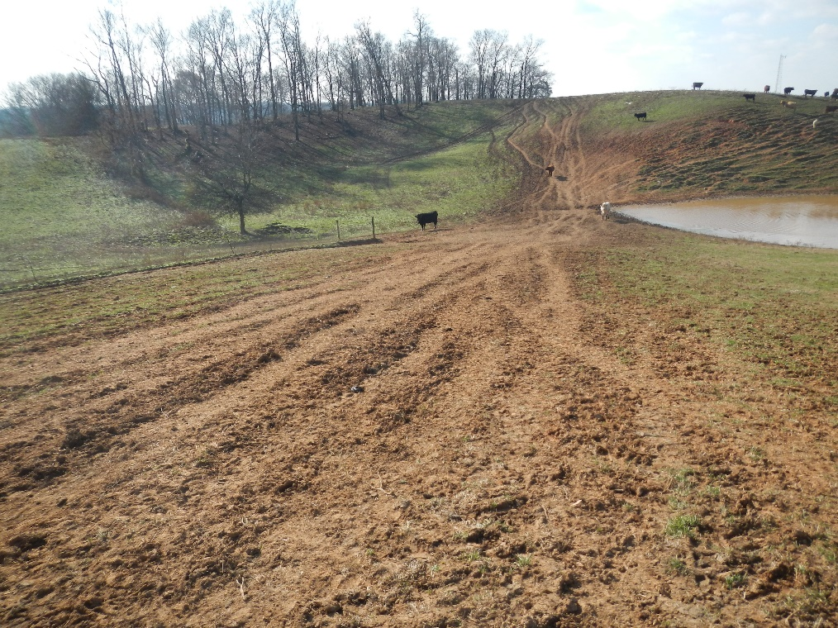
Best Management Practices Examples
(KY Soil Erosion & Water Quality Cost Share)

