Slide 1

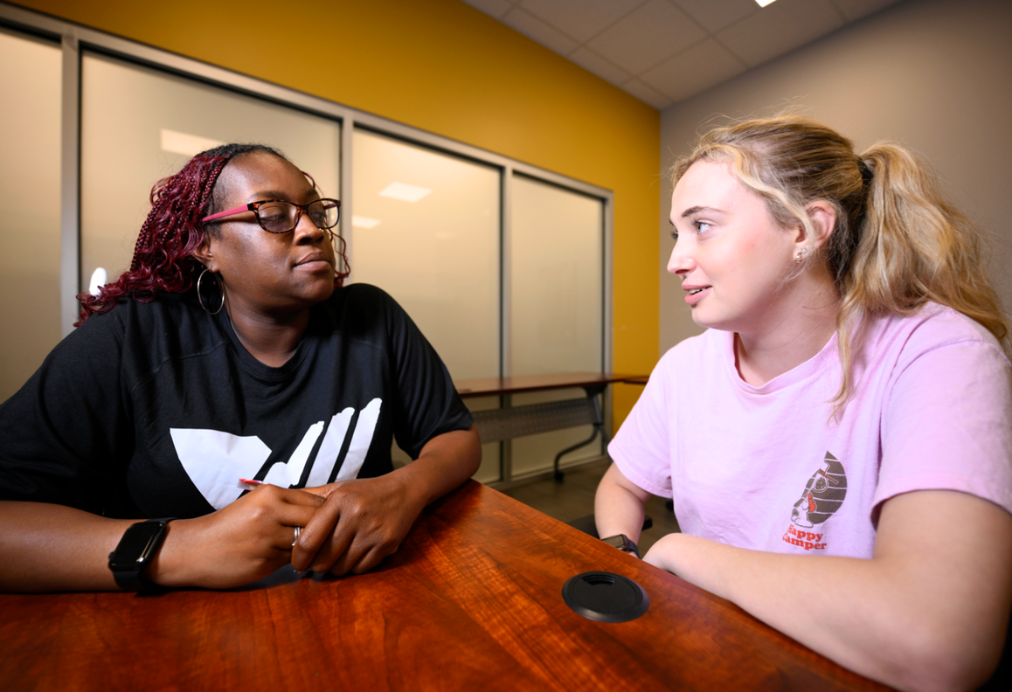

RESTORATIVE JUSTICE
Transforming Communities
by Increasing Accountability and Support for Youth.

Slide 2
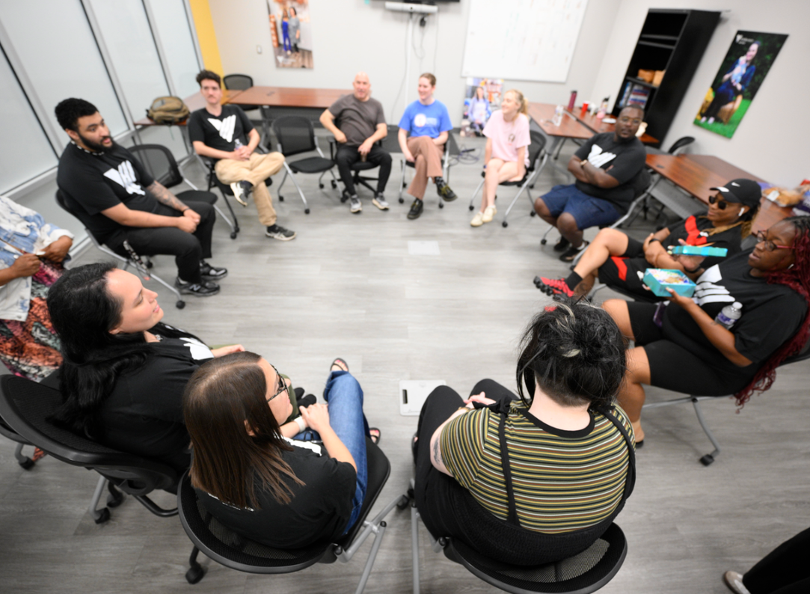
PROGRAM OVERVIEW
VOA’s Restorative Justice Center provides a facilitated process to allow youth harmed by crime or wrongdoing to meet with the person(s) who caused the harm so they can negotiate their own resolution to address the harm outside of traditional systems.

Slide 3
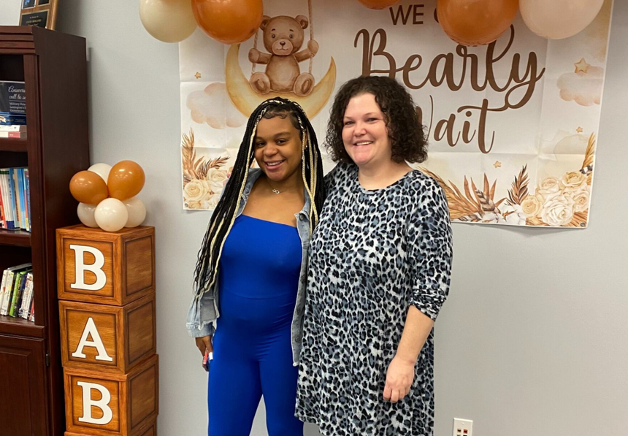
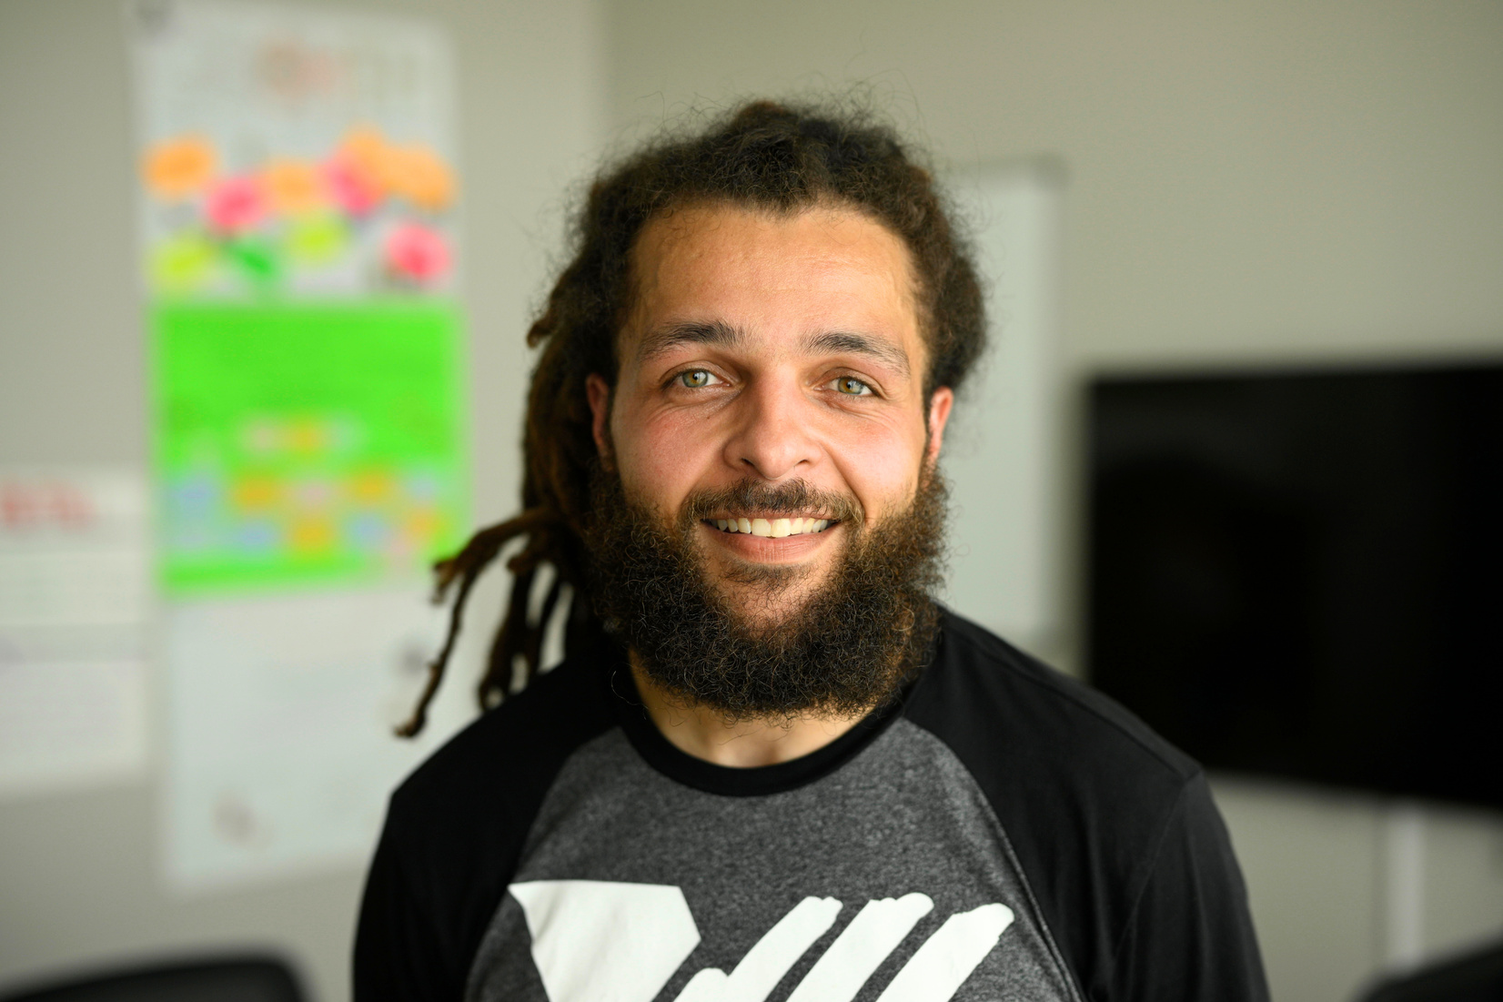
HOW IT WORKS
RJ provides a holistic and comprehensive approach to the traditional criminal justice system by bringing together the offender, victim, and community to make things right.
Through facilitated conferences, parties collectively identify the harm and determine a solution-based resolution.
The restorative justice approach ensures that restitution and compassion are integral parts of the judicial process.

Slide 4
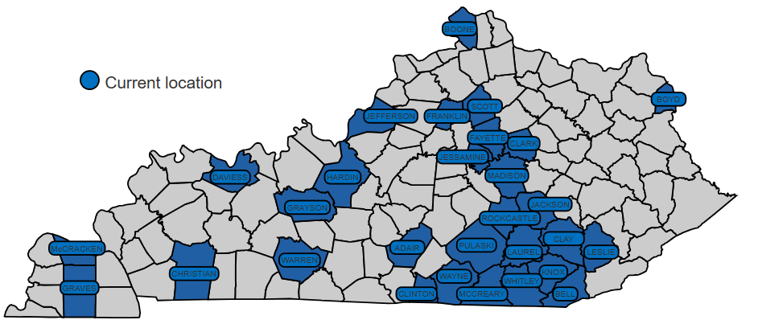
OUR CURRENT VOA RJ SERVICE AREA

Slide 5
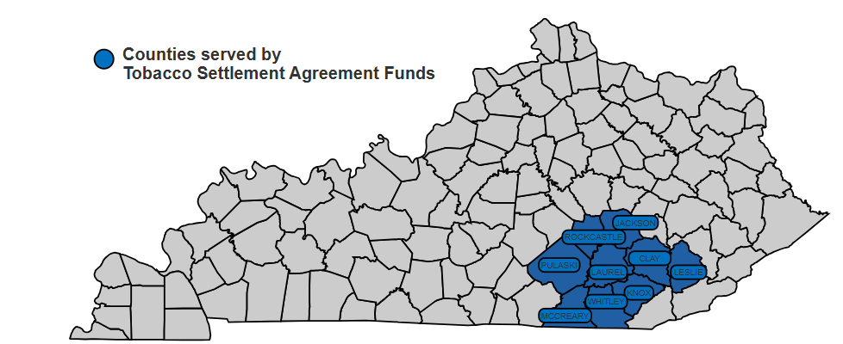
COUNTIES SERVED BY
TOBACCO SETTLEMENT AGREEMENT FUNDS

Slide 6
ODCP RESTORATIVE JUSTICE SPENDING FY24-25
Personnel
FY24: $236,709
FY25: $144,176
Travel/Training
FY24: $13,188
FY25: $6,056
Consulting
FY24: $5,272
FY25: $9,553
Project Evaluation
FY24: $67,314
FY25: $21,079
Supplies
FY24: $11,611
FY25: $1,745
Education/Outreach
FY24: $92,173
FY25: $0
Operating Expenses
FY24: $40,424
FY25: $31,549
Administration
FY24: $49,866
FY25: $19,341
Total
FY24: $516,557
FY25: $233,500

Slide 7
RESTORATIVE JUSTICE FUNDING SOURCES
Southeast KY Restorative Justice Program
Funding source: ODCP Tobacco Funds
FY24: $516,557
FY25: $233,500
CVI Pivot to Peace
Funding source: ARPA
FY24: $0
FY25: $220,000
Jefferson County Restorative Justice Program
Funding source: DJJ
FY24: $134,174
FY25: $140,000
Community Mediation Center
Funding source: EAF
FY24: $9,000
FY25: $0
Pivot to Peace - Gun Violence Initiative
Funding source: OSHN
FY24: $100,000
FY25: $0
Title II
Funding source: DJJ
FY24: $149,863
FY25: $0
Victims of Crime Act (VOCA)
Funding source: OVC
FY24: $85,024
FY25: $77,372
JCPS Project Prevent
Funding source: Department of Education
FY24: $176,915
FY25: $174,720
Restorative Justice Program
Funding source: Private donation
FY24: $25,000
FY25: $0
Restorative Justice Program expansion
Funding source: ARPA
FY24: $1,300,000
FY25: $0
Restorative Justice Program
Funding source: ARPA/OSHN General Fund
FY24: $0
FY25: $707,720
JCPS Title I Expansion
Funding source: Jefferson County Board of Ed.
FY24: $0
FY25: $165,080
Alternatives to Detention
Funding source: DJJ
FY24: $458,333
FY25: $3,000,000
Victims of Crime Act (VOCA)
Funding source: ARPA
FY24: $126,235
FY25: $0
Total
FY24: $3,081,101
FY25: $4,718,397

Slide 8
RESTORATIVE JUSTICE OUTCOMES
VOA RJ Program expanded to Southeastern Kentucky in spring of 2021, during COVID pandemic. Due to disruptions to schools and court systems – our two primary source of referrals – the program started slowly with only 13 cases in the first year.
Over the next five years, the VOA RJ Program has steadily grown into a trusted, community-based alternative for youth involved in the court system.
By year four, referrals expanded to 62, reflecting increased awareness among schools, courts, and community partners that VOA RJ offers a meaningful path forward for young people.
Today, VOA RJ has served more than 180 youth across Southeastern Kentucky.

Slide 9
RESTORATIVE JUSTICE OUTCOMES
Southeast KY RJ five-year evaluation report
Study conducted by Erin Stevenson, PhD, MSW, and Stephanie Saulnier, MSW
Department of Social Work, Eastern Kentucky University
The report evaluates the VOA RJ Program operating in Clay, Jackson, Knox, Laurel, Leslie, McCreary, Pulaski, Rockcastle, and Whitley County.
Recidivism rates:
Among the 49 participants who completed the program in FY23, the 24 month recidivism rate was 24.5%
Compared to AOC FY23 24 month recidivism rate for overall diversion eligible youth at 40.4%
Cost effectiveness:
Based on calculations from this evaluation, the average cost per day for VOA RJ service delivery is $19.43/day.
Compared to Group Homes at $556/day, Secure Detention at $600/day, or Youth Development custody at $631/day.

Slide 10
THANK YOU

Slide 11

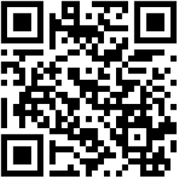

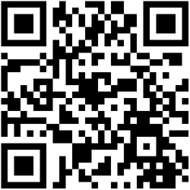

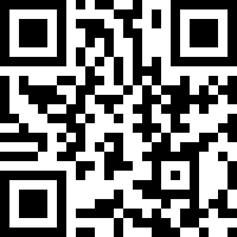

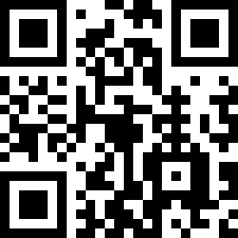

Follow us!
Like us!
Share us!
Follow us on social @voamid
Scan here
from your mobile device
Visit our website at voamid.org

