Slide 1

Tobacco Settlement Agreement Fund Oversight Committee
March 2, 2026

Slide 2
Department for Behavioral Health, Developmental and Intellectual Disabilities
Substance Use Prevention and Treatment for Pregnant Women
Rachel Dockal, Division Director
Sarah Johnson, Division Director

Slide 3
Substance Use Prevention and Treatment for Pregnant Women - Annual Funding All Sources
Tobacco Funds
•24RS HB6 Annual Appropriation: $1,300,000
•Prior year Tobacco Settlement carryforward
Restricted Funds
•Neonatal Abstinence Syndrome Tobacco funds received from Justice and Public Safety Cabinet
General Funds
•24RS HB6 Substance Use Disorder funding
Federal Grant Funds
•Substance Use Disorder Block Grant

Slide 4
Breakdown of Expenditures for Administrative and Program Costs
Expenditure by Category
Administrative Costs
 | Tobacco | General | Restricted | Federal | Total
Admin Costs
Personnel | $181,113 | - | - | - | $181,113
Operating | $1,160 | - | - | - | $1,160
Grants Loans & Benefits | $2,513 | - | - | - | $2,513
Total Admin Costs | $184,786 | - | - | - | $184,786
Program Costs
 | Tobacco | General | Restricted | Federal | Total
Program Costs
Partner Contracts | $2,632,939 | $486,100 | $2,877,605 | $707,498 | $6,704,141
Total Program Costs | $2,632,939 | $486,100 | $2,877,605 | $707,498 | $6,704,141

Slide 5

Itemization of Tobacco Funds for Program Services
SFY25 Program Costs through Partner Contracts
Community mental health centers (CMHCs)
Not-for-profit entities
Other community partners
Appalachian Regional Healthcare | $47,108 |  | New Vista Of The Bluegrass | $58,000
Chrysalis House | $211,074 |  | Northkey Community | $156,728
Communicare | $193,471 |  | Pathways | $219,304
Comprehend | $158,000 |  | Pennyroyal Center | $158,000
Cumberland River Behavioral Health | $148,073 |  | Rivervalley Behavioral Health | $113,850
Kentucky River Community Care | $117,740 |  | Seven Counties Services | $172,314
Lake Cumberland Regional Mental Health | $182,503 |  | St Elizabeth Medical | $7,204
Lifeskills | $237,858 |  | Western Ky Regional Mental Health | $184,029
Mountain Comprehensive Care | $413,300 |  | Various - Prior Year Adjustments | ($145,616)

Slide 6




What Programs We Support — A Comprehensive Continuum of Care
Prevention & Early Identification
Screening, brief intervention, and referral to treatment
Addiction prevention education
Plan of Safe Care and overdose prevention, family planning, and education
Family & Early Childhood Supports
Trauma-informed early childhood intervention
Parenting education and family stabilization services
Workforce & Community Infrastructure
Provider training and consultation
Support services such as housing, childcare, transportation, and employment assistance
Treatment & Recovery Services
Medications for opioid use disorder (MOUD)
Outpatient and residential addiction treatment
Care coordination through pregnancy and postpartum
Recovery housing and transitional living

Slide 7
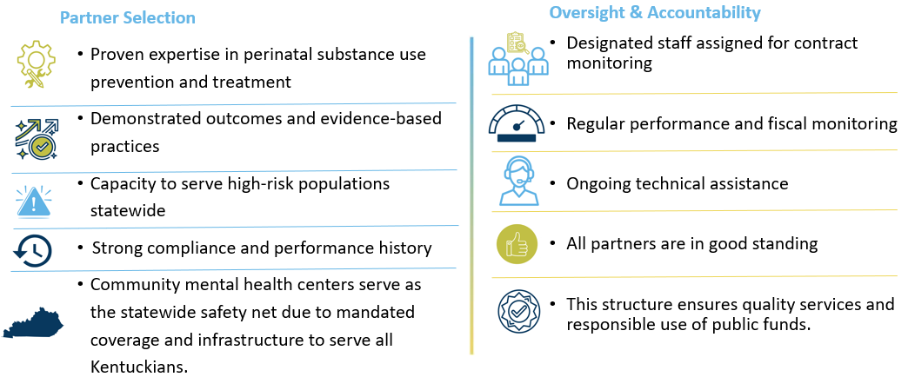
How We Select and Monitor Partners

Slide 8



Program - Outcomes and Return on Investment
Health & Cost Impact
$21,000–$46,000 estimated lifetime savings per treated mother–infant pair
Reduced NICU stays and maternal complications
Lower child welfare and criminal justice involvement
Strong Economic Returns
Treatment benefit-to-cost ratios range from up to 10:1
Prevention strategies yield even higher long-term savings
System-Level Benefits
Reduced Medicaid expenditures
Improved maternal and infant health outcomes
Stronger family stability and workforce participation
Bottom Line: Investing in prevention, treatment, and family-centered recovery improves outcomes while reducing long-term public system costs.

Slide 9
Department for Community Based Services
All STARS, Adoption & Foster Care Supports, and Children’s Advocacy Centers
Misty Sammons, Division Director
Andrea Day, Division Director

Slide 10
Child Care Funding

Slide 11
Early Childhood Development Program Tobacco Allotment $9,800,000

Slide 12
Kentucky All STARS Levels by Provider Type
 | Level 1 | Level 2 | Level 3 | Level 4 | Level 5 | Total
Certified | 164 | 17 | 17 | 14 | 2 | 214
Licensed Type I | 1009 | 100 | 309 | 168 | 148 | 1,734
Licensed Type II | 24 | 5 | 3 | 1 | 1 | 34
Total | 1,189 | 124 | 346 | 189 | 145 | 1,982
25 Programs have opted out of Kentucky All STARS (23 Type I and 2 Certified)

Slide 13
Protection & Permanency Funding

Slide 14
Early Childhood Adoption & Foster Care Supports Tobacco Allotment $2,000,000

Slide 15

Department for Public Health
HANDS, Early Childhood Oral Health, Lung Cancer Screening,
Smoking Cessation, Healthy Start, Early Childhood Mental Health
Julie Brooks, Policy Specialist
Mike Tuggle, Assistant Division Director, Administration and Financial Management

Slide 16
Health Access and Nurturing Development Services (HANDS)
Health Access and Nurturing Development Services (HANDS)
FY | Total (all sources) | Funding Source
 |  | MSA Tobacco | General | Restricted | Federal
FY2026 Budget | $ 47,761,775 | $ 6,365,400 | $ 5,302,700 | $ 28,000,000 | $ 8,093,675
FY2025 Expenditures | $ 45,303,822 | $ 7,613,904 | $ 6,610,476 | $ 25,197,533 | $ 5,881,909
FY2024 Expenditures | $ 49,474,371 | $ 15,654,977 | $ 5,615,339 | $ 20,237,453 | $ 7,966,602
Outcomes:
Program performance on federal Maternal Infant Early Childhood Home Visiting program benchmarks
Performance measures across the program benchmarks
Number of families enrolled in services

Slide 17
Smoking Cessation
Smoking Cessation
FY | Total (all sources) | Fund Source
 |  | MSA Tobacco | Federal
FY2026 Budget | $ 4,025,954 | $ 2,369,600 | $ 1,656,354
FY2025 Expenditures | $ 3,619,813 | $ 2,346,279 | $ 1,273,534
FY2024 Expenditures | $ 3,925,300 | $ 2,140,850 | $ 1,784,449
Outcomes:
Decreased adult smoking rate
Decreased youth smoking rate
Increased calls to quit lines
Continued comprehensive community smoke free ordinances

Slide 18
Lung Cancer Screening
Lung Cancer Screening
FY | Total (all sources) | MSA Tobacco
FY2026 Budget | $ 1,266,700 | $ 1,266,700
FY2025 Expenditures | $ 561,373 | $ 561,373
FY2024 Expenditures | $ 153,882 | $ 153,882
Outcomes:
Increase lung cancer screening
Reduce morbidity and mortality from lung cancer
Reduce the cost of treating lung cancer among citizens of the Commonwealth

Slide 19
Early Childhood Oral Health
Early Childhood Oral Health
FY | Total (all sources) | MSA Tobacco
FY2026 Budget | $ 3,541,200 | $ 3,541,200
FY2025 Expenditures | $ 2,451,602 | $ 2,451,602
FY2024 Expenditures | $ 1,517,583 | $ 1,517,583
Outcomes:
Number of dental varnishes provided through Local Health Departments
Increased number of Public Health Dental Hygiene Teams
New dental school graduates
Upgraded water systems

Slide 20
Healthy Start
Healthy Start
FY | Total (all sources) | MSA Tobacco
FY2026 Budget | $ 1,151,900 | $ 1,151,900
FY2025 Expenditures | $ 797,916 | $ 797,916
FY2024 Expenditures | $ 788,916 | $ 788,916
Outcomes:
Number of trainings and consultations provided for childcare staff
Number of completed playground assessments for safety
Number of facility assessments

Slide 21
Early Childhood Mental Health
Early Childhood Mental Health
FY | Total (all sources) | MSA Tobacco
FY2026 Budget | $ 1,802,300 | $ 1,802,300
FY2025 Expenditures | $ 821,743 | $ 821,743
FY2024 Expenditures | $ 753,017 | $ 753,017
Outcomes:
Direct services provided to children and families (50% billable time)
Non-billable services (training, technical assistance, consultation, community outreach)

Slide 22
Questions?

