Slide 1

Tobacco Settlement Agreement Fund
Oversight Committee
Jay Nelson, Director
Kentucky Division of Conservation
September 10, 2026

Slide 2
DOC: Division of Conservation
SWCC: Soil & Water Conservation Commission
TSAF: Tobacco Settlement Agreement Fund

Slide 3
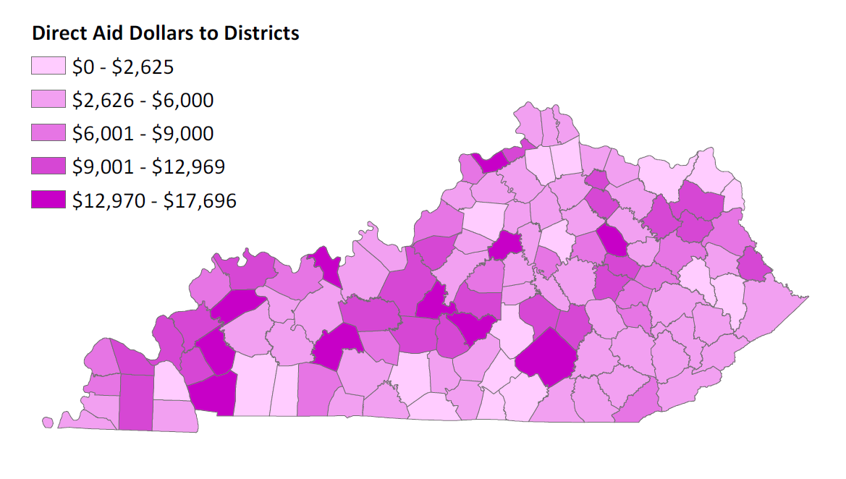
FY26 Direct Aid to Conservation Districts

Slide 4
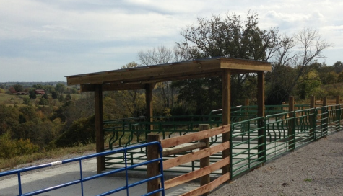
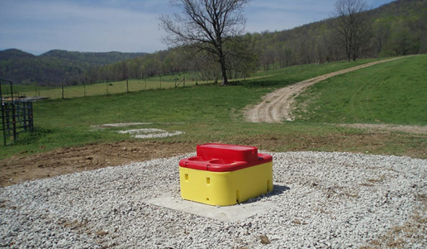
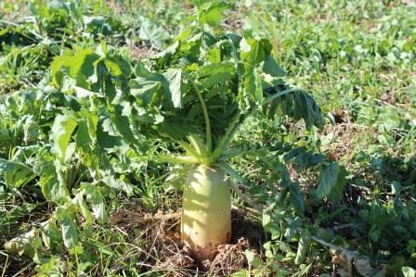
State Cost Share Summary
Originally established in 1994 and funded from General Funds and pesticide Product Registration Fees.
Since 2000, the program has been funded through Tobacco Master Settlement Agreement Funds.
Provides financial assistance to farmers at a 75% reimbursement rate for those implementing best management practices on their farms with the assistance of local conservation districts.

Slide 5
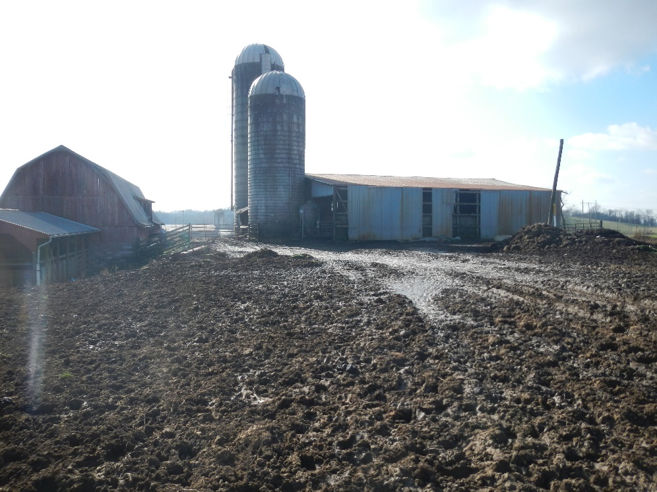
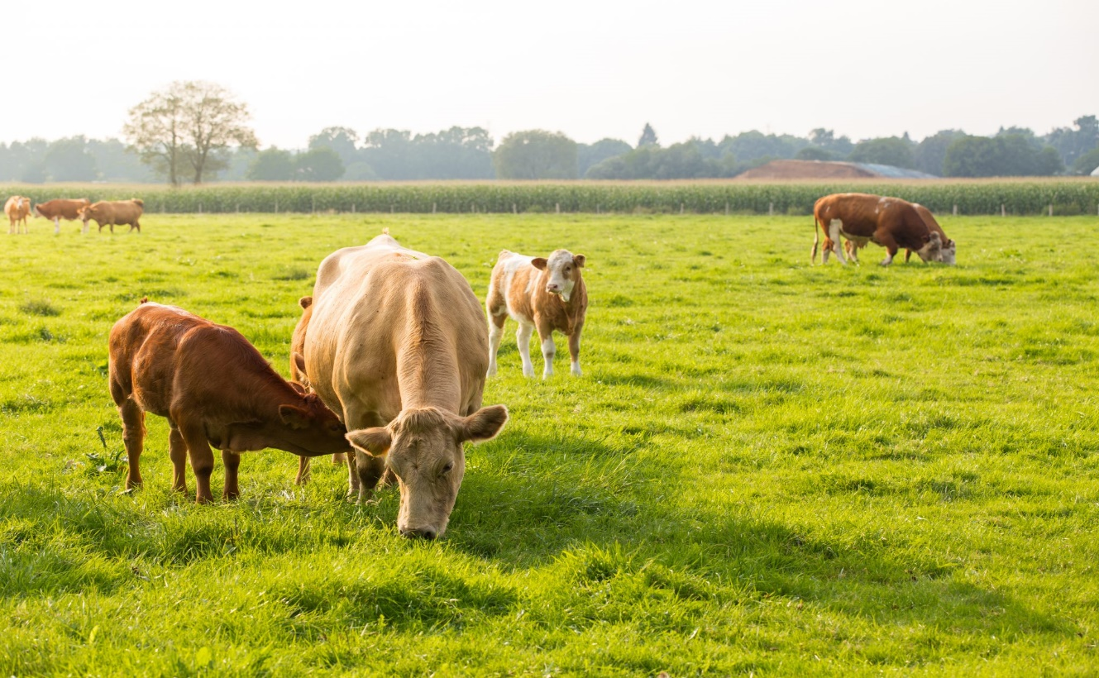
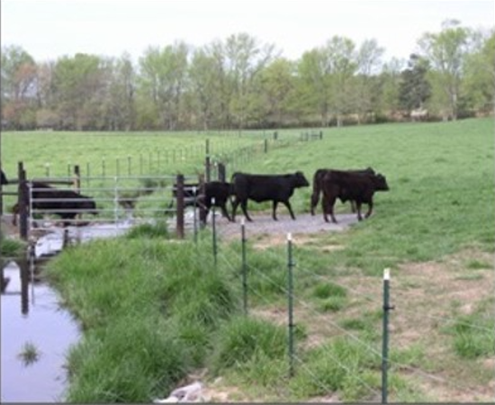
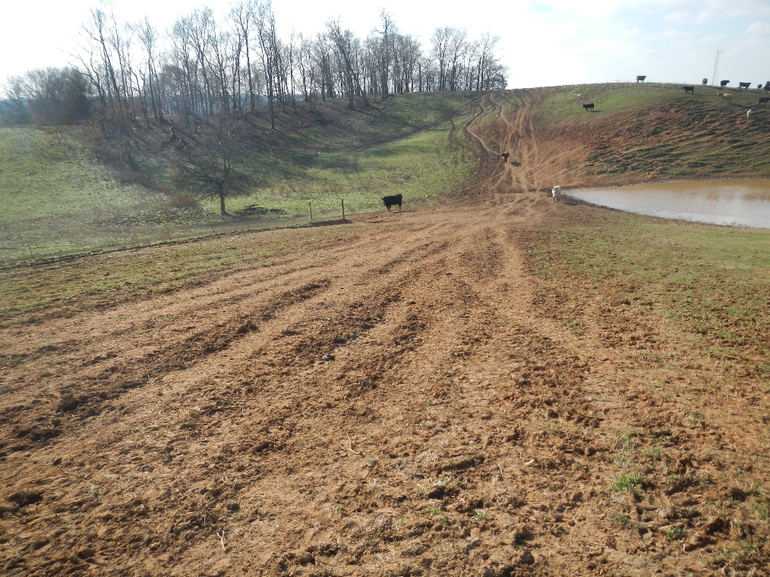

Slide 6
FY26 Approved in March 2026
Requests from 707 individuals for a total of $8,570,469 in funding
Approved 306 individuals for $3,758,278 in funding
43% approval rate

Slide 7
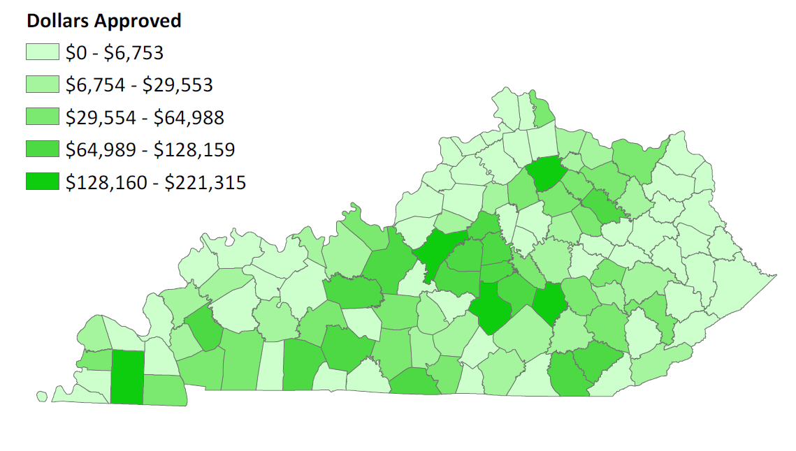
State Cost Share Projects Approved
FY 26 Funds

Slide 8
FY25 Approved in February 2025
Requests from 699 individuals for a total of $7,971,330 in funding
Approved 363 individuals for $3,955,936 in funding
52% approval rate

Slide 9
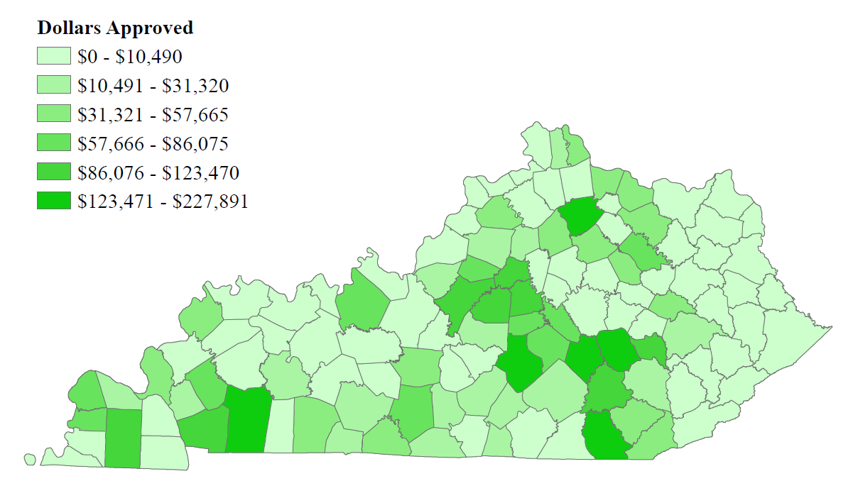
State Cost Share Projects Approved
FY 25 Funds

Slide 10
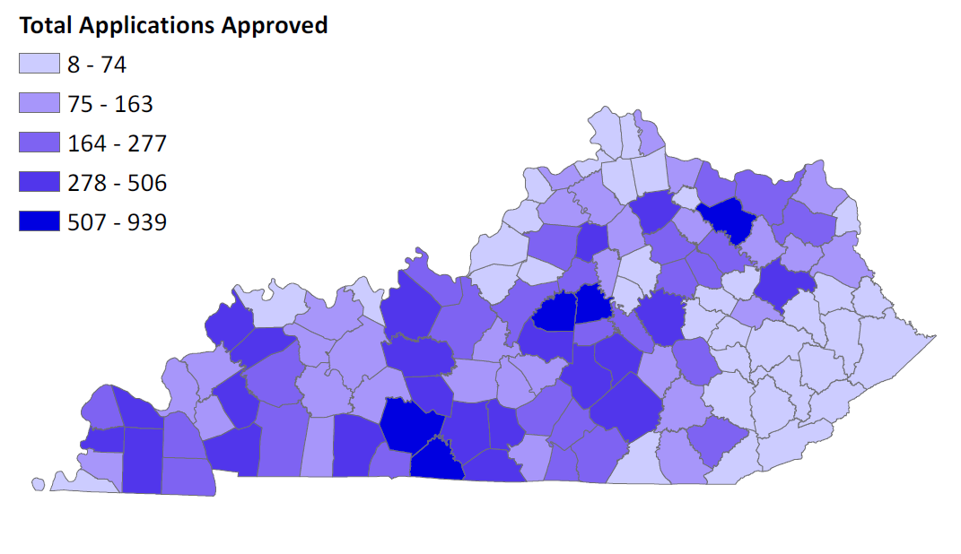
Program Total Applications Approved
1994-2026

Slide 11
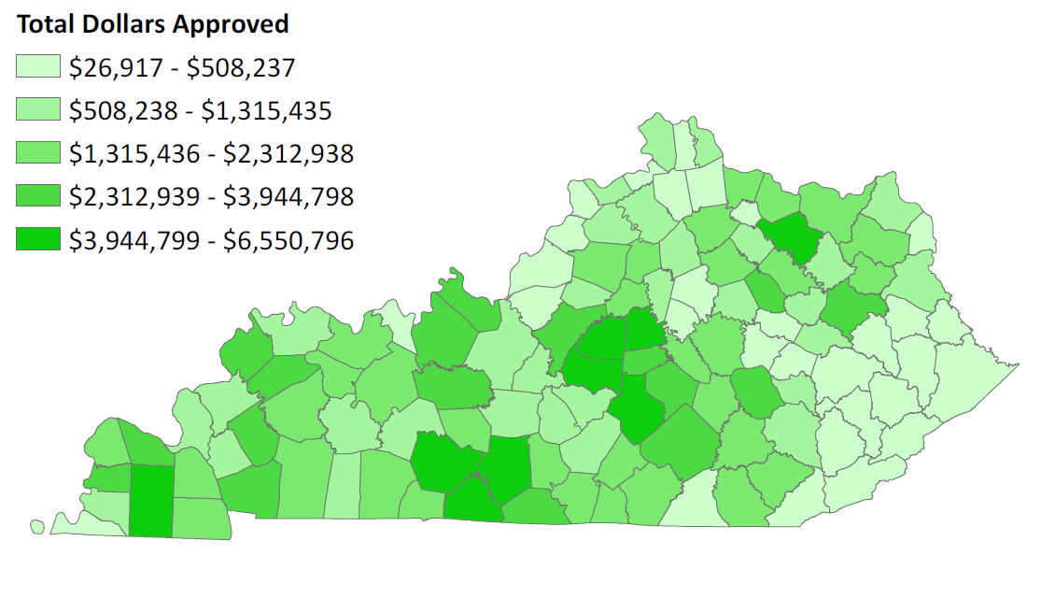
Program Total Dollars Approved
1994-2026

Slide 12
Account Balance
$8,470,130 available for FY27
  $886,500 obligated Direct Aid to Conservation Districts
    Approximately $133,155 will be paid to contracted auditor during FY27
    Remaining $753,345 will be distributed to conservation districts in September 2026
  $1,579,463 obligated from FY25
  $3,621,069 obligated from FY26
  $177,310 required contingency fund set aside
      $17,000 of that total has been obligated

Slide 13
Demonstration of Need
The Kentucky Soil & Water Quality State Cost Share Program continues to have significant interest with agricultural producers across the Commonwealth.
Over the past few program years, approximately one third to one half of total funding requests are approved.
Interest in the program has slightly waned due to less funding available.
Cut off for FY27 funding will be November 15, 2026
  Approval in January 2027.
Ag operations that practice good conservation are always more profitable than those that do not.

Slide 14

Contact Information
Jay Nelson, Division Director
jay.nelson@ky.gov
502-782-5761
Kentucky Division of Conservation
  300 Sower Blvd, 2nd floor

