Slide 1
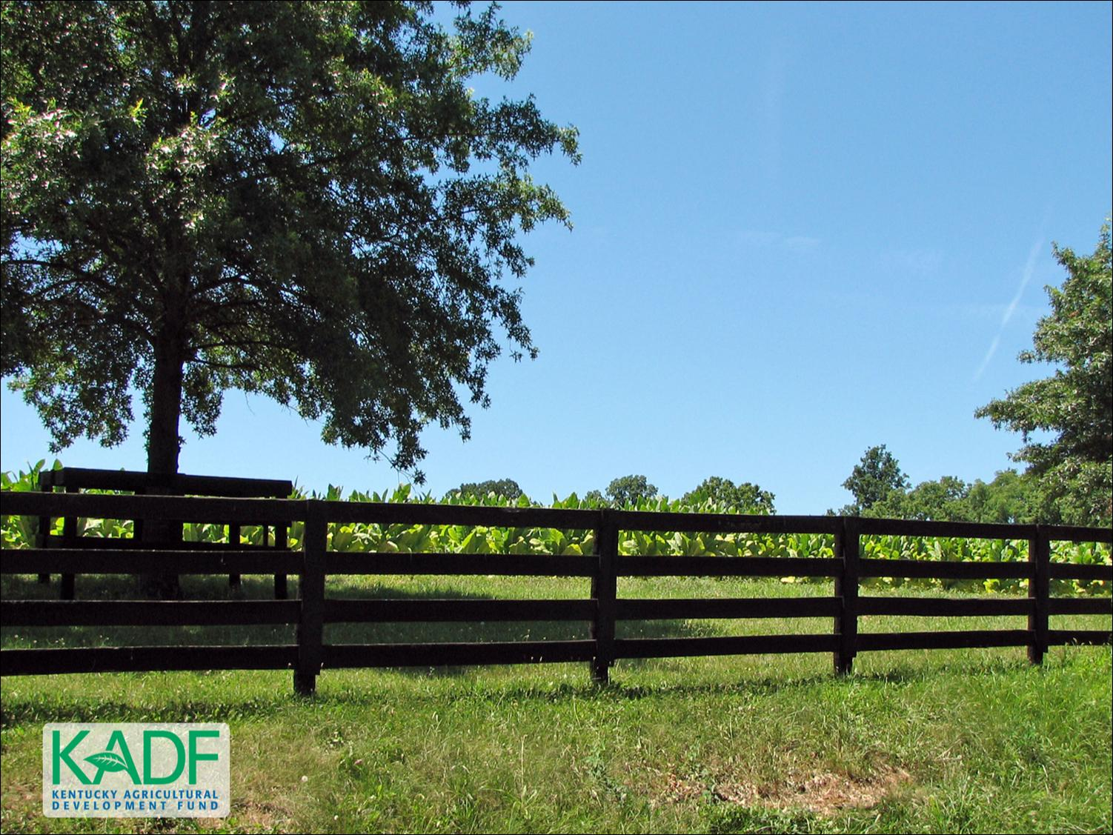
KOAP’s Report of
June – August 2026

Slide 2
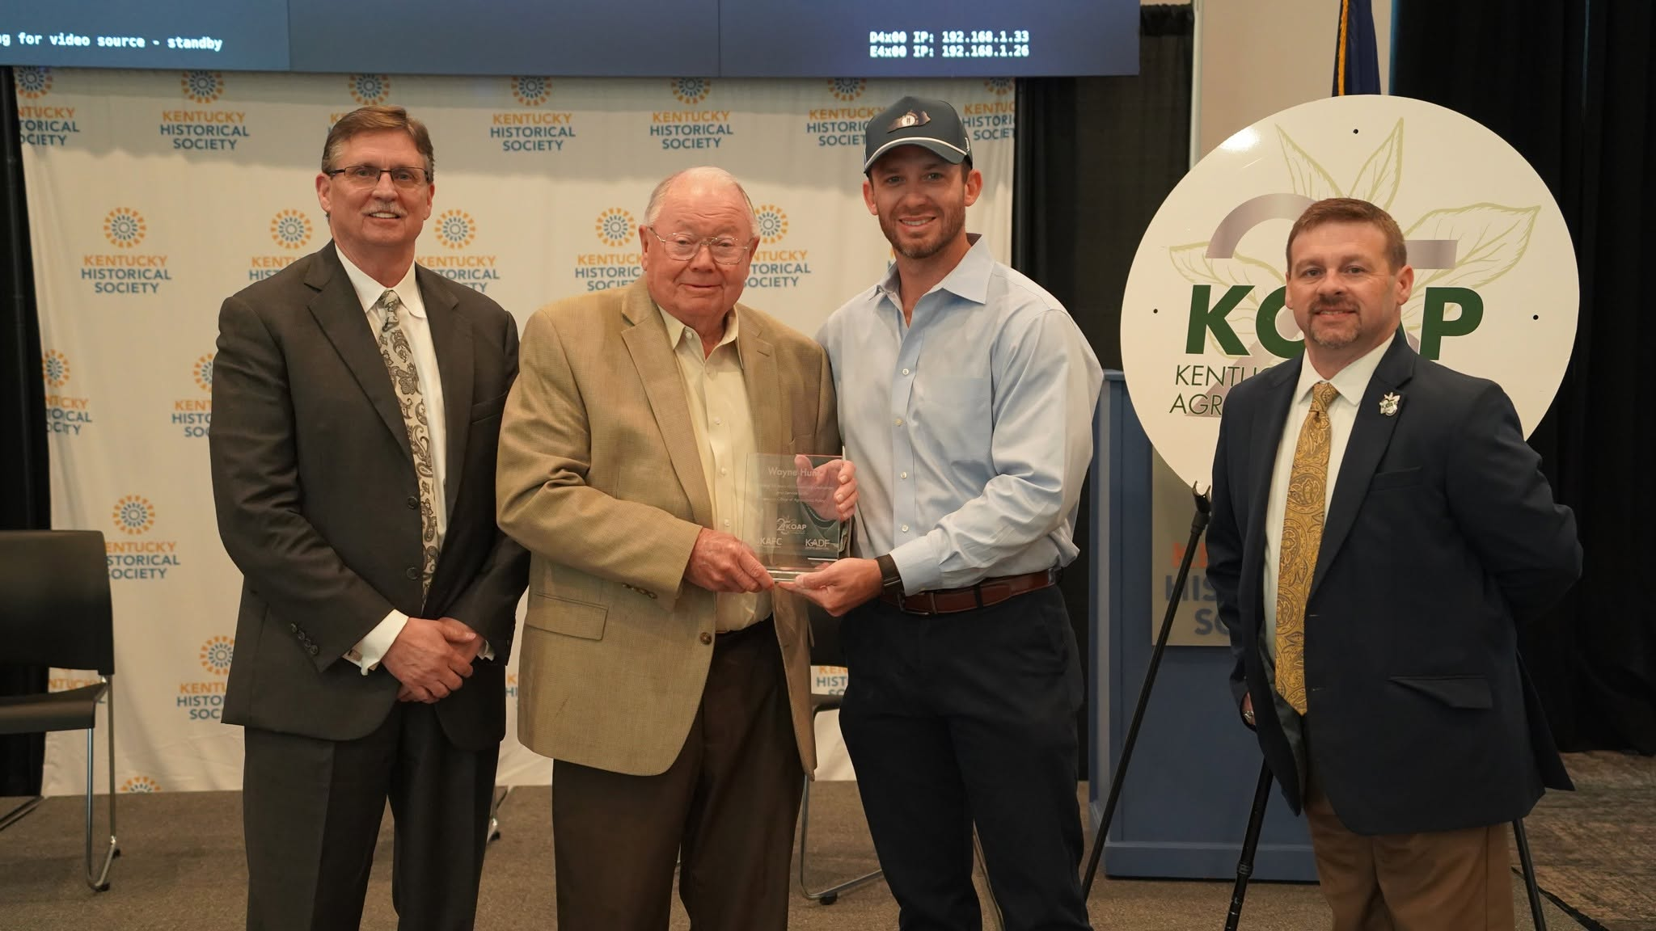
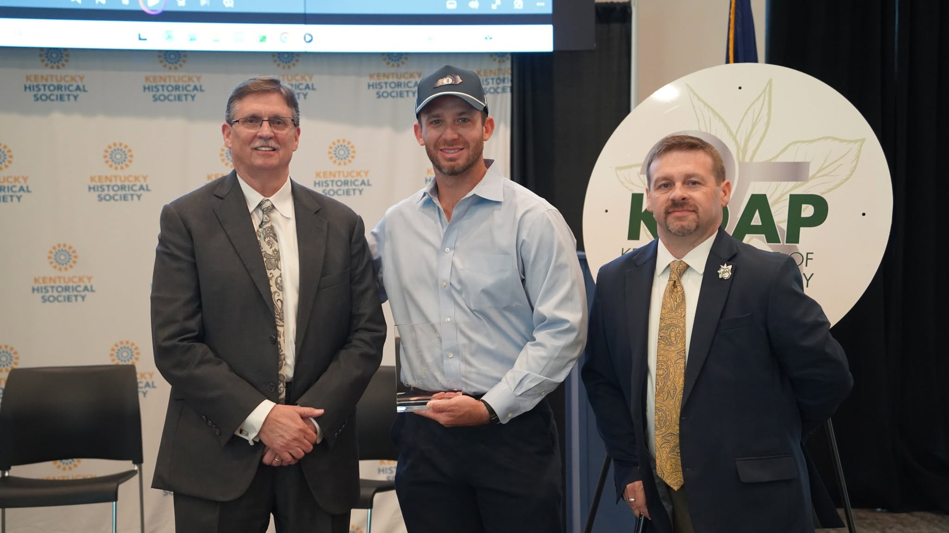
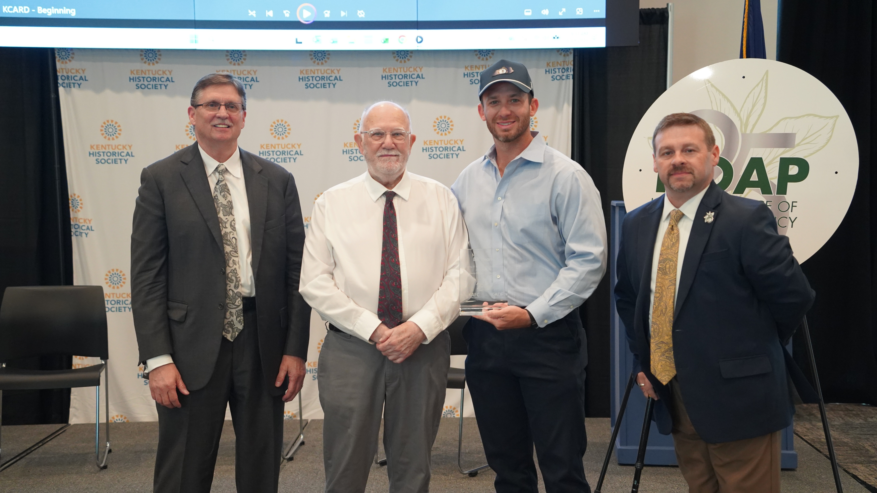
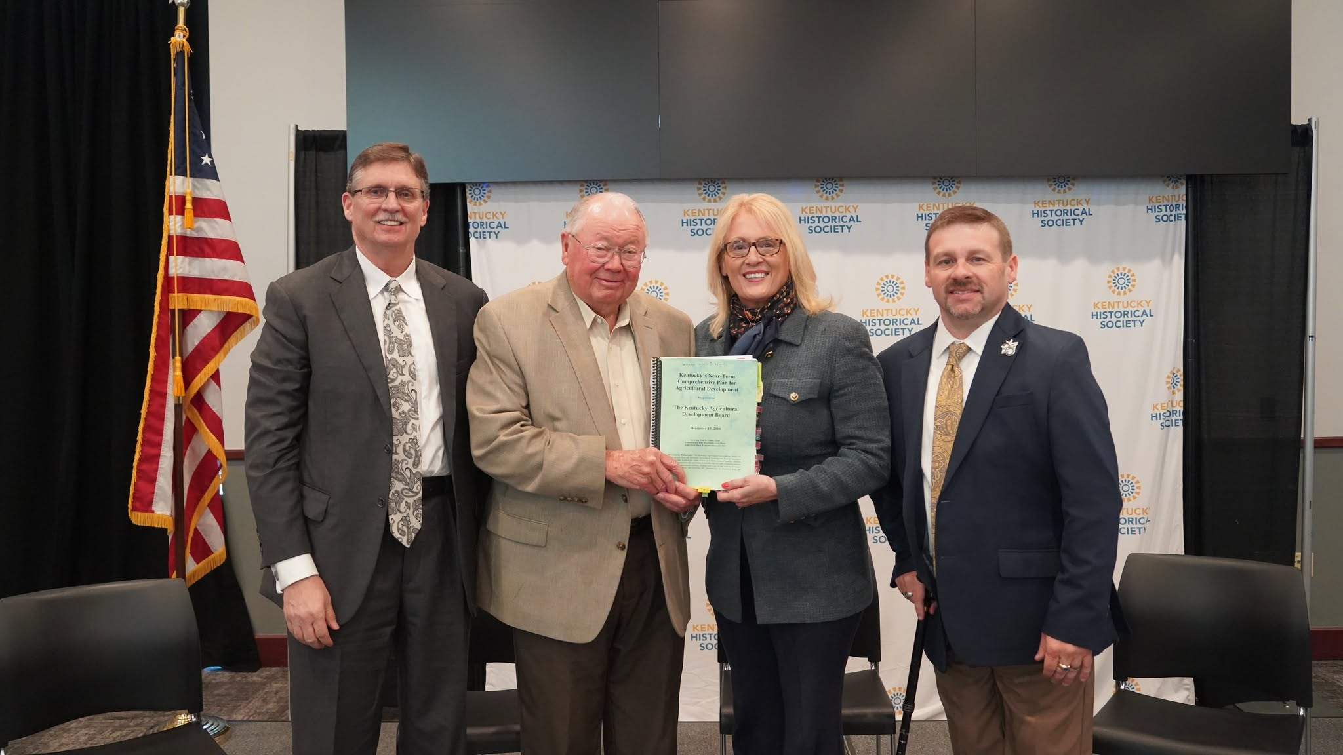
Kentucky Office of Agricultural Policy
Sent from my iPhone

Slide 3
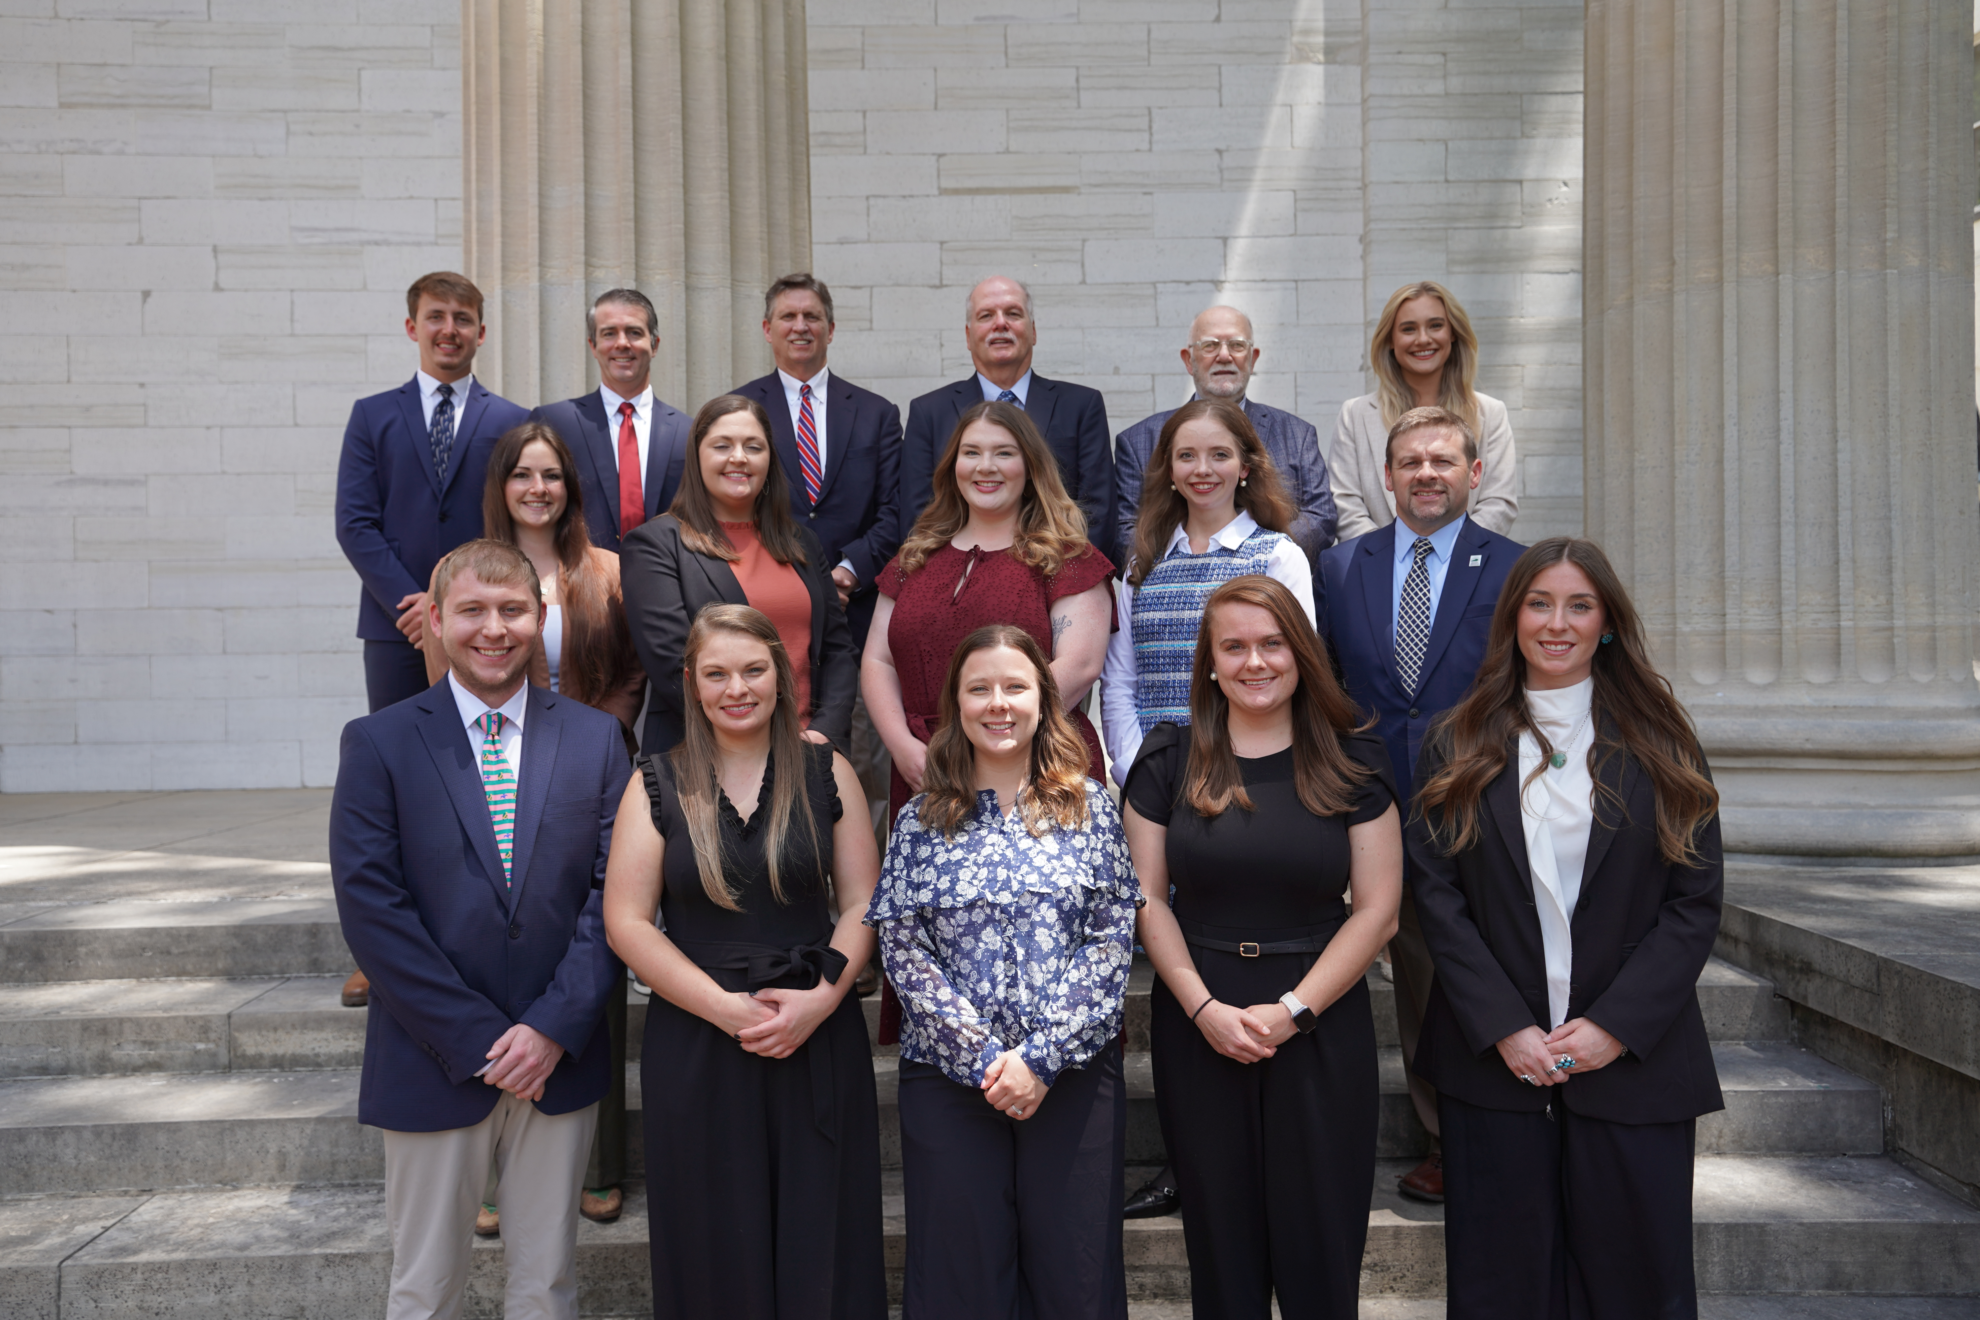
KOAP Staff
Brandon Reed
  Executive Director
Bill McCloskey
  Deputy Executive Director
Bill Hearn
  Fiscal Officer
Brian Murphy
  General Counsel
Chelsea Smither
  KAFC Loan Programs Manager
Hannah Sharp-Johnson
  Boards & Special Projects Manager
Alexis Scheidt
  KADF Regional Manager
Jeff Parman
  KADF Field Compliance Manager
Rachel Cowherd
KADF Regional Manager
Bailey Siry-Crowder
  KADF Compliance Manager
Rebecca Besok
  KAFC Loan Programs Manager
Sarah Charles
  KADF Programs Manager
Jesse Moore
  KADF Regional Manager
Savanna Hill
  KADF Regional Manager
Alandria Lee
  KAFC Loan Programs Manager

Slide 4


Monthly Board Approvals:
June:
KAFC KADB
$2.9 MM $3.7 MM
July:
KAFC KADB
$1.4 MM $1.7 MM
August:
KAFC KADB
$1.8 MM $2.5 MM

Slide 5
KOAP Highlights:
  June – August 2026
  42 County Agricultural Development Councils attended by staff
  16 Site visits conducted by staff
  54 KADF programs cl0sed out
  53 KADF project reports received
  13 KADF program reviews conducted

Slide 6
Bill & Brandon’s Top June – August Picks
    June
(page 13) City of Middlesboro –
$ 2,903 in Bell County funds and up to $230,000 in state funds
(page 15) Need More Acres Farm, LLC - $62,500 in multi-county funds and up to $212,671 in state funds
(page 17) Central Kentucky Feed LLC - $65,000 in multi-county funds
July
(page 11 ) Kentucky Department of Agriculture, Yellow Legged Hornet- $62,000 in state funds
August
(page 9) Creekside Veterinary Services, LLC - $16,667 in multi-county funds and up to $83,333 in state funds
(page 13) Primes Poultry Partners LLC - $4,000 in Taylor County funds and a forgivable loan up to $162,755

