Slide 1
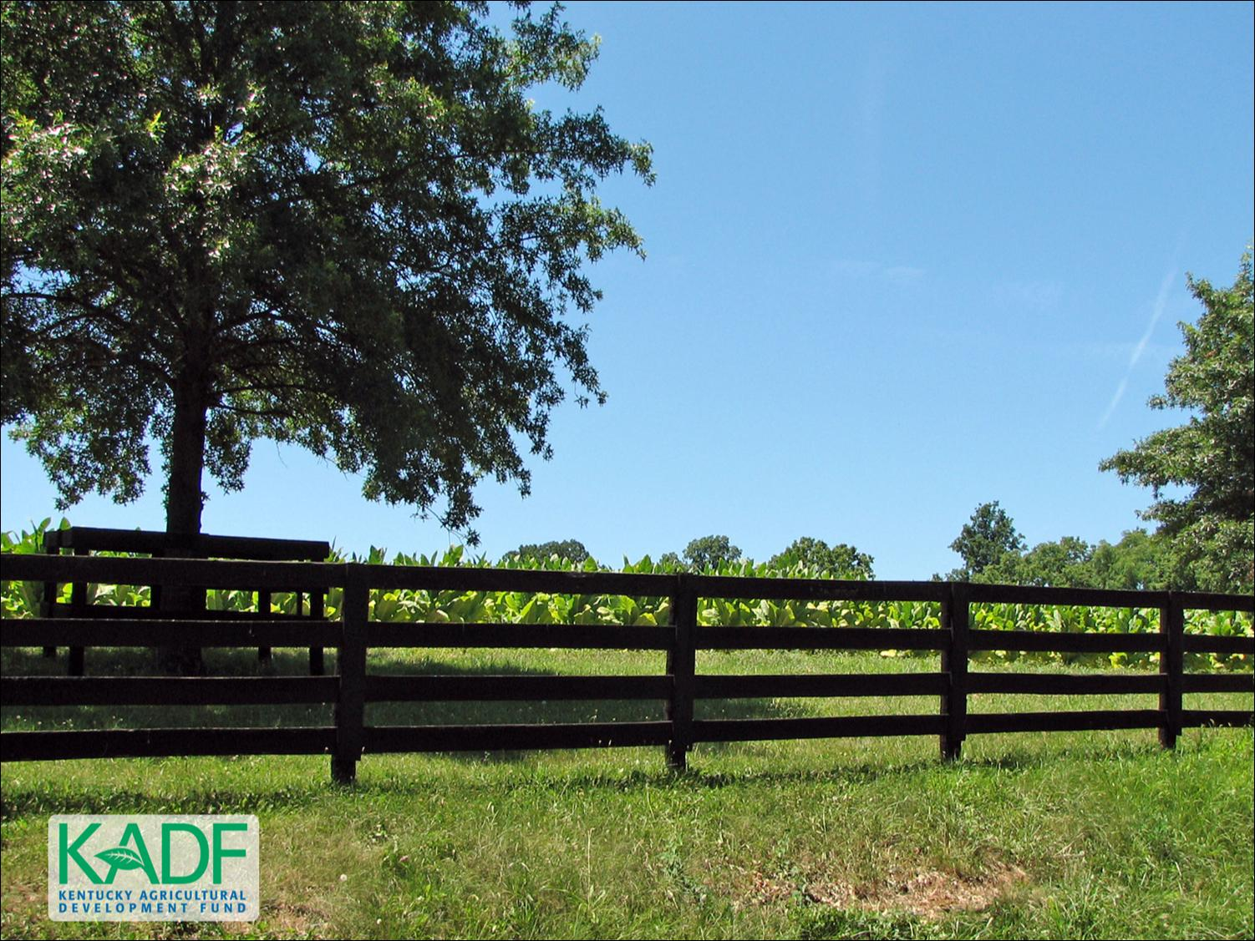
KOAP’s Report of
September 2026

Slide 2
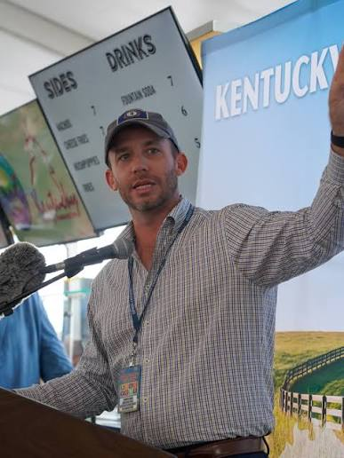
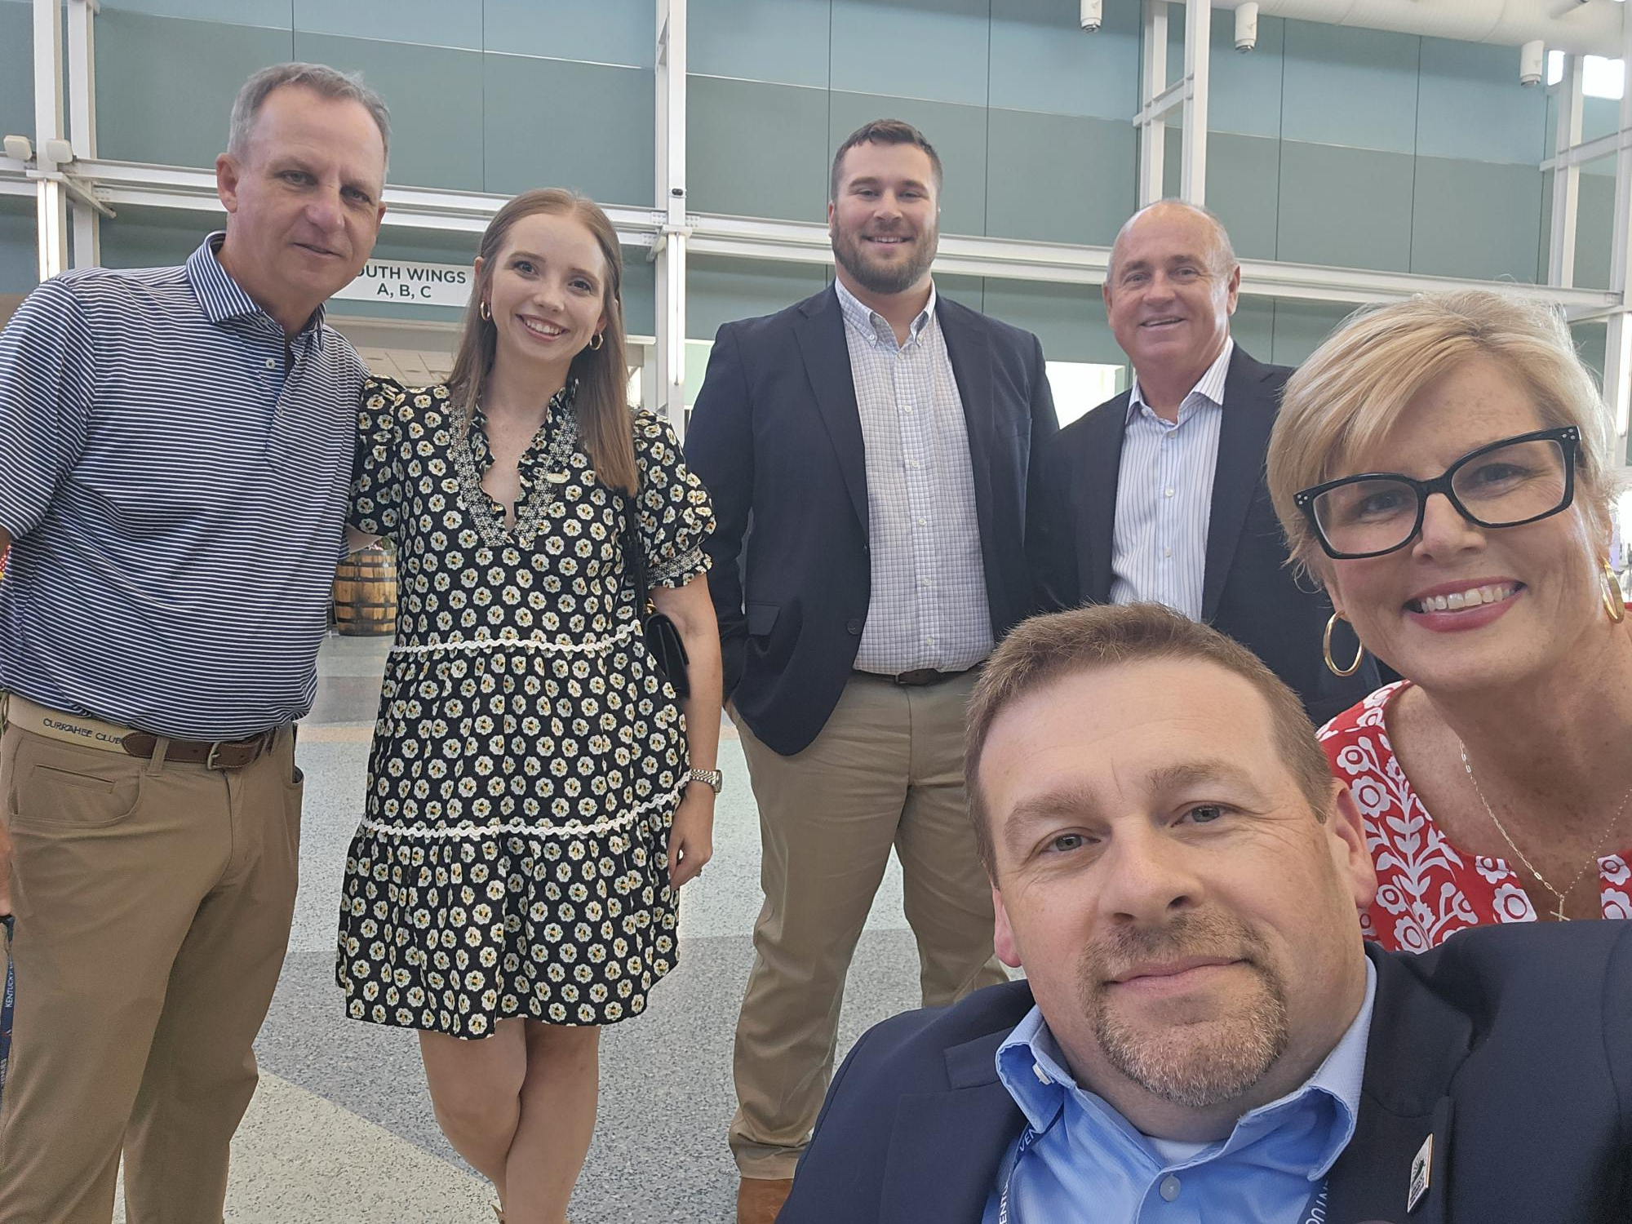
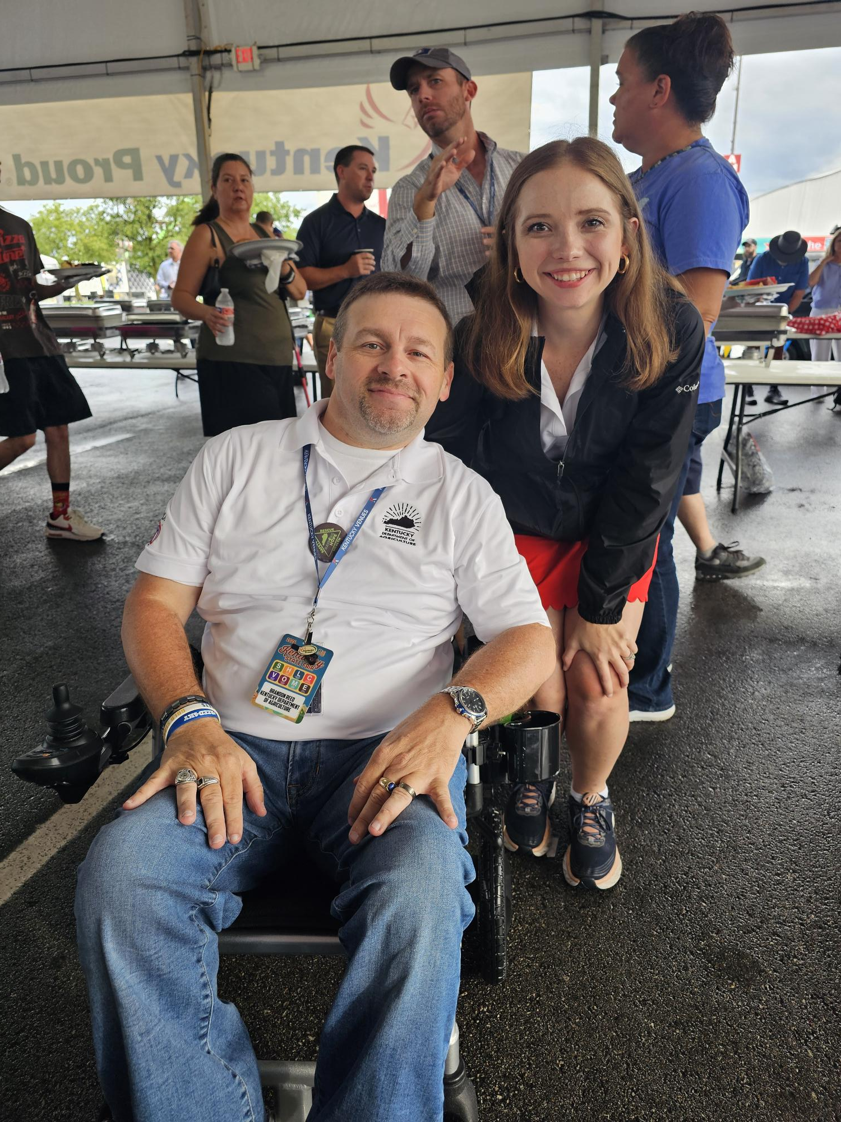
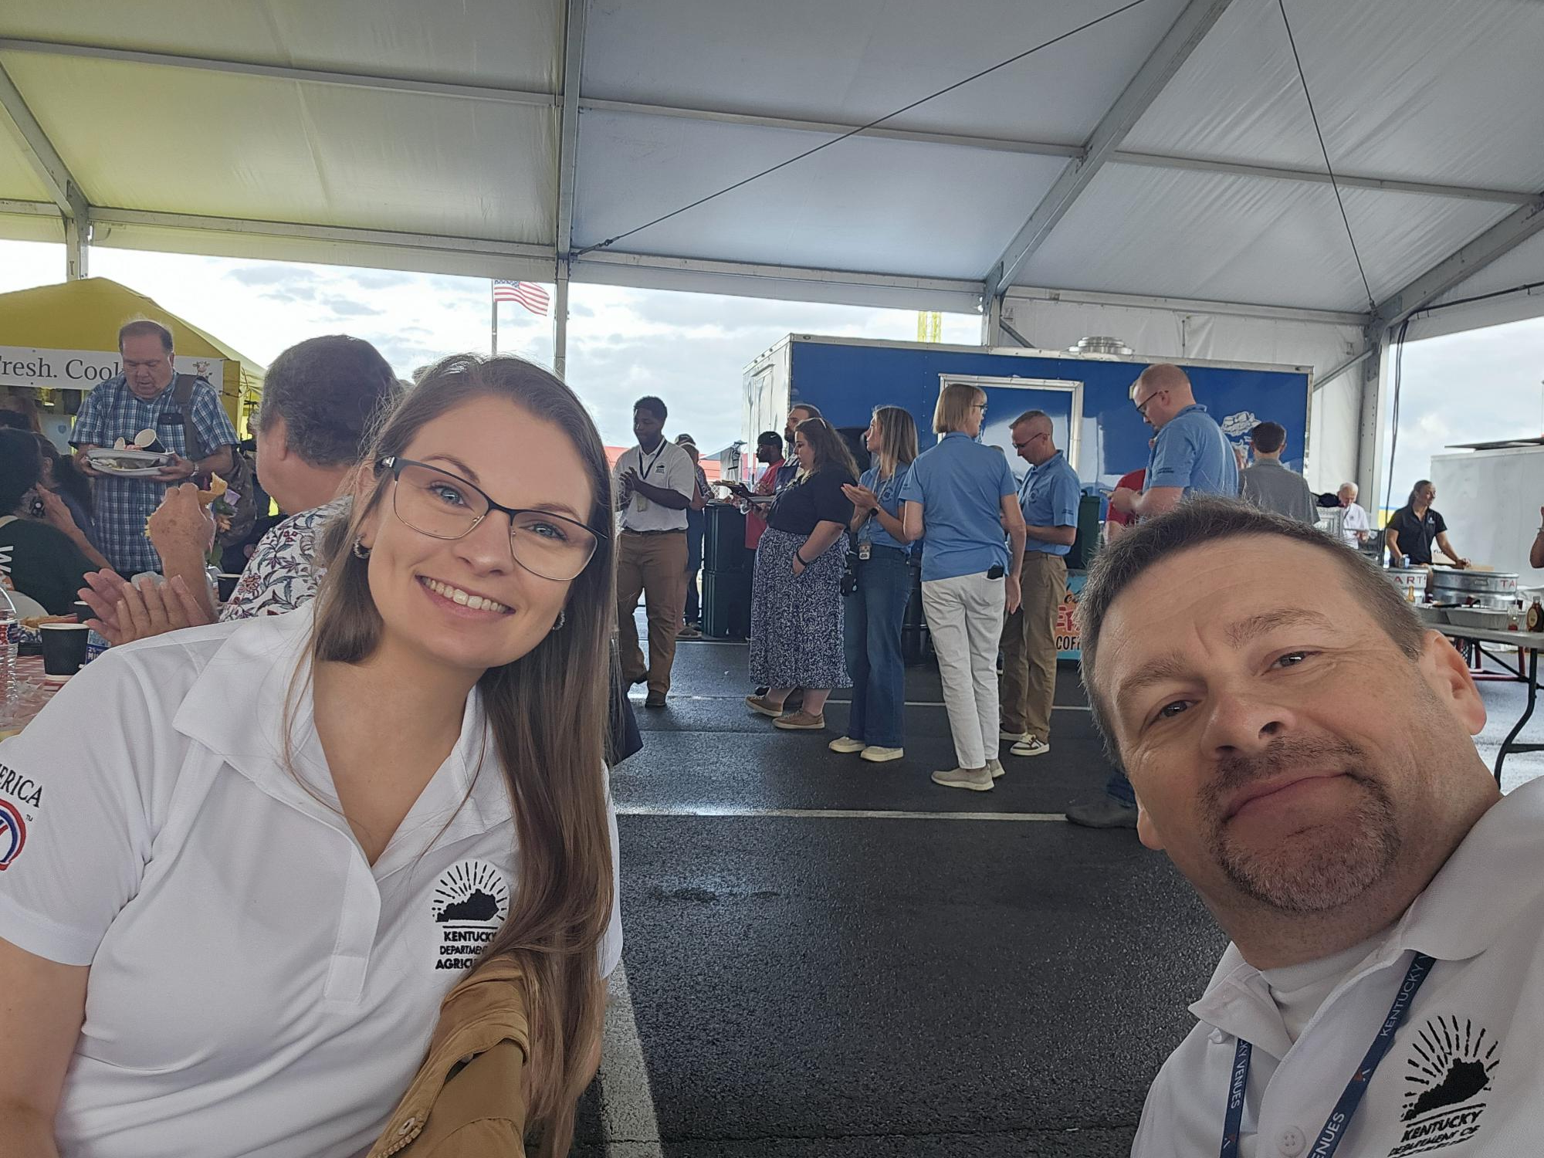
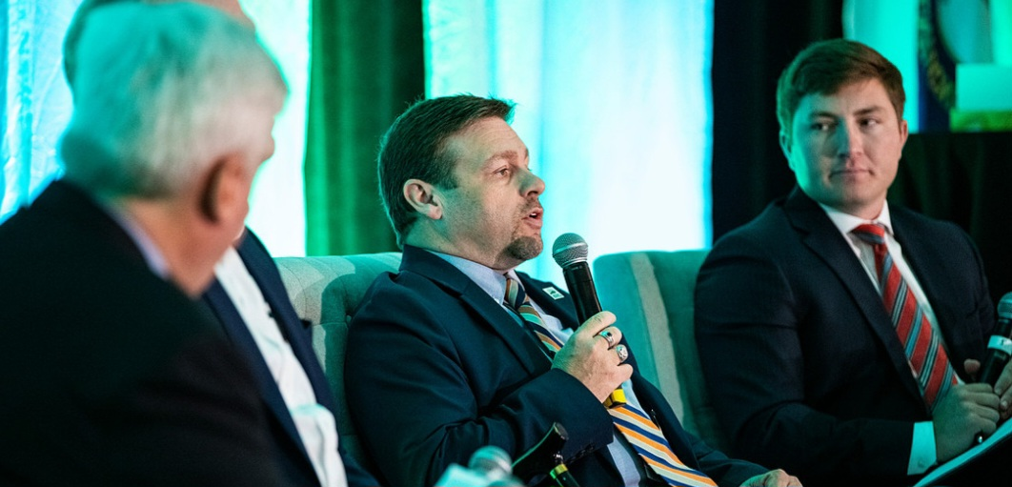
Kentucky Office of Agricultural Policy
Sent from my iPhone

Slide 3
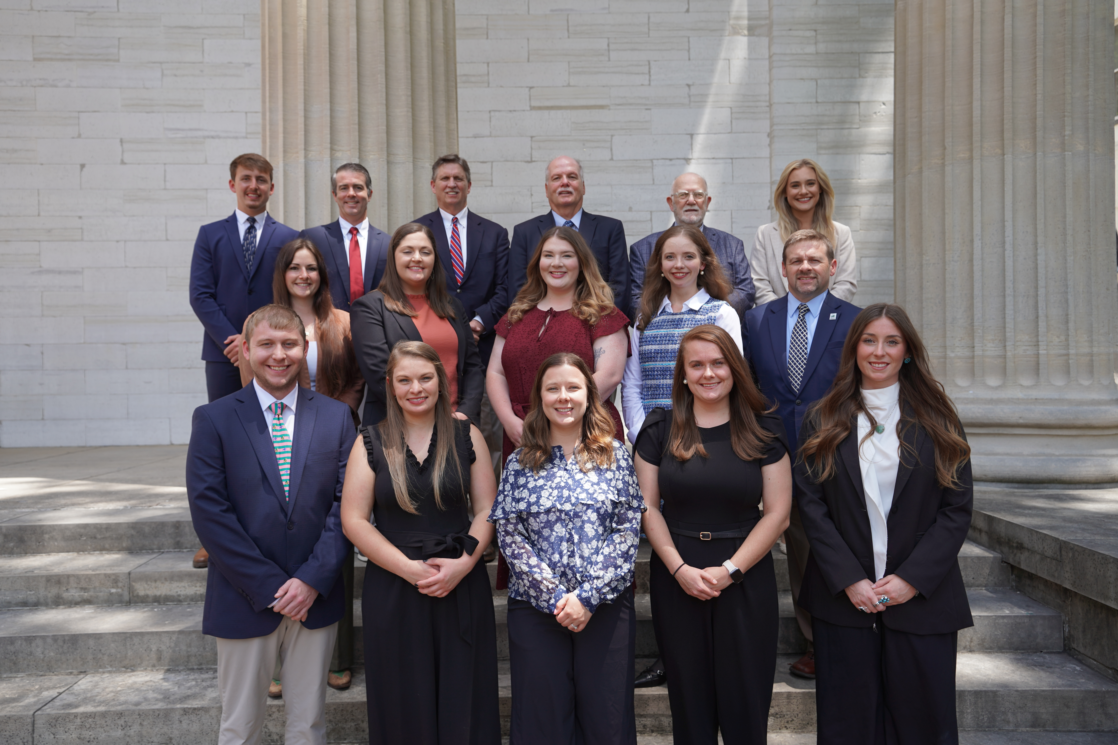
KOAP Staff
Brandon Reed
  Executive Director
Bill McCloskey
  Deputy Executive Director
Bill Hearn
  Fiscal Officer
Brian Murphy
  General Counsel
Chelsea Smither
  KAFC Loan Programs Manager
Hannah Sharp-Johnson
  Boards & Special Projects Manager
Alexis Scheidt
  KADF Regional Manager
Jeff Parman
  KADF Field Compliance Manager
Rachel Cowherd
KADF Regional Manager
Bailey Siry-Crowder
  KADF Compliance Manager
Rebecca Besok
  KAFC Loan Programs Manager
Sarah Charles
  KADF Programs Manager
Jesse Moore
  KADF Regional Manager
Savanna Hill
  KADF Regional Manager
Alandria Lee
  KAFC Loan Programs Manager

Slide 4


Monthly Board Approvals:
September:
KAFC KADB
$1.9 MM $1.5 MM

Slide 5
KOAP Highlights:
  September 2026
  3 Site visits conducted by staff
  8 County Agricultural Development Councils attended by staff
  4 KADF program reviews conducted
  14 KADF programs cl0sed out
  17 KADF project reports received

Slide 6
Bill & Brandon’s Top September Picks:
September
(page 9 ) Seedleaf, Inc. - $ 22,524 in county funds
(page 10) Kanbol, Inc - $557,250 in state funds as a participation loan and referred the applicant to the KAEDB
(page 11) Carter County Fair Inc. - $30,000 in Carter County funds

